Slide 1
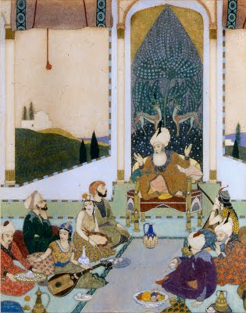
The Arabian Nights
or The Thousand and One Nights
Left: Edmund Dulac, Sinbad the Sailor entertains Sinbad the Landsman [from Stories from the Arabian Nights], 1914. (French book illustrator)
Source: Kendra and Allan Daniel Collection

Slide 2
East Meets West
Whose Arabian Nights? Which Arabian Nights?
World Text in Multiple Versions!
Who’s interested in making Arabian Nights—and for what reasons?
Stories in the Arabian Nights: many ancient origins, oral traditions (pre-Islam)
Persian
Indian
Arabic
Unified written collection (Manuscripts): Islamic Golden Age
Multiple manuscripts! Multiple copies! Variations, Additions, Expansions…(beginning 1200s?)

Slide 3
Islamic Golden Age (7th-13th centuries, CE)
During Middle Ages in Europe
Spread of Islam—new religion and empire
from Middle East through southern Europe (modern Spain) and Africa, and eastward into India
Schools/universities throughout Islamic world
Preserved and expanded arts, sciences, literature, mathematics from classical era
transcribed oral traditions of many cultures
Arabian Nights reflects cultural diversity of the Islamic empire of the Golden Age

Slide 4
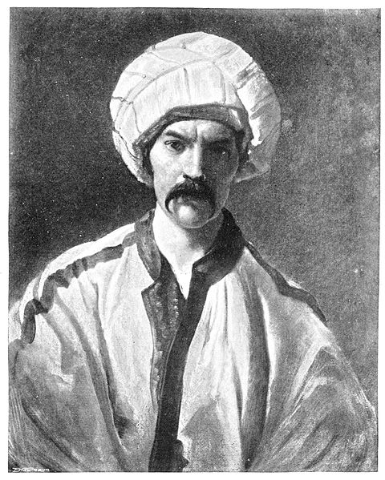
European Versions
Translated/Adapted into French (Antoine Galland, ~1700)
Works with earliest known Arabic text (1400s)
Builds on it to help compile the Bibliotheque Orientale (encyclopedia reference guide to Muslim world-published 1697
Basis for European perspective on “Arab world”
English Translations: Calcutta I, II and Bulaq manuscripts
Studied by British East India Company officials to learn Arabic
William Lane—translation, 1830s
Richard Burton—1880s
Sir Richard Francis Burton in Persian costume

Slide 5
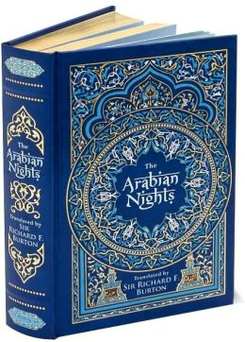
Issues and Influence: English Translations
Errors and distortions in translation !
(Lane versions, early 1800s)—BOWDLERIZES the Nights: Prudish expurgation!
Richard Burton (1880s): Exaggerates the OPPOSITE WAY: elaborate embellishment, sensationalizing—especially sexual content
Claims that Arabian Nights authentically represents daily life and beliefs in Baghdad or Damascus
Too-literal translation—creates artificially stilted experience
(Burton): Highly ornate/embellished stylized language—never steps down to colloquial everyday speech
Galland and Burton—very influential in defining the Western experience of The Arabian Nights (18th - 20th centuries)
Adaptations for children’s books
illustrations / art (as in Edmund Dulac’s pictures)
Music: Rimsky-Korsakov’s “Scheherezade”

Slide 6
Arabic Versions Syrian vs. Egyptian manuscripts—two distinct branches
Syrian version: Oldest existing manuscripts (1300s)
Contain same core group of stories
Represented in our first volume (The Arabian Nights)
Egyptian versions (later—1600s through 1800s)—add stories to the core version, apparently to fill up the 1001 nights)
Source of the broadest multicultural variation (Persian, Indian, African, etc), and range of story types
(represented in our second volume (Sindbad)
Many of these stories were made popular in Europe by the Galland and Burton translations! (Aladdin, Ali-Baba, Sinbad)
Arabic printed editions (1800s)—varied widely, sometimes combining stories from Syrian and Egyptian manuscripts
“Bulaq edition” (1835): based on late Egyptian manuscript: contains 1001 stories—appears “complete”
Authenticity promoted/publicized as completeness and full quantity
Compilation of stories added by copyists, editors, publishers at different moments—mostly in the 1700s and 1800s

Slide 7
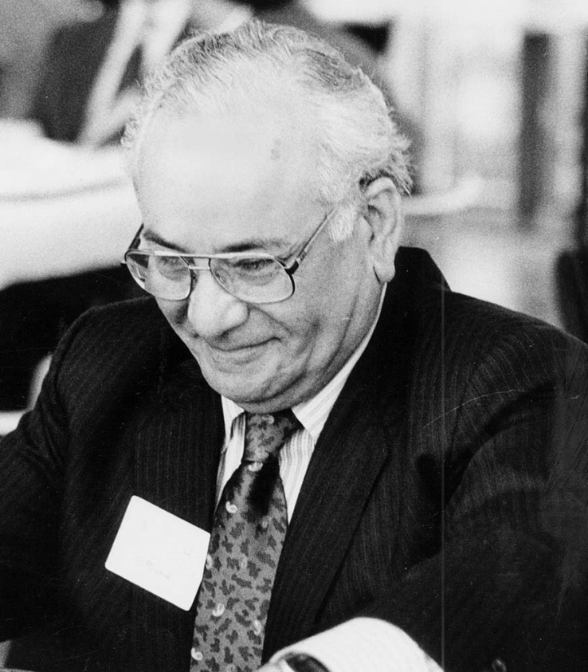
Authentic Edition?
Seek out earliest complete manuscript in Arabic
Muhsin Mahdi edition (in modern Arabic) (1984)
First definitive, scholarly edition
Based on 14th-c. Syrian ms used by Galland!
Adaptation of medieval Arabic to modern language
Avoiding embellishments / distortions introduced by later copyists/translators
Translator (Haddawy), fluent in both English and Arabic
But it’s only 35 and a half stories: 282 nights only.
Above: Muhsin Mahdi (1926-2007)
b. In Iraq, educated at American U. in Beirut, studied and taught Arabic and medieval Islamic politics/philosophy at U. of Chicago and Harvard

Slide 8
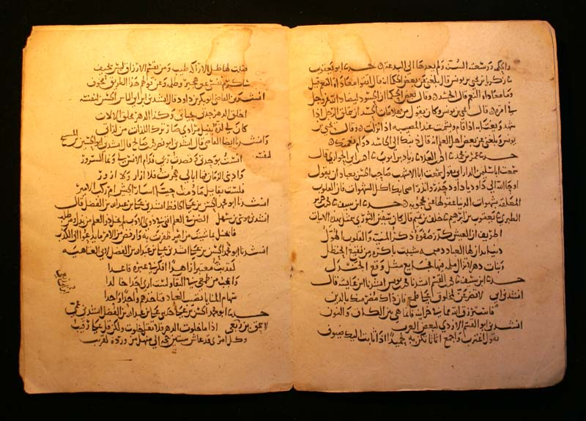
Malcolm and Ursula Lyons: Work with the Calcutta II manuscript, used by Richard Burton (our text: 2008)
Most extensive collection of the Nights we have
(Calcutta II = Manuscript brought to India by a British army officer (Major Macan), collected by Henry Salt—early 19th-century)
Returns to manuscript to produce a new modern translation from Arabic to English
Emphasis on storytelling narrative, rather than scholarship on the Middle East!

Slide 9
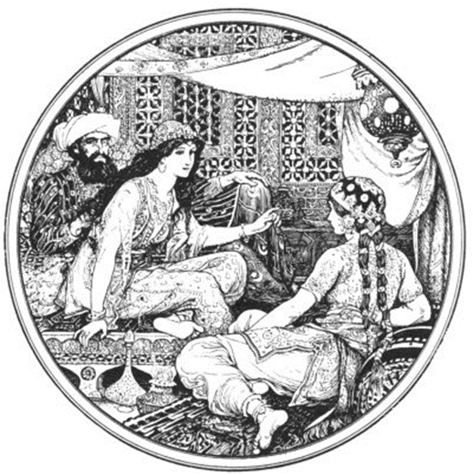
Story Labyrinth: Outermost layer of narrative:
Shahryar (Shah Zaman) and Shahrzad
Marital infidelity: king’s wives and African slaves
Occasion to travel (why?)→ Jinnee + girl-in-box (5-6)
Return home…consequences→NARRATIVES-IN-NARRATIVES:
Shahrzad and Dunyazad: vizier’s daughters
Relation of King to Vizier?
(Vizier’s narrative of Merchant, donkey, bull, aggressive wife, and rooster) (8-9)
Control of women?

Slide 10
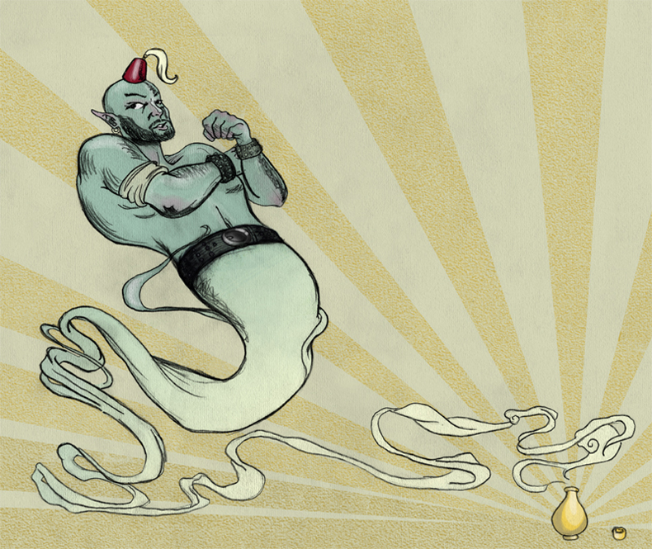
Stories over the Nights:
Nights 1 – 3: Merchant – Dates
3 old men + enchanted animals: Gazelle,
Two Saluki dogs
Mule
Fisherman and the Jinni (Nights 3 – 9)
Fisherman tells of K. Yunan and Sage Duban (pp. 25-34)
Ifrit inside or outside bottle?
4 fish and Release of Story: Enchanted Prince

