Slide 1
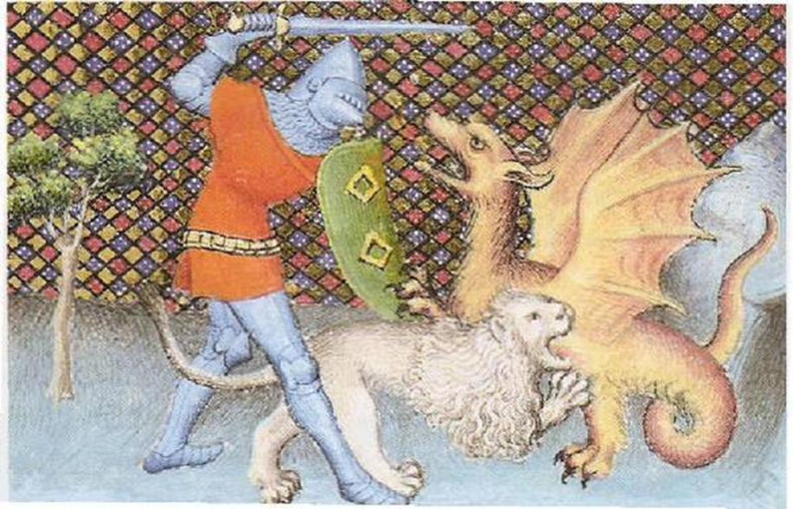
Romance
and Chrétien de Troyes

Slide 2
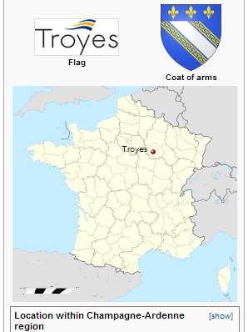
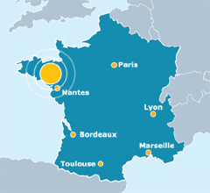
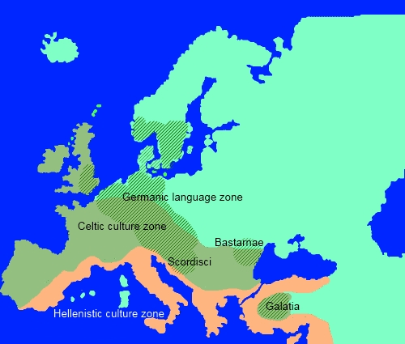
Chrétien. . . Of Troyes!
4 romances, composed c. 1170s
Erec and Enide, Lancelot (Knight of the Cart), Yvain (Knight of the Lion), Cliges
Mythology of England. . .and King Arthur
Norman invasion of England, 1066
Association of French with Britons (Celts)—via Brittany / Bretagne
Imperial order / unification of Roman civilization after Roman empire (feudalism)

Slide 3
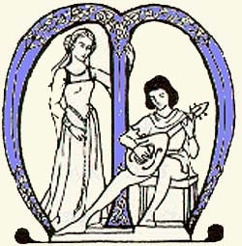
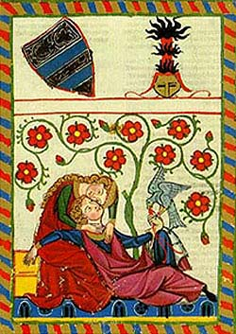
Chrétien and court patronage
Patroness: Countess Marie de Champagne
Writing to entertain the royal courts
Paid to write certain kinds of stories: promote values and ways of the court
ROMANCE
Composed in metrical verse
Standard meter: 4-beat (octosyllabic) rhyming couplets
Adventures (aventures) of questing knights—individuals
Shfiting experience of time / place / identity
Purposeful quest into the unknown→ COMPLICATION/CHANGE → Return home
Chivalry: (rel. to chevaliers/cavalry. .. Horseback riders!)
Knightly bravery and skill
Courtly code of honor : service to those in need of defense, service to one’s court / respect of fair play in combat
Courtly love
(“amour courtois”—defined in late 19th-c by scholars of the romances)
Assoc. with Eleanor of Aquitaine—whose daughter is Chretien’s patron
Rich, powerful women—ambiguous relations with vassals / knights of lesser rank
Marriage: usually not about emotional affection
Culturally-endorsed capacity for powerful women to attain love outside marriage
Women’s authority over castles/ estates/ feudal society while husbands away on Crusades / war
Origins in Mediterranian / Islamic cultures
Ideal Love that leads to great deeds in defense of one’s Lady
Troth: (faith or loyalty, and truth/honesty—except in loyal concealment / discretion!

