Slide 1
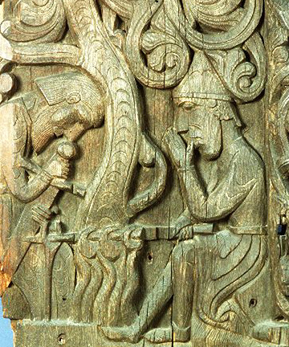
The Saga of the Volsungs
Image of Sigurd and Regin—remaking the sword, Gram
From a wooden carving on a medieval stave (wooden) church in Norway

Slide 2
Norse Sagas
Prose sagas (as opposed to verse “lays”)
Oral tradition→writing: preserved in Iceland
Icelandic poets: “skalds” (Compare w/ Anglo Saxon “scops”)—traveled Norse countries and Anglo Saxon England
Oral traditions as poetry→transcribed as prose sagas in Iceland

Slide 3
Time Depth
Saga of Volsungs, first recorded 1200s AD.
  manuscript our editor works with—1400s.
  Events: from period of Germanic migrations around Europe—300s or 400s AD (4th or 5th centuries)
Sagas—continuance of pagan stories with Christian era…often images from sagas carved on medieval churches!
Volsunga Saga: strong influence on 19th- and 20th- c. literature and art
  Richard Wagner’s Ring Cycle, and fantasy writings of Tolkien, Ursula Le Guin, and others
  Source of 19th-c. images on Odin, Sigmund, dragons
  Continuing importance to fantasy writers:
  Shapeshifting, ,magical relations of humans and animals, rings/treasure, curses, approaches to fate and destiny. . .

Slide 4
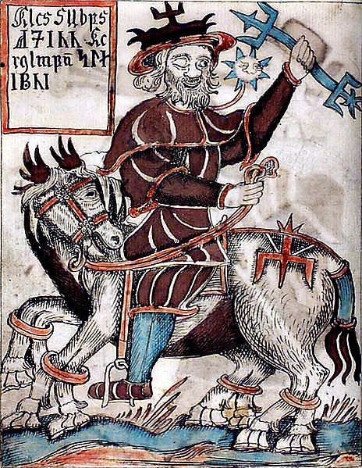
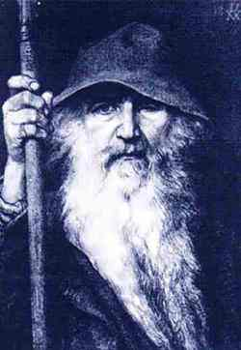
Odin, the “All-Father,” one-eyed
Ruler of the gods (Aesir)
Associated with ravens
Travels as an old man, often a nameless stranger
Fated Doom of the gods in Norse tradition: Ragnarok

Slide 5
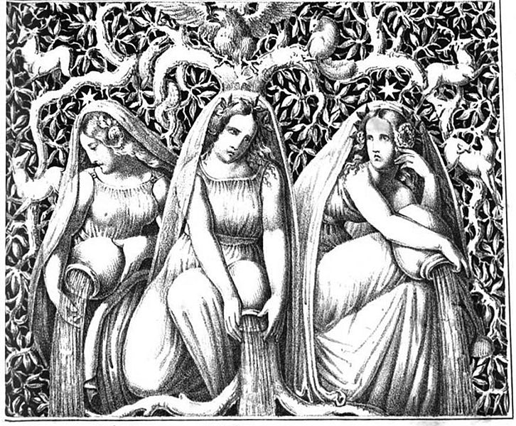
Norns, Spaewomen, Valkyries
Female servants of Odin
Norns: associated with fate, destiny
  (like the three Fates or “Graiae”, but can be more than three)
Spaewomen: female guardian spirits (see p. 53)
Valkyries—associated with battlefield—collect spirits of fallen warriors for afterlife
(Valhalla vs. Hel)

Slide 6
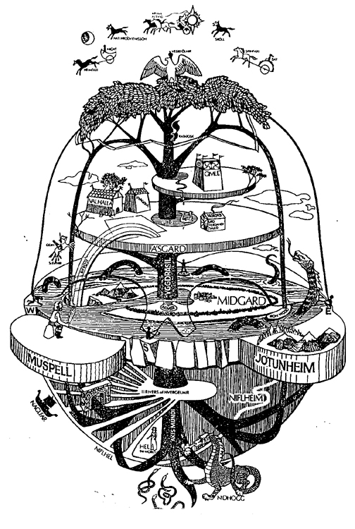
Yggdrasil: the World Tree
Cosmic tree of the Norse universe (often an ash or a thorn tree)
Roots in the realms of giants / monsters (Jotunheim)
People in Midgard
Gods in Asgard
Odin hangs himself from the tree to learn the wisdom of runes
(Tree of sacrifice)

Slide 7
Correlation with Beowulf
A scop sings of Sigmund and Fitela as uncle and nephew in Beowulf, and Sigmund as dragon slayer
  (related to Sigmund and Sinfjotli)
VS.
Saga of the Volsungs:
  Here Sigurd, Sigmund’s son with Hjordis, fights the dragon, Fafnir, alone
  And Sigmund and Sinfjotli are uncle/nephew AND father/son…

Slide 8
Volsung Family Tree
Stories of violent dispossession! Broken families, heroism and fate fostered by Odin over generations
Sigi—killer of the thrall, Bredi (Bredi’s drift) (p. 35)
Sigi’s son Rerir—and his childless queen
  Miraculous and prolonged pregnancy (6 years!)
  Child: Volsung
Volsung and the Barnstock tree (37)
Odin’s visitations: sword in the tree—proving of Sigmund

Slide 9
Sigmund and Signy…. Vs. King Siggeir
Signy’s unhappy marriage to King Siggeir (unwilling peace-weaving queen!)
  Siggeir’s treachery to Volsung and his 10 sons
  Sigmund—how he alone survived… honeyed tongue-kissing with a wolf!
Signy’s Revenge against Siggeir
  SHAPE SHIFTING
  Ordering offspring killed
Pairing: Sigmund and Sinfjotli
  Werewolves! (8)

Slide 10
Sinfjotli’s Role
Vengeance of Volsungs against Siggeir (45-46)
Aiding Sigmund
Child of incest…
Reputation?
  Engages in senna (contest of insults) with Granmar (49) Note the kinds of insults.

Slide 11
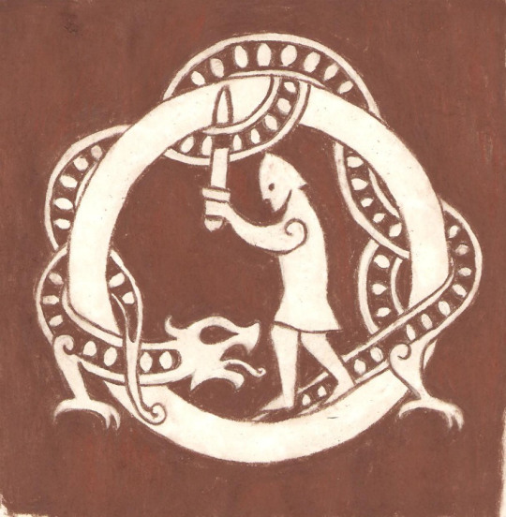
Sigurd
Position in the saga
Avenger of his father
Foster child relationship with Regin
Dragon-slayer! Fafnir
Image Source: The Struts and Frets image for their Winnipeg Fringe Fest troupe performance of “Sigurd the Dragonslayer” http://sfplayers.wordpress.com/tag/fringe/

Slide 12
Women’s Will in the Saga
Signy, Sigrun, Borghild, Hjordis, Brynhild
  Marriage issues
  Patrilocal tradition (wife moves in with in-laws)
  Women breaking tradition?
  Signy (Sigmund’s sister)
  Sigrun (chooses Sigmund’s son Helgi)—pp. 48-50
  Borghild (trouble over Sinfjotli /exiled by Sigmund) (51)
  Hjordis—chooses aging Sigmund…disguise after battle
  Brynhild—thwarter of Odin! Rune wisdom…

Slide 13
Magical Words
Speech of wolves, birds
Runes (language of gods)– Brynhild’s knowledge

Slide 14
THE VOLSUNGS: Family Trees
Odin
Signy m. Siggeir
Sigi
Rerir m. queen (pregnant for 6 years)… helped by wish maiden Hljod
four boys,
(2 killed by Sigmund, 2 killed by Sinfjotli
Volsung m. Hljod
Sigmund
Signy (f) (twins)
9 other brothers
Sinfjotli

Slide 15
VOLSUNGS: Family trees, continued
Sigmund m. Borghild (Borghild poisons Sinfjotli)
Hamund
Helgi
m. Sigrun
(rescued from arranged marriage)
Hreidmar
Sigmund m. Hjordis
Hjordis m. Alf (in Denmark)
--Sigurd raised in foster court by Regin…
Fafnir (dragon), Otr, Regin (foster father for Sigurd)
Sigurd

Slide 16
VOLSUNGS: Family trees, part 3
Sigurd + Brynhild
Budli
Aslaug (f)
Atli
(Atilla the Hun)
Brynhild
Oddrun (f)
Bekkhild (m. Heimir)
Gjuki m. Grimhild (sorceress queen)
Gunnar (m. Brynhild)
and
(m. Glaumvor)
Alsvid
Hogni (m. Kostbara)
Guttorm
(kills Sigurd)
Gudrun (m. Sigurd),
(m. Atli),
(m. Jonakr)
w/ Sigurd:
two sons, and Svanhild (f)
w/ Jonakr: Hundir, Sorli, and Erp

