Slide 1
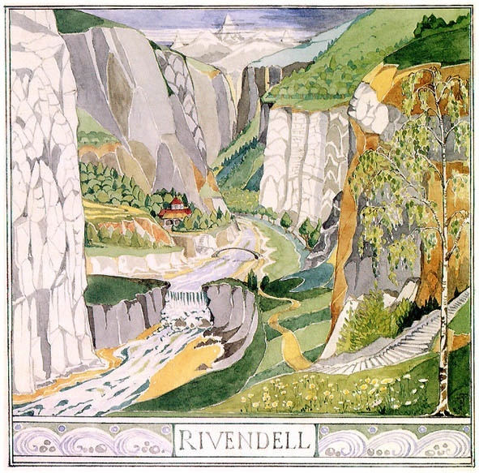
Middle Earth and J. R. R. Tolkien

Slide 2
Forming/Transforming
Middle Earth
Conceptualization vs. Publication
  Writing for Publication transforms narrative
  Generation of modern fantasy from esoteric sources
Transition from private, family significance and scholarly artistry to public “cult” phenomenon
Tolkien’s scholarly roots: study of old languages, ancient epics

Slide 3
Philology—not a current major!
Tolkien was a philologist:
Philology: study of languages as systems (late 19th- and early 20th- c)
(The study of the structure and development of language; the science of language; linguistics. Now usu. restricted to the study of the development of specific languages or language families, esp. research into phonological and morphological history based on written documents.
This sense has never been current in the U.S. Linguistics is now the more usual term for the study of the structure of language, and, with qualifying adjective or adjective phrase, is replacing philology even in the restricted sense. (Oxford English Dictionary**)
Tolkien’s work as a philologist→contributes to the First Edition of the Oxford English Dictionary (OED)
OED: aims to deliver complete history of word origins, etymologies

Slide 4
Epic
Written epics important to philologists: document earliest uses of words and contexts
Ancient highly elevated art form: Odyssey, Iliad = oldest known written epics
Traditionally: long episodic narrative poem
  Originally an ORAL tradition (“Primary epic”), spoken, sung, chanted by poets
High, serious tone—elevated style
Features heroic or half-divine figure whose actions are pivotal to culture, tribe, or the world as we know it

Slide 5
Epics in “Literary” Tradition
“Primary” Classical epics: Greek, Roman epics helped to shape English / European poetic standards in Middle Ages, Renaissance into our time.
“Secondary epic”: Written, recorded versions, or poems written in imitation of ancient style (e.g. Dante’s Divine Comedy, Milton’s Paradise Lost = “Secondary epic”)
“Mock epics:” (Alexander Pope, The Rape of the Lock) parody classical epic standards for humorous effect
By 20th century, tired, dead? Epic heroism no longer “literary”? For comics and “pulp” fiction—cheapening value?

Slide 6
19th-20th-century study of epics
Recovering alternative epic traditions: Gothic, Arabic, Norse, Aztec—not just Greek and Roman
Reading epics is connected with study of linguistic groups
Efforts to record oral legends into coherent epic cycles
Tolkien—new approach to epics: source of worldview, imaginative vision of past cultures

Slide 7
Tolkien and Epic Traditions of England/Northern Europe
“Beowulf: The Monsters and the Critics”: Tolkien’s commentary on Beowulf:
  Should not be judged in same terms as Greek/Roman epics.
  Beowulf as “Heroic-Elegaic” poem… vs. classical Epic
Finnish epic, Kalevala
  Epic cycle (or series of narratives) transcribed for the first time in the 1830s and 40s by Elias Lönnrot
  This 19th-c. edition→major influence on Tolkien’s research and creative fantasy writing

Slide 8
Tolkien and the Kalevala
Gathered from scattered songs, traditions passed through generations, called “runes” / “rune singers”
Runes of the Kalevala cycle and study of Finnish grammar inspires Tolkien:
  Invention of “Elvish” language: “heavily Finnicized”
  More than invention of languages: modes of storytelling
    Early conceptions of Middle Earth: narrative poems
    Prose versions (Silmarillion) summarize private, fragmented poetic efforts
(read from 7 June 1955 letter to Auden, pp. 213-14, The Letters of J. R. R. Tolkien)

Slide 9
Rune: definition from The Oxford English Dictionary
“1. A letter or character of the earliest Teutonic alphabet, which was most extensively used (in various forms) by the Scandinavians and Anglo-Saxons. Also, a similar character or mark having mysterious or magical powers attributed to it; applied to a letter or character of a non-Germanic alphabet (esp. in fictional writings) having a resemblance to the Germanic runes.
The original runic alphabet dates from at least the second or third century, and was formed by modifying the letters of the Roman or Greek alphabet so as to facilitate cutting them upon wood or stone.”
2. A Finnish poem, or division of a poem, esp. one of the separate songs of the Kalevala. Also incorrectly applied to old Scandinavian poems.
transf. Any song, poem, or verse; spec. a cryptic or magic verse, an incantation; a lament.
***NOW, See the page 25 (Fellowship of the Ring)

Slide 10
Old English and Modern Fantasy
Cynewulf’s Crist:
Eala earendel engla beorhtast / ofer middangeard monnum sended.
  (Tolkien’s translation): Hail Earendel, brightest of angels / above the middle-earth sent unto men.
  Inspires story of “Earendil the Mariner” in The Silmarillion: Early development of Middle Earth mythology
  --Middle Earth: common conception in Old English/Norse/Gothic mythologies of Earth poised in the middle between Overheaven and Underworld

Slide 11
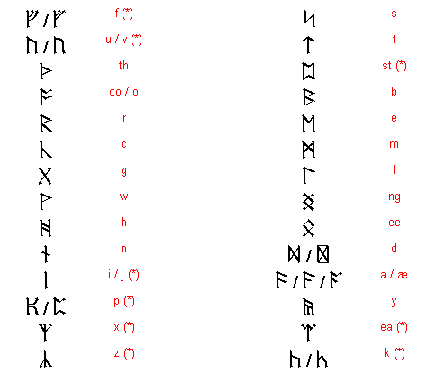
Dwarf Runes in The Hobbit
In The Hobbit, Tolkien uses Anglo-Saxon runes (see table below).
Later he invents a new runic script for the dwarves of LotR.

Slide 12
Fantasy (distinctly modern)
--involves creation of an imaginary world, with its own laws, rules, traditions, language
--Separate from conventions, habits, rules, sights of our known/accustomed reality
--Often based on new revisions of old stories, other cultures
-- “On Fairy Stories” (1938): Tolkien theorizes on modern adults’ need for fantasy:
  * should NOT be written merely to entertain or teach moral lessons to children
    * Needed to restore/refresh/unlock imagination, help us cope with modern life.

Slide 13
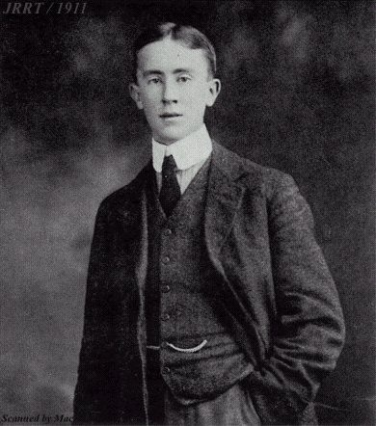
Fantasy and War
John Ronald Reuel Tolkien (1892-1973)
b. in South Africa, moved to industrial Midlands of Britain as young boy
Propensity for languages while very young
Scholar of languages (Old English, Germanic, Welsh, Finnish) at Oxford (1911-15)
1916: marriage to Edith Bratt, just on eve of draft (Edith is associated with the story of Luthien and Beren in Silmarillion)
Active duty in trench warfare/trench fever: World War I
1917-18, hospitalized/recovering—intensively and obsessively develops stories/legends/poems that will turn into the Silmarillion

Slide 14
“In a hole in the ground, there lived a hobbit. . .”
Professor Tolkien: teaching and working on first edition of the Oxford English Dictionary
Hobbits emerge in act of marking exam booklets!
The Hobbit first develops in stories told to Tolkien’s children
  Middle Earth, and many other stories and poems already existed.
  The Hobbit takes place in a time a bit later than the first stories
  Tolkien had written of Middle Earth after WWI.
The Hobbit: published in 1937 (Allen and Unwin), by advice of an editor/friend who ran across Tolkien’s messy manuscript
  Relationship with publishers—they want more stories about hobbits!

Slide 15
Middle Earth and the Publishers
Tolkien’s epic vision compromised—rejection of Silmarillion draft
Composition of The Lord of the Rings slowly
  (1936-1949, first fully published 1955—lots of revision work into the 1960s)
The Hobbit, revised in 1950s to better connect with The Lord of the Rings

Slide 16
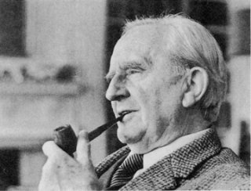
Author vs. Readers
To Tolkien’s immense surprise, The Hobbit and LotR invent modern fantasy
  cult following of 1960s: “Bible” for an “Alternative Society”!
  Tolkien’s global popularity—translated into over 47 languages
Sharable imaginary world, convincingly detailed
  Language
  History
  Backstories
Transmission of cultural memory WITHIN Middle Earth
  songs! Old weapons in troll caves…
  The Hobbit: Quest to recover something lost in the past~ Thorin’s memory of his father / grandfather…

Slide 17
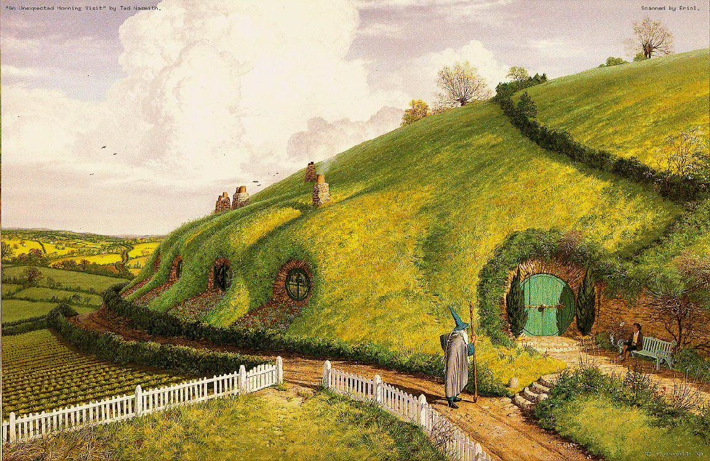
Hobbit’s eye-view of epic Middle-earth

