Slide 1
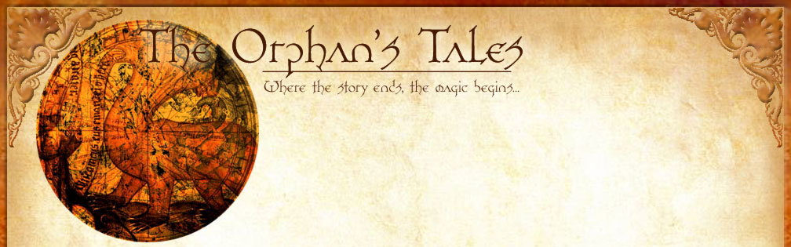
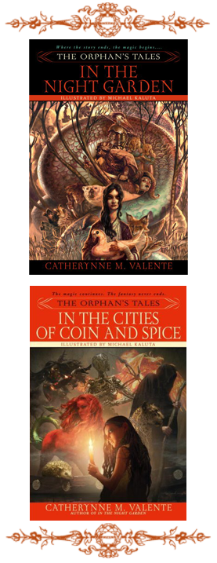
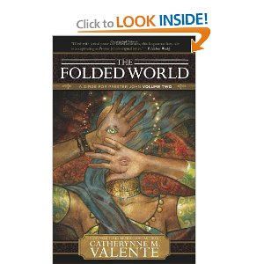
In the Night Garden (2006)
Catherynne Valente

Slide 2
Anthropology and Secondary Worlds?
Fantasy generated at cultural intersections?
Readers’ “secondary belief”—engaged temporarily within “Secondary World”
Borders: stories traded, exchanged—or silenced/ended
Review: Beowulf, 1001 Nights, Saga of the Volsungs:
Borders between cultures represented within the narratives
As generative of new stories→mythology removed from original cultural contexts
As source of “magic” within stories?
Anthropology as source material: research of ancient cultures, nonWestern cultures
Ursula Le Guin (Earthsea cycle)– Le Guin as daughter of anthropologists
Catherynne Valente: research of world mythologies, anthropology, medieval lit

Slide 3
Secondary World(s) of Orphan’s Tales
1001 Nights structure: enhanced
Persian / Middle Eastern palace
Cast-out orphan girl and Dinarzad’s little brother
Tales on eyelids. . . Night Garden experience
Inside vs. Outside Palace walls
Nature associations / experience
Trade/exchange: food for stories
Childhood verging on adulthood
Tale of Prince and Goose → Witch’s tale—leads to experience of horsewomen’s culture. . .

Slide 4
Culture and Gender
Grandmother Bentbow and Knife…. Vs. Prince Leander and his father the King
Historical context: Persians invading the steppes
SHAPE-SHIFTING MAGIC : conflict of gender authority?
Female Authority vs. Male Authority:
Matrilineal order: culture organized through inheritance of property and family order from mother to children. (Males can be tribal leaders… Females too. Sharing authority.) sibling relations are stronger than father-son relations. Women’s defining relationships are with their children and their siblings, mothers, and aunts. Husbands are temporary pair bonds. Ancient social orders…. Men and Women can both be leaders of society
Patrilineal order: property and family inheritance from father to children. Identity derived from fathers. Women’s identities redefined by marriage.
********************************************
Matriarchal society: political and moral leadership dominated by women. Mother as exclusive authority. Inheritance, family organized through mothers’ line. Many anthropologists claim there have been no true matriarchies.
Mythical example: Amazons: did they exist?
Patriarchal society: political and moral authority dominated by men. Men control distribution of wealth, resources, including wives. Inheritance, family, organized by fathers.
“your father, the King” controls social order. If women rule, they rule in the roles of men!

Slide 5
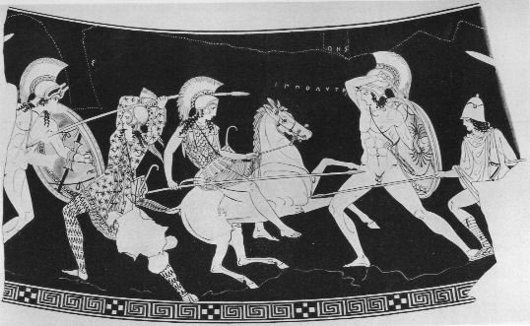
Nomadic Steppe People
“Scythians” (Greek name from Herodotus)
Multiple cultural groups on the Eurasian plains or steppes
Greeks and Persians vs. Scythians– ancient history of conflicts
Massagetae: nomadic tribe near the Aral sea, led by Queen Tomyris: defeated a Persian invading force and killed the Persian king, Cyrus the Great living in the vicinity of the Aral Sea who under the leadership of their queen, Tomyris, defeated and killed Cyrus the Great, Achaemenid Persian king, when he tried to invade her lands in 530 BCE.
Horses central to nomadic cultural life
20th-c archaeological excavations from the 1920s throught the 1990s: uncovering burial sites—revealing religious practices / women’s authority
Women revealed to have been leaders and warriors

Slide 6
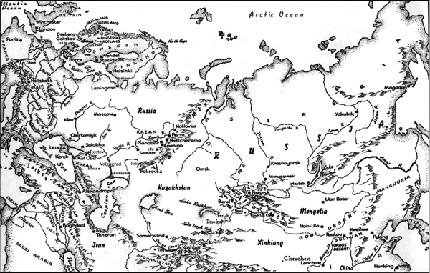
Eurasian Steppes

Slide 7
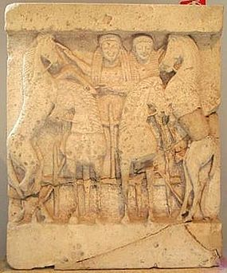
Aganippe: The Mare who Destroys Mercifully
Horse form of Gk. Goddess Demeter, worshipped by ancient, localized cults
Idol to Aganippe in Mavrospelya, the Black Cave, in Phigalia: mare with mane of snakes, surrounded by other creatures…
related to later myths of Pegasus, flying horse
Demeter: associated with the earth’s fertility, harvest, sustaining life
Very ancient forms: associated with life cycle as Virgin, Mother, and Crone (bringer of death)

Slide 8
Narrative Structure
Immersion in “secondary belief” systems
Cultural experience?
Tangible experience of supernatural:
Mare and fox, holes full of light…spilling into the world
Source of magic…as resistance?
Blood – Light Transfusions!
Significance to
Knife (48)
Prince Leander?
orphan girl and prince in outside frame?

Slide 9
Conflicts and Intersections: Ages, Genders, Cultures
Bear vs. Harpoon Star
animal – human transformation (tavern-keeper)
conflict with star-beings (death of Snake Star)
humans vs animals? Relations with star-beings, and QUESTS (104)
[What’s a quest?]
Beast and Marsh King
Interactions with princes and witches
(Prince Mathematics… Universal Monarchic Algorithm) (110-111)
Magadin
Stepmother (Iolanthe) / stepsisters… (“All stepmothers are witches” (128)
BEAST / Monstrosity vs. tower captivity
Wizards and Kings vs. Witches
and the boy-prince in frame narrative?

