Slide 1
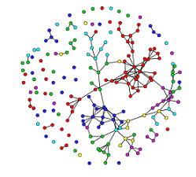
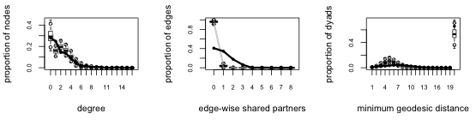
OBSERVED NETWORK
ESTIMATED COEFFICIENTS
MODEL
SIMULATED NETWORKS
TEST STATISTICS OF OBSERVED DATA
TEST STATISTICS OF SIMULATED DATA
MODEL ASSESSMENT

