Slide 1
statnetWeb for Teaching and Learning Network Analysis
XXXV Sunbelt conference
June 24, 2015
Emily Beylerian
Martina Morris

Slide 2
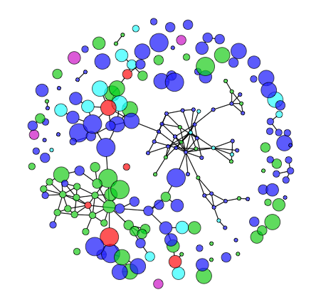
What is statnetWeb?
statnetWeb is a graphical user interface for network analysis
Based on statnet suite of R packages
www.statnet.org
Runs in a web browser
Users can perform complete analyses of relational data
Network visualization
Model estimation and evaluation
Model-based simulation
And download results and figures throughout the process

Slide 3
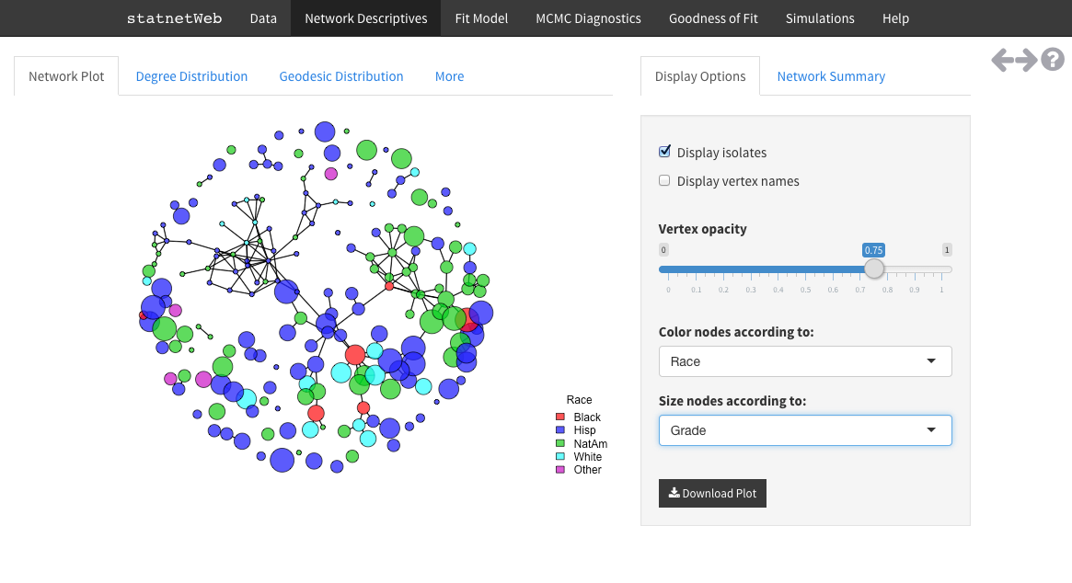
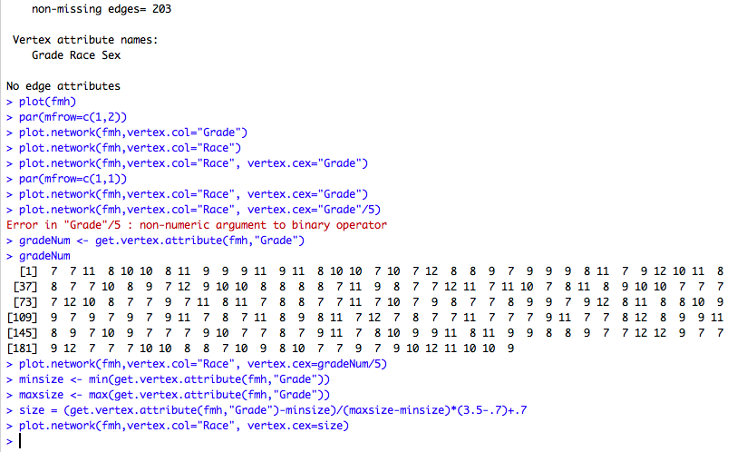
Why is it useful?

Slide 4
Why is it useful?
Network analysis techniques have progressed immensely over the past 60 years and continue to develop quickly.
Command line programs: flexible analysis possibilities, requires initial investment
GUI-based programs: available to wider audience, limited analysis possibilities
The statnet suite of R packages gives users powerful network analysis tools, accessed from the flexibility of the R command line.
The Shiny framework from RStudio allows us to build a friendly interface for statnet that runs in a web browser.
Rather than reinforcing the dichotomy between access to the command line and standalone GUIs, statnetWeb occupies the middle ground.
Teach and learn introductory network analysis
Perform exploratory tasks quickly
Transition to the command line for formal research

Slide 5
This Workshop
1. Accessing statnetWeb
2. statnetWeb in the classroom: Intro to Network Analysis
3. Development with Shiny

Slide 6
Accessing statnetWeb
through the web
Through rstudio and github
TBD, depends on how we host the app
Amazon
Shinyapps.io
Currently
https://ebey.shinyapps.io/statnetWeb/
Everything runs on the host server
Install the necessary packages in RStudio
install.packages(c("statnet", "shiny", "shinythemes", "shinyBS", "RColorBrewer", "lattice", "latticeExtra"))
Launch the application by sourcing code from the GitHub repository
shiny::runGitHub("statnetWeb","statnet")
Everything runs on your local machine

Slide 7
statnetWeb in the Classroom
Course outline
Network analysis basics
Data
Network descriptives
Statistical models
Diagnostics
Model-based simulation
Review and further topics
See the supplemental materials for more background and examples on each of these topics

Slide 8
Network Analysis Basics
Motivation
What is a network?
Nodes (vertices, actors)
Can have attributes associated
Ties (edges, links)
Can be directed/undirected and valued/binary
What can be represented as a network?
What kind of questions can we answer?
Definitions
Types of networks
Configurations: dyads, triads, k-stars
Types of network analysis
Descriptive
Statistical
Examples:
Friendship (node i likes j)
Sexual contact (nodes i and j have a relationship)
Affiliation (node i is a member of club a)
Social role (i gives advice to j)

Slide 9
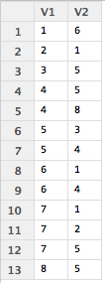
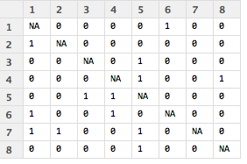
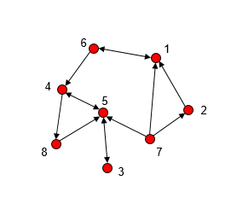
Data
Data collection
Sampling designs
Data storage
Adjacency matrices (sociomatrices), edge lists, incidence matrices
Data presentation
Numeric (matrices)
Pictorial (graphs)
Graph notation
Graph terminology

Slide 10
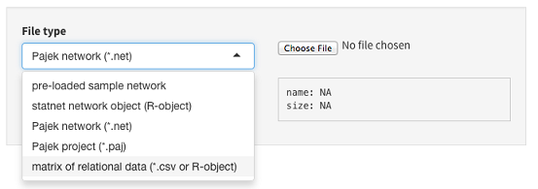
Data
Uploading to statnetWeb
Matrices (.csv or R-object)
Adjacency matrices should have node labels in the first row and column of .csv files
Incidence matrices should have edge labels in the first row and node labels in the first column of .csv files
Edge lists should not have row or column labels in .csv files
Built-in datasets
ergm object (R-object)
Pajek
Network (.net)
Project (.paj)
Interactive: open statnetWeb and attempt to upload the dataset that you brought with you
For most of the workshop we will be using the built-in networks to standardize our results

Slide 11
Data
Editing data
Symmetrize edges
Upper triangle
Lower triangle
Strong (intersection)
Weak (union)
Upload new attribute values
Network summary
Verify that the network has the basic characteristics you expect
Can go back to this on almost every page of statnetWeb

Slide 12
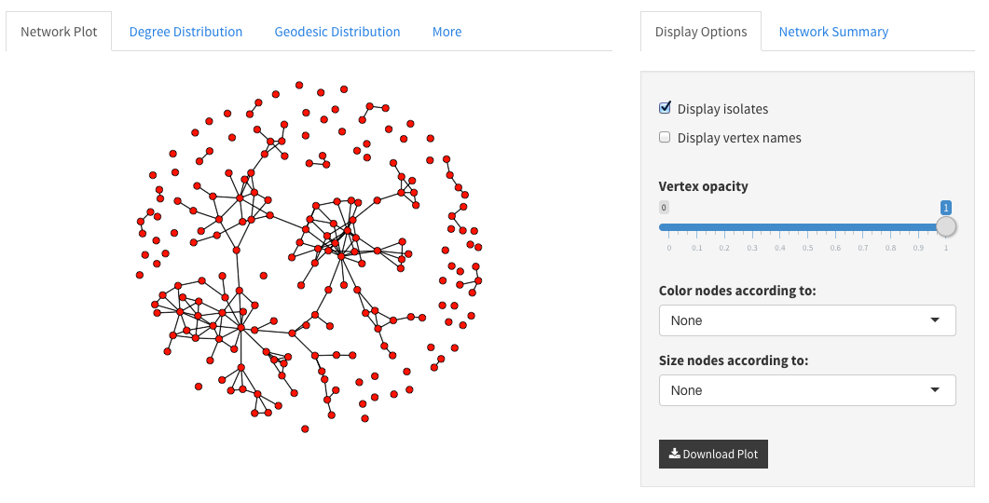
Network Descriptives
It is always a good idea to look at your data before trying to model
Graphical exploration
Numerical summaries
Network plot
Color code nodes by attributes
Size by numeric attributes or betweenness
Note: if larger nodes obscure small ones you can edit the opacity to ensure that all nodes are visible
Interactive: Load the faux.mesa.high data and examine the network plot.
Play around with color-coding the nodes
What do you notice after color-coding the nodes based on grade?
Now edit the size of the nodes based on betweenness.
What have we already learned about the social structure of this school?

Slide 13
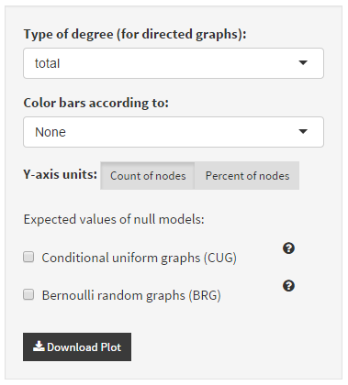
Network Descriptives
Degree Distribution
Plot of a numerical summary
How are degrees distributed?
Geodesic Distribution
How “connected” is the network?
Note: we can compare our network to the expected values under certain conditions – we will come back to this later!

Slide 14
Network Descriptives
Numerical summaries
Different levels of measurement
Mixing matrices
Node-level indices
Graph-level indices

Slide 15
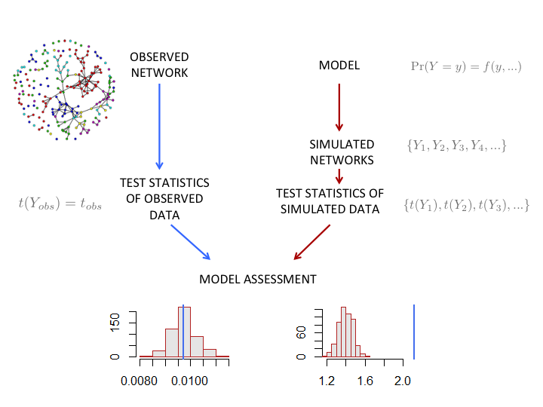
Statistical Models
Idea: We want to capture the underlying structural features of a network with a few parameters.
Chosen parameters are determining factors in specifying the probability of other possible networks.
If we have a good model, simulations from it will resemble our original network.
The appropriate model depends on the type of data. For now, we consider fully observed binary networks.

Slide 16
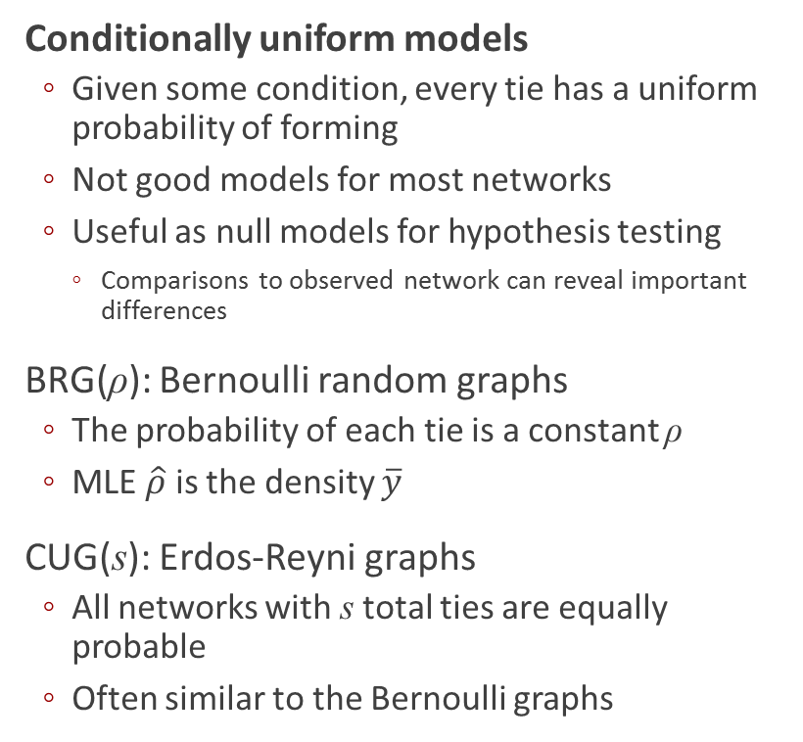
Statistical Models
Conditionally uniform models
Given some condition, every tie has a uniform probability of forming
Not good models for most networks
Useful as null models for hypothesis testing
Comparisons to observed network can reveal important differences
BRG(ρ): Bernoulli random graphs
The probability of each tie is a constant ρ
MLE $\hat{ρ}$ is the density $\overline{y}$
CUG(s): Erdos-Reyni graphs
All networks with s total ties are equally probable
Often similar to the Bernoulli graphs
Interactive: Revisit the plots of degree and geodesic distributions.
Add overlays of expected distributions from the null models.
What can we learn about faux.mesa.high from these comparisons?
What do the null models not tell us?

Slide 17
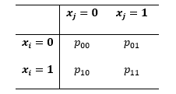
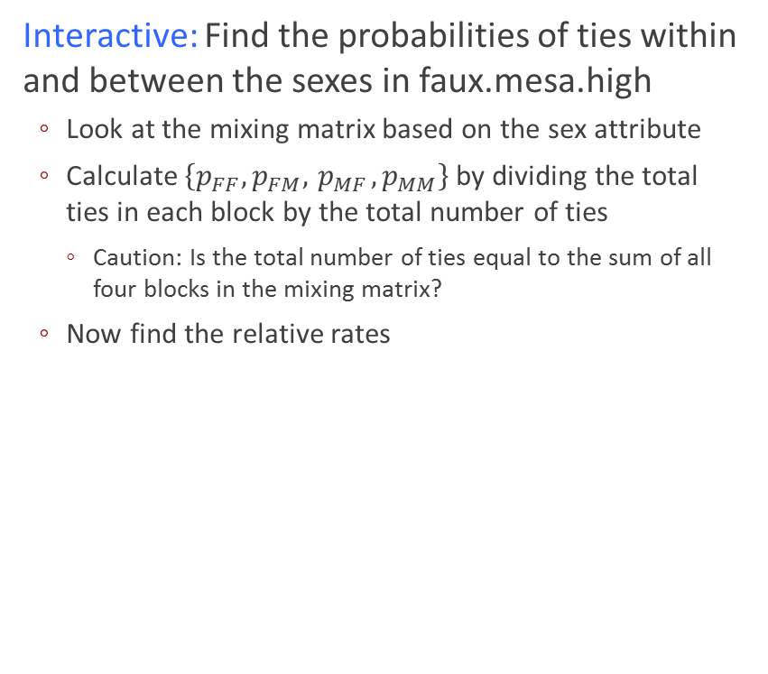
Statistical Models
Covariate effects
We can rearrange the rows and columns of an adjacency matrix to create a blockmodel, where nodes are grouped by values of a nodal covariate
Each block is a subgraph with its own density
The relative rates capture the relative tendency of ties in heterogeneous pairs compared to the baseline rate p₀₀
Odds ratios for tie preferences
The odds ratio represents the preference for homophily
Interactive: Find the probabilities of ties within and between the sexes in faux.mesa.high
Look at the mixing matrix based on the sex attribute
Calculate $\left\{p_{FF}, p_{FM},{ p}_{MF},p_{MM}\right\}$ by dividing the total ties in each block by the total number of ties
Caution: Is the total number of ties equal to the sum of all four blocks in the mixing matrix?
Now find the relative rates

Slide 18
Statistical Models
Logistic regression
Model the effect of binary covariates on the likelihood of ties
where x_{i} is the value of a covariate for node i, and x_{j} is the value for node j
β₀ is the baseline log odds of a tie when x_{i}=x_{j}=0
β₁ represents the “effect” of x_{i}
β₂ represents the “effect” of x_{j}
β₁₂ represents the effect of the interaction x_{i} x_{j}
Interactive: Fit this model in statnetWeb.
On the “Fit Model” page enter as the ergm formula:
edges + nodefactor("Sex") + nodematch("Sex",diff=TRUE,keep=2))
We can do this because logistic regression models are ERGMs! More on this later.

Slide 19
Statistical Models
Logistic regression
Model the effect of binary covariates on the likelihood of ties
where x_{i} is the value of a covariate for node i, and x_{j} is the value for node j
β₀ is the baseline log odds of a tie when x_{i}=x_{j}=0
β₁ represents the “effect” of x_{i}
β₂ represents the “effect” of x_{j}
β₁₂ represents the effect of the interaction x_{i} x_{j}
How are {beta,….} related to

Slide 20
Statistical Models
Individual effects

Slide 21
Statistical Models
p₁ model

Slide 22
Statistical Models
Markov graphs

Slide 23
Statistical Models
Exponential random graph models (p*)

Slide 24
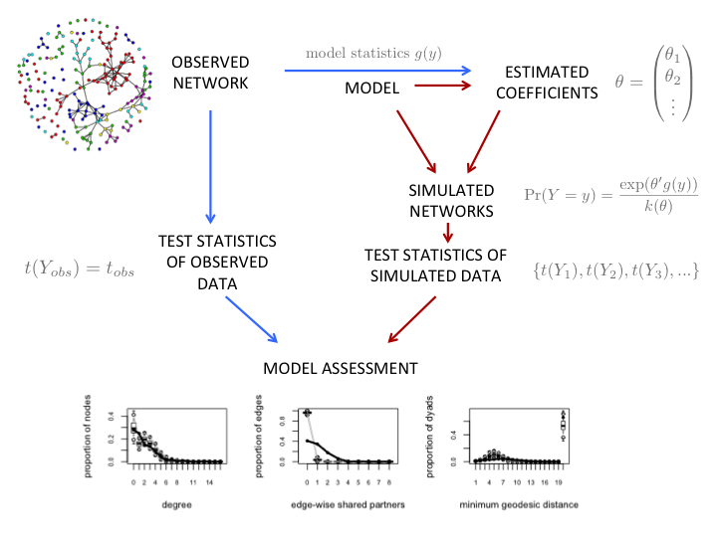
Statistical Models
What is an ERGM?
Class of models for specifying the probability distribution for a set of random graphs or networks
Y: random variable for state of network (with realization y)
g(y): vector of model statistics for network y
θ: vector of coefficients for statistics g(y)
k(θ): numerator summed over all possible networks with same node set as y

Slide 25
Diagnostics

Slide 26
Model-Based Simulation

Slide 27
Review & Further Topics

