Slide 1
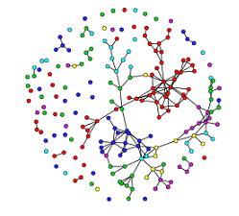
OBSERVED NETWORK
MODEL
SIMULATED NETWORKS
TEST STATISTICS OF OBSERVED DATA
TEST STATISTICS OF SIMULATED DATA
MODEL ASSESSMENT

