Slide 1
statnetWeb for Teaching and Learning Network Analysis
XXXV Sunbelt conference
June 24, 2015
Emily Beylerian
Martina Morris

Slide 2
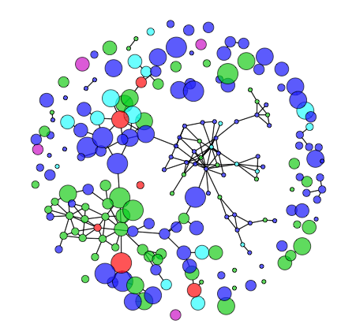
What is statnetWeb?
statnetWeb is an interactive web application for social network analysis.
Users can perform complete analyses of relational data
Network visualization
Model estimation and evaluation
Model-based simulation
And download results and figures throughout the process

Slide 3
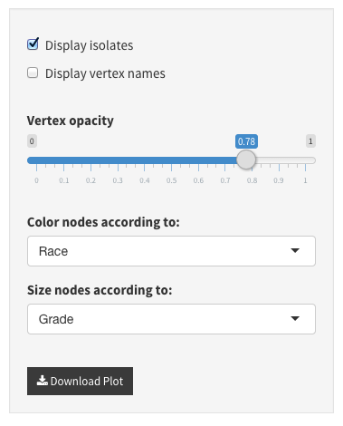
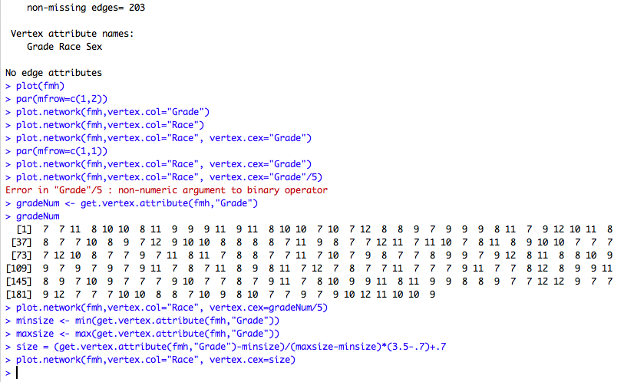
Why is it useful?

Slide 4
Why is it useful?
Network analysis techniques have progressed immensely over the past 60 years and continue to develop quickly.
Command line programs: flexible analysis possibilities, requires initial investment
GUI-based programs: available to wider audience, limited analysis possibilities
The statnet suite of R packages gives users powerful network analysis tools, accessed from the flexibility of the R command line.
The Shiny framework from RStudio allows us to build a graphical user interface for statnet that runs in a web browser.
Rather than an isolated GUI, statnetWeb occupies a middle ground ________

Slide 5
Course Outlines
Network analysis basics
Data
Network descriptives
Statistical models
Diagnostics
Model-based simulation
Review and further topics

Slide 6
Network Analysis Basics
Motivation
What is a network?
Nodes (vertices, actors)
Can have attributes associated
Ties (edges, links)
Can be directed/undirected and valued/binary
What can be represented as a network?
What kind of questions can we answer?
Definitions
Types of networks
Configurations: dyads, triads, k-stars
Types of network analysis
Descriptive
Statistical
Examples:
Friendship (node i likes j)
Sexual contact (nodes i and j have a relationship)
Affiliation (node i is a member of club a)
Social role (i gives advice to j)

Slide 7
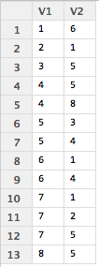
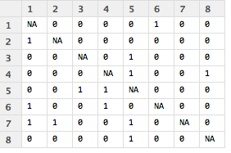
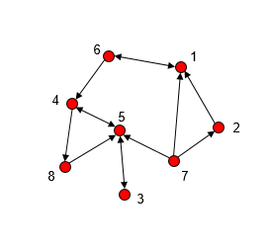
Data
Data collection
Sampling designs
Data storage
Adjacency matrices, edge lists, incidence matrices
Data presentation
Numeric (matrices)
Pictorial (graphs)
Graph notation
Graph terminology

Slide 8
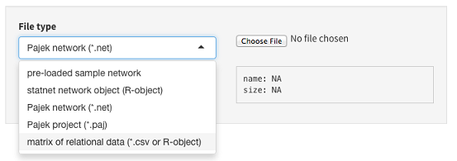
Data
Uploading to statnetWeb
Matrices (.csv or R-object)
Adjacency matrices should have node labels in the first row and column of .csv files
Incidence matrices should have edge labels in the first row and node labels in the first column of .csv files
Edge lists should not have row or column labels in .csv files
Built-in datasets
ergm object (R-object)
Pajek
Network (.net)
Project (.paj)
Interactive: open statnetWeb and attempt to upload the dataset that you brought with you
For most of the workshop we will be using the built-in networks to standardize our results

Slide 9
Data
Editing data
Nw summary
Can go back to this on almost every page of sW

Slide 10
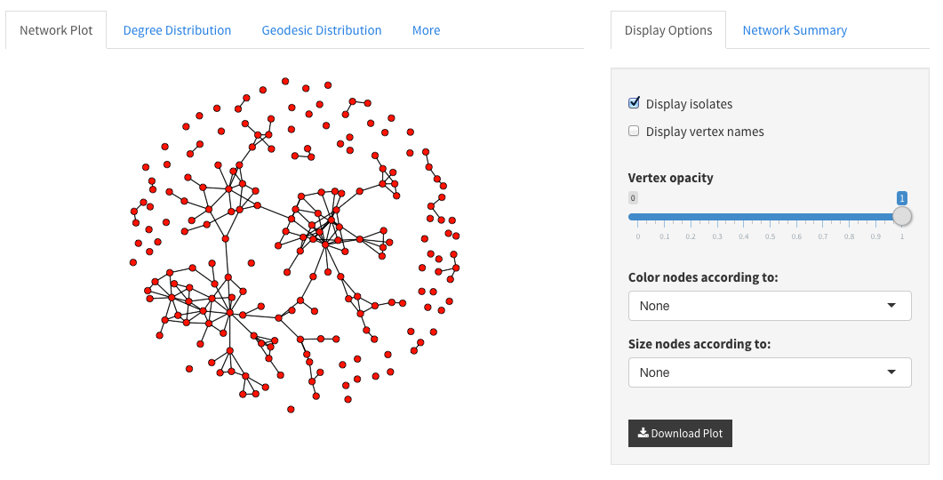
Network Descriptives
It is a good idea to look at your data before trying to model
Graphical exploration
Numerical summaries
Network plot
Color code nodes by attributes
Size by numeric attributes or betweenness
Note: if larger nodes obscure small ones you can edit the opacity to ensure that all nodes are visible
Interactive: Load the faux.mesa.high data and examine the network plot.
Play around with color-coding the nodes
What do you notice after color-coding the nodes based on grade?
Now edit the size of the nodes based on betweenness.
What have we already learned about the social structure of this school?

Slide 11
Network Descriptives
Degree Distribution
Plot of a numerical summary
How are degrees distributed?
Geodesic Distribution
How “connected” is the network?
Note about expected values – go back later!

Slide 12
Network Descriptives
Numerical summaries
Different levels of measurement

Slide 13
Statistical Models

Slide 14
Diagnostics

Slide 15
Model-Based Simulation

Slide 16
Review & Further Topics

