Slide 1
statnetWeb for Teaching and Learning Network Analysis
XXXV Sunbelt conference
June 24, 2015
Emily Beylerian
Martina Morris

Slide 2
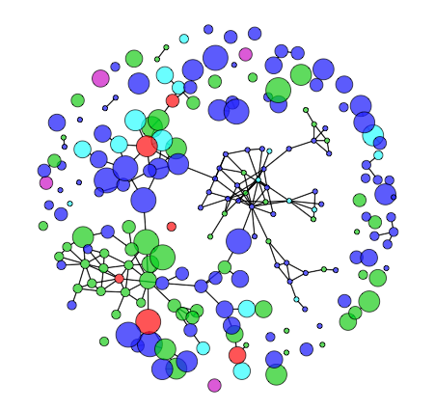
What is statnetWeb?
statnetWeb is a graphical user interface for network analysis
Based on statnet suite of R packages
www.statnet.org
Runs in a web browser
Users can perform complete analyses of relational data
Network visualization
Model estimation and evaluation
Model-based simulation
And download results and figures throughout the process

Slide 3
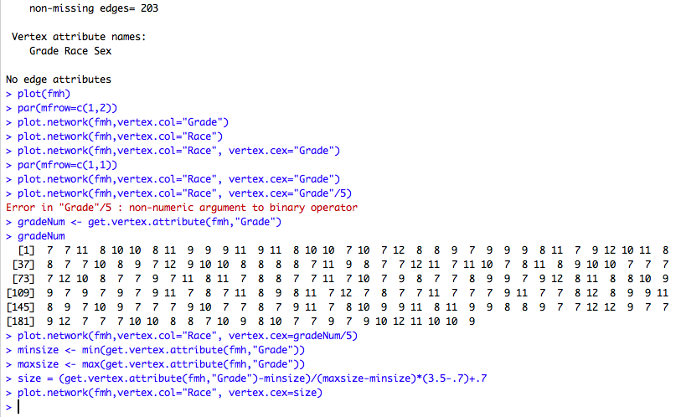
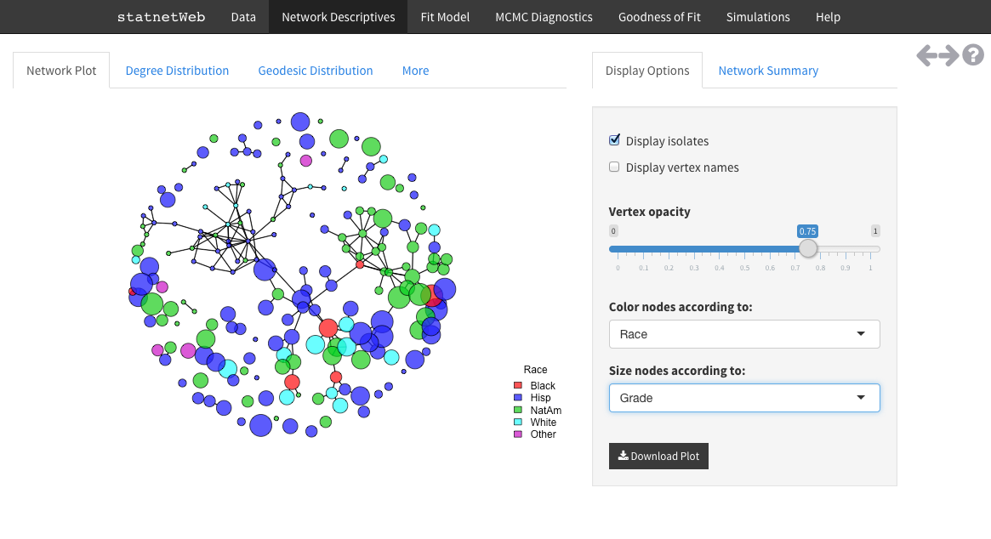
Why is it useful?
Network analysis techniques have progressed immensely over the past 60 years and continue to develop quickly.
Command line programs: flexible analysis possibilities, requires initial investment
GUI-based programs: available to wider audience, limited analysis possibilities
The statnet suite of R packages gives users powerful network analysis tools, accessed from the flexibility of the R command line.
The Shiny framework from RStudio allows us to build a friendly interface for statnet that runs in a web browser.

Slide 4
Why is it useful?
Rather than reinforcing the dichotomy between access to the command line and standalone GUIs, statnetWeb occupies the middle ground.
Teach and learn introductory network analysis
Perform exploratory tasks quickly
Transition to the command line for formal research

Slide 5
This Workshop
1. Accessing statnetWeb
2. statnetWeb in the classroom: Intro to Network Analysis
3. Development with Shiny

Slide 6
Accessing statnetWeb
through the web
Through rstudio and github
TBD, depends on how we host the app
Amazon
Shinyapps.io
Currently
https://ebey.shinyapps.io/statnetWeb/
Everything runs on the host server
Install the necessary packages in RStudio
install.packages(c("statnet", "shiny", "shinythemes", "shinyBS", "RColorBrewer", "lattice", "latticeExtra"))
Launch the application by sourcing code from the GitHub repository
shiny::runGitHub("statnetWeb","statnet")
Everything runs on your local machine

Slide 7
Accessing statnetWeb
through the web
Through rstudio and github
TBD, depends on how we host the app
Amazon
Shinyapps.io
Currently
https://ebey.shinyapps.io/statnetWeb/
Everything runs on the host server
Install the necessary packages in RStudio
install.packages(c("statnet", "shiny", "shinythemes", "shinyBS", "RColorBrewer", "lattice", "latticeExtra"))
Launch the application by sourcing code from the GitHub repository
shiny::runGitHub("statnetWeb","statnet")
Everything runs on your local machine

Slide 8
statnetWeb in the Classroom
Course outline
Network analysis basics
Data
Network descriptives
Statistical models
Diagnostics
Model-based simulation
Review and further topics
See the supplemental workshop materials for more background and examples on each of these topics

Slide 9
Network Analysis Basics
Motivation
What is a network?
Nodes (vertices, actors)
Can have attributes associated
Ties (edges, links)
Can be directed/undirected and valued/binary
What can be represented as a network?
What kind of questions can we answer?
Definitions
Types of networks
Configurations: dyads, triads, k-stars
Types of network analysis
Descriptive
Statistical
Examples:
Friendship (node i likes j)
Sexual contact (nodes i and j have a relationship)
Affiliation (node i is a member of club a)
Social role (i gives advice to j)

Slide 10
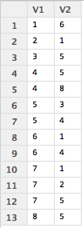
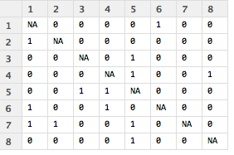
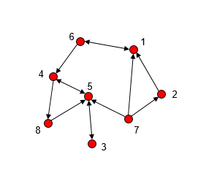
Data
Data collection
Sampling designs
Data storage
Adjacency matrices (sociomatrices), edge lists, incidence matrices
Data presentation
Numeric (matrices)
Pictorial (graphs)
Graph notation
Graph terminology

Slide 11
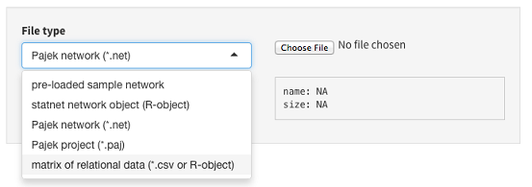
Data
Uploading to statnetWeb
Matrices (.csv or R-object)
Adjacency matrices should have node labels in the first row and column of .csv files
Incidence matrices should have edge labels in the first row and node labels in the first column of .csv files
Edge lists should not have row or column labels in .csv files
Built-in datasets
ergm object (R-object)
Pajek
Network (.net)
Project (.paj)
Interactive: open statnetWeb and attempt to upload the dataset that you brought with you
For most of the workshop we will be using the built-in networks to standardize our results

Slide 12
Data
Editing data
Symmetrize edges
Upper triangle
Lower triangle
Strong (intersection)
Weak (union)
Upload new attribute values
Network summary
Verify that the network has the basic characteristics you expect
Can go back to this on almost every page of statnetWeb

Slide 13
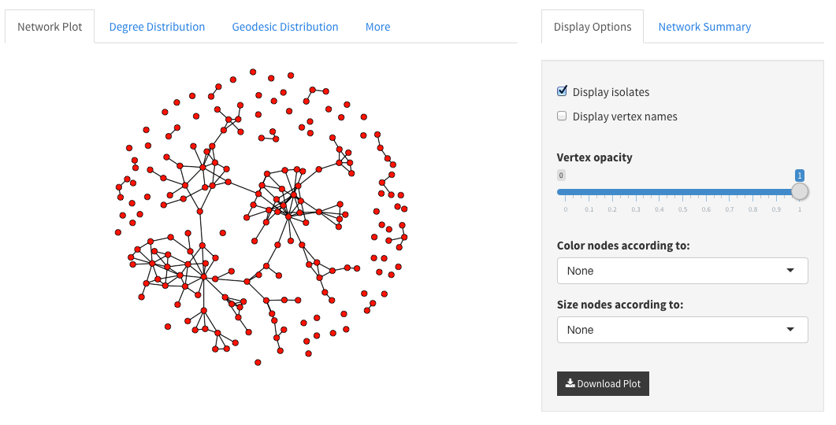
Network Descriptives
It is always a good idea to look at your data before trying to model
Graphical exploration
Numerical summaries
Network plot
Color code nodes by attributes
Size by numeric attributes or betweenness
Note: if larger nodes obscure small ones you can edit the opacity to ensure that all nodes are visible
Interactive: Load the faux.mesa.high data and examine the network plot.
Play around with color-coding the nodes
What do you notice after color-coding the nodes based on grade?
Now edit the size of the nodes based on betweenness.
What have we already learned about the social structure of this school?

Slide 14
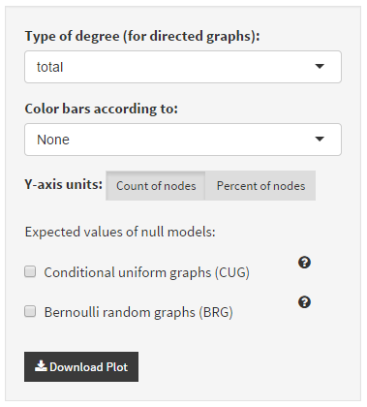
Network Descriptives
Degree Distribution
Plot of a numerical summary
How are degrees distributed?
Geodesic Distribution
How “connected” is the network?
Interactive: Explore these plots for the faux.mesa.high network
Note: we can compare our network to the expected values under certain conditions – we will come back to this later!

Slide 15
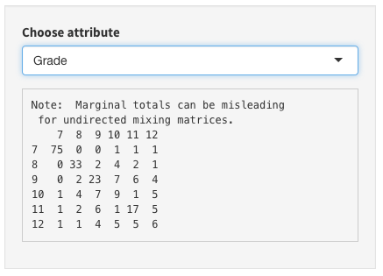
Network Descriptives
Numerical summaries
Different levels of measurement
Mixing matrices
Assortative mixing – tendency to favor nodes with similar characteristics to one’s own
Node-level indices
Graph-level indices
Interactive: Navigate to the “More” tab under Network Descriptives
What do mixing matrices reveal about tendency toward assortative mixing/homophily?
Scroll through node-level descriptives

Slide 16
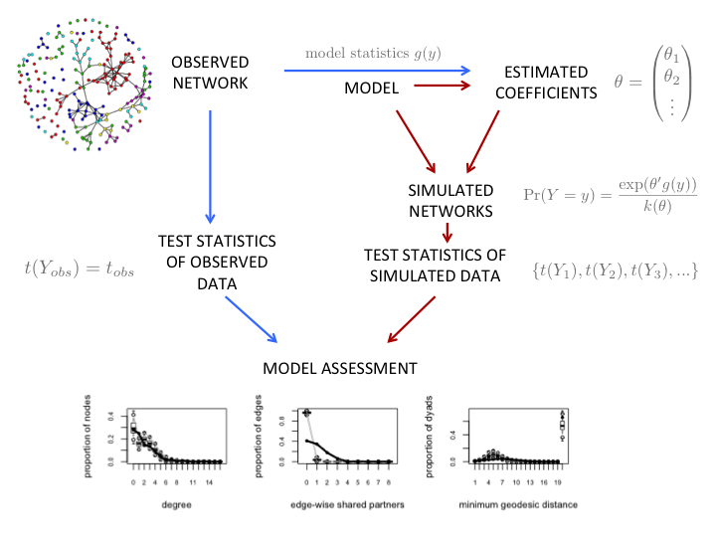
Statistical Models
Idea: We want to capture the underlying structural features of a network with a few parameters.
Chosen parameters are determining factors in specifying the probability of other possible networks.
If we have a good model, simulations from it will resemble our original network.
The appropriate model depends on the type of data. For now, we consider fully observed binary networks.

Slide 17
Statistical Models
Exponential random graph models (ERGMs)
A class of models for specifying the probability distribution for a set of random graphs or networks.
statnetWeb is based on the ergm package from statnet, a powerful and flexible framework for fitting and simulating from network models
Based on what we can observe about our network, we will choose some key network statistics to include as the basis of our model
We can choose from any of the ergm terms
See documentation box in statnetWeb
Use help(“ergm-terms”) in the R command line
Skye’s reference page online?
Many simple models fit into this framework, even though they were developed far before the ERGM theory.

Slide 18
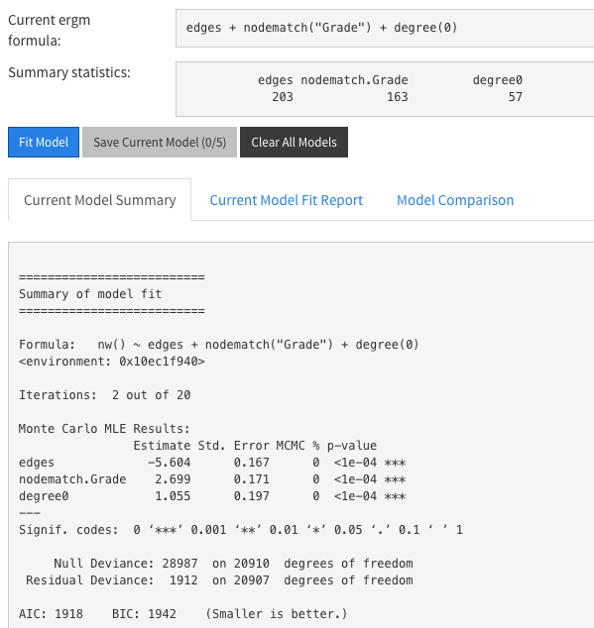
Statistical Models
Exponential random graph models (p*)
Y: random variable for state of network (with realization y)
g(y): vector of model statistics for network y
We choose g from the collection of ergm terms
We can see g(y_{obs}) in the model summary statistics
θ: vector of coefficients for statistics g(y)
statnetWeb estimates these
k(θ): numerator summed over all possible networks with same node set as y
Hard to calculate!

Slide 19
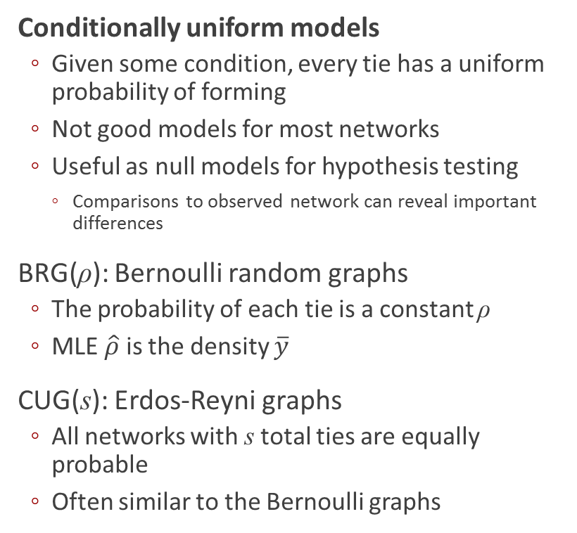
Statistical Models
Conditionally uniform models
Given some condition, every tie has a uniform probability of forming
Not good models for most networks
Useful as null models for hypothesis testing
Comparisons to observed network can reveal important differences
BRG(ρ): Bernoulli random graphs
The probability of each tie is a constant ρ
MLE $\hat{ρ}$ is the density $\overline{y}$
CUG(s): Erdos-Reyni graphs
All networks with s total ties are equally probable
Often similar to the Bernoulli graphs
Interactive: Revisit the plots of degree and geodesic distributions.
Add overlays of expected distributions from the null models.
What can we learn about faux.mesa.high from these comparisons?
What do the null models not tell us?

Slide 20
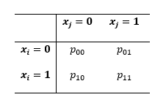
Statistical Models
Covariate effects
We can rearrange the rows and columns of an adjacency matrix to create a blockmodel, where nodes are grouped by values of a nodal covariate
Each block is a subgraph with its own density
The relative rates capture the relative tendency of ties in heterogeneous pairs compared to the baseline rate p₀₀
Odds ratios for tie preferences
The odds ratio represents the preference for homophily

Slide 21
Statistical Models
Interactive: Find the probabilities of ties within and between the sexes in faux.mesa.high
Look at the mixing matrix based on the sex attribute
Calculate {p_{FF}, p_{FM}, p_{MF}, p_{MM}} by dividing the total ties in each block by the total number of ties
Caution: Is the total number of ties equal to the sum of all four blocks in the mixing matrix?
Now find the relative rates and interpret

Slide 22
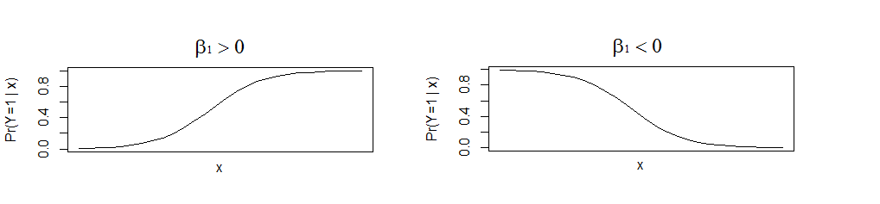
Statistical Models
Logistic regression
Model the effect of a covariate x on the likelihood of ties
β₀ is the baseline log odds of a tie when x=0
β₁ represents the effect of x

Slide 23
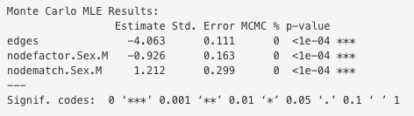
Statistical Models
Why can we fit logistic regression models in statnetWeb?
Logistic regression models are ERGMs!
How do we fit a logistic regression (or any) model in statnetWeb?
Decide which terms correspond to the model
Enter terms (and any necessary arguments) into the formula box
Note that after adding terms to a formula, you can see a summary of those statistics in your network
Model summary
Estimates of coefficients, standard errors, p-values

Slide 24
Statistical Models
Logistic regression
Model the effect of multiple covariates on the likelihood of ties
where x_{i} is the value of a covariate for node i, and x_{j} is the value for node j
β₀ is the baseline log odds of a tie when x_{i}=x_{j}=0
β₁ represents the effect of x_{i}
β₂ represents the effect of x_{j}
β₁₂ represents the effect of the interaction x_{i} x_{j}
Interactive: Fit this model in statnetWeb.
Let x_{i}=1 if node i is male
Read the help documentation for the ergm terms nodefactor and nodematch
Does it make sense that the following ergm formula is fitting the same model as on the left?
edges + nodefactor("Sex") + nodematch("Sex",diff=TRUE,keep=2))
Fit the model
Interpret the coefficients
Exponentiate the coefficients and compare to relative rates

Slide 25
Statistical Models
Logistic regression
How are {β₀, β₁, β₂, β₁₂} from our model related to ?
If network density is low, 1-p_{xixj} ≈ 1
o_{xixj} = p_{xixj} / (1-p_{xixj}) ≈ p_{xixj}
Note that if we don’t include any covariates our logistic regression model becomes much simpler
β₀ is the log odds of any tie
This is the Bernoulli model

Slide 26
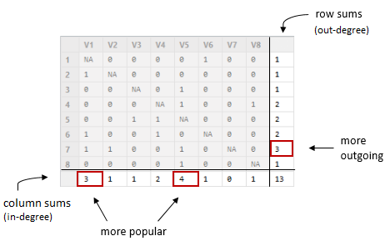
Statistical Models
Individual effects (directed networks)
Some are more likely to send ties (more sociable)
Some are more likely to receive ties (more popular)
Capture the variability of out-degree and in-degree by fitting the marginal totals of a network’s adjacency matrix.

Slide 27
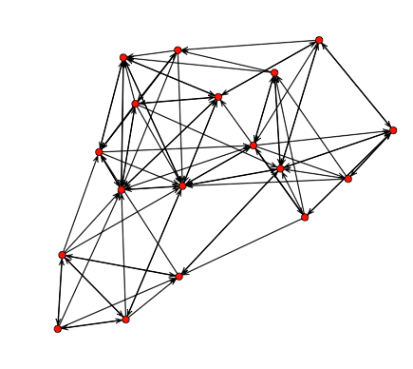
Statistical Models
Individual effects (directed networks)
Some are more likely to send ties (more sociable)
Some are more likely to receive ties (more popular)
Capture the variability of out-degree and in-degree by fitting the marginal totals of a network’s adjacency matrix.
Interactive: Fit an individual effects model.
Load the samplike dataset.
Perform some exploratory analysis and discuss with your neighbors.
Fit this individual effects model with
samplike ~ edges + sender + receiver

Slide 28
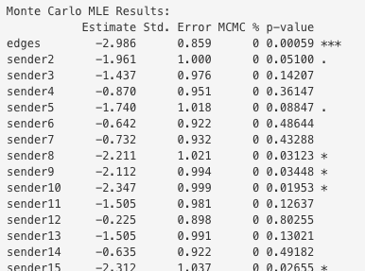
Statistical Models
p₁ model
So far we have assumed independence between all ties.
In the p₁ model we allow for dependence within dyads.
Same sender and receiver effects as the individual effects model
Additional parameter γ measures tendency for ties to be mutual
Relations between dyads are still independent.
Interactive: Fit model.
samplike ~ edges + sender + receiver + mutual
As you can see, the individual effects and p₁ models include many parameters, which are specific to the network in question.
Ideally, we want to work with a model that is more generalizable and parsimonious.

Slide 29
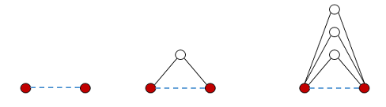
Statistical Models
Markov graphs
Dyads are dependent only if they share a node
Groups of nodes that are all dependent on each other form triangles and k-stars
“A friend of my friend is my friend”
Example of a Markov graph is one where individuals are more likely to become friends if they have existing friends in common
More friends in common ➔ more triangles will close as a result of friendship
Interactive: Fit a Markov graph model using the triangle term.
faux.mesa.high ~ edges + triangle
What happens when you fit this model?

Slide 30
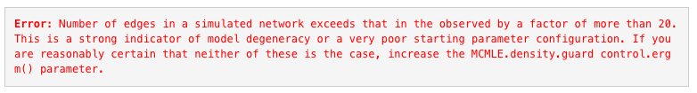
Statistical Models
Markov chain Monte Carlo estimation
Used in models that involved dyadic dependence.
Iteratively simulate graphs and approximate coefficients that approach the maximum likelihood estimates.
Computationally intensive process and comes with limitations.
Degeneracy
For certain sets of parameters, dyadic dependence quickly cascades across the network, causing the outcome graphs to become unreasonably dense.
The triangle term is one of the worst offenders.

Slide 31
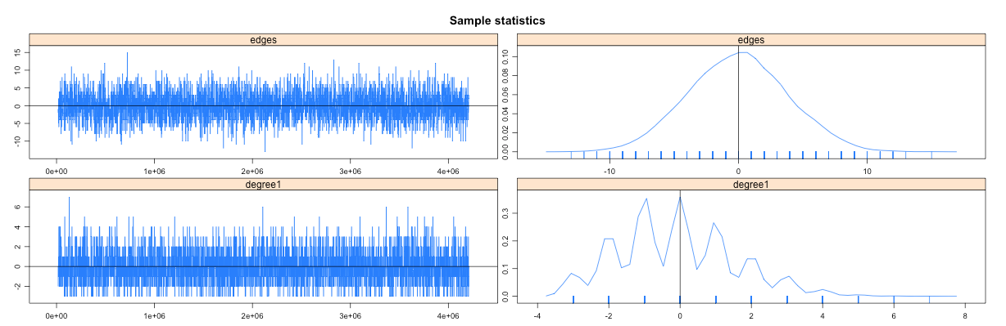
Diagnostics
MCMC Diagnostics
To verify that our model is not degenerate:
We want the MCMC sample statistics to vary randomly around the observed values
And the difference between the observed and simulated values of the sample statistics to have a roughly bell-shaped distribution, centered at 0

Slide 32
Diagnostics
Goodness of fit
If a statistic is included in our model, simulations should always reproduce the observed value
Checking this verifies that the model is performing the way we expect it to.
If a model is able to reproduce statistics that are not explicitly included in the model, this is a sign that we have captured the key structural features of the data.
statnetWeb has a built in goodness of fit mechanism.
For various terms (degree, egdewise shared partners, geodesic distance and more), the user can check statistics and boxplots of simulated values and compared them to the observed network.
When multiple models are saved, compare GOF plots in a chart.

Slide 33
Statistical Models
Back to ERGMs
More examples
Save multiple models and compare results

Slide 34
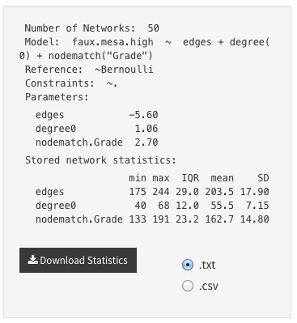
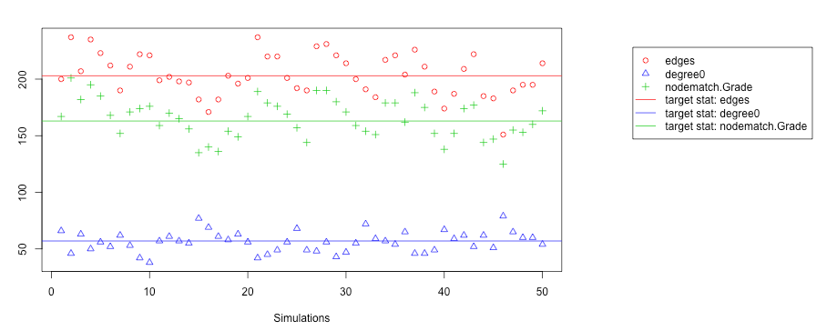
Model-Based Simulation
Choose the number of simulations and edit MCMC control options if desired
Browse through plots of each simulation
Plot simulation statistics compared to targets
Download files of simulation summary

Slide 35
Review & Further Topics
Missing data
Longitudinal analysis (STERGMs)

Slide 36
statnetWeb Development
statnetWeb is written in Shiny, a framework for creating web applications with content written in R
http://shiny.rstudio.com/
The code for statnetWeb is publicly available at our GitHub repository
https://github.com/statnet/statnetWeb
Feel free to browse the code, make suggestions and report issues.

