Slide 1
statnetWeb for Teaching and Learning Network Analysis
XXXV Sunbelt conference
June 24, 2015
Emily Beylerian
Martina Morris

Slide 2
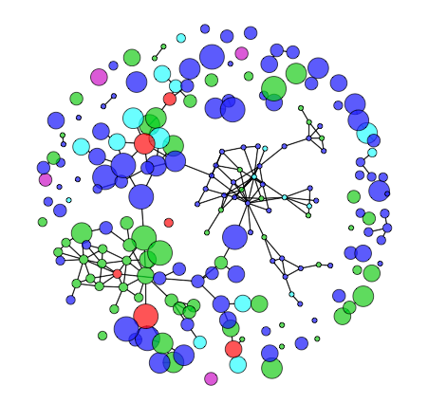
What is statnetWeb?
statnetWeb is an interactive web application for social network analysis.
Users can perform complete analyses of relational data
Network visualization
Model estimation and evaluation
Model-based simulation
And download results and figures throughout the process

Slide 3
Why is it useful?
Network analysis techniques have progressed immensely over the past 60 years and continue to develop quickly.
Command line programs: flexible analysis possibilities, requires initial investment
GUI-based programs: available to wider audience, limited analysis possibilities

Slide 4
Course Outlines
Network analysis basics
Data
Network descriptives
Statistical models
Diagnostics
Model-based simulation
Review and further topics

Slide 5
Network Analysis Basics
Motivation
What is a network?
What can be represented as a network?
What kind of questions can we answer?
Sampling Designs
Census, adaptive sample, egocentric sample
The type of sample impacts the type of analysis
Types of network analysis
Descriptive
Statistical

Slide 6
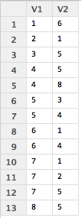
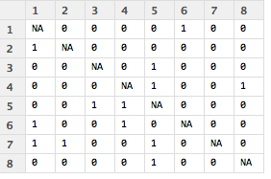
Data
Data storage
Adjacency matrices, edge lists, incidence matrices
Network data as a graph
Graph notation
Graph terminology

Slide 7
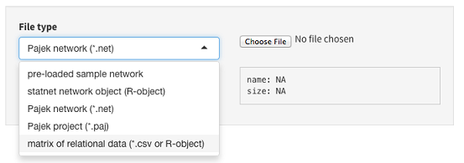
Data
Uploading to statnetWeb
ergm object (R-object)
Pajek network (.net)
Pajek project (.paj)
Matrices (.csv or R-object)
Adjacency matrices should have node labels in the first row and column of .csv files
Incidence matrices should have edge labels in the first row and node labels in the first column of .csv files
Edge lists should not have row or column labels in .csv files
Interactive: open statnetWeb and attempt to upload the dataset that you brought with you
For most of the workshop we will be using the pre-loaded sample networks to standardize our results

Slide 8
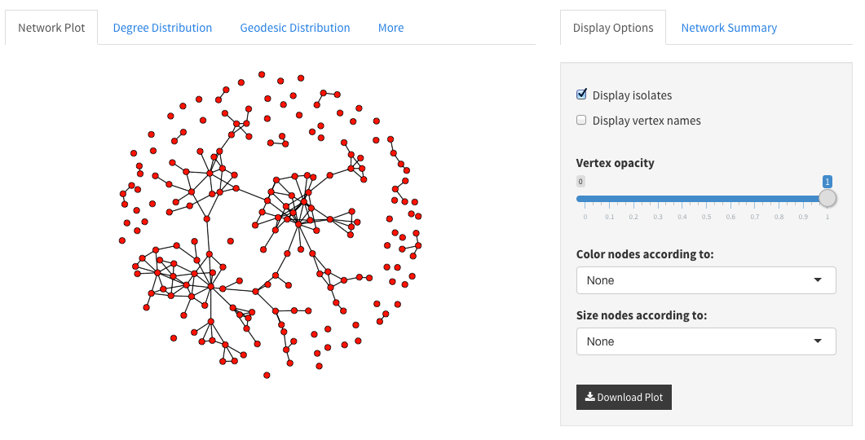
Network Descriptives
With some initial insight into structure of the observed network, we get
Better model formulations
Better interpretation of results
Network plot
Color code nodes by attributes
Size by numeric attributes or betweenness
Note: if larger nodes obscure small ones you can edit the opacity to ensure that all nodes are visible
Interactive: Load the faux.mesa.high data and examine the network plot.
Play around with color-coding the nodes
What do you notice after color-coding the nodes based on grade?
Now edit the size of the nodes based on betweenness.
What have we already learned about the social structure of this school?

Slide 9
Network Descriptives
Degree Distribution
How are degrees distributed?
Geodesic Distribution
How “connected” is the network?

Slide 10
Statistical Models

Slide 11
Diagnostics

Slide 12
Model-Based Simulation

Slide 13
Review & Further Topics

