Slide 1


Use Case Presentation
By-
Varun Bhatnagar

Slide 2
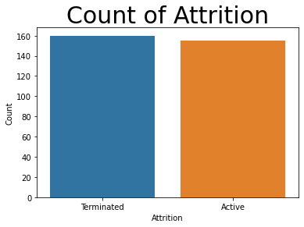
Business Requirements
1. Identify the profile/s of people who are likely to exit from the organization in the next 6-9 months.
2. Identify attrition risk and key attrition drivers against each employee in the organization.
3. Identify cohort-wise attrition drivers in the organization.
4. Identify the top Talent competitors (companies and Industries) where we are losing talent
5. Initiate the data-driven methodology to bring the change to help create a hyper-personalized experience to cater to the needs of the current workforce.
*49.21% for Managers overall in ABC Company

Slide 3










Employee Churn Data analytics
Data Sources
Data Insights
Performance Review, Joining and Last Promotion
Key Factor for Churn Analysis
Data Based Decisions
Work Experience
Better Planning.
Insights
Active and Terminated Employees
Predict Employees who can leave soon
Education
Predict KPIs/Departments to be worked on Prioirty.
AI/ML Advanced Analytics
Certifications

Slide 4
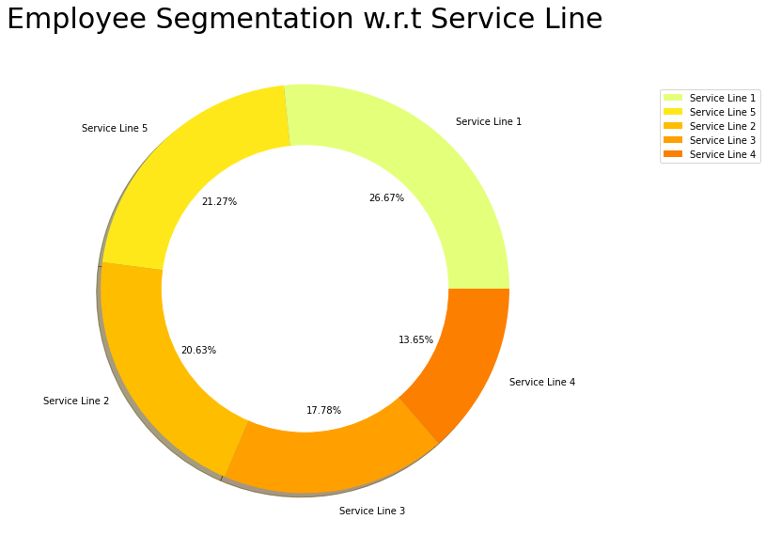
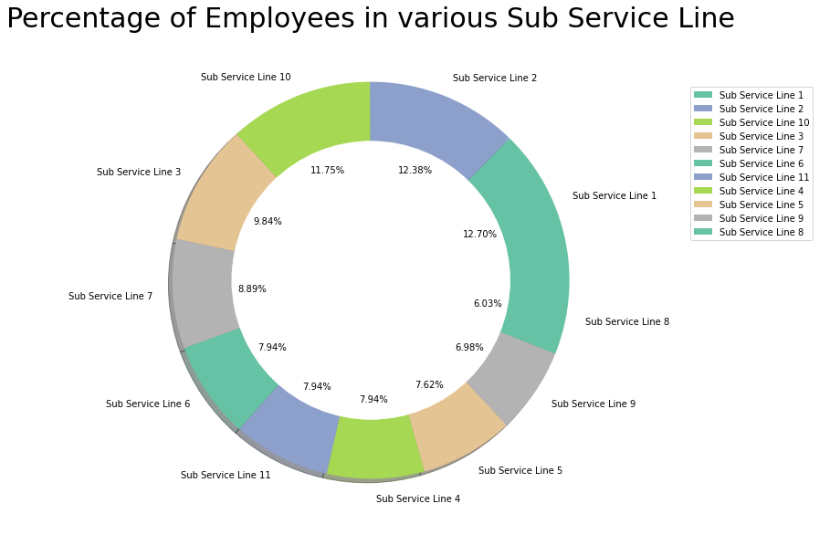
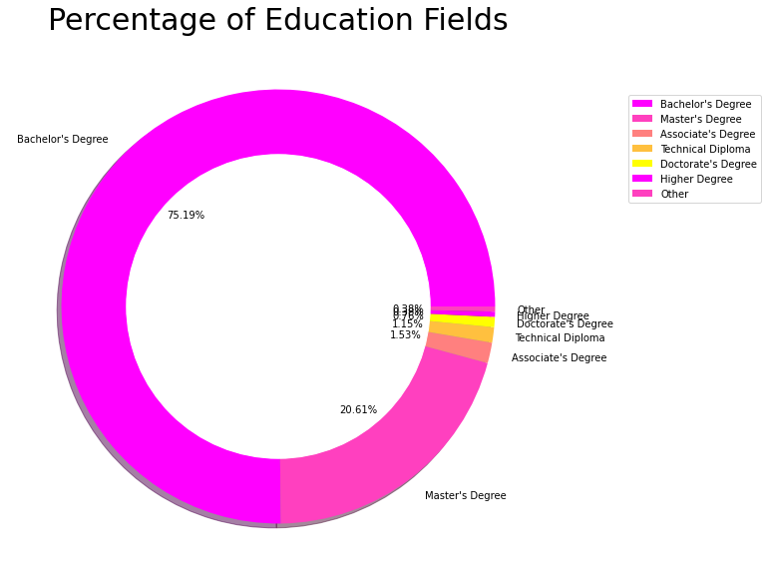
Understanding Data - 1

Slide 5
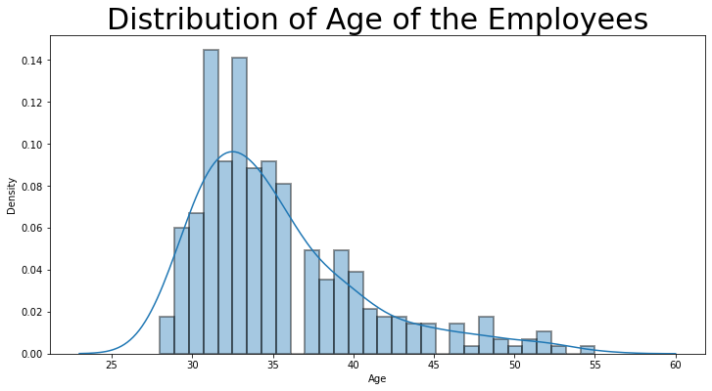
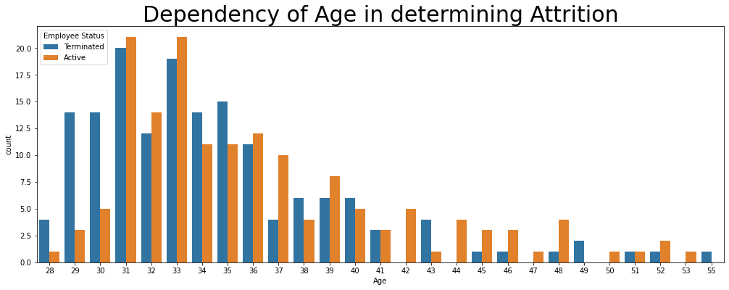
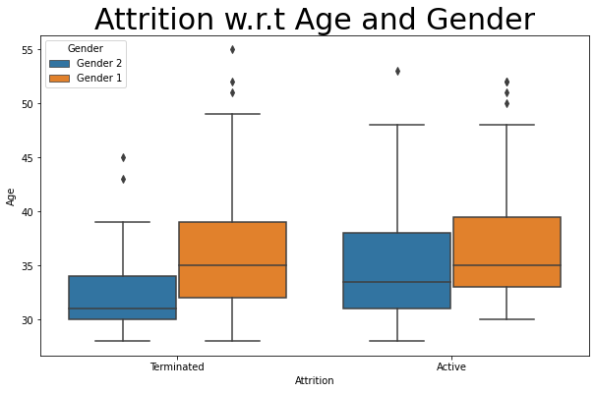
Understanding Data - 2

Slide 6
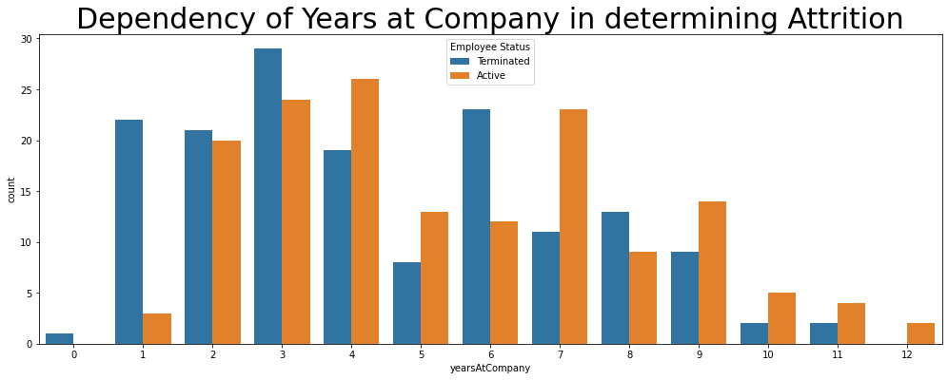
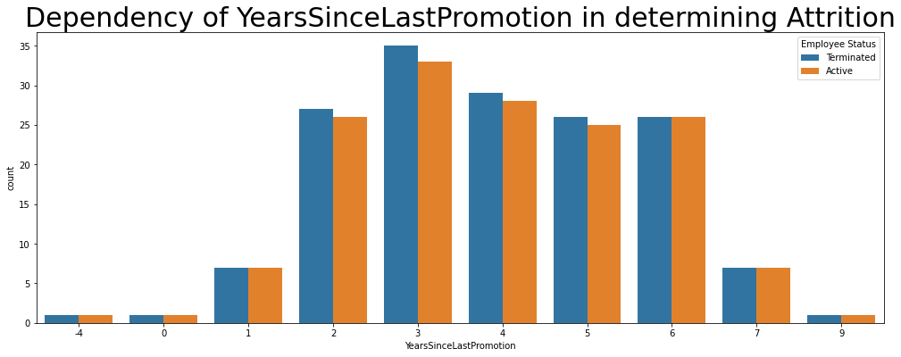
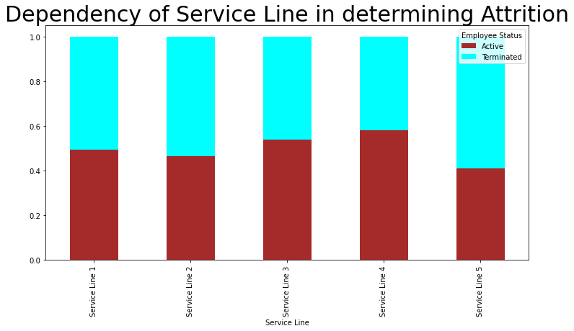
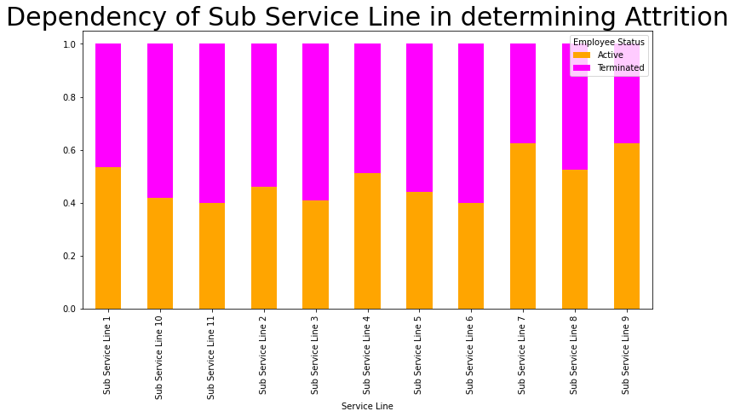
Factors Influencing Attrition

Slide 7
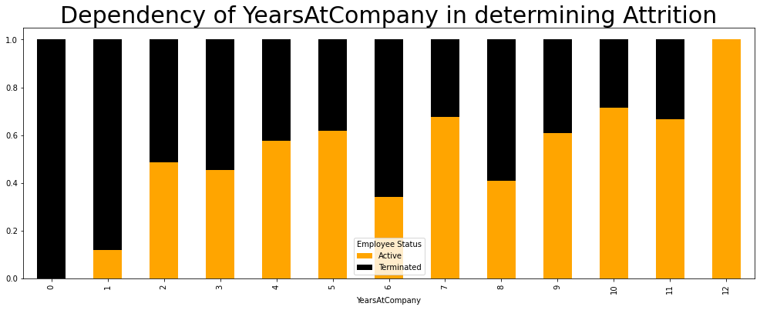
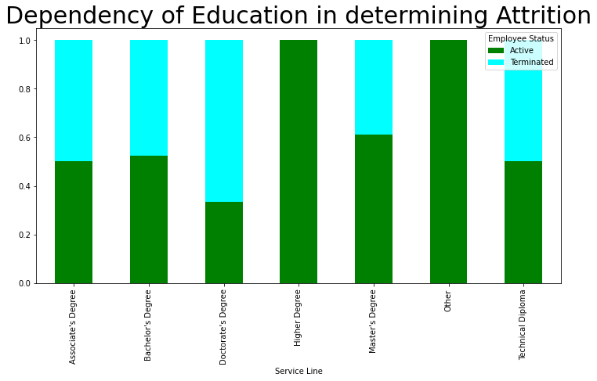
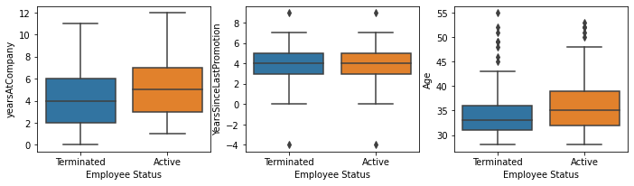
Factors Influencing Attrition - 2

Slide 8
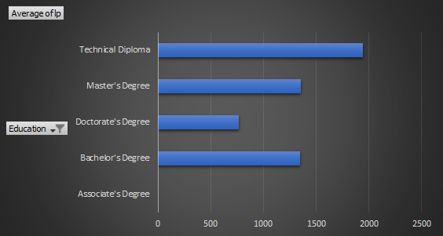
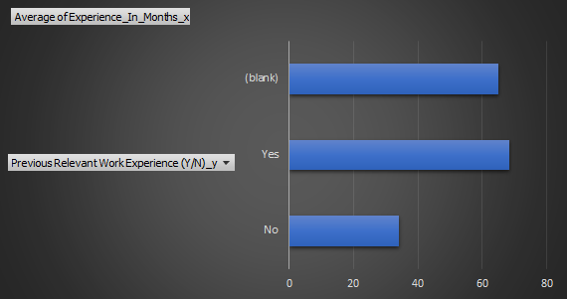
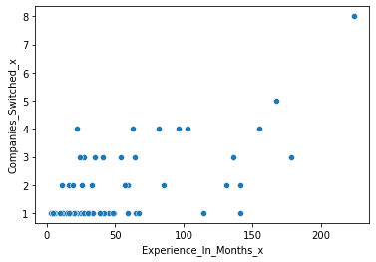
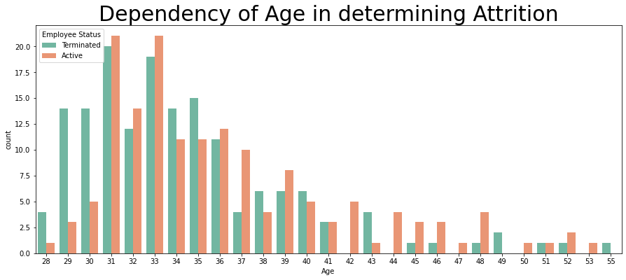
Key Factors
People with Technical Diploma or Bachelors Degree are more frequently leaving ABC Company
People with Relevant Work Ex from previous companies are staying more
People are leaving organization in early phase of their career.
People with >1 certifications tend to switch more
3
2
4
Key KPIs
Selected for ABC Company’s
HR to Look
People leaving the org are having minimum promotion
People not given promotion for 2 years are leaving
ABC company was showing upward trends with Promotion early but trend was not followed later
People are switching more from Service Line -5 and Sub Service Line – 3,6,10,11
1
5

Slide 9
AI/ML for Prediction

Slide 10

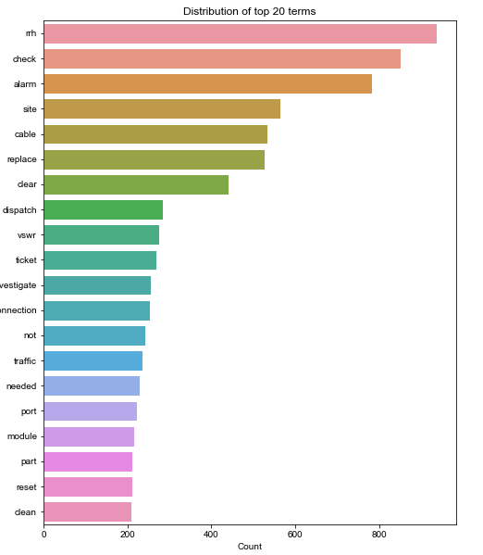

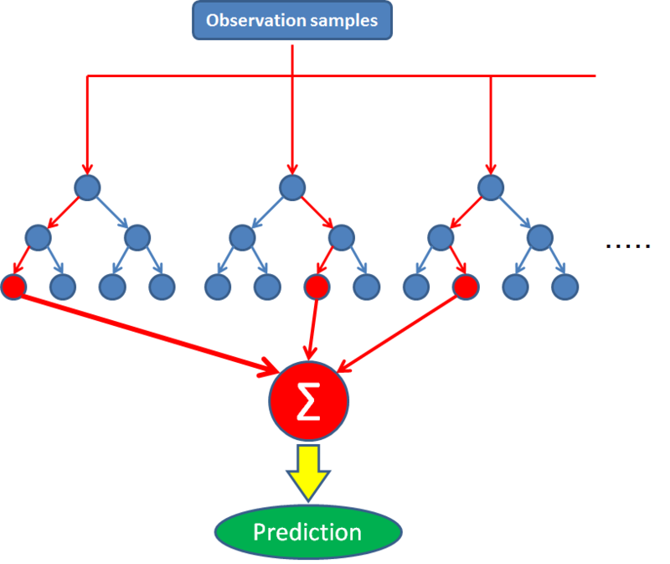
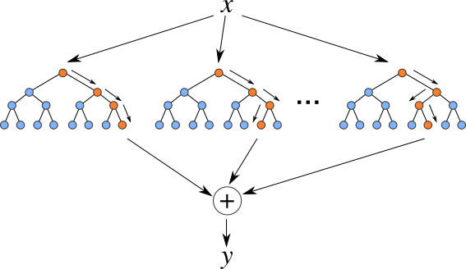
Use case overview
Use case
AI/ML to for Churn Analysis in ABC Company
AI/ML also to predict Key KPIs and critical areas where HR should focus immediately.
Methodology
Feature set identification
Data Labelling
Offline Training of ML Models
Churn prediction for short term and long term
Classification analysis for Key KPIs
Technologies
Sklearn , Python
Algorithms : Random Forest Regressor, XG Boost
Model Performance: ROC/Lift charts, AUC, F1 Score

Slide 11
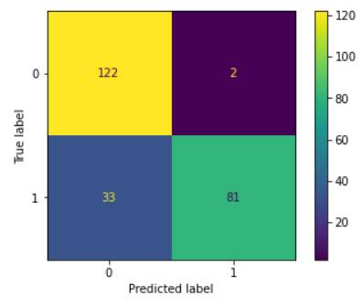
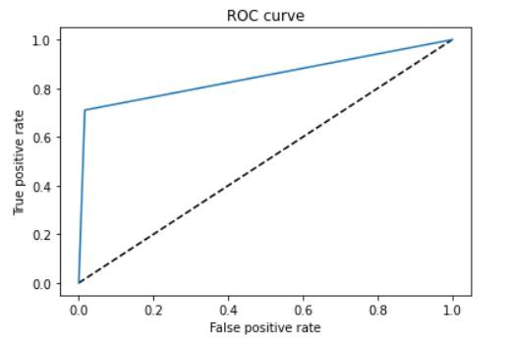
Prediction Model
Several ML models have been built based on different input: Employee Info, Certifications, Work Ex, Education etc.
Identify KPI based prediction models show the best results

Slide 12
Thank You

