Slide 1
ETL Replacement

Slide 2
Tech Stack
Java
Spring boot (Harness features, Swagger for support endpoints)
Spring file polling with Transaction management + java DSL
Spring Integration for xml marshalling/Unmarshalling.
Gralde + jaxb configuration for import/Export XSD to Java domains
Mongodb for persistence
Gradle for dependencies management , build
Embedded tomcat server
Junit + Mockito for unit testing.

Slide 3
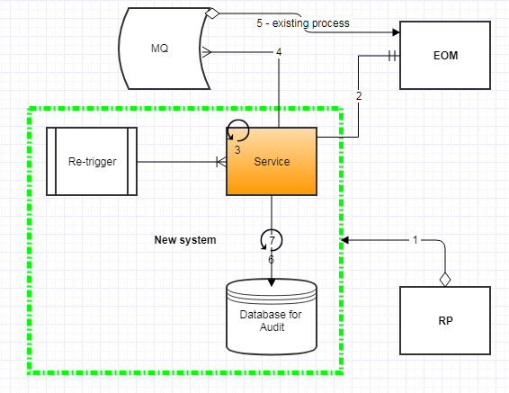
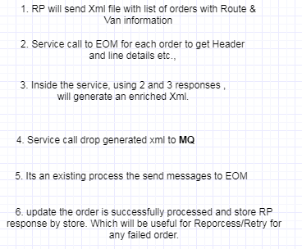

Slide 4
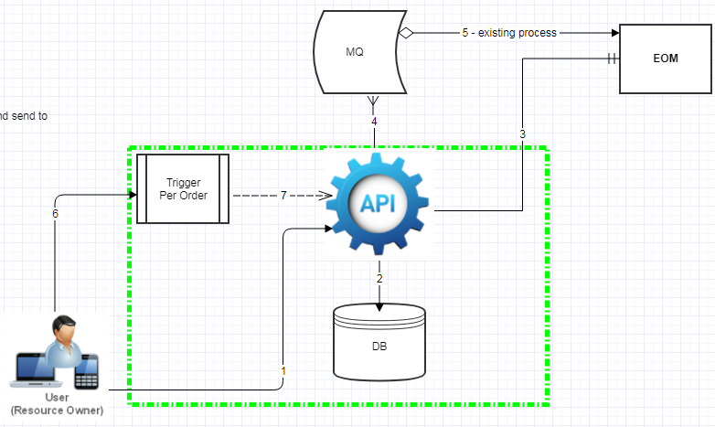
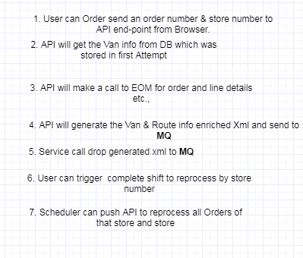
Retry Mechanism

Slide 5
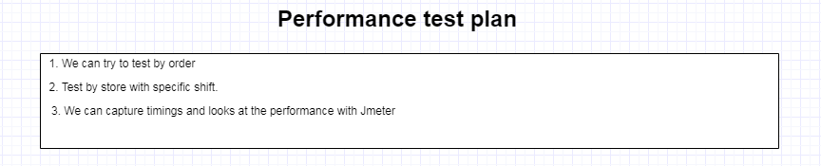
Test plan

Slide 6
Pending Items
RP to EOM xml – XSD document (Datatypes mapping, template mapping)
RP route/Van info xml XSD (to find which are needed attributes)
Customer order xml mapping with RP response.
Query for Getting the orders by store to find the Orders to Unrouted. – Skipped the DO created Orders -- Nitesh
Notes:
Query:
SELECT
po.tc_purchase_orders_id AS orderkey,
'' AS senderid,
ROW_NUMBER() OVER(
ORDER BY po.tc_purchase_orders_id
) AS scheduleid,
'0' AS stopnumber,
'' AS stopid,
'' AS plannedbegundate,
'' AS plannedcompleteddate,
'' AS resourcekey,
'' AS planneddeparteddate,
'UR' AS routeid,
'' AS stoporderline,
'' AS vandeparttime,
'' AS vanarrivaltime
FROM
osflca.purchase_orders po,
osflca.po_ref_fields porf
WHERE
po.purchase_orders_id = porf.purchase_orders_id
AND
porf.ref_num5 = '3'-- '<SHIFT>'
AND
po.purchase_orders_status = 400
AND
po.purchase_orders_id IN (
SELECT DISTINCT
poli.purchase_orders_id
FROM
osflca.purchase_orders_line_item poli
WHERE
poli.dsg_ship_via = 'A1'
AND
trunc(poli.req_dlvr_dttm) = trunc(TO_DATE('20180326','yyyymmdd','NLS_DATE_LANGUAGE = American') )
AND
poli.o_facility_alias_id = '1211' --'<STORE_NUM>'
AND
poli.is_deleted = 0
)
UNION
SELECT
'' AS orderkey,
'' AS senderid,
1 AS scheduleid,
'0' AS stopnumber,
'' AS stopid,
'' AS plannedbegundate,
'' AS plannedcompleteddate,
'' AS resourcekey,
'' AS planneddeparteddate,
'UR' AS routeid,
'' AS stoporderline,
'' AS vandeparttime,
'' AS vanarrivaltime
FROM
dual;

Slide 7
Technical tasks
Listener mechanism for start processing the shift orders based on RP file arrived to application. -- Subir
Find the required attributes from RP response for Order enrichment.
Maintain the Route/Van info by order & store
Establish the EOM api integration to get order details.
Create the Token expiry and re-request mechanism
Request CO details for each order.
3. Create JMS connection to send Final CO to EOM/MIF MQ. - Subir
4. Establish the EOM DB connection for fetching the Shift orders per store.
5. Find the additional logic to make orders unrouted. – Static Values
6. Handle Dummy RP response if no optimization has done.

Slide 8
SLA
Store count : 500
Orders per shift : 50
Time to complete : 15 mins
Avg. throughput : 1.6k / min

Slide 9
EOM Services
Token service:
Wsdl : http://ecom-eom.safeway.com/services/SecuritySOAPService?wsdl
Request:
<soapenv:Envelope xmlns:soapenv="http://schemas.xmlsoap.org/soap/envelope/" xmlns:sec="http://security.services.scope.manh.com/">
<soapenv:Header/>
<soapenv:Body>
<sec:getAuthToken>
<!--Optional:-->
<arg0>eomadmin</arg0>
<!--Optional:-->
<arg1>Password1!</arg1>
</sec:getAuthToken>
</soapenv:Body>
</soapenv:Envelope>

Slide 10
EOM Services
Customer order service:
Wsdl : http://ecom-eom.safeway.com/services/CustomerOrderWebService?wsdl
Request:
<soapenv:Envelope xmlns:soapenv="http://schemas.xmlsoap.org/soap/envelope/" xmlns:impl="http://impl.ejb.customerordermanager.sellingservice.services.scope.manh.com/">
<soapenv:Header/>
<soapenv:Body>
<impl:getCustomerOrderDetails>
<!--Optional:-->
<arg0>replace token value from Token service</arg0>
<!--Optional:-->
<arg1><![CDATA[<tXML xmlns:xsi="http://www.w3.org/2001/XMLSchema-instance" xsi:noNamespaceSchemaLocation="get Customer Order Details input.xsd">
<Header>
<Source>Source</Source>
<Action_Type>update</Action_Type>
<Message_Type>getCustomerOrder</Message_Type>
<Company_ID>70</Company_ID>
</Header>
<Message>
<EntityType>Customer Order</EntityType>
<GetCustomerOrderDetails>
<OrderNumber>8092016001</OrderNumber>
<CustomerInfo/>
</GetCustomerOrderDetails>
</Message>
</tXML>
]]></arg1>
</impl:getCustomerOrderDetails>
</soapenv:Body>
</soapenv:Envelope>

Slide 11
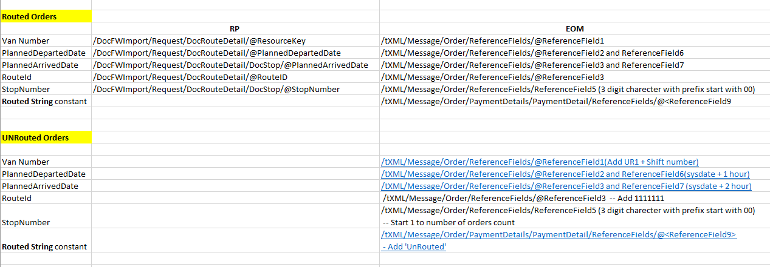
RP-EOM Attributes mapping

Slide 12
Sizing
Sno. |  | OS Red Hat Enterprise Linux Server release 7.2 (Maipo) |  | Java 1.8 |  | Git plugin |  | Jenkins Agent |  | Mongo (MongoDB 3.6) |  | Hardware |  | # of Cores per Unit | RAM (GB) per Unit | Memory (GB)
Node-1 |  | Yes |  | Yes |  | Yes |  | Yes |  | Yes |  | x86_64 |  | 4 | 32 | 200
Node-2 |  | Yes |  | Yes |  | Yes |  | Yes |  | Yes |  | x86_64 |  | 4 | 32 | 200
Node-3 |  | Yes |  | Yes |  | Yes |  | Yes |  | Yes |  | x86_64 |  | 4 | 32 | 200
Node-4 |  | Yes |  | Yes |  | Yes |  | Yes |  | Yes |  | x86_64 |  | 4 | 32 | 200

