Slide 1
Tag-subscription

Slide 2
Capabilities
Generating the Tag subscription based on store users input file.
UI Capabilities [Upload input file/files and download Tag subscription mapping file] - Progress
Convert tag subscription mapping CSV to store-layout xml and post in MIF Listener MQ. - Progress

Slide 3
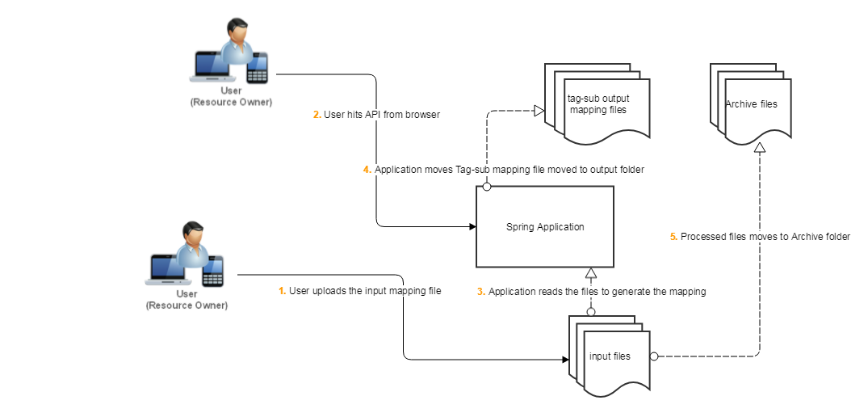
Current system

Slide 4
Business Requirements
#Aisle
tag_sub.aisle.a001_099=01....99
tag_sub.aisle.a201_249=Invalid aisle
tag_sub.aisle.a300=PR
tag_sub.aisle.a350=FL
tag_sub.aisle.a351=PR
tag_sub.aisle.a400=BA
tag_sub.aisle.a450=DE
tag_sub.aisle.a500_549=ME
tag_sub.aisle.a601_699=CH
tag_sub.aisle.a700=PH
tag_sub.aisle.a800=LI
#tag_sub.aisle.a900=WL
tag_sub.aisle.default=Invalid aisle
# Section
tag_sub.section.s0_99=Invalid section
tag_sub.section.s100_199=R
tag_sub.section.s300_399=L
tag_sub.section.s400_499=B
tag_sub.section.s200_299=F
tag_sub.section.CH=S
tag_sub.section.default=Invalid section

Slide 5
System Available information
Application is available at:
http://phvgpru7.safeway.com:8080/tags/generate-item-loc-mapping
Application details Avaiable at:
https://github.com/ebhun851/tag-subscription/blob/master/README.adoc

Slide 6
Deployment process
cd to project directory in your local
run command: gradlew.bat clean eclipse build
cd build/libs
copy application jar to production using below command: scp -r item-tagsub-0.0.1.jar ii00wl@phvgpru7:/apps/scope/custom-apps/tag-subscription
Now ssh to production box, and cd /apps/scope/custom-apps/tag-subscription
Kill previous process of running jar from shell : jps -l
[ii00wl@phvgpru7 tag-subscription]$ jps -l 16034
/apps/scope/mmc-workspace/sd2-tools/lib/remoting-2.34.jar
20195 sun.tools.jps.Jps 17867 item-tagsub-0.0.1.jar
Then kill 17867 [example]
kill -9 17867
run command to start application using below command: nohup java -jar item-tagsub-0.0.1.jar &

Slide 7
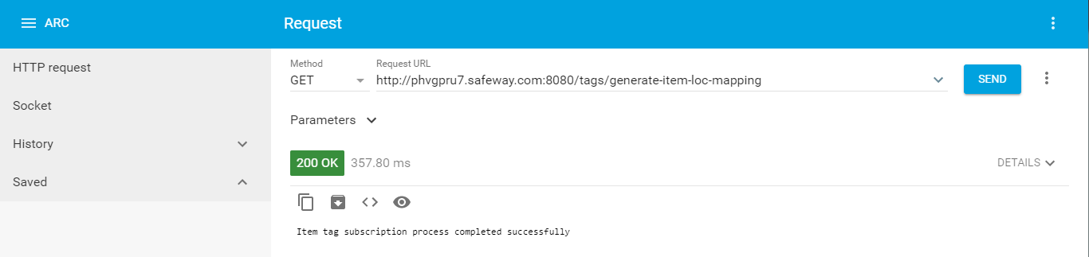
Application Usage
Install any Rest client. Example – Google Chrome “Advance rest client”
Execute Url as below get request.

