Slide 1




EBS
Ecommerce for Banking Sector

Slide 2

Introduction & Problem Definition
WHY ?
Simulating for E-Banking.
System purpose.

Slide 3
SDLC
Planning
Analysis
Design
Implementation
Testing & Integration
Maintenance

Slide 4
Project phases
Phase 1 (Planning and Analysis):
Brainstorming
Dividing to Teams
Data Gathering
Requirements Analysis

Slide 5
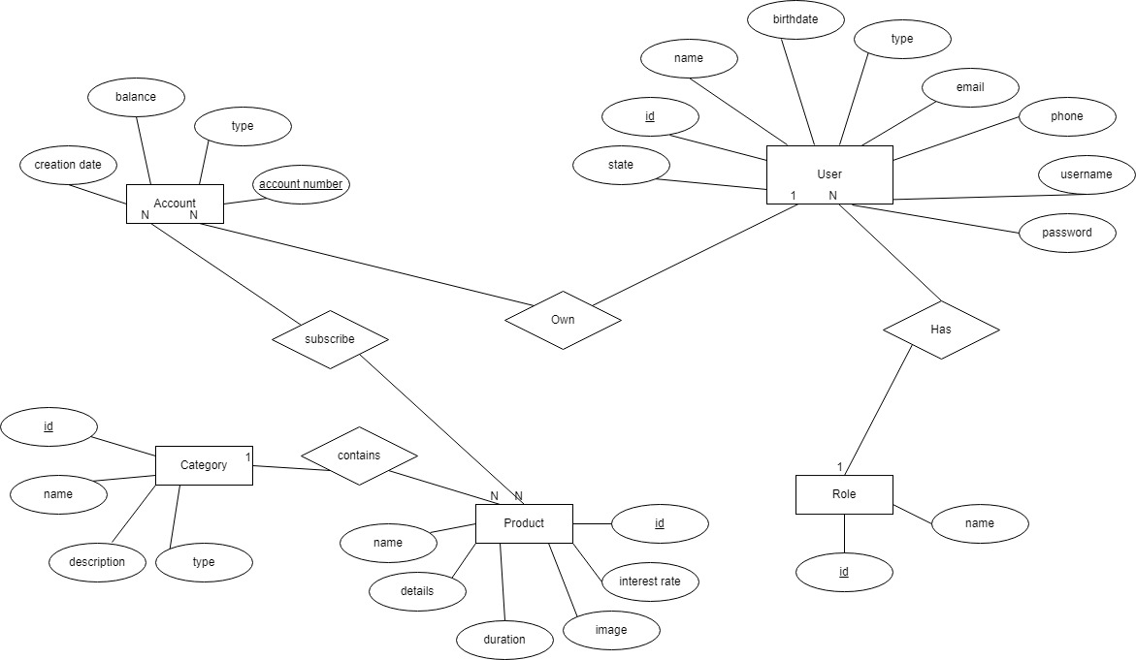
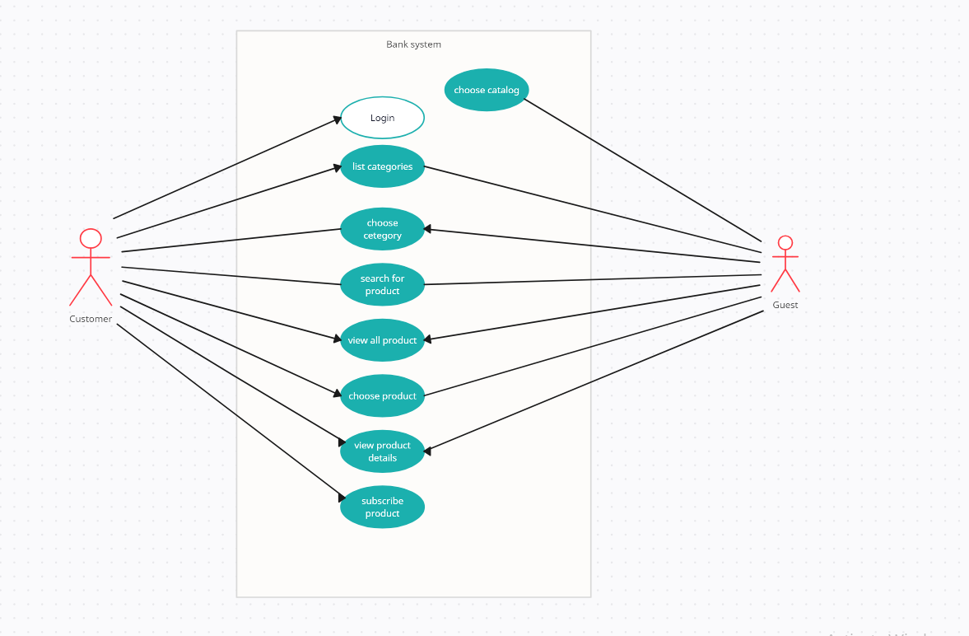
Project phases
Phase 2 (Design):
Database Structure
Database Design (ERD)
Use case Diagram (UML)
Prototype

Slide 6
Project phases
Phase 3 (Implementation):
Using PM Tool for Tasks Assigning
Database Implementation
Code Implementation
Version Control (Git & Github)
Phase 4 (Testing):
System Testing

Slide 7
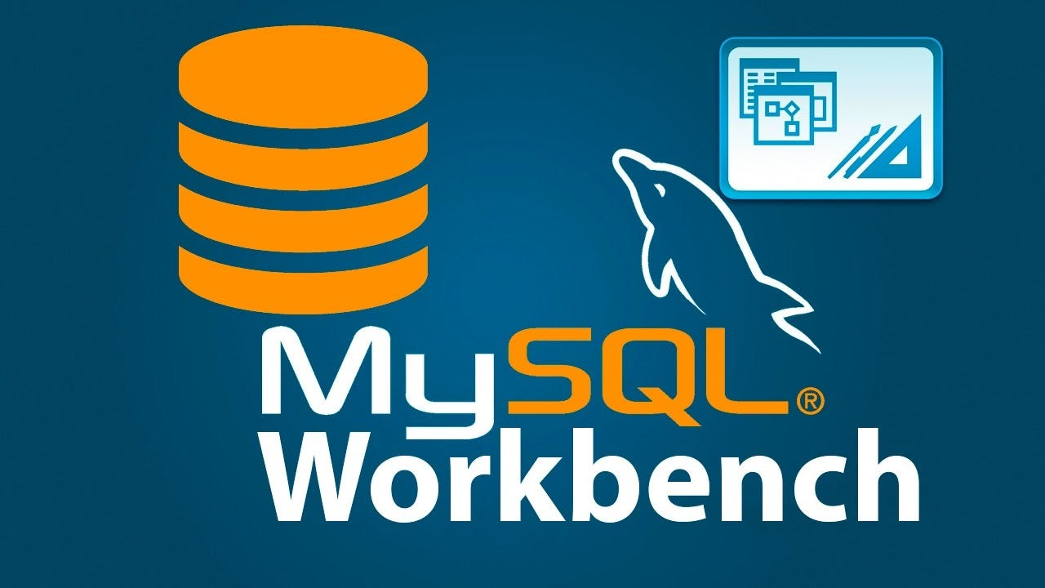




Used Technology, Tools and IDE’s
MySQL (DBMS) & MySQL Workbench
IntelliJ IDEA (Spring boot, Java, JSP)
Trello (PM tool to organize tasks)
Draw.IO (Create Diagrams)
Git (Version control system)

Slide 8

Any question

Slide 9
LIVE DEMO

Slide 10

Thank You!
EBS Team

