Slide 1
InterProScan 5
Analyses, Architecture and JMS

Slide 2
Introduction to InterProScan: automatic annotation of protein sequence
Protein
Sequence
Analysis
algorithm
Reported
Matches
Predictive
Models

Slide 3
Introduction to InterProScan: automatic annotation of protein sequence
Protein
Sequence
Analysis
algorithm
“Raw”
Matches
Filtering
algorithm
Reported
Matches
Predictive
Models

Slide 4
Scale problem: computational load
>25 million
Protein
Sequences in UniParc
Run analysis using HMMER 2 on a single desktop PC?
Single set of models, e.g. TIGRFAM
No chance - would take several years to run to completion.

Slide 5
Scale problem: complexity (this is just a sub-set!)
sequence
HMMER 3
HMMER 2
assignment
pantherScore
Pfam
Gene3D
SMART
TIGRFAM
PIRSF
SUPERFAMILY
PANTHER
Raw matches
GA cut-off
E-value cut-off
E-value cut-off
TC cut-off
pirsf
clan
domainFinder
threshold
(kinase)
nested
Filtered matches

Slide 6
InterProScan 5 : Why build another one?
InterPro internal analysis Pipeline (Onion)
Java
Not portable
Legacy architecture / code
Matches stored:
UniParc <-> all member DBs.
InterProScan 4.0
Perl
Portable
Some problems with local configuration. Not modular. Lack of resource for maintenance
80% overlap in functionality
Maintainable
Easy to add new model sets
Modular architecture
Back-end for new InterPro web site
Consistent results
Release developer time
Reliable / auditable
No redundant calculations
Incorporate new data model / XML exchange format
Easy to port on to different architectures:
Single machine
Simple LAN
LSF
PBS
Sun Grid Engine ...cloud? GRID?
Supports:
Onion & InterProScan 4.0 functionality
metagenomic data analysis
genomic sequence analysis (ORF prediction etc.)
InterProScan 5.0

Slide 7
Design for modularity – ease of maintenance
Cluster Platform
Queues & monitors analysis steps
JMS (Java Messaging Service) Layer
Job Management Layer
Scheduling analyses
Web Services
Java API
“Business Logic” Layer
Performing analyses
Oracle
MySQL
PostgreSQL
HSQLDB
InterPro website
Data Access Layer
Database I/O
XML
XML Reading / Writing
Input / Output Layer
File I/O
Dependencies,
represented by:
Are all one-way,
resulting in low-coupling between the layers. Each layer can be replaced relatively easily (especially layers at the top of the stack) improving maintainability
Data Model

Slide 8
Java Messaging Service: ease of development and platform flexibility
“Worker”
Peforms task / sub-task and reports back to Broker
“Master”
Schedules tasks / sub-tasks and places them on a JMS queue
JMS Broker
Manages JMS queues / topics.
Broker starts
workers on demand
“Worker”
Peforms task / sub-task and reports back to Broker
“Worker”
Peforms task / sub-task and reports back to Broker
“Worker”
Peforms task / sub-task and reports back to Broker
“Worker”
Peforms task / sub-task and reports back to Broker
“Worker”
Peforms task / sub-task and reports back to Broker
“Worker”
Peforms task / sub-task and reports back to Broker
“Worker”
Peforms task / sub-task and reports back to Broker
Workers take tasks
off queues
Monitoring / Management Application
Web application or stand-alone application to monitor and manage InterProScan
Simple and robust programming model – quite easy to code against!
JMS is mature and stable – current version released in 2002
Guaranteed message delivery to a single worker
Easy to monitor
Flexible – easy to implement on multiple platforms

Slide 9
Why JMS?
Community standard → many implementations.
Mature and stable – version 1.1, 2002.
Can write
pure JMS
vendor extensions (tie-in).
We are not using any of these…

Slide 10
What are messages?
Have a header and body
Can be filtered by the recipient
Body may consist of:
TextMessage (just a String)
BytesMessage (for legacy messaging system interoperability)
MapMessage
StreamMessage
ObjectMessage (anything Serializable)

Slide 11
Message Modes
Point-to-point. Guarantees delivery to...
Zero or one client (non-persistent message)
Exactly one client (persistent message)
Publish / Subscribe (pub/sub)
'Multicast' messages
Message Transport Options
In-JVM, TCP/IP, HTTP, HTTPS, RMI......

Slide 12
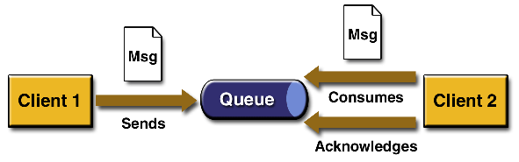
Point-to-Point Messages
Use destinations called queues
Acknowledgement:
AUTO_ACKNOWLEDGE
CLIENT_ACKNOWLEDGE
DUPS_OK_ACKNOWLEDGE

Slide 13
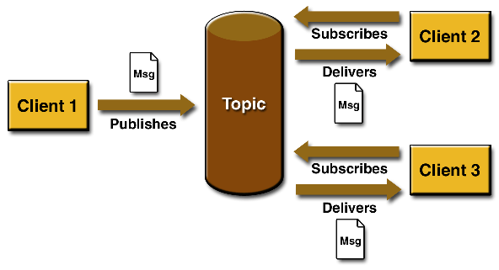
Pub/Sub
Uses destinations called Topics

Slide 14
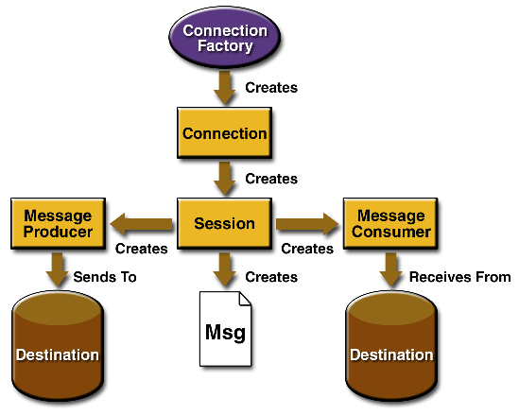
JMS Objects

Slide 15
Reliability
Configurable – for some systems (e.g. news broadcast) reliability is not so important
Persistent messages (p2p): guaranteed delivery
Re-delivery
Message header includes redelivery information
Configurable – 'try 3 times'
'Dead letter' queue – manage failure.
Time-to-live

Slide 16
JMS Architecture in I5
Master
JMS Broker
Worker
(n of these)
Work
Scheduler
WorkerRunner
<<creates>>
Job request
workerJobRequestQueue
Job request
Response
Monitor
(runs in
own thread)
Job result
jobResponseQueue
Job result

Slide 17
Jobs and Steps
Jobs
Holder for all Job instances
Job
Binds together Steps
Step
Defines how to perform a Step
StepInstance
Defines what to perform the Step upon – the intent to run a Step.
StepExecution
Captures an actual attempt to run a StepInstance.
*
*
*
*
*
*
Depends upon
Depends upon
Jobs – the full set of workflows defined by the system
Job – a single workflow (e.g. an analysis)
Step – e.g. defines how to “run HMMER3” (concrete Step instances implement an execute() method)
StepInstance – e.g. “Run HMMER3 for proteins 101 – 200”. Describes the intent to run a Step for a particular set of proteins or models.
StepExecution – e.g. “First attempt to run HMMER3 for proteins 101 – 200”. Describes an attempt at running a StepInstance.
Dependencies: Defined at the Step level. As StepInstances are created, these dependencies cascade down to the StepInstance level as illustrated:
Step dependency: “Pfam run HMMER3” depends upon “write fasta file”
StepInstance dependency: “Pfam run HMMER3 for proteins 101 – 200” depends upon “write fasta file for proteins 101 – 200”.

Slide 18
Dependencies in a Workflow
Write FASTA File
The arrows represent the “depends upon” relationship, pointing to the Steps that must complete prior to the Step being considered for execution. (This may seem counter-intuitive, but is the way in which it is implemented).
Run HMMER3 Binary
Delete FASTA file
Parse / store HMMER3 Output
Delete HMMER3 Output
Perform Pfam Post Processing

Slide 19
Data Model (Simplified)
Protein
Match
Protein

