Slide 1

JMS – Java Messaging Service
… A lot more than just messages

Slide 2
Why JMS?
Community standard → many implementations.
Mature and stable – version 1.1, 2002.
Can write
  pure JPA
  vendor extensions (tie-in).

Slide 3
What are messages?
Have a header and body
Can be filtered by the recipient
Body may consist of:
  TextMessage (just a String)
  BytesMessage (for legacy messaging system interoperability)
  MapMessage
  StreamMessage
  ObjectMessage (anything Serializable)

Slide 4
Message Modes
Point-to-point. Guarantees delivery to...
  Zero or one client (non-persistent message)
  Exactly one client (persistent message)
Publish / Subscribe (pub/sub)
  'Multicast' messages
Message Transport Options
  In JVM, TCP/IP, HTTP, HTTPS, RMI......

Slide 5
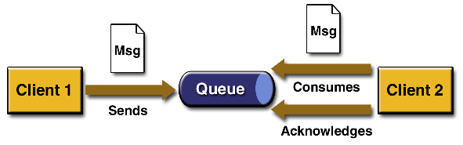
Point-to-Point Messages
Use destinations called queues
Acknowledgement:
  AUTO_ACKNOWLEDGE
  CLIENT_ACKNOWLEDGE
  DUPS_OK_ACKNOWLEDGE

Slide 6
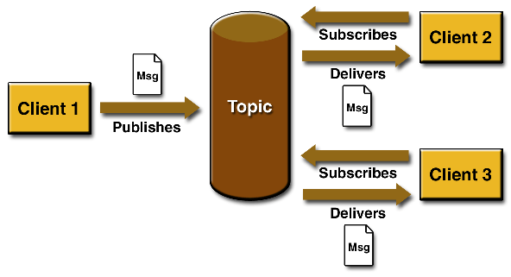
Pub/Sub
Use destinations called Topics
Durable or Non-durable

Slide 7
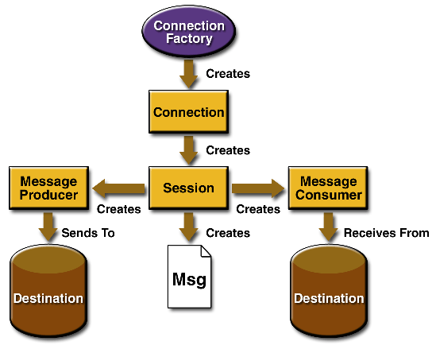
JMS Objects

Slide 8
Reliability
Configurable – for some systems (e.g. news broadcast) reliability is not so important
Persistent messages (p2p): guaranteed delivery
Re-delivery
  Message header includes redelivery information
  Configurable – 'try 3 times'
  'Dead letter' queue – manage failure.
Time-to-live

Slide 9
Job Creation, Queueing, Response
Master
JMS Broker
Worker
(n of these)
Work
Scheduler
WorkerRunner
<<creates>>
Job request
workerJobRequestQueue
Job request
Response
Monitor
(runs in
own thread)
Job result
jobResponseQueue
Job result

Slide 10
System Monitoring and Shutdown – JMX ????
Master
Broker
Worker
(n of these)
Management
Thread
WorkerManagerTopic
.poll : String (returns host & JVM ID)
.shutdown()
.kill()
All workers
Subscribed
And receive
These messages
Management
Thread
shutdown() or kill() or poll()
Poll result
workerManagerResponseQueue
Poll result
Poll result
Management
Request
MasterManagerRequestQueue
.shutdown()
.kill()
shutdown() or kill()
Note that the poll result / master / manager use JMSCorrelationId so that the result is associated with the request.
Production Manager
(Perhaps with Swing GUI?)
Monitors number of running workers and allows clean shutdown or kill.
The Manager could also monitor the dead-letter queue for failed jobs, to report to the production manager.

Slide 11
Master
Broker
Worker
(n of these)
WorkerRunner
<<creates>>
Work
Scheduler
QueueJumper
(runs in own thread)
Job request
taskSubmissionQueue
workerRequestQueue
Job request
Response
Monitor
(runs in
own thread)
Job result
workerResponseQueue
Job result
WorkerManagerTopic
.poll : String (returns host & JVM ID)
.shutdown()
.kill()
All workers
Subscribed
And receive
These messages
Response
Handler
Response
Handler
Response
Handler
shutdown() or kill() or poll()
Management
Request
MasterManagerRequestQueue
.shutdown()
.kill()
shutdown() or kill()
Poll result
workerManagerResponseQueue
Poll result
Poll result
Note that the poll result / master / manager use JMSCorrelationId so that the result is associated with the request.
Production Manager
(Perhaps with Swing GUI?)
Monitors number of running workers and allows clean shutdown or kill.
The Manager could also monitor the dead-letter queue for failed jobs, to report to the production manager.

Slide 12
Master
Broker
Workers
WorkerRunner
<<creates>>
QueueJumper
(runs in own thread)
Parallel
Workers
(N of these)
One
StepExecution
only.
job_request_queue
Step request
InterProScanMaster
Filter: Parallel
Step request
job_submission_queue
Filter: Serial
Serial
Worker
(1 of these)
JVM is
'persistent':
Any number
Of
StepExecutions
Run by
Master at
startup.
Response
Monitor
(runs in
own thread)
Step result
job_response_queue
Step result
Response
Handler
worker_manager_topic
.poll : String (returns host & JVM ID)
.shutdown()
.kill()
All workers
Subscribe
And receive
These messages
Management request
worker_manager_response_queue
Poll result
Poll result
JVM
Class / Interface
The Manager could also monitor the dead-letter queue for failed jobs, to report to the production manager.
JMS Queue
Production Manager
Monitors number of running workers and allows clean shut-down or kill.
JMS Topic
JMS Message

