Slide 1
InterPro Architecture

Slide 2
Why do we need an architecture?
“Non-architected” architectures:
Big ball of mud : Large unused segments. Unused parts so enmeshed with everything else that they're impossible to identify, much less remove.
Spaghetti : No logical flow. Any part may be connected to any other part. Most of the parts share some dependency on many or most of the other parts, even if such dependencies make little difference to overall functionality
House of cards : Every part depends on many others. A change to one part breaks several, and fixing one problem introduces many more.

Slide 3
CLI
Web
Presentation
tier
Implements use cases
as clearly defined
entry points
Transaction control
Remoting
Business services
tier
DAO interface layer
Interface to find and
persist domain objects
DAO
implementation
layer
O-R mapping

Slide 4




Client
tier
Presentation
tier
Business
tier
Integration
tier
Resource
tier
Grails,
Wicket, GWT,
JSF
Swing,
Flex, JavaFX
Oracle
MySQL
HSQL
Spring Framework
Lucene, Terracotta
Hibernate

Slide 5
Technologies
Web sites: Grails, Wicket, JSF
Rich Internet applications: Flex, JavaFX
Web services: SOAP, REST
Programming languages: Java, Groovy, Scala
Application frameworks: Spring
Persistence frameworks: Hibernate
Database platforms: Oracle, MySQL, HSQL
Data grid: Terracotta
Compute grid: ProActive, grids, clouds

Slide 6
Limitations of current Onion + InterProScan
Database design
  Inflexible – single member DB version
  Redundant
Tight coupling
  Internal
    Difficult to test/debug
  External
    Oracle
    LSF
    File system

Slide 7
Why rewrite?
Merge Onion and InterProScan
  Reduced maintenance overhead, more time for development of new software
  Consistent results
Separate software concerns
  Easier to design, build and test, which improves reliability
  Promotes re-use in InterPro and other groups at EBI and beyond
  Job submission framework makes the best use of limited resources by allowing us and our users run to jobs on local queues and remote grids
Focus on API and data model
  Remote access via web services and RMI provides flexibility to our internal and external users
  Serialisation to and from XML and other formats can be delegated to well-tested third-party libraries
  Persistence framework provides choice of RDBMS for us and our users

Slide 8
cron / Quartz
CLI
Web app
Web service
InterProScan
Get sequences
Run calculations
Filter results
Get signatures
Scheduler
Submit jobs
Monitor jobs
Resource Manager
LSF
SGE
PBS
Grid

Slide 9
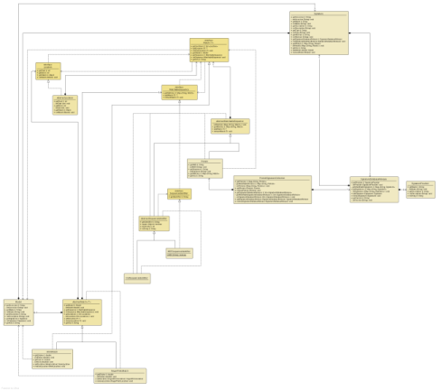
Data model

