Slide 1
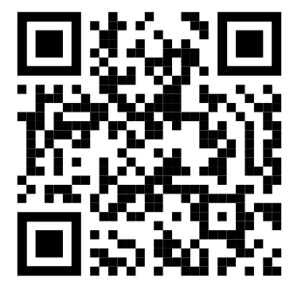
Chat With Your Data
WeAreDevelopers
North America
Alper Ebicoglu
Co-founder Volosoft
FOLLOW ME on TWITTER
Building an
AI-Powered
Reporting Tool
with .NET
x.com/alperebicoglu

Slide 2


The Luis María Peralta Adobe (1797)
The oldest surviving building in San Jose.
Credits https://ulleseit.com/local-history-the-peralta-adobe/
Notes:
This building has survived for more than 225 years.
Authorities are not rebuilding this one and preserve it.
Some foundations should remain stable.
In the software business, this is not the case.
Today, AI has changed one very old problem:
How do we get answers from our data?
We used to build reports.
Then dashboards.
Then self-service BI.
Now, we can simply ask.
but in the age of AI;
we developers should use some new techniques for reporting.

Slide 3
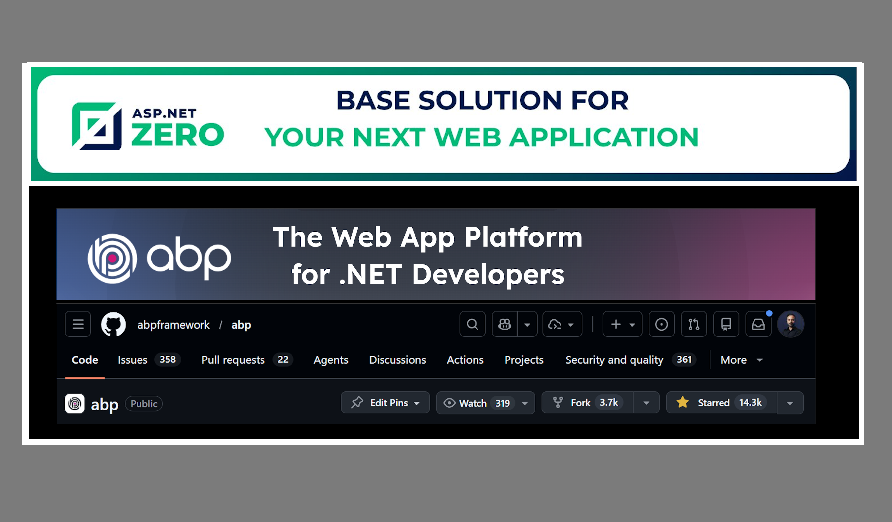
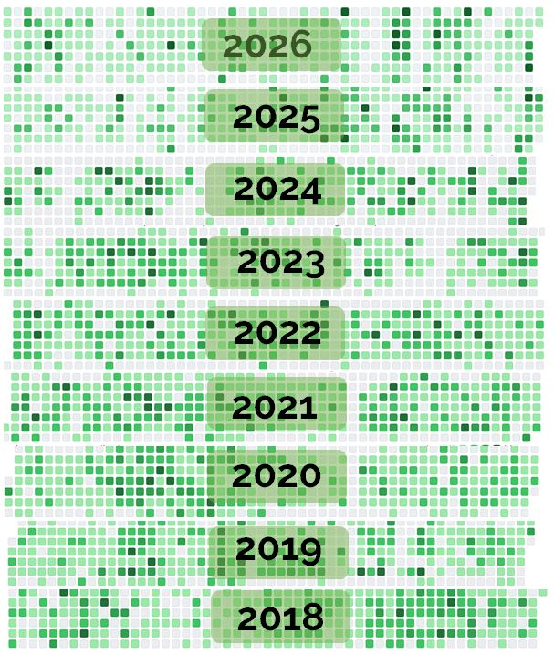
1997
Intel i386 processor with Q-Basic programming
2004
First .NET App developed on .NET Framework 1.0
2006
Computer Engineering
2010
Master Degree
2017
Co-Founder of Volosoft

Slide 4
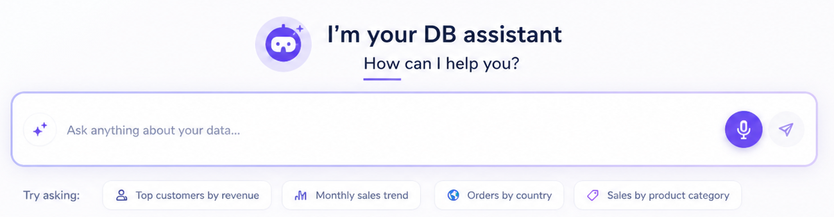

Slide 5
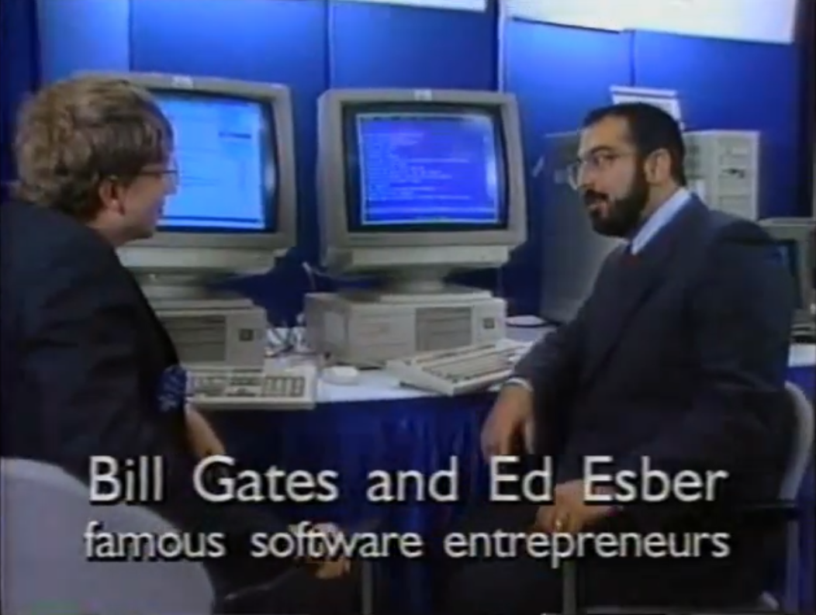
Understanding The Problem 🤝
SQL Server Commercial
Are you a .NET dev?
Have you written SQL before?
Have you created a reporting screen before?

Slide 6
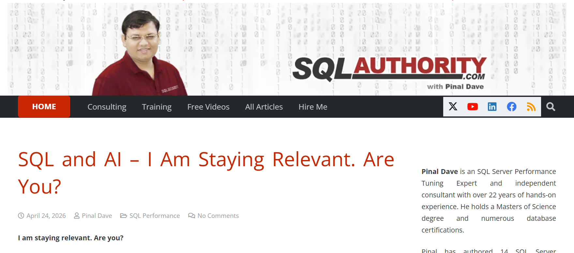
AI Era: Adapt or Fall Behind
Pinal Dave, known for decades of SQL expertise, is now using AI to help people understand and work with data faster
Source: SQLAuthority blog, Apr 24, 2026

Slide 7
The Reporting Challenge
Reporting tools: rigid
Power BI, Salesforce, Qlik, SAP Analytics 👉 Create ticket for a new report
Data is locked behind technical curtains!
Implementing custom report: slow
Writing SQL, Page Design, Testing, Deployment 👉 Needs too much things
Developers: bottleneck
The real value is trapped behind technical gatekeepers
Business waits on engineers

Slide 8
What if you could
just ask
your database?

Slide 9
What We'll Build
Main steps of the solution
1
Understand user intent parse the natural-language question
2
Read the schema tables, columns, relationships
3
Generate SQL safely LLM + strict prompt + validator
4
Execute the query return structured results
5
Export to Excel & Visualization turn data into decisions
Notes:
1— parse what the user actually asked
2— the LLM has to know your tables
3 — with validation, not blind trust
4— run it against the real database
5— Excel and generating charts, because that is what people actually do with results
[EMPHASIZE] 'Each one of these is boring on its own. The magic is the chain.'
[TRANSITION] 'Here is how we will walk through it.'

Slide 10
The Pipeline
01
User
natural language
02
Prompt
schema + rules
03
LLM 🤖
reasoning
04
SQL
generated query
05
Validator
safety gate
06
Execute
results
✅
07
Error
❌
"top 10 customers by revenue this year" SELECT TOP 10 ...

Slide 11
Schema & System Prompt
TEACH THE AI YOUR DATA
Tables & columns
Relationships & keys
Data types
Enum Values
Optional: sample values
WRITE THE RULES
// system prompt
You are a SQL assistant.
RULES:
• SELECT only
• No DELETE/UPDATE/DROP
• Return SQL only
• Use the schema above
Without schema, the LLM will guess!
Notes:
DDL: Data Definition Language

Slide 12
Demo
A Simple .NET Console App
CHAT WITH YOUR DATA
LIVE

Slide 13
Live Demo — Console
LIVE
Visual Studio > Chat.Console.OpenAI
$ dotnet run
Ask your database > top 10 customers by revenue
// generated SQL
SELECT TOP 10 c.Name,
SUM(o.Total) AS Revenue
FROM Customers c
JOIN Orders o ON o.CustomerId=c.Id
GROUP BY c.Name
ORDER BY Revenue DESC;
⏸Would you
run this
in production?
The validator →
⏸
Notes:
[LIVE DEMO — Console] Alt-tab to Visual Studio. Make sure Chat.Console.OpenAI is already loaded and the font is LARGE.
Step 1: Start the app. Let them see the prompt blink.
Step 2: Type 'top 10 customers by revenue' slowly, so people can read.
Step 3: Pause before hitting enter. Ask: 'What SQL do you expect?'
Step 4: Hit enter. The generated SQL appears.
[TRUST MOMENT] Stop. Read the SQL out loud. Then ask the audience:
'Would you run this in production?'
[PAUSE 3s] Let them sit with it. Some will say yes, some no.
Then: 'Right — we would not trust it blindly. That is why the next stage is validation.'
[CUE] Point back to the pipeline slide mentally: we just completed Schema → Prompt → LLM → SQL. Validation is next.
Keep the console running — we'll use the same session for validation + execution.

Slide 14
Validation + Execution
🛡 VALIDATE
Never trust the LLM
Block DELETE, UPDATE, DROP
Block multi-statement queries
Allow only SELECT
Enforce row limits
Sanitize identifiers
▶ EXECUTE
Run it, return it
Read-only connection
Timeout guard
Return as structured data
Log every query
The DB user should only SELECT.

Slide 15
This is a pipeline,
not magic.
AI starts being a software
inspectable | testable | replaceable | enterprise-friendly
Notes:
Every stage you just saw is inspectable. Testable. Replaceable. You can swap the LLM. You can add a cache in front of it. You can unit-test the validator.
When something goes wrong in production — and it will — you can open a log and see exactly which stage failed.
That is why this works in an enterprise context. Because it stops being AI and starts being software.

Slide 16
Architecture — 3 Layers
Clean boundaries. Each layer does one thing well.
1
Intake
Understand the user question
User Query
Schema Reader
2
Brain
Generate safe SQL
Prompt Builder
LLM Service
Validator
3
Output
Run and format results
Executor
Formatter
Exporter
Notes:
[ARCHITECTURE] Architects in the room, this slide is for you.
Three layers. Walk through top to bottom:
Layer 1 — Intake. The only layer that touches the user and the database schema. It answers: 'What did they ask, and what do we know about the data?'
Layer 2 — Brain. The LLM lives here, and so does the validator. Input: user intent plus schema. Output: safe SQL. Nothing else gets in or out.
Layer 3 — Output. Runs the query, formats the results, feeds downstream consumers like Excel or charts.
[EMPHASIZE] Read the bottom strip: 'Swap the LLM, swap the database, swap the UI — the contract between layers stays the same.'
'Which means when OpenAI releases a better model next week, you change one class. When you move from SQL Server to Postgres, you change one class. That is the win.'
[TRANSITION] 'And because the layers are clean, this whole thing fits in one NuGet module.'

Slide 17
The Whole Setup 👌🏻
builder.Services.AddAiReporting(opt =>
{
opt.ConnectionString = config["Db"];
opt.LlmProvider = {"OpenAI", ApiKey}
});

Slide 18
Live Demo 2 — Blazor Web App
STEP 1
🎤
Speak
"Show sales trends last 6 months"
STEP 2
⚡
Query runs
Same pipeline. Faster feedback.
STEP 3
📊
Chart renders
Table + chart
STEP 4
📄
Export
Excel report.
Notes:
[LIVE DEMO] Switch to the Blazor browser window. Make sure the mic permission is already granted before the talk.
Demo script — roughly 4 minutes total:
1. Click the mic button. Say clearly: 'Show me sales trends for the last six months.'
2. Let the audience watch the transcription appear.
3. Show the SQL it generated (same pipeline as before — point this out).
4. Watch the table render.
5. Switch to the chart tab — the 'wow' moment.
6. Click Export to Excel. Open the file briefly so they see it's real.
[EMPHASIZE] 'Voice in. Chart out. Spreadsheet in my downloads folder. Zero SQL.'
[FALLBACK] If the mic fails, just type the query. Don't panic. Say: 'Let me type this instead.'
[TRANSITION] Return to slides. 'Why does this feel different from the console? Let's talk about UX.'

Slide 19
this’s what you'd actually ship to business users
TALK TO YOUR DATA
Let's turn this
into a real product
LIVE
Same backend but this time with interactive voice | Blazor Server
Notes:
'Second demo: the product. Same backend, but now with voice input, live charts, and Excel export. This is what you'd actually ship to business users.'

Slide 20
Same Backend, Closer to a Real Product
🎤
Voice input
Talk to your data
⚡
Live query
Real-time to SQL
📊
Charts
Visualize results
📄
Excel
One click to report
THE BACKEND DIDN'T CHANGE.
Blazor reuses the exact same module.
The frontend is where the product lives.
Notes:
The console app proved the pipeline works.
That demo was a stripped-down version to show the concept in its purest form, without any technological complexities.

Slide 21
The LLM is 20% of the work.
01
Simplicity
One input. One answer. Hide everything else until they ask.
02
Speed
Stream the SQL. Stream the result. No spinners over 2 seconds.
03
Trust
Always show the SQL. Let users verify before they believe. And save
The LLM 20% of the work.
The rest is just connecting the pieces.
Notes:
[REFLECTION] Slow down here. The audience just saw something cool — give them a moment to integrate it.
Three UX truths this project taught me:
- Simplicity wins. The user types or speaks. That's it. No dropdowns, no filters, no form fields.
- Instant feedback. Show the SQL. Show the table. Show the chart. Never leave the user staring at a spinner with no context.
- Trust in results. Every answer can be inspected — show me the query, show me the row count, let me verify.
[EMPHASIZE] 'The tech is the LLM. The product is the trust.'
[TRANSITION] 'So where does this actually fit in the real world?'

Slide 22
Where This Fits in the Real World
▣ Admin dashboards
"How many new users last week?"
◉ Internal tools
"Failed orders from the EU region."
⚡Support & ops
"Customers who churned in March."
📊Exec reporting
"Revenue by product, last 4 quarters."
🔍 Ad-hoc analysis
"Orders over $1k with no shipment."
📈Self-serve BI
"Top 20 SKUs by margin this year."
Notes:
[MAKE IT REAL] This is where you connect the demo to their day job. Tailor the examples to the room if you can — if you know someone works in finance, lean on that one.
Four places this pattern ships today:
- Admin dashboards — internal tools where PMs, ops, and support staff self-serve data
- Customer support — '/lookup everything for account 1234' without a Slack ticket to engineering
- Finance and BI — replacing half-built Power BI reports that nobody maintains
- Sales ops — 'what's my pipeline this quarter?' asked and answered in five seconds
[EMPHASIZE] 'Every company you've worked at had this need. You just didn't have the tools to solve it cheaply. Now you do.’
ACTIONS:
Create reservations
Remove spam users
Add/update products
merge duplicate records
Fix invalid phone numbers
Auto create campaigns based on my sales
[TRANSITION] 'Before you go build one — the real talk.'

Slide 23
Challenges
⚠ Multi-tenancy & permissions
Separate conn-string with roles, sub-db, views, TenantId
⚠ Hallucination
Only tables in the prompt ➡ all others via MCP
⚠ Ambiguous questions
“best month”,“good song”
⚠ Cost & Latency
Cache aggressively
⚠ Privacy concerns
Only schema or Ollama
Notes:
Multi-tenancy & permissions:
Give each user separate connection string & permissions so you can configure their roles
Separate sub databases for specific user groups
Create & send only views to AI
Add TenantId to each select query
Hallucination:
Write an MCP also add retry mechanism
Ambigous questions:
Most production issues are not SQL errors.
User's intent is unclear, I don't want the AI to guess. So clarify question first
Cost & Latency:
LLM latency + query latency compounds. Cache aggressively.
Confidential data
You’ll send only your table,column names not the data. But if still an issue, use local LLM

Slide 24
Best Practices
✓ Validate queries block unsafe ones
✓ Read-only DB user for the connection string
✓ Human in the loop approval before execution
✓ Enforce limits max 9999 records, max 30 seconds
✓ Log everything prompt, SQL, result
✓ Save working queries set as shared query or private
✓ Start small ship the ugly version first: one table & one user
Notes:
Validate queries
Block unsafe queries before execution. Allow only SELECT
Read-only DB user
Set connection string read-only
Human in the loop
First versions require human-approved queries
Enforce limits:
Limit row count and set a timeout
Log everything
For debugging and improve the system
Save working queries
Save user queries and SQL so people can re-run, they can share the working queries
Start small
Ship the ugly version first.

Slide 25

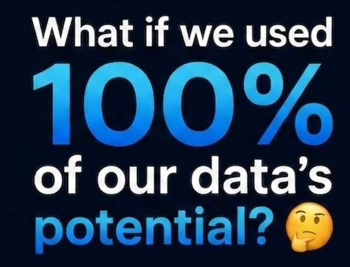
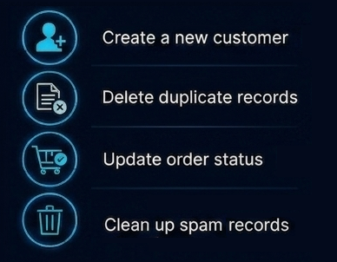
Notes:
Right now we are cautious about using AI, just like we did when ATM machines first came out, but in the future AI will be a reliable part of our systems.

Slide 26
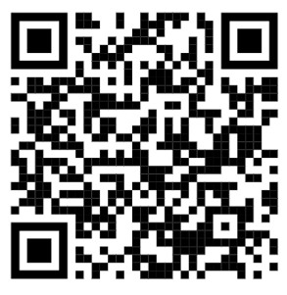
Until now we learnt programming languages to talk with computers
now they learnt
our language
Alper Ebicoglu
x.com/alperebicoglu
Download presentation and
demo project
github.com/ebicoglu/chat-with-your-data-conference

