Slide 1

TODAY’S AGENDA
Talk#2026.05
🗣 Alper Ebicoglu
ABP Community News
Introducing Low-Code module

Slide 2
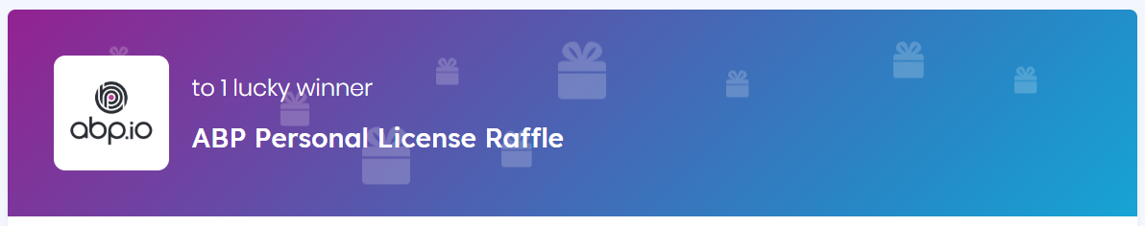
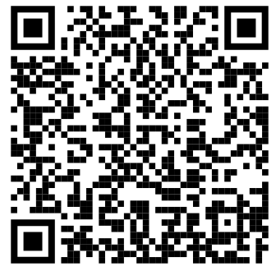

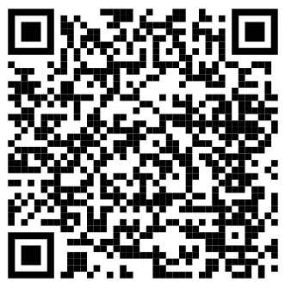
Visit abp.io/community/raffles and join these raffles for free.

Slide 3
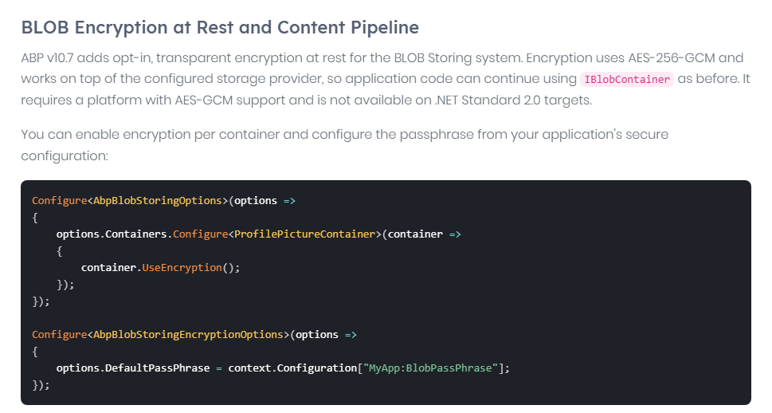
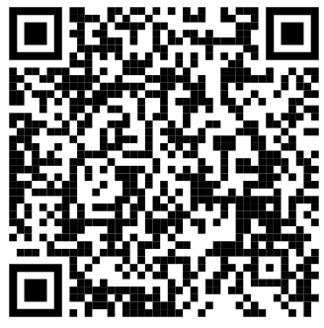
What's New with ABP v10.7
Blog post 👉 https://abp.io/community/announcements/announcing-abp-10-7-release-candidate-2u85sb02 → Scan & browse →

Slide 4
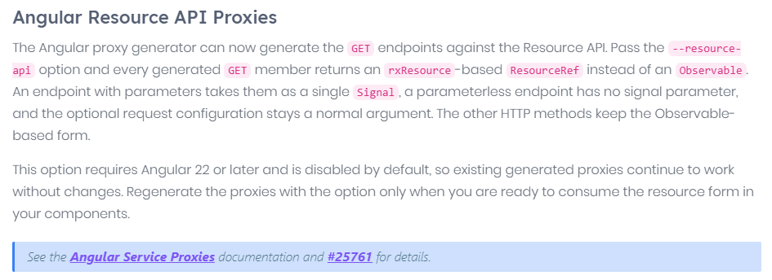
What's New with ABP v10.7
Blog post 👉 https://abp.io/community/announcements/announcing-abp-10-7-release-candidate-2u85sb02 → Scan & browse →
Notes:
Angular Service Proxies automatically generate strongly typed services, DTOs, and enums from ABP backend APIs.
This reduces repetitive frontend work, keeps Angular applications synchronized with backend contracts, and makes API integration faster and more reliable.

Slide 5
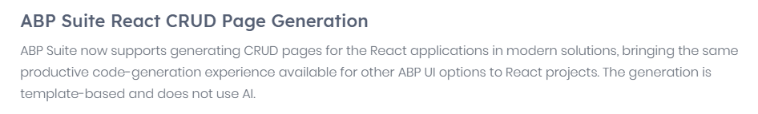
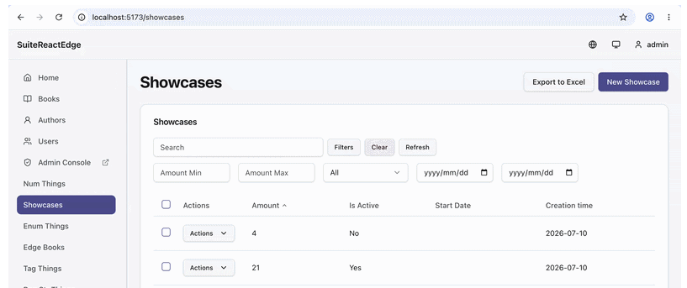
What's New with ABP v10.7
Blog post 👉 https://abp.io/community/announcements/announcing-abp-10-7-release-candidate-2u85sb02 → Scan & browse →
Notes:
ABP Suite now generates complete React CRUD pages for modern ABP applications using customizable templates. Generated pages support core operations such as listing, filtering, paging, exporting, creating, editing, and deleting, along with validation, permissions, localization, file uploads, relationships, and master-detail scenarios—all based on the entity configuration defined in ABP Suite.

Slide 6
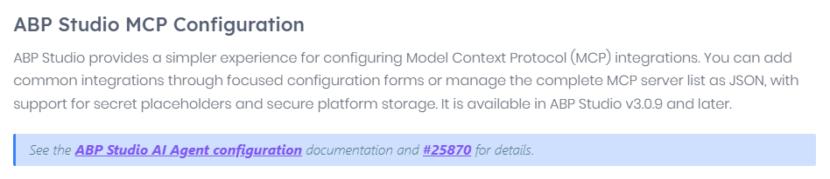
What's New with ABP v10.7
ABP Studio v3.0.9
Blog post 👉 https://abp.io/community/announcements/announcing-abp-10-7-release-candidate-2u85sb02 → Scan & browse →
Notes:
ABP Studio v3.0.9 introduces a simpler way to configure MCP integrations for the AI Agent.
Developers can add common integrations through focused forms or manage the complete server list as JSON, with support for secret placeholders, secure platform storage, connection status, and per-tool controls.

Slide 7
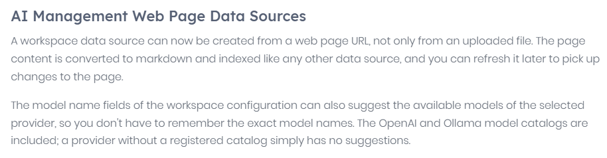
What's New with ABP v10.7
Blog post 👉 https://abp.io/community/announcements/announcing-abp-10-7-release-candidate-2u85sb02 → Scan & browse →
Notes:
AI Management module now lets users create workspace data sources directly from web page URLs.
The page content is converted to Markdown, indexed for AI use, and can be refreshed as the source changes.
Workspace settings also suggest available models for supported providers such as OpenAI and Ollama.
It makes configuration faster with less error.

Slide 8
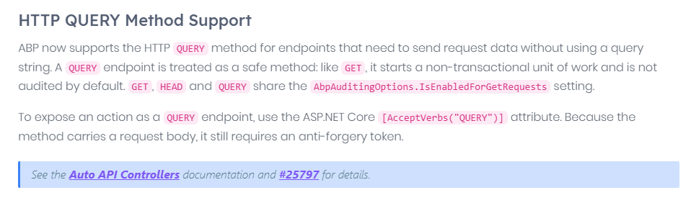
What's New with ABP v10.7
The HTTP QUERY Method RFC 10008
https://datatracker.ietf.org/doc/rfc10008/
June 15, 2026
Blog post 👉 https://abp.io/community/announcements/announcing-abp-10-7-release-candidate-2u85sb02 → Scan & browse →
Notes:
First New Method in 16 Years: This is the first standard method (verb) added to the HTTP protocol since the PATCH method in 2010.
The IETF (Internet Engineering Task Force) officially published the HTTP QUERY method as RFC 10008 standard on June 15, 2026.

Slide 9
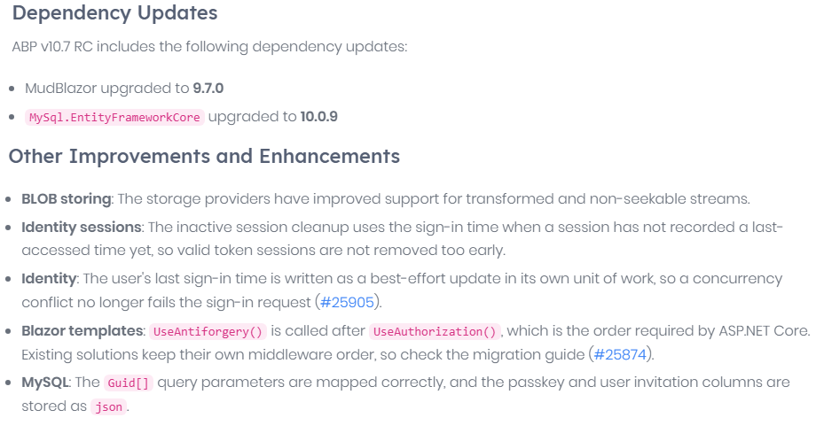
What's New with ABP v10.7
Blog post 👉 https://abp.io/community/announcements/announcing-abp-10-7-release-candidate-2u85sb02 → Scan & browse →

Slide 10
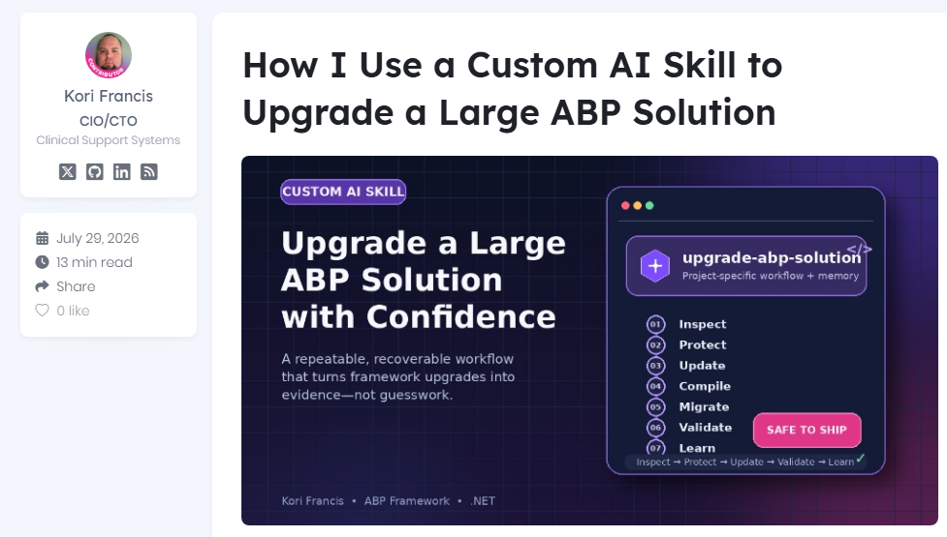
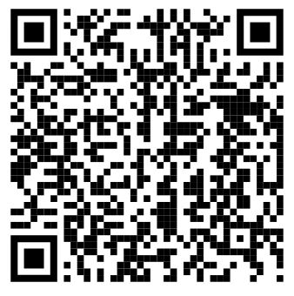
Scan to go to website

Slide 11
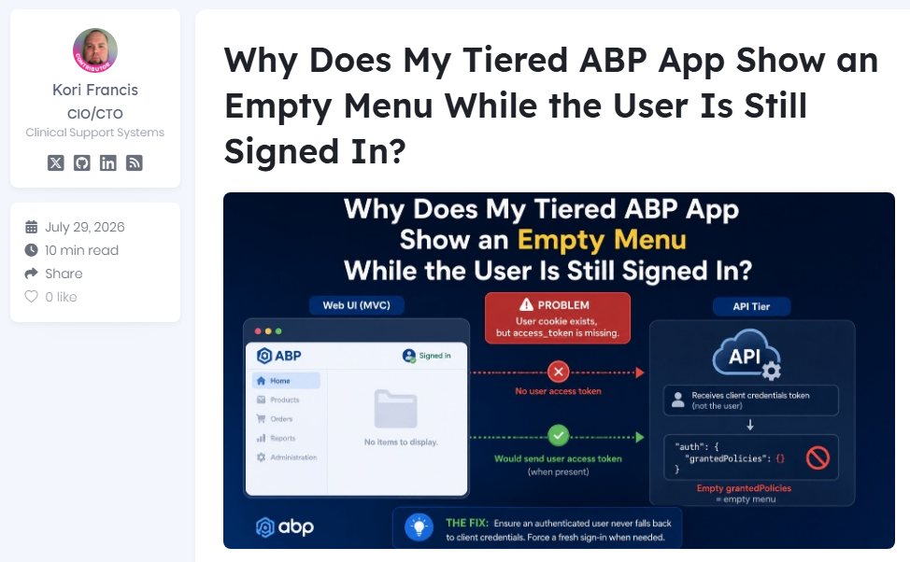
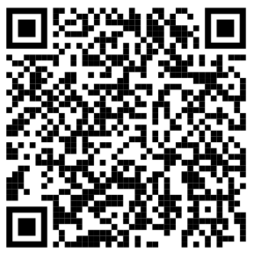
Scan to go to website
Scan to go to website

Slide 12
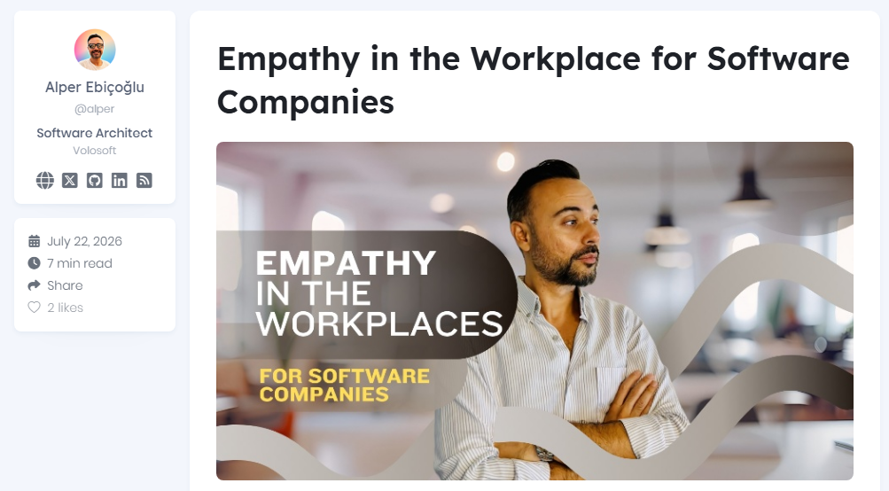
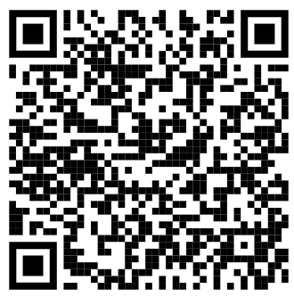
Scan to go to website

Slide 13
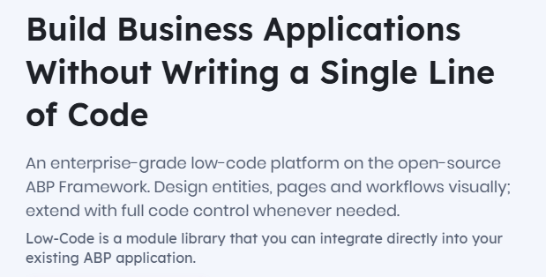
WHAT’S ABP LOW-CODE SYSTEM?
INTRODUCTION PAGE → https://abp.io/low-code
TECHNICAL DOCS → https://abp.io/docs/latest/low-code

Slide 14
ABP LOW-CODE SYSTEM
Build data-driven business applications visually — while staying inside the ABP architecture.
1
MODEL
2
DESIGN
3
RUN
4
EXTEND
→
→
→
Entities & relations
Pages, forms & permissions
CRUD APIs + React runtime
Scripts, endpoints & code
NO 👇
• DTO
• Repository
• Application Service
• Controller
Standard CRUD flow, without the usual boilerplate
Data Grid
Form
Kanban
Calendar
Gallery
Dashboard

Slide 15
WHY IT MATTERS
Ship More. Change Faster. Depend Less on Development.
Low-Code moves repetitive operational work out of the release cycle without creating a separate platform or black box.
Runtime changes
Ready-to-use APIs
⚡
Create or update models, screens and permissions without regenerating the whole solution or waiting for a normal UI release cycle.
↗
Dynamic entities come with CRUD REST APIs; custom endpoints can be added when the standard flow is not enough.
Non-technical builders
One ABP foundation
◎
Business or platform users can create operational screens visually while developers focus on advanced logic and differentiation.
⌁
Same database, permissions, multi-tenancy and enterprise foundations — with full-code extension whenever needed.
GREAT FOR
Back-office apps • Internal tools • Admin panels • Rapid prototypes • Frequently changing processes • Projects without a dedicated development team

Slide 16
SEE IT IN ACTION
HOTEL MANAGEMENT SYSTEM
🤵
Customers
🛏️
Rooms
📅
Reservations
📊
Dashboard

Slide 17
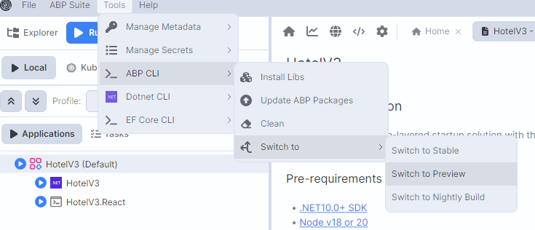
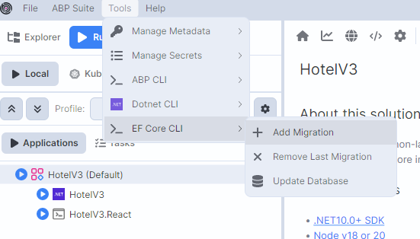
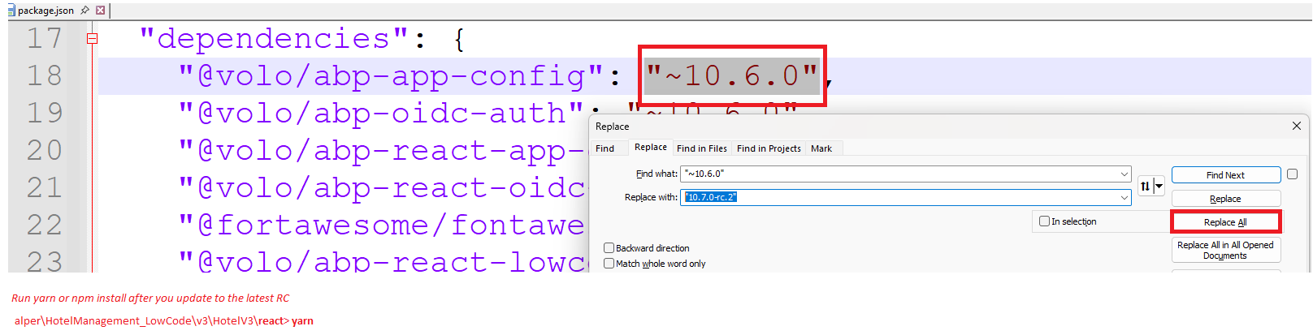

Slide 18
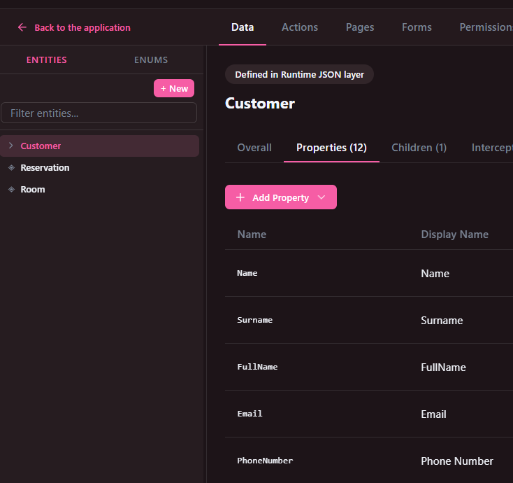
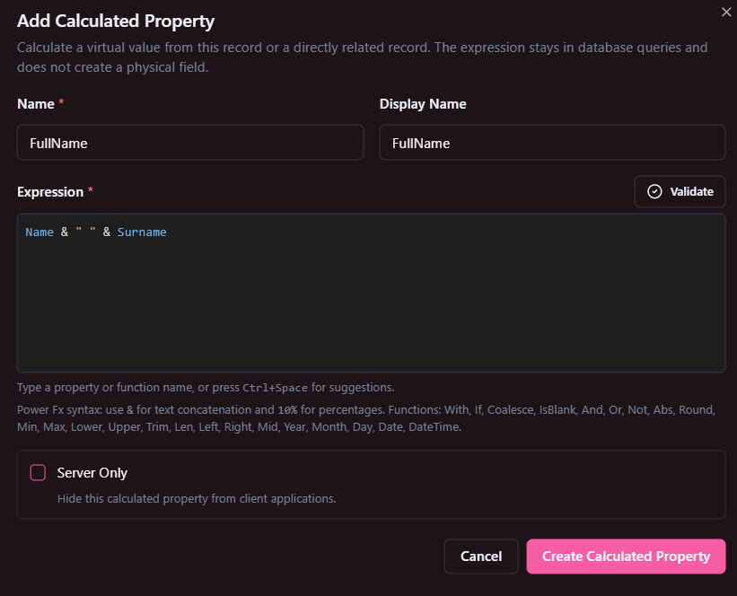
CUSTOMER

Slide 19
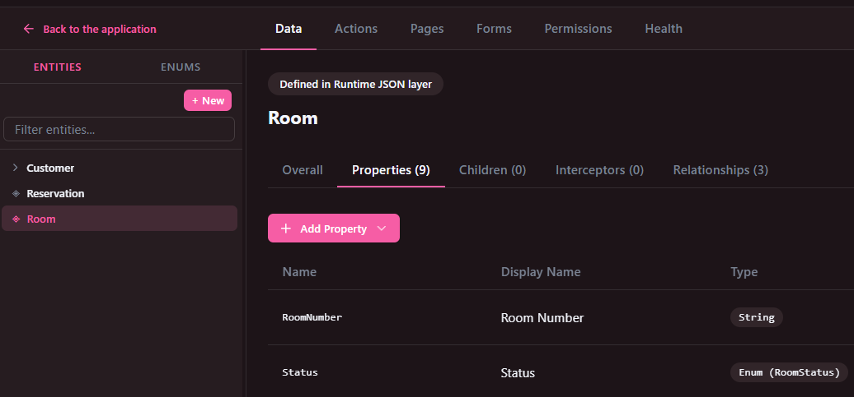
ROOM

Slide 20
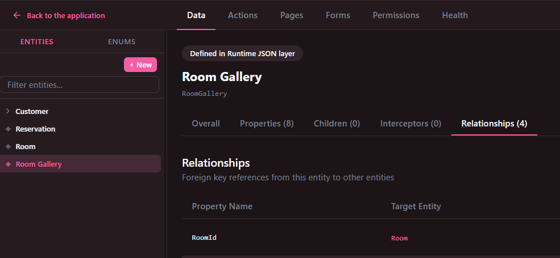
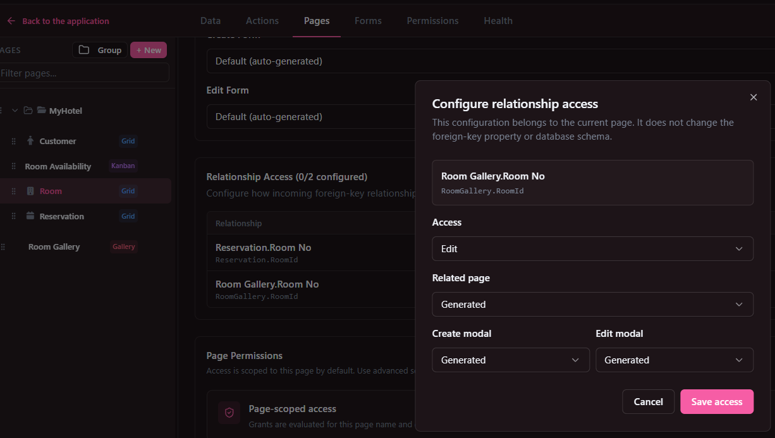
ROOM GALLERY
(1)
(2)

Slide 21
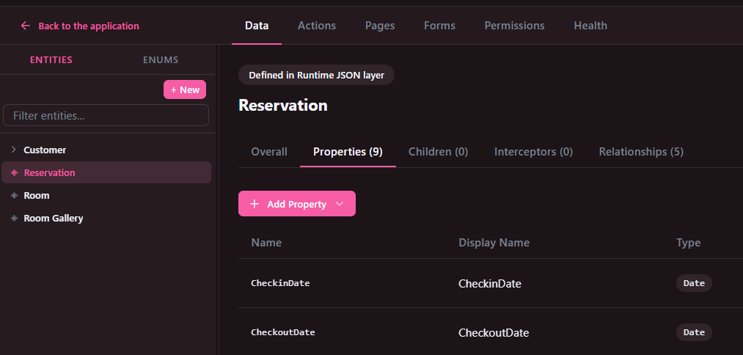
RESERVATION

Slide 22
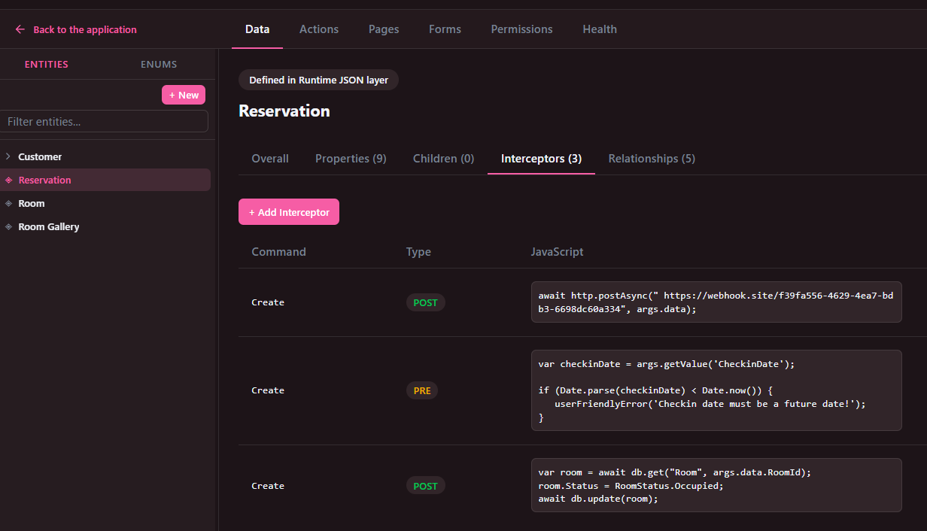
RESERVATION
INTERCEPTORS
Notes:
await http.postAsync(" https://webhook.site/f39fa556-4629-4ea7-bdb3-6698dc60a334", args.data);
https://webhook.site/#!/view/f39fa556-4629-4ea7-bdb3-6698dc60a334/74687e09-27f5-4d81-bdb7-5634c0f70a4a/1
---
var checkinDate = args.getValue('CheckinDate');
if (Date.parse(checkinDate) < Date.now()) {
userFriendlyError('Checkin date must be a future date!');
}
---
var room = await db.get("Room", args.data.RoomId);
room.Status = RoomStatus.Occupied;
await db.update(room);

Slide 23
RESERVATION
CALCULATED PROPERTY
(Year(CheckoutDate) - Year(CheckinDate)) * 365
+ (Month(CheckoutDate) - Month(CheckinDate)) * 30
+ Day(CheckoutDate) - Day(CheckinDate)

Slide 24
ACTIONS:
HTTP: Create custom HTTP endpoints and Web APIs for your application.
Handlers: Listen for distributed events and run custom logic when an event is published.
Jobs: Background jobs… Run asynchronous tasks in the background, such as sending emails, generating reports, or processing data.
Workers: Background workers…Run recurring tasks automatically on a defined schedule or interval.
PAGES:
Group : Grouping features for navigation menu.
New: Create a new standalone page. You can add multiple pages to the application.
Form: Create forms for adding and updating entity records.
Permissions: Control access to the page and the actions users can perform.
Health: Find configuration and design issues in the Low-Code Designer. This is not an application runtime health check.

Slide 25
FORMS:
Creates a form for an entity, automatically generating fields from its properties. Typically used for Create and Update operations.
PERMISSIONS:
Create custom permissions to control access to pages and actions. Permissions can be organized under parent permissions.
HEALTH:
Checks the Low-Code model for broken references and configuration issues before they cause runtime errors.

