Slide 1

Building Multi-Tenant ASP.NET Core Applications
& the ABP Framework
Alper Ebicoglu
Co-Founder of Volosoft
alper.ebicoglu@volosoft.com
twitter.com/alperebicoglu

Slide 2



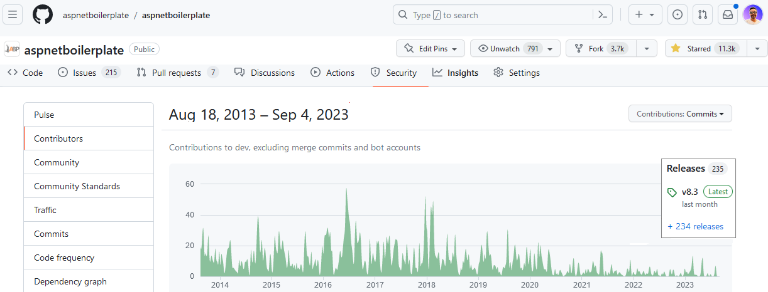
Open-source Framework on

Slide 3

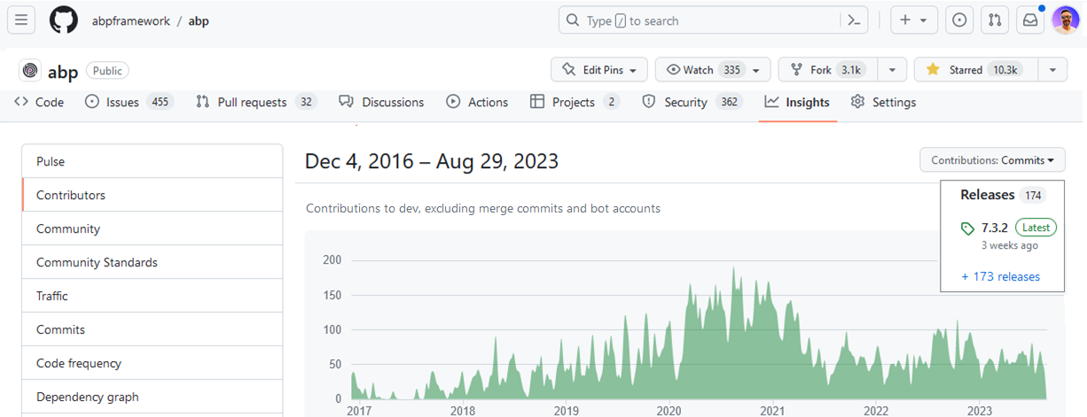
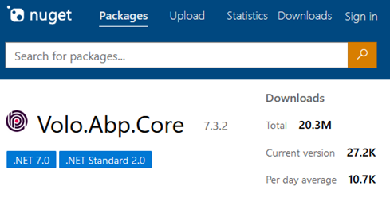
Open-source Framework on

Slide 4



What is ABP Framework?
🚀
Your Application
do what you do best
Focus on your business code
Multi-tenancy
Audit logging
Exception handling
Background jobs
Modularity
Event bus
Unit of work
etc…
ABP Web Framework
An opinionated architecture to build line-of-business web apps
Routing
Dependency injection
Session management
Request / response
Security
etc…
ASP.NET Core Web Framework
Generic web framework

Slide 5
Agenda
Introduction to SaaS & Multi-Tenancy
Pros and Cons of Multi-Tenancy
Database & Deployment Scenarios
Identifying and Changing the Active Tenant
Data Isolation
Conditionally Turning Multi-Tenancy On / Off
Handling Database Migrations
Implementation of the Feature System

Slide 6
What is Multi-Tenancy?
A common approach to build SaaS solutions
Resources are shared between tenants
Application data is isolated between tenants
Tenants: Our clients, using the service
Host: Service provider
Parties
An ideal multi-tenant application should be
Unaware of multi-tenancy as much as possible!
Deployable to on-premise as well
Notes:
Architectural approach to build SaaS
Hardware + Software resources shared btw tenants.
Tenant's data and configurations are logically or physically separated.
Tenants: Customers --- Host: Solution owner
Unaware of multi-tenancy :
Multi-tenancy system should be designed to work seamlessly and make your application code multi-tenancy unaware as much as possible.
---- You shouldn’t pass TenantId to all your controllers, application services, repositories or domain services…
---- Do all tenancy related stuff in a low level layer and keep your business code clean as much as possible.
---
When you want to build a solution, you need to deal first with multi-tenancy.
Different cloud customers access the same resources..
So each client operates within its isolated environment, unaware of the existence of other tenants.
Their application data is physically or virtually isolated.
There are 2 parties in this scenario: Tenants and Host.
Tenants are our customers and the host is the owner of the platform that develops, maintains, and offers the software to customers.
—
Ideally, your application code should not be aware of multi-tenancy related code.
What I mean is, you shouldn’t pass TenantId to all your controllers, application services, repositories or domain services…
Do all tenancy related stuff in a low level layer and keep your business code clean as much as possible.
And also, when a customer wants to setup your solution to his own servers, you should be doing that without any code changes.

Slide 7
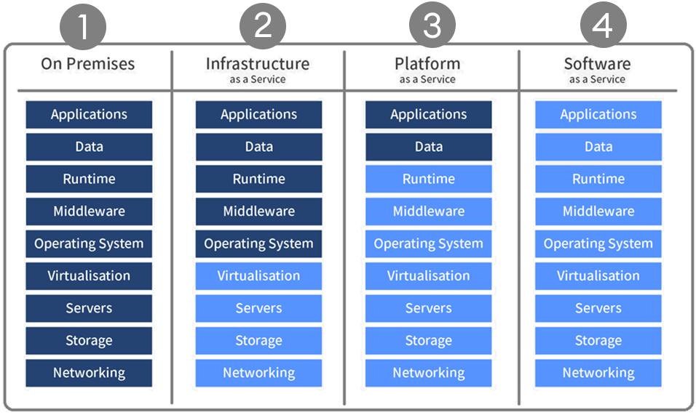
As-a-Service Business Models
You manage
3rd Party Manages

Slide 8
Advantages of Multi-Tenancy
Cost efficiency — max utilization
Consistent user experience
Ease of maintenance
Scalability
Rapid deployment for new users

Slide 9
Challenges of Multi-Tenancy
Data isolation
Configuration & customization per tenant
Performance balance: Noisy neighbors!
Security
Backup and recovery
Notes:
Data isolation: Ensuring proper data isolation btw tenants to prevent unauthorized access to sensitive information
Customization and configuration: Your clients request to customize the application according to their requirements. They want to make rebranding and customize the UI, logo, colors. Managing different configurations and customizations for each tenant without compromising the core architecture can be challenging.
Performance balance: some customers may use the system extensively We can call this “Noisy neighbors“. Some tenants can consume too much resources. We should ensure that the resource usage of one tenant does not negatively impact the performance of other. This should be done by monitoring the system.
Security: When a hacker gets into your server he can steal all your client data. Also if you have a security hole, a tenant can gain access to other tenant’s data.
Backup and recovery: This involves database and storage backup per tenant. It will be very easy to backup/restore when you have a separate DB for each tenant, but if you have a shared DB then you need to get backup of the specific tenant. And tenants may have different retention policies, so you need to implement different strategies for each tenant. Government agencies + banks

Slide 10
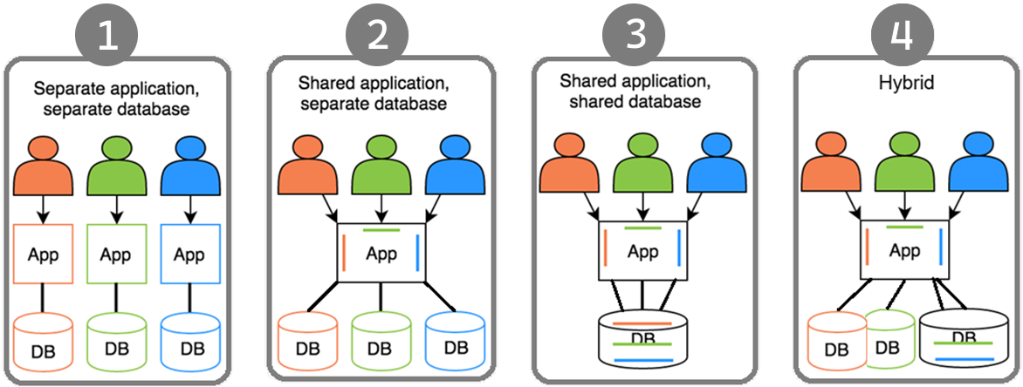
Deployment & Database Architectures

Slide 11
Maintaining Application States
Application code & services should be stateless!
Where should we save the state?🤔
HTTP Request (cookie, header, query string, payload)
Authentication ticket
Database
Distributed cache (Redis, Memcached, ...)

Slide 12
Identifying the Active Tenant

Slide 13
Identifying the Active Tenant
How to determine the current tenant?🤔
CurrentUserTenantResolveContributor
QueryStringTenantResolveContributor
RouteTenantResolveContributor
HeaderTenantResolveContributor
CookieTenantResolveContributor
DomainTenantResolver

Slide 14
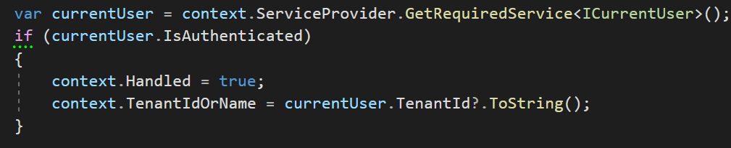
Identifying the Active Tenant
1. Current User (claims)
HttpContext.User.Identity.Claims .FirstOrDefault(c => c.Type == “TenantId”)

Slide 15
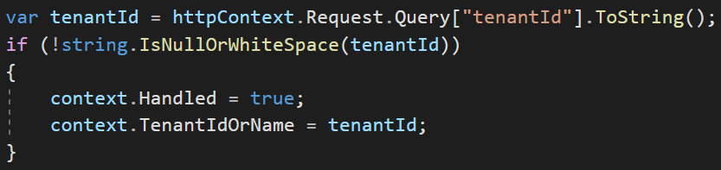
Identifying the Active Tenant
2. Query String
https://fabrikam.com?tenantId=3

Slide 16
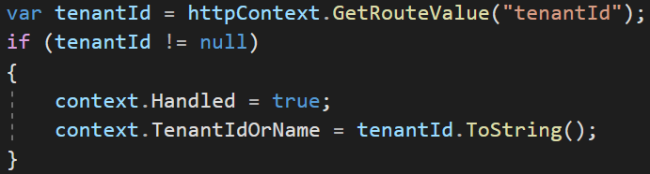
Identifying the Active Tenant
3. Route
https://fabrikam.com/acme/

Slide 17
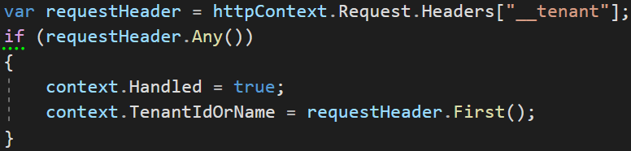
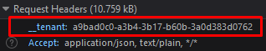
Identifying the Active Tenant
4. Header

Slide 18
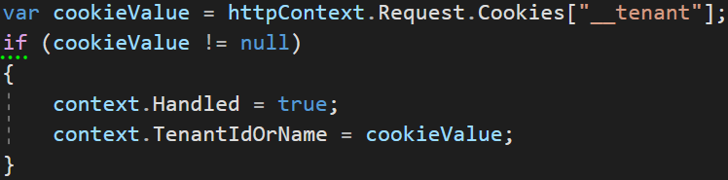
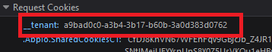
Identifying the Active Tenant
5. Cookie

Slide 19
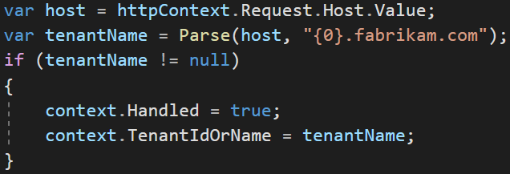
Identifying the Active Tenant
6. Domain
https://acme.fabrikam.com

Slide 20
Data Isolation
✓ Identifying the Active Tenant

Slide 21
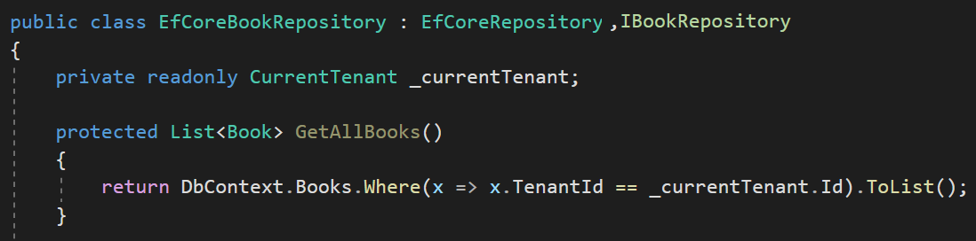
Data Isolation — Traditional way
You normally do this

Slide 22
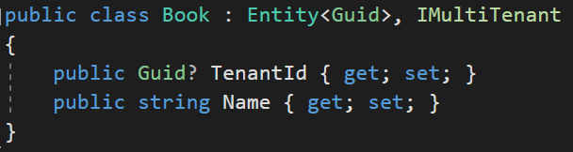
Data Isolation

Slide 23
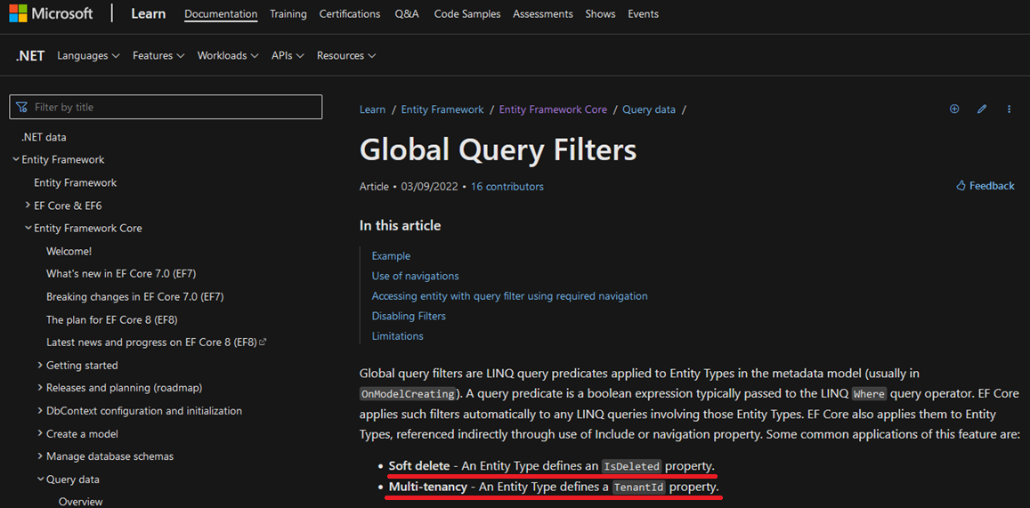
Data Isolation — EF Core
* Soft delete: An Entity Type defines an IsDeleted property.
* Multi-tenancy: An Entity Type defines a TenantId property.

Slide 24
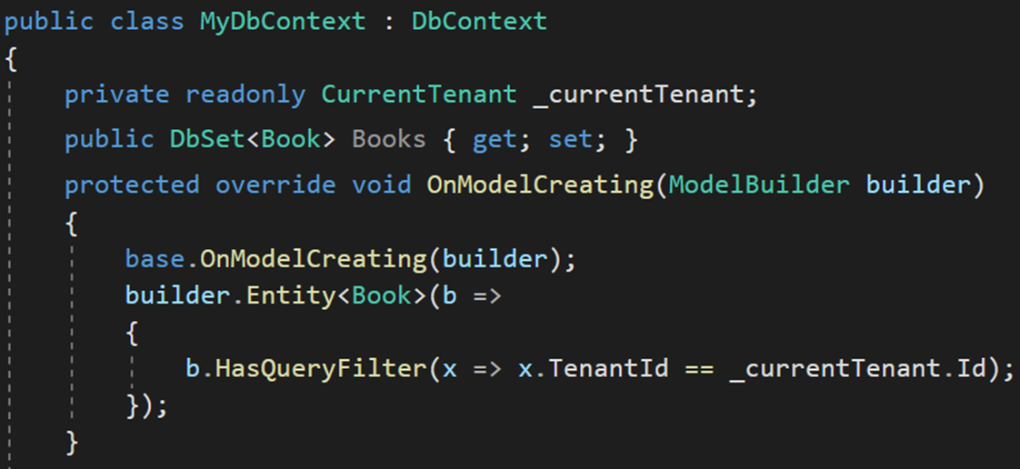
Data Isolation — EF Core Manual Way
HasQueryFilter() for global filtering

Slide 25
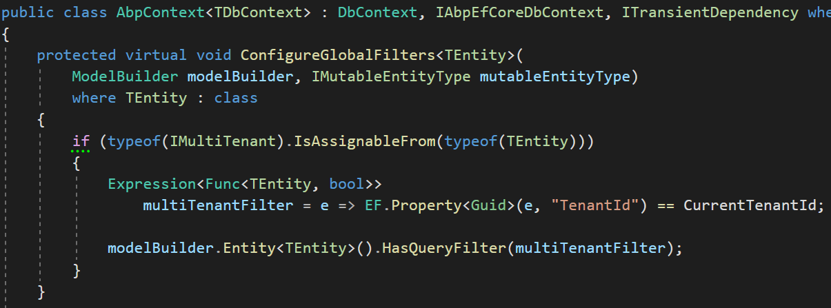
Data Isolation — EF Core
1-) Find all entities implement IMultiTenant
2-) Create LINQ expression
3-) Add to global filters

Slide 26
Data Isolation — EF Core PROS & CONS
😊 Easy to implement
😊 Supports navigation properties as well
😕 Works only with EF Core

Slide 27
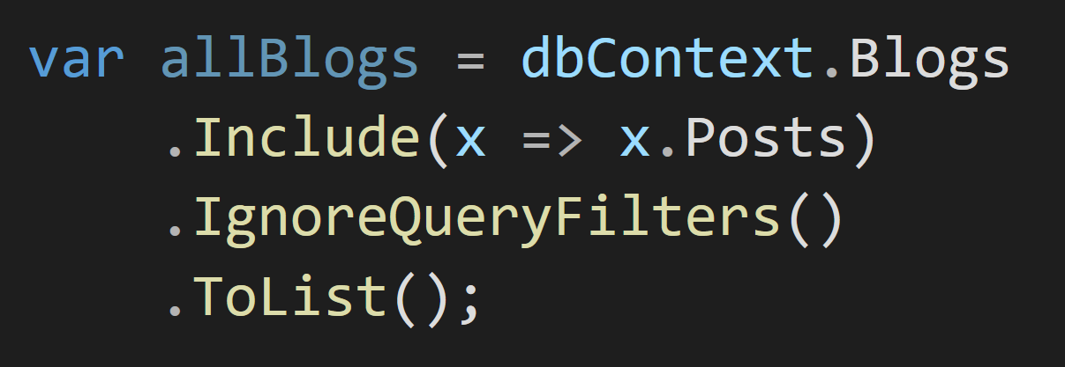
Data Isolation — EF Core PROS & CONS
😡 IgnoreQueryFilters() disables all filters

Slide 28
Data Isolation — EF Core PROS & CONS
😡 Can be defined for the root entity
of the inheritance hierarchy
Define to Animal

Slide 29
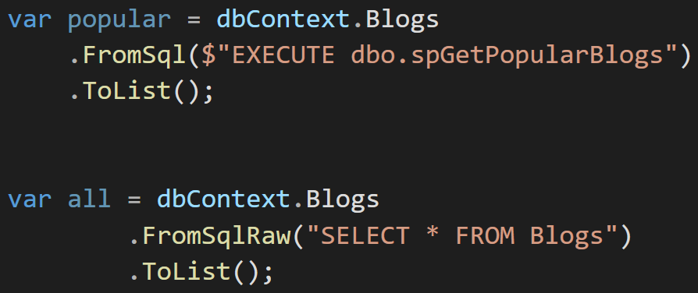
Data Isolation — EF Core PROS & CONS
😡 Does not support Stored Procedures or T-SQL

Slide 30
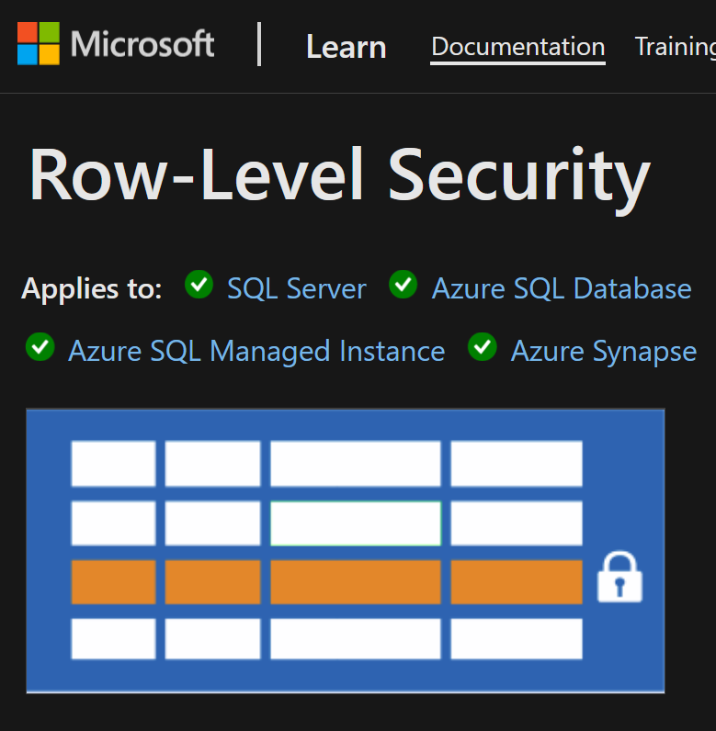
Data Isolation — EF Core PROS & CONS
Database level solution
👉 Row Level Security
Rows filtered based on user roles, attributes
Restriction logic is done in the DB
https://learn.microsoft.com/en-us/sql/relational-databases/security/row-level-security

Slide 31
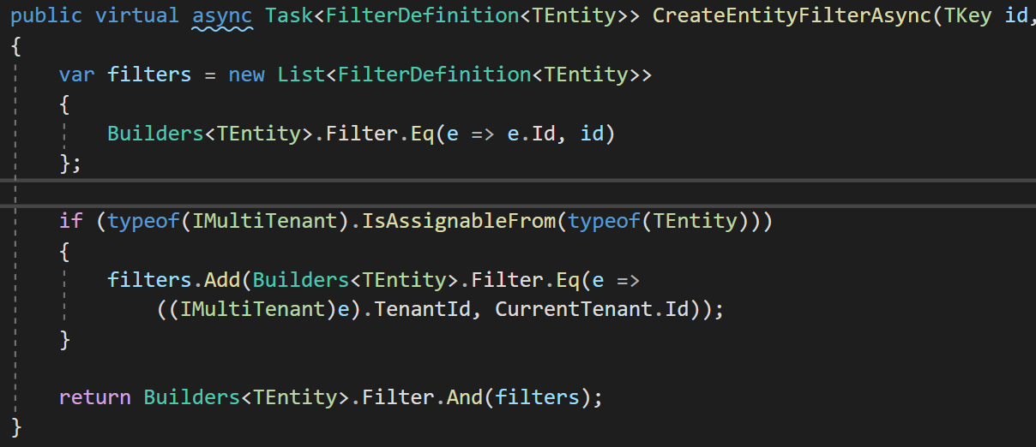
Data Isolation — MongoDB
1-Find all IMultiTenant
2-Create filter expression
3-Add to our custom global filters

Slide 32
Set TenantId for New Entities
✓ Identifying the Active Tenant
✓ Data Isolation

Slide 33
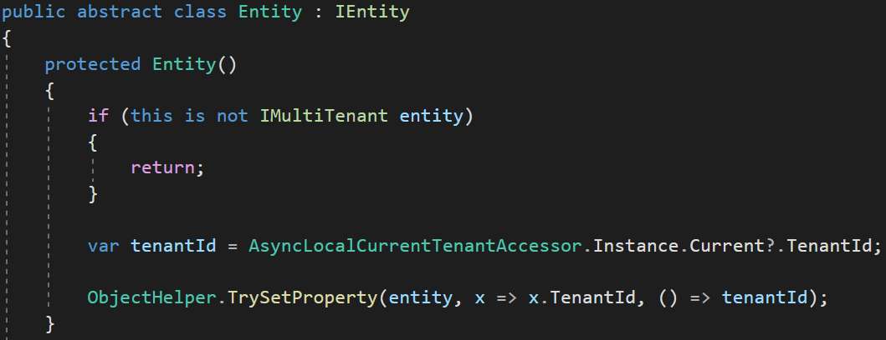
Set TenantId for New Entities
Set TenantId by reflection
Notes:
To avoid mistakes.
We set the TenantId for a new multi-tenant entity in the constructor.
We get the active TenantId from the active tenant’s scope and set it.
This way we are sure that TenantId is always being set

Slide 34
DB Connection String Selection
✓ Identifying the Active Tenant
✓ Data Isolation
✓ Set TenantId for New Entities

Slide 35
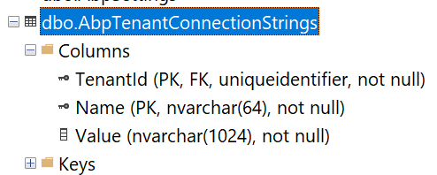
Connection String Selection — DB
The current tenant
The current module / microservice
The default connection string
Fallbacks

Slide 36
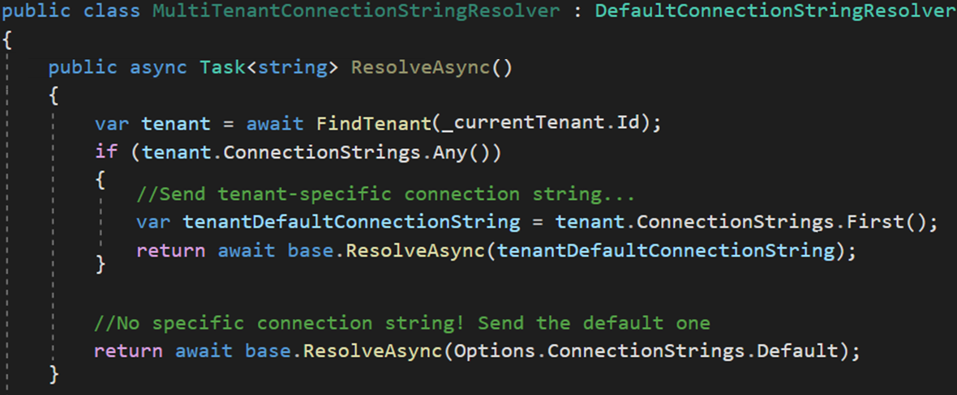
Connection String Selection — Code
Dedicated DB
Shared DB

Slide 37
Changing the Active Tenant
✓ Identifying the Active Tenant
✓ Data Isolation
✓ Set TenantId for New Entities
✓ DB Connection String Selection

Slide 38
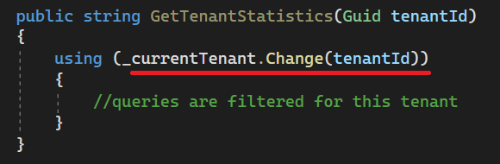
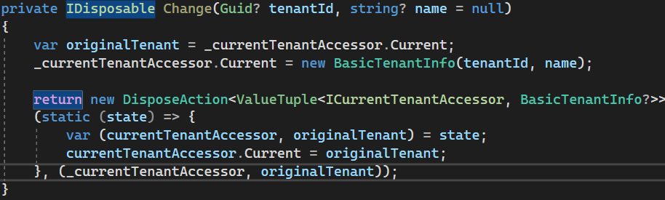
Changing the Active Tenant
Set active tenant
Revert back
Notes:
In each HTTP request, you can only query for the active tenant.
But sometimes it may be necessary to change the active tenant.
For example when you have background job that generates reports for each tenant (or in Windows Services)
In this case, we use a disposable method which is being used with “using” keyword.
Here we keep the original tenant in a temporary variable and set the new tenant.
Doing this, we filter all queries by this tenant.
Then we restore the original tenant after using the existing statement.

Slide 39
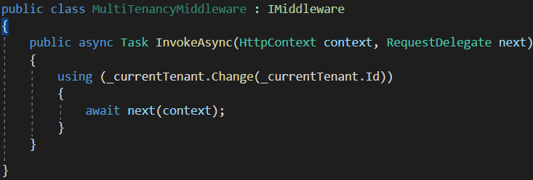
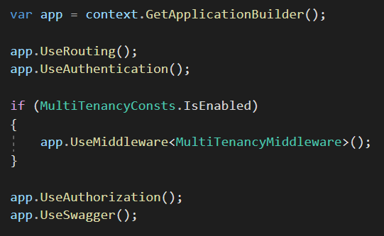
Setting the Active Tenant in Middleware
Set the current tenant within the middleware

Slide 40
Temporarily Disable Multi-Tenancy
✓ Identifying the Active Tenant
✓ Data Isolation
✓ Set TenantId for New Entities
✓ DB Connection String Selection
✓ Changing the Active Tenant

Slide 41
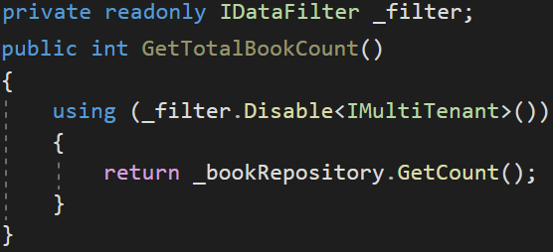
Disabling Multi-Tenancy Filter (Usage)
Returns book count without tenantId filter

Slide 42
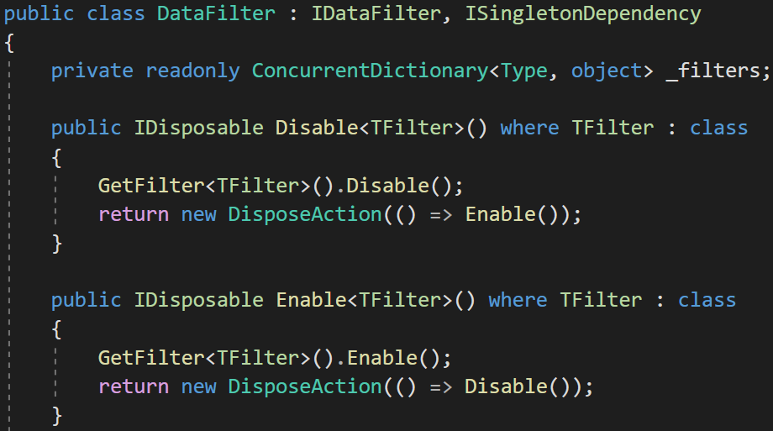
Disabling Multi-Tenancy Filter (Implementation)

Slide 43
Database Migration
✓ Identifying the Active Tenant
✓ Data Isolation
✓ Set TenantId for New Entities
✓ DB Connection String Selection
✓ Changing the Active Tenant
✓ Temporarily Disable Multi-Tenancy

Slide 44
Database Migration
Approach-1: Make DB migration with a custom tool
😊 Easy to implement. All tenants are in the same version
😡 May get too long time for big number of tenants and data.
😡 All tenants wait for all upgrade progress
Approach-2: Run migration on first DB access
😊 Upgrading is distributed to time. A tenant does not wait for another
😡 First user may wait too much and see timeout exception.
😡 Hard to implement (concurrency problems)!

Slide 45
Database Migration — Ideal Way
Approach-3: Make two types application servers.
Upgraded tenants use the new application, other tenants use the old application
😊 Minimum wait time for a tenant
😊 Upgrading can be scheduled for tenants
😊 Run A/B tests and see bugs before anyone else
😡 Requires multiple app servers
😡 Hard to maintain and monitor

Slide 46
Feature System
✓ Identifying the Active Tenant
✓ Data Isolation
✓ Set TenantId for New Entities
✓ DB Connection String Selection
✓ Changing the Active Tenant
✓ Temporarily Disable Multi-Tenancy
✓ Database Migration

Slide 47
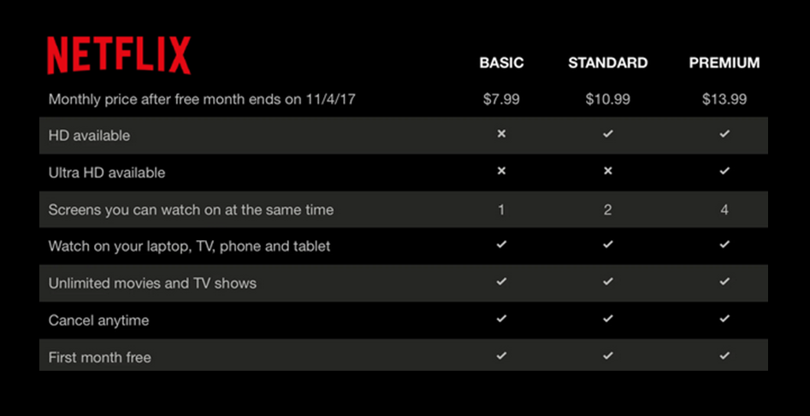
The Feature System
Editions
Features

Slide 48
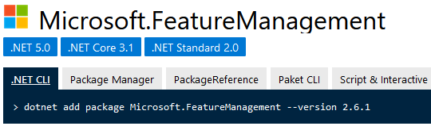
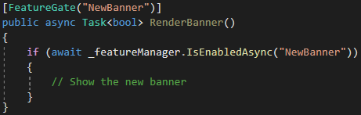
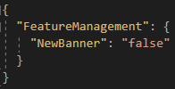
The Feature System — Microsoft’s Solution
Defined only for Boolean values
Usually for A/B testing
No multi-tenancy support
appsettings.json

Slide 49
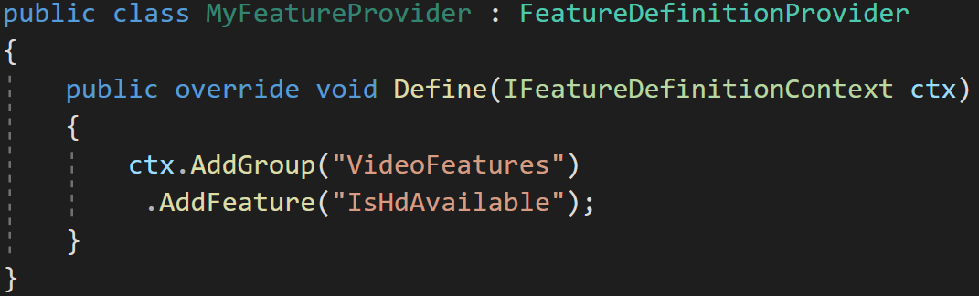
The Feature System — Define features
Features are stored in a readonly list

Slide 50
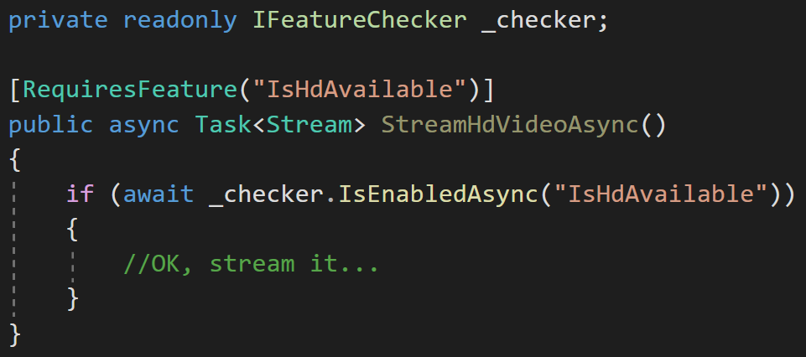
The Feature System — Check the features
Declarative check
Conditional check

Slide 51
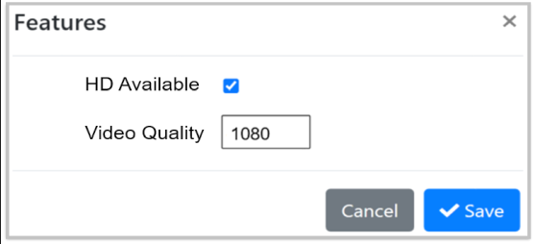
The Feature System — UI
Use a Management UI to manage features for tenants

Slide 52






Thank you for listening
https://twitter.com/alperebicoglu
https://github.com/ebicoglu
open-source web application
framework
https://medium.com/@alperonline
Download this presentation:
https://github.com/ebicoglu/presentations
https://abp.io

