Slide 1



What’s new with ABP 7.4
Alper Ebicoglu
ABP Development Core Team Member
https://twitter.com/alperebicoglu

Slide 2

ABP 7.4-RC Version Released
ABP version 7.4-RC2 released. https://blog.abp.io/abp/ABP.IO-Platform-7-4-RC-Has-Been-Published
https://commercial.abp.io/releases/tag/7.4.0-rc.1
https://commercial.abp.io/releases/tag/7.4.0-rc.2
The stable version is planned to be released on September 12, 2023
Notes:
ABP 7.4 rc2 version has been lately released.
Here’s the blog post about this version.
https://blog.abp.io/abp/ABP.IO-Platform-7-4-RC-Has-Been-Published
Check out the blog post to understand how to create a new ABP project with this RC version.
Learn how to migrate from 7.0 to 7.1 and see the changes.
Commercial Release Notes
As you know ABP commercial is an not open-source repo. Therefore you cannot track the internal issues.
We created a new page for all the PRs that have been resolved in the corresponding release.
See https://commercial.abp.io/releases/tag/7.4.0-rc.1
We’re planning to release the stable version on September 12, 2023

Slide 3

Thanks to the contributors of v7.4
Migration Guide
https://docs.abp.io/en/abp/7.4/Migration-Guides/Abp-7_4
Notes:
This version has been released with 20 contributors.
Thanks to all developers who took part in this version.
There are a few breaking changes in this version that may affect your application.
Please see the following migration documents, if you are upgrading from v7.3 or earlier:
https://docs.abp.io/en/abp/7.4/Migration-Guides/Abp-7_4
Every release of ABP includes improvements to performance, stability, and new features.
Let’s see what’s new with this version…

Slide 4
What’s new with ABP 7.4
Dynamic Setting Store added
Introducing the AdditionalAssemblyAttribute
CorrelationId Support on Distributed Events
Database Migration System for EF Core
Notes:
The Dynamic Setting Store, allows you to collect and get all setting definitions from a single point and overcome the setting management problems on microservices.
In some rare cases, your module may consist of multiple assemblies and only one of them defines a module class, and you want to make the other assemblies parts of your module. This is especially useful if you can't define a module class in the target assembly or you don't want to depend on that module's dependencies.
CorrelationId is a unique key that is used in distributed applications to trace requests across multiple services. ABP generates a CorrelationId for each request and passes it to the distributed events. If you are using the transactional outbox or inbox pattern provided by ABP Framework, you can see the correlationId in the extra properties of the IncomingEventInfo or OutgoingEventInfo classes with the standard X-Correlation-Id key.
For the Database Migration System we added base classes and events to migrate the database schema and seed the DB on application startup. It supports multi-tenancy and once a new tenant is created or you change a tenant’s DB connection string, it automatically migrates.

Slide 5
Oher updates of ABP 7.4
OpenIddict library has been upgraded to v4.7.0
https://github.com/abpframework/abp/pull/17334
Introducing the Volo.Abp.Maui.Client package
https://github.com/abpframework/abp/pull/17201
Support module class type at AbpAspNetCoreIntegratedTestBase
https://github.com/abpframework/abp/pull/17039
Notes:
* .NET MAUI Client package added to the ABP Framework, which is used by the MAUI mobile application.
* We added AbpAspNetCoreIntegratedTestBase class. It gets either a startup class or an ABP module class. By doing this, you can use configurations from an ABP module or classic ASP.NET Core Startup class in your test classes.

Slide 6

What’s new with ABP Commercial 7.4
Dynamic Text Template Store added
Notes:
Dynamic Text Template Store enables you to manage your text templates in a distributed architected environment.
It allows you to store and get all text templates from your admin application.
This update comes with a DB Migration therefore you need to add new migration and apply to your DB.
You can configure your application as seen on the screenshot. And this is only for microservice templates no need to do this for other templates.

Slide 7
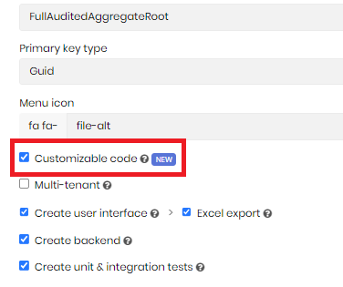
What’s new with ABP Commercial 7.4
Preserving Custom Code in ABP Suite
Notes:
This is one of the most wanted features in ABP Suite and we finally implemented it: THE CUSTOM CODE support
This new feature allows you to customize the generated code-blocks and preserve your custom code changes in the re-generation of an entity.
ABP Suite specifies hook-points to allow adding custom code blocks. Then, the code that you wrote to these hook points will be respected and will not be overridden in the next entity generation.
To enable custom code support, you should check the Customizable code option

Slide 8
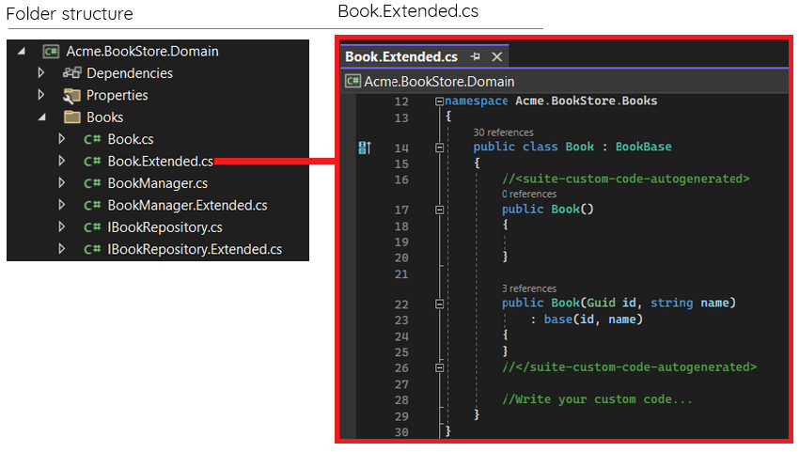
What’s new with ABP Commercial 7.4
Preserving Custom Code in ABP Suite (Backend Code)
Notes:
We created abstract classes for entities, application services, interfaces, domain services.
You can write your custom code in those classes (*.Extended.cs)
When you regenerate an entity these Extended.cs will not be overwritten.
only the base abstract classes will be re-generated and your changes on Suite will be respected
If you want to override the entity and add your own code,
keep the <suite-custom-code-autogenerated>...</suite-custom-code-autogenerated> section as original.
Because the constructor of the entity always being regenerated

Slide 9
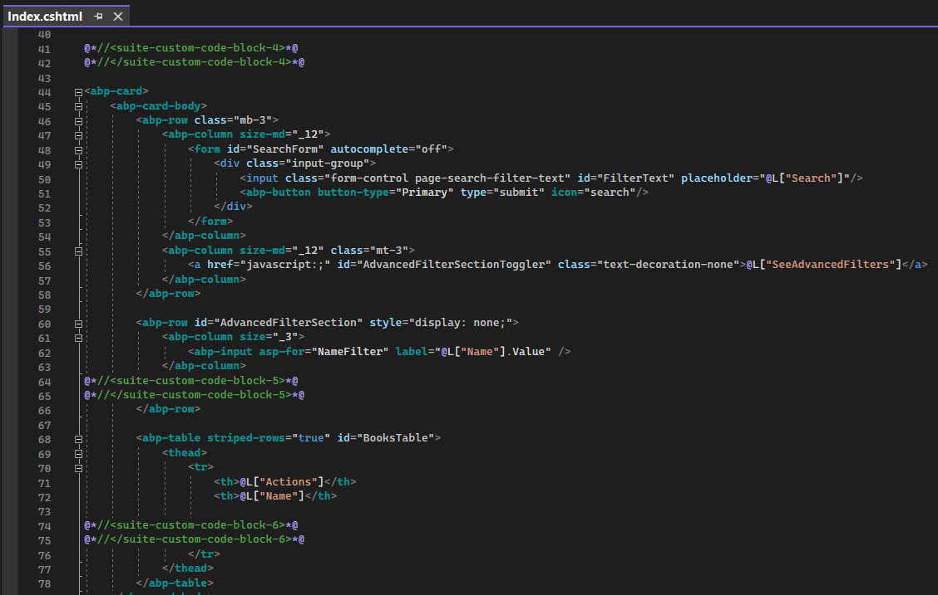
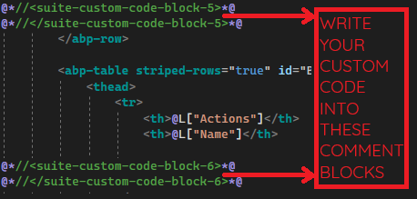
What’s new with ABP Commercial 7.4
Preserving Custom Code in ABP Suite (Frontend Code)
Notes:
This is the UI code.
As you see we added comment placeholders into different parts of the UI code for MVC & Blazor applications.
When you write your own code into these sections, your custom code will be safe.

Slide 10
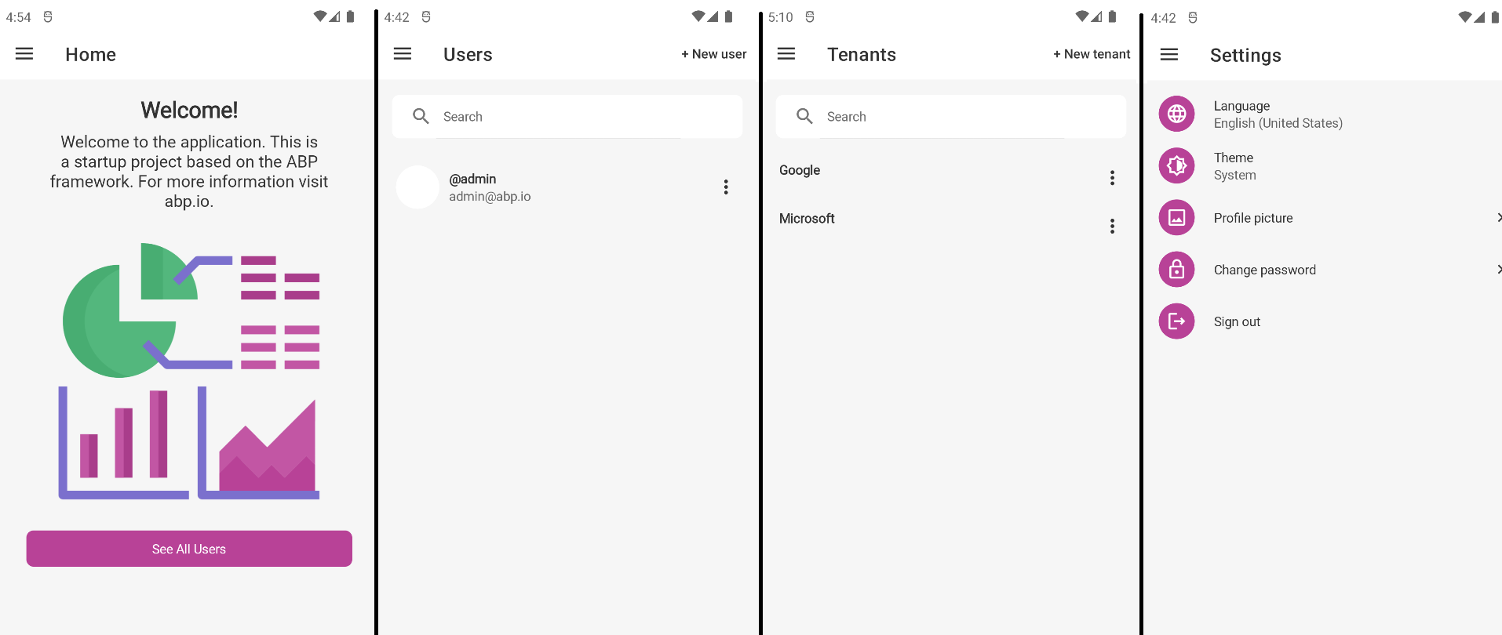
What’s new with ABP Commercial 7.4
.NET MAUI & React Native UI Improvements
Notes:
In this version, we renewed .NET MAUI & React Native mobile applications.
We added new pages, functions and modernized the look of the UI.
--
For the .NET MAUI app, we added user and tenant management. And also a setting page to change the current language, the profile picture, password, and the current theme.

Slide 11
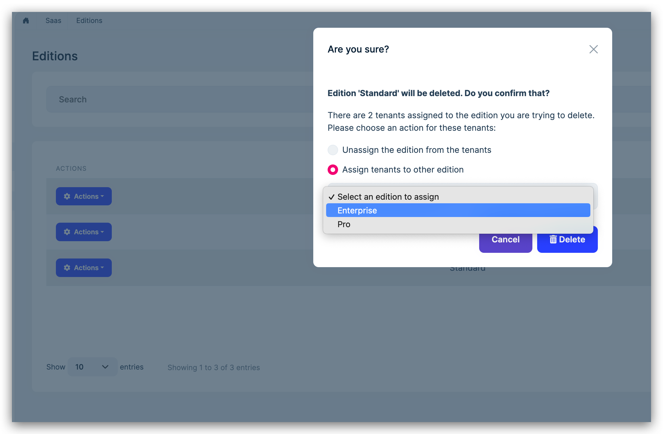
What’s new with ABP Commercial 7.4
Cascade Move On Deletion
Notes:
Sometimes you need to delete an entity which has relationships with other entities.
And when there are other entities attached to that entity, your database will have inconsistency and residual relationships. We've made an improvement in ABP Commercial’s Organization Unit (user), Role (tenant) and Edition (tenant) pages.
when you delete an Edition, we ask the user what they want to do with the existing tenants linked to this editon.

Slide 12
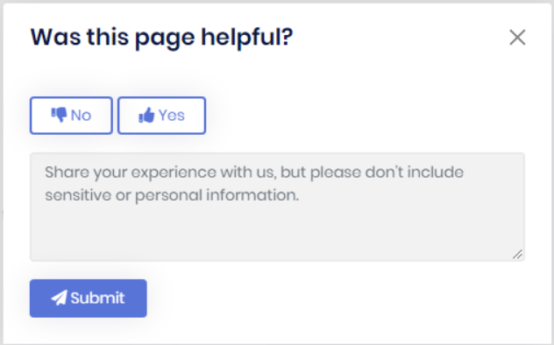
What’s new with ABP Commercial 7.4
CMS Kit Pro: Page Feedback
Read the docs
https://docs.abp.io/en/commercial/7.4/modules/cms-kit/page-feedback
Notes:
This is also a new feature: the Page Feedback feature.
You can add this box to any page of your application, and get feedback from your customers.
For example, you have blog website, and you want to learn how the customers are reacting to your posts.
Then this basic modal will help you.
This is added to the CMS Kit Pro module and the documentation is being written.

Slide 13
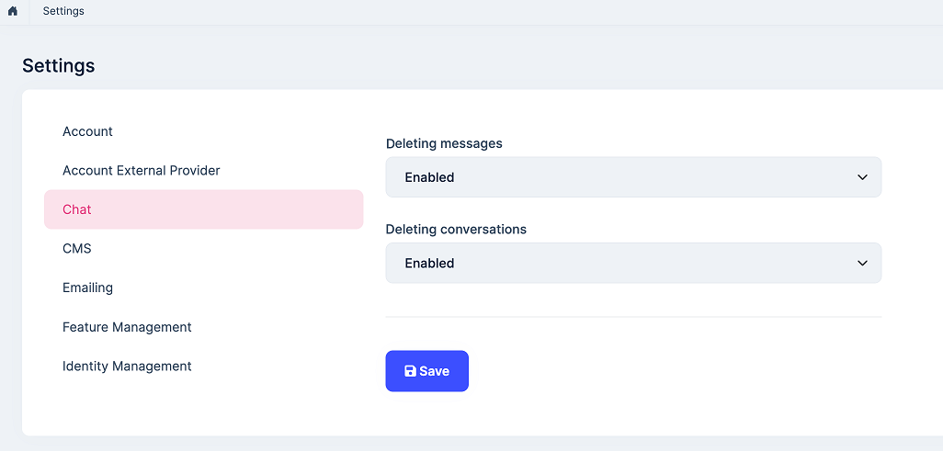
What’s new with ABP Commercial 7.4
Chat Module: Deleting Messages & Conversations
Notes:
We added an option to allow users to delete individual messages or a complete conversation in the chat module.
You can configure it on the Settings page.

Slide 14
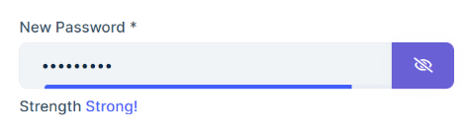
What’s new with ABP Commercial 7.4
Password Complexity Indicators
Read the docs
https://docs.abp.io/en/commercial/7.4/ui/angular/password-complexity-indicator-component
Notes:
You see this password complexity indicator on some websites.
This is useful especially when you have some rules when creating a new password.
This feature dynamically evaluates and rates the strength of user-generated passwords by visually indicating the complexity level.

Slide 15
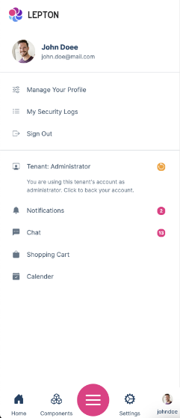
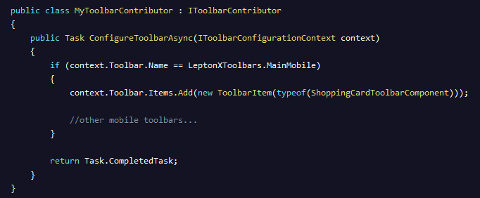
LeptonX Theme Features 2.4.0-rc.1
Mobile Toolbars
Notes:
The Toolbar System is used to define toolbars on the user interface.
Modules can add items to the toolbar, and it’s seen on the toolbar menu
You can create a component and add it as a mobile toolbar as seen on the code section

Slide 16
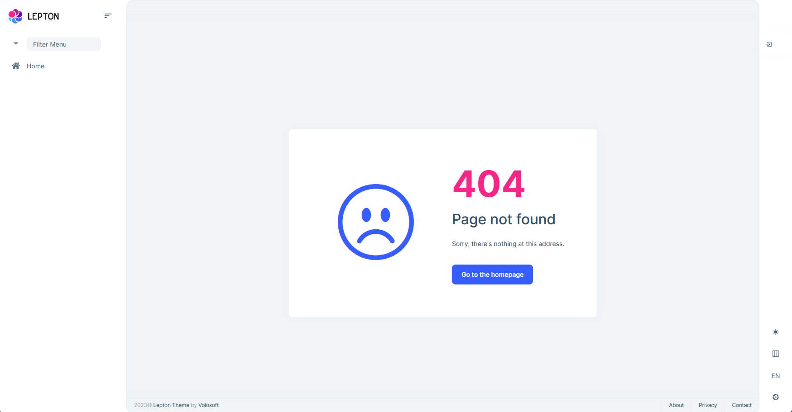
LeptonX Theme Features 2.4.0-rc.1
New Error Page Designs
Notes:
With this version, we have added new error pages.
This is one of them 404 error

Slide 17
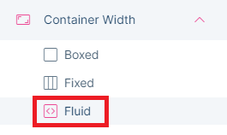
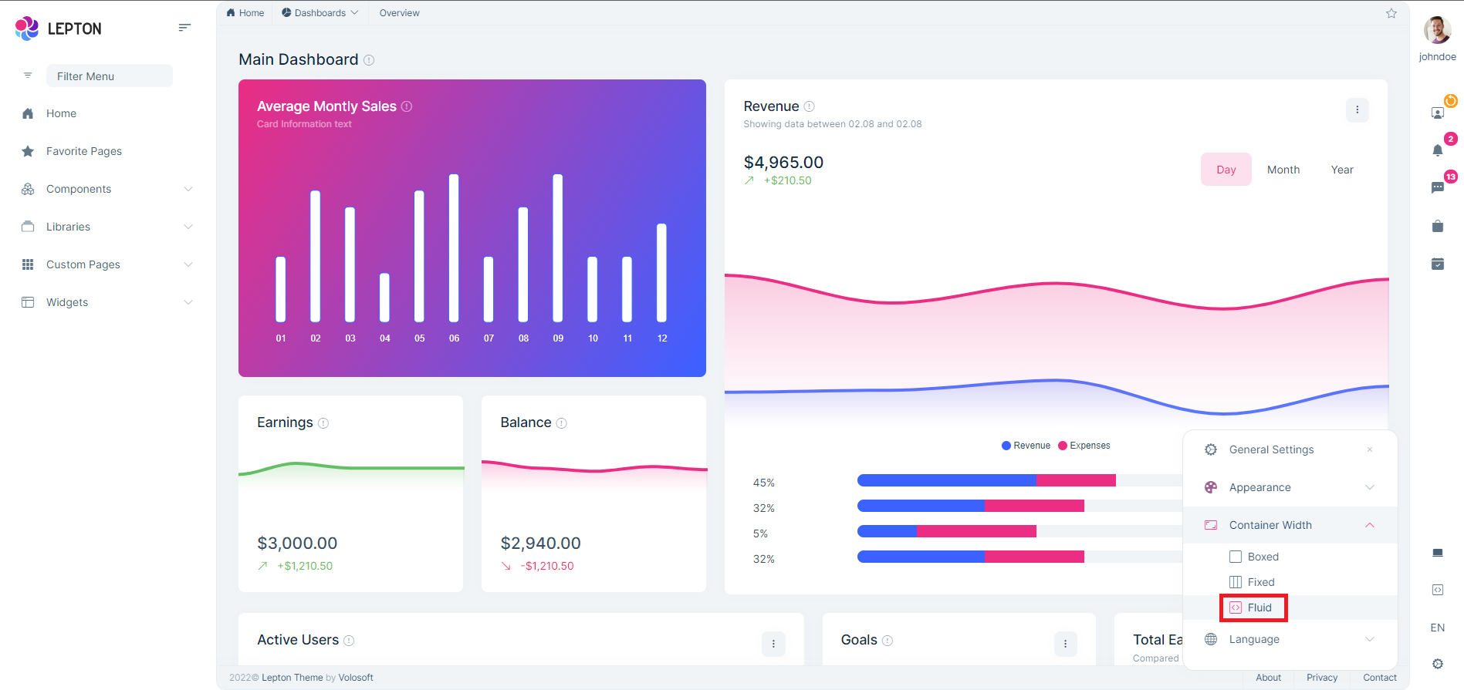
LeptonX Theme Features 2.4.0-rc.1
Fluid Layout
Notes:
The Fluid Layout is designed to be a very flexible way of supporting different screen sizes from desktop to smartphones.
We added this flexible grid system to the Container Width area.

Slide 18

Community Shares
https://community.abp.io/posts/abp-commercial-gdpr-module-overview-kvmsm3ku
Notes:
Engincan explains ABP Commercial's GDPR Module and shows you how to provide personal data to the GDPR Module that is collected by your application and make it aligned with personal data download results.

Slide 19
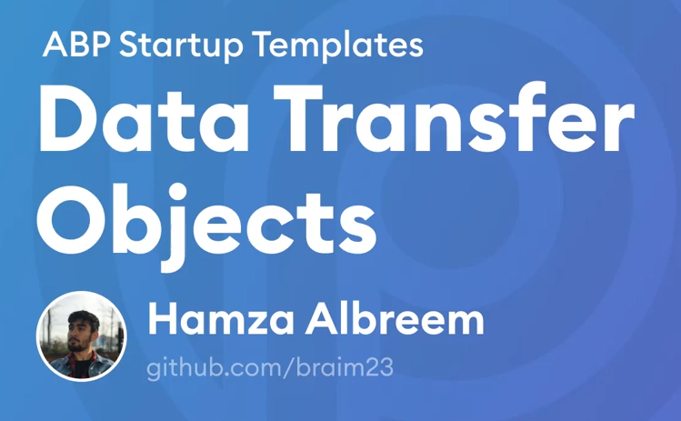
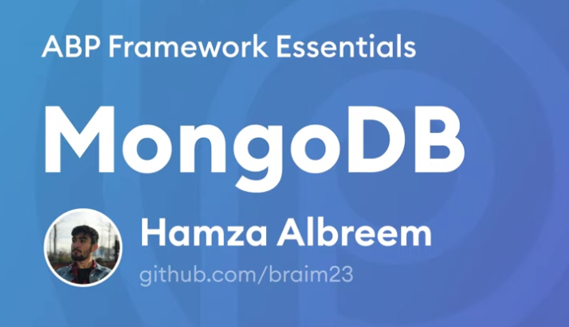

Community Shares
https://www.youtube.com/watch?v=mSDGfRLE3Yo
https://www.youtube.com/watch?v=eXlcGJeazZc
Notes:
ABP Essentials video series:
Data transfer objects
MongoDB

Slide 20
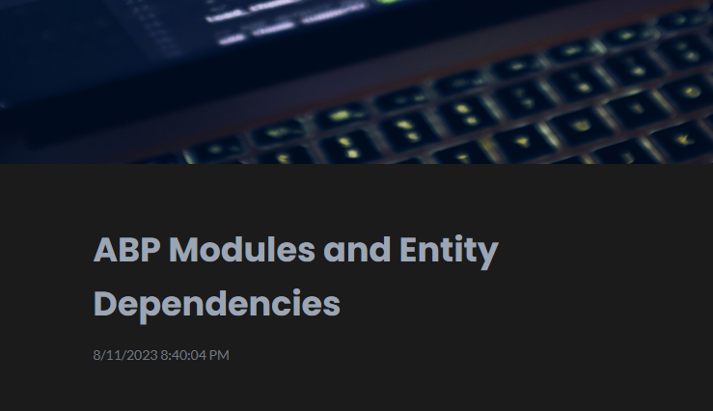

Community Shares
https://community.abp.io/posts/abp-modules-and-entity- dependencies-hn7wr093
Notes:
abp module definition and provides an example of how to handle entity synchronization between modules.

Slide 21
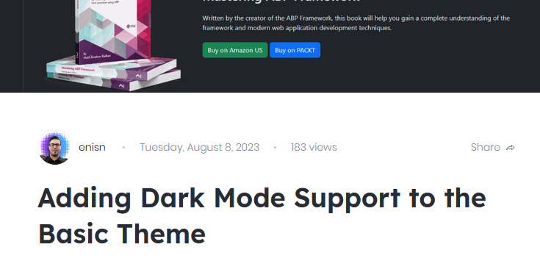
Community Shares
https://community.abp.io/posts/how-to-add-dark-mode-support-to-the-basic-theme-in-3-steps-ge9c0f85
Notes:
Basic Theme uses plain bootstrap and does not have any custom colors & styles. This article will show you how to add dark mode support to the Basic Theme.

Slide 22
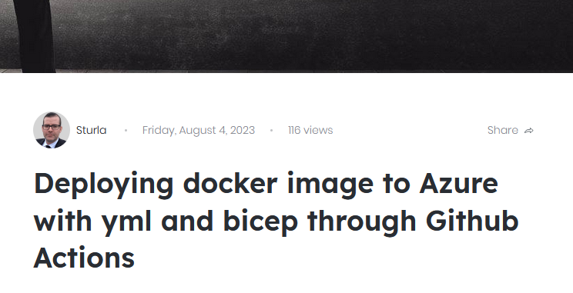
Community Shares
https://community.abp.io/posts/deploying-docker-image-to-azure-with-yml-and-bicep-through-github-actions-cjiuh55m
Notes:
Sturla wrote blog post about how to setup CI/CD for Blazor Server using PostgreSQL using GitHub Actions.
Its aimed at getting a minimal working version to a dev environment with code present to go to production.

Slide 23
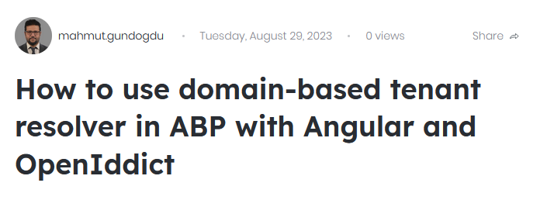
Community Shares
https://community.abp.io/posts/How%20to%20use%20domain-based%20tenant%20resolver%20in%20ABP%20with%20Angular%20and%20OpenIddict-v9y8da7v
Notes:
In this article, Mahmut shows us how to configure your ABP Angular application to support sub domains for your tenants.
like http://tenant1.sample.com , http://tenant2.sample.com

Slide 24


That’s all from my side
Alper Ebicoglu
ABP Development Core Team Member
https://twitter.com/alperebicoglu

