Slide 1




ABP Suite:
Explore the potential of
code generation
Alper Ebiçoğlu
ABP Core Team Member
twitter.com/alperebicoglu

Slide 2

Agenda
What’s ABP Suite?
How to install and run it?
How does it help with your daily development?
Upcoming features
Demo
Q&A: Ask questions in the chat
Notes:
Today me and Engincan will host this session.
I’ll explain what’s abp suite for those who hears this tool for the first time.
Later I’ll show how to install it on your computer.
And I’ll show how Suite speeds up your daily development.
Next I’ll list the new features that will come up in the upcoming versions
And lastly Engincan will show you Suite in action with latest features like master-detail tables, preserving custom code…

Slide 3
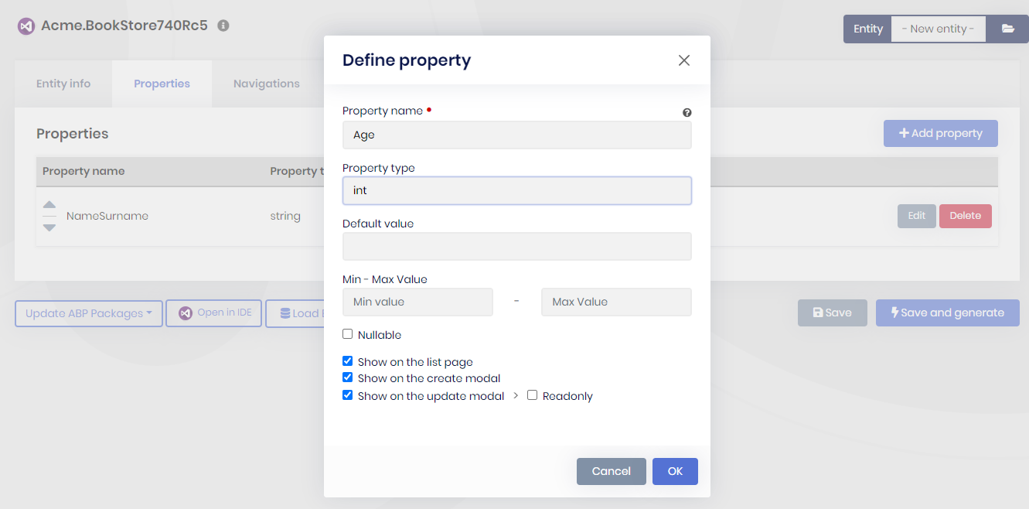
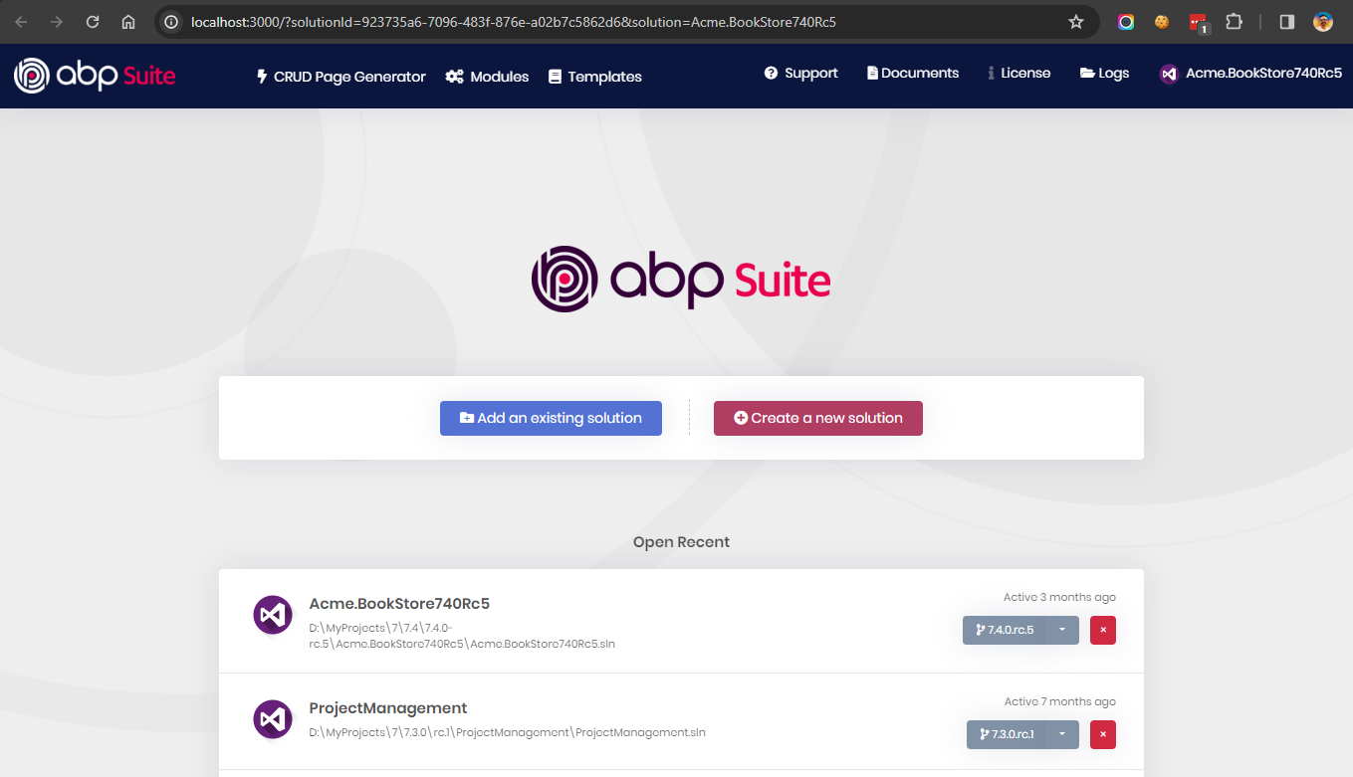
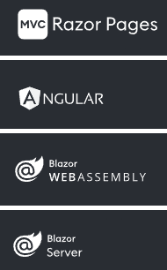
What’s ABP Suite?
SUPPORTED UI
Notes:
ABP Suite is a part of the ABP Commercial platform.
To be able to use ABP Suite, you need to have an active ABP Commercial license.
It is a .NET Core Global tool designed to create a new ABP solution, generating CRUD pages, updating your ABP project and managing your modules in your ABP project.
It runs on your browser, which means it’s cross-platform that works on your MAC, Windows or Linux.
So the major feature of Suite is creating a CRUD pages. It is a time-consuming process for web developers.
For a CRUD page, you simply create repositories, web APIs, input validations, unit tests, HTML, CSS, JavaScript….
And according to my observations, %80 of an admin or back office website consists of CRUD pages.
Although ABP platform is not a low-code platform, ABP Suite turns into a low-code platform.
CLICK ANIMATION
By just typing your entity properties, it creates a fully working CRUD page.
With the Entity definition, Repository classes , Application Service, adds Code First Migration and updates your database, creates JavaScript/TypeScript and CSHTML/HTML files and good part unit-tests as well.
It supports Angular, MVC and BLAZOR UIs.
Also if you are using EF Core or MongoDB for your project, it generates suitable repositories.

Slide 4
How to install ABP Suite?
1- Install ABP CLI
3- Install ABP Suite
dotnet tool install -g Volo.Abp.Cli
abp suite install
2- Login
4- Start ABP Suite
abp login –u <username>
abp suite
Find documents at https://docs.abp.io/en/commercial/latest/abp-suite/index
Notes:
To install it,
First, you must install ABP CLI tool. It’s also a .NET Core Global tool.
Second, you need to login your ABP Commercial account
Third, install it by running abp suite install command
Finally to run the Suite just type abp suite.

Slide 5
How Suite speeds up software development?
Supports one to many (1-N) and many to many (N-N) relationships
Preserves custom-code that you write
Master-child tables
Regenerates already generated pages
Unit tests
Input validations
Filtering
Excel export
CRUD
PAGE
Notes:
I want to explain you how ABP Suite speeds up your daily development tasks.

Slide 6
How Suite speeds up software development?
Creates new ABP projects
Loads entity from an existing database
Downloads the source-code of ABP modules
Updates NuGet and NPM packages

Slide 7
What’s next with Suite?
File/Image as a property type
View-only modal/page for an entity
Allow Aggregate Roots to show in a master-child table
Extra Properties on CRUD Page generation
Configurable page size
Custom Form Layouts (multiple tabs, multiple columns, wizard)

Slide 8
What’s next with Suite?
Allow to create PAGE instead of MODAL
Optional INSERT/UPDATE/DELETE operations on CRUD page generation
Support DateOnly and TimeOnly types
Allow to inherit from an existing entity class
Import data from Excel or CSV
PDF export support
View an entity audit history

Slide 9
Write your feature requests at 👇
https://support.abp.io/QA/Questions/6529

Slide 10




That’s all from me ☺
https://twitter.com/alperebicoglu
https://github.com/ebicoglu
https://medium.com/@alperonline

