Slide 1
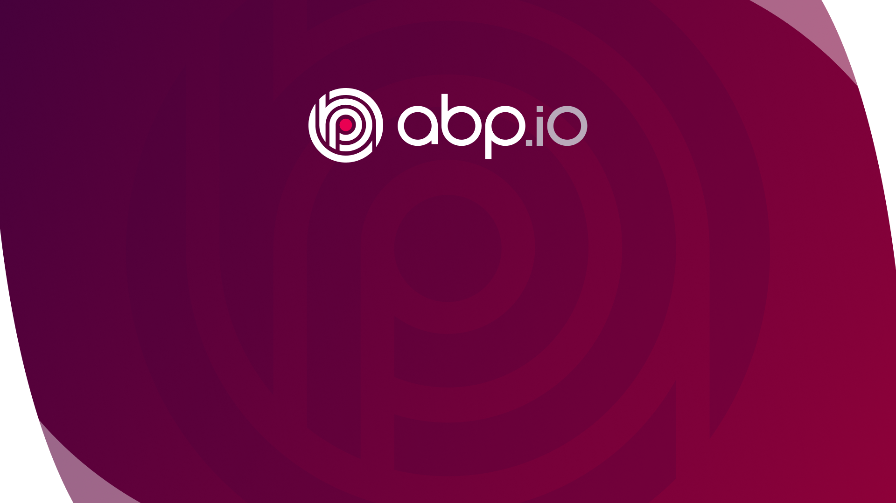
Welcome to ABP Community Talks
Alper EBICOGLU
Notes:
Hi everyone,
Welcome to the ABP Community Talks, the very first meeting!
I’m Alper, from the ABP development team,
And today, we will talk about brand new staff at ABP 5.
We are excited to give some insights about the ABP Framework and tell you about what we are up to.
This is our first online meet up and if we get enough attraction we're planning to move this on with the next episodes.
We’re planning this session to make it for 1,5 hour and I hope you will enjoy it.

Slide 2
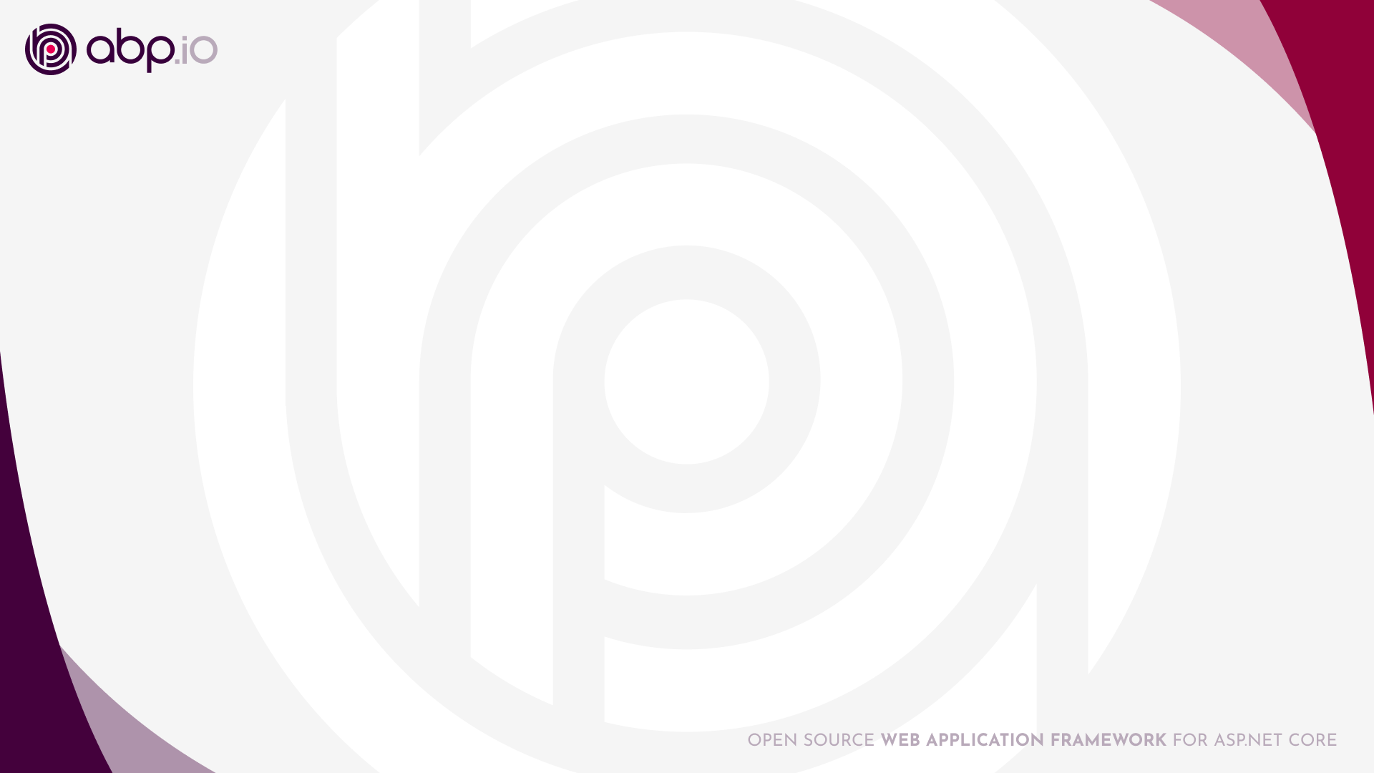
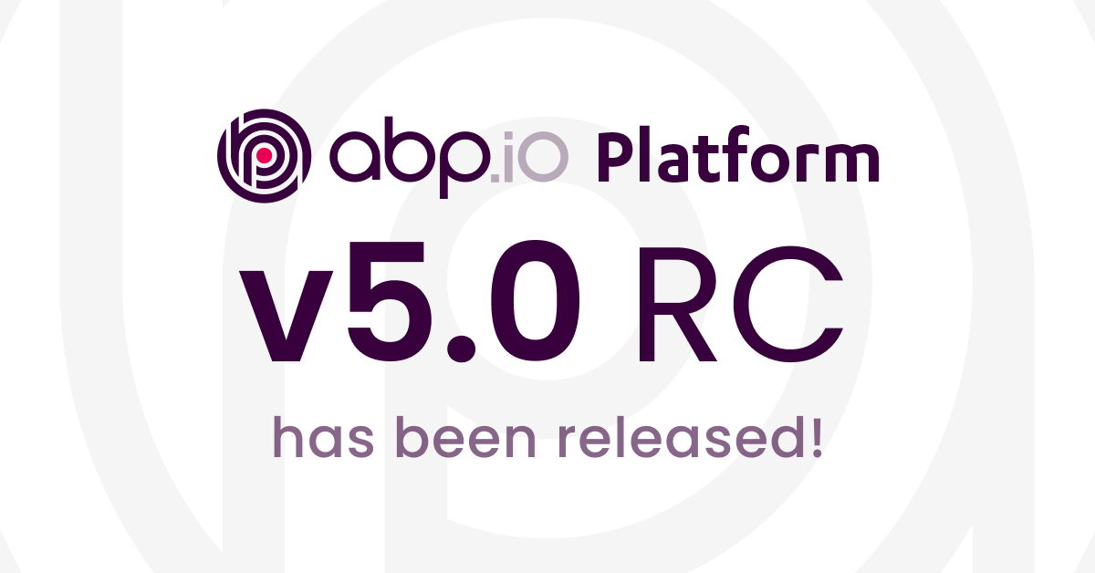
ABP 5.0.0 released (.NET 6 , Angular 12 , Bootstrap 5)
Blog post https://blog.abp.io/abp/ABP-IO-Platform-5.0-RC-1-Has-Been-Released
Create a new project with ABP CLI tool https://docs.abp.io/en/abp/latest/cli or directly from https://abp.io/get-started
Notes:
Well, as some of you may know, we’ve just released ABP version 5 which comes with great features with .NET6, Angular 12 and Bootstrap 5.
So, if you haven’t installed it, you can install the latest stable version and check out the blog post at blog.abp.io.
I'll go over this document shortly and tell you what’s new and what’s changed in the new version.
As you know you can create a new project with ABP CLI tool or directly from abp.io/get-started web page
And let us know what you think in the comments.
We’ll try to answer your questions at the end.

Slide 3
Agenda
👉 Outbox / Inbox patterns | Halil Ibrahim KALKAN
Static C# and JavaScript proxies | Ahmet COTUR
Angular UI changes & news | Mehmet ERIM
eShopOnAbp | Galip Tolga ERDEM & Enis NECIPOGLU
The new ABP theme: Lepton X | Bunyamin COSKUNER
Breaking changes & migration guide | Alper EBICOGLU
ABP community news | Alper EBICOGLU
Notes:
Today we are going to cover 7 topics... And each session will be presented by a different member of the team.
First we’ll start with;
1- Outbox/inbox patterns: As you know Outbox Inbox pattern solves the transactional event publishing problem for distributed systems. Halil will explain this pattern to you in detail and show how we solved it in ABP, with an example scenario.
2- and Ahmet will talk about ABP static C# and Javascript proxies.
3- then Mehmet from the ABP Angular Team will tell us the new Angular UI changes and news
4- after that Galip and Enis will describe you what's eShopOnAbp
5- later on Bunyamin from the ABP Angular Team will mention you about our new theme
6- And lastly I’ll explain some of the important breaking changes with ABP 5 and how you can migrate to the latest version
and I’ll share some community links and news about us…
So let’s start with Halil…Yes Halil, you can show us this cool pattern.

Slide 4
Agenda
Outbox / Inbox patterns | Halil Ibrahim KALKAN
👉Static C# and JavaScript proxies | Ahmet COTUR
Angular UI changes & news | Mehmet ERIM
eShopOnAbp | Galip Tolga ERDEM & Enis NECIPOGLU
The new ABP theme: Lepton X | Bunyamin COSKUNER
Breaking changes & migration guide | Alper EBICOGLU
ABP community news | Alper EBICOGLU
Notes:
2- Static C# and JavaScript Proxies: Ahmet will introduce you the static C# and JavaScript proxies.
Now, let's have your say Ahmet!

Slide 5
Agenda
Outbox / Inbox patterns | Halil Ibrahim KALKAN
Static C# and JavaScript proxies | Ahmet COTUR
👉Angular UI changes & news | Mehmet ERIM
eShopOnAbp | Galip Tolga ERDEM & Enis NECIPOGLU
The new ABP theme: Lepton X | Bunyamin COSKUNER
Breaking changes & migration guide | Alper EBICOGLU
ABP community news | Alper EBICOGLU
Notes:
3- Angular UI changes & news :
As you know Angular 12 is there.
We updated our templates to Angular 12.
While the Angular has its own enhancements, we also improved our Angular UI templates.
Mehmet will introduce you the new things about Angular changes.
So Mehmet, we are listening to you.

Slide 6
Agenda
Outbox / Inbox patterns | Halil Ibrahim KALKAN
Static C# and JavaScript proxies | Ahmet COTUR
Angular UI changes & news | Mehmet ERIM
👉eShopOnAbp | Galip Tolga ERDEM & Enis NECIPOGLU
The new ABP theme: Lepton X | Bunyamin COSKUNER
Breaking changes & migration guide | Alper EBICOGLU
ABP community news | Alper EBICOGLU
Notes:
4- eShopOnAbp: Developing a microservice solution is hard! We get many questions about the practices of developing a microservice project. eShopOnAbp is a showcase on how to organize things with a microservice architected solution on top of ABP. In the this session, Enis and Galip will explain you why they need to create a new microservice sample project.
So Galip, What’s eShopOnAbp?

Slide 7
Agenda
Outbox / Inbox patterns | Halil Ibrahim KALKAN
Static C# and JavaScript proxies | Ahmet COTUR
Angular UI changes & news | Mehmet ERIM
eShopOnAbp | Galip Tolga ERDEM & Enis NECIPOGLU
👉The new ABP Theme: Lepton X | Bunyamin COSKUNER
Breaking changes & migration guide | Alper EBICOGLU
ABP community news | Alper EBICOGLU
Notes:
5- Lepton X: As you know we have been developing Lepton Theme since the first versions of ABP.
And now we are excited to announce our new theme LeptonX .
Bunyamin from the ABP Angular team will tell us the new theme.
Ok @Bunyamin, What will you tell us about this new theme?

Slide 8
Agenda
Outbox / Inbox patterns | Halil Ibrahim KALKAN
Static C# and JavaScript proxies | Ahmet COTUR
Angular UI changes & news | Mehmet ERIM
eShopOnAbp | Galip Tolga ERDEM & Enis NECIPOGLU
The new ABP theme: Lepton X | Bunyamin COSKUNER
👉Breaking changes & migration guide | Alper EBICOGLU
👉ABP community news | Alper EBICOGLU
Notes:
6-Breaking Changes & Migration Guide: I’ll explain some of the important breaking changes with ABP 5 and how you can migrate to the latest version.
7-ABP Community News: And lastly, I’ll share some community links and news about us…

Slide 9
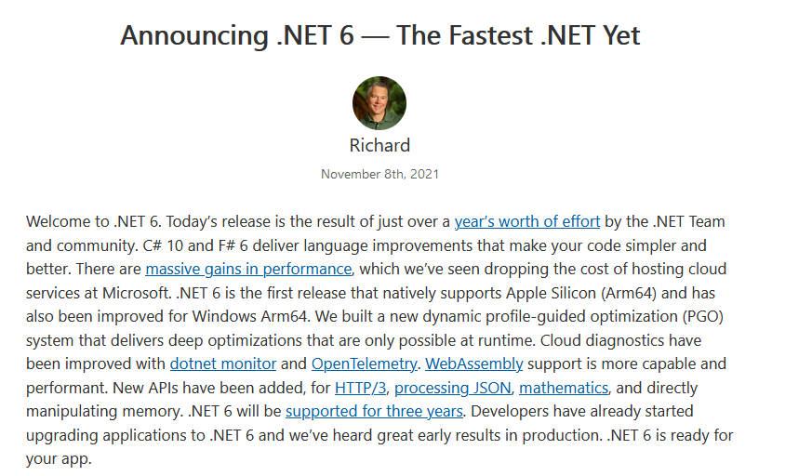
.NET 6
https://devblogs.microsoft.com/dotnet/announcing-net-6/
Notes:
Microsoft just shipped the .NET 6 framework.
.NET 6 comes with many features and updates. Hot reload improvements, RyuJIT compiler, runtime performance boosts, and early builds of MAUI which is the new generation of the Xamarin project.
The major update coming with ABP 5 is the .NET6 upgrade. We have adopted to .NET6 the stable version.,
And we have upgraded our templates and all libraries to .NET 6.
And we are one of the first adopters of .NET6. Our abp.io websites have been running on .NET6 since the first preview version…
Check out the Richard’s blog post about .NET 6 features and enhancements…

Slide 10


ABP 4.x to 5.0 - Migration guide
.NET 6.0
ABP 5.0 runs on .NET 6.0 now. Upgrade your projects for targeting .NET 6.
See https://devblogs.microsoft.com/dotnet/announcing-net-6
Bootstrap 5
ABP 5.0 runs on the Bootstrap 5 as the fundamental HTML/CSS framework.
See https://blog.getbootstrap.com/2020/12/07/bootstrap-5-beta-1
Startup Template Changes
The startup template has changed.
See https://docs.abp.io/en/abp/5.0/Migration-Guides/Upgrading-Startup-Template
Notes:
If you are planning to migrate from ABP 4 to 5 there are some changes, I will briefly tell you about them.
First of all with .NET 6 upgrade, you need to install the latest Visual Studio 2022 (twenty-twenty two) or Rider 2021.3 (twenty-twenty one point three)
Bootstrap 5
As you may know Bootstrap 5 the stable version has been released on May 5.
In this new version, there are some breaking changes:
As a major change from the previous versions, jQuery is no longer a dependency of Bootstrap
RTL support has been added
Internet Explorer 10 and 11 support dropped
New responsive font came
And the package is lighter now
There are new APIs are available
Also some classes are dropped. There are replacements or ways to achieve the same result. Like data-* attributes transformed to data-bs-*..
In the new ABP templates we have applied these changes and successfully migrated to Bootstrap 5.
Check out the Bootstrap’s blog post for more information.
ABP 5.0 uses the Bootstrap 5 as the fundamental HTML/CSS framework. We've migrated all the UI themes, tag helpers, UI components and the pages of the pre-built application modules. You may need to update your own pages by following the Bootstrap's migration guide.
Startup Template Changes
The startup template has changed. You don't need to apply all the changes, but it is strongly suggested to follow this guide and make the necessary changes for your solution.

Slide 11
ABP 5.0 - Migration guide
MongoDB
ABP Framework will serialize the datetime from now on.
You can revert back this behavior:
Publishing Auto-Events in the Same Unit of Work ( GitHub #9896)
Deprecated (GitHub #9897)
EntityCreatingEventData
EntityUpdatingEventData
EntityDeletingEventData
EntityChangingEventData
Removed ModelBuilderConfigurationOptions classes (GitHub #8887)
Notes:
MONGODB
ABP Framework will serialize the datetime based on AbpClockOptions starting from ABP v5.0. It was saving DateTime values as UTC in MongoDB. Check out MongoDB Datetime Serialization Options.
If you want to revert back this feature, set UseAbpClockHandleDateTime to false in AbpMongoDbOptions:
Publishing Auto-Events in the Same Unit of Work
Local and distributed auto-events are handled in the same unit of work now. That means the event handles are executed in the same database transaction and they can rollback the transaction if they throw any exception. The new behavior may affect your previous assumptions. See #9896 for more
Deprecated EntityCreatingEventData, EntityUpdatingEventData, EntityDeletingEventData and EntityChangingEventData
As a side effect of the previous change, EntityCreatingEventData, EntityUpdatingEventData, EntityDeletingEventData and EntityChangingEventData is not necessary now, because EntityCreatedEventData, EntityUpdatedEventData, EntityDeletedEventData and EntityChangedEventData is already taken into the current unit of work. Please switch to EntityCreated / Updated / Deleted / Changed EventData if you've used the deprecated events. See #9897 to learn more.
Removed ModelBuilderConfigurationOptions classes
If you've used these classes, please remove their usages and use the static properties to customize the module's database mappings. See #8887 for more.

Slide 12
ABP 5.0 - Migration guide
Removed Obsolete APIs
IRepository doesn't inherit from IQueryable anymore. It was made obsolete in 4.2.
Automatically Setting the TenantId for New Entities
ABP will automatically set the TenantId property from the current active tenant.
Other Breaking Changes
IObjectValidator methods have been changed to asynchronous. #9549
Use ASP NET Core's authentication scheme to handle AbpAuthorizationException. #9940
Use IRemoteContentStream without form content headers. #9180
Notes:
Removed Obsolete APIs
IRepository doesn't inherit from IQueryable anymore. It was made obsolete in 4.2.
Automatically Setting the TenantId for New Entities
Beginning from the version 5.0, ABP automatically sets the TenantId for you when you create a new entity object (that implements the IMultiTenant interface). It is done in the constructor of the base Entity class (all other base entity and aggregate root classes are derived from the Entity class). The TenantId is set from the current value of the ICurrentTenant.Id property.
This can be a breaking change in rare cases (for example, if you create host side entities from a tenant context and do not explicitly set host entity's TenantId to null).
Other Breaking Changes
#9549 IObjectValidator methods have been changed to asynchronous.
#9940 Use ASP NET Core's authentication scheme to handle AbpAuthorizationException.
#9180 Use IRemoteContentStream without form content headers.

Slide 13
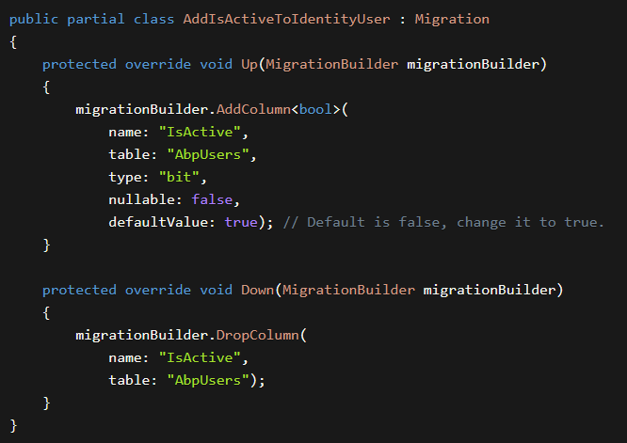
ABP 5.0 - Migration guide
User Active/Passive
IsActive <bool> property is added to the IdentityUser entity.
UPDATE AbpUsers SET IsActive=1
EF Core
MongoDB
Notes:
User Active/Passive
An IsActive <bool> property is added to the IdentityUser entity. This flag will be checked during the authentication of the users.
EF Core developers need to add a new database migration and update their databases.
After the database migration, set this property to true for the existing users: UPDATE AbpUsers SET IsActive=1. Otherwise, none of the users can login to the application.
Alternatively, you can set defaultValue to true in the migration class (after adding the migration). This will add the column with true value for the existing records.
For MongoDB, you need to update the IsActive field for the existing users in the database.
You can use following script in MongoShell:
db.AbpUsers.updateMany({},{$set:{ IsActive : true }})

Slide 14
ABP 5.0 - Migration guide
UI Migration Guides
https://docs.abp.io/en/abp/5.0/Migration-Guides/Abp-5_0-Angular
https://docs.abp.io/en/abp/5.0/Migration-Guides/Abp-5-0-MVC
https://docs.abp.io/en/abp/5.0/Migration-Guides/Abp-5-0-Blazor
See the ABP 5.0 migration guide => http://docs.abp.io/en/abp/5.0/Migration-Guides/Abp-5_0
Notes:
UI Providers
Angular UI 4.x to 5.0 Migration Guide
ASP.NET Core MVC / Razor Pages UI 4.x to 5.0 Migration Guide
Blazor UI 4.x to 5.0 Migration Guide

Slide 15
Community news
Notes:
I have some news about us and I have got community links for you..
You can ask questions in the chat, after this session, I will jump in to those and then we’ll head over to Halil for the Question & Answers section.

Slide 16
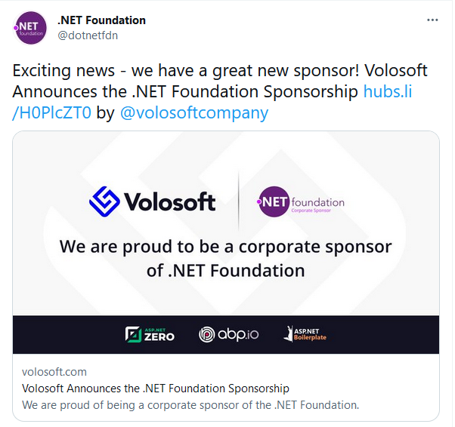
.NET Foundation Sponsorship
Notes:
We are really happy to be one of the sponsors of the .NET Foundation.
We are proud to support other open source projects by being a corporate sponsor.

Slide 17
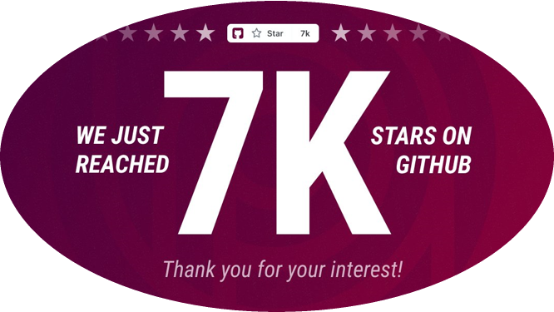
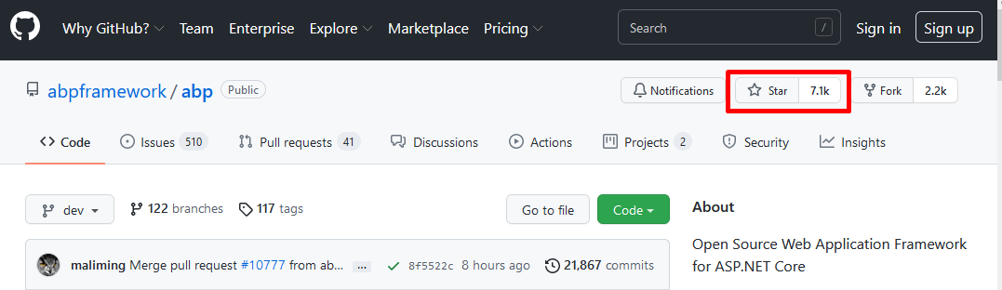
ABP Reaches 7K Stars
Notes:
The other thing I want to say is we knocked over 7 thousands stars on GitHub.
This shows how fast our community is growing.
Thank you for this to all our audience.

Slide 18
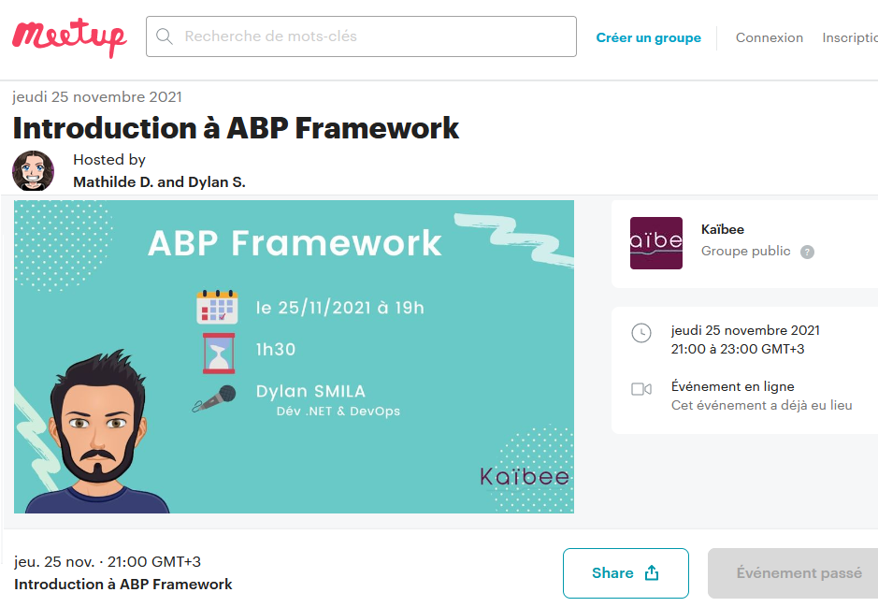
ABP Community Grows
https://www.meetup.com/fr-FR/kaibee/events/281712081/
-- Thanks to Dylan SMILA --
Notes:
And I told you that our community is growing fast.
In this regard, events are also held around the world.
Dylan SMILA gave a presentation on introduction to ABP in Paris.
Thanks to Dylan for his session.

Slide 19
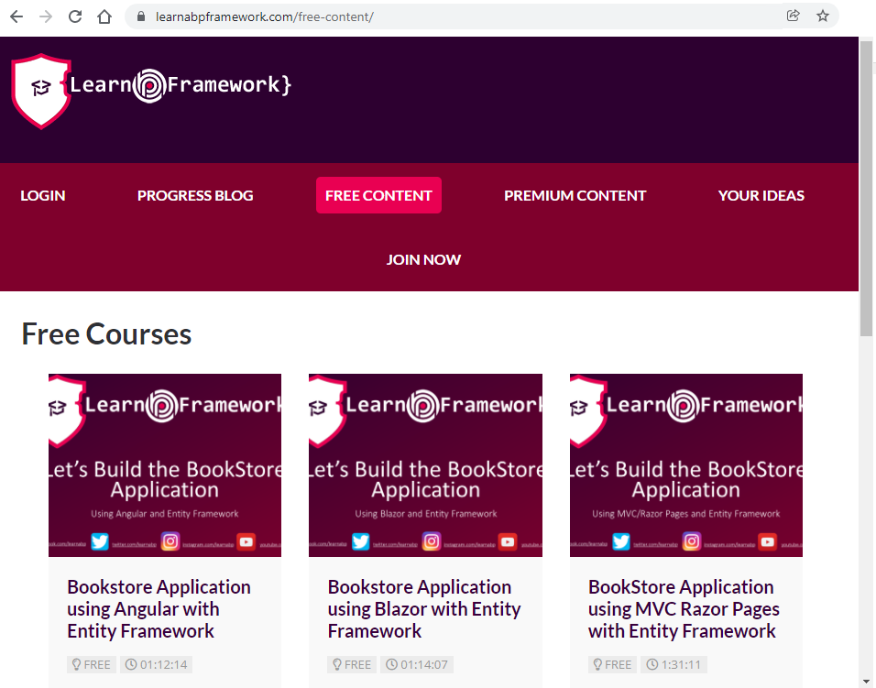
https://learnabpframework.com
Notes:
Our members regularly ask video courses…
I know how useful video courses are.
LearnABPFramework.com helps you here.
I’d like to say it’s doesn’t belong to ABP.io platform, one of our community members created this website
It provides paid and free ABP Framework trainings.
It provides premium screencasts and build applications and modules.
Go check out LearnABPFramework.com !

Slide 20
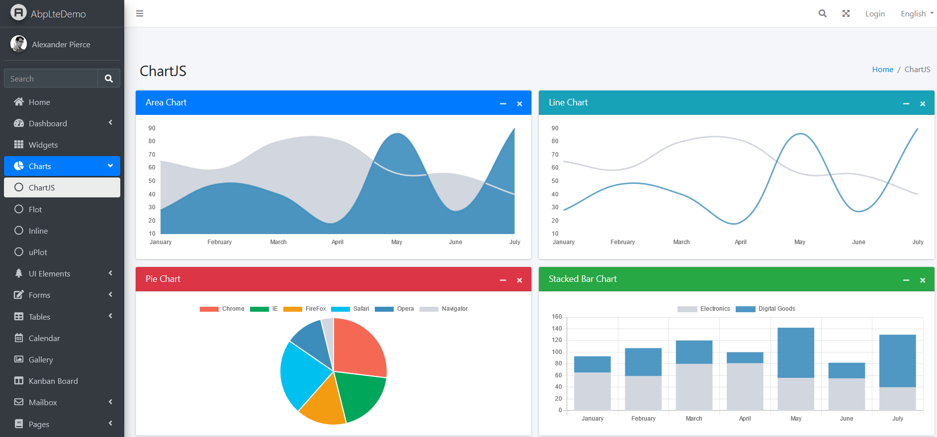
ABP AdminLTE Theme
https://github.com/go2ismail/ABP-Framework-Theme-Using-AdminLTE3-Template
Notes:
Ismail from Indonesia, dressed the AdminLTE theme on ABP application template.
You can check out his work from his GitHub repository.
Paid theme
https://codelib.app/gojazz-abp-framework-theme-in-asp-net-core-5-x-x-razor-pages

Slide 21
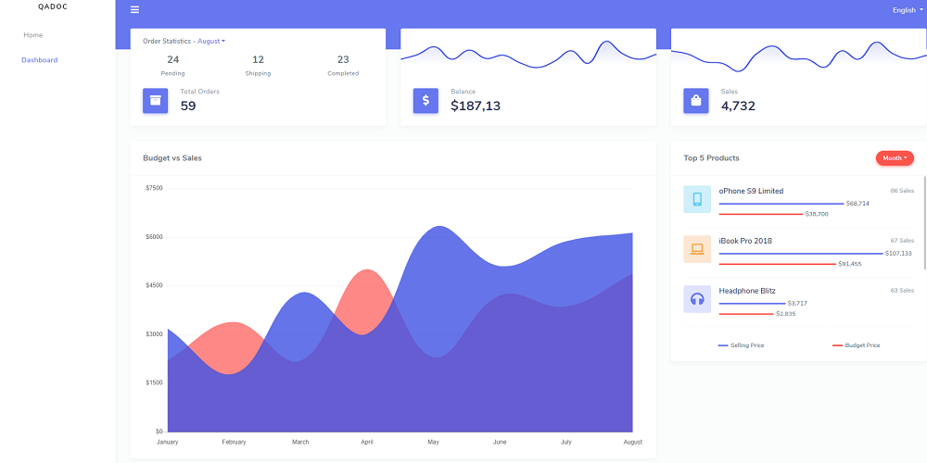
ABP Stisla Theme
Bootstrap-based admin template: https://getstisla.com/
ABP Implementation: https://github.com/realLiangshiwei/Lsw.Abp.AspNetCore.Mvc.UI.Theme.Stisla
Notes:
Another template implementation is Stisla Template.
It’s a bootstrap based admin template and Liang from China dressed ABP Framework with this template
Go check out his work on https://github.com/realLiangshiwei/Lsw.Abp.AspNetCore.Mvc.UI.Theme.Stisla

Slide 22
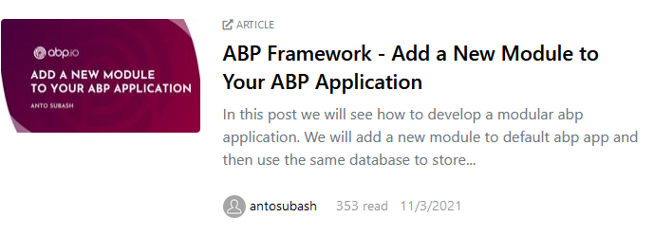
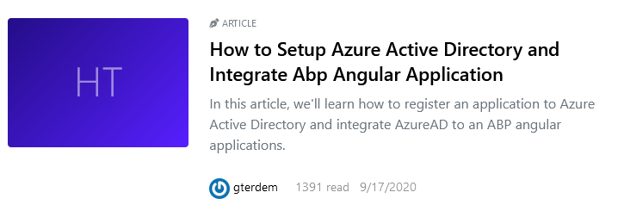
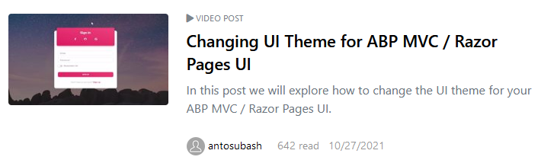
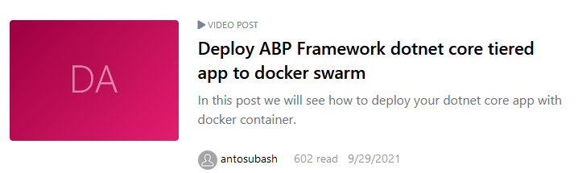
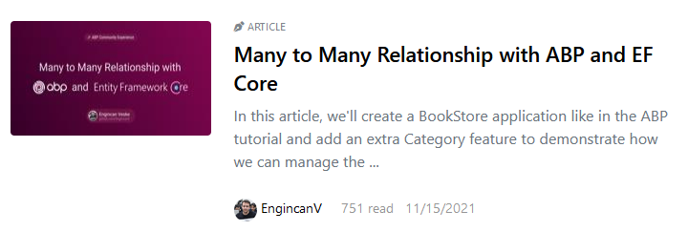
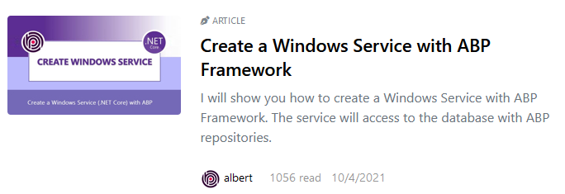
https://community.abp.io
Notes:
And we have lots of ABP Community articles and videos.
As you know community.abp.io

Slide 23
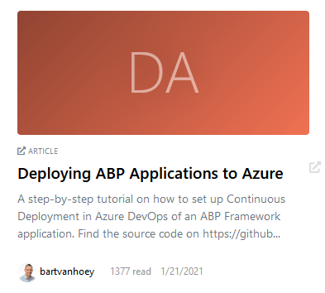
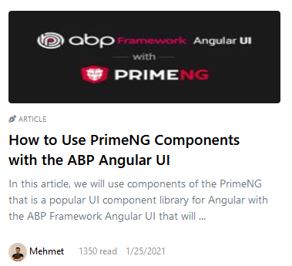
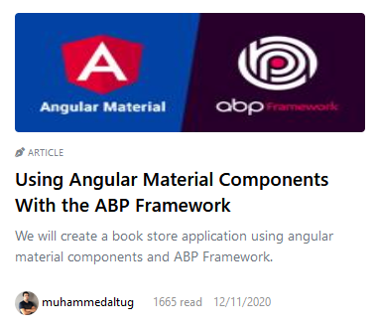
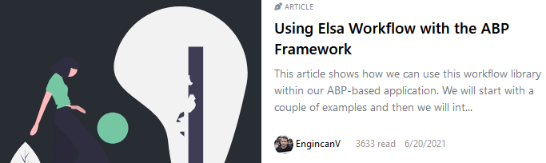
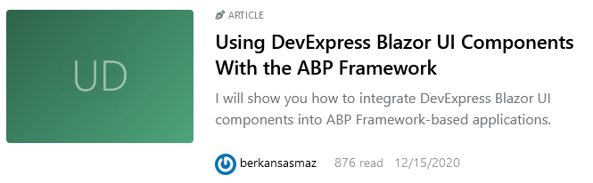
https://community.abp.io
Notes:
And we have lots of ABP Community articles and videos.
As you know community.abp.io

Slide 24
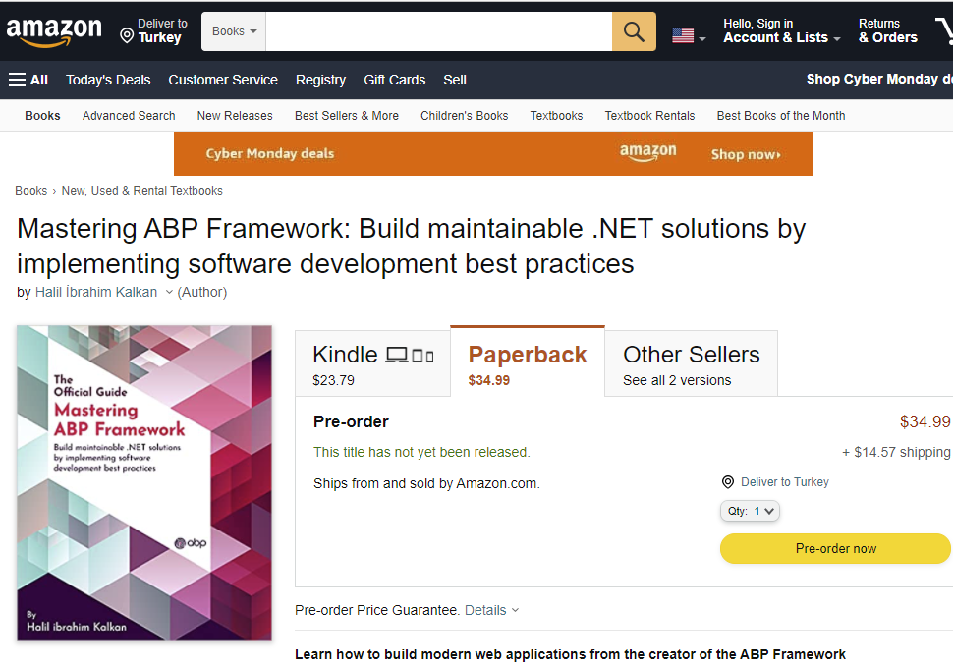
Official Book of ABP
A complete guide to start working with the ABP Framework, explore the ABP features and concepts. and it is on presale.
https://www.amazon.com/Mastering-ABP-Framework-maintainable-implementing-dp-1801079242/dp/1801079242
Notes:
Halil the lead developer has been writing a book for the ABP Framework.
Mastering ABP Framework is a complete guide to start working with the ABP Framework
In this book, you can see the fundamentals of ABP Framework and learn how to implement software development with best practices.
It’s on presale.

Slide 25
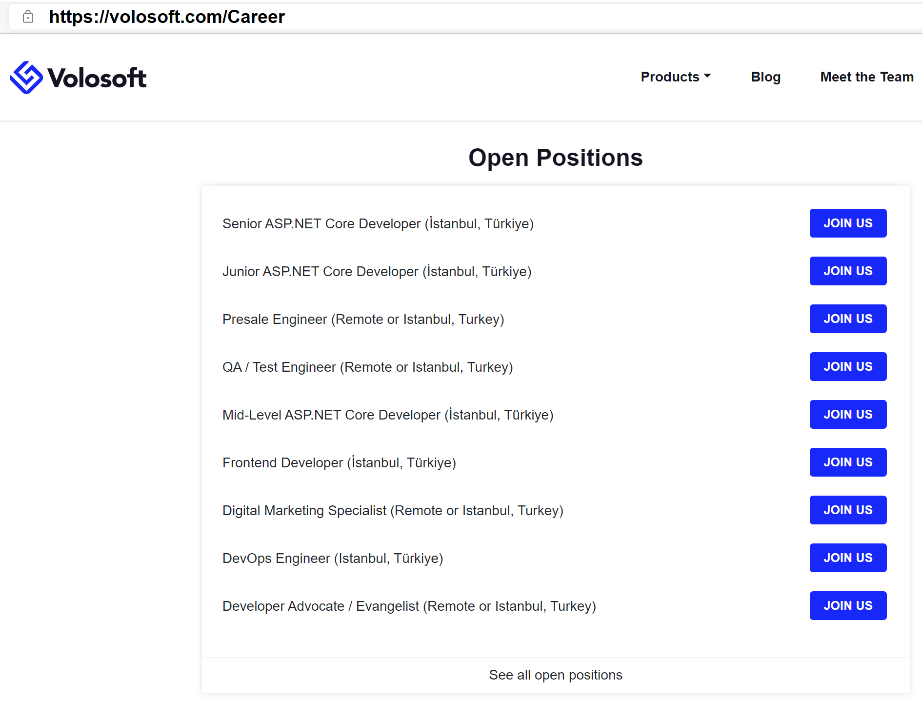
We are hiring
Visit
volosoft.com/Career
Send your CV to
hr@volosoft.com
Notes:
And I have an announcement.
As our community is getting bigger, we want to write more articles, video courses and tutorials.
Therefore we are hiring a developer advocates, .NET Developers, DevOps Engineer and Angular Developers
To apply, please send an email, attached your formal CV to hr@volosoft.com

Slide 26
Questions Answers
You can find all the links I shared at
https://bit.ly/community-talk-1
Notes:
Thank you for listening and taking the time to listen to us.
If you have questions we would like to answer them.

