Slide 1
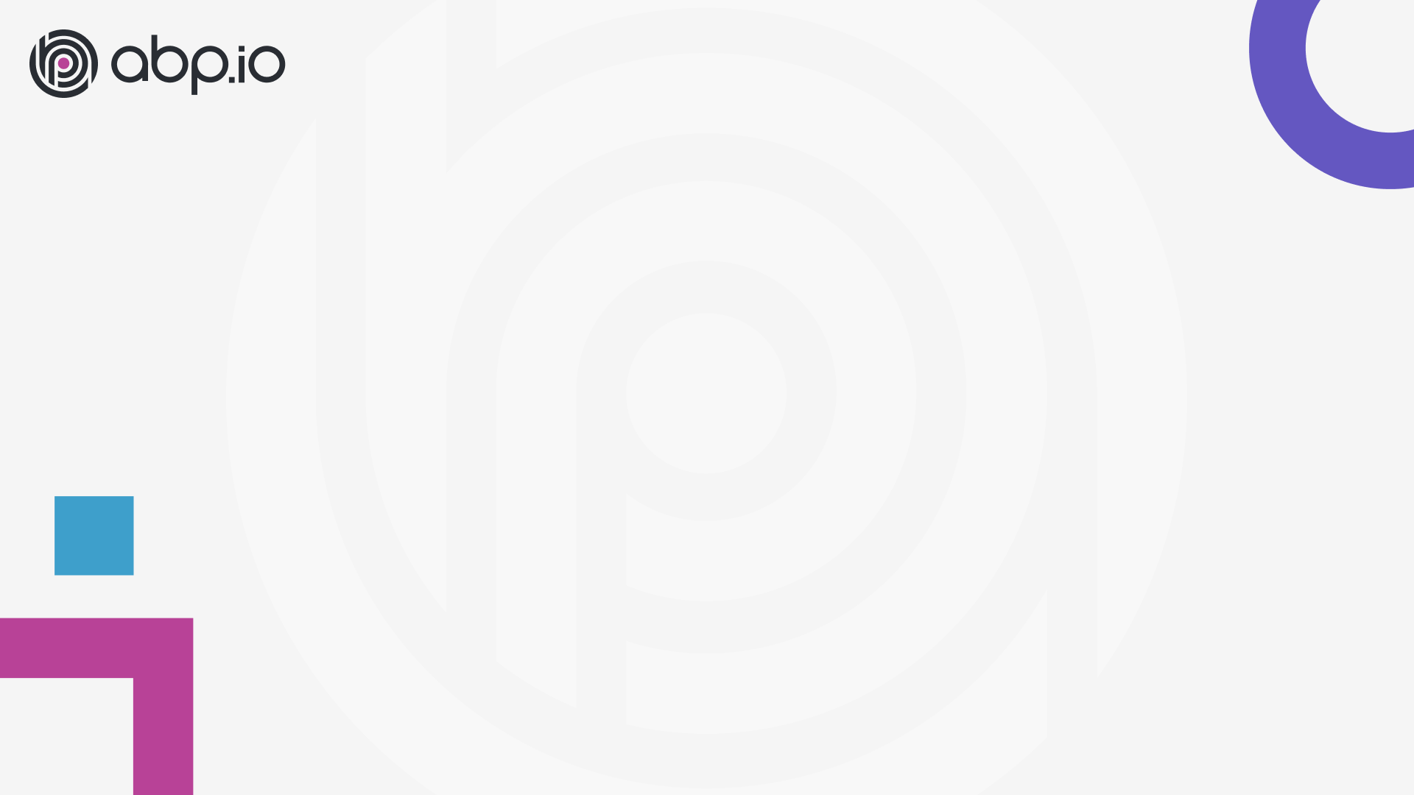
ABP Community Talks 2022.2
Alper EBICOGLU
Notes:
Hello everyone,
Good morning, good afternoon or good evening whatever the timezone you’re in…
I’m Alper, from the ABP development team,
I'm happy to have Bunyamin and Enis from the ABP Team.
And today, we're here to talk about ABP’s new theme LeptonX.
We got lots of positive attractions from the community for our past community talks and we’re planning to continue these series..
I’m excited to give some updates about the ABP Platform as well….
if you have specific topics on your mind for the next episodes, you can write your thoughts to the chat section.
We’re planning this session to make it for 1 hour and I hope you will enjoy it.

Slide 2

Community news
Notes:
I have some news about us and I have got community links for you..
You can ask questions in the chat, after this session,

Slide 3
Questions Answers
Notes:
Thank you for listening and taking the time to listen to us.
If you have questions we would like to answer them.

