Slide 1
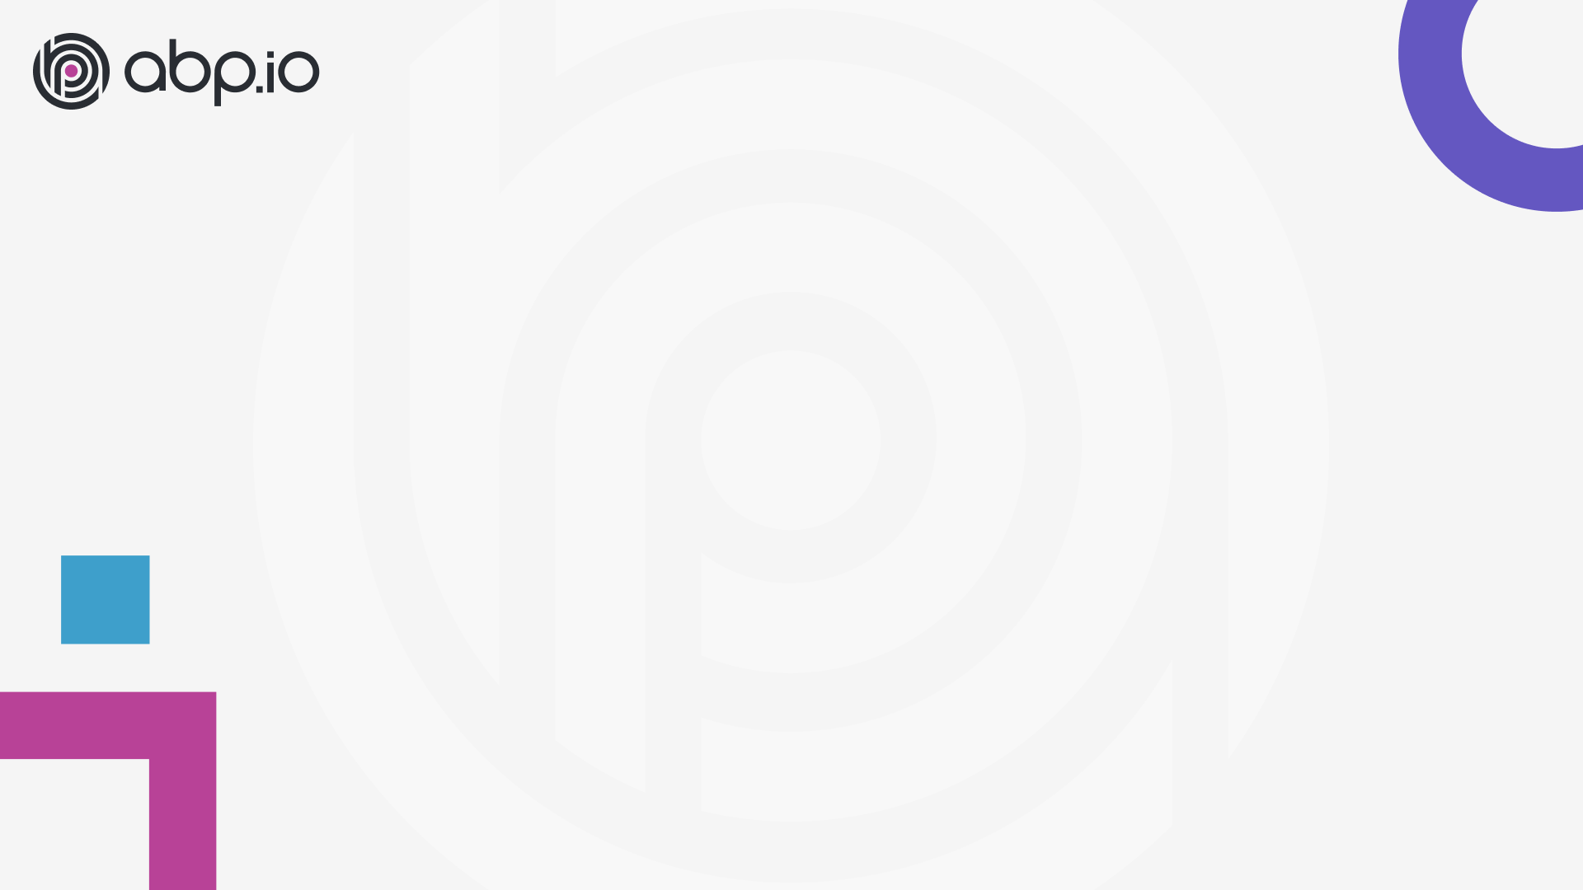
ABP Community Talks 2022.3
Alper EBİÇOĞLU
Notes:
Hello everyone,
Thank you so much for watching our talk today.
And I hope wherever you are you’re doing well.
I’m Alper Ebiçoğlu, from the ABP development team,
And this is our 3rd ABP community event and thanks to Jon, Lee and Anto for joining us today’s show.
I’m excited to give some updates about the ABP Platform.
And if you have specific topics on your mind for the next episodes, you can write your thoughts to the chat section.
Also if you have any questions about this session, you can also write them to the chat.

Slide 2

Community news
Discord channel: https://discord.gg/abp
Notes:
The first news of ABP; is our new Discord Channel.
We created a Discord channel to help community fellows interact with each other.
And most likely, ABP members share ideas, tips, and questions, ask for help, showcases and ABP related jobs here.
It’s a good place to interact with other ABP developers.
Although it has been a short time since we opened the channel, we are already 500 people.
I’ll share the Discord channel join link in the chat. Also, We will add this link under this video.
https://discord.gg/abp

Slide 3
ABP v5.2.0: New release new contributors
Community news
Discord channel: https://discord.gg/abp
Notes:
https://github.com/abpframework/abp/releases
We have recently released the stable version of ABP 5.2 (five point two).
On GitHub release page, you can see all the closed issues in this version here.
As you can see, a bunch of issues has been resolved and closed.
Here we have new contributors in this release. So thanks to;
@maxijabase Maximiliano Jabase (Maksimilyano Habeyz)
@mahmut-gundogdu Mahmut Gündoğdu
@malikmasis Malik Masis
@hpfan haiping fan (Hayping Fen)
made their first contributions to the framework.

Slide 4
ABP v5.2.0: New release new contributors
Community news
Discord channel: https://discord.gg/abp
What’s new with this version? 5.2.0 Blog Post
Notes:
I will briefly go over the new version’s blog post
Single-layer Solution Template:
As you know, ASP.NET created a minimal API template and the main motivation for creating such a template, was when someone who starts the very first application with .NET shouldn’t see a complex structure with 20 files in an empty project, this was leading the new developer to think it was very complex.. A similar motivation is here on the ABP side.. Previous ABP project templates had several project layers. We created a new project type called “Single Layer Solution” which is a merge of all layers into a single project. The feature set is the same as other ABP application templates. But in this new template, there’s only one project that’s why it’s very fast in terms of building and running in Visual Studio. This project type is ideal for small-scaled and minimum maintenance required projects. As this project type doesn’t have a DbMigrator app, you can run “dotnet run --migrate-database” to create/update your DB This new template supports MVC (default), Angular and Blazor Server UI options and for the database Entity Framework Core + MongoDB.
You can check out Hamza’s video tutorial about developing a minimalist application based on Single Project Application Template.
https://community.abp.io/posts/developing-a-minimalist-application-with-the-abp-framework-mvad01ca
API Versioning
ABP adds additional features and shortcuts on top of the ASP.NET’s API versioning library. This feature was already done but not documented. With this new release, we have documented how to implement API versioning for your ABP applications.
libs Folder Has been Removed from Source Control
As you know the LIBS folder is where your client-side packages (mostly JavaScript and CSS) files are located.
Until this version, the LIBS folder was included in all the project types.
With version 5.2, we have ignored the LIBS folder from source-control and removed it. We removed this folder to reduce the project size.
By removing the lib folder the project size decreased by -97% an amazing save on the network traffic.
To install the client side packages, just run “abp install-libs” in the UI project's root directory. When you create a new project via ABP CLI, it automatically installs the libs folder, but it’ll be excluded in the .gitignore file
so when your team members fetch the source-code, they should also run “abp install-libs” command.
Hiding the Default ABP Endpoints from Swagger UI
We added a new option to the ABP Swagger library to exclude ABP’s official endpoints in Swagger UI. The ABP endpoints are still functional but hidden from Swagger UI. By enabling this feature, you’ll only see your custom built API endpoints.
This will help you to create Swagger documentation only for your own endpoints. Engincan Veske has written an article about how to use this new feature
https://community.abp.io/posts/how-to-hide-abp-related-endpoints-on-swagger-ui-mb2w01fe
Custom Global CSS and JavaScript for the CMS Kit module
As some of you may know, ABP has a CMS module to create your own website with CMS features enabled.
We added a new page to let you write custom JavaScript and CSS code to customize your application look and behavior without compiling the project. It just runs on runtime.. And it’s being applied immediately to all your pages.
Other news
We are using Blazorise in our Blazor templates. We upgraded the Blazorise library to v1.0
What's New with ABP Commercial 5.2?
For the commercial side, all the framework features I explained here, are also available including the Single Solution Layer (PRO) template.
Many to Many Relations on Code Generation
As you know, ABP Suite is our CRUD page generator RAD Tool.
We added the most wanted feature to ABP Suite.
It has been generating only one to many relationship CRUD pages.
Now it has the ability to generate many to many relationship, so that users can pick multiple items for a record.
For example an invoice can have multiple detail lines. The new feature is available with the "Add navigation collection“ button.

Slide 5
ABP v5.2.0: New release new contributors
Community news
Discord channel: https://discord.gg/abp
What’s new with this version? 5.2.0 Blog Post
Community shares
Notes:
Community Shares
Community.abp.io is becoming a more and more content-rich site day by day.
I will share with you some newly added community articles and video tutorials since last month.
1- MudBlazor is a Blazor Component Library and Ahmet Urel submitted a series of articles that shows the integration of MudBlazor library with the ABP Framework Blazor UI
https://community.abp.io/posts/mudblazor-theme-in-abp-blazor-webassembly-ae23zz17
2- As you know .NET MAUI is becoming more popular day by day and both Enish Neciplioglu and Bart Van Hoey has created articles about .NET MAUI and the ABP Framework.
Enis has also created an article to demonstrate how to use his own open source AutoFilterer library with the ABP Framework.
Enis -> https://community.abp.io/posts/integrating-maui-client-via-using-openid-connect-aqjjwsdf
Bart Van Hoey -> https://community.abp.io/posts/abp-framework-consumed-by-a-.net-maui-app-e74fmblw
3- “Enes Sadık Özbek” has written 2 articles. First one is about integrating a zero trust microservice architecture with ABP Framework.
Zero trust refers to a security model where you never implicitly trust a device or service and always verify them.
Second one is creating a Discord bot with .NET and ABP Framework. https://community.abp.io/posts/zero-trust-microservice-architecture-with-abp-framework-xpiz9nvh
https://community.abp.io/posts/creating-a-discord-bot-with-.net-and-the-abp-framework-usxl4e1k
4- Jonathan Potts has created his first ABP Community article that shows how to use Bootswatch themes with the ABP Framework.
https://community.abp.io/posts/customizing-the-abp-basic-theme-with-bootswatch-4luoqzr0
5- “Anto Subash” has created a series of video tutorial to show us how to create a .NET Core microservice solution with ABP.
https://community.abp.io/posts/.net-core-microservice-application-with-abp-initial-setup-part-1-v86sa21b
4- learnabpframework.com is providing educational contents for ABP. He shows how to build ToDoApp on ABP Framework MVC/Razor Pages. It is the video version of tutorial on docs.abp.io.
https://community.abp.io/posts/quick-start-build-todoapp-bbvqxo5b
5- “Kori Francis” wrote an article on integrating WPF template with an ABP solution. ABP has a WPF template, but he is describing how to create a more advanced WPF application with ABP.
https://community.abp.io/posts/how-to-integrate-wpf-template-with-an-abp-solution-including-tests-9qp7ei16
Thanks to all contributors. If you want to submit your article or video post, you can share your knowledge with the ABP community. Go to https://community.abp.io/posts/submit
You can ask questions in the chat, after this session,

Slide 6
That’s all from me ☺
Notes:
Community Shares
Community.abp.io is becoming a more and more content-rich site day by day.
I will share with you some newly added community articles and video tutorials since last month.
1- MudBlazor is a Blazor Component Library and Ahmet Urel submitted a series of articles that shows the integration of MudBlazor library with the ABP Framework Blazor UI: Part 1, Part 2 and Part 3.
As you can see, he explains the integration in detail.
2- “Anto Subash” has created a series of video tutorial to show us how to create a .NET Core microservice solution with ABP.
3- “Enes Sadık Özbek” has written 2 articles. First one is about integrating a zero trust microservice architecture with ABP Framework.
Zero trust refers to a security model where you never implicitly trust a device or service and always verify them.
Second one is creating a Discord bot with .NET and ABP Framework.
4- learnabpframework.com is providing educational contents for ABP. He shows how to build ToDoApp on ABP Framework MVC/Razor Pages. It is the video version of tutorial on docs.abp.io.
5- As you know .NET MAUI is trending and both Enish Neciplioglu and Bart Van Hoey has created articles about .NET MAUI and the ABP Framework. Enis has also created an article to demonstrate how to use his own open source AutoFilterer library with the ABP Framework.
Jonathan Potts has created his first ABP Community article that shows how to use Bootswatch themes with the ABP Framework. See it here.
Thanks to the contributors. If you want to submit your post (this can be article or video tutorial) you can share your knowledge with the ABP community. Go to https://community.abp.io/posts/submit
You can ask questions in the chat, after this session,

