Slide 1


How to contribute to the ABP Framework?
Alper EBİÇOĞLU
/ alperebicoglu
Notes:
And hello everyone!
Welcome to the ABP Community Talk number 4.
I’m Alper, from the ABP development team,
So happy seeing everyone checking-in from all over the world, it’s great, we have a global community.
And this time, we will focus on how to contribute to the ABP Framework…
We’re planning this session to make it for 1 hour and I hope you will enjoy it.

Slide 2

Agenda
@Malik (ABP team member)
4Why is the ABP community important?
4What are the expectations from the ABP community?
@Ismail (ABP Community member)
4How he has contributed to the framework?
4Showcase of his contributions to the ABP Framework
@Hamza (ABP team member)
4Forking, building solution, sending PRs and creating issues?
4A quick contribution: Fixing a typo in the documentation.
4Localizing framework, modules and startup templates to another language?
4Translating ABP documents?
4How to share ABP related contents?
@Malik (ABP team member)
4ABP on other platforms: StackOverflow, GitHub issues/discussions, Discord
4Discussing ABP-related topics.
Notes:
This the highlights of the today’s talk
Today we have Malik , Ismail and Hamza.
Ismail is one of the ABP contributors, he has made several contributions to the framework. So we’re hosting him today.

Slide 3
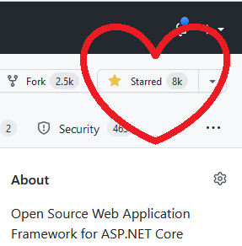
GitHub stars matter! ABP reaches 8K stars
https://github.com/abpframework/abp
Notes:
I’ve a good news!
We have reached to 8.000 stars on GitHub.
Why it’s important, because it’s a social signal for open source projects, acting as a feedback loop for project creators.
It creates motivation for the creators to continue working on the project initially.
So thank you all for supporting us and make the community bigger.
And if you haven't given a star you can do it now

Slide 4
The Discord Channel is growing!
https://community.abp.io/discord
Notes:
We are seven hundred twenty six developers in the ABP discord channel right now
You can ask technical questions, share ideas, discuss ABP related topics and also find ABP developers to hire in this channel.
So join us at community.abp.io/discord

Slide 5
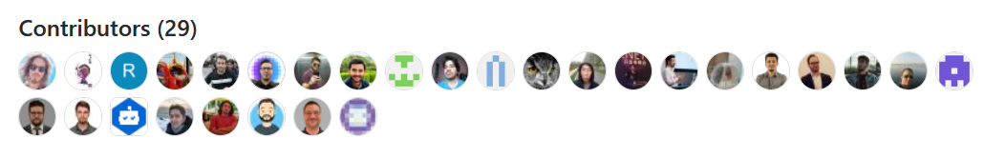
ABP v5.3.0 first preview published
V5.3.0-rc.1 has been published. https://github.com/abpframework/abp/releases
29 developers have been contributed to this version.
The stable version will be published on 2022-05-31.
LeptonX beta.1 published! Installation document:
https://docs.abp.io/en/abp/5.3/Themes/LeptonXLite/mvc
https://docs.abp.io/en/abp/5.3/Themes/LeptonXLite/blazor
https://docs.abp.io/en/abp/5.3/Themes/LeptonXLite/angular
Notes:
The new RC.1 is here and there's tons of great features and optimizations.
We have a very long list of closed issues in this version, both from the core team and the ABP community.
Thank you to all 29 developers involved in this release.
And the stable version is planned to be published on the last day of this month.
I’m gonna jump in to the RC blog post.

Slide 6
Questions?

