Slide 1


Overview: MAUI
Alper EBİÇOĞLU
/ alperebicoglu
Notes:
And hello everyone! Thank you for joining us today.
I see fellows who follow us regularly.
Thank you all for being a part of this community.
This time, I will talk about .NET MAUI… The next generation of Xamarin.

Slide 2

What’s .NET MAUI?
.NET Multi-platform App UI (.NET MAUI) is a framework for building modern, multi-platform, natively compiled iOS, Android, macOS, and Windows apps using C# and XAML in a single codebase.
Notes:
With .NET MAUI, you can build native applications from a single codebase for Android, iOS, macOS, Windows and Tizen which is backed by Samsung.
If you’ve used Xamarin Forms, MAUI will be very familiar to you. Instead of different projects for desktop, mobile, and each OS, all your code is in a single project.
Where Xamarin Forms was mobile only, MAUI adds support for desktop environments. There’s even the option of hosting Blazor in MAUI, with embedded web view controls to run Razor components natively on your target device.
The decoupled UI and single project enables you to stay focused on one application instead of juggling the unique needs of multiple platforms.
It’s the new baby of Microsoft and I know there will be more libraries and the broader ecosystem come alongside .NET MAUI in the following months.

Slide 3
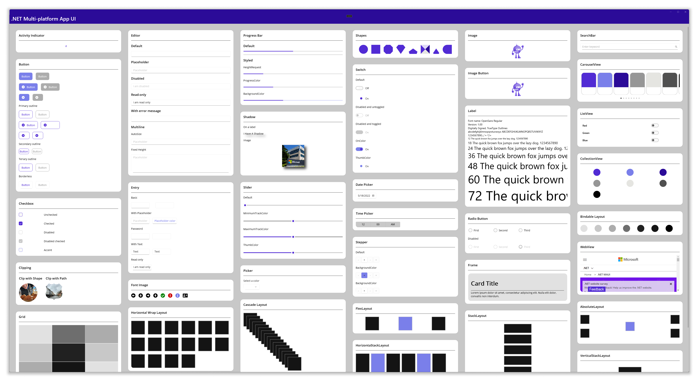
What’s .NET MAUI?
FULL LIST -> https://docs.microsoft.com/en-us/dotnet/maui/user-interface/controls/
Notes:
There are tons of components out of the box.
Here you can see some of them rendered in one screen.
See the full list: https://docs.microsoft.com/en-us/dotnet/maui/user-interface/controls/

Slide 4

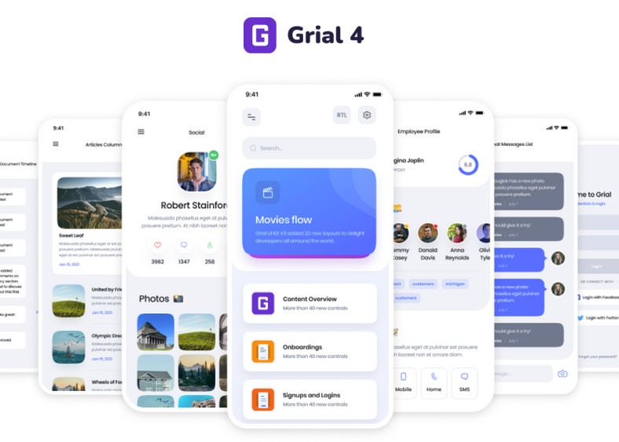
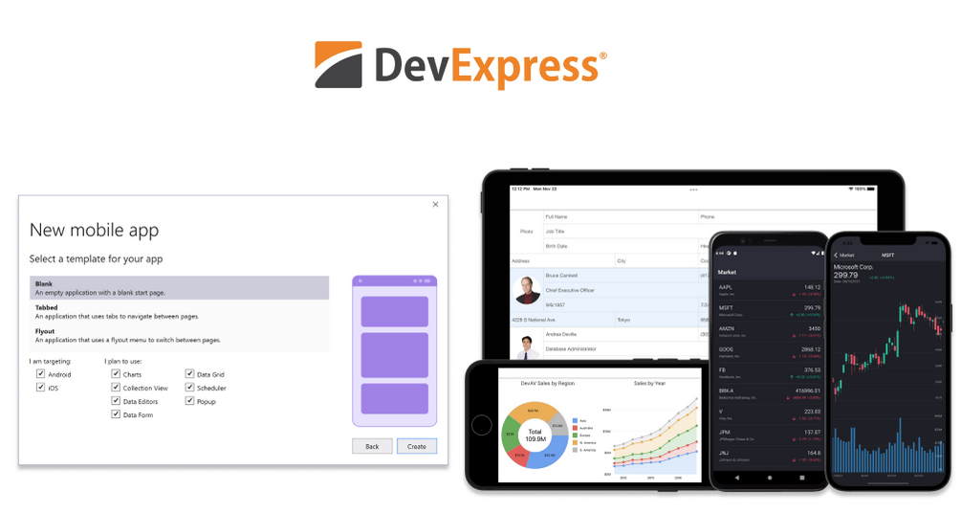

Rich Components
https://www.syncfusion.com/maui-controls
https://grialkit.com/
https://www.devexpress.com/maui/
https://www.telerik.com/maui-ui
Notes:
UI component ecosystem is already rich.
You can get productive fast, with beautiful re-usable UI components from top component vendors like Syncfusion, DevExpress, UX Divers, GrapeCity, Telerik…

Slide 5
Xamarin vs MAUI
👉
Single project for different platforms
Graphics APIs
.NET 6 support
Slim renderers
One location to manage all assets
Notes:
.NET MAUI is the next step of Xamarin.Forms. I’ll show you some of the advantages that comes with MAUI
All platforms can be managed in a single project: This means, there will be no multiple projects for each target platform. As you know Xamarin uses separate projects for each platform. In MAUI, shared resource files are within the single project. A single application manifest that specifies the app title, id, and version. A single cross-platform app entry point helps you to develop faster.

Slide 6
Xamarin vs MAUI
Single project for different platforms
Graphics APIs
.NET 6 support
Slim renderers
One location to manage all assets
👉
Notes:
Graphics APIs: Xamarin does not have direct APIs to handle any drawing requirements. You have to do it on the native side using renderers.. But .NET MAUI abstracts native drawing. The cross-platform graphics functionality in .NET MAUI provides a drawing canvas for drawing and painting shapes.

Slide 7
Xamarin vs MAUI
Single project for different platforms
Graphics APIs
.NET 6 support
Slim renderers
One location to manage all assets
👉
Notes:
.NET 6 support .NET MAUI is integrated into .NET 6, on the other hand Xamarin.Forms is a .NET Framework. Due to .NET 6 integration, you can use the new .NET 6 and C#10 features in .NET MAUI.

Slide 8
Xamarin vs MAUI
Single project for different platforms
Graphics APIs
.NET 6 support
Slim renderers
One location to manage all assets
👉
Notes:
Slim renderers: In Xamarin App we were using Custom Renderers. There’s no custom renderers but now we can use Slim Renderers. Doing so makes your application lightweight and streamlines the development experience.

Slide 9
Xamarin vs MAUI
Single project for different platforms
Graphics APIs
.NET 6 support
Slim renderers
One location to manage all assets
👉
Notes:
One location to manage all assets: You can manage resources like fonts, images, splash screen, CSS, or raw assets from one place. Where the Xamarin.Forms have multiple projects for those.

Slide 10
Xamarin vs MAUI
👉
Multi-targeting to organize platform-specific code
Support for the Model View Update (MVU) pattern
Support for Blazor
Unification of libraries
Complete support for hot reloads
Notes:
Multi-targeting to organize platform-specific code: A .NET MAUI project contains a Platforms folder, with each child folder representing a different supported platform. So you can easily manage different platform specific code.

Slide 11
Xamarin vs MAUI
Multi-targeting to organize platform-specific code
Support for the Model View Update (MVU) pattern
Support for Blazor
Unification of libraries
Complete support for hot reloads
👉
Notes:
Model View Update (MVU) pattern is supported out of the box: As you know Xamarin.Forms supports Model-View-Viewmodel and ReactiveUI patterns. In addition to those, .NET MAUI supports Model-View-Update and Blazor development patterns. This pattern provides a unified way to build cross-platform native front ends from a single code base.

Slide 12
Xamarin vs MAUI
Multi-targeting to organize platform-specific code
Support for the Model View Update (MVU) pattern
Support for Blazor
Unification of libraries
Complete support for hot reloads
👉
Notes:
Support for Blazor: As we know, Blazor is one of the most adaptive programming models for building web applications. .NET 6 will extend Blazor’s target scenarios to include native desktop applications that may rely on web-based rendering. Blazor desktop will be structured similar to the way the Electron works.

Slide 13
Xamarin vs MAUI
Multi-targeting to organize platform-specific code
Support for the Model View Update (MVU) pattern
Support for Blazor
Unification of libraries
Complete support for hot reloads
👉
Notes:
Unification of libraries: .NET MAUI comes with the unification of critical libraries. It provides several benefits by merging the Xamarin.Essentials library into .NET MAUI so that you can easily use device capabilities like device sensors, photos, contacts and other services you use on a regular basis like authentication and secure storage.

Slide 14
Xamarin vs MAUI
Multi-targeting to organize platform-specific code
Support for the Model View Update (MVU) pattern
Support for Blazor
Unification of libraries
Complete support for hot reloads
👉
Notes:
Complete support for hot reloads: You can modify both your XAML and managed source code while the application is running. Then observe the result of your modifications without stopping, rebuilding and starting your application.

Slide 15
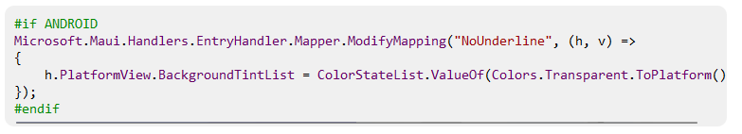
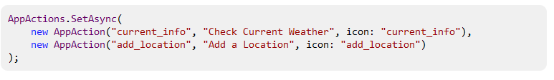
Why MAUI?
Accessibility First
Easy to establish a new platform
APIs to access services
Notes:
So now, why should I choose .NET MAUI for my cross-platform application?
Accessibility First
One major advantage of using native UI is the inherited accessibility support.
It makes easy to create highly accessible applications with semantic services.
Properties such as description, hint, and heading level
Focus
Screen reader
Automation properties
The documentation → https://docs.microsoft.com/en-us/dotnet/maui/fundamentals/accessibility
Easy to establish a new platform
.NET MAUI is architected for extensibility, so you never hit a wall. Take, for example, the Entry control – a canonical example of a control that renders differently on one platform. Android draws an underline below the text field, and developers often want to remove that underline. With .NET MAUI, customizing every Entry in your entire project is just a few lines of code.
APIs to access services
.NET MAUI provides simple APIs to access services and features of each platform such as accelerometer, app actions, file system, notifications and more. In this example, you can configure “App Actions” that adds menu options to the app icon on each platform:
Documentation → https://docs.microsoft.com/en-us/dotnet/maui/

Slide 16
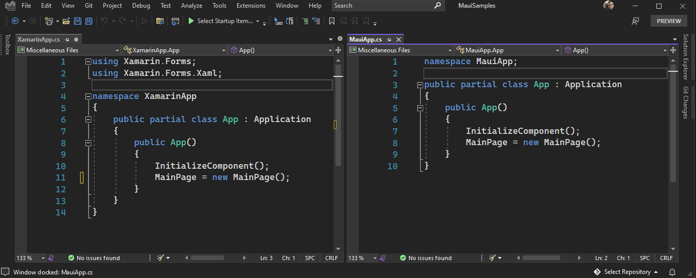
Why MAUI?
Global using statements and File scoped namespaces
Notes:
.NET MAUI uses the new C# 10 features introduced in .NET 6, including global using statements and file scoped namespaces
This is great for reducing clutter in your files.

Slide 17
Why MAUI?
Single project for different platforms
Notes:
In new .NET MAUI projects, platforms are placed in a subfolder that gives your focus to your application..
Within your project’s Resources folder you have a single place to manage your fonts, images, app icon, splash screen, raw assets, and styling.
.NET MAUI will do the work to optimize them for each platform’s unique requirements.
Documentation → https://docs.microsoft.com/en-us/dotnet/maui/fundamentals/single-project

Slide 18
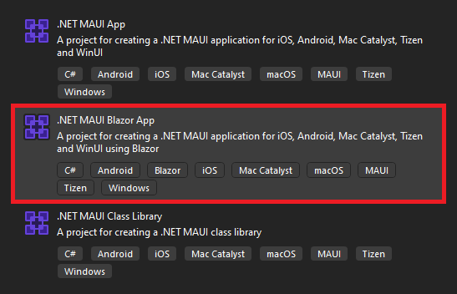
Why MAUI?
Use Blazor for Desktop and Mobile
Notes:
NET MAUI is also great for web developers looking to run web code in native client apps.
You can use your web development skills to build cross-platform native client applications for mobile, desktop, and web.
It executes your Blazor components natively on the device. No WebAssembly needed!
And renders them to an embedded web view control.
Your Blazor components compile and execute in the .NET process, they aren’t limited to the web platform and can leverage any native platform features, like notifications, Bluetooth, geo-location and sensors, filesystem and many more.

Slide 19
Why MAUI?
Optimized for Speed
.NET Podcast sample application
First startup duration: 1299ms
Latest GA version, it’s: 814.2ms
37.3% improvement since Preview 13.
Notes:
There’s a good improvement on performance and reducing app size after .NET 6 transition.
The team reduced the Java <-> C# call cycles
And no more creation C# objects from Java
The .NET Podcast sample application is built with .NET MAUI.
-> First, it was starting up in 1299 -twelve ninety nine- milliseconds
-> Now it’s 814 -eight hundred fourteen- milliseconds
-> %37 -thirty seven- percent improvement…

Slide 20
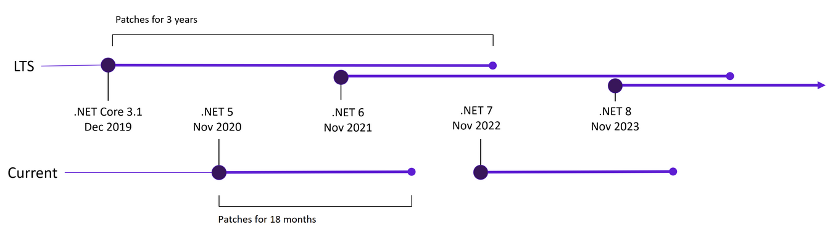
Current Status of the MAUI
It’s currently GA (General Availability)
Notes:
Current status of the .NET MAUI
It is on GA.
GA: General Availability, means that's a fully and problem-less release.
It’s not a pre-release, so there shouldn't be any breaking changes expected.
After that it’ll be in LTS - Long Term Support.
So if you're running an application internally that you can easily update, you might want to stay up to date with the latest GA version...
But if you're deploying software that is relatively hard to update and needs to be supported for long periods, you can stick with Long Term Support version.

Slide 21
Migrating from a Xamarin App
Convert the projects from .NET Framework to .NET SDK style.
Update namespaces.
Update any incompatible NuGet packages.
Address any breaking API changes.
Run the converted app and verify that it functions correctly.
https://docs.microsoft.com/en-us/dotnet/maui/get-started/migrate
dotnet tool install --global upgrade-assistant
https://dotnet.microsoft.com/en-us/platform/upgrade-assistant
Notes:
If you are thinking to migrate from a Xamarin application, you don't need to rewrite your old Xamarin.Forms application to move them to .NET MAUI.
You can use single-project features without merging all of your Xamarin.Forms projects into one project.
Also there is a tool developed by Microsoft. It’s called “Upgrade Assistant”
It’s not originally for .NET MAUI, but you can use it migrating your Xamarin.Forms projects

Slide 22
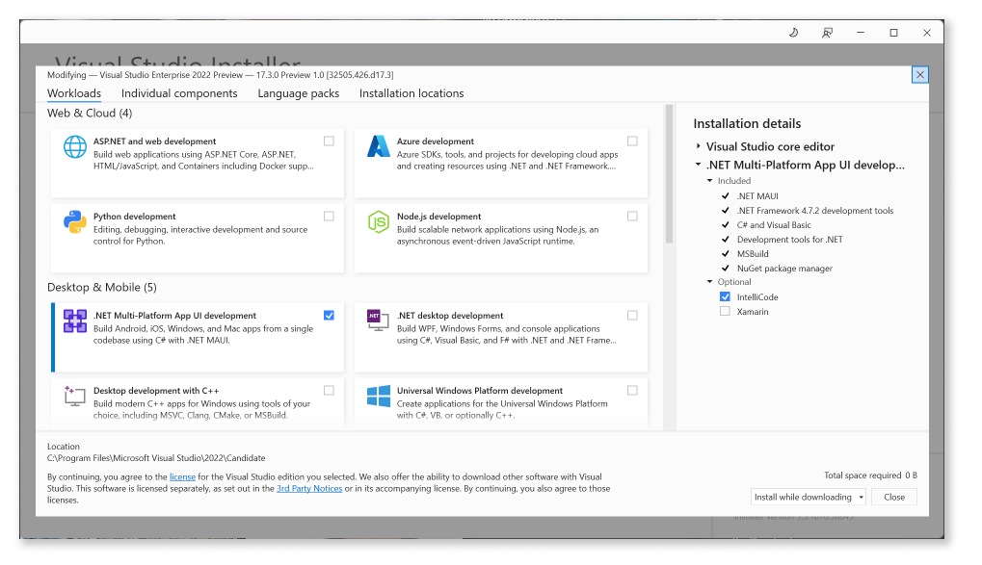
Get Started MAUI
.NET Multi-platform App UI development
Visual Studio 2022 Preview to version 17.3 Preview 1.1
Notes:
To get started using .NET MAUI on Windows, install or update Visual Studio 2022 Preview to version 17.3 Preview 1.1.
In the installer, choose the workload “.NET Multi-platform App UI development”.
For MAC install the new Visual Studio 2022 preview (17.3 Preview 1).

Slide 23

Learn .NET MAUI for Beginners
https://www.youtube.com/watch?v=DuNLR_NJv8U
Notes:
Lastly, there’s a very practical 4 hours workshop from James Montemagno.
He’s working in Microsoft since the Xamarin project.
In this free YouTube course, you will learn the basics including how to build user interfaces , how MVVM and data binding works, how to navigate between pages, access platform features like geolocation, optimize data collections, and theme.
This course has everything you need to learn the basics of .NET MAUI development.

Slide 24
References
https://devblogs.microsoft.com/dotnet/introducing-dotnet-maui-one-codebase-many-platforms/
https://www.youtube.com/watch?v=s48vzy4sC0k
https://www.banditoth.net/2021/12/30/upgrading-xamarin-forms-projects-to-net-maui/
https://www.grapecity.com/blogs/whats-the-difference-between-maui-and-uno
https://www.syncfusion.com/blogs/post/advantages-net-maui-over-xamarin.aspx
https://dotnet.microsoft.com/en-us/apps/maui
Notes:
Here’s the list of resources I refer to and get help.

Slide 25
Thank you 🙏🏽
Alper EBİÇOĞLU
/ alperebicoglu
Notes:
And that’s it from my side.

Slide 26
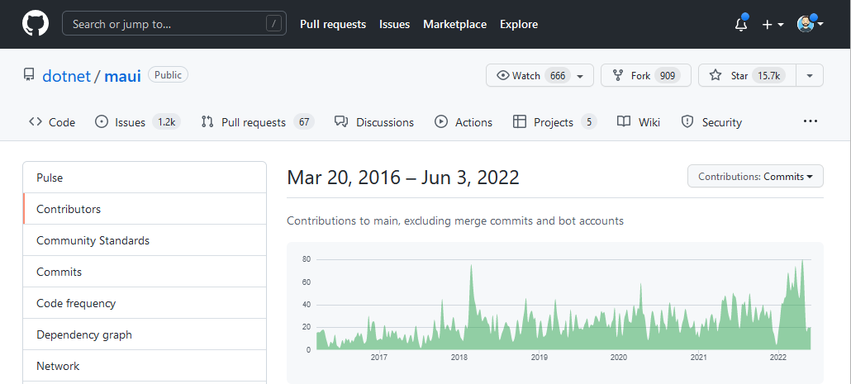
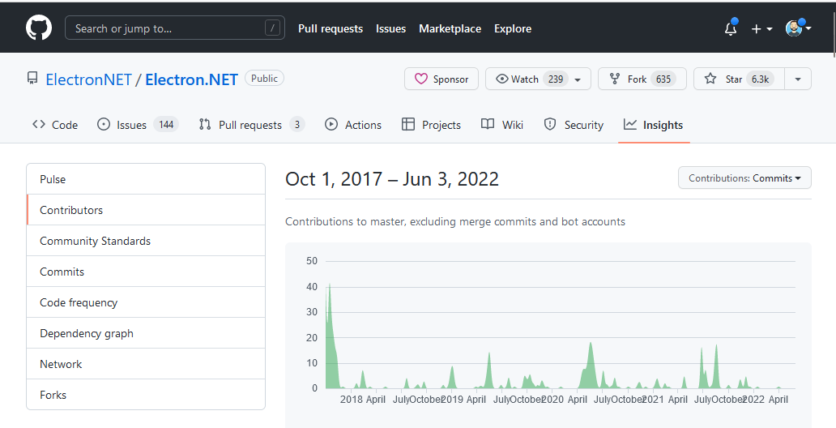
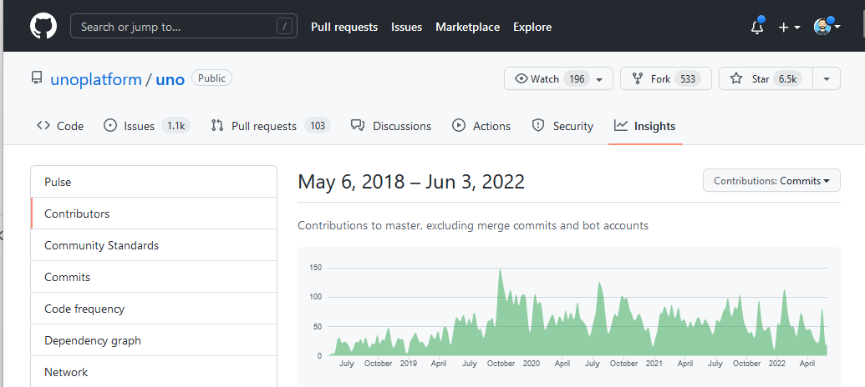
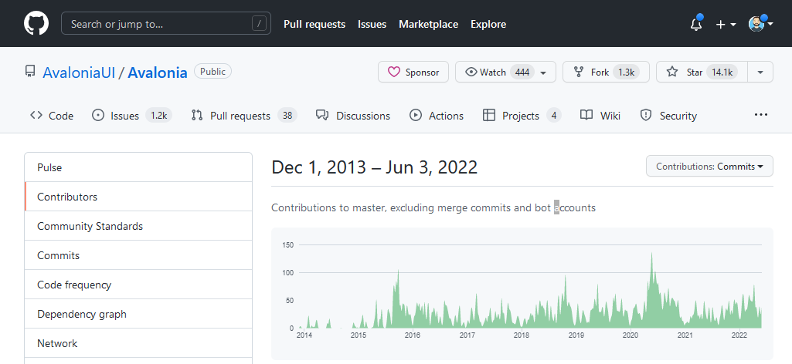
Notes:
And there’s Flutter. Flutter is mainly mobile with some support for web.
Uno supports basically everything (mobile, web, desktop) and Avalonia is more desktop centered with some preview mobile features.
Avalonia and Uno are based on WPF and UWP. If you choose these you’ll stick to C#.
But my choice will be MAUI.

Slide 27
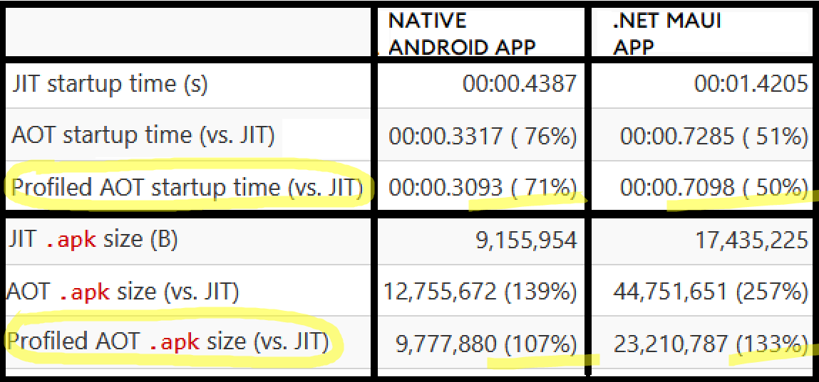
Pixel 5 device performance tests
Notes:
There’s the native application on the left side, and .NET MAUI on the right column.
While the native application loads in half seconds, .NET MAUI adds 1 second overhead in JIT (Just in time) compilation.
When AOT (ahead of time) compilation is enabled, it loads 2 times faster.
In terms of the file size, when AOT (ahead of time) compilation is enabled, the file size getting larger but it loads very fast.
So by doing AOT partially, the parts of your application that are only executed at startup, thus balancing over speed and size.
https://devblogs.microsoft.com/dotnet/announcing-net-maui-preview-9/#quick-android-startup

Slide 28
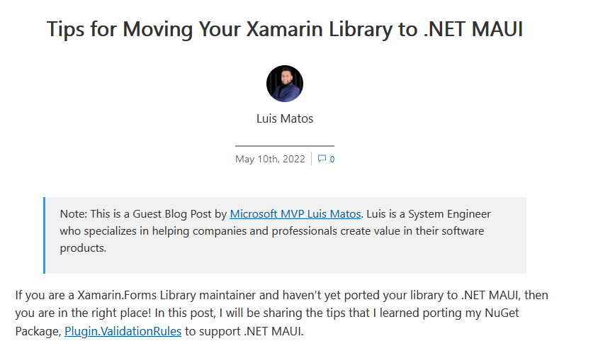
https://devblogs.microsoft.com/xamarin/tips-for-porting-your-xamarin-library-to-dotnet-maui/?WT.mc_id=dotnet-0000-bramin
Notes:
https://devblogs.microsoft.com/xamarin/tips-for-porting-your-xamarin-library-to-dotnet-maui/?WT.mc_id=dotnet-0000-bramin

