Slide 1

Take a closer look at the code generation ABP Suite
Alper EBICOGLU
@alperebicoglu
Notes:
Hi everyone,
Thank you so much for joining us today.
And I hope you’re doing well.
I’m Alper, from the ABP development team,
Today I’ll talk about ABP Suite and how it helps your development to get faster.
Also if you have any questions during the talk, you can write them to the chat, and I’ll try to answer them in the end.

Slide 2

Agenda
What’s ABP Framework?
What’s ABP Commercial?
Generating CRUD pages with ABP Suite
Create, Read, Update, Delete
Notes:
Today we’ll talk about what’s ABP Framework and what it provides us.
Then I’ll show you some benefits of ABP Commercial.
And we’ll generate CRUD pages with ABP Suite.
CRUD page means the page that consists of four basic operations: create, read, update, and delete.

Slide 3
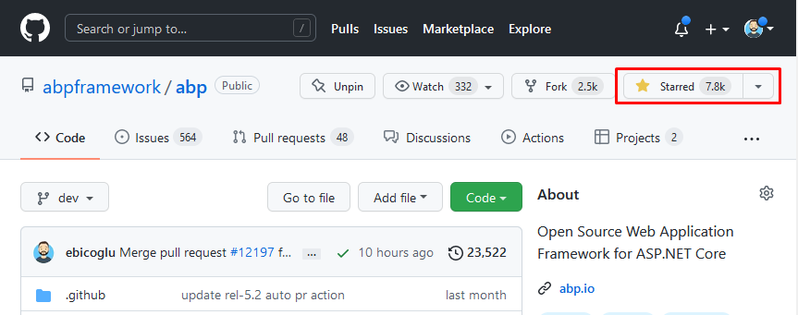
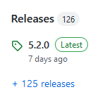
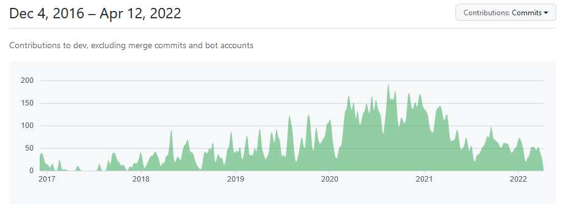
What’s ABP?
https://abp.io
Notes:
ABP Framework is an open-source, microservice compliant web framework on top of ASP.NET Core.
It’s a modular web application framework.
So each module can be a separate microservice application with its own database.
It’s a very active repository with almost 8K stars
It’s said to be a mature framework, It started in 2016 and 126 (hundred and twenty six) releases have been published until today,
The ABP simplifies and automates cross cutting concerns and common non-functional requirements like Exception Handling, Validation, Authorization, Localization, Caching, Dependency Injection, Setting Management, and many more.
A whole bunch of best practices is pre-implemented.
You start providing business value, for your customer, immediately right after you download the project.

Slide 4


Different Tech Options
UI Framework Options
Database Provider Options
Notes:
It’s a full-stack developer experience.
It helps you to skip all the hassle to kick start a project and you start coding your business logic in the first day which is amazing!
It provides ready to use application templates. These are Visual Studio solutions and module solutions with the most famous tools are integrated.
You can create your own solution based on different UI frameworks and database providers.
MVC, Angular, Blazor Server or Blazor Web Assembly can be used for the UI.
Entity Framework Core, MongoDB or Dapper can be used for the database provider.

Slide 5
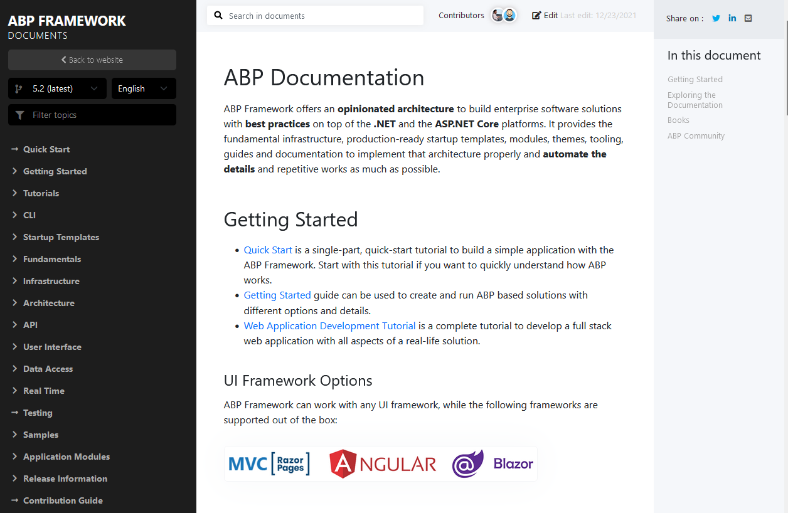
Documentation: docs.abp.io
Notes:
ABP has a very rich documentation. The documentation is being hosted on GitHub and it’s open-source as well.
And the documentation website is also built with ABP Framework and this module is called VoloDocs
It is a free module https://docs.abp.io/en/abp/latest/Apps/VoloDocs
We also implemented our entire websites with ABP.
We're using it before we release a stable version so we can foresee the potential issues with the upcoming versions.

Slide 6


ABP Commercial
ABP Commercial Benefits
+ Professional themes
+ Paid modules
+ Microservice template
+ Premium support
+ ABP Suite
Notes:
There’s also a commercial version of ABP for companies and individual developers.
It’s called ABP Commercial. It is built on top of the ABP Framework.
So it has all the features of the free ABP, plus, it provides you
+ Professional themes
+ A microservice template
+ Premium support
+ Paid modules like “Audit Logging”, “CMS Kit”, “Forms”, “SMS Module”, “Identity Server UI”, “Payment”, “Chat”, “File Management”, “Language Management”,
→ https://commercial.abp.io/modules
+ Lastly, ABP Suite! (which is a Rapid Application Development Tool for ABP.)

Slide 7
ABP Suite
Is cross-platform
Creates new ABP solutions / modules
Generates CRUD pages
Manages your modules in your solution
Updates NuGet and NPM packages in your solution
Notes:
And today’s topic is ABP Suite!
ABP Suite is a RAD tool which allows you to visually build web applications in a matter of minutes.
It's a .NET Core Global tool that can be installed from the command line.
ABP Suite is built with .NET Core and it is cross platform. It runs as a web application on your local computer. You can run it on Windows, Mac and Linux
ABP Suite allows you to easily create CRUD pages. You just need to define your entity and its properties, let the rest to ABP Suite for you! ABP Suite generates all the necessary code for your CRUD page in a few seconds. It supports Angular, MVC and Blazor user interfaces.
It doesn't generate magic files that work on runtime. ABP Suite generates the source code for Entity, Repository, Application Service, Code First Migration, JavaScript/TypeScript and Razor/HTML pages. ABP Suite also generates the code according to the Best Practices of software development, so you don't have to worry about the quality of the output code.
Since you have the source code of the generated page, you can easily modify the source code and inject your custom code to the generated code.

Slide 8
Install
ABP Suite
Install ABP CLI
C:\dotnet tool install -g Volo.Abp.Cli
C:\abp suite install
C:\abp suite
Start
Notes:
Before installing ABP Suite, you need to first install the ABP CLI.
Write “dotnet tool install –g Volo.Abp.Cli” to install this dotnet tool as globally.
After that, write “abp suite install” to install the latest version.
And to start the application, write “abp suite”.
I’ll install it to my computer now, and we’ll have a look at the user interface…
And then we’ll create CRUD pages…

Slide 9
Data Model
Book
Author
Reader
(n – 1)
(n – n)
Title <string>
PageCount <int>
Price <float>
NameSurname<string>
Email <string>
Gender <enum>
Name <string>
Birthdate <datetime>
Active <bool>
Notes:
This is the data model of our entity relationships.
The “Author” entity will have string, datetime and Boolean properties.
The “Book” will have string, int, float properties and it depends on “Author” entity with 1-to-many relationship
In the one-to-many relationship, one record in a table can be associated with one or more records in another table.
And the “Reader” entity will be connected to the “Book” entity with many to many relationship.
A many-to-many relationship occurs when multiple records in a table are associated with multiple records in another table.
We’ll also use a custom Enum called “Gender” in the Reader entity.
So in the end, we will be able to pick an author when creating a Book entity.
And select multiple Books when creating a Reader entity.

Slide 10
Questions?

