Slide 1

Building Multi-Tenant ASP.NET Core Applications
& the ABP Framework
Alper Ebicoglu
Co-Founder of Volosoft
alper.ebicoglu@volosoft.com
twitter.com/alperebicoglu
Notes:
Ladies and gentlemen welcome to the multi-tenancy session.
Thank you for joining me today.
My name is Alper, and I'm one of the co-founders of Volosoft.
Our company that has been empowering .NET developers.
At Volosoft, we are creating frameworks and simplifying the complexities of software development,
allowing you to focus on your business.
One of our flagship projects is the ABP Framework, a powerful framework that implements many cross cutting concerns of a web app.
Today, I am excited to share with you some of the experiences and insights I've gained while implementing major multi-tenancy requirements.

Slide 2



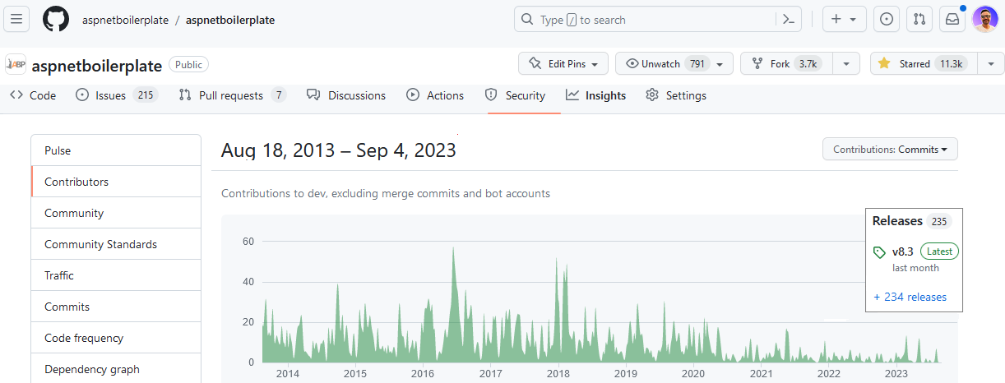
Open-source Framework on
Notes:
I want to mention you about our first open-source web application framework.
It’s called ASP.NET Boilerplate
We started this project in 2013 (twenty thirteen).
We have released 234 versions so far.
It has 11K stars on GitHub which is amazing for a .NET repo.

Slide 3

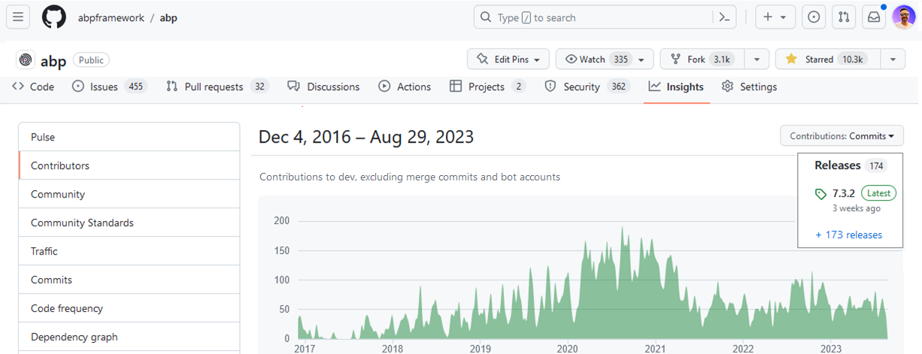
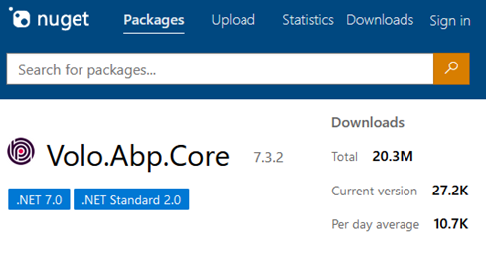
Open-source Framework on
Notes:
how we solved some real problem multi-tenancy issues.
--------------
After ASP.NET Boilerplate we started writing ABP Framework which is fully modular, multi-tenant and microservice compatible.
It has been developed as open source since 2016 (twenty sixteen). ️
We have released 173 versions so far.
It has 10K stars on GitHub
And over 20 million downloads on NuGet until now.
Why I’m showing this to you, because we have a good experience of modular application development, microservice architecture, DDD and multi-tenancy.
In the next slides, I’ll share you how we solved some real problem multi-tenancy issues.

Slide 4



What is ABP Framework?
🚀
Your Application
do what you do best
Focus on your business code
Multi-tenancy
Audit logging
Exception handling
Background jobs
Modularity
Event bus
Unit of work
etc…
ABP Web Framework
An opinionated architecture to build line-of-business web apps
Routing
Dependency injection
Session management
Request / response
Security
etc…
ASP.NET Core Web Framework
Generic web framework
Notes:
Raw ASP.NET Core is Generic and provides essential features.
ABP provides enterprise software solution features.
CROSS CUTTING CONCERNS (ex handling, caching, localization, validation, transaction management, social media logins, forgot password)
You can focus on your business logic.
---
ABP Framework offers an opinionated architecture to build enterprise software solutions with the best practices.
And it’s built on top of .NET and the ASP.NET Core platforms.
On the ground level, there’s raw ASP.NET Core and next level our framework comes up with all kinds of generic features that a line-of-business app should have, and on the roof level you write your custom business code.
You don’t worry about multi-tenancy and all its challenges.
I’ll explain our solutions and experiences on creating a multi-tenant application framework.

Slide 5
Agenda
Introduction to SaaS & Multi-Tenancy
Pros and Cons of Multi-Tenancy
Database & Deployment Scenarios
Identifying and Changing the Active Tenant
Data Isolation
Conditionally Turning Multi-Tenancy On / Off
Handling Database Migrations
Implementation of the Feature System

Slide 6
What is Multi-Tenancy?
A common approach to build SaaS solutions
Resources are shared between tenants
Application data is isolated between tenants
Tenants: Our clients, using the service
Host: Service provider
Parties
An ideal multi-tenant application should be
Unaware of multi-tenancy as much as possible!
Deployable to on-premise as well
Notes:
If you build SaaS,
Hardware + Software resources
Data isolated
Tenants, Host
Ideal app => Unaware MT, deploy on premise
---
When you want to build a solution, you need to deal first with multi-tenancy.
Different cloud customers access the same resources..
So each client operates within its isolated environment, unaware of the existence of other tenants.
Their application data is physically or virtually isolated.
There are 2 parties in this scenario: Tenants and Host.
Tenants are our customers and the host is the owner of the platform that develops, maintains, and offers the software to customers.
—
Ideally, your application code should not be aware of multi-tenancy related code.
What I mean is, you shouldn’t pass TenantId to all your controllers, application services, repositories or domain services…
Do all tenancy related stuff in a low level layer and keep your business code clean as much as possible.
And also, when a customer wants to setup your solution to his own servers, you should be doing that without any code changes.

Slide 7
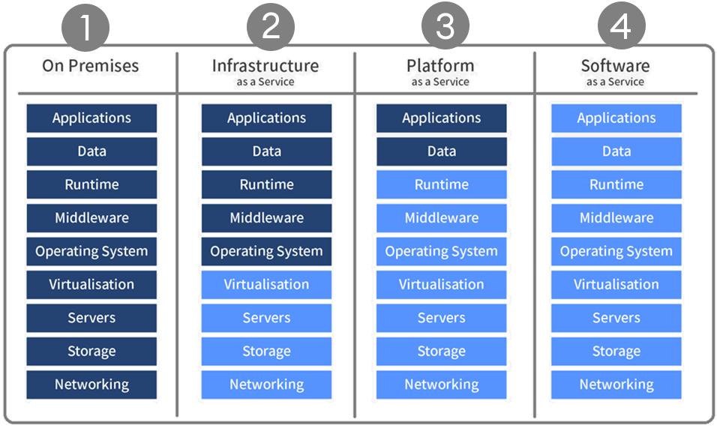
As-a-Service Business Models
You manage
3rd Party Manages
Notes:
2- Infrastructure as a Service: Google Compute Engine, Azure Virtual Machines
3- Platform as a Service: Azure App Service, Heroku, Google App Engine
4- Software as a Service: Discord, Zoom, Gmail, Netflix
---
On Premises: "on-prem" is installed and runs on computers on the premises of the organization using the software, rather than at a remote facility.
Infrastructure as a Service Customers with access to computing resources, like servers, storage, and networking. It allows users to rent these resources on a pay-as-you-go basis, so they don't need to invest in hardware or software upfront. IaaS customers have full control over the virtual machines and can install and configure their own software and applications.
Platform as a Service Customers can develop, run, and manage web applications without having to worry about the underlying infrastructure. PaaS provides customers a platform to build and deploy applications quickly and easily.
Software as a Service SaaS is a cloud computing model in which software applications are hosted on a remote server, and customers access them through a web browser. SaaS eliminates the need for customers to install and manage the software on their own systems.

Slide 8
Advantages of Multi-Tenancy
Cost efficiency — max utilization
Consistent user experience
Ease of maintenance
Scalability
Rapid deployment for new users
Notes:
Multi-tenant solutions are very trendy nowadays because there are some really good advantages.
Cost Efficiency: Multi-tenancy allows for resource sharing among tenants, resulting in reduced infrastructure costs. Instead of deploying separate instances for each tenant, resources like servers, databases, and maintenance efforts can be optimized.
Consistent User Experience: All our customers use the latest version. So we as developers can focus on maintaining a single codebase, ensuring that all tenants receive updates and improvements at the same time.
Ease of maintenance: Maintaining a single codebase and infrastructure for all tenants simplifies software updates, patches, and bug fixes. It reduces the complexity of managing multiple instances, making it easier for developers and administrators to maintain the system.
Scalability: Resources can be allocated dynamically based on the needs of individual tenants. This leads to better resource utilization and responsiveness to demand spikes.
Ease of Deployment: New tenants can be onboarded quickly within the existing infrastructure, you don’t need to set up a new environment for the new client. When a new tenant comes, you just add a new line into your Tenants table.

Slide 9
Challenges of Multi-Tenancy
Data isolation
Configuration & customization per tenant
Performance balance: Noisy neighbors!
Security
Backup and recovery
Notes:
Despite these advantages, multi-tenancy also presents challenges, such as
Data isolation: Ensuring proper data isolation btw tenants to prevent unauthorized access to sensitive information
Customization and configuration: Your clients request to customize the application according to their requirements. They want to make rebranding and customize the UI, logo, colors. Managing different configurations and customizations for each tenant without compromising the core architecture can be challenging.
Performance balance: some customers may use the system extensively We can call this “Noisy neighbors“. Some tenants can consume too much resources. We should ensure that the resource usage of one tenant does not negatively impact the performance of other. This should be done by monitoring the system.
Security: When a hacker gets into your server he can steal all your client data. Also if you have a security hole, a tenant can gain access to other tenant’s data.
Backup and recovery: This involves database and storage backup per tenant. It will be very easy to backup/restore when you have a separate DB for each tenant, but if you have a shared DB then you need to get backup of the specific tenant. And tenants may have different retention policies, so you need to implement different strategies for each tenant.

Slide 10
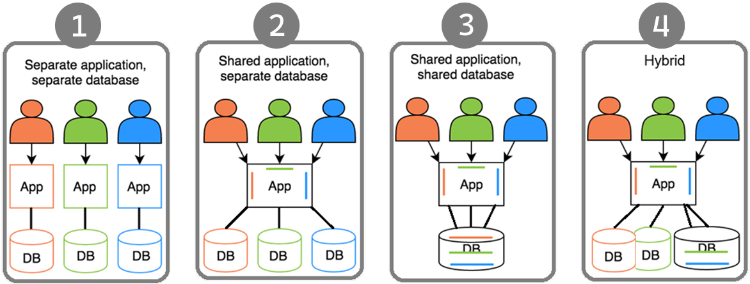
Deployment & Database Architectures
Notes:
There are 4 scenarios of the application and DB deployments.
This one looks like on-premises deployment. Each client has its own web app and database. Not a SaaS friendly architecture.
This is better than the first one. All the clients shares the same application but uses separate DBs. Not good for resource utilization. Because you need to maintain / update schemas of the databases.
This one is the ideal one. Everyone uses the same app and the same DB. Minimum cost with maximum client coverage. The downside of this approach is; some customers might have excessive data and consume resources much more than others. Also according to some GDPR rules, some clients may want to locate the DB in their country like banks. Therefore you need to separate those DBs.
Last one covers all kinds of challenges. You can provide separate DB if a client pays more or locate their data in a different geo-location. On the other hand, small clients can share the same DB.

Slide 11
Maintaining Application States
Application code & services should be stateless!
Where should we save the state?🤔
HTTP Request (cookie, header, query string, payload)
Authentication ticket
Database
Distributed cache (Redis, Memcached, ...)
Notes:
A stateless application doesn’t save any client session (state) data on the server like TenantId.
And HTTP is a stateless protocol. This means that user data is not persisted from one web page to the next.
Our multi-tenant application should also be stateless.
Besides, the Stateless approach is multi-thread friendly!
Then where should we save the state?
In HTTP Requests, Authentication tickets as in JWT, DB, Distributed caches like Redis.

Slide 12
Identifying the Active Tenant
Notes:
So far I gave you some general information about MT
Now let’s see some code and real-world solutions

Slide 13
Identifying the Active Tenant
How to determine the current tenant?🤔
CurrentUserTenantResolveContributor
QueryStringTenantResolveContributor
RouteTenantResolveContributor
HeaderTenantResolveContributor
CookieTenantResolveContributor
DomainTenantResolver
Notes:
When a user makes a request to the application, you need to understand Which tenant's user is this user?
There are 6 ways of finding the current/active tenant in our implementation.

Slide 14
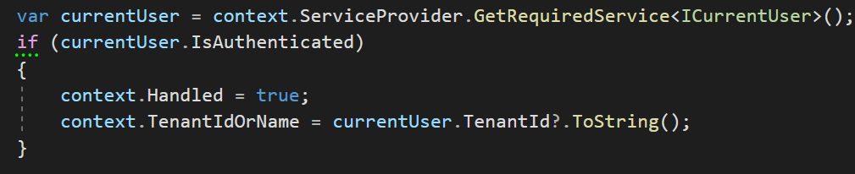
Identifying the Active Tenant
1. Current User (claims)
HttpContext.User.Identity.Claims .FirstOrDefault(c => c.Type == “TenantId”)
Notes:
When a user logs in, we save his TenantId to the claims.
And when user comes back again, we identify the user from this TenantId that’s retrieved from the claims.

Slide 15
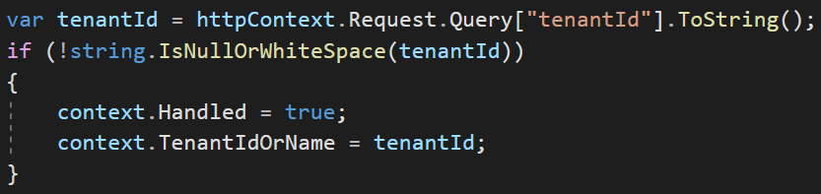
Identifying the Active Tenant
2. Query String
https://fabrikam.com?tenantId=3

Slide 16
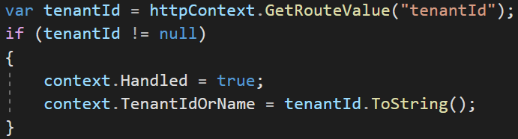
Identifying the Active Tenant
3. Route
https://fabrikam.com/acme/
Notes:
Store tenantId as route path

Slide 17
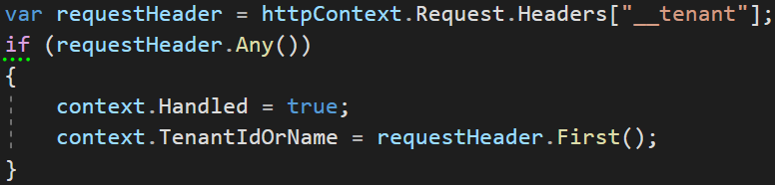
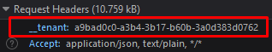
Identifying the Active Tenant
4. Header
Notes:
We use headers especially for SPA or 3rd party clients like mobile apps.

Slide 18
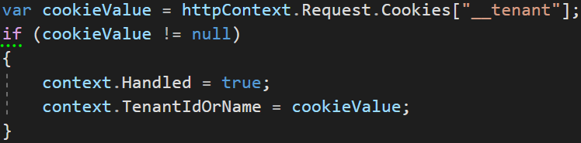
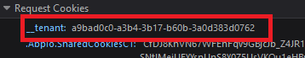
Identifying the Active Tenant
5. Cookie

Slide 19
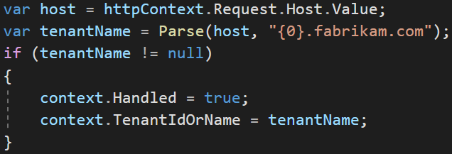
Identifying the Active Tenant
6. Domain
https://acme.fabrikam.com
Notes:
This is good if your customers make e-commerce, online shopping etc.
So far we understand who the tenant is, now let's look at data isolation.

Slide 20
Data Isolation
✓ Identifying the Active Tenant

Slide 21
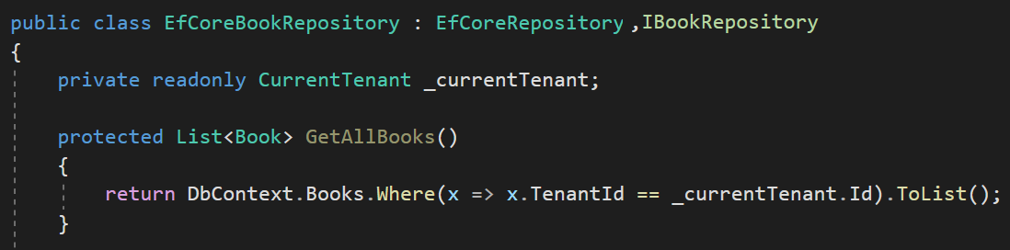
Data Isolation — Traditional way
You normally do this

Slide 22
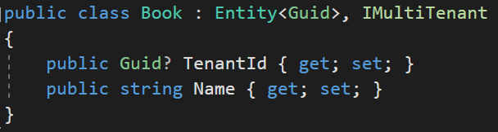
Data Isolation
Notes:
We use IMultiTenant interface to make an entity multi-tenant.
By using interface in this way, we make the TenantId field standard so that we can easily filter
ABP automatically sets the TenantId when you create a new entity.
----------
ABP Framework supports
Shared Database: All tenants are stored in a single database.
Database per Tenant: Every tenant has a separate, dedicated database to store the data related to that tenant.
Hybrid: Some tenants share a single databases while some tenants may have their own databases.
---
Multi-tenancy works seamlessly in the framework level.
When you implement your entities from this interface, ABP Framework automatically filters entities for the current tenant when you query from database. So, you don't need to manually add TenantId condition while performing queries. So we isolate the tenant data by default.
---

Slide 23
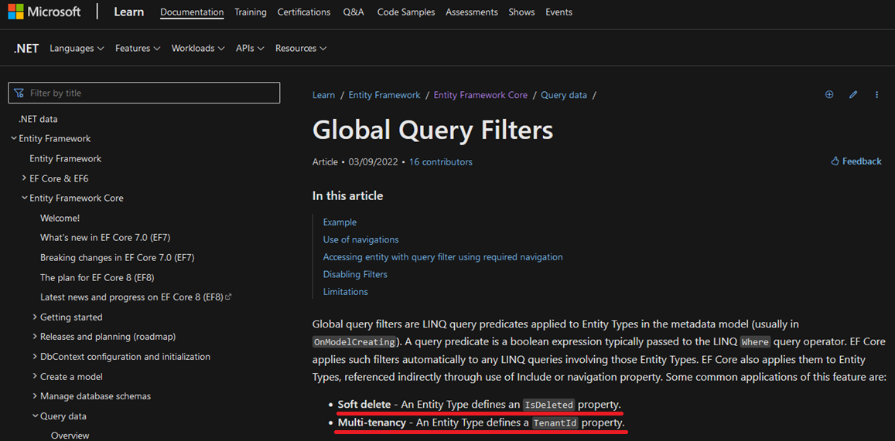
Data Isolation — EF Core
* Soft delete: An Entity Type defines an IsDeleted property.
* Multi-tenancy: An Entity Type defines a TenantId property.
Notes:
Allows you to define a filter condition that is automatically applied to all database queries for a given entity.
* Softdelete, Multi-Tenancy, Published
These filters are LINQ expressions that applies to Entities OnModelCreating phase.
This feature is generally being used for soft deleting an entity and multi-tenancy.
These features are generic features that should be filtered application-wide.
And ABP uses this system for the EF Core Integration.
So, it is well integrated to EF Core and works as expected even if you directly work with DbContext.

Slide 24
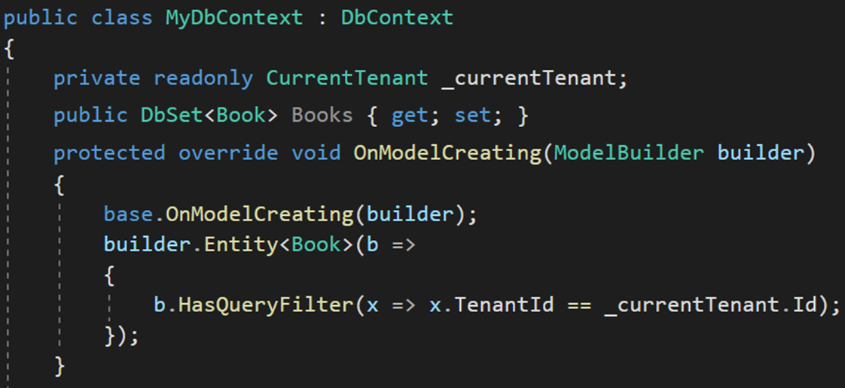
Data Isolation — EF Core Manual Way
HasQueryFilter() for global filtering
Notes:
In traditional way, you need to use HasQueryFilter for all your multi-tenant entities in OnModelCreating method of the DbContext.
Let's see how we automate this in the framework.

Slide 25
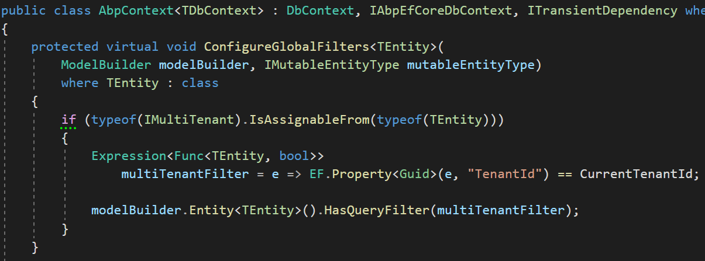
Data Isolation — EF Core
1-) Find all entities implement IMultiTenant
2-) Create LINQ expression
3-) Add to global filters
Notes:
We find all entities that implement an IMultiTenant interface.
To filter the multi-tenant entities by default we are using EF Core Global Query Filters.
These filters are LINQ query expressions that applies to Entities OnModelCreating phase.
This feature is generally being used for soft deleting an entity and multi-tenancy.
These features are generic features that should be filtered application-wide.
And ABP uses this system for the EF Core Integration.
So, it is well integrated to EF Core and works as expected even if you directly work with DbContext.

Slide 26
Data Isolation — EF Core PROS & CONS
😊 Easy to implement
😊 Supports navigation properties as well
😕 Works only with EF Core
Notes:
Planning to change EFCore later, doesn’t work for other Db Providers!

Slide 27
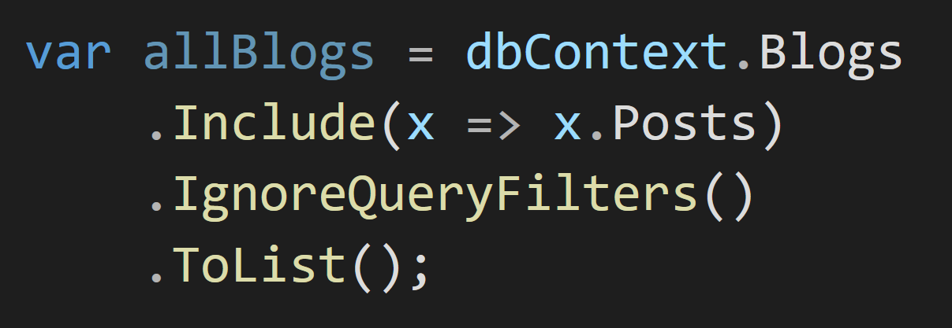
Data Isolation — EF Core PROS & CONS
😡 IgnoreQueryFilters() disables all filters
Notes:
IgnoreQueryFilters doesn’t get a specific filter as a parameter.
You can't just disable multitenancy but leave soft delete active

Slide 28
Data Isolation — EF Core PROS & CONS
😡 Can be defined for the root entity
of the inheritance hierarchy
Define to Animal
Notes:
In this example, Animal is the root entity type
BigAnimal and SmallAnimal inherit from Animal.
You can just define to the Animal class

Slide 29
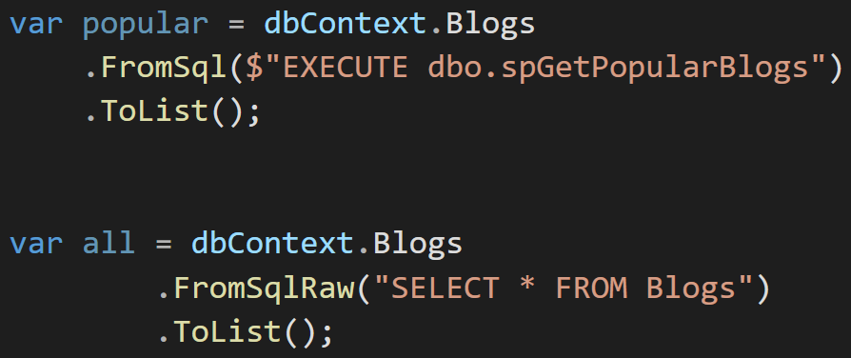
Data Isolation — EF Core PROS & CONS
😡 Does not support Stored Procedures or T-SQL
Notes:
And there’s Row Level Security which covers almost all cases.
But Row Level Security is relatively complex to implement and you need to stick to SQL Server.
EF Core Global filters method is ideal for a pragmatic solution

Slide 30
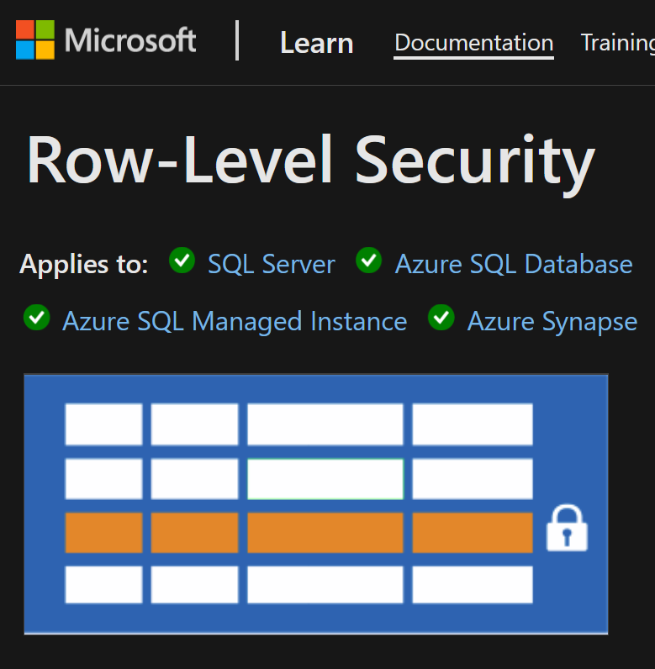
Data Isolation — EF Core PROS & CONS
Database level solution
👉 Row Level Security
Rows filtered based on user roles, attributes
Restriction logic is done in the DB
https://learn.microsoft.com/en-us/sql/relational-databases/security/row-level-security
Notes:
And there’s Row Level Security which covers almost all cases.
But Row Level Security is relatively complex to implement and you need to stick to SQL Server.
EF Core Global filters method is ideal for a pragmatic solution

Slide 31
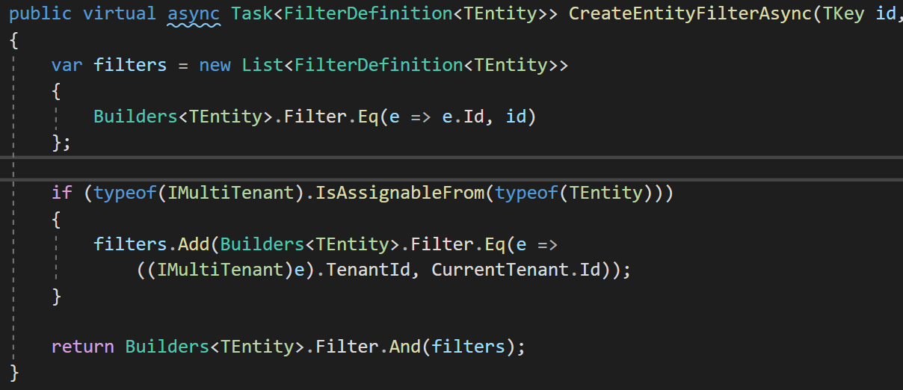
Data Isolation — MongoDB
1-Find all IMultiTenant
2-Create filter expression
3-Add to our custom global filters
Notes:
We have MongoDB implementation as well.
ABP abstracts the IMongoDbRepositoryFilterer interface to implement data filtering for the MongoDB Integration, it works only if you use the repositories properly.
Currently, the best way to implement a data filter for the MongoDB integration is to create a derived class of MongoDbRepositoryFilterer and override AddGlobalFilters. Example:
MongoDbRepositoryFilterer is being used for data filtering
The framework automatically adds TenantId filter to all the queries
https://docs.abp.io/en/abp/latest/MongoDB

Slide 32
Set TenantId for New Entities
✓ Identifying the Active Tenant
✓ Data Isolation

Slide 33
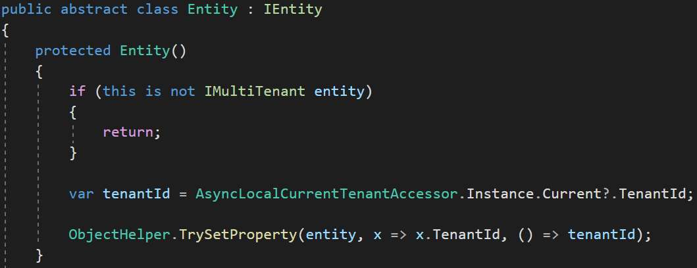
Set TenantId for New Entities
Set TenantId by reflection
Notes:
We set the TenantId for a new multi-tenant entity in the constructor.
We get the active TenantId from the active tenant’s scope and set it.
This way we are sure that TenantId is always being set

Slide 34
DB Connection String Selection
✓ Identifying the Active Tenant
✓ Data Isolation
✓ Set TenantId for New Entities

Slide 35
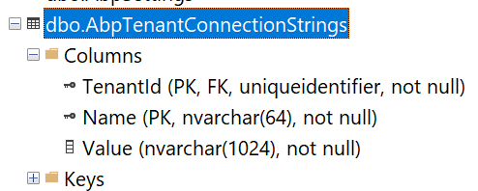
Connection String Selection — DB
The current tenant
The current module / microservice
The default connection string
Fallbacks
Notes:
When your application allows customers choose their own database, then you need to save each tenant’s connection string.
The master database connection string is stored in the configuration file: appsettings.json
And if a tenant wants a separate database then we store its connection string in AbpTenantConnectionStrings table with TenantId and Value.
This way we setup a hybrid approach for both shared and dedicated database architecture.
Module connection string:
https://github.com/abpframework/abp/blob/dev/templates/module/aspnet-core/host/MyCompanyName.MyProjectName.HttpApi.Host/appsettings.json#L5

Slide 36
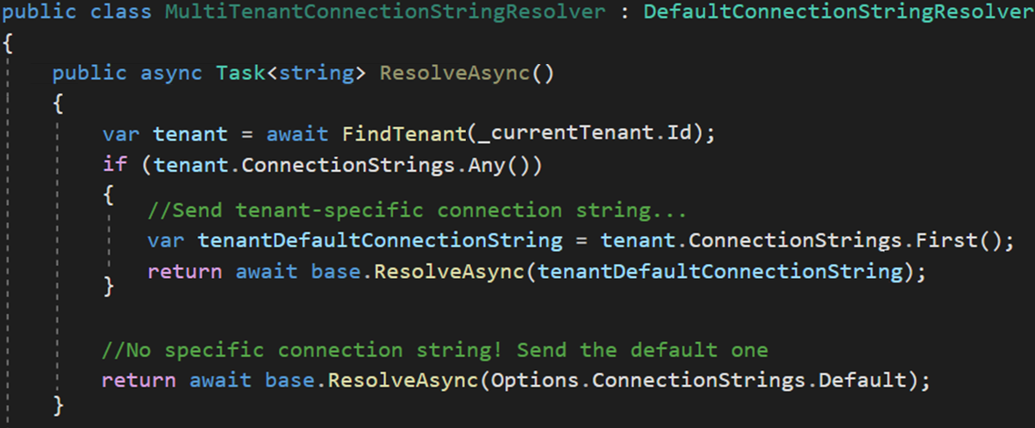
Connection String Selection — Code
Dedicated DB
Shared DB
Notes:
We use a factory service to dynamically set the connection string when the DbContext is being created.
We use DbContextCreationOptions for this approach
https://learn.microsoft.com/en-us/dotnet/api/microsoft.entityframeworkcore.dbcontextoptionsbuilder?view=efcore-7.0

Slide 37
Changing the Active Tenant
✓ Identifying the Active Tenant
✓ Data Isolation
✓ Set TenantId for New Entities
✓ DB Connection String Selection

Slide 38
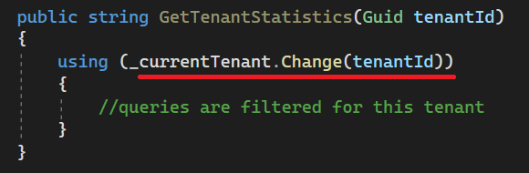
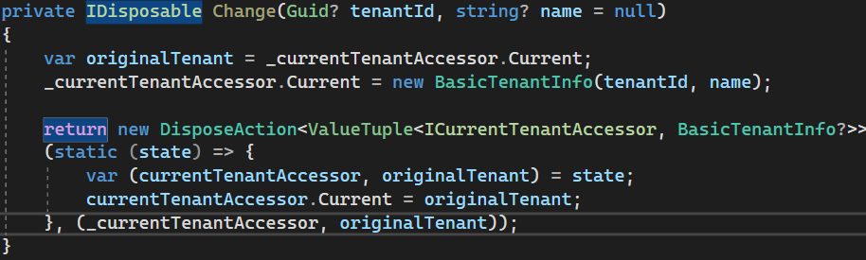
Changing the Active Tenant
Set active tenant
Revert back
Notes:
In each HTTP request, you can only query for the active tenant.
But sometimes it may be necessary to change the active tenant.
For example when you have background job that generates reports for each tenant (or in Windows Services)
In this case, we use a disposable method which is being used with “using” keyword.
Here we keep the original tenant in a temporary variable and set the new tenant.
Doing this, we filter all queries by this tenant.
Then we restore the original tenant after using the existing statement.

Slide 39
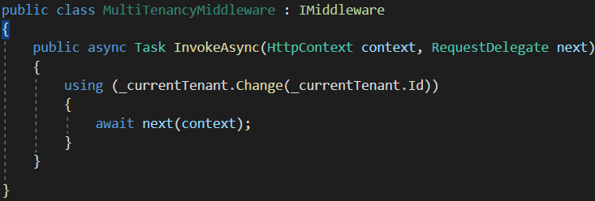
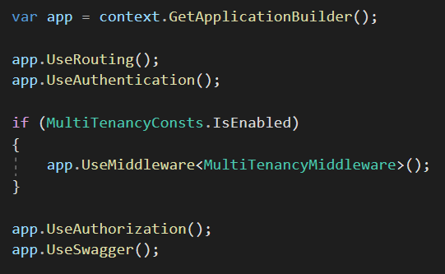
Setting the Active Tenant in Middleware
Set the current tenant within the middleware
Notes:
We created a middleware called MultiTenancyMiddleware.
And we set the current active tenant in this middleware.

Slide 40
Temporarily Disable Multi-Tenancy
✓ Identifying the Active Tenant
✓ Data Isolation
✓ Set TenantId for New Entities
✓ DB Connection String Selection
✓ Changing the Active Tenant

Slide 41
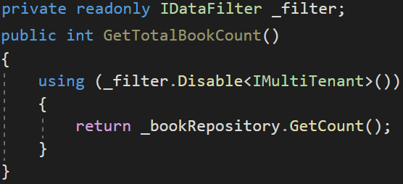
Disabling Multi-Tenancy Filter (Usage)
Returns book count without tenantId filter
Notes:
Sometimes, you may need to query on all tenants especially when your tenants share the same database.
Getting report among your tenants.
In this example we get all book count without tenant filter.
After the “Using” code block finishes, TenantId will be restored and multi-tenancy filtering will run again.

Slide 42
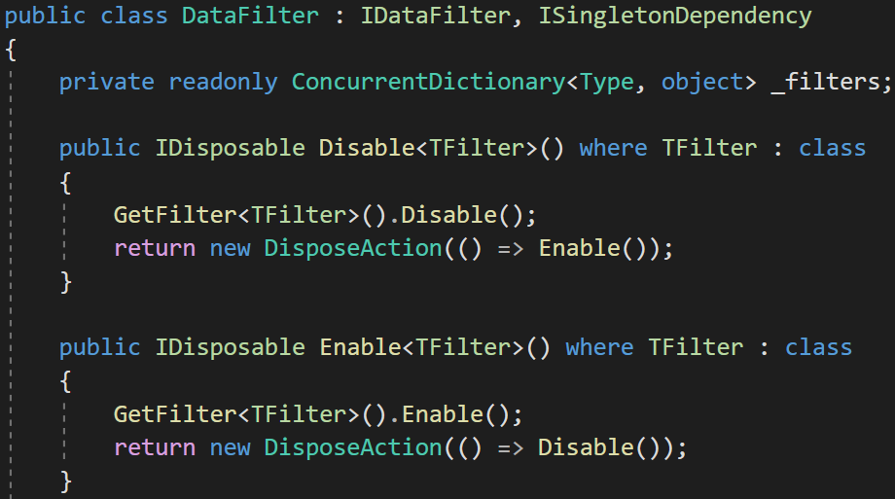
Disabling Multi-Tenancy Filter (Implementation)
Notes:
We use a singleton class called DataFilter and save all filters in a concurrent dictionary.
To keep the active passive state of a filter.
If you disable multi-tenancy filter then, it’ll be ignored in global filters.
It returns DisposableAction to allow “Using” statement

Slide 43
Database Migration
✓ Identifying the Active Tenant
✓ Data Isolation
✓ Set TenantId for New Entities
✓ DB Connection String Selection
✓ Changing the Active Tenant
✓ Temporarily Disable Multi-Tenancy
Notes:
There are 3 database migration approaches

Slide 44
Database Migration
Approach-1: Make DB migration with a custom tool
😊 Easy to implement. All tenants are in the same version
😡 May get too long time for big number of tenants and data.
😡 All tenants wait for all upgrade progress
Approach-2: Run migration on first DB access
😊 Upgrading is distributed to time. A tenant does not wait for another
😡 First user may wait too much and see timeout exception.
😡 Hard to implement (concurrency problems)!
Notes:
Approach 2: race condition

Slide 45
Database Migration — Ideal Way
Approach-3: Make two types application servers.
Upgraded tenants use the new application, other tenants use the old application
😊 Minimum wait time for a tenant
😊 Upgrading can be scheduled for tenants
😊 Run A/B tests and see bugs before anyone else
😡 Requires multiple app servers
😡 Hard to maintain and monitor
Notes:
Sometimes you see the old UI of Gmail and your friend sees the new UI.
Why doesn’t Gmail migrates everyone at the same time.
Because it’s time consuming. The migration is spread over time.
So Google separates the Gmail as old and new versions.
A tool updates the applications and databases in the background.
Each tenant is being notified if they are upgraded.
this is the ideal way For big systems !

Slide 46
Feature System
✓ Identifying the Active Tenant
✓ Data Isolation
✓ Set TenantId for New Entities
✓ DB Connection String Selection
✓ Changing the Active Tenant
✓ Temporarily Disable Multi-Tenancy
✓ Database Migration

Slide 47
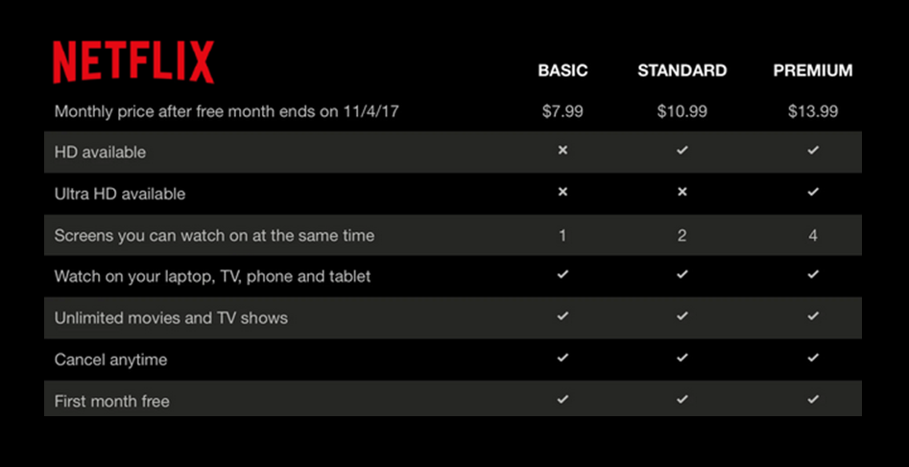
The Feature System
Editions
Features
Notes:
To explain what a feature means, first we need to know the term: Edition
A standard SaaS application sells the customers different plans with different prices.
Each subscription plan is called an edition
And each edition should consist of different features.
Netflix is a good SaaS example. It has 3 editions and 8 features
We need to enable/disable each feature based on the current tenant on runtime.
https://docs.abp.io/en/abp/latest/Features

Slide 48
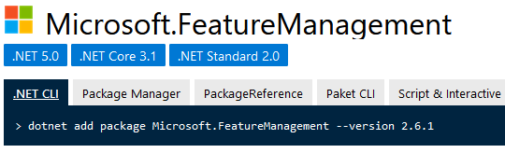
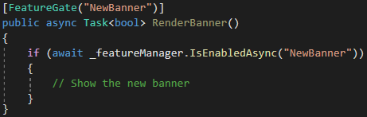
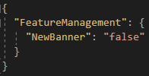
The Feature System — Microsoft’s Solution
Defined only for Boolean values
Usually for A/B testing
No multi-tenancy support
appsettings.json
Notes:
Microsoft FeatureManagement package also allows you to define feature flags
But it support only Boolean value type.
It’s commonly used for A/B testing.
It doesn’t support multi-tenancy out of the box

Slide 49
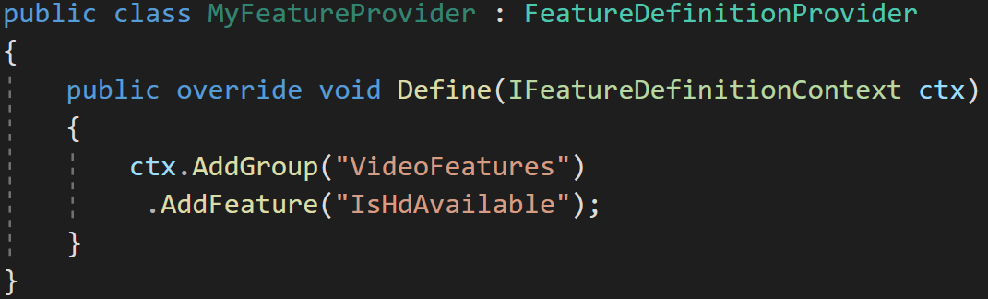
The Feature System — Define features
Features are stored in a readonly list
Notes:
Features are stored in a ReadOnlyList
https://docs.abp.io/en/abp/latest/Features

Slide 50
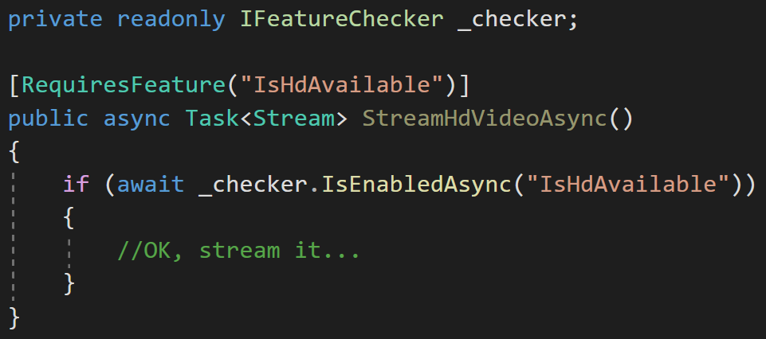
The Feature System — Check the features
Declarative check
Conditional check
Notes:
We created [RequiresFeature] attribute to be used on methods.
When you add [RequiresFeature] the ABP framework intercepts the method and injects a check before the execution of the method.
So, it works with any class that is injected from the dependency injection.

Slide 51
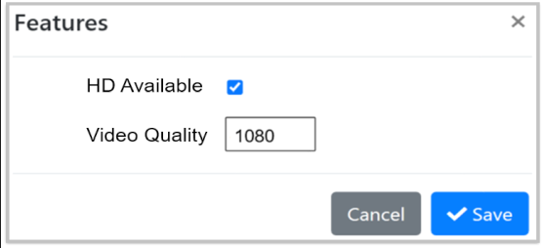
The Feature System — UI
Use a Management UI to manage features for tenants
Notes:
And we created a page for the admin user to be able to manage the tenant’s features
This screenshot is from ABP’s startup template’s admin project.

Slide 52






Thank you for listening
https://twitter.com/alperebicoglu
https://github.com/ebicoglu
open-source web application
framework
https://medium.com/@alperonline
Download this presentation:
https://github.com/ebicoglu/presentations
https://abp.io

