Slide 1

TODAY’S AGENDA
Talk#2026.06
🗣 Alper Ebicoglu
ABP Community News
🗣 Yunus Emre Kalkan
AI Coding Agent & ABP Studio

Slide 2
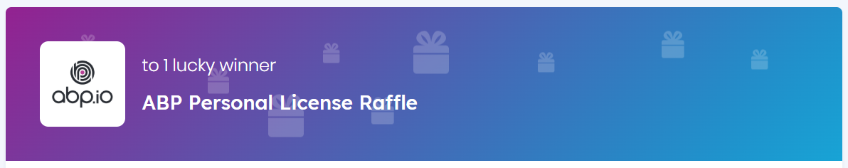
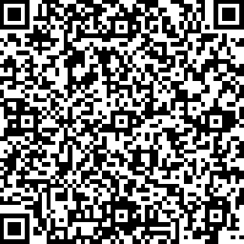

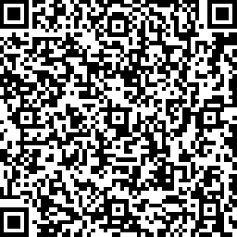
Visit abp.io/community/raffles and join these raffles for free. We’ll give them in the end of the show

Slide 3
What's New with ABP 10.7.0
Latest stable ABP version: 10.7.0 on 6 October 2026.
The release is a quality-focused milestone.
This release is primarily focused on Low-Code, documentation, stability, security, and framework polishing,
🚀 Low-Code & Studio
Major expansion of Low-Code documentation:
  Existing solution integration
  Formula properties & navigation
  10.7 workflows
  Minimal formula definitions
  Vendor onboarding guide
  Community articles
ABP Studio:
  MCP integration documentation
  MCP server docs restored
  CLI abp mcp command documented
  Studio releases: 3.0.8 → 3.0.9 → 3.0.10 → 3.1.0

Slide 4
What's New with ABP 10.7.0
📚 Documentation
Prepared documentation for 10.6 and 10.7 RC releases.
Added:
  React CRUD generation docs
  React API synchronization guide
  BLOB provider selection
  ABP vs ASP.NET Zero refresh
  ABP Suite legacy many-to-many regeneration
Numerous fixes to images, formatting, and release posts.

Slide 5
What's New with ABP 10.7.0
🛠 Framework Improvements
Added HTTP QUERY method support.
Added HasAbpJsonConversion property builder extension.
Better request cancellation support (RequestAborted).
Unit of Work improvements (complete before response starts).
Better handling of dynamic background jobs/events.
ConfigureAwait shared MSBuild property.

Slide 6
What's New with ABP 10.7.0
🔒 Security & Reliability
Fixed antiforgery authentication ordering.
Improved identity session validation.
Prevented last sign-in concurrency issues.
Tenant connection strings:
  removed from audit logs
  hashed for API keys
  sent in request body instead of URL.

Slide 7
What's New with ABP 10.7.0
🎨 UI / UX
MudBlazor improvements:
  toolbar refresh
  active-tab rendering
  dialog focus
  dispatcher updates
  action menu fixes
Accessible password visibility toggles.
Removed indeterminate "Grant All" permission state.
Branding/logo URL fixes.

Slide 8
What's New with ABP 10.7.0
⚡ Performance & Data
Fixed Mapperly ExtraProperties.
Fixed MySQL EF Core 10 issues.
Query ordering before paging.
Aggregate root update optimization.
User deletion cleanup improvements.

Slide 9
What's New with ABP 10.7.0
🌐 Frontend & Dependencies
Upgraded many packages including:
MudBlazor 9.7
Blazorise 2.3
jQuery 4
MongoDB.Driver 3.12
Npgsql 10.0.3
AWS SDK
Angular 22.1
React dependency updates

Slide 10
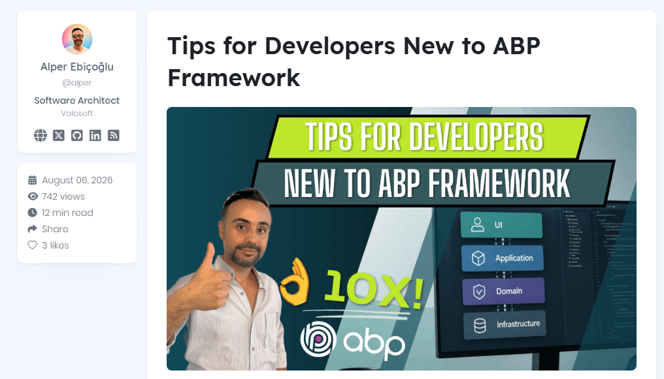

Scan to go to website
Notes:
A practical guide for ASP.NET Core developers learning ABP Framework, covering common barriers, CRUD vs real modules, DDD trade-offs, and a better path.

Slide 11
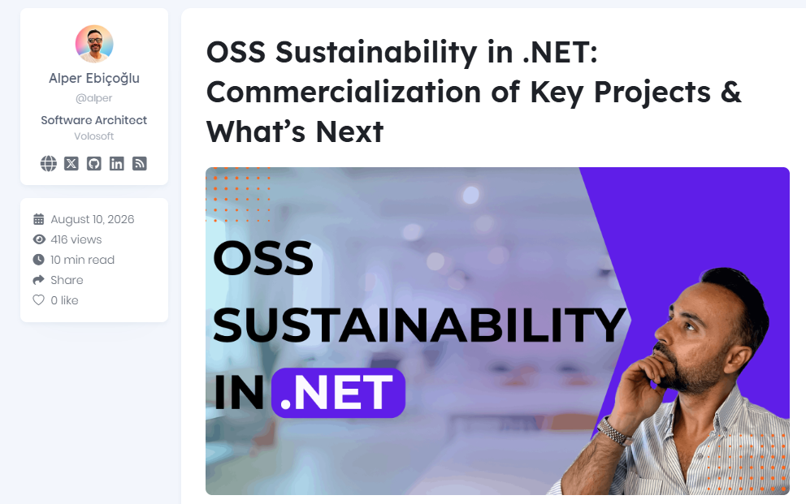
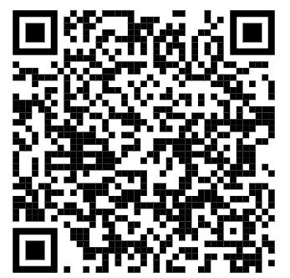
Scan to go to website
Notes:
A reflective look at why major .NET OSS projects are going commercial, what it means for teams, and how to manage dependency risk.

Slide 12
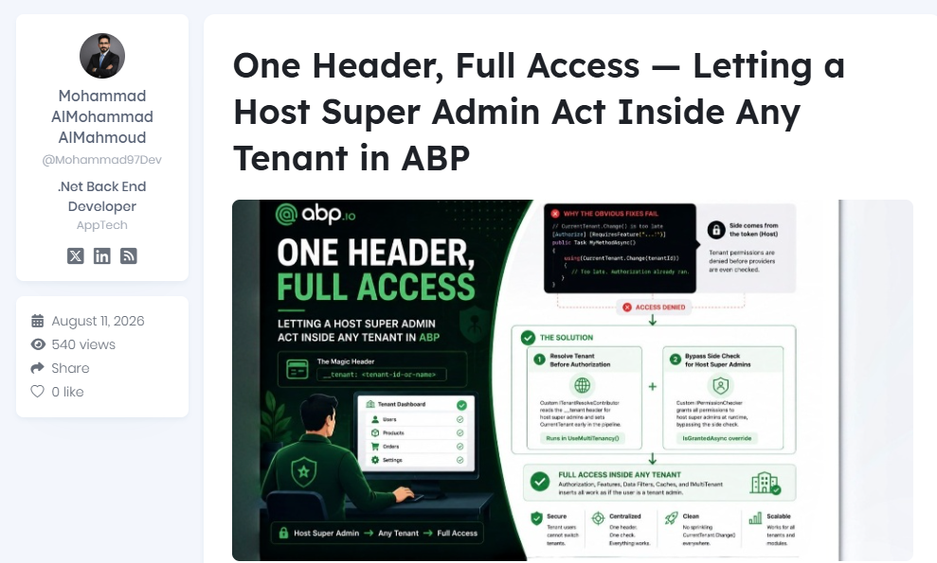

Scan to go to website
Notes:
A practical ABP.io solution that lets a Host Super Admin access any tenant using the __tenant header, without changing tenant IDs inside every method. It explains why CurrentTenant.Change() and custom permission providers fail, then introduces a tenant resolver and permission checker to make authorization work correctly across the tenant.

Slide 13
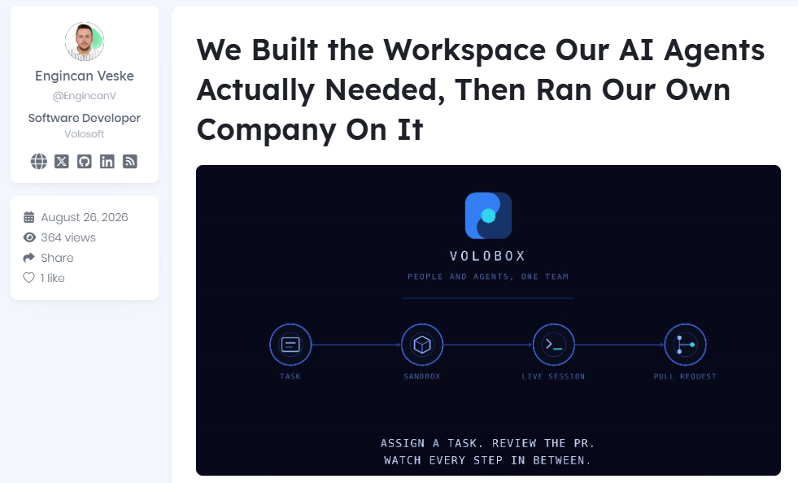

Scan to go to website
Notes:
Read to learn how Volobox turns an assigned task into a reviewed pull request with every step visible, permissioned, and audited...

Slide 14
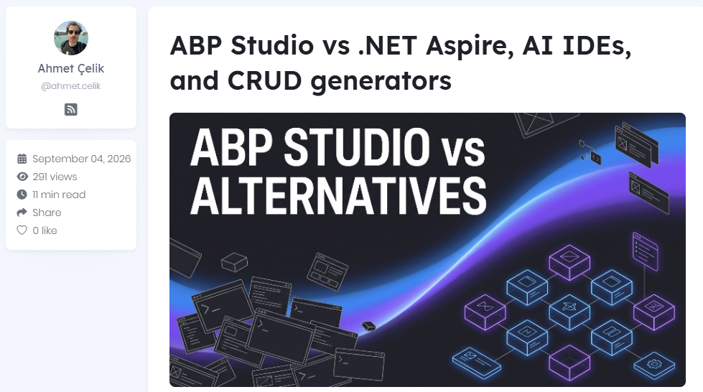

Scan to go to website
Notes:
Compare ABP Studio with .NET Aspire, generic AI IDEs, and CRUD generators, and see how Studio, Agent, Solution Runner, and Suite fit together across solution structure, runtime workflows, and UI generation.

Slide 15
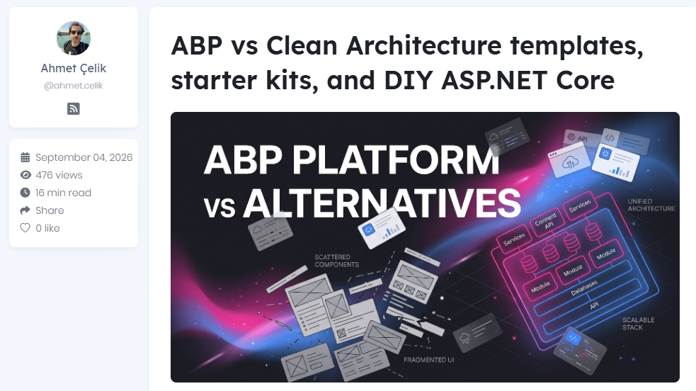

Scan to go to website
Notes:
Compare ABP Platform with DIY ASP.NET Core, Clean Architecture templates, and starter kits, and learn which trade-offs matter for multi-tenancy, identity, modularity, UI choices, and long-term maintenance.

Slide 16
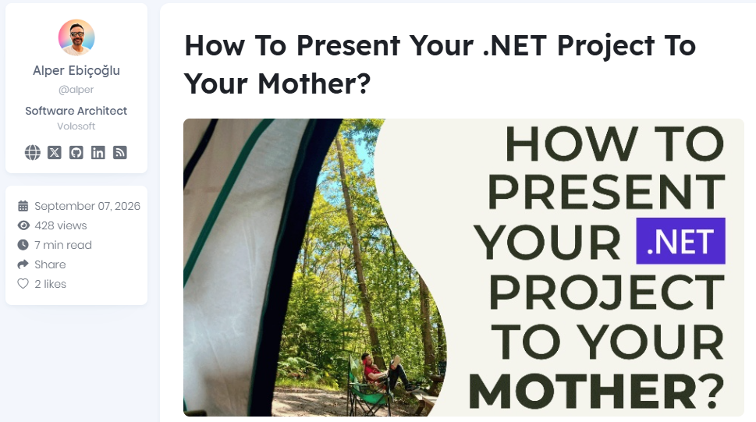

Scan to go to website
Notes:
Ever tried explaining your project to your mother or kid… and realized you have no idea how to explain it without technical jargon? 😅 This article explores how to explain your technical project to non-IT people so that they can understand... But without dumbing them down. From choosing the right words and analogies to handling the questions you didn’t expect, it might completely change how you present your next project. And yes, your mother is the ultimate test. 😉

Slide 17
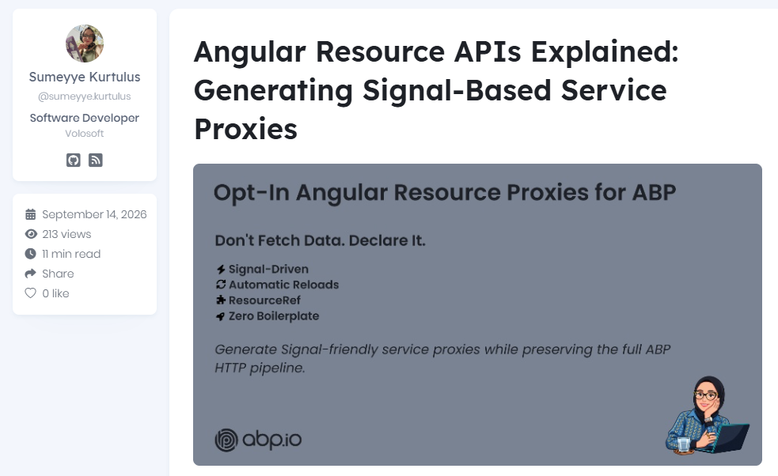

Scan to go to website
Notes:
Angular Resource APIs introduce a declarative, Signal-driven approach to data fetching, eliminating much of the boilerplate traditionally associated with asynchronous state management. In this article, we'll explore Angular's Resource APIs, compare them with Observable-based patterns, and see how ABP integrates them into generated service APIs. You'll learn when to use Resource APIs, how they work under the hood, and how they help you build cleaner, more reactive Angular applications.

Slide 18
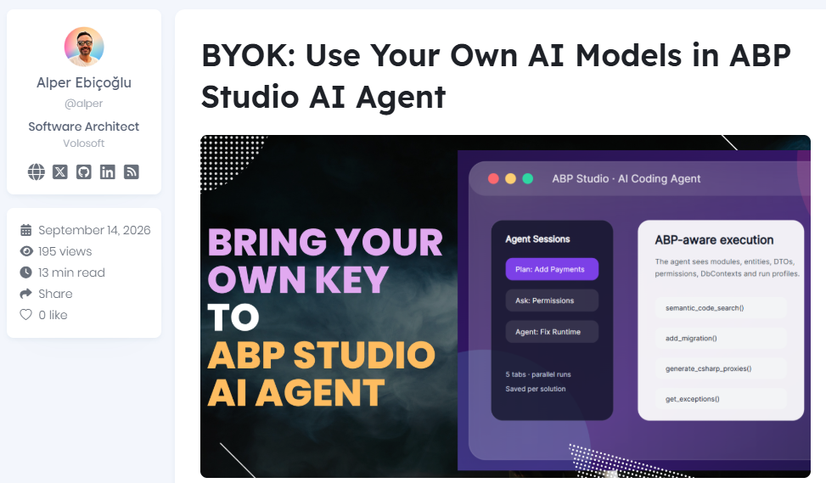

Scan to go to website
Notes:
Learn how ABP Studio's AI Agent now supports "Bring Your Own Key" (BYOK): connect your own OpenAI-compatible service, Azure OpenAI, or local Ollama server instead of using Built-in AI.

Slide 19
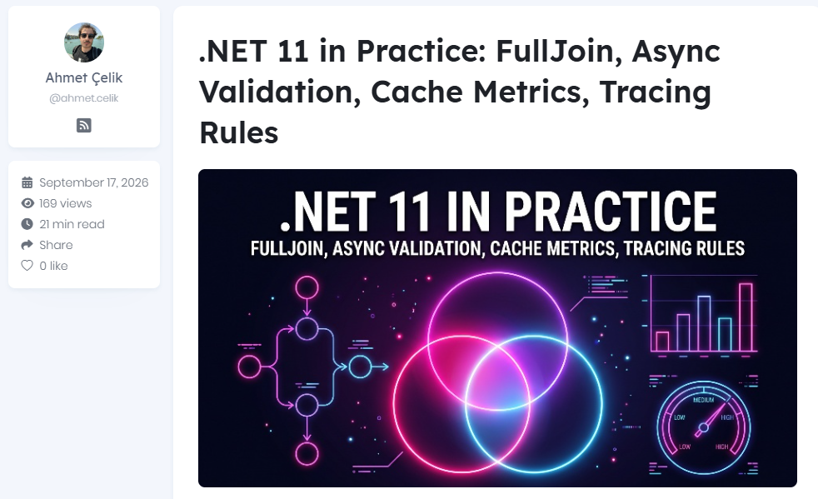

Scan to go to website
Notes:
A hands-on look at four .NET 11 features you will use in everyday code: LINQ FullJoin, async DataAnnotations validation, built-in MemoryCache metrics, and configuration-driven Activity tracing rules. Each one comes with a runnable example, real output from RC1, the gotchas found while testing, and an adoption checklist. All examples live in a sample app with 28 tests.

Slide 20
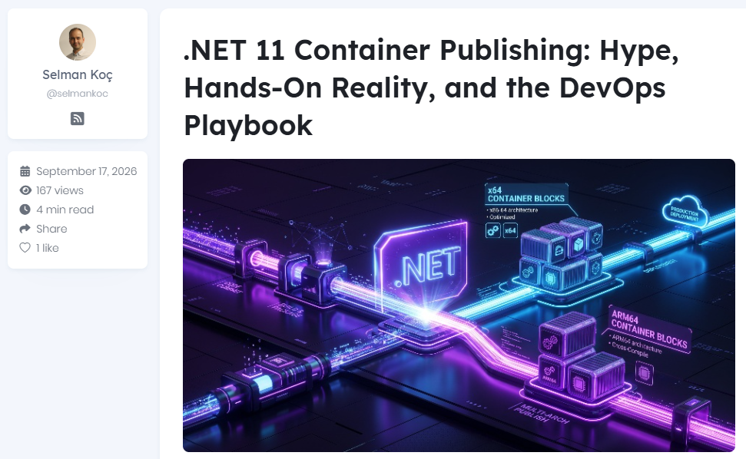

Scan to go to website
Notes:
Shipping multi-platform, secure containers without maintaining complex Dockerfiles is the holy grail for platform engineering. With .NET 11 (Release Candidate 1), Microsoft heavily markets its built-in SDK container publishing as the solution. But marketing claims and CI/CD realities often clash.

Slide 21
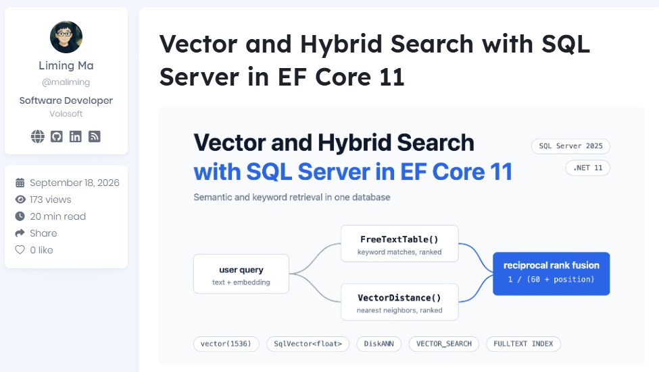

Scan to go to website
Notes:
SQL Server 2025 added a vector type, distance functions, and DiskANN vector indexes. EF Core 10 made the storage side usable from .NET. EF Core 11 adds the remaining query-side building blocks: approximate search over a vector index, full-text search table-valued functions, and translation for .NET 11's new FullJoin operator. This article follows that help center from the first embedding to a working hybrid search, adding each feature at the point where the previous step stops being enough.

Slide 22
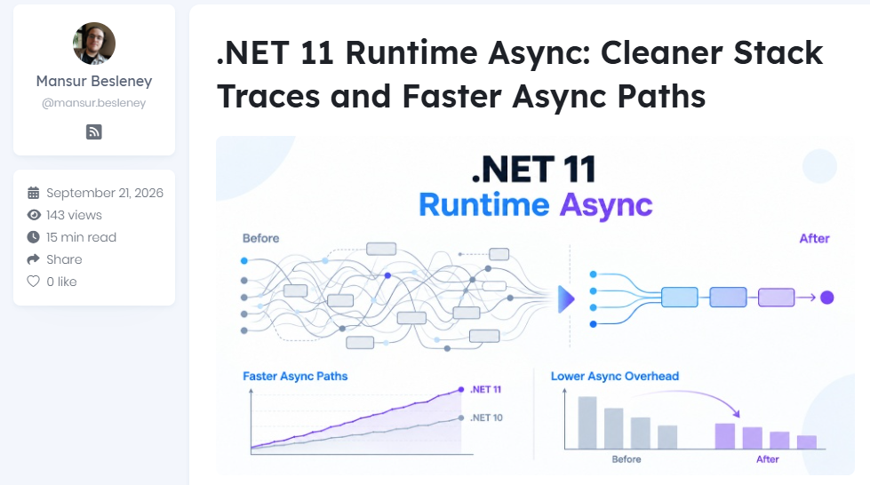

Scan to go to website
Notes:
This article explores the new Runtime Async improvements in .NET 11, focusing on cleaner live async stack traces and faster async execution paths. It explains how moving more async handling into the runtime and JIT can reduce overhead, improve debugging, and create new performance optimization opportunities while keeping the familiar async/await programming model unchanged.

Slide 23
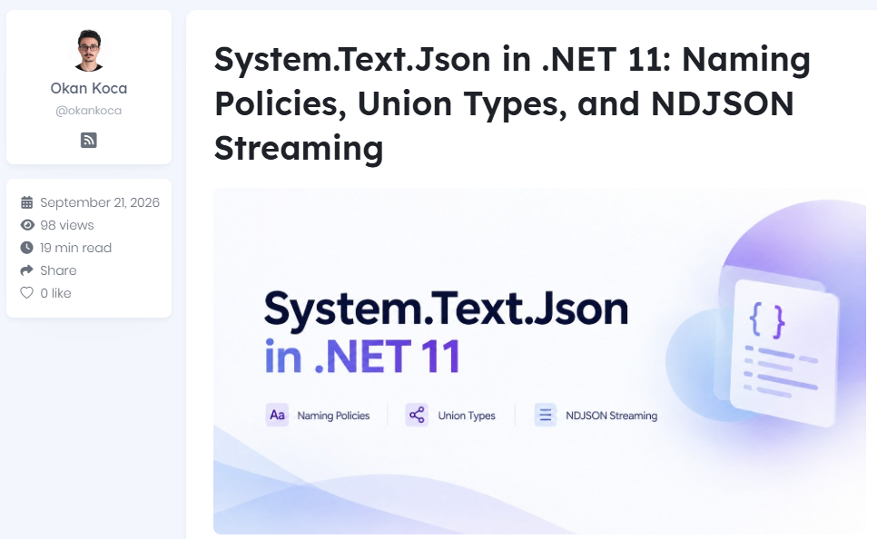

Scan to go to website
Notes:
Explore the key System.Text.Json improvements in .NET 11, including flexible naming policies, C# union type serialization, and NDJSON streaming. This article demonstrates these features with runnable ASP.NET Core examples and explains their impact on API contracts, frontend clients, OpenAPI, streaming, performance, and production adoption.

Slide 24
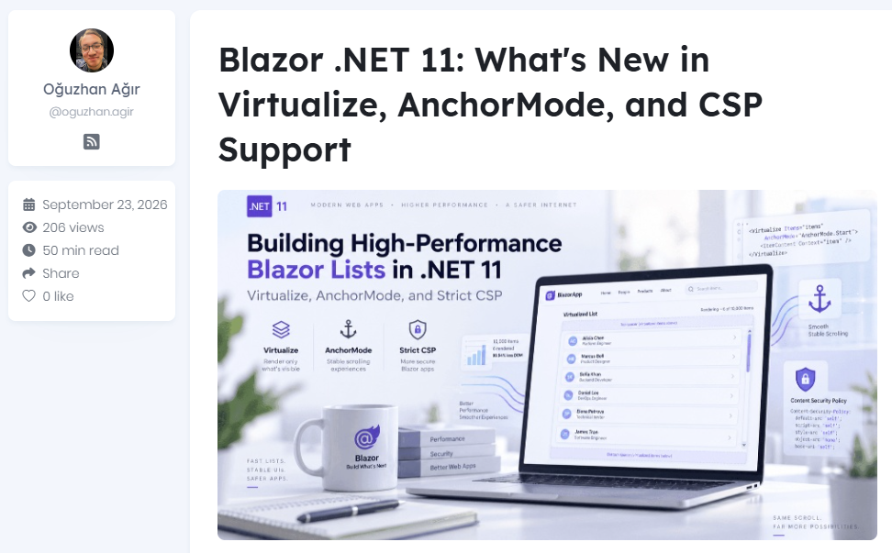
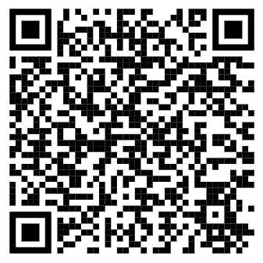
Scan to go to website
Notes:
Explore Blazor .NET 11's Virtualize improvements, including variable-height items, scroll anchoring, AnchorMode, and strict Content Security Policy support. Build efficient feeds, chats, and data grids with practical code examples, performance benchmarks, cross-browser tests, and production considerations based on .NET 11 RC1.

Slide 25
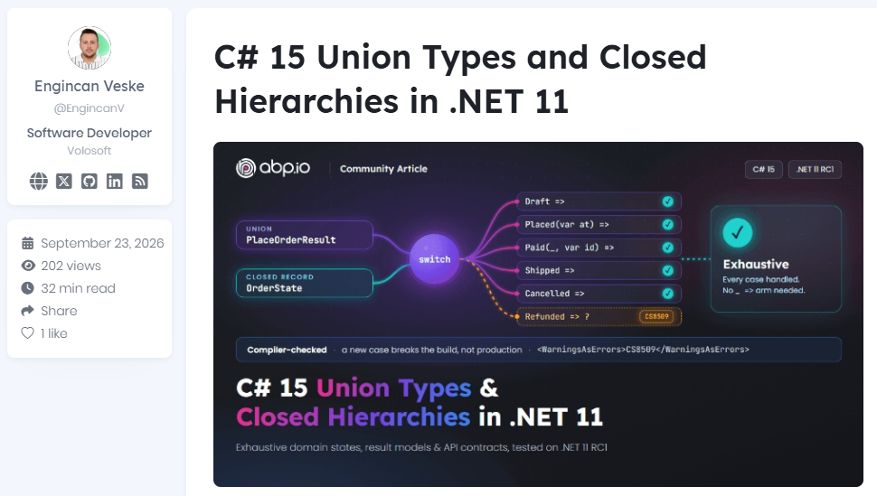
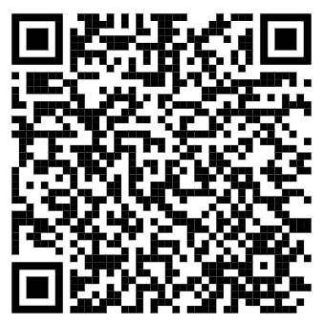
Scan to go to website
Notes:
In this article, we'll start with the simplest possible usage of each feature, look at what they actually compile to, compare them with the patterns we use today, and then build a small order API where both features do real work. I built and tested every example on .NET 11 RC1, and I'll share the exact outputs, including a few surprises that ABP developers should know about before they start using these features.

Slide 26
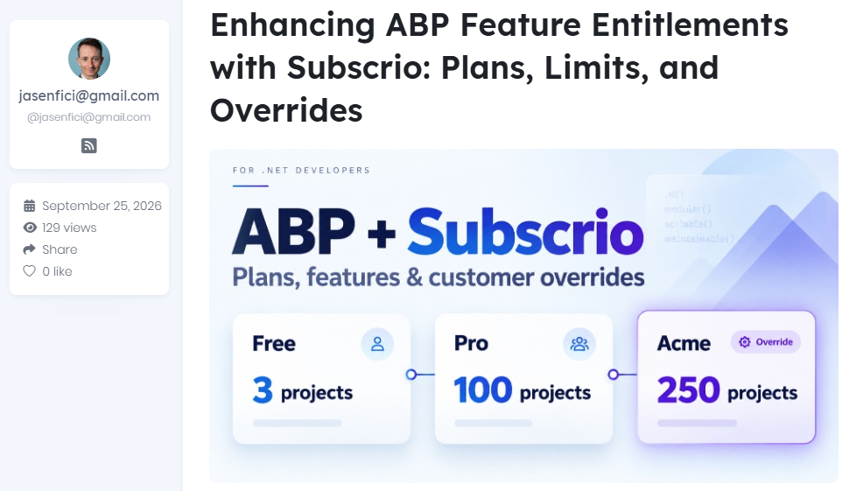

Scan to go to website
Notes:
Add enhanced plans, feature limits, and customer overrides to ABP with Subscrio, a free, open-source entitlement engine. Follow a working .NET sample from feature defaults to plan values and a customer-specific override, while application code keeps using IFeatureChecker. Supports recurring subscriptions, one-time purchases, and lifetime access.

Slide 27
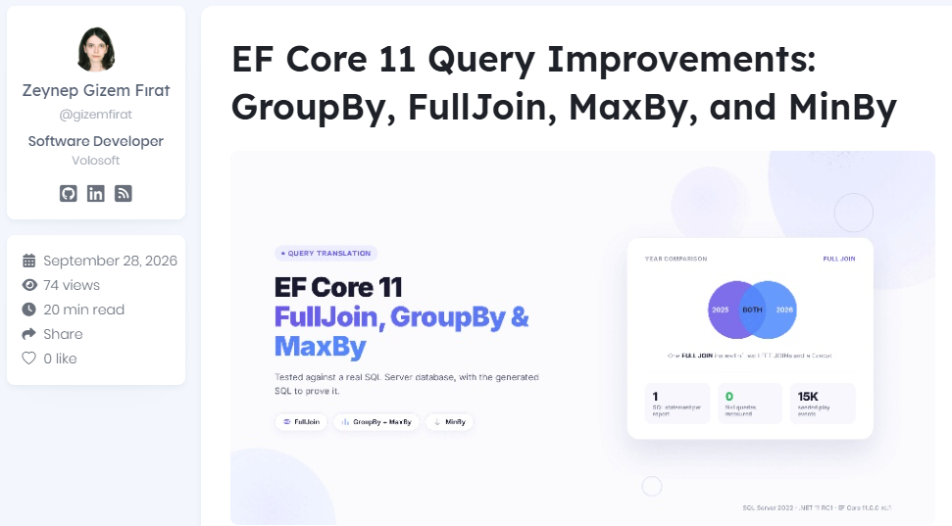

Scan to go to website
Notes:
A hands-on look at EF Core 11's LINQ translation improvements (FullJoin, GroupBy with MaxBy, MinBy/MaxBy and leaner split queries), tested against a real SQL Server database with a music "year in review" report. Each feature comes with the generated SQL, and a test proves the GroupBy + MaxBy query runs in a single round-trip.

Slide 28
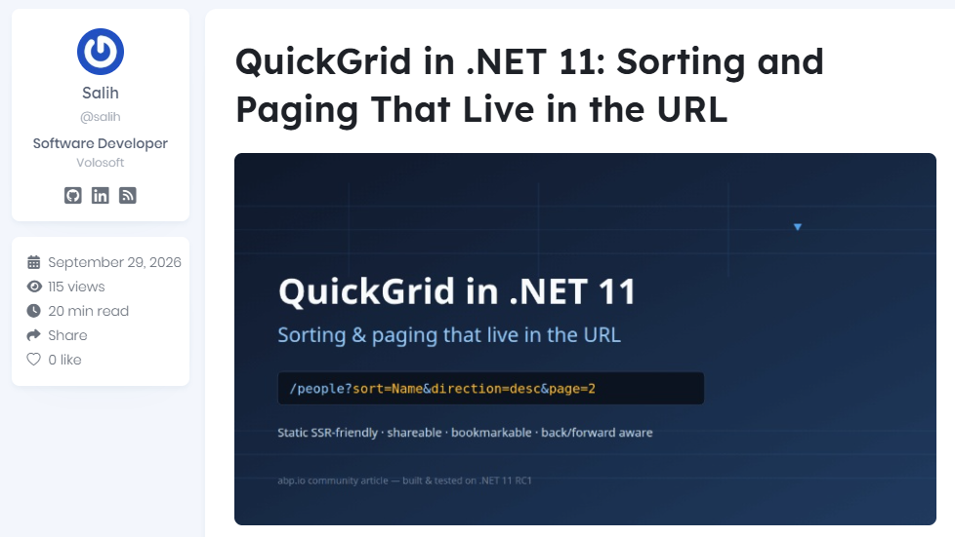

Scan to go to website
Notes:
.NET 11 puts QuickGrid's sort and page state in the URL (?sort=Name&direction=desc&page=2), so sorting and paging finally work on statically rendered Blazor pages — and every grid state becomes a link you can share, bookmark, or go Back to. A working static-SSR sample, tested edge cases, and the RC1 caveats to know before adopting it.

Slide 29
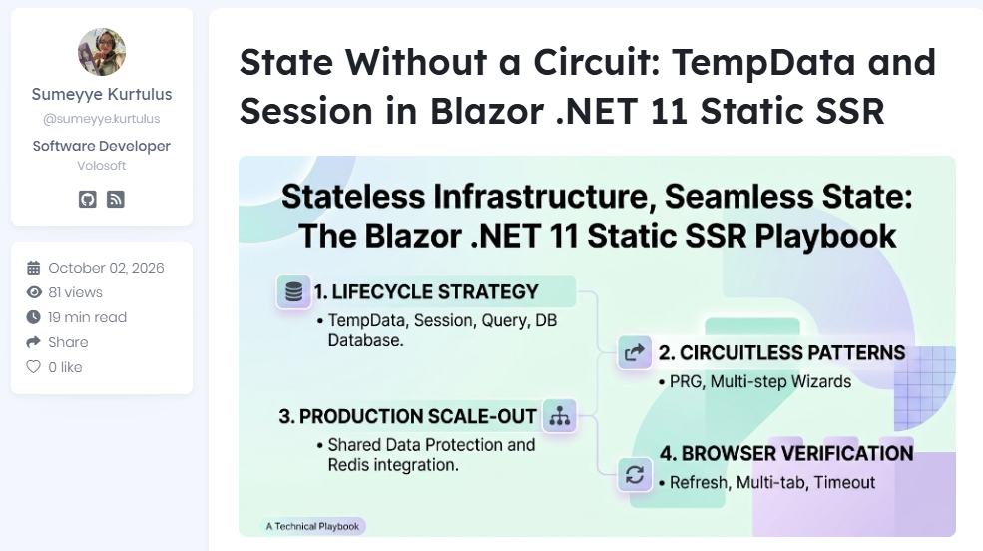
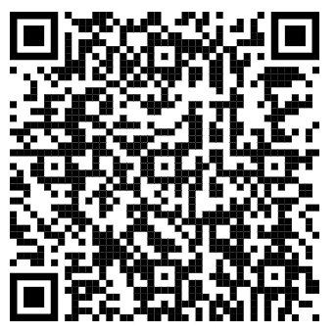
Scan to go to website
Notes:
A practical, deep-dive guide for .NET developers on managing state in Blazor .NET 11 Static SSR using [SupplyParameterFromTempData] and [SupplyParameterFromSession] explaining real-world PRG patterns, multi-step wizards, security, scale-out, and browser matrix verification without SignalR circuits.

Slide 30
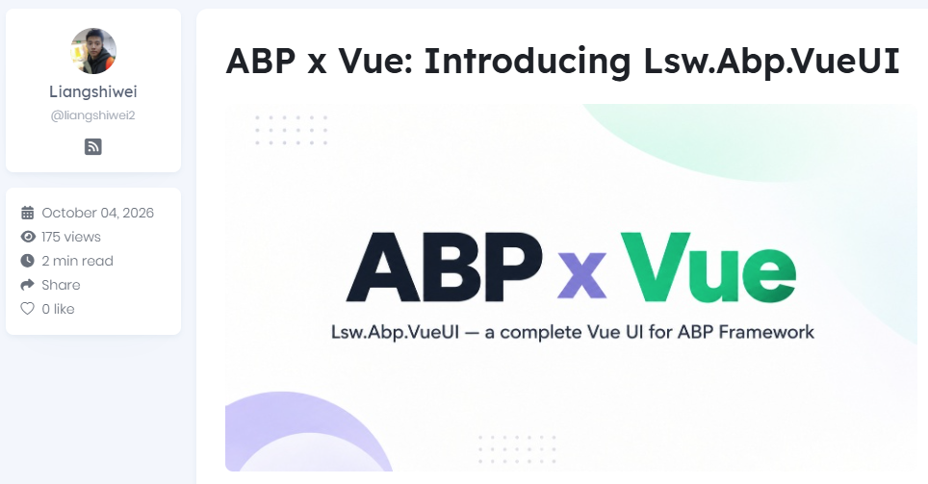

Scan to go to website
Notes:
Introducing Lsw.Abp.VueUI, a complete Vue 3 frontend for ABP Framework, with built-in modules, extensible pages, multiple themes, and a familiar ABP development experience.

Slide 31
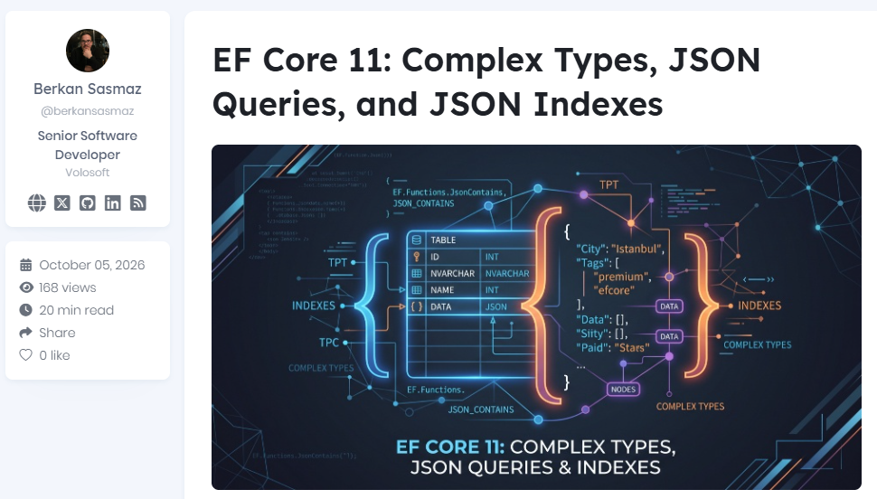
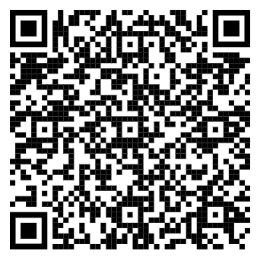
Scan to go to website
Notes:
Master EF Core 11 JSON capabilities, JSON indexing, and Complex Types with SQL Server 2025 to drastically boost .NET performance. Learn how ToJson(), JSON_CONTAINS, and LINQ querying allow high-speed document search directly inside relational tables without losing strong typing. Build efficient hybrid database architectures by combining JSON persistence with TPT/TPC inheritance in modern C# applications.

Slide 32
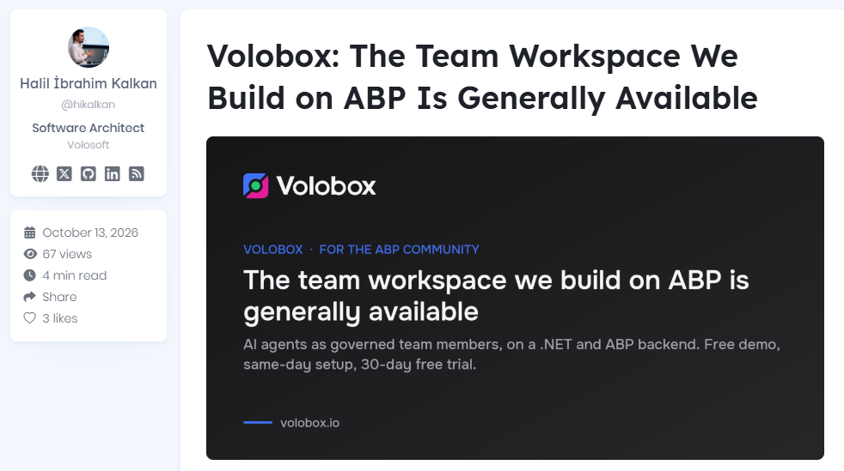

Scan to go to website
Notes:
ıntroducing Volobox to the ABP Community. Volobox is a new workspace where people and agents work as one team
https://volobox.io/

Slide 33
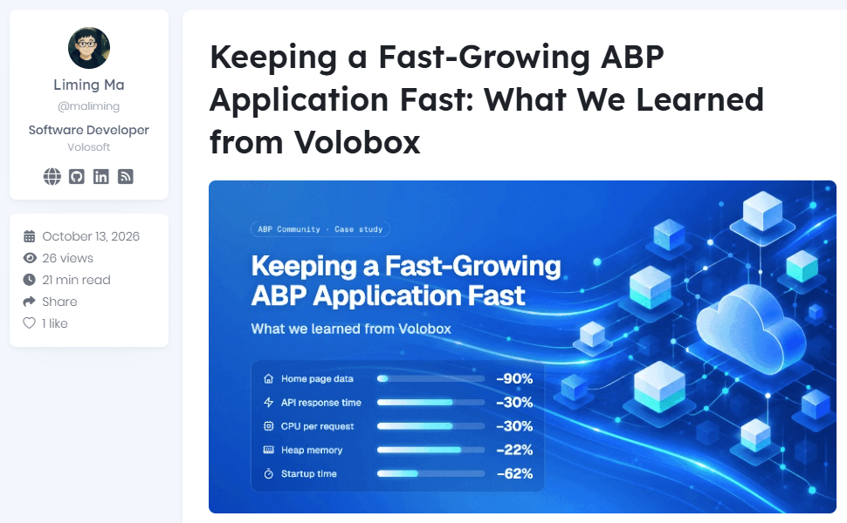

Scan to go to website
Notes:
Volobox is an ABP application with a React front end, and it moves fast: new features ship every few days. Between mid-August and early October, we added video meetings, calendar sync, booking pages and support desks with a customer portal. We also added a choice of coding agents and coding sessions on your own machines. And it got much faster: between two releases, the home page data took about 90% less time in a warm API replay against production, and the median replay now finishes in under half a second.

Slide 34
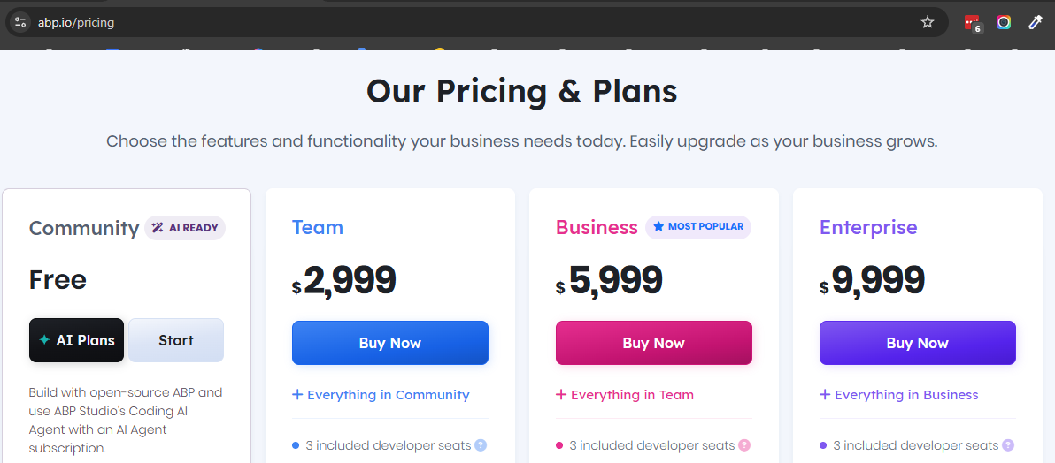
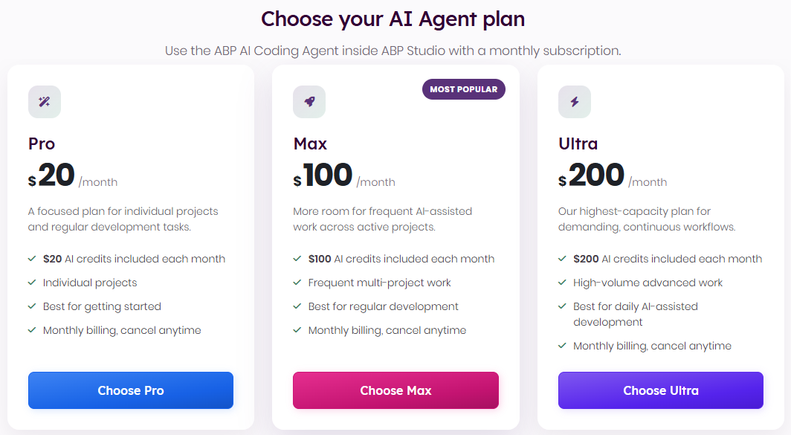

Slide 35
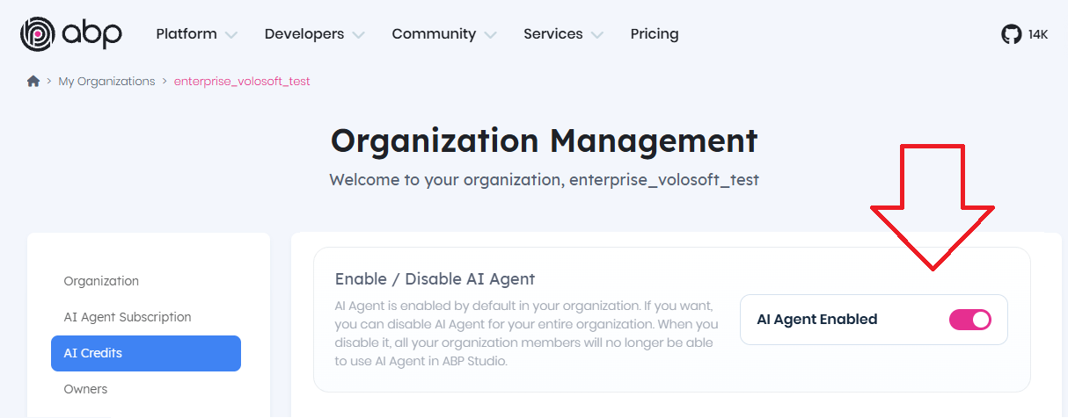
ENABLE/DISABLE AI AGENT AT YOUR ORGANIZATION

Slide 36
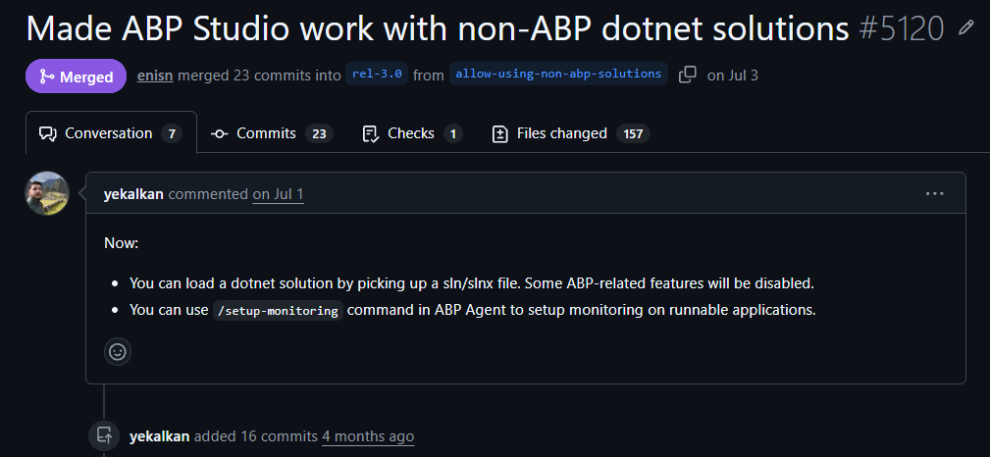
ABP STUDIO NOW WORKS WITH ALL .NET SOLUTIONS
YES, EVEN IF IT’S NOT AN ABP PROJECT
Notes:
This PR lets ABP Studio open any plain .NET solution (via `.sln`/`.slnx`) by introducing a `SolutionKind` (Abp vs DotNet) that gates ABP-specific features throughout the app, and adds a new lightweight monitoring client (`Volo.Abp.Studio.General.Client.*`) so non-ABP apps can still stream logs/requests/exceptions to Studio.

Slide 37
WHAT YOU CAN DO WITH ABP STUDIO ON NON-ABP PROJECTS
Area | What works
Opening solutions | Pick a .sln/.slnx file directly — Studio detects it's a plain .NET solution (SolutionKindDetector looks for ABP package refs / AbpModule usage; defaults to DotNet if none found)
Run profiles | Auto-generates run profiles for any runnable project (RunnableProjectInspector classifies Web/Worker/Console projects by SDK + OutputType), not just ABP "host" packages
AI Agent | Fully usable with a parallel generic .NET prompt set (DotNetAgentModeBasePrompt, DotNetPlanModeBasePrompt, DotNetAskModeBasePrompt) — no ABP framing, generic SOLID/.NET guidance instead
Code discovery tools | read_files, search_code, semantic_code_search, find_files all work; get_outlines (ABP package analysis) is hidden/skipped since it needs ABP metadata
Build / Run / Start-Stop apps | Still available (via dotnet build, run_tests, start_applications, etc.)
Shell commands | Available with a .NET-flavored tool description (no ABP module jargon)
Git code review | Works, using a non-ABP review system prompt (BuildDotNetBaseSystemPrompt) — no "research_abp_docs" tool, reviews focus on general .NET/C# quality, security, performance
Subagents | research, websearch, browser subagents work, with .NET-specific tool sets/prompts (DotNetResearchTools); abpdocsearcher is explicitly blocked with a message to use websearch/research instead
Slash command: /setup-monitoring (new) | Scans the solution for ASP.NET Core web projects and has the agent install/wire the new Volo.Abp.Studio.General.Client.AspNetCore package into Program.cs/Startup.cs (handles minimal hosting, Serilog, Startup-based, and generic host patterns)
Runtime monitoring (Logs/Requests/Exceptions) | Once the General Client package is installed, Studio's monitoring tabs work for plain .NET apps too, via a new gRPC-based IStudioHub link — independent of ABP Framework/distributed event bus
Lesson saving | Available, with .NET-flavored wording (no ABP doc references)

Slide 38
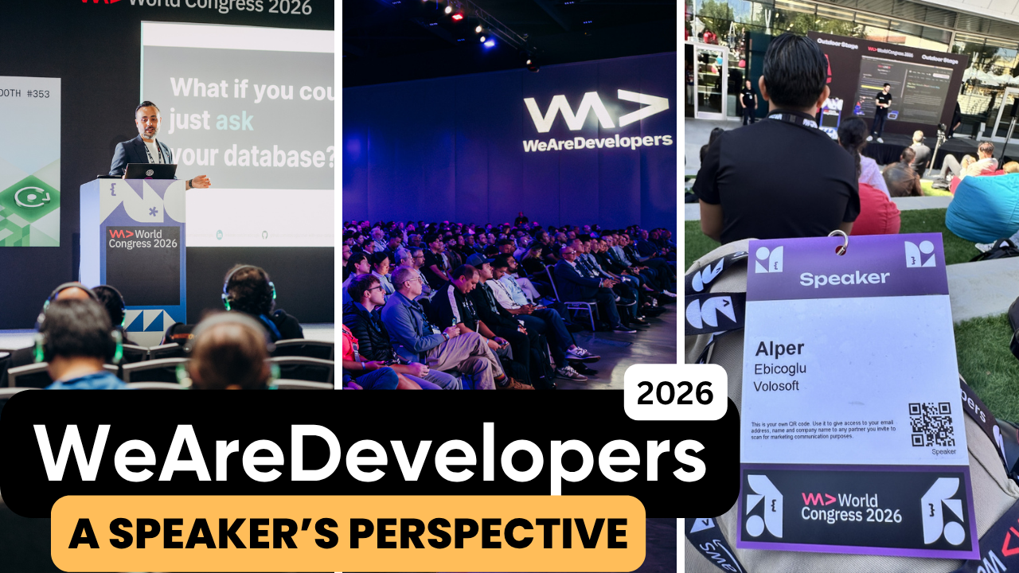
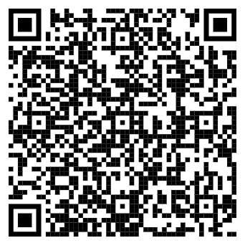
Scan to read this article
San Jose

Slide 39
THAT’S ALL FROM ME ☺

