Slide 1
What are the key differences between layered and microservices architectures, and how do they impact scalability and maintainability?
In which scenarios would a modular monolithic architecture be more advantageous than adopting microservices?
How does the complexity of managing microservices compare to that of a well-structured layered architecture?
What are the challenges associated with transitioning from a layered architecture to a microservices-based system?
How do deployment strategies differ between modular and microservices architectures?
What are the performance implications of inter-service communication in microservices compared to intra-layer communication in layered architectures?
How does data management differ between modular monolithic and microservices architectures, particularly concerning data consistency and integrity?
What are the best practices for maintaining module boundaries within a modular monolithic architecture to prevent tight coupling?
How do layered and microservices architectures handle cross-cutting concerns like security and logging?
What factors should be considered when deciding between a layered, modular, or microservices architecture for a new project?

Slide 2
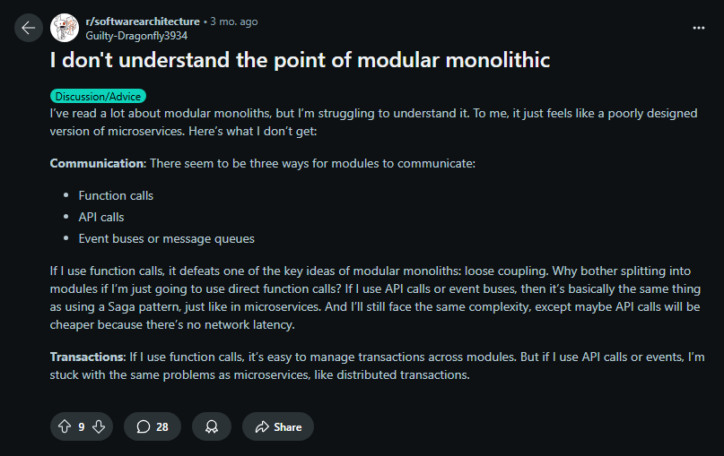
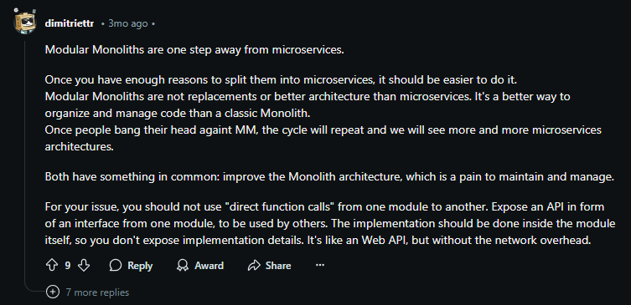

Slide 3


Notes:
Microservices gained popularity for their modularity and scalability, but they often introduce significant complexity and challenges, especially in messaging and maintenance, which can hinder rapid development and MVP delivery. A Modular Monolith approach combines the benefits of monoliths and microservices by organizing code into distinct modules within a single system, reducing plumbing complexity while retaining scalability and separation of concerns as the system evolves.
https://hexmaster.nl/posts/are-modular-monoliths-a-winner/

Slide 4


Notes:
https://www.reddit.com/r/dotnet/comments/15sltta/are_modular_monoliths_a_winner/

Slide 5

Notes:
https://www.reddit.com/r/dotnet/comments/15sltta/comment/jwfiefs/

Slide 6

Notes:
https://www.reddit.com/r/dotnet/comments/15sltta/comment/jwfgo8i/

Slide 7
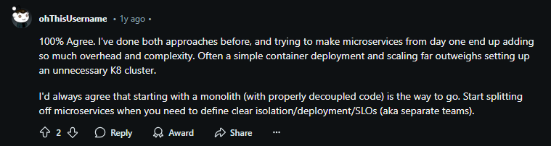
Notes:
https://www.reddit.com/r/dotnet/comments/15sltta/comment/jwhr6ae/

Slide 8

Notes:
https://www.reddit.com/r/dotnet/comments/15sltta/comment/jwfj5f8/

Slide 9
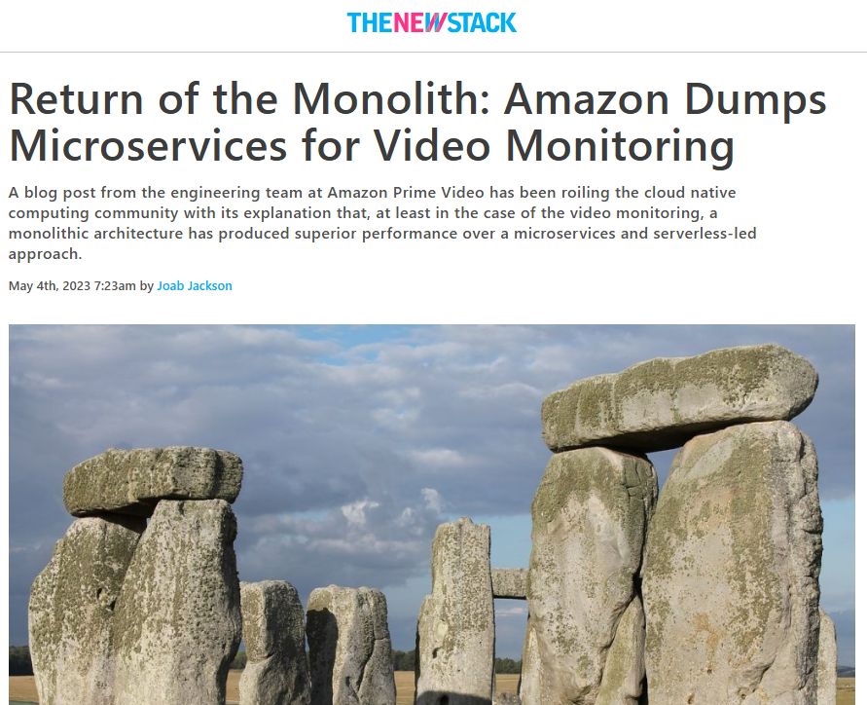
https://thenewstack.io/return-of-the-monolith-amazon-dumps-microservices-for-video-monitoring/
Notes:
Amazon returned to a Monolith for there Video Monitoring
https://thenewstack.io/return-of-the-monolith-amazon-dumps-microservices-for-video-monitoring/

Slide 10
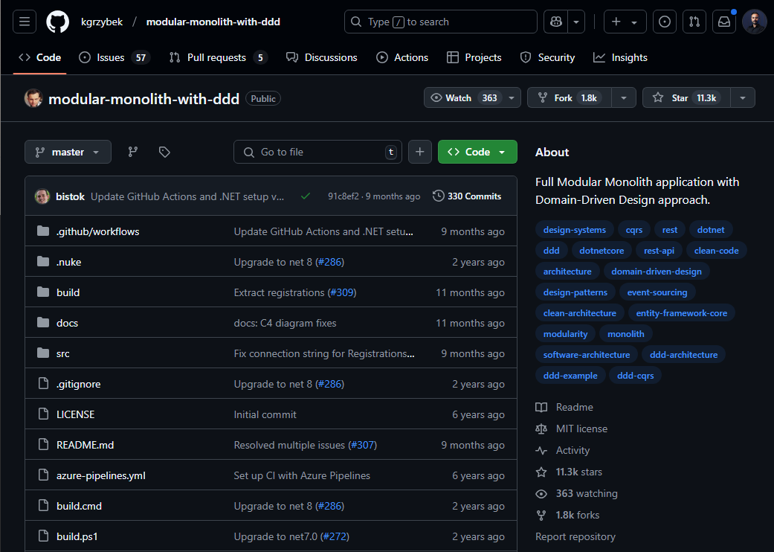
https://github.com/kgrzybek/modular-monolith-with-ddd
Notes:
https://github.com/kgrzybek/modular-monolith-with-ddd

Slide 11

Notes:
https://www.reddit.com/r/softwarearchitecture/comments/1f75l7r/is_it_efficient_to_orchestrate_a_modular_monolith/

Slide 12

Notes:
https://www.reddit.com/r/csharp/comments/pyt0ka/implementing_pub_sub_in_a_modular_monolith/

Slide 13

Notes:
https://www.reddit.com/r/dotnet/comments/1bd6g2p/modular_monolith_and_relationships/

Slide 14
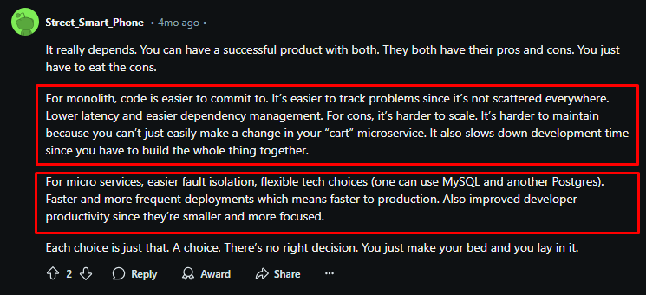
Notes:
https://www.reddit.com/r/sre/comments/1fg19nl/comment/ln087u2/

Slide 15

Notes:
https://www.reddit.com/r/softwarearchitecture/comments/1c9z9sv/acid_and_rollback_in_modular_monolith/

Slide 16
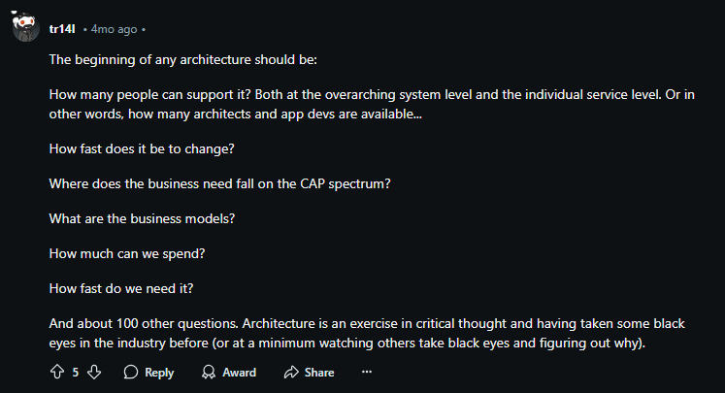
Notes:
https://www.reddit.com/r/softwarearchitecture/comments/1f75l7r/comment/ll7f0o2/

Slide 17
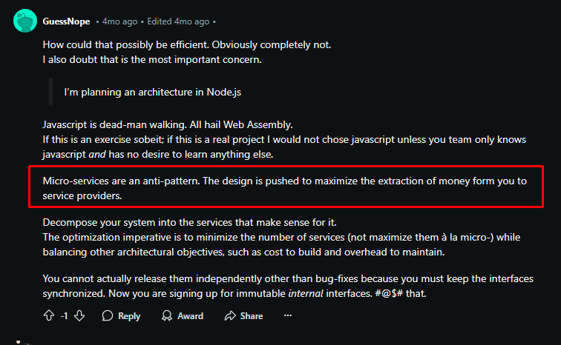
Notes:
https://www.reddit.com/r/softwarearchitecture/comments/1f75l7r/is_it_efficient_to_orchestrate_a_modular_monolith/

Slide 18
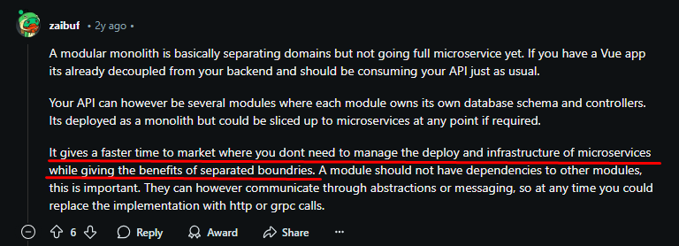
Notes:
https://www.reddit.com/r/csharp/comments/101bp7h/comment/j2mykuj/

Slide 19

Notes:
https://www.reddit.com/r/softwarearchitecture/comments/1f75l7r/comment/ll75f59/

Slide 20


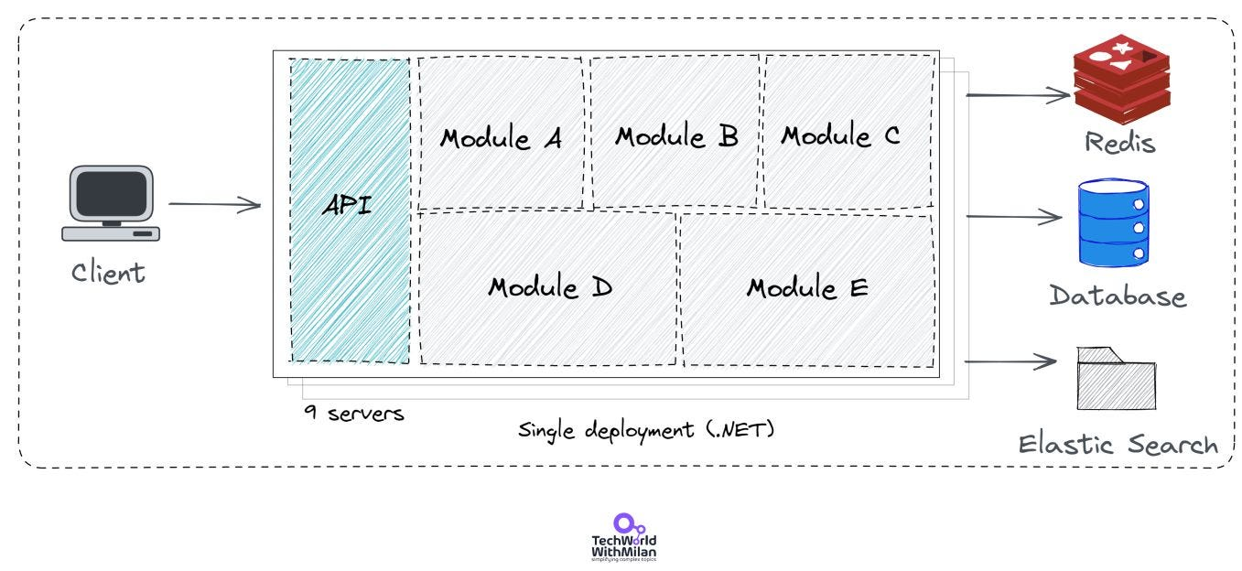
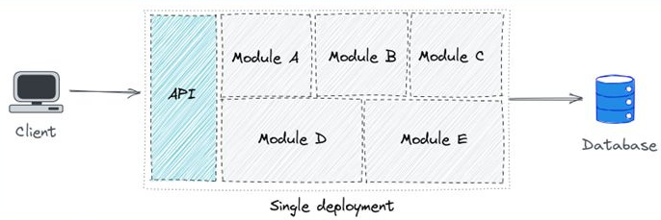
Notes:
https://newsletter.techworld-with-milan.com/p/stack-overflow-architecture

Slide 21

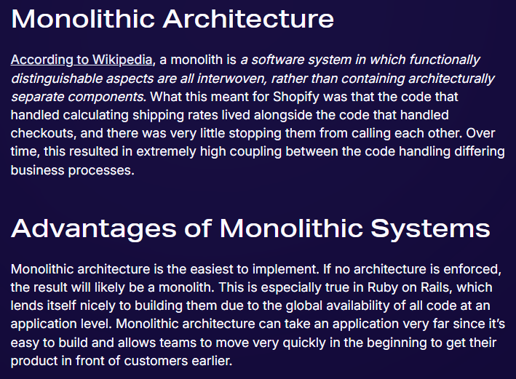
Notes:
https://shopify.engineering/deconstructing-monolith-designing-software-maximizes-developer-productivity

Slide 22
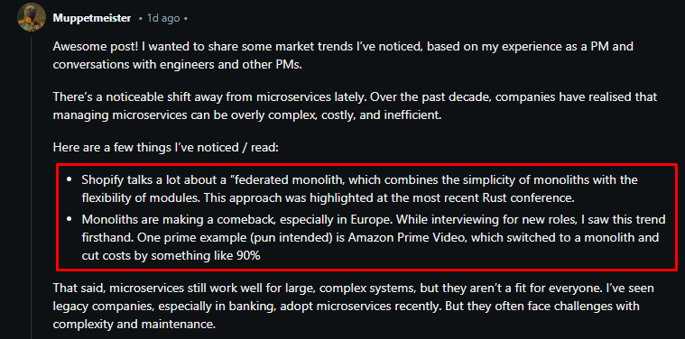
Notes:
https://www.reddit.com/r/ProductManagement/comments/1hqlj8u/comment/m4rrct0/

