Slide 1






ABP Community News
Alper EBICOGLU
@alperebicoglu
ABP Core Team Member
@ebicoglu

Slide 2

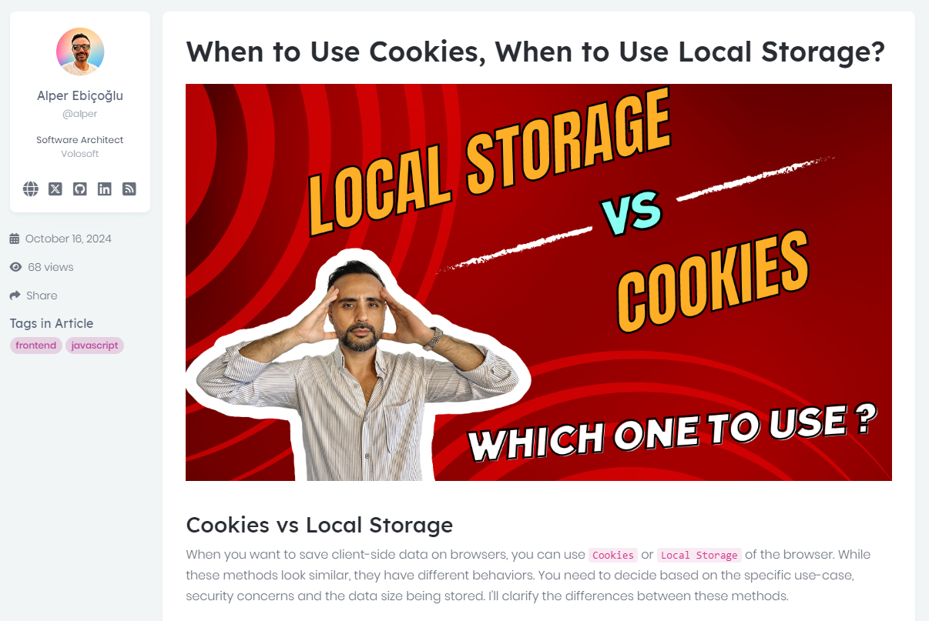
Community News

Slide 3
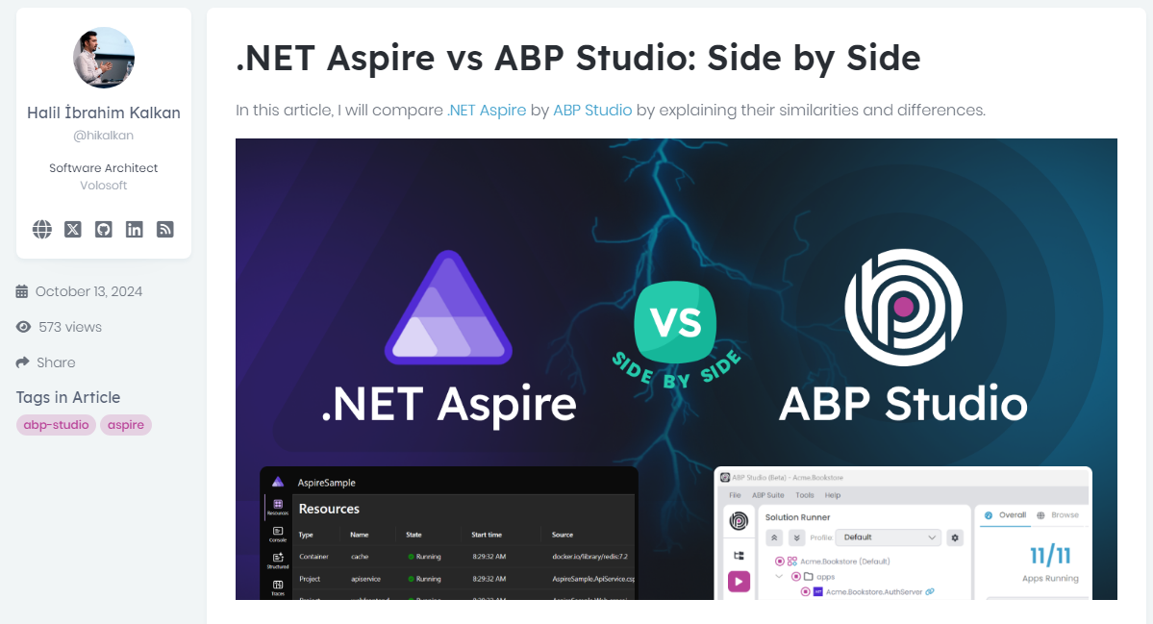
Community News
Notes:
Comparison of .NET Aspire and ABP Studio by explaining their similarities and differences.

Slide 4
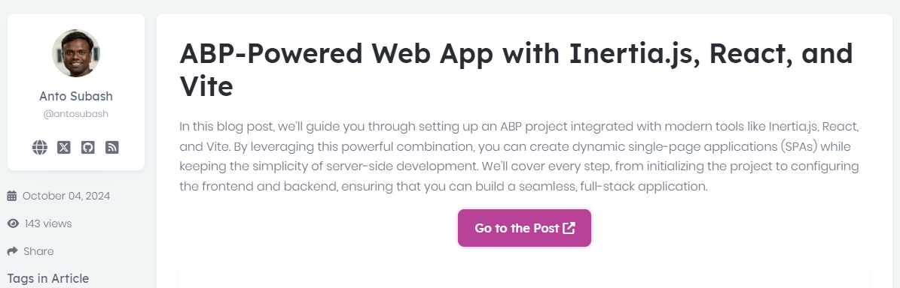
Community News
Notes:
guide you through setting up an ABP project integrated with modern tools like Inertia.js, React, and Vite.
With this powerful combination, you can create dynamic single-page applications (SPAs)

Slide 5
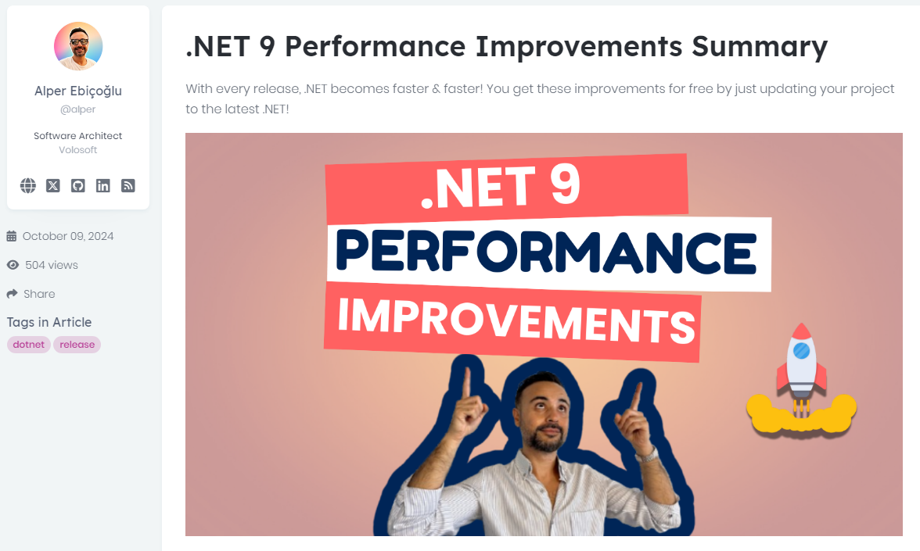
Community News

Slide 6
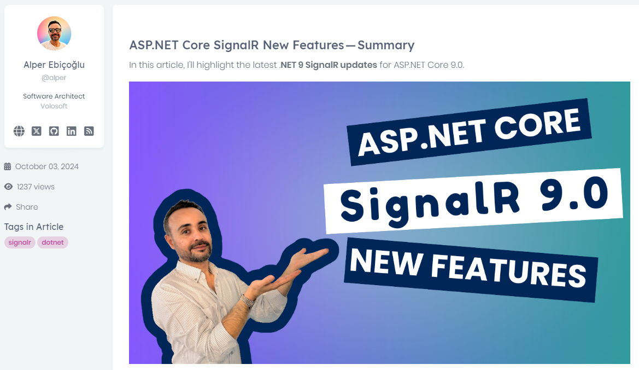
Community News

Slide 7
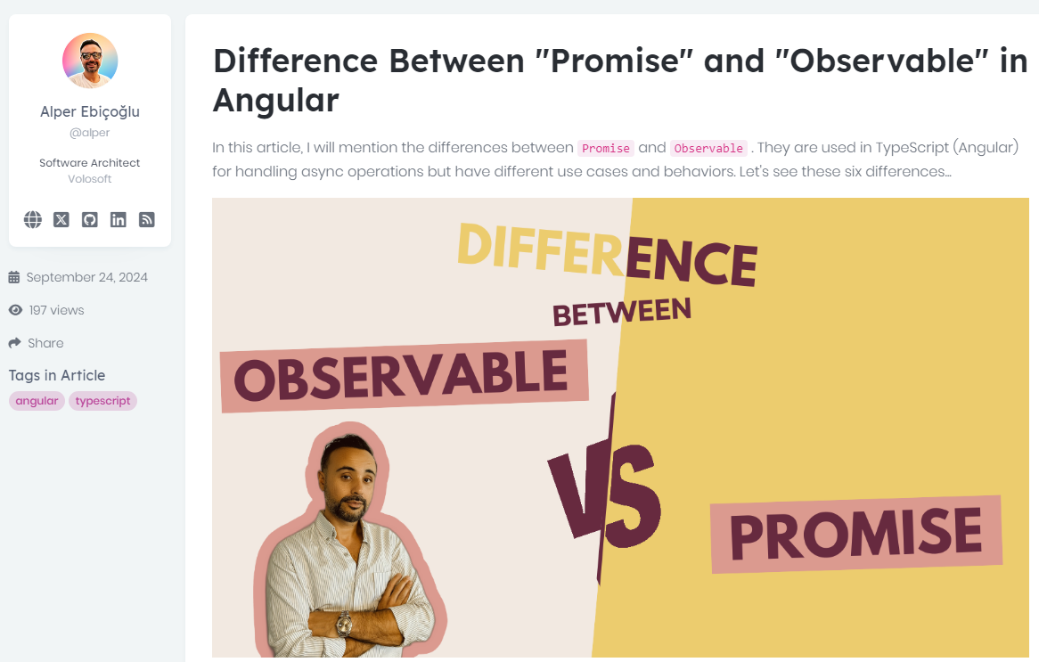
Community News

Slide 8
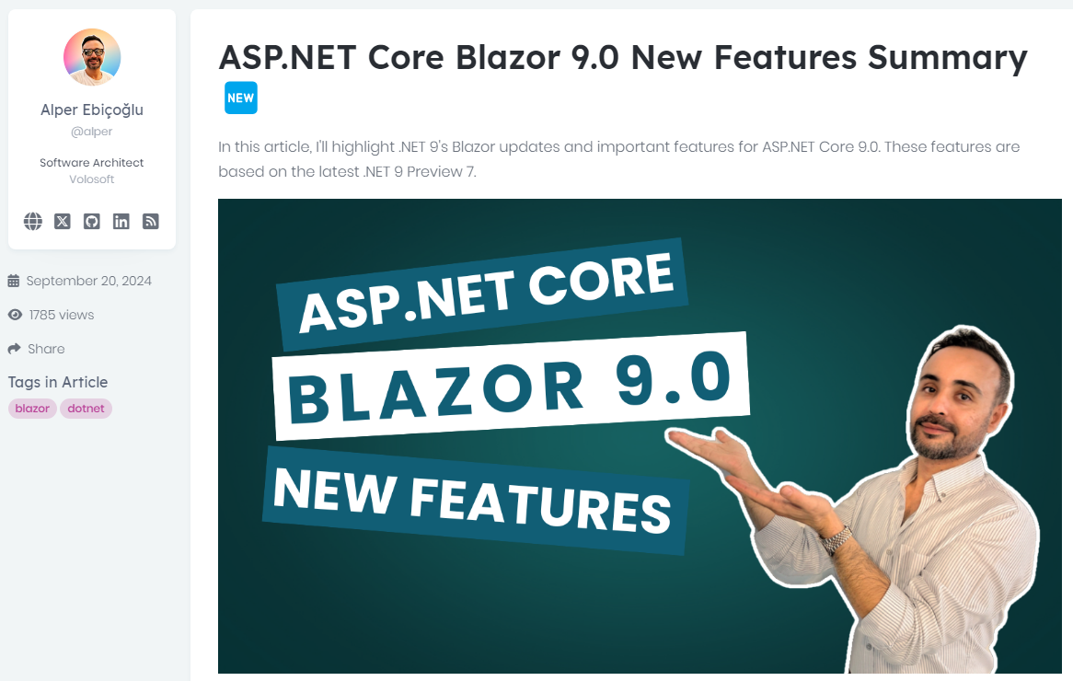
Community News

Slide 9
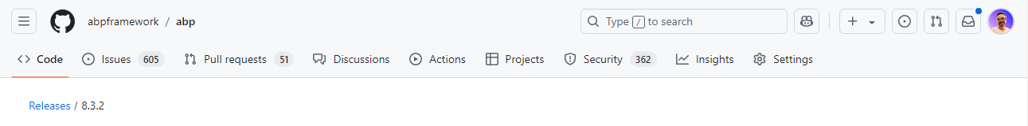
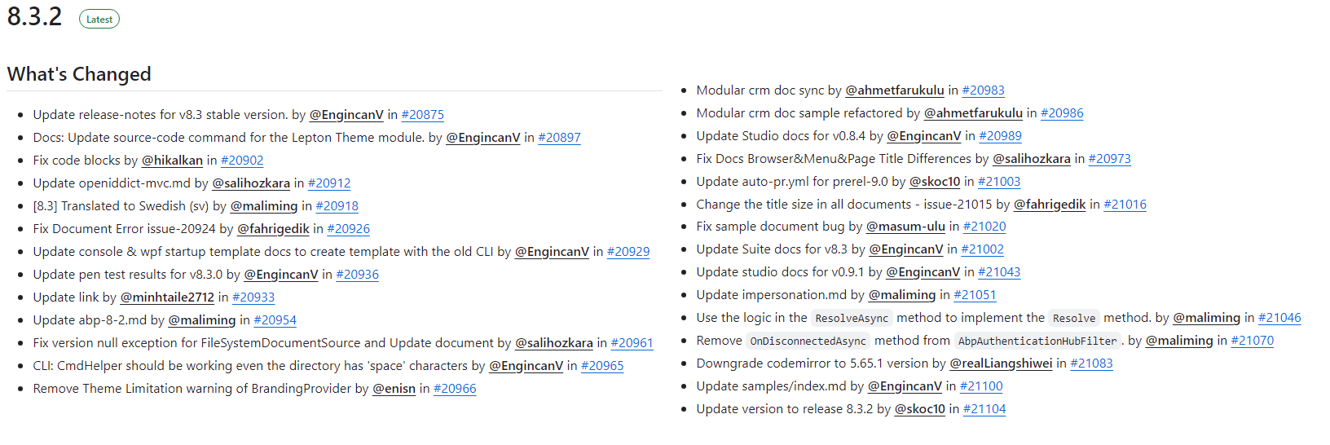
Community News
Notes:
Patch version of 8.3
In this release we fixed bugs and problems reported by the community.

Slide 10

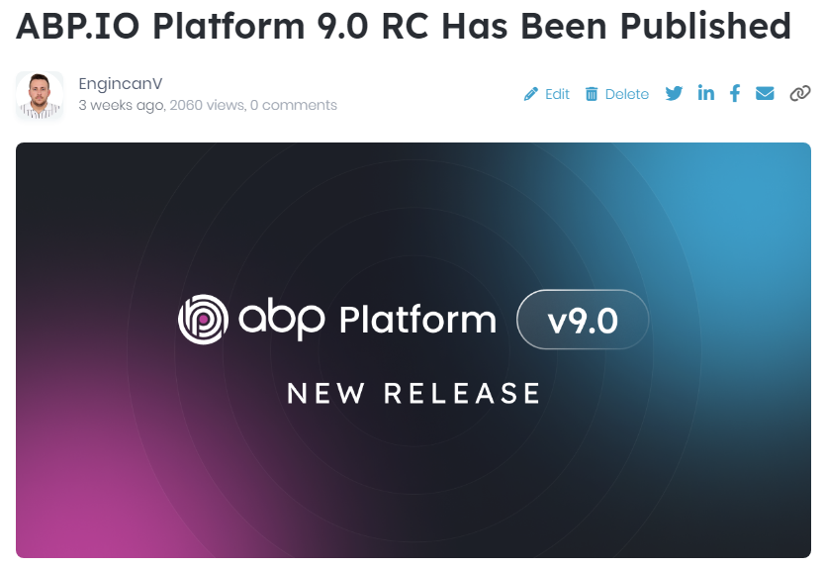

ABP 9 Improvements

Slide 11

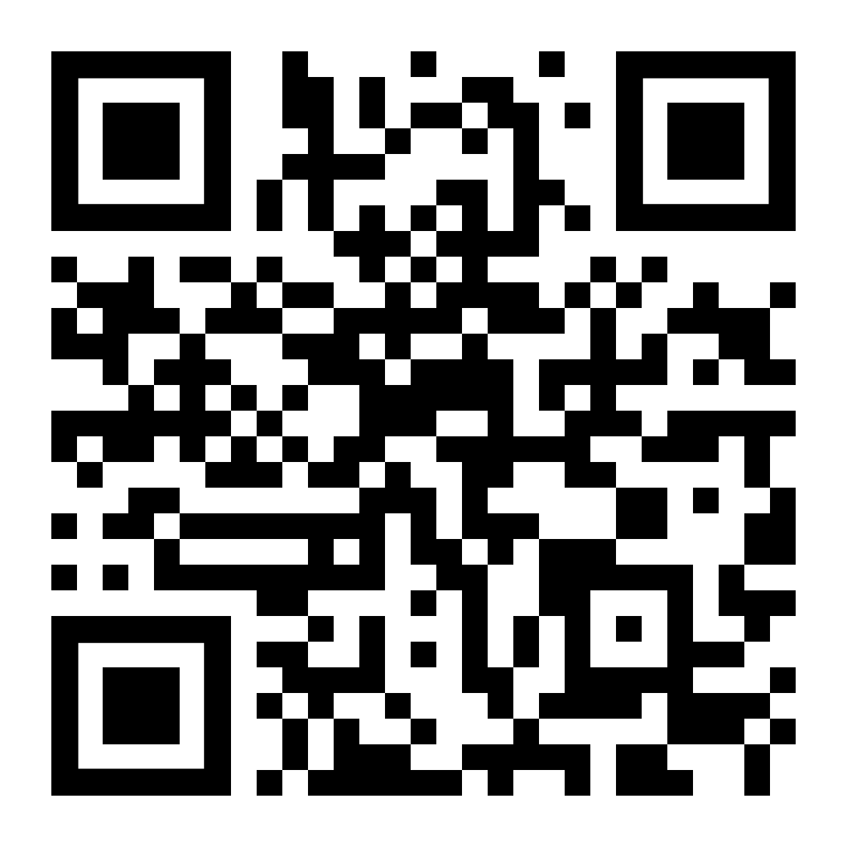



That’s all from the community side ☺
Follow me on Twitter
Alper Ebicoglu
https://twitter.com/alperebicoglu
https://github.com/ebicoglu
https://medium.com/@alperonline

