Slide 1

Building Multi-Tenant ASP.NET Core Applications
& the ABP Framework
Alper Ebicoglu
Co-Founder of Volosoft
alper.ebicoglu@volosoft.com
twitter.com/alperebicoglu
Notes:
I’m Alper
I’ve been software developer for 20 years and working on .NET technologies since .NET Framework 1.0.
For the last 7 years I’m running a software company Volosoft that produces open-source web application frameworks and tools.

Slide 2

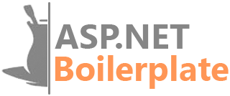
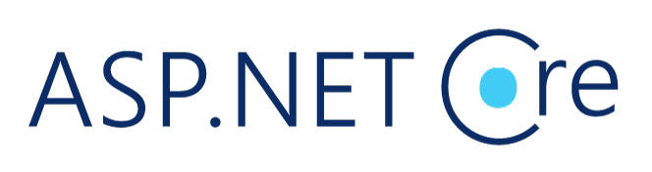
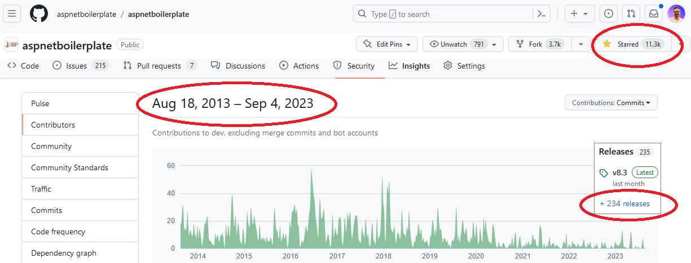
Open-source Framework for
Notes:
I want to mention you about an open-source web application framework.
It’s called ASP.NET Boilerplate
We started this project in 2013 (twenty thirteen).
We have released 234 versions so far.
It has 11K stars on GitHub which is amazing for a .NET repo.

Slide 3

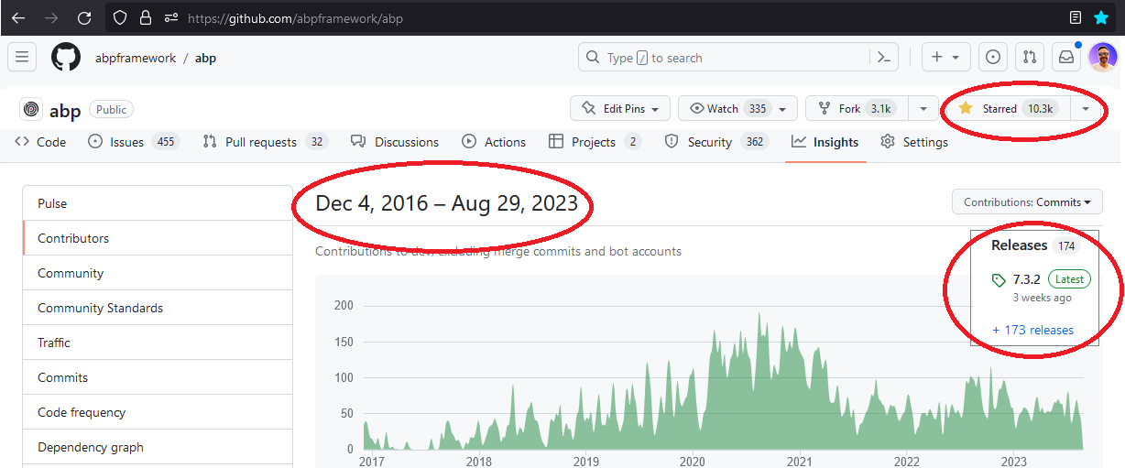
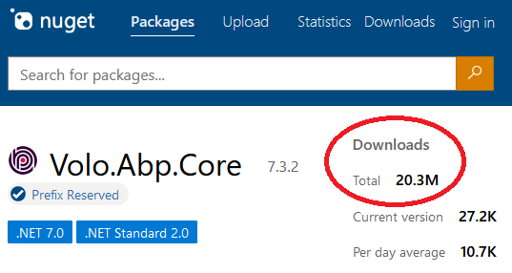
Open-source Framework for
Notes:
After ASP.NET Boilerplate we started writing ABP Framework which is fully modular, multi-tenant and microservice compatible.
It has been developed as open source since 2016 (twenty sixteen). ️
We have released 173 versions so far.
It has 10K stars on GitHub
And over 20 million downloads on NuGet until now.
Why I’m showing this to you, because we have a good experience of modular application development, microservice architecture, DDD and multi-tenancy.
In the next slides, I’ll share you how we solved some key points of multi-tenancy in the real world applications.

Slide 4
Agenda
Introduction to SaaS & Multi-Tenancy
Pros and Cons of Multi-Tenancy
Database & Deployment Scenarios
Determining and Changing the Active Tenant
Data Isolation
Conditionally Turning Multi-Tenancy On / Off
Handling Database Migrations
Implementation of the Feature System
Notes:
I’ll give you some insights about multi-tenant application development that we have experienced during our framework implementations.

Slide 5
What is Multi-Tenancy?
A common approach to build SaaS solutions
Hardware & software resources are shared among tenants
Application data is isolated between tenants
Parties:
Tenant: Our customers, using our platform
Host: The platform owner that is responsible to provide the service
An ideal multi-tenant application;
Should be unaware of multi-tenancy as much as possible!
Should be deployable to on-premise as well
Notes:
When you want to build a SaaS solution, you need to deal first with multi-tenancy.
Multi-Tenancy?— Different cloud customers access the same resources..
So each client operates within its isolated environment, unaware of the existence of other tenants.
Their application data is physically or virtually isolated.
There are 2 parties in this scenario: Tenants and Host.
Tenants are our clients and the host is the owner of the platform.
—
Ideally, your application code should not be aware of multi-tenancy related code.
What I mean is, you shouldn’t pass TenantId to all your controllers, application services, repositories or domain services…
Do all tenancy related stuff in a low level layer and keep your business code clean as much as possible.
And also, when a customer wants to setup your solution to his own servers, you should be doing that without any code changes.

Slide 6
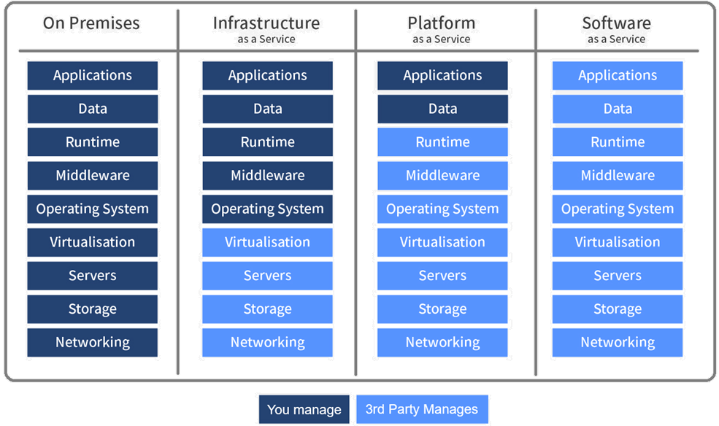
As-a-Service Business Models
Notes:
On Premises: "on-prem" is installed and runs on computers on the premises of the organization using the software, rather than at a remote facility.
Infrastructure as a Service Customers with access to computing resources, like servers, storage, and networking. It allows users to rent these resources on a pay-as-you-go basis, so they don't need to invest in hardware or software upfront. IaaS customers have full control over the virtual machines and can install and configure their own software and applications. Examples: Azure, AWS, Google Compute Engine
Platform as a Service Customers can develop, run, and manage web applications without having to worry about the underlying infrastructure. PaaS provides customers a platform to build and deploy applications quickly and easily. Examples: Google Search Engine, Azure
Software as a Service SaaS is a cloud computing model in which software applications are hosted on a remote server, and customers access them through a web browser. SaaS eliminates the need for customers to install and manage the software on their own systems. Examples: Discord, Zoom, Gmail, Netflix
ADVANTAGES:
Easy to use and no installs or downloads required
Eliminates the need for users to maintain and manage software
Automatic updates (so you always have the right version)
Offers marketers increased speed to market and reduced friction (for Sitecore SaaS solutions specifically. Say that 10 times fast.)
Highly scalable
Typically a lower cost of ownership, especially as compared to on-prem software

Slide 7
Advantages of Multi-Tenancy
Cost efficiency — max utilization
Consistent user experience
Centralized management
Scalability
Ease of Deployment
Notes:
Multi-tenant solutions are very trendy nowadays because there are some really good advantages.
Cost Efficiency: Multi-tenancy allows for resource sharing among tenants, resulting in reduced infrastructure costs. Instead of deploying separate instances for each tenant, resources like servers, databases, and maintenance efforts can be optimized.
Consistent User Experience: All our customers use the latest version. So we as developers can focus on maintaining a single codebase, ensuring that all tenants receive updates and improvements at the same time.
Centralized Management: Application updates, security patches, and new features can be centrally applied. This avoids the extra effort to update servers for each customer.
Scalability: Scaling resources becomes easier as the infrastructure can be expanded or contracted to accommodate the changing needs of multiple tenants collectively. This leads to better resource utilization and responsiveness to demand spikes.
Ease of Deployment: New tenants can be onboarded quickly within the existing infrastructure, you don’t need to set up a new environment for the new client. When a new tenant comes, you just add a new line into your Tenants table.

Slide 8
Challenges of Multi-Tenancy
Data isolation
Configuration & customization per tenant
Performance balance: Noisy neighbors!
Security
Backup and recovery
Notes:
Despite these advantages, multi-tenancy also presents challenges, such as
Data isolation: Ensuring proper data isolation btw tenants to prevent unauthorized access to sensitive information
Customization and configuration: Your clients request to customize the application according to their requirements. They want to make rebranding and customize the UI, logo, colors. Managing different configurations and customizations for each tenant without compromising the core architecture can be challenging.
Performance balance: We can call this “Noisy neighbors“. Some tenants can consume too much resources. We should ensure that the resource usage of one tenant does not negatively impact the performance of other. This should be done by monitoring the system.
Security: This is one of the most challenging and risky issues. Because when a hacker gets into your server he can steal all your client data. Also if you have a security hole, a tenant can gain access to other tenant’s data.
Backup and recovery: This involves database and storage backup per tenant. It will be very easy to backup/restore when you have a separate DB for each tenant, but if you have a shared DB then you need to get backup of the specific tenant. And tenants may have different retention policies, so you need to implement different strategies for each tenant.

Slide 9
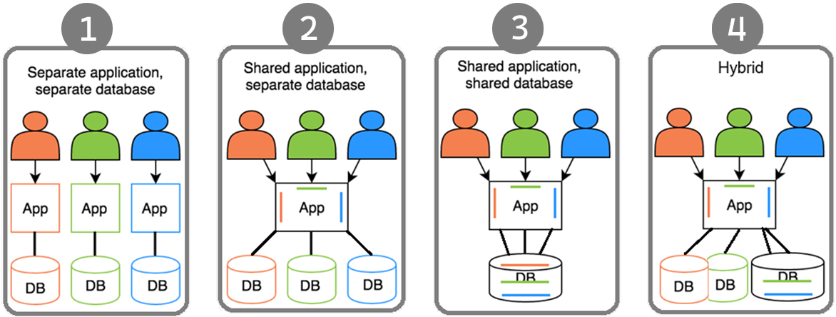

Deployment & Database Architectures
Notes:
There are 4 scenarios of the application and DB deployments.
This one looks like on-premises deployment. Each client has its own web app and database. Not a SaaS friendly architecture.
This is better than the first one. All the clients shares the same application but uses separate DBs. Not good for resource utilization. Because you need to maintain / update schemas of the databases.
This one is the ideal one. Everyone uses the same app and the same DB. Minimum cost with maximum client coverage. The downside of this approach is; some customers might have excessive data and consume resources much more than others. Also according to some GDPR rules, some clients may want to locate the DB in their country like banks. Therefore you need to separate those DBs.
Last one covers all kinds of challenges. You can provide separate DB if a client pays more or locate their data in a different geo-location. On the other hand, small clients can share the same DB.

Slide 10
Maintaining Application States
Application code & services should be stateless!
States can be stored at:
HTTP Request (cookie, header, query string, payload)
Authentication ticket
Database (relational, non-relational, ...)
Distributed cache (Redis, Memcached, ...)
Notes:
A stateless application doesn’t save any client session (state) data on the server like TenantId.
And HTTP is a stateless protocol. This means that user data is not persisted from one Web page to the next.
Our multi-tenant application should also be stateless.
Besides, the Stateless approach is multi-thread friendly!
Then where should we save the state?
In HTTP Requests, Authentication tickets as in JWT, DB, Distributed caches like Redis.

Slide 11


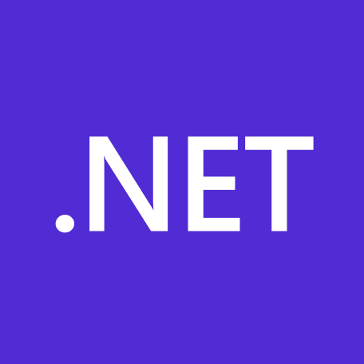
What is ABP Framework?
An opinionated architecture to build line-of-business web apps on top of ASP.NET Core
Your Application
Focus on your own business code!
ABP.IO Platform
Architecture & Infrastructure for Real-World Business Applications
.NET Platform / ASP.NET Core
Web Application & HTTP Service Development Framework
Notes:
ABP Framework offers an opinionated architecture to build enterprise software solutions with the best practices.
And it’s built on top of the .NET and the ASP.NET Core platforms.
On the ground level, there’s raw ASP.NET Core and next level our framework comes up with all kinds of generic features that a line-of-business app should have, and on the roof level you write your custom business code.
You don’t worry about multi-tenancy and all its challenges.
I’ll explain our solutions and experiences on creating a multi-tenant application framework.

Slide 12
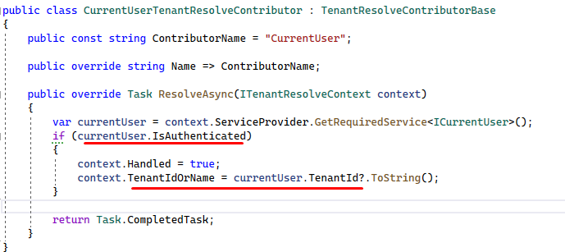
Determining the Current Tenant
1. CurrentUserTenantResolveContributor
HttpContext.User.Identity.Claims.FirstOrDefault(c => c.Type == “TenantId”)
Notes:
If the user is authenticated, we can get the TenantId from the claims

Slide 13
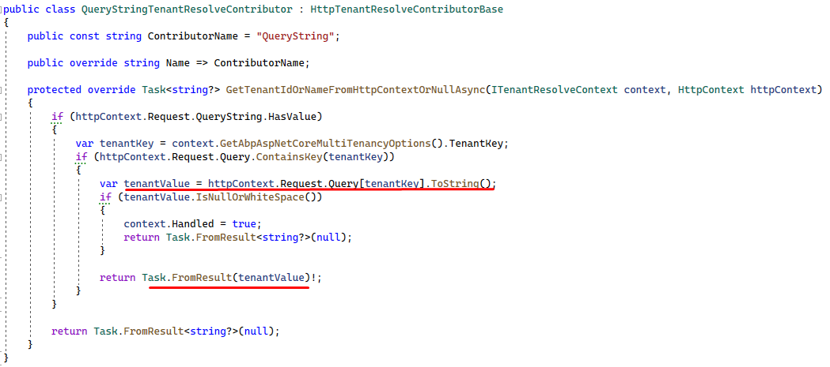
Determining the Current Tenant
2. QueryStringTenantResolveContributor
https://fabrikam.com?tenantId=3

Slide 14
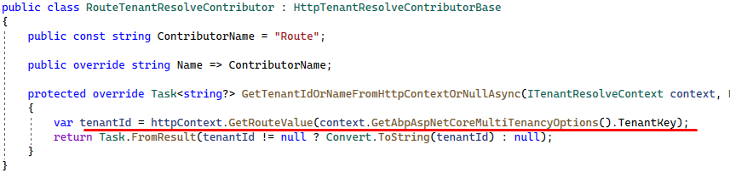
Determining the Current Tenant
3. RouteTenantResolveContributor
https://fabrikam.com/acme/

Slide 15
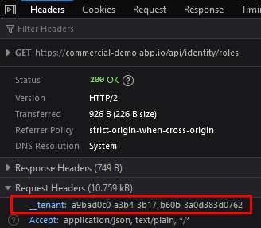
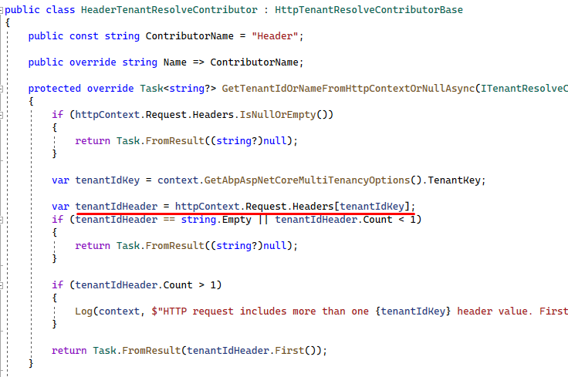
Determining the Current Tenant
4. HeaderTenantResolveContributor

Slide 16
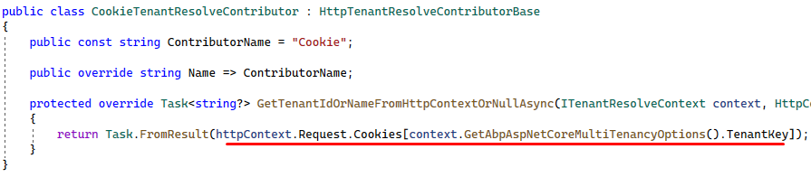
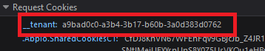
Determining the Current Tenant
5. CookieTenantResolveContributor

Slide 17
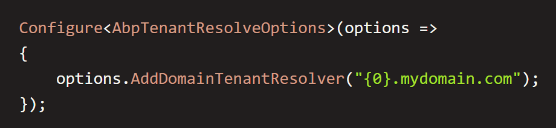
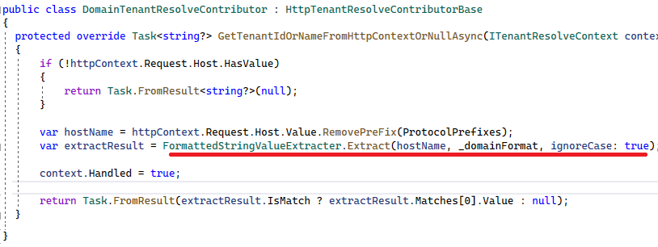
Determining the Current Tenant
6. DomainTenantResolver
https://acme.fabrikam.com
Notes:
Explain DomainTenantResolver….
And finally there’s ITenantResolveContributor so that you can implement your TenantResolver logic.

Slide 18
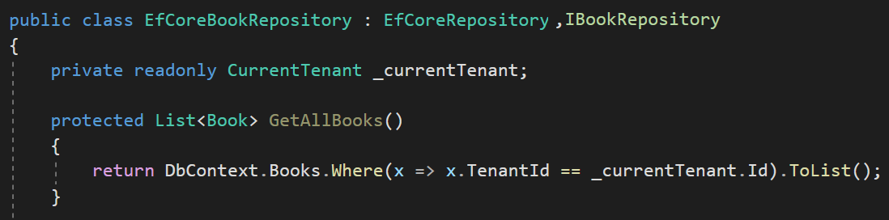
Data Isolation — Traditional way
You normally do this

Slide 19
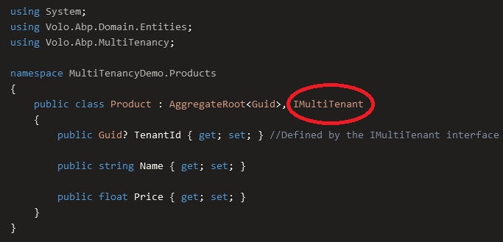
Data Isolation
Notes:
ABP Framework supports
Shared Database: All tenants are stored in a single database.
Database per Tenant: Every tenant has a separate, dedicated database to store the data related to that tenant.
Hybrid: Some tenants share a single databases while some tenants may have their own databases.
---
Multi-tenancy works seamlessly in the framework level.
When you implement your entities from this interface, ABP Framework automatically filters entities for the current tenant when you query from database. So, you don't need to manually add TenantId condition while performing queries. So we isolate the tenant data by default.
---
ABP automatically sets the TenantId for you when you create a new entity object. It is done in the constructor of the base Entity class
The TenantId is set from the current value of the ICurrentTenant.Id property (see the next section).

Slide 20
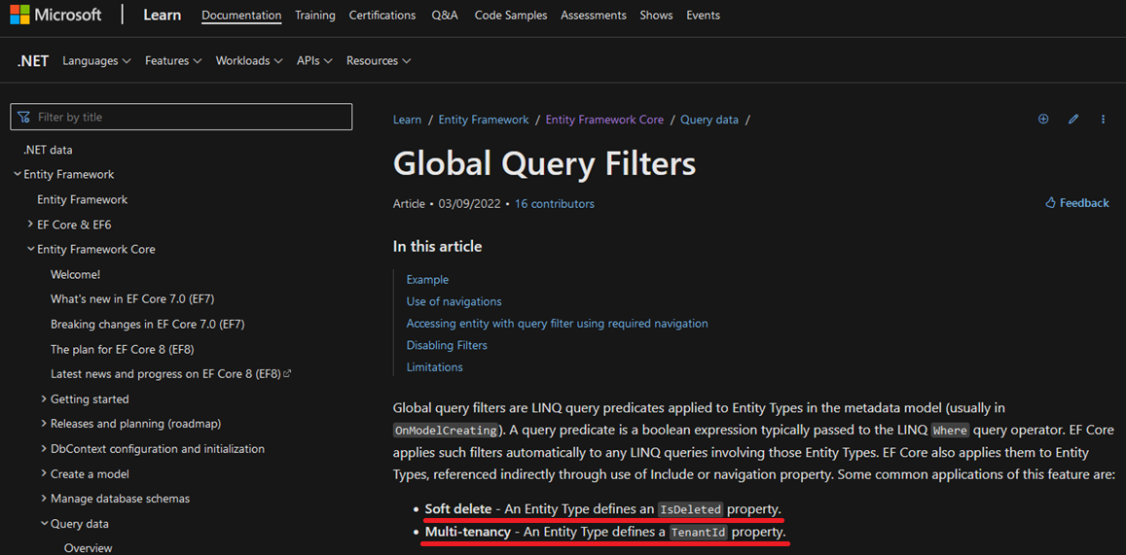
Data Isolation — EF Core
* Soft delete: An Entity Type defines an IsDeleted property.
* Multi-tenancy: An Entity Type defines a TenantId property.
Notes:
To filter the multi-tenant entities by default we are using EF Core Global Query Filters.
These filters are LINQ query expressions that applies to Entities OnModelCreating phase.
This feature is generally being used for soft deleting an entity and multi-tenancy.
These features are generic features that should be filtered application-wide.
And ABP uses this system for the EF Core Integration.
So, it is well integrated to EF Core and works as expected even if you directly work with DbContext.

Slide 21
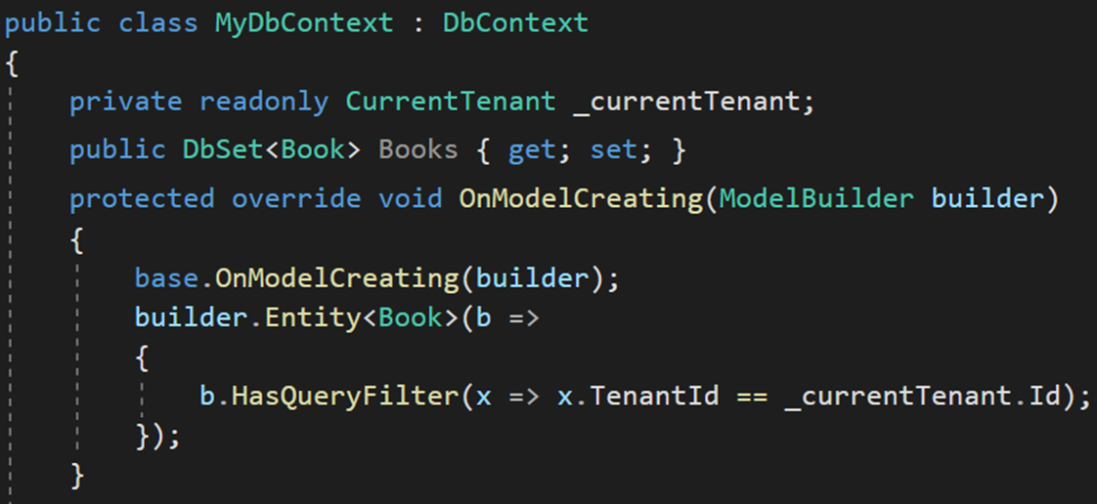
Data Isolation — EF Core
HasQueryFilter() for global filtering

Slide 22
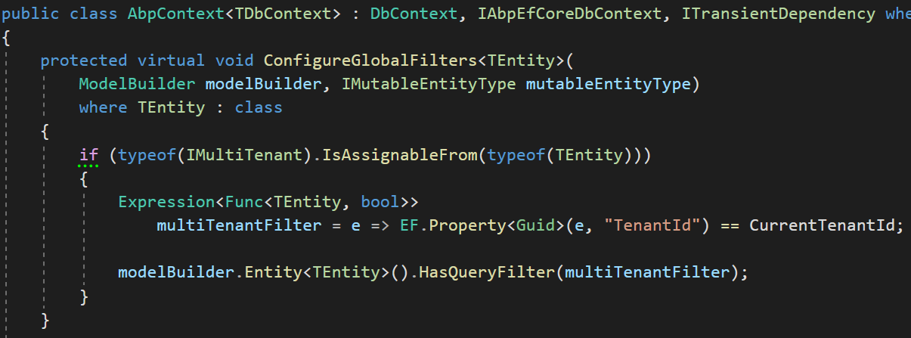
Data Isolation — EF Core
Find all IMultiTenant
Create LinQ expression
Add to global filters
Notes:
To filter the multi-tenant entities by default we are using EF Core Global Query Filters.
These filters are LINQ query expressions that applies to Entities OnModelCreating phase.
This feature is generally being used for soft deleting an entity and multi-tenancy.
These features are generic features that should be filtered application-wide.
And ABP uses this system for the EF Core Integration.
So, it is well integrated to EF Core and works as expected even if you directly work with DbContext.

Slide 23
Data Isolation — EF Core PROS & CONS
EF Core Global filters
+ Works only when used EF Core
+ Supports navigation properties as well
- Does not work with Stored Procedures or T-SQL
Better solution is Row Level Security
https://learn.microsoft.com/en-us/sql/relational-databases/security/row-level-security
Notes:
To cover these you can use Row Level Security. All the filters work perfectly with Row Level Security
Row Level Security
+Works with SQL Server and Azure SQL Database
+Completely integrated to DBMS works almost in all cases
The disadvantage is relatively complex to implement and you need to stick to SQL Server.
I will not go in deep on this solution
https://learn.microsoft.com/en-us/sql/relational-databases/security/row-level-security

Slide 24
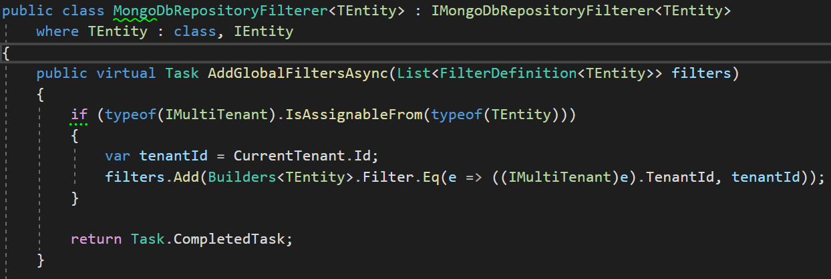
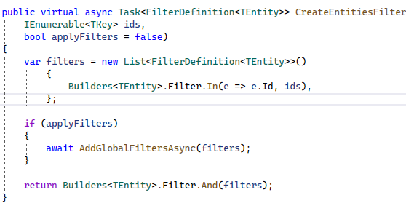
Data Isolation — MongoDB
We filter all queries in the framework!
Notes:
We have MongoDB implementation as well.
ABP abstracts the IMongoDbRepositoryFilterer interface to implement data filtering for the MongoDB Integration, it works only if you use the repositories properly.
Currently, the best way to implement a data filter for the MongoDB integration is to create a derived class of MongoDbRepositoryFilterer and override AddGlobalFilters. Example:
MongoDbRepositoryFilterer is being used for data filtering
The framework automatically adds TenantId filter to all the queries

Slide 25
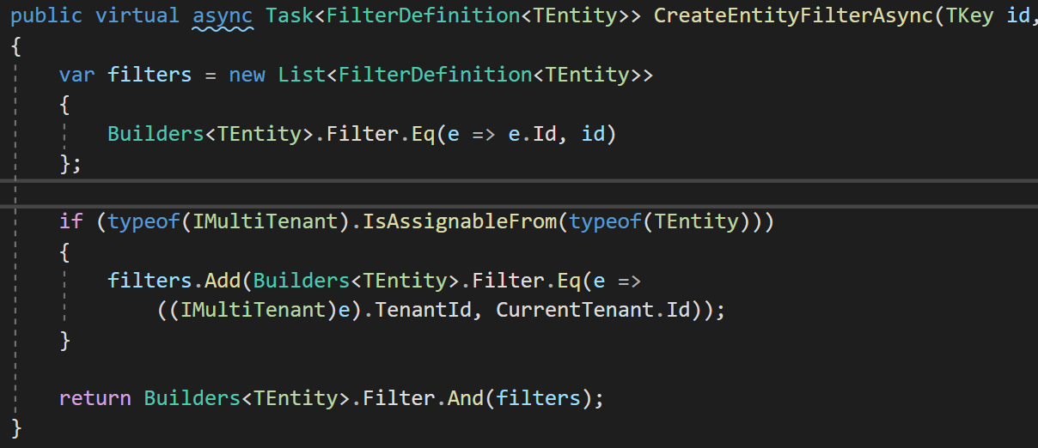
Data Isolation — MongoDB
Find all IMultiTenant
Create filter expression
Add to our custom global filters
Notes:
We have MongoDB implementation as well.
ABP abstracts the IMongoDbRepositoryFilterer interface to implement data filtering for the MongoDB Integration, it works only if you use the repositories properly.
Currently, the best way to implement a data filter for the MongoDB integration is to create a derived class of MongoDbRepositoryFilterer and override AddGlobalFilters. Example:
MongoDbRepositoryFilterer is being used for data filtering
The framework automatically adds TenantId filter to all the queries

Slide 26
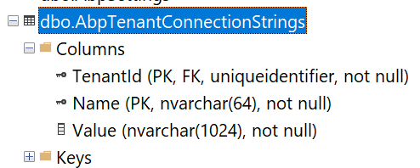
Connection String Selection
The current tenant
The current module / microservice
Fallbacks to the default connection string
Notes:
When your application allows customers choose their own database, then you need to save each tenant’s connection string.
We have our own master database connection string in appsettings.json files.
And if a tenant wants a separate database then we store the connection strings in AbpTenantConnectionStrings table with TenantId and Value.
Module connection string:
https://github.com/abpframework/abp/blob/dev/templates/module/aspnet-core/host/MyCompanyName.MyProjectName.HttpApi.Host/appsettings.json#L5

Slide 27
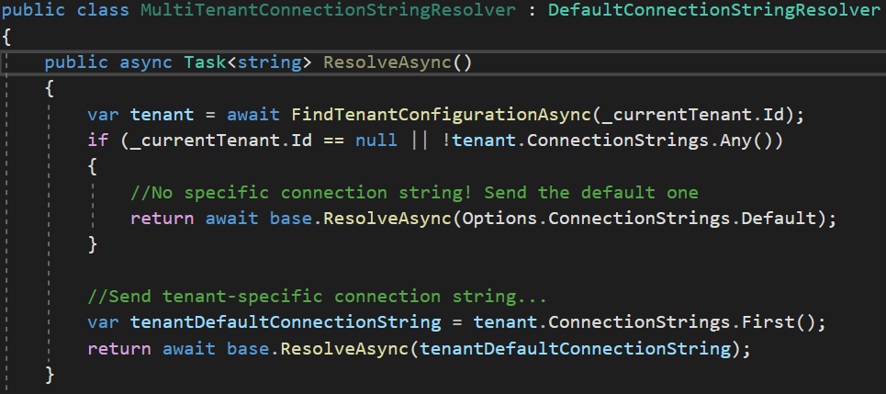
Connection String Selection
Notes:
When your application allows customers choose their own database, then you need to save each tenant’s connection string.
We have our own master database connection string in appsettings.json files.
And if a tenant wants a separate database then we store the connection strings in AbpTenantConnectionStrings table with TenantId and Value.
Module connection string:
https://github.com/abpframework/abp/blob/dev/templates/module/aspnet-core/host/MyCompanyName.MyProjectName.HttpApi.Host/appsettings.json#L5

Slide 28
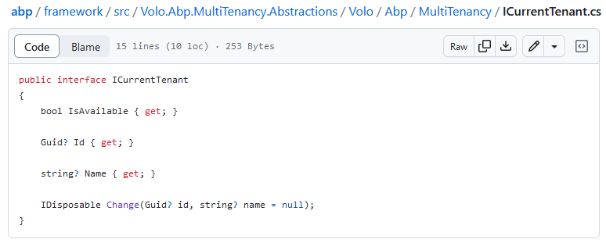
Retrieving the current tenant: ICurrentTenant
Id (Guid): Id of the current tenant. Can be null.
Name (string): Name of the current tenant. Can be null.

Slide 29
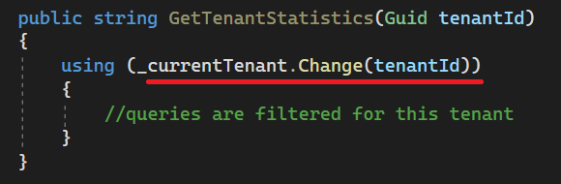
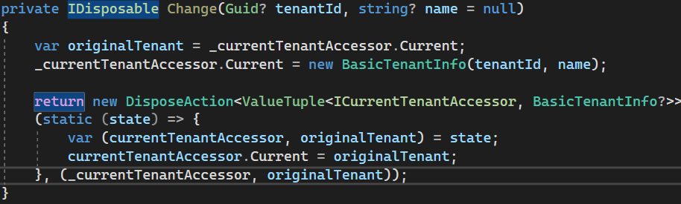
Changing the Active Tenant
Set active tenant
Revert back
Notes:
Sometimes it may be necessary to change the existing tenant.
In this case, we created a disposable method that can be used with “using” keyword.
Here we keep the original tenant in a temporary variable and set the new tenant.
Doing this, we filter all queries by this tenant.
Then we restore the original tenant after using the existing statement.

Slide 30
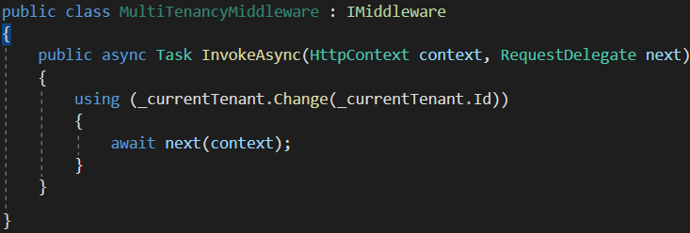
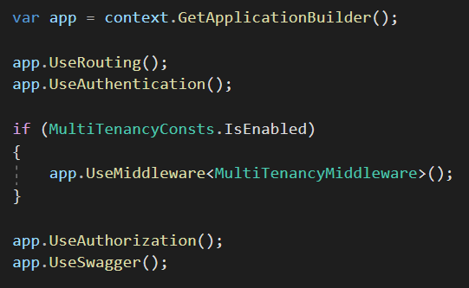
Setting the Active Tenant in Middleware
Set the current tenant within the middleware
Notes:
We created a middleware called MultiTenancyMiddleware.
And we set the current active tenant in this middleware.

Slide 31
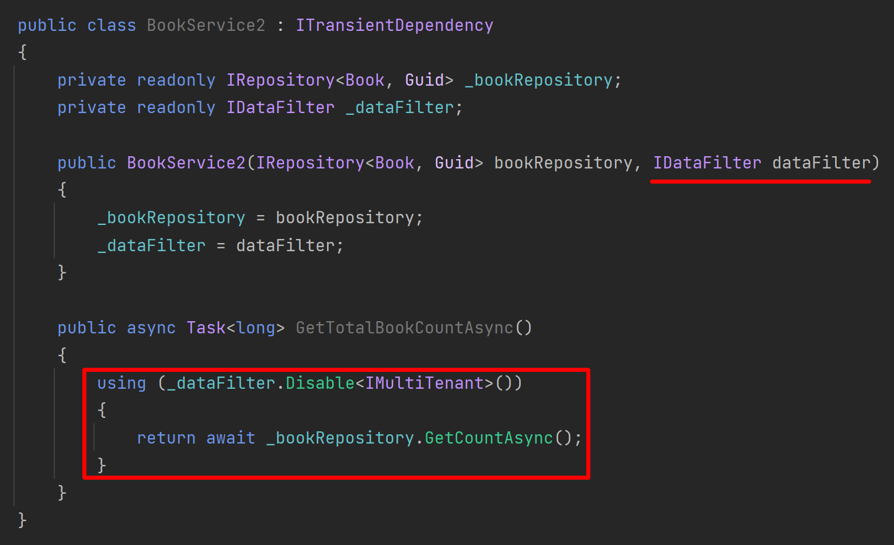
Disabling Multi-Tenancy Filter
Notes:
And we use a singleton class to keep the active passive state of a filter.
If you disable multi-tenancy filter then, it’ll be ignored in global filters.

Slide 32
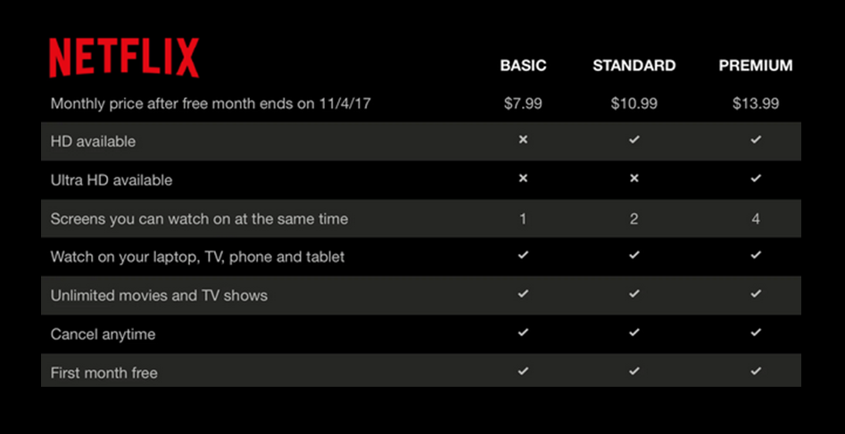
The Feature System
Notes:
To explain what a feature means, first we need to know the term: Edition
A standard SaaS application sells the customers different plans with different prices.
Each subscription plan is called an edition
And each edition should consist of different features.
Netflix is a good SaaS example. It has 3 editions and 8 features
We need to enable/disable each feature based on the current tenant on runtime.
https://docs.abp.io/en/abp/latest/Features

Slide 33
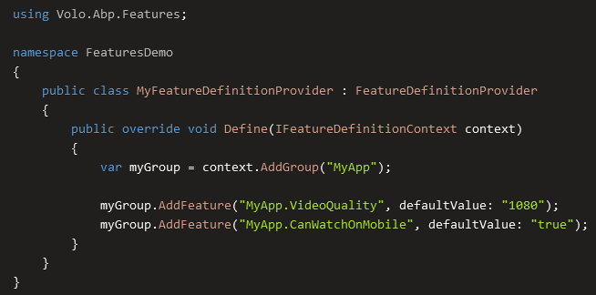
The Feature System
Define your features by code

Slide 34
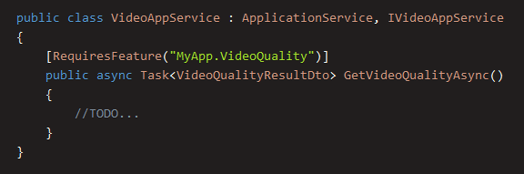
The Feature System
Check the feature with [RequiresFeature] attribute

Slide 35
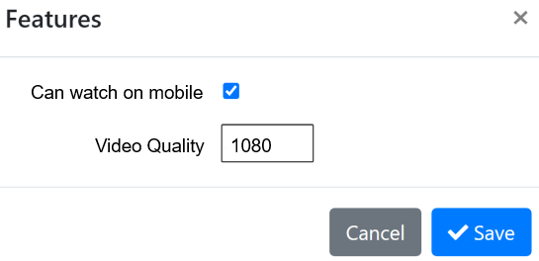
The Feature System
Use the Management UI to enable features for tenants

Slide 36




Thank you for listening
https://twitter.com/alperebicoglu
https://github.com/ebicoglu
https://medium.com/@alperonline
Download this presentation:
https://github.com/ebicoglu/presentations/blob/main/Multi-Tenancy-with-ABP.pptx

