Slide 1

Building Multi-Tenant ASP.NET Core Applications
and the ABP Framework
Alper Ebicoglu

Slide 2

Agenda
SaaS & Multi-Tenancy
Introducing the ABP Framework
Demo: Multi-Tenancy in Action
Multi-Tenant Development with the ABP Framework

Slide 3
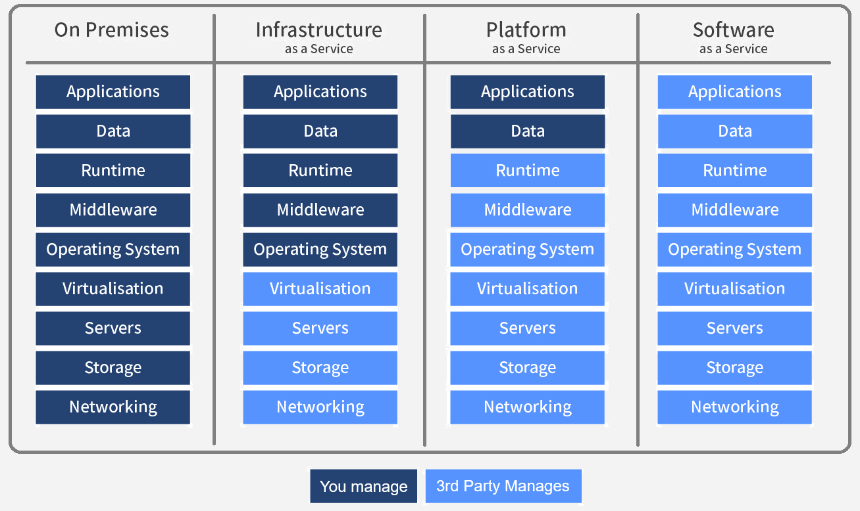
As-a-Service Business Models
Notes:
On Premises: "on-prem" is installed and runs on computers on the premises of the organization using the software, rather than at a remote facility.
Infrastructure as a Service Customers with access to computing resources, like servers, storage, and networking. It allows users to rent these resources on a pay-as-you-go basis, so they don't need to invest in hardware or software upfront. IaaS customers have full control over the virtual machines and can install and configure their own software and applications. Examples: Azure, AWS, Google Compute Engine
Platform as a Service Customers can develop, run, and manage web applications without having to worry about the underlying infrastructure. PaaS provides customers a platform to build and deploy applications quickly and easily. Examples: Google Search Engine, Azure
Software as a Service SaaS is a cloud computing model in which software applications are hosted on a remote server, and customers access them through a web browser. SaaS eliminates the need for customers to install and manage the software on their own systems. Examples: Discord, Zoom, Gmail, Netflix
ADVANTAGES:
Easy to use and no installs or downloads required
Eliminates the need for users to maintain and manage software
Automatic updates (so you always have the right version)
Offers marketers increased speed to market and reduced friction (for Sitecore SaaS solutions specifically. Say that 10 times fast.)
Highly scalable
Typically a lower cost of ownership, especially as compared to on-prem software

Slide 4
What is Multi-Tenancy?
A common approach to build SaaS solutions
Hardware & software resources are shared among tenants
Application data is isolated between tenants
Parties:
Tenant: Our customers, using our platform
Host: The platform owner that is responsible to provide the service
An ideal multi-tenant application codebase;
Should be unaware of multi-tenancy as much as possible!
Should be deployable to on-premise as well

Slide 5
Advantages of Multi-Tenancy
Maximum utilization / low costs
Easy to add a new customer (tenant)
All customers use the same application version
Easy maintanance and upgrade

Slide 6
Challenges of Multi-Tenancy
Data isolation
Configuration & customization per tenant
Database and storage backup & restore per tenant
Performance balance between tenants
Heavy use by one tenant affects others!

Slide 7
Application State
Application code / services should be stateless!
Main state origins:
HTTP Request: cookie, header, query string, payload
Authentication ticket/cookie
Database (relational, non-relational, ...)
Distributed cache (Redis, Memcached, ...)

Slide 8
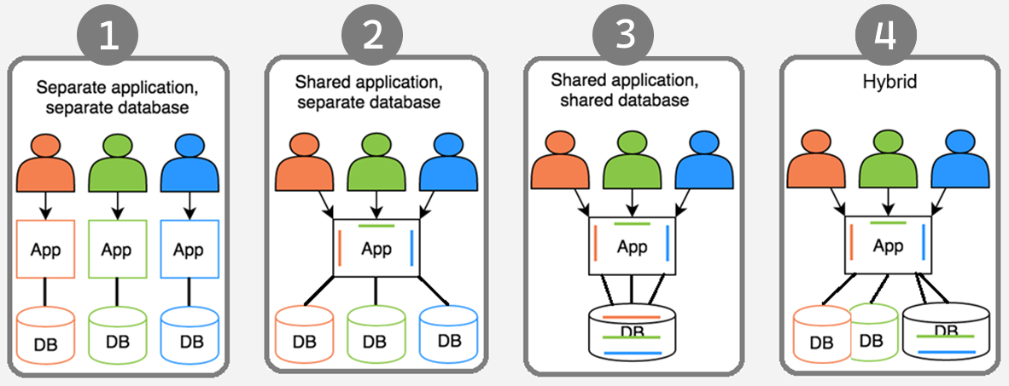
Deployment & Database Architectures

Slide 9


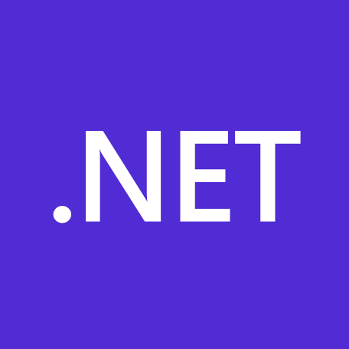
What is ABP Framework?
An opinionated architecture to build line-of-business web apps on top of the ASP.NET Core
Your Application
Focus on your own business code!
ABP.IO Platform
Architecture & Infrastructure for Real-World Business Applications
.NET Platform / ASP.NET Core
Web Application & HTTP Service Development Framework
Notes:
ABP Framework offers an opinionated architecture to build enterprise software solutions with the best practices.
And it’s built on top of the .NET and the ASP.NET Core platforms.
On the ground level, there’s raw ASP.NET Core and next level our framework comes up with all kinds of generic features that a line-of-business app should have, and on the roof level you write your custom business code.
You don’t worry about multi-tenancy and all its challenges.

Slide 10
The Architecture of ABP Framework
Domain Driven Design
& Layered Solution
Modular
Multi-Tenancy (SaaS infrastructure)
Microservice compatible

Slide 11
Components of ABP Framework
Framework packages (NuGet & NPM)
Application modules
UI themes
Startup templates
ABP CLI

Slide 12
ABP Framework: Multi-Tenancy in Action
Demo

Slide 13
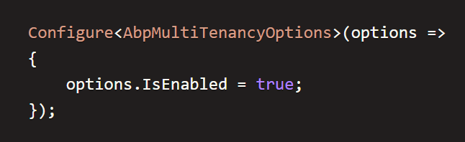
Enable / Disable Multi-Tenancy Globally

Slide 14
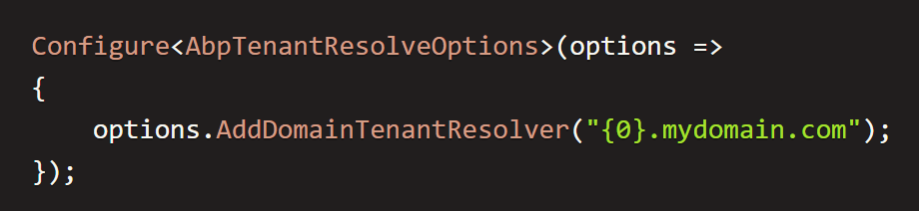
Tenant Identification
Tenant Resolvers:
CurrentUserTenantResolveContributor
QueryStringTenantResolveContributor
RouteTenantResolveContributor
HeaderTenantResolveContributor
CookieTenantResolveContributor
Custom Resolvers (implement your ITenantResolveContributor)
And

Slide 15
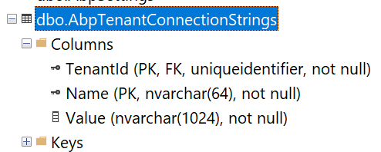
Connection String Selection
The current tenant
The current module / microservice
Fallbacks to the default connection string
Notes:
When your application allows customers choose their own database, then you need to save each tenant’s connection string.
Module connection string:
https://github.com/abpframework/abp/blob/dev/templates/module/aspnet-core/host/MyCompanyName.MyProjectName.HttpApi.Host/appsettings.json#L5

Slide 16
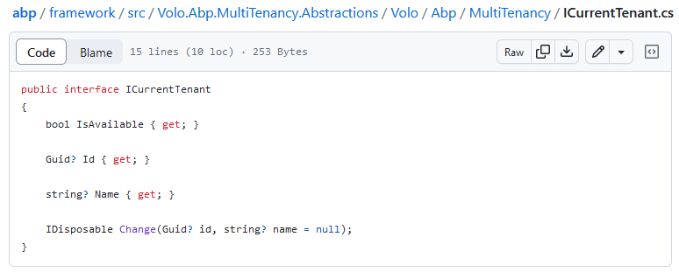
Retrieving the current tenant: ICurrentTenant
Id (Guid): Id of the current tenant. Can be null.
Name (string): Name of the current tenant. Can be null.

Slide 17
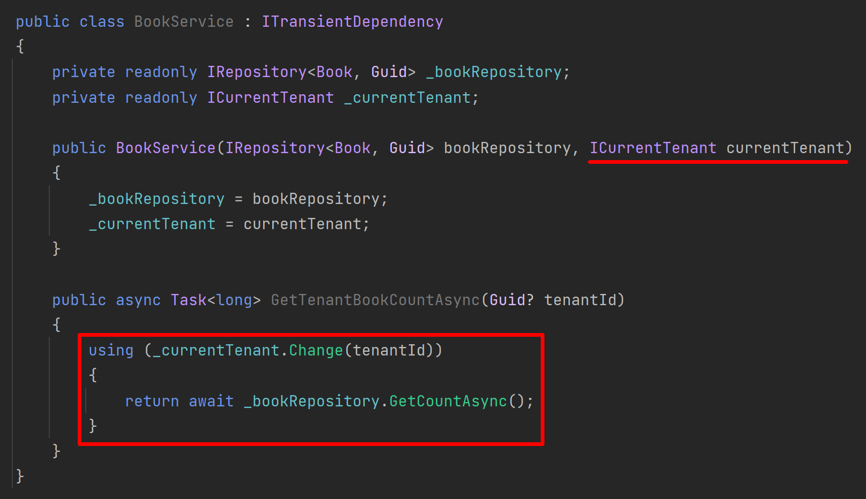
Switching the current tenant: ICurrentTenant

Slide 18
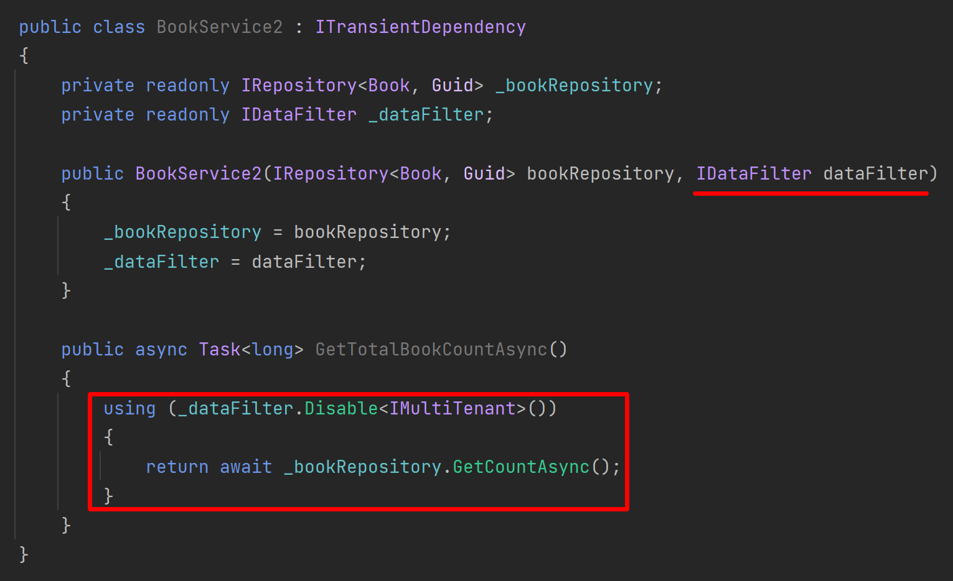
Disabling Multi-Tenancy Filter

Slide 19
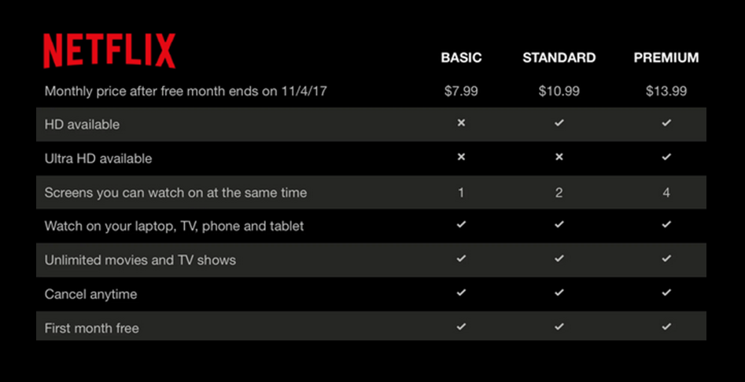
The Feature System
Notes:
To explain what a feature means, first we need to know the term: Edition
A standard SaaS application sells the customers different plans with different prices.
Each subscription plan is called an edition
And each edition should consist of different features.
Netflix is a good SaaS example. It has 3 editions and 8 features
We need to enable/disable each feature based on the current tenant on runtime.
https://docs.abp.io/en/abp/latest/Features

Slide 20
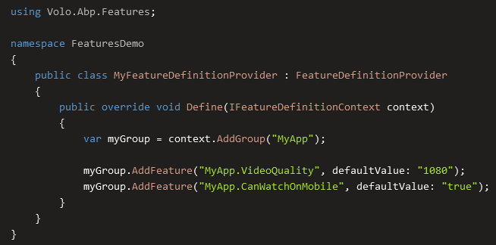
The Feature System
Define your features by code

Slide 21
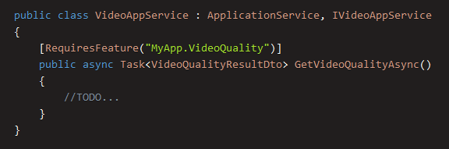
The Feature System
Check the feature with [RequiresFeature] attribute

Slide 22
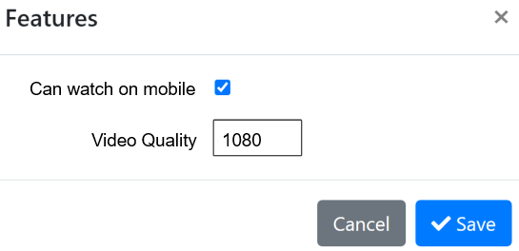
The Feature System
Use the Management UI to enable features for tenants

Slide 23
The Feature System
DEMO

Slide 24
Multi-Tenant Compatible Framework: ABP
Authentication & Authorization
Audit Logging
BLOB Storing
Caching
Data Seeding
Setting Management
Text Templating
…more

Slide 25



Thank You for Listening
https://twitter.com/alperebicoglu
https://github.com/ebicoglu
https://medium.com/@alperonline
Download this presentation at
https://github.com/ebicoglu/presentations/blob/main/Multi-Tenancy-with-ABP.pptx

