Slide 1

Building Multi-Tenant ASP.NET Core Applications
& the ABP Framework
Alper Ebicoglu
Co-Founder of Volosoft
alper.ebicoglu@volosoft.com
twitter.com/alperebicoglu
Notes:
I’m Alper. I’m co-founder of Volosoft.
I’ve been software developer for 20 years and working on .NET technologies since .NET Framework 1.0.
Our company is building framework and tools for .NET developers.
I’m one of the lead developers of the ABP Framework and I’ve been working on since the beginning.
Today I’ll share my experiences on how to implement major multi-tenancy requirements.

Slide 2

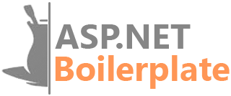
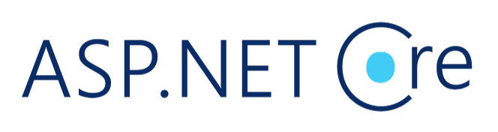
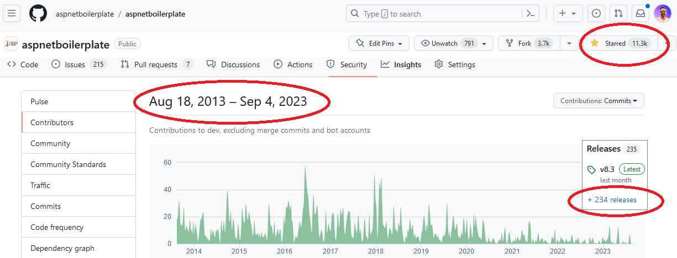
Open-source Framework for
Notes:
I want to mention you about our first open-source web application framework.
It’s called ASP.NET Boilerplate
We started this project in 2013 (twenty thirteen).
We have released 234 versions so far.
It has 11K stars on GitHub which is amazing for a .NET repo.

Slide 3

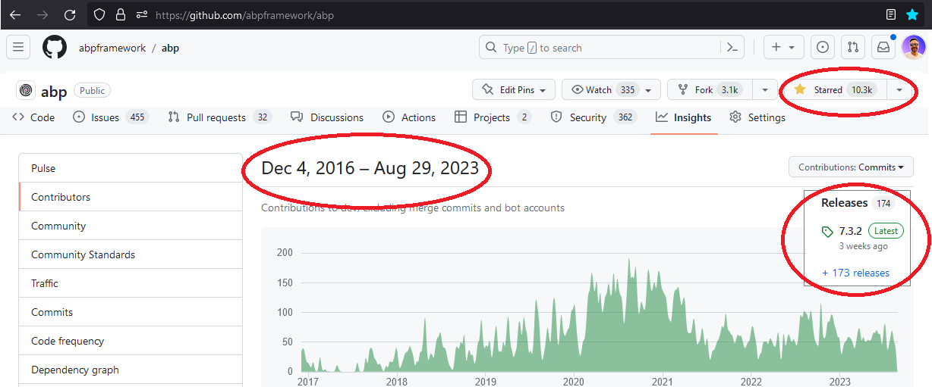
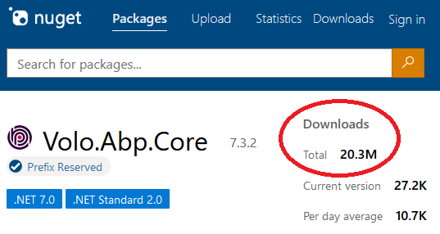
Open-source Framework for
Notes:
After ASP.NET Boilerplate we started writing ABP Framework which is fully modular, multi-tenant and microservice compatible.
It has been developed as open source since 2016 (twenty sixteen). ️
We have released 173 versions so far.
It has 10K stars on GitHub
And over 20 million downloads on NuGet until now.
Why I’m showing this to you, because we have a good experience of modular application development, microservice architecture, DDD and multi-tenancy.
In the next slides, I’ll share you how we solved some key points of multi-tenancy in the real world applications.

Slide 4


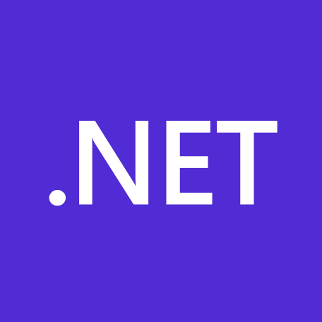
What is ABP Framework?
An opinionated architecture to build line-of-business web apps on top of ASP.NET Core
Your Application
Focus on your own business code!
ABP Framework
Architecture & infrastructure for the real-world business apps
.NET Platform / ASP.NET Core
Web application & HTTP service development framework
Notes:
ABP Framework offers an opinionated architecture to build enterprise software solutions with the best practices.
And it’s built on top of the .NET and the ASP.NET Core platforms.
On the ground level, there’s raw ASP.NET Core and next level our framework comes up with all kinds of generic features that a line-of-business app should have, and on the roof level you write your custom business code.
You don’t worry about multi-tenancy and all its challenges.
I’ll explain our solutions and experiences on creating a multi-tenant application framework.

Slide 5
Agenda
Introduction to SaaS & Multi-Tenancy
Pros and Cons of Multi-Tenancy
Database & Deployment Scenarios
Determining and Changing the Active Tenant
Data Isolation
Conditionally Turning Multi-Tenancy On / Off
Handling Database Migrations
Implementation of the Feature System
Notes:
I’ll give you some insights about multi-tenant application development that we have experienced during our framework implementations.

Slide 6
What is Multi-Tenancy?
A common approach to build SaaS solutions
Hardware & software resources are shared btw tenants
Application data is isolated btw tenants
Tenants: Our clients, using the service
Host: Service provider
Parties
An ideal multi-tenant application
Should be unaware of multi-tenancy as much as possible!
Should be deployable to on-premise as well
Notes:
When you want to build a Software As a Service (SaaS) solution, you need to deal first with multi-tenancy.
Multi-Tenancy?— Different cloud customers access the same resources..
So each client operates within its isolated environment, unaware of the existence of other tenants.
Their application data is physically or virtually isolated.
There are 2 parties in this scenario: Tenants and Host.
Tenants are our customers and the host is the owner of the platform that develops, maintains, and offers the software to customers.
—
Ideally, your application code should not be aware of multi-tenancy related code.
What I mean is, you shouldn’t pass TenantId to all your controllers, application services, repositories or domain services…
Do all tenancy related stuff in a low level layer and keep your business code clean as much as possible.
And also, when a customer wants to setup your solution to his own servers, you should be doing that without any code changes.

Slide 7
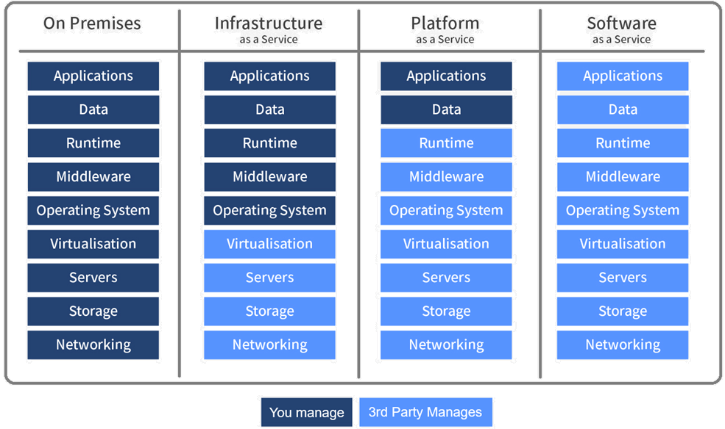
As-a-Service Business Models
Notes:
On Premises: "on-prem" is installed and runs on computers on the premises of the organization using the software, rather than at a remote facility.
Infrastructure as a Service Customers with access to computing resources, like servers, storage, and networking. It allows users to rent these resources on a pay-as-you-go basis, so they don't need to invest in hardware or software upfront. IaaS customers have full control over the virtual machines and can install and configure their own software and applications. Examples: Azure, AWS, Google Compute Engine
Platform as a Service Customers can develop, run, and manage web applications without having to worry about the underlying infrastructure. PaaS provides customers a platform to build and deploy applications quickly and easily. Examples: Google Search Engine, Azure
Software as a Service SaaS is a cloud computing model in which software applications are hosted on a remote server, and customers access them through a web browser. SaaS eliminates the need for customers to install and manage the software on their own systems. Examples: Discord, Zoom, Gmail, Netflix
ADVANTAGES:
Easy to use and no installs or downloads required
Eliminates the need for users to maintain and manage software
Automatic updates (so you always have the right version)
Offers marketers increased speed to market and reduced friction (for Sitecore SaaS solutions specifically. Say that 10 times fast.)
Highly scalable
Typically a lower cost of ownership, especially as compared to on-prem software

Slide 8
Advantages of Multi-Tenancy
Cost efficiency — max utilization
Consistent user experience
Centralized management
Scalability
Ease of Deployment
Notes:
Multi-tenant solutions are very trendy nowadays because there are some really good advantages.
Cost Efficiency: Multi-tenancy allows for resource sharing among tenants, resulting in reduced infrastructure costs. Instead of deploying separate instances for each tenant, resources like servers, databases, and maintenance efforts can be optimized.
Consistent User Experience: All our customers use the latest version. So we as developers can focus on maintaining a single codebase, ensuring that all tenants receive updates and improvements at the same time.
Centralized Management: Application updates, security patches, and new features can be centrally applied. This avoids the extra effort to update servers for each customer.
Scalability: Scaling resources becomes easier as the infrastructure can be expanded or contracted to accommodate the changing needs of multiple tenants collectively. This leads to better resource utilization and responsiveness to demand spikes.
Ease of Deployment: New tenants can be onboarded quickly within the existing infrastructure, you don’t need to set up a new environment for the new client. When a new tenant comes, you just add a new line into your Tenants table.

Slide 9
Challenges of Multi-Tenancy
Data isolation
Configuration & customization per tenant
Performance balance: Noisy neighbors!
Security
Backup and recovery
Notes:
Despite these advantages, multi-tenancy also presents challenges, such as
Data isolation: Ensuring proper data isolation btw tenants to prevent unauthorized access to sensitive information
Customization and configuration: Your clients request to customize the application according to their requirements. They want to make rebranding and customize the UI, logo, colors. Managing different configurations and customizations for each tenant without compromising the core architecture can be challenging.
Performance balance: We can call this “Noisy neighbors“. Some tenants can consume too much resources. We should ensure that the resource usage of one tenant does not negatively impact the performance of other. This should be done by monitoring the system.
Security: This is one of the most challenging and risky issues. Because when a hacker gets into your server he can steal all your client data. Also if you have a security hole, a tenant can gain access to other tenant’s data.
Backup and recovery: This involves database and storage backup per tenant. It will be very easy to backup/restore when you have a separate DB for each tenant, but if you have a shared DB then you need to get backup of the specific tenant. And tenants may have different retention policies, so you need to implement different strategies for each tenant.

Slide 10
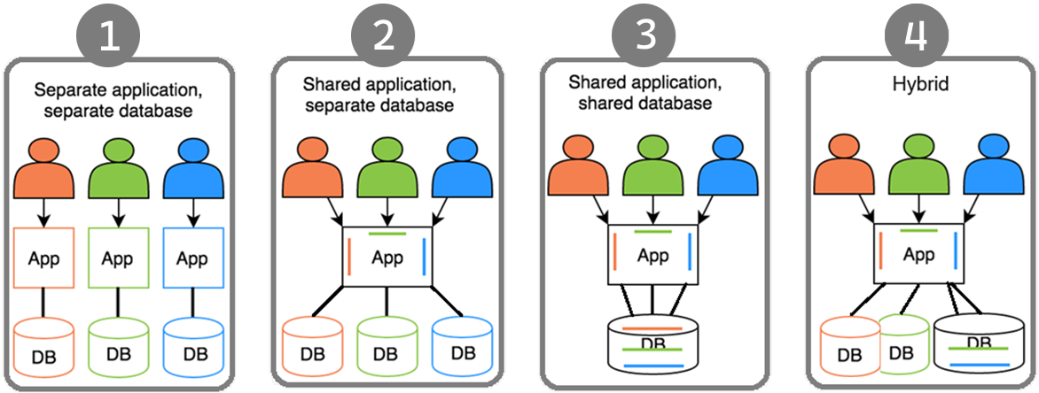




Deployment & Database Architectures
Notes:
There are 4 scenarios of the application and DB deployments.
This one looks like on-premises deployment. Each client has its own web app and database. Not a SaaS friendly architecture.
This is better than the first one. All the clients shares the same application but uses separate DBs. Not good for resource utilization. Because you need to maintain / update schemas of the databases.
This one is the ideal one. Everyone uses the same app and the same DB. Minimum cost with maximum client coverage. The downside of this approach is; some customers might have excessive data and consume resources much more than others. Also according to some GDPR rules, some clients may want to locate the DB in their country like banks. Therefore you need to separate those DBs.
Last one covers all kinds of challenges. You can provide separate DB if a client pays more or locate their data in a different geo-location. On the other hand, small clients can share the same DB.

Slide 11
Maintaining Application States
Application code & services should be stateless!
States can be stored at:
HTTP Request (cookie, header, query string, payload)
Authentication ticket
Database (relational, non-relational)
Distributed cache (Redis, Memcached, ...)
Notes:
A stateless application doesn’t save any client session (state) data on the server like TenantId.
And HTTP is a stateless protocol. This means that user data is not persisted from one web page to the next.
Our multi-tenant application should also be stateless.
Besides, the Stateless approach is multi-thread friendly!
Then where should we save the state?
In HTTP Requests, Authentication tickets as in JWT, DB, Distributed caches like Redis.

Slide 12
Determining the Active Tenant
CurrentUserTenantResolveContributor
QueryStringTenantResolveContributor
RouteTenantResolveContributor
HeaderTenantResolveContributor
CookieTenantResolveContributor
DomainTenantResolver
Notes:
There are 6 ways of finding the current/active tenant in our implementation.

Slide 13
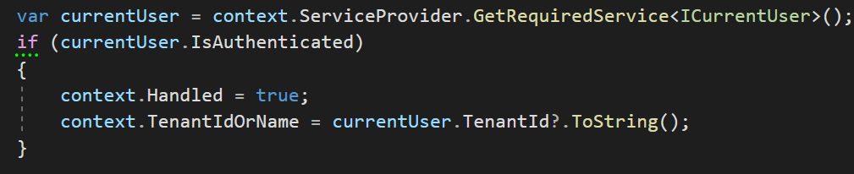
Determining the Active Tenant
1. CurrentUserTenantResolveContributor
HttpContext.User.Identity.Claims .FirstOrDefault(c => c.Type == “TenantId”)
Notes:
We set TenantId to claims when a user logs in.
And when user comes back again, we identify the user from this TenantId that’s retrieved from the claims.

Slide 14
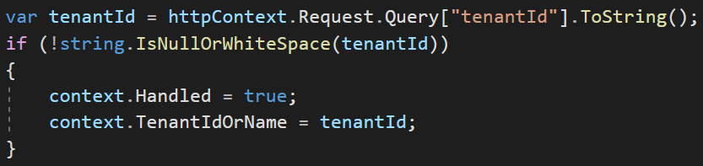
Determining the Active Tenant
2. QueryStringTenantResolveContributor
https://fabrikam.com?tenantId=3

Slide 15
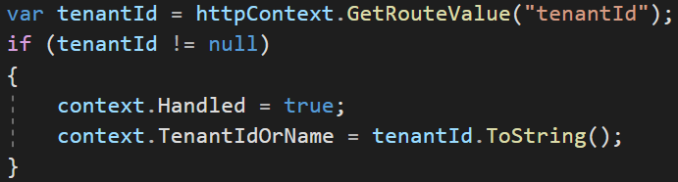
Determining the Active Tenant
3. RouteTenantResolveContributor
https://fabrikam.com/acme/

Slide 16
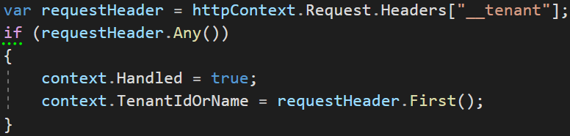
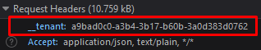
Determining the Active Tenant
4. HeaderTenantResolveContributor
Notes:
We use headers especially for single page applications or 3rd party clients like mobile apps.

Slide 17
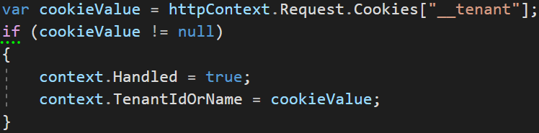
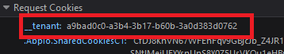
Determining the Active Tenant
5. CookieTenantResolveContributor

Slide 18
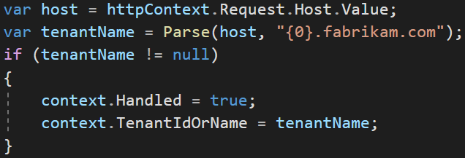
Determining the Active Tenant
6. DomainTenantResolver
https://acme.fabrikam.com
Notes:
So far we understand who the tenant is, now let's look at data isolation.

Slide 19
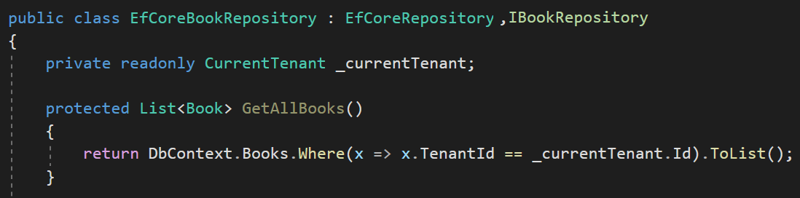
Data Isolation — Traditional way
You normally do this

Slide 20
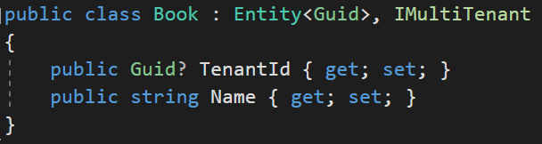
Data Isolation
Notes:
We use IMultiTenant interface to make an entity multi-tenant.
By using interface in this way, we standardize the TenantId field so that we can easily filter
ABP automatically sets the TenantId when you create a new entity.
----------
ABP Framework supports
Shared Database: All tenants are stored in a single database.
Database per Tenant: Every tenant has a separate, dedicated database to store the data related to that tenant.
Hybrid: Some tenants share a single databases while some tenants may have their own databases.
---
Multi-tenancy works seamlessly in the framework level.
When you implement your entities from this interface, ABP Framework automatically filters entities for the current tenant when you query from database. So, you don't need to manually add TenantId condition while performing queries. So we isolate the tenant data by default.
---

Slide 21
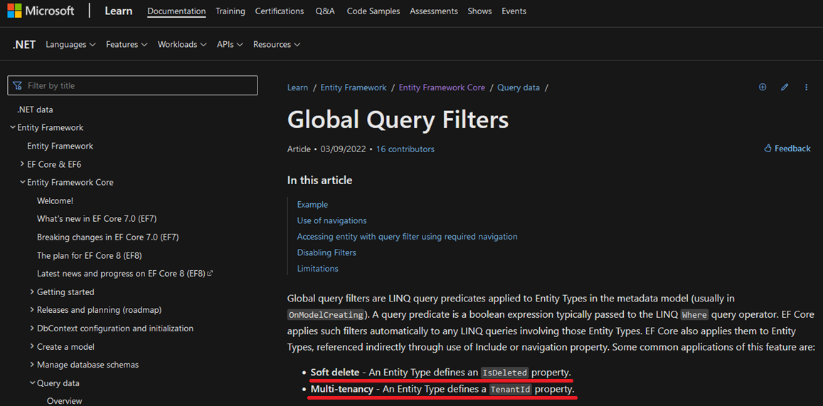
Data Isolation — EF Core
* Soft delete: An Entity Type defines an IsDeleted property.
* Multi-tenancy: An Entity Type defines a TenantId property.
Notes:
To filter the multi-tenant entities by default we are using EF Core Global Query Filters.
These filters are LINQ query expressions that applies to Entities OnModelCreating phase.
This feature is generally being used for soft deleting an entity and multi-tenancy.
These features are generic features that should be filtered application-wide.
And ABP uses this system for the EF Core Integration.
So, it is well integrated to EF Core and works as expected even if you directly work with DbContext.

Slide 22
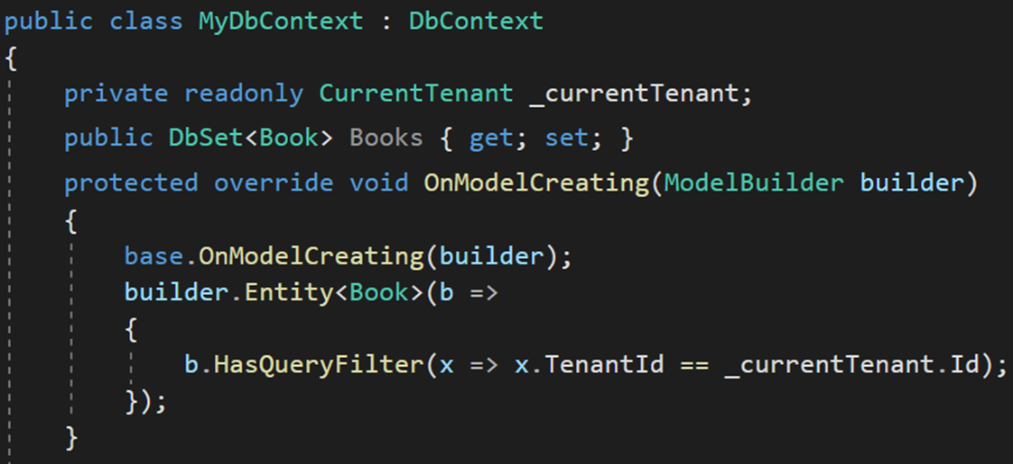
Data Isolation — EF Core Manual Way
HasQueryFilter() for global filtering
Notes:
In traditional way, you need to use HasQueryFilter for all your multi-tenant entities in OnModelCreating method of the DbContext.
Let's see how we automate this in the framework.

Slide 23
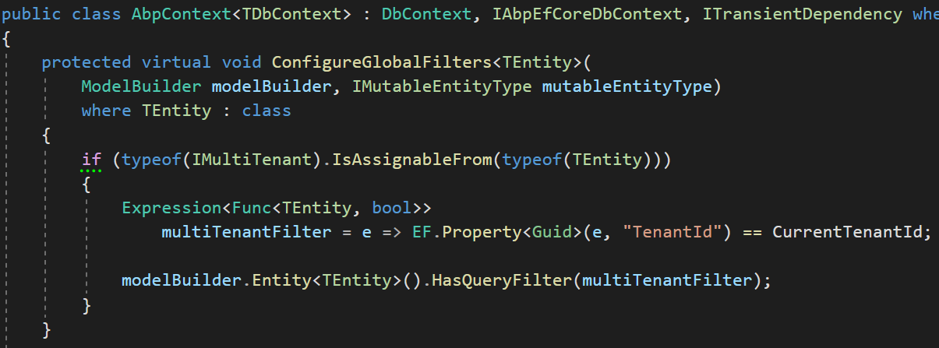
Data Isolation — EF Core
1-) Find all IMultiTenant
2-) Create LINQ expression
3-) Add to global filters
Notes:
We find all entities that implement an IMultiTenant interface.
To filter the multi-tenant entities by default we are using EF Core Global Query Filters.
These filters are LINQ query expressions that applies to Entities OnModelCreating phase.
This feature is generally being used for soft deleting an entity and multi-tenancy.
These features are generic features that should be filtered application-wide.
And ABP uses this system for the EF Core Integration.
So, it is well integrated to EF Core and works as expected even if you directly work with DbContext.

Slide 24
Data Isolation — EF Core PROS & CONS
EF Core Global filters
😊 supports navigation properties as well
😕 works only with EF Core
😡 does not support Stored Procedures or T-SQL
Database level solution 👉 Row Level Security
https://learn.microsoft.com/en-us/sql/relational-databases/security/row-level-security
Notes:
---
And there’s Row Level Security which covers almost all cases.
It only supports SQL Server and Azure SQL. No support for MySQL or SQLite.
But Row Level Security is relatively complex to implement and you need to stick to SQL Server.
EF Core is ideal for a pragmatic solution

Slide 25
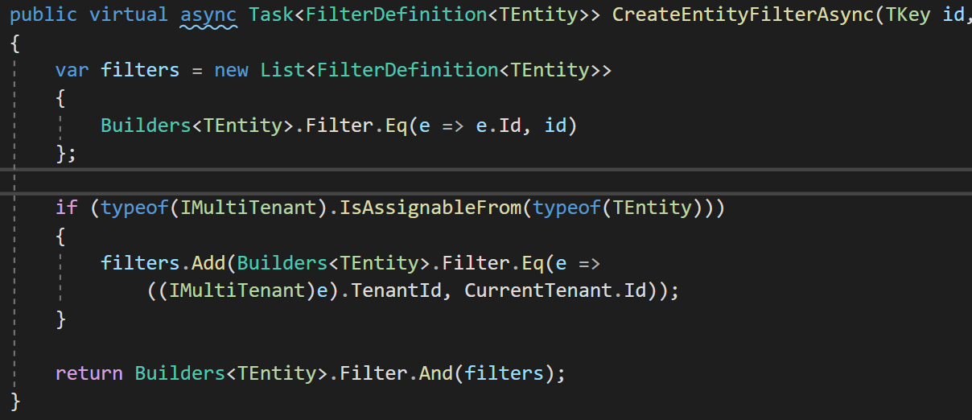
Data Isolation — MongoDB
Find all IMultiTenant
Create filter expression
Add to our custom global filters
Notes:
We have MongoDB implementation as well.
ABP abstracts the IMongoDbRepositoryFilterer interface to implement data filtering for the MongoDB Integration, it works only if you use the repositories properly.
Currently, the best way to implement a data filter for the MongoDB integration is to create a derived class of MongoDbRepositoryFilterer and override AddGlobalFilters. Example:
MongoDbRepositoryFilterer is being used for data filtering
The framework automatically adds TenantId filter to all the queries

Slide 26
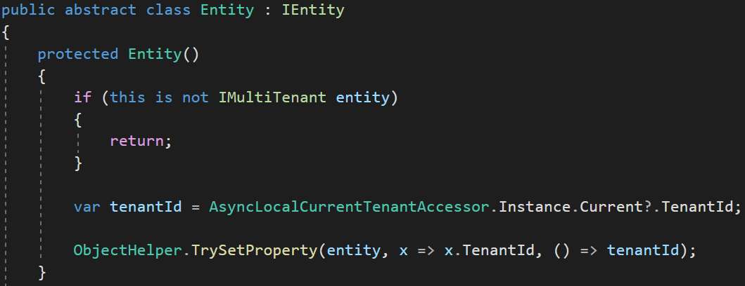
Data Isolation — Set TenantId for Entity
Set TenantId by reflection
Notes:
We set the tenantId for a new multi-tenant entity in the constructor.
We get the active TenantId from the ambient context and set it.
This way we are sure that TenantId is always being set

Slide 27
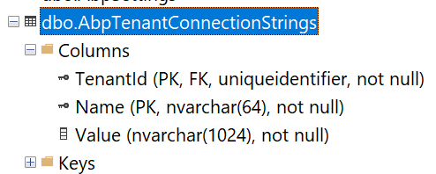
Connection String Selection
The current tenant
The current module / microservice
Fallbacks to the default connection string
Notes:
When your application allows customers choose their own database, then you need to save each tenant’s connection string.
The master database connection string is stored in the configuration file: appsettings.json
And if a tenant wants a separate database then we store its connection string in AbpTenantConnectionStrings table with TenantId and Value.
This way we setup a hybrid approach for both shared and dedicated database architecture.
Module connection string:
https://github.com/abpframework/abp/blob/dev/templates/module/aspnet-core/host/MyCompanyName.MyProjectName.HttpApi.Host/appsettings.json#L5

Slide 28
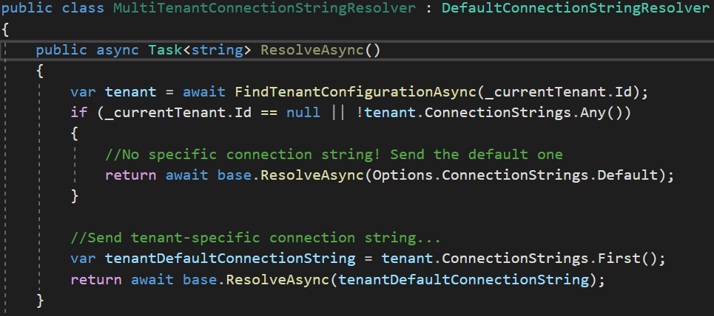
Connection String Selection
Shared DB
Dedicated DB
Notes:
We use a factory service to dynamically set the connection string when the DbContext is being created.
We use DbContextCreationOptions for this approach
https://learn.microsoft.com/en-us/dotnet/api/microsoft.entityframeworkcore.dbcontextoptionsbuilder?view=efcore-7.0

Slide 29
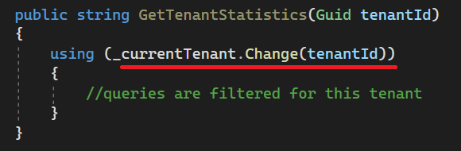
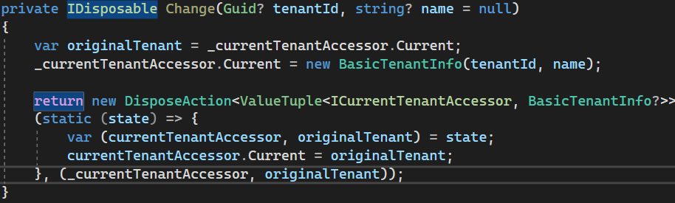
Changing the Active Tenant
Set active tenant
Revert back
Notes:
In each HTTP request, you can only query for the active tenant.
But sometimes it may be necessary to change the active tenant.
For example when you have background job that generates reports for each tenant (or in Windows Services)
In this case, we use a disposable method which is being used with “using” keyword.
Here we keep the original tenant in a temporary variable and set the new tenant.
Doing this, we filter all queries by this tenant.
Then we restore the original tenant after using the existing statement.

Slide 30
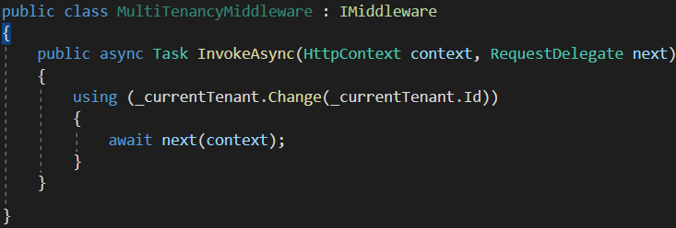
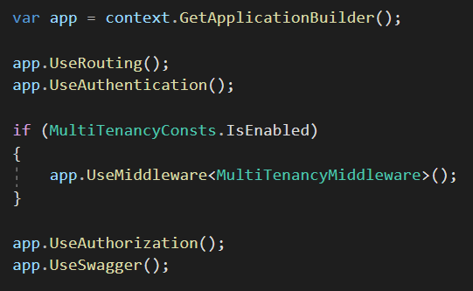
Setting the Active Tenant in Middleware
Set the current tenant within the middleware
Notes:
We created a middleware called MultiTenancyMiddleware.
And we set the current active tenant in this middleware.

Slide 31
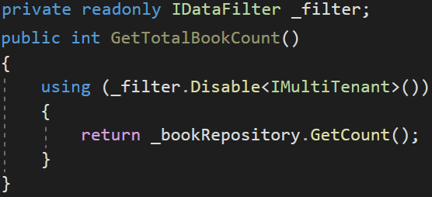
Disabling Multi-Tenancy Filter — Usage
Notes:
Sometimes, you may need to query on all tenants especially when your tenants share the same database.
Especially when you want to get a report among your tenants.
In this example we get all book count without filtering tenants.
After the “Using” code block finishes, TenantId will be restored and multi-tenancy filtering will run again.

Slide 32
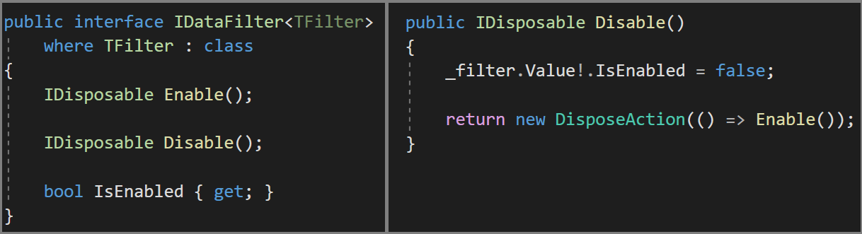
Disabling Multi-Tenancy Filter
Notes:
We use a singleton class called DataFilter and save all filters in a concurrent dictionary.
To keep the active passive state of a filter.
If you disable multi-tenancy filter then, it’ll be ignored in global filters.
It returns DisposableAction to allow “Using” statement

Slide 33
Database Migration
Approach-1: Make DB migration with a custom tool
😊 Easy to implement. All tenants are in the same version
😡 May get too long time for big number of tenants and data.
😡 All tenants wait for all upgrade progress
Approach-2: Run migration on first DB access
😊 Upgrading is distributed to time. A tenant does not wait for another
😡 First user may wait too much and see timeout exception.
😡 Hard to implement (concurrency problems)!
Notes:
Multiple database migration

Slide 34
Database Migration — Ideal Way
Approach-3: Make two types application servers.
Upgraded tenants use the new application, other tenants use the old application
😊 Minimum wait time for a tenant
😊 Upgrading can be scheduled for tenants
😊 Run A/B tests and see bugs before anyone else
😡 Requires multiple app servers
😡 Hard to maintain and monitor
Notes:
Sometimes you see the old UI of Gmail and your friend sees the new UI.
Why doesn’t Gmail migrates everyone at the same time.
Because it’s time consuming.
So Google separates the Gmail as old and new versions.
A tool updates the applications and databases in the background.
Each tenant is being notified if they are upgraded.
this is the ideal way For big systems !

Slide 35
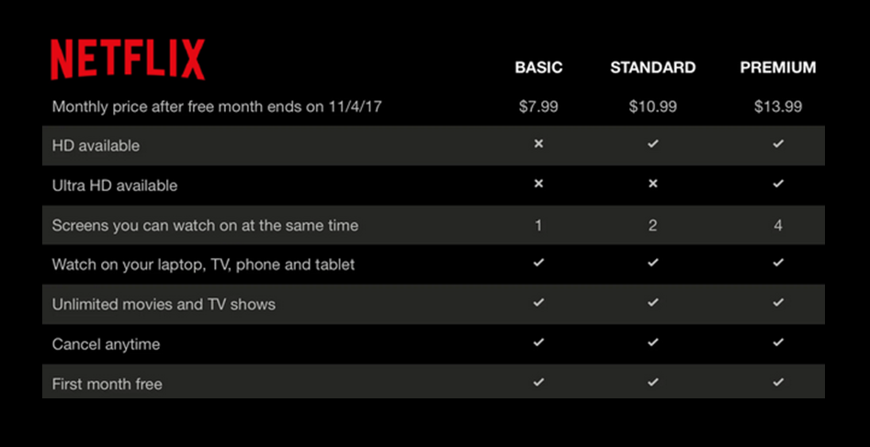
The Feature System
Editions
Features
Notes:
To explain what a feature means, first we need to know the term: Edition
A standard SaaS application sells the customers different plans with different prices.
Each subscription plan is called an edition
And each edition should consist of different features.
Netflix is a good SaaS example. It has 3 editions and 8 features
We need to enable/disable each feature based on the current tenant on runtime.
https://docs.abp.io/en/abp/latest/Features

Slide 36
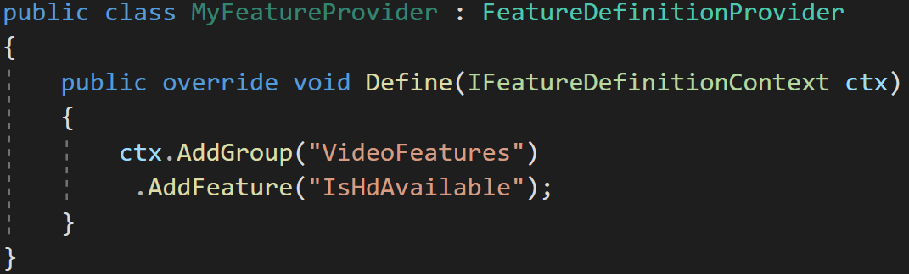
The Feature System — Define your features
Features are stored in a readonly list
Notes:
Features are stored in a ReadOnlyList
https://docs.abp.io/en/abp/latest/Features

Slide 37
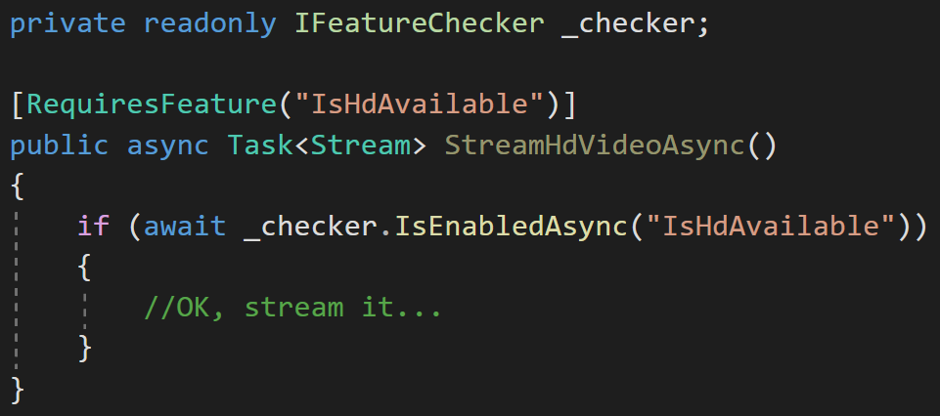
The Feature System — Check the features
Declarative check
Conditional check
Notes:
We created [RequiresFeature] attribute to be used on methods.
When you add [RequiresFeature] the ABP framework intercepts the method and injects a check before the execution of the method.
So, it works with any class that is injected from the dependency injection.

Slide 38
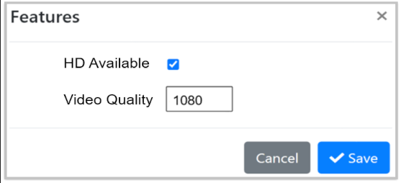
The Feature System
Use the Management UI to manage features for tenants
Notes:
And we created a page for the admin user to be able to manage the tenant’s features
This screenshot is from ABP’s startup template’s admin project.

Slide 39




Thank you for listening
https://twitter.com/alperebicoglu
https://github.com/ebicoglu
https://medium.com/@alperonline
Download this presentation:
https://github.com/ebicoglu/presentations/

