Slide 1



How to Build a Multi-Tenant ASP.NET Core Application
Alper Ebicoglu
Co-Founder of Volosoft
twitter.com/alperebicoglu
Notes:
Ladies and gentlemen, thank you for joining me today.
My name is Alper, and I'm one of the co-founders of Volosoft.
Our company that has been empowering .NET developers by creating frameworks and simplifying the complexities of software development,
allowing you to focus on your business.
One of our flagship projects is the ABP Framework, a powerful framework that implements many cross cutting concerns of a web app.
Today, I will share my experiences and insights I've gained while implementing major multi-tenancy requirements.

Slide 2

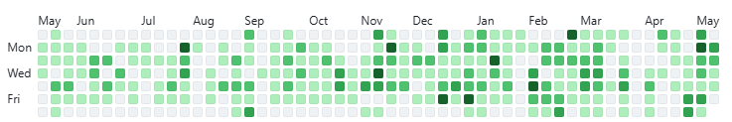

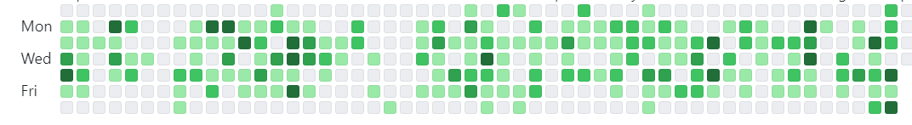
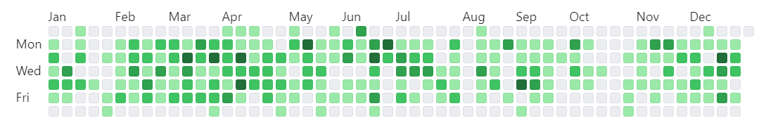
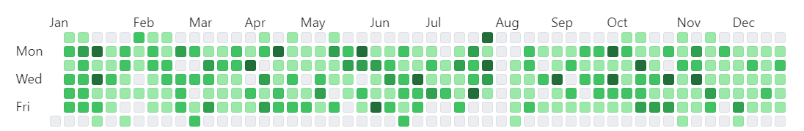
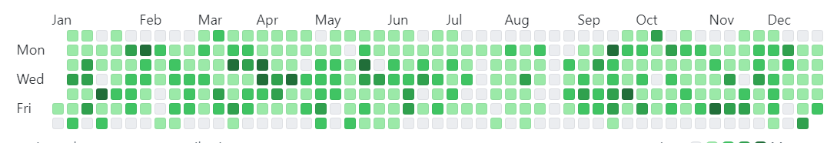
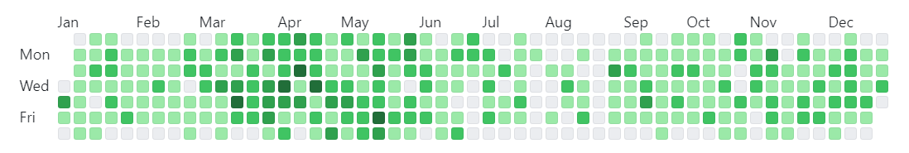
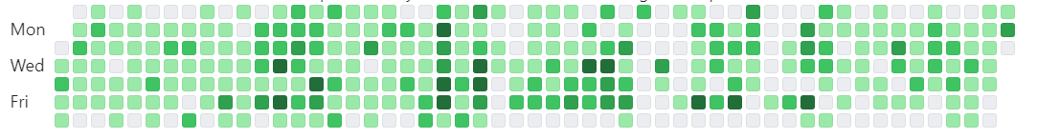
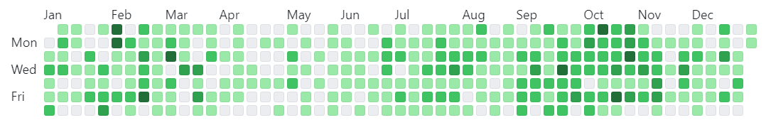
1997
2025
Started programming with Q-Basic
2024
2004
2023
First .NET App developed on .NET Framework 1.0
2022
2006
Software Engineering
2021
2010
2020
Master Degree
2019
2017
Co-Founder of Volosoft
2018
Notes:
Open source since 2016
more than 200 versions so far.
12K stars on GitHub
And over 20 million downloads on NuGet until now.
Why I’m showing this to you, because we have a good experience of modular application development, microservice architecture, DDD and multi-tenancy.
In the next slides, I’ll share you how we solved some real world problem multi-tenancy issues.

Slide 3


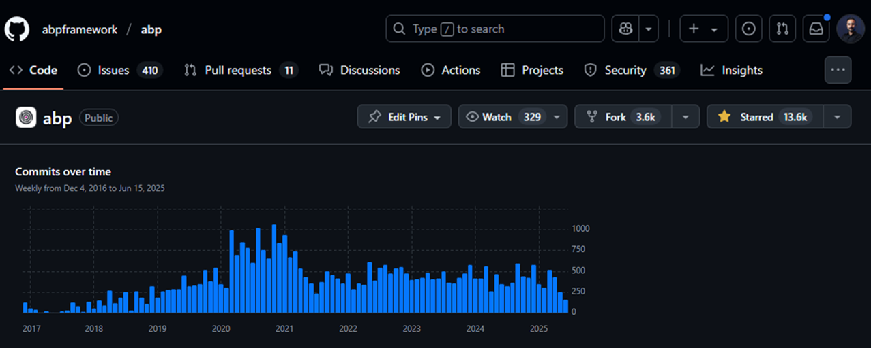
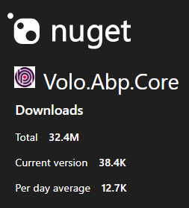
Open-source Web App Framework
Notes:
Open source since 2016
more than 200 versions so far.
12K stars on GitHub
And over 20 million downloads on NuGet until now.
Reduce repetitive work
Multi-tenancy, Microservice, Modularity , Authentication & AuthorizationUI Options:
Blazor, MVC/Razor Pages, Angular (with pre-built UIs).
Ideal For:
B2B SaaS platforms
Enterprise web apps
Admin panels & internal tools
Why I’m showing this to you, because we have a good experience of modular application development, microservice architecture, DDD and multi-tenancy.
In the next slides, I’ll share you how we solved some real world problem multi-tenancy issues.

Slide 4
Agenda
Introduction to Multi-Tenancy
Pros and Cons of Multi-Tenancy
Database & Deployment Scenarios
Identifying and Changing the Active Tenant
Data Isolation
Conditionally Turning Multi-Tenancy On / Off
Handling Database Migrations
Implementation of the Feature System

Slide 5
What is Multi-Tenancy?
A common approach to build SaaS solutions
Resources are shared between tenants
Application data is isolated between tenants
Tenants: Our clients, using the service
Host: Service provider
Parties
An ideal multi-tenant application should be
Unaware of multi-tenancy as much as possible!
Deployable to on-premise as well
Notes:
Multi-tenancy; architectural approach to build SaaS
Hardware + Software resources shared btw tenants.
Tenant's data and configurations are logically or physically separated.
Tenants: Customers
Host: Solution owner
Ideal Multi-tenant:
Unaware of multi-tenancy: System should be designed to work seamlessly and make your application code multi-tenancy unaware as much as possible. Shouldn’t pass TenantId to all your controllers, application services, repositories or domain services… tenancy related stuff in a low-level layer and keep your business code clean as much as possible.
Deployable to on-premise: When a customer wants to setup your solution to his own servers, you should be doing that without any code changes.

Slide 6
Advantages of Multi-Tenancy
Cost efficiency — max utilization
Consistent user experience
Ease of maintenance
Scalability
Rapid deployment for new users
Notes:
Cost Efficiency: You share the hardware and software among customers, you reduce costs and serve the maximum number of customers.
Same User Experience: All the customers use the latest version. Ensuring that all tenants receive updates and improvements at the same time. Focus on maintaining a single codebase,
Easy Maintenance: Maintaining a single codebase and infrastructure for all tenants simplifies software updates, patches, and bug fixes. It reduces the complexity of managing multiple instances, making it easier for developers and administrators to maintain the system.
Scalability: When there are demand spikes, you can easily increase system resources. You can add extra servers behind your load balancer. This way, you can serve more customers.. This leads to better resource utilization and responsiveness to demand spikes. But if it was an on premise system, then it would hard to increase the resources of each tenant.
Ease of Deployment: New tenants can be onboarded quickly within the existing infrastructure; No need to set up a new environment for the new client. When a new tenant comes, you just add a new line into your Tenants table.

Slide 7
Challenges of Multi-Tenancy
Data isolation
Configuration & customization per tenant
Performance balance: Noisy neighbors!
Security
Backup and recovery
Notes:
Data isolation: Ensuring proper data isolation btw tenants to prevent unauthorized access to sensitive information
Customization and configuration: Your clients request to customize the application according to their requirements. They want to make rebranding and customize the UI, logo, colors. Managing different configurations and customizations for each tenant without compromising the core architecture can be challenging.
Performance balance: Some customers may use the system extensively We call this Noisy neighbors. We should ensure that the resource usage of one tenant does not negatively impact the performance of other. This should be done by monitoring the system.
Security: A security hole in tenant isolation can expose one tenant’s data to another + When a hacker gets into your server he can steal all your customers’ data.
Backup and recovery: This involves database and storage backup per tenant. It will be very easy to backup/restore when you have a separate DB for each tenant, but if you have a shared DB then you need to get backup of the specific tenant. And tenants may have different retention policies, so you need to implement different strategies for each tenant. Government agencies + banks

Slide 8
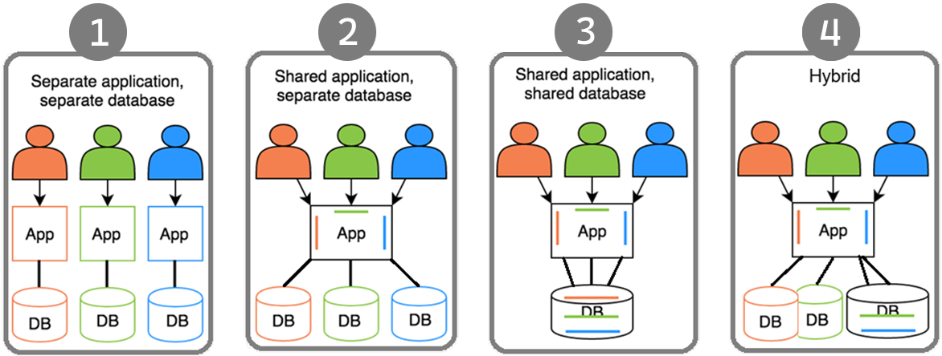

Deployment & Database Architectures
Notes:
1-) on-premises deployment. Not a SaaS friendly architecture 2-) Not good for resource utilization => Migrating databases at the same time! 3-) SaaS friendly + Max Utilization + Customers will ask you to separate their DB (banks, government agencies) 4-) covers all kinds of requirements. If pays more separate DB.

Slide 9
Identifying the Active Tenant
Notes:
So far I gave you some general information about multi-tenancy.
Now let’s see some code and real-world solutions

Slide 10
How to determine the current tenant?🤔
CurrentUserTenantResolveContributor
QueryStringTenantResolveContributor
RouteTenantResolveContributor
HeaderTenantResolveContributor
CookieTenantResolveContributor
DomainTenantResolver
Request pipeline
Notes:
When a user makes a request to the application, you need to understand Which tenant's user is this user?
There are 6 ways of finding the current/active tenant in our implementation.
These strategies, known as Tenant Resolve Contributors, allow the application to extract the tenant ID from different parts of the HTTP request. Here are the most common sources:

Slide 11
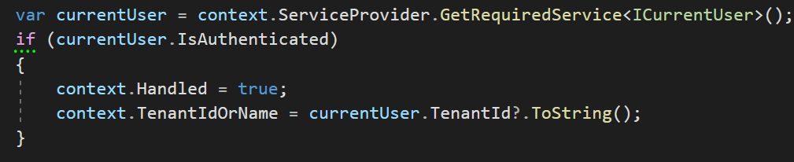
Identifying the Active Tenant
1. Current User (Claims)
HttpContext.User.Identity.Claims .FirstOrDefault(c => c.Type == “TenantId”)
Notes:
When a user logs in, we save his TenantId to the claims.
And when user comes back again, we identify the user from this TenantId that’s retrieved from the claims.

Slide 12
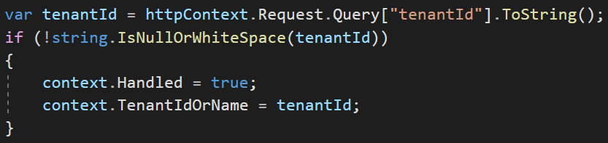
Identifying the Active Tenant
2. Query String
https://fabrikam.com?tenantId=3

Slide 13
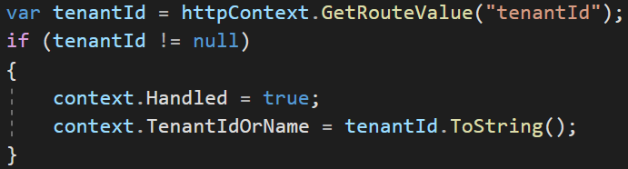
Identifying the Active Tenant
3. Route
https://fabrikam.com/acme/
Notes:
Store tenantId as route path

Slide 14
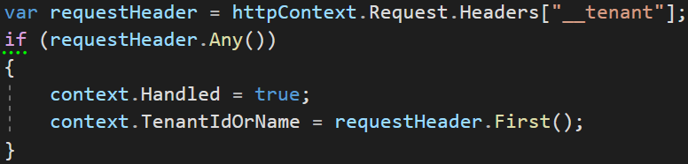
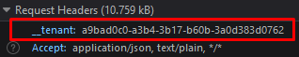
Identifying the Active Tenant
4. Header
Notes:
We use headers especially for SPA or 3rd party clients like mobile apps.

Slide 15
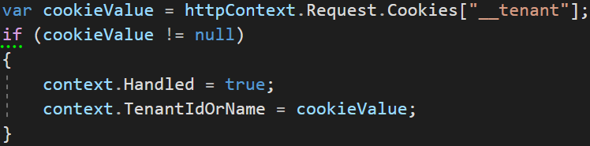
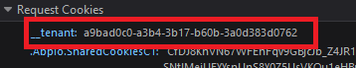
Identifying the Active Tenant
5. Cookie

Slide 16
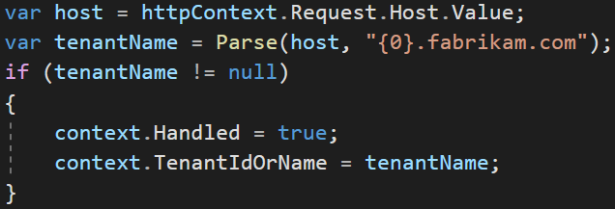
Identifying the Active Tenant
6. Domain
https://acme.fabrikam.com
Notes:
This is good if your customers make e-commerce, online shopping etc.
So far we understand who the tenant is, now let's look at data isolation.

Slide 17
Data Isolation
✓ Identifying the Active Tenant
Notes:
When the tenant’s don’t use shared DB no problem.
But when shared DB…

Slide 18
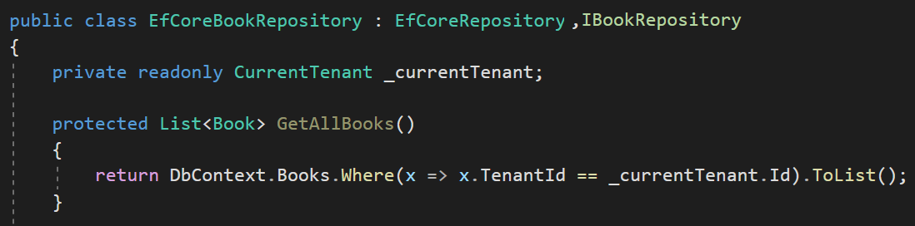
Data Isolation — Traditional way
You normally do this

Slide 19
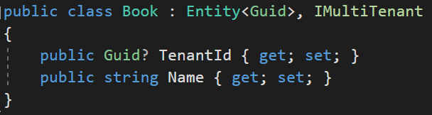
Data Isolation — How to make it standard?
Notes:
We use IMultiTenant interface to make an entity multi-tenant.
By using interface in this way, we make the TenantId field standard so that we can easily filter
ABP automatically sets the TenantId when you create a new entity.
----------
ABP Framework supports
Shared Database: All tenants are stored in a single database.
Database per Tenant: Every tenant has a separate, dedicated database to store the data related to that tenant.
Hybrid: Some tenants share a single databases while some tenants may have their own databases.
---
Multi-tenancy works seamlessly in the framework level.
When you implement your entities from this interface, ABP Framework automatically filters entities for the current tenant when you query from database. So, you don't need to manually add TenantId condition while performing queries. So we isolate the tenant data by default.
---

Slide 20
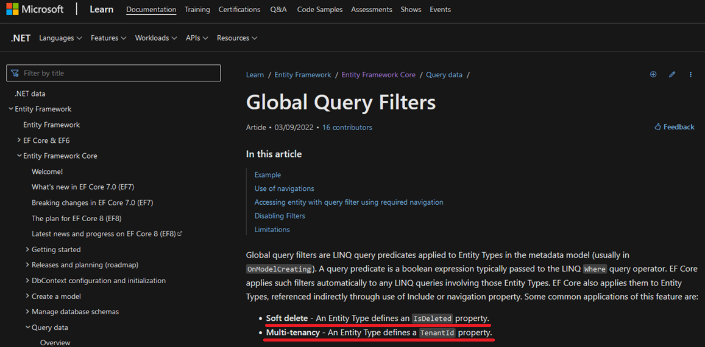
Data Isolation — EF Core
* Soft delete: An entity type defines an IsDeleted property.
* Multi-tenancy: An entity type defines a TenantId property.
Notes:
Allows you to define a filter condition that is automatically applied to all queries for a given entity.
* Softdelete, Multi-Tenancy, Published
These filters are LINQ expressions that applies to Entities OnModelCreating phase.
This feature is generally being used for soft deleting an entity and multi-tenancy.
These features are generic features that should be filtered application-wide.
And ABP uses this system for the EF Core Integration.
So, it is well integrated to EF Core and works as expected even if you directly work with DbContext.

Slide 21
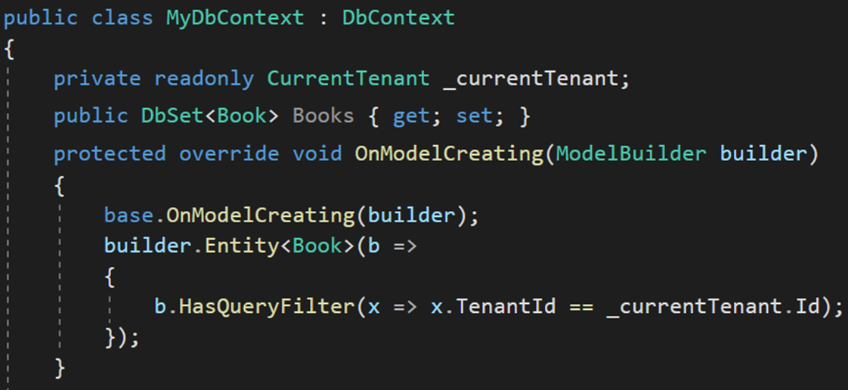
Data Isolation — EF Core Manual Way
HasQueryFilter() for global filtering
Notes:
Use HasQueryFilter for all your multi-tenant entities in OnModelCreating method of the DbContext.
Let's see how we automate this in the framework.

Slide 22
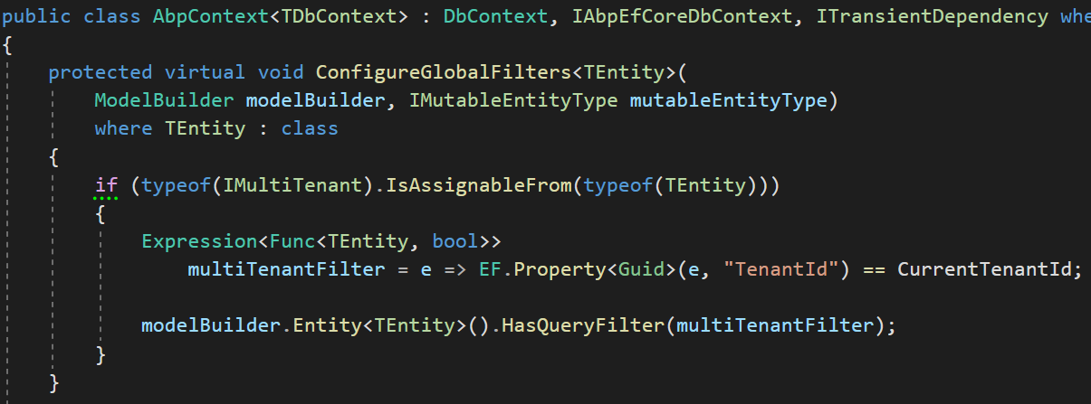
Data Isolation — EF Core
1-) Find all entities implement IMultiTenant
2-) Create LINQ expression
3-) Add to global filters
Notes:
We find all entities that implement an IMultiTenant interface.
To filter the multi-tenant entities by default we are using EF Core Global Query Filters.
These filters are LINQ query expressions that applies to Entities OnModelCreating phase.
This feature is generally being used for soft deleting an entity and multi-tenancy.
These features are generic features that should be filtered application-wide.
And ABP uses this system for the EF Core Integration.
So, it is well integrated to EF Core and works as expected even if you directly work with DbContext.

Slide 23
Data Isolation — EF Core PROS & CONS
😊 Easy to implement
😊 Supports navigation properties
Notes:
Planning to change your ORM later, doesn’t work for other ORM!

Slide 24
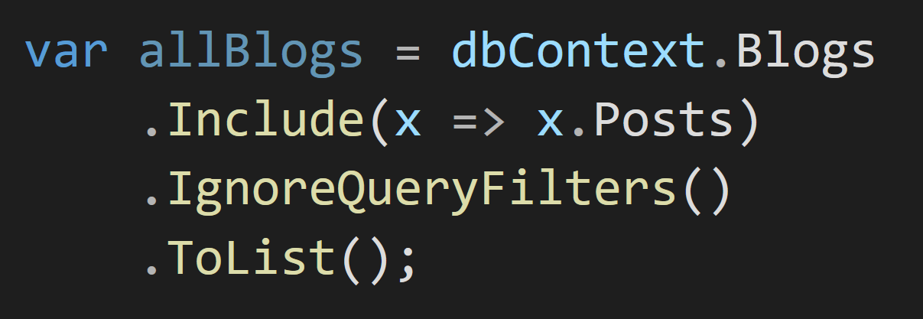
Data Isolation — EF Core PROS & CONS
😡 IgnoreQueryFilters() disables all filters
Notes:
IgnoreQueryFilters doesn’t get a specific filter as a parameter.
You can't just disable multitenancy but leave soft delete active

Slide 25
Data Isolation — EF Core PROS & CONS
😡 Can be defined for the root entity
of the inheritance hierarchy
Define to Animal
Notes:
In this example, Animal is the root entity type
BigAnimal and SmallAnimal inherit from Animal.
You can just define to the Animal class

Slide 26
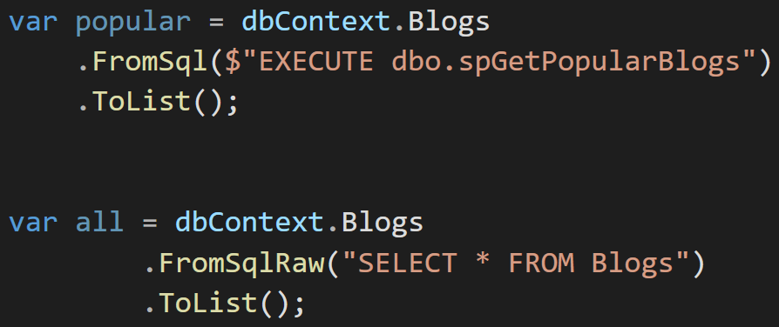
Data Isolation — EF Core PROS & CONS
😡 Does not support Stored Procedures or T-SQL
Notes:
And there’s Row Level Security which covers almost all cases.
But Row Level Security is relatively complex to implement and you need to stick to SQL Server.
EF Core Global filters method is ideal for a pragmatic solution

Slide 27
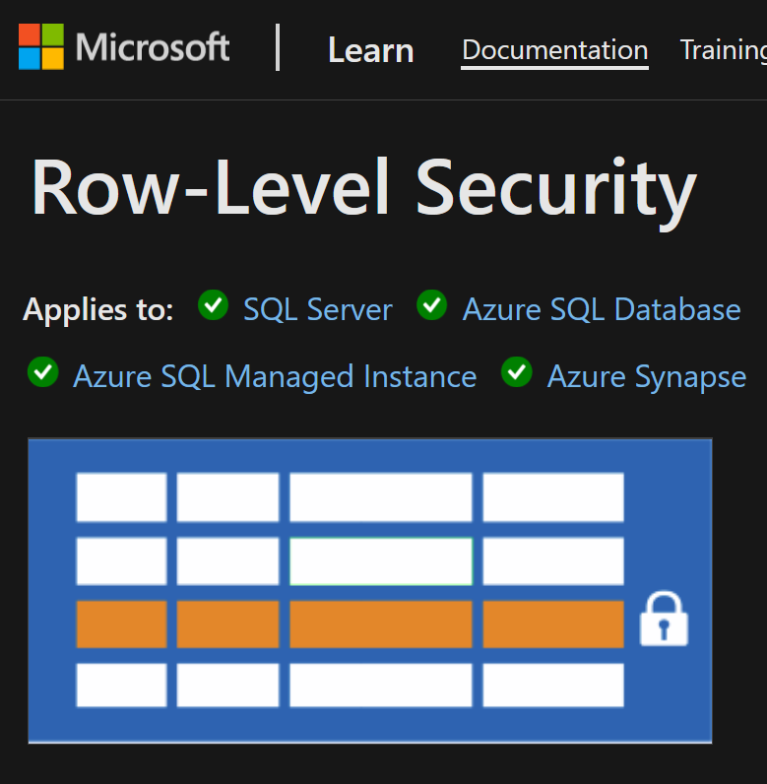
Data Isolation — EF Core PROS & CONS
Database level solution
👉 Row Level Security
Rows filtered based on user roles, attributes
Restriction logic is done in the DB
https://learn.microsoft.com/en-us/sql/relational-databases/security/row-level-security
Notes:
And there’s Row Level Security which covers almost all cases.
But Row Level Security is relatively complex to implement and you need to stick to SQL Server.
EF Core Global filters method is ideal for a pragmatic solution

Slide 28
Set TenantId for New Entities
✓ Identifying the Active Tenant
✓ Data Isolation

Slide 29
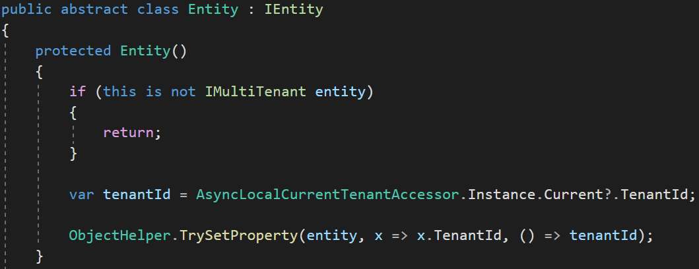
Set TenantId for New Entities in the Base Class
Set TenantId by reflection
Notes:
To avoid mistakes.
We set the TenantId for a new multi-tenant entity in the constructor.
We get the active TenantId from the active tenant’s scope and set it.
This way we are sure that TenantId is always being set

Slide 30
DB Connection String Selection
✓ Identifying the Active Tenant
✓ Data Isolation
✓ Set TenantId for New Entities

Slide 31
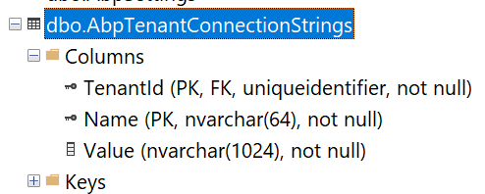
DB Connection String Selection
The current tenant
The current module / microservice
The default connection string
Notes:
When your application allows customers choose their own database, then you need to save each tenant’s connection string.
The master database connection string is stored in the configuration file: appsettings.json
And if a tenant wants a separate database then we store its connection string in AbpTenantConnectionStrings table with TenantId and Value.
This way we setup a hybrid approach for both shared and dedicated database architecture.
Module connection string:
https://github.com/abpframework/abp/blob/dev/templates/module/aspnet-core/host/MyCompanyName.MyProjectName.HttpApi.Host/appsettings.json#L5

Slide 32
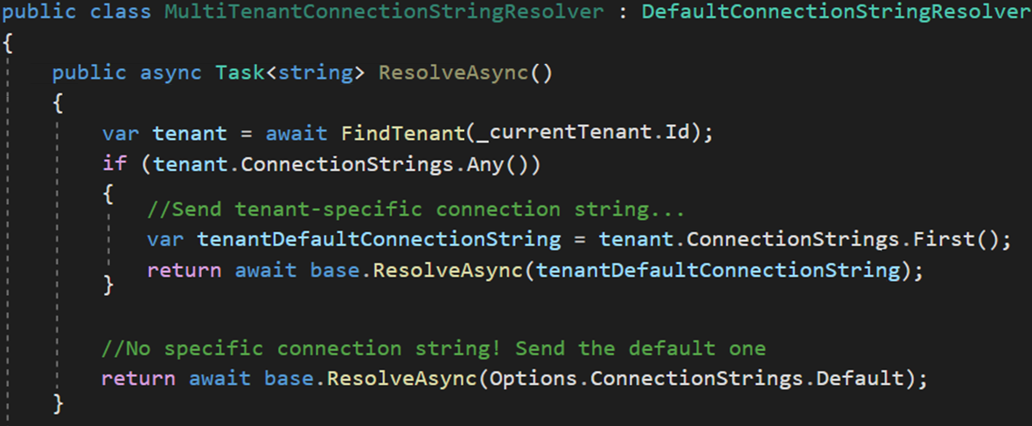
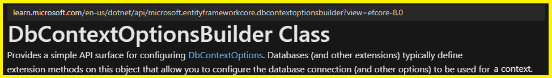
DB Connection String Selection — Implementation
Dedicated DB
Shared DB
Notes:
We use a factory service to dynamically set the connection string when the DbContext is being created.
We use Microsoft’s DbContextCreationOptions for this approach
https://learn.microsoft.com/en-us/dotnet/api/microsoft.entityframeworkcore.dbcontextoptionsbuilder

Slide 33
Changing the Active Tenant
✓ Identifying the Active Tenant
✓ Data Isolation
✓ Set TenantId for New Entities
✓ DB Connection String Selection

Slide 34
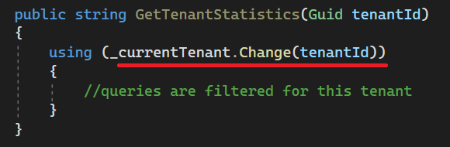
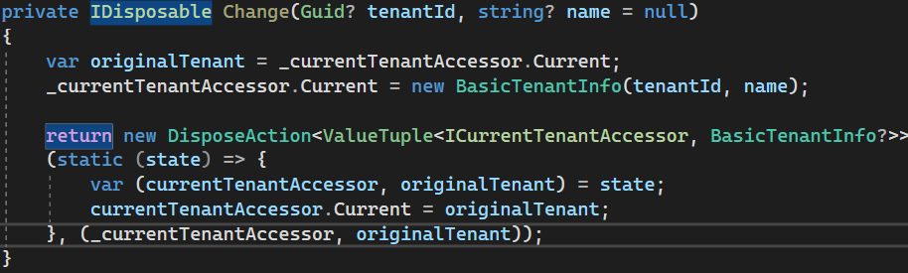
Changing the Active Tenant
Usage
Set active tenant
Finally revert back to original
Notes:
It may be necessary to change the active tenant when you have background job that generates reports for each tenant (or in Windows Services)
In this case, we use a disposable method which is being used with “using” keyword.
Here we keep the original tenant in a temporary variable and set the new tenant.
Doing this, we filter all queries by this tenant.
Then we restore the original tenant after using the existing statement.

Slide 35
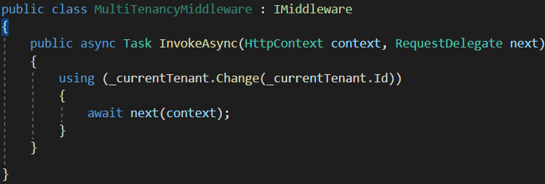
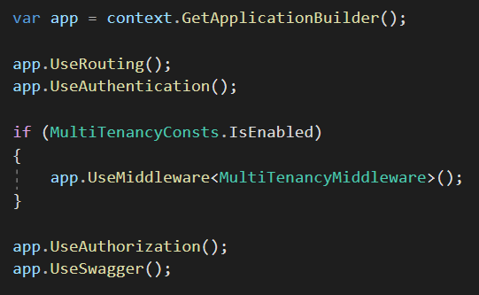
Setting the Active Tenant in Middleware
Set the current tenant within the middleware
Notes:
Rgister a custom MultiTenancyMiddleware.
This middleware resolves the tenant early in the pipeline and sets the current tenant using _currentTenant.Change().

Slide 36
Temporarily Disable Multi-Tenancy
✓ Identifying the Active Tenant
✓ Data Isolation
✓ Set TenantId for New Entities
✓ DB Connection String Selection
✓ Changing the Active Tenant

Slide 37
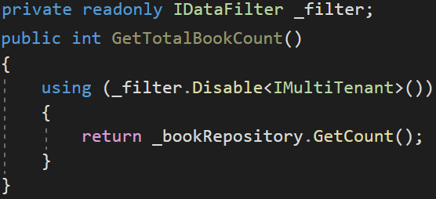
Disabling Multi-Tenancy Filter
Usage
Returns book count without “TenantId” filter
Notes:
Sometimes, you may need to query data across all tenants, especially when they share the same database—for example, to generate a report that includes all tenants. In the following example, we retrieve the total book count without applying the tenant filter. Once the Using code block completes, the TenantId is automatically restored, and multi-tenancy filtering resumes as normal.

Slide 38
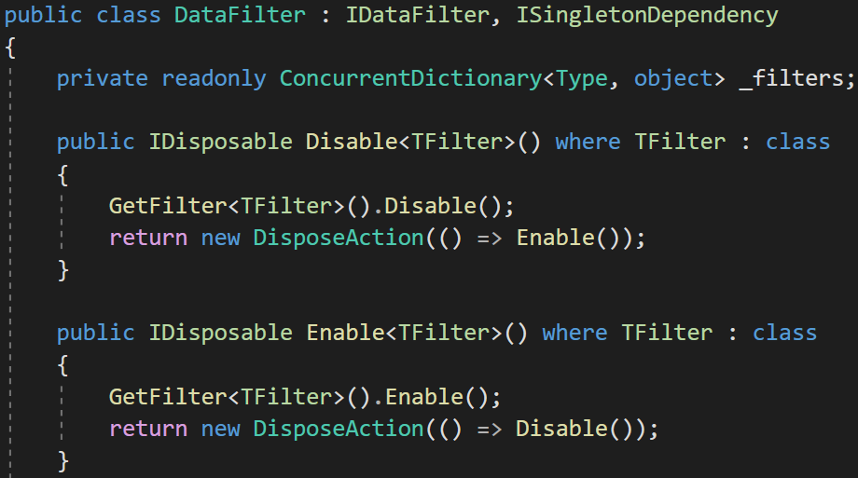
Disabling Multi-Tenancy Filter - Implementation
Notes:
We use a singleton class called DataFilter and save all filters in a concurrent dictionary.
To keep the active passive state of a filter.
If you disable multi-tenancy filter then, it’ll be ignored in global filters.
It returns DisposableAction to allow “Using” statement

Slide 39
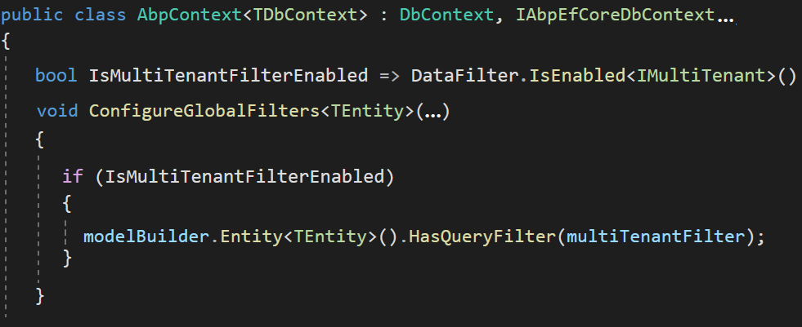
Disabling Multi-Tenancy Filter - Implementation
HasQueryFilter works if only the DataFilter is enabled

Slide 40
Database Migration
✓ Identifying the Active Tenant
✓ Data Isolation
✓ Set TenantId for New Entities
✓ DB Connection String Selection
✓ Changing the Active Tenant
✓ Temporarily Disable Multi-Tenancy
Notes:
There are 3 database migration approaches

Slide 41
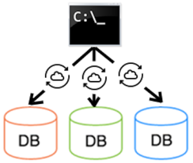
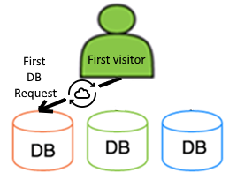
Database Migration Strategies
#1: Custom DB Migration Tool
😊 Simple implementation
😊 All tenants are upgraded to the same version at once
😡 Can be slow with many tenants or large datasets
😡 All tenants are blocked until the entire upgrade is completed
#2: Run DB Migration On First DB Access
😊 Upgrading is distributed to time. A tenant doesn’t wait for another
😡 The first user may wait too much,
Expect timeout exceptions
😡 Complex implementation (concurrency/race condition issues)

Slide 42
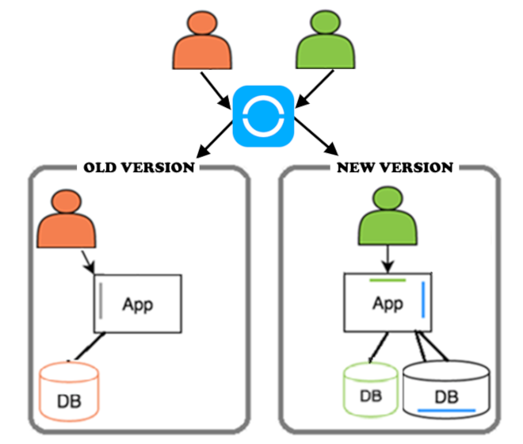
Database Migration Strategies
#3: Two Types of Application Servers
Upgraded tenants are routed to the new version,
while others continue using the old version.
😊Min downtime/wait time per tenant
Scheduled upgrades & staged rollouts
😊Run A/B tests & see bugs beforehand
😡Complexity in deployment, monitoring and maintenance multiple servers
Notes:
Sometimes you see the old UI of Gmail and your friend sees the new UI.
Why doesn’t Gmail migrates everyone at the same time.
Because it’s time consuming. The migration is spread over time.
So Google separates the Gmail as old and new versions.
A tool updates the applications and databases in the background.
Each tenant is being notified if they are upgraded.
this is the ideal way For big systems !

Slide 43
Feature System
✓ Identifying the Active Tenant
✓ Data Isolation
✓ Set TenantId for New Entities
✓ DB Connection String Selection
✓ Changing the Active Tenant
✓ Temporarily Disable Multi-Tenancy
✓ Database Migration

Slide 44
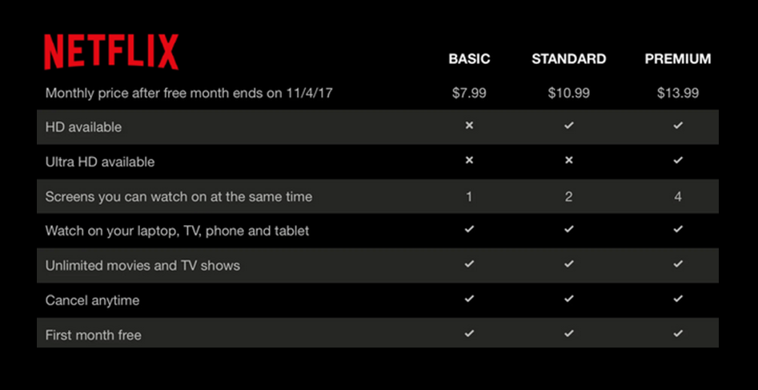
The Feature System
Editions
Features
Notes:
To explain what a feature means, first we need to know the term: Edition
A standard SaaS application sells the customers different plans with different prices.
Each subscription plan is called an edition
And each edition should consist of different features.
Netflix is a good SaaS example. It has 3 editions and 8 features
We need to enable/disable each feature based on the current tenant on runtime.
https://docs.abp.io/en/abp/latest/Features

Slide 45
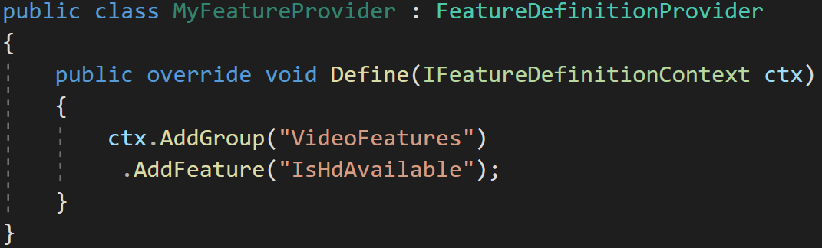
The Feature System — Define features
Features are stored in a readonly list
Notes:
Features are stored in a ReadOnlyList
https://docs.abp.io/en/abp/latest/Features

Slide 46
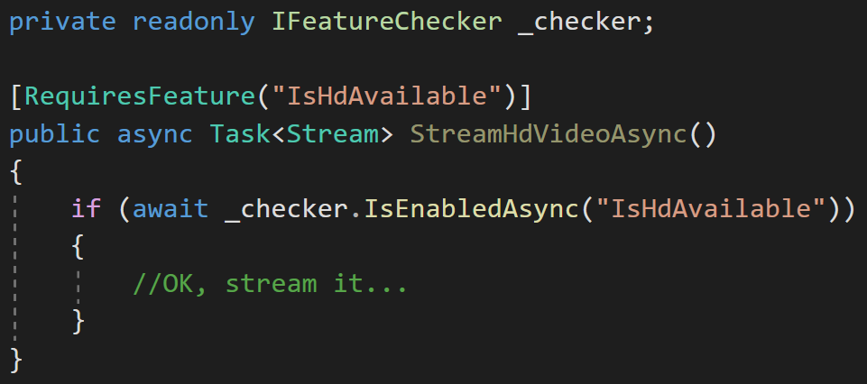
The Feature System — Check the features
Declarative check
Conditional check
Notes:
We created [RequiresFeature] attribute to be used on methods.
When you add [RequiresFeature] the ABP framework intercepts the method and injects a check before the execution of the method.
So, it works with any class that is injected from the dependency injection.

Slide 47
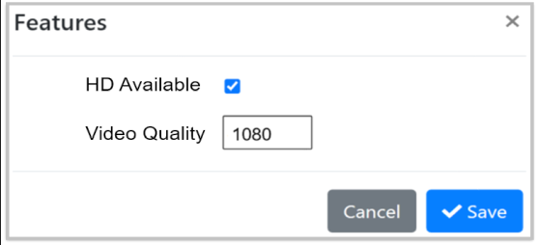
The Feature System — UI
Use a Management UI to manage features for tenants
Notes:
And we created a page for the admin user to be able to manage the tenant’s features
This screenshot is from ABP’s startup template’s admin project.

Slide 48

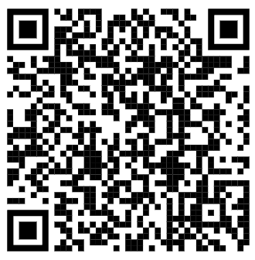



ALPER EBICOGLU
Download Presentation
https://x.com/alperebicoglu
https://github.com/ebicoglu
https://medium.com/@alperonline
github.com/ebicoglu/presentations

