Slide 1
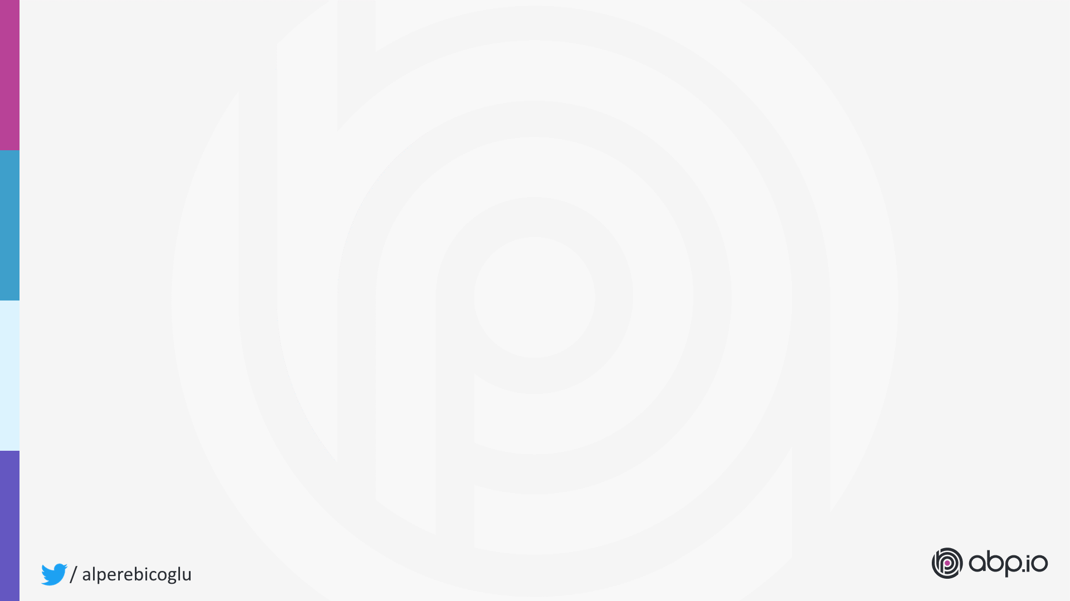
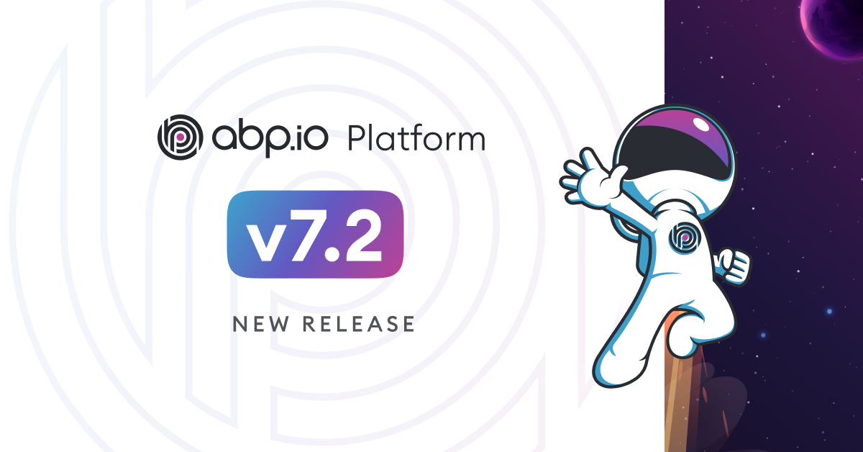
April 11, 2023
https://blog.abp.io/abp/ABP.IO-Platform-7.2-RC-Has-Been-Published
Notes:
ABP v7.2 rc2 version has been lately released on April 11.
Here’s the blog post about this version.
https://blog.abp.io/abp/ABP.IO-Platform-7.2-RC-Has-Been-Published
After me, Halil will explain you the new features and changes with this release.
We’re planning to release the stable version on May 2nd.

Slide 2
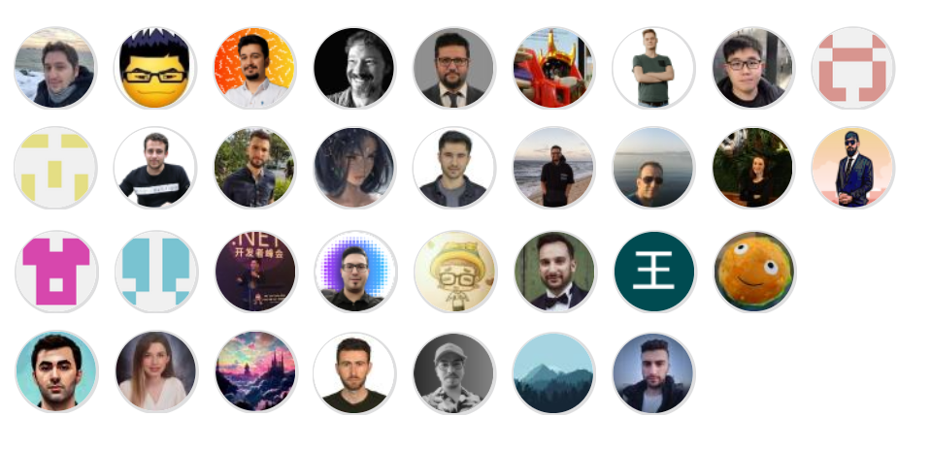
Thanks to the contributors of v7.2
Notes:
Every release of ABP includes improvements to performance, quality, stability, and ease of use of the APIs that make up the active and growing ABP ecosystem.
And this version has been released with 31 contributors.
Thanks to all developers who took part in this version.

Slide 3

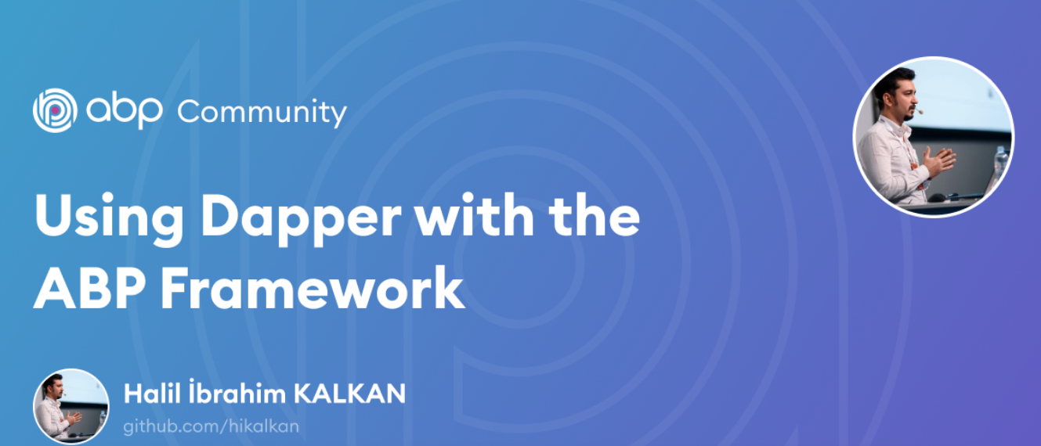
Community News
https://community.abp.io/posts/using-dapper-with-the-abp-framework-shp74p2l
Notes:
Dapper is an open-source (ORM) framework developed by the engineering team at Stack Overflow.
It is designed to provide a simple and efficient way to access relational databases using object-oriented programming.
One of the key benefits of Dapper is its performance. It is known for its ability to handle large volumes of data with minimal overhead, making it an ideal choice for applications that require high-speed data access.
In this post Halil is explaining when to use Dapper?
And how to switch your ABP project to use Dapper.

Slide 4
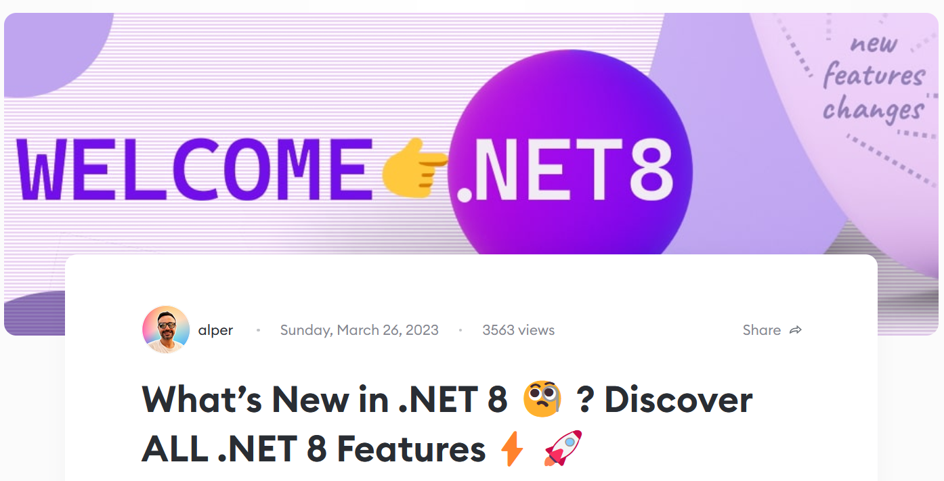
Community News
https://community.abp.io/posts/whats-new-in-.net-8-discover-all-.net-8-features-llcmrdre
Notes:
.NET 8 is the successor to .NET 7. It will be supported for three years as a long-term support (LTS) release.
.NET 8 is in Preview 3 now.
And it’s expected to be released as stable in November 2023.
In this post, I'll briefly mention the new features of .NET 8 and the changes.

Slide 5
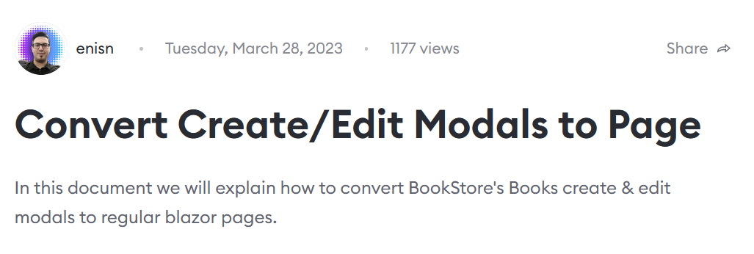

Community News
https://community.abp.io/posts/converting-createedit-modal-to-page-blazor-eexdex8y
Notes:
Some of us don’t like modals to edit or create an entity. Especially when you have many inputs on a form it makes the HTML DOM heavier.
Enis Necipoğlu explains how to convert BookStore's Books create & edit modals to regular Blazor pages.

Slide 6
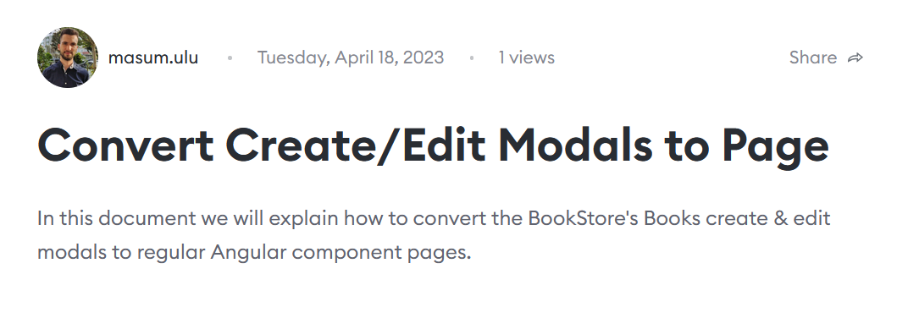
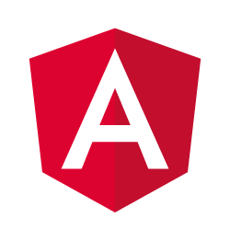
Community News
https://community.abp.io/posts/converting-createedit-modal-to-page-angularui-doadhgil
Notes:
And this is the similar post but here “Masum Ulu” explains converting modals to regular Angular pages.

Slide 7
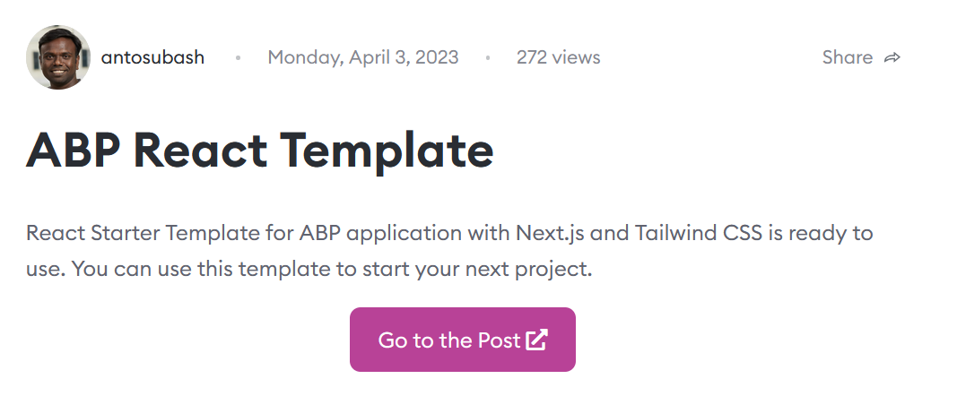
Community News
https://community.abp.io/posts/abp-react-template-33pjmran
Notes:
React UI is one of the best and trending UI Framework among others.
Anto Subash created “React UI” for ABP application which fills a gap as there’s no built-in ReactUI for now.
It’s a dotnet template based on ABP, NextJs and Tailwind CSS.
You can use this template to start your next project.
If you want to kickstart your next project with React UI based on open-source ABP, try this template.
Thanks to Anto for this contribution.

Slide 8
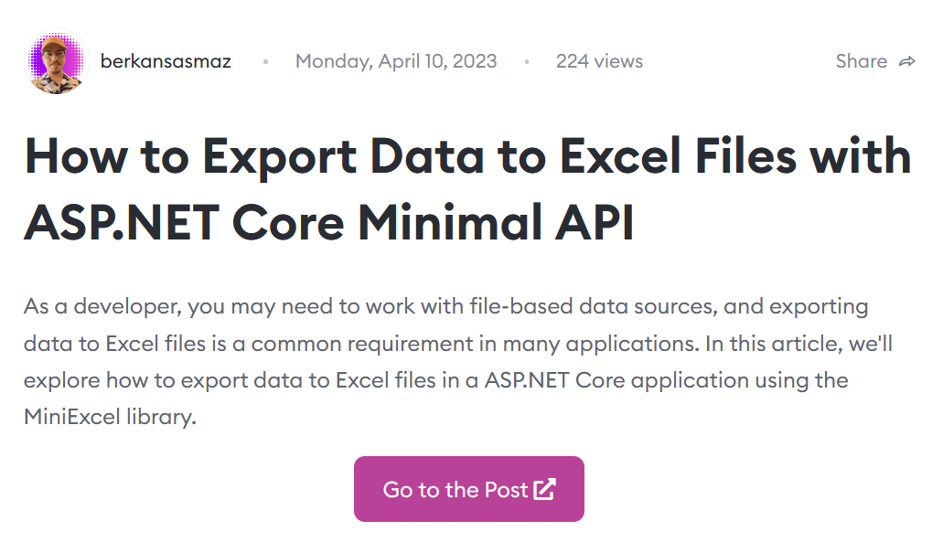
Community News
https://community.abp.io/posts/how-to-export-data-to-excel-files-with-asp.net-core-minimal-api-79o45u3s
Notes:
Perhaps every backend developer has had to deal with Excel exporting at some point in their career.
In this article, Berkan Şaşmaz shows how to export data to Excel files in an ASP.NET Core application using the MiniExcel library.

Slide 9
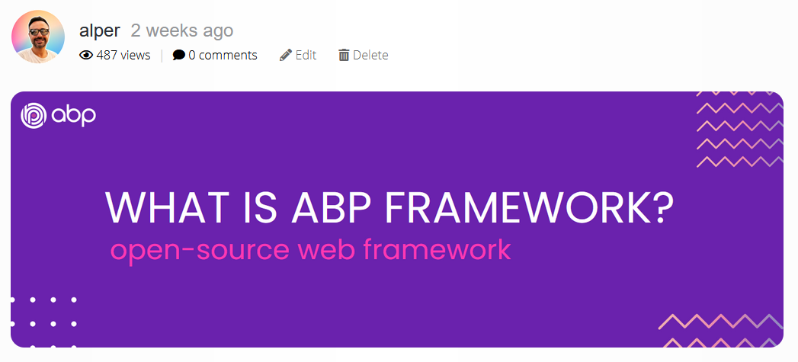
Community News
https://blog.abp.io/abp/open-source-web-application-development-framework
Notes:
This blog post is for those who are not familiar with ABP Framework.
I’m explaining the ABP framework essentials.

Slide 10
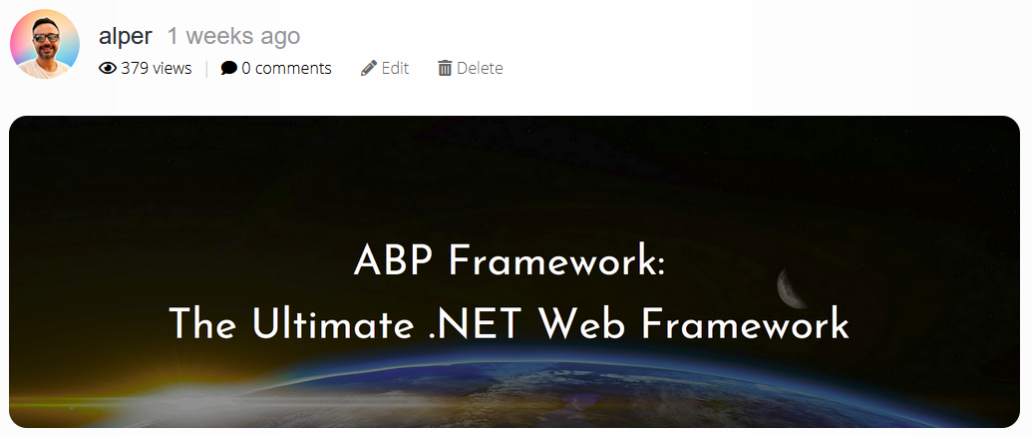
Community News
https://blog.abp.io/abp/ultimate-net-web-framework-for-rapid-application-development
Notes:
This is my other blog post! This is similar with the previous one.
I explain the major features, the architecture of the ABP Framework.
These 2 posts are for introducing our project to the new comers.

Slide 11
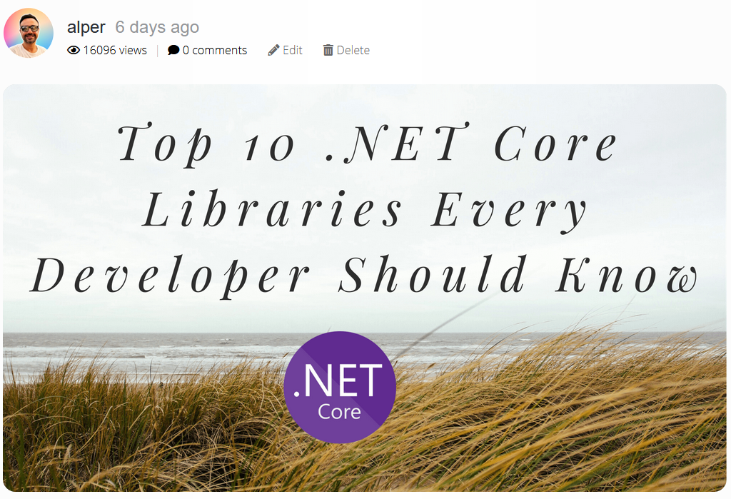
Community News
https://blog.abp.io/abp/Top-10-.NET-Core-Libraries-Every-Developer-Should-Know
Notes:
This is my recent article about the most popular .NET Core open-source libraries.
I listed all these from NuGet.org statistics.
If you want to know the top 10 list, check out my blog post.

Slide 12
That’s it from the ABP Community News 😊
Notes:
I give the word to Bige.

