Slide 1
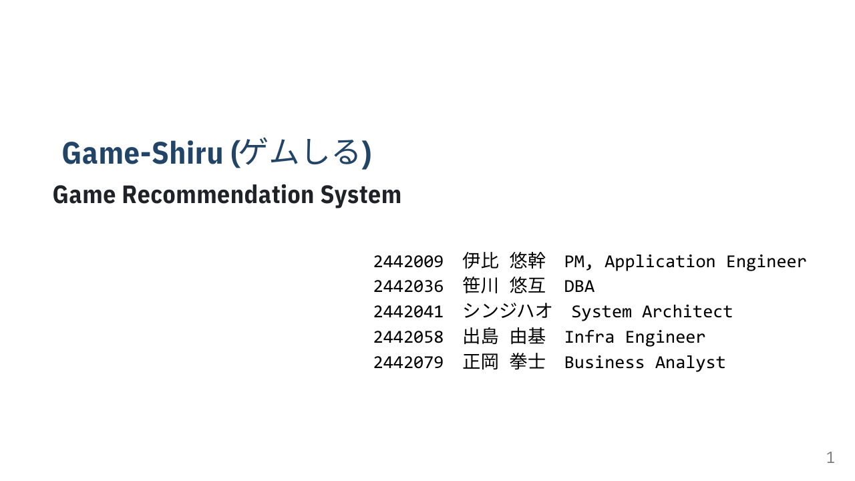

Slide 2
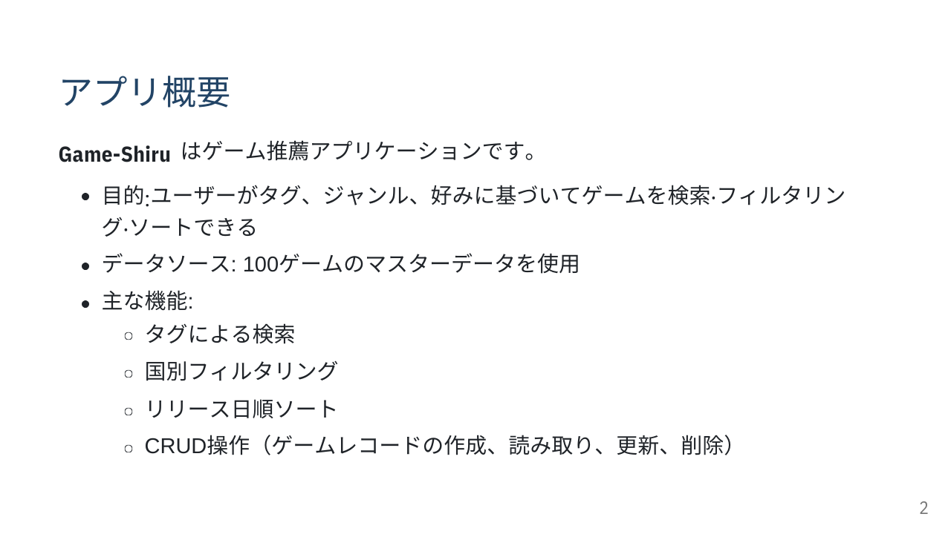

Slide 3
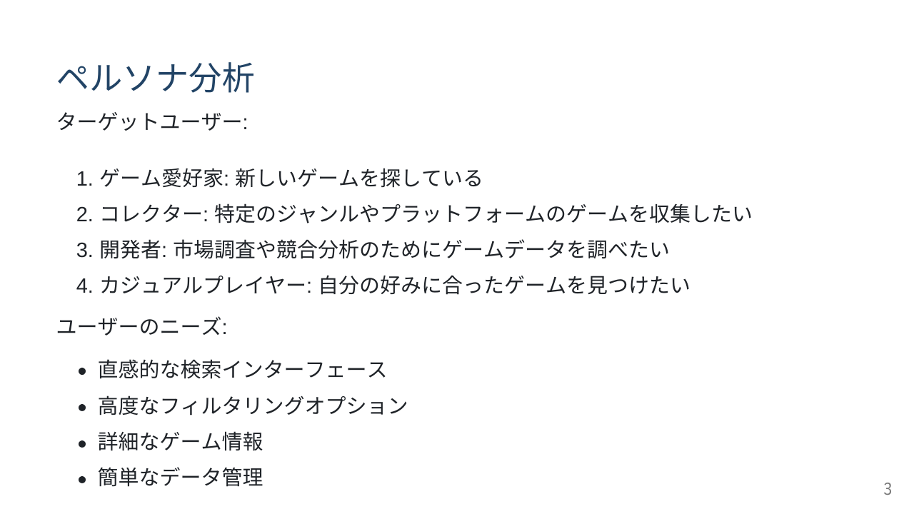

Slide 4
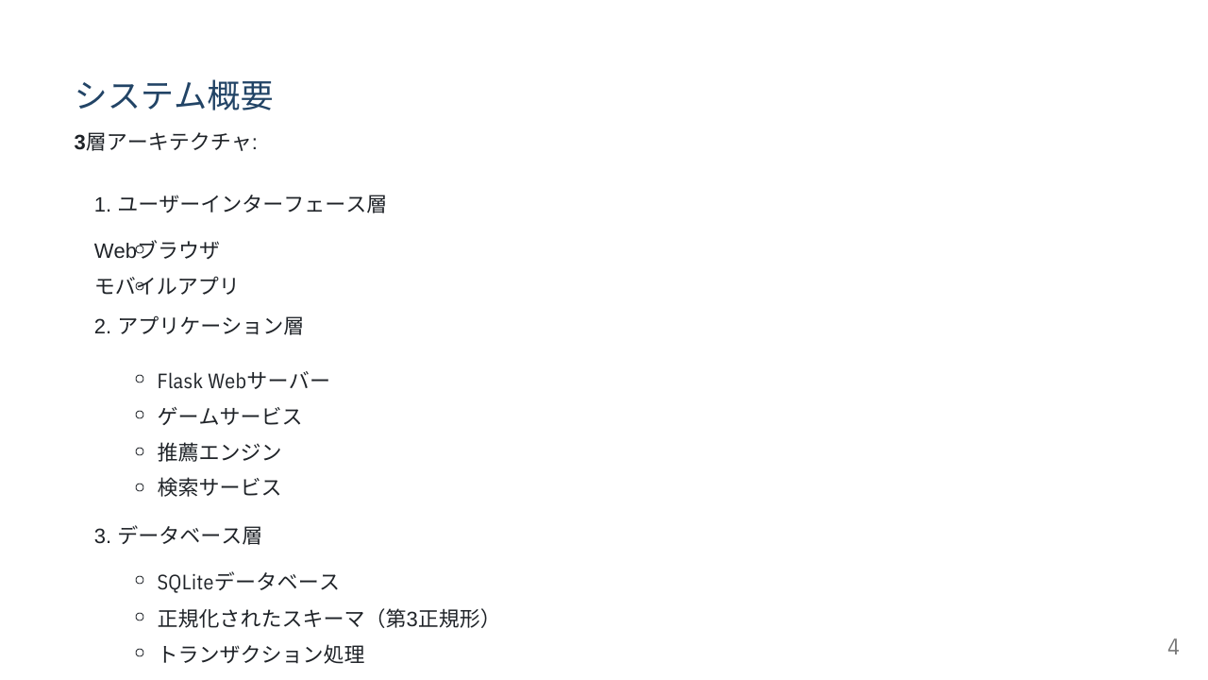

Slide 5
デモ動画
https://drive.google.com/file/d/1pCJEL2-gz9Bc5oOMvt7zbcINs2uu5EMr/view?usp=sharing

Slide 6
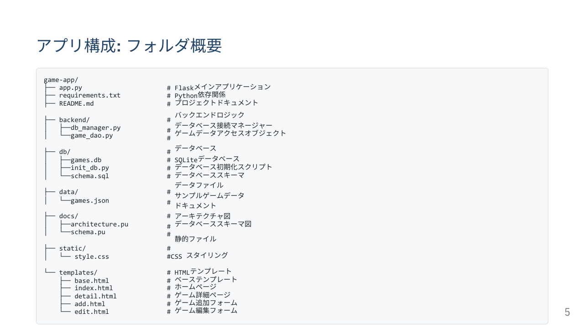

Slide 7
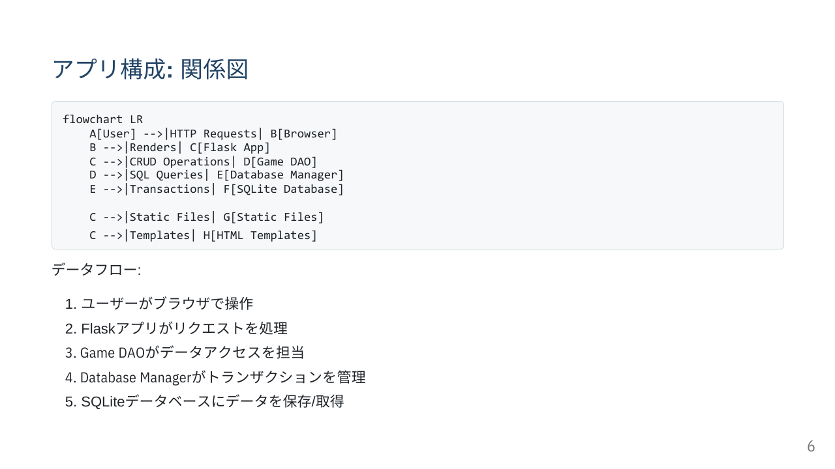

Slide 8
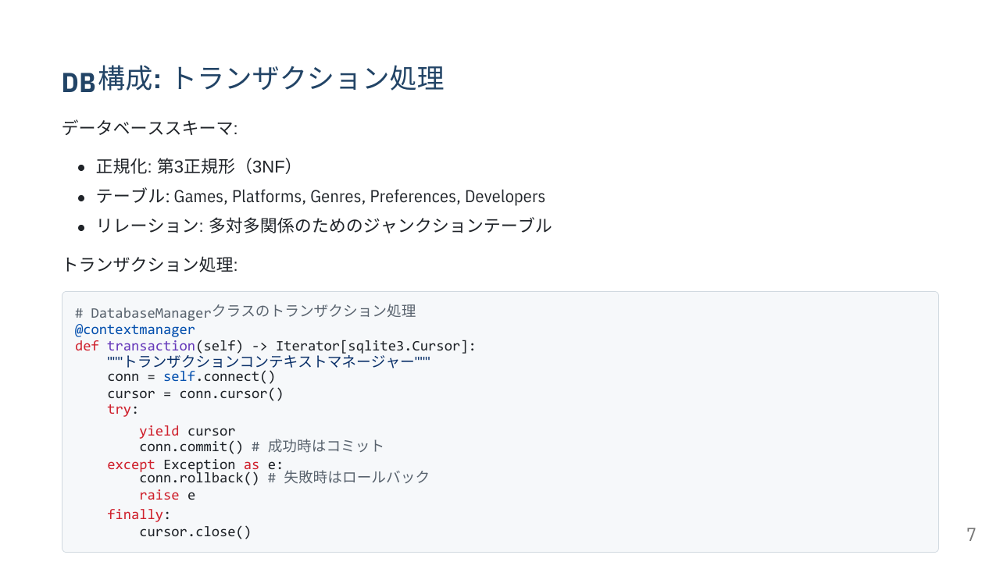

Slide 9
