Slide 1
⚽
Slotit
Sports Venue Booking & Tournament Management System
Subject: Database Management Systems (DBMS)
Group: 9
Electrical and computer – ER5
B24ELA09 Afroz Shanavas Palott
B24ELA21 Ebin Biju Abraham
B24ELA52 Niveditha C M
B24ELA66 Tharun Bhaskaran

Slide 2
01 INTRODUCTION
What is Slotit?
Slotit is a web-based platform that allows sports enthusiasts to discover and book local sports venues — such as football turfs, cricket nets, and badminton courts — by the hour.
It also provides venue managers with a simple dashboard to organize amateur tournaments, manage team registrations, and track live match scores.
The system uses a hybrid database approach:
• SQL (MySQL) — for structured data like users, bookings, and payments
• NoSQL (MongoDB) — for flexible data like live commentary and player statistics
The core technical challenge is preventing double-booking of time slots when multiple users try to book the same slot simultaneously, which is solved using database transactions and locking.

Slide 3
02 PROBLEM STATEMENT
Problems We Solve
📞
⚠️
🏆
Manual Booking
Double Booking
No Tournament Tools
Most local turfs still rely on phone calls and WhatsApp messages to manage bookings.
There is no centralized system to view available slots in real time.
When two groups try to book the same slot at the same time, manual systems cannot detect the conflict.
Both groups show up, leading to disputes.
Organizing local tournaments involves pen-and-paper brackets and manual score tracking.
There is no simple digital tool for small-scale sporting events.

Slide 4
03 OBJECTIVES
Project Objectives
1
To build a platform where players can search for nearby sports venues and book available time slots online.
2
To prevent double-booking of time slots using database transactions and locking mechanisms.
3
To provide venue owners a dashboard for managing their schedules, tracking payments, and viewing booking history.
4
To enable creation and management of local tournaments with automated bracket generation and live score updates.
5
To implement a hybrid database architecture using SQL for structured booking data and NoSQL for flexible match statistics.

Slide 5
04 TOOLS & TECHNOLOGIES
Tech Stack
Structure
Styling
HTML5
CSS3
Page layouts — booking forms, venue listings, tournament brackets, and dashboard views.
Visual design — light/dark themed UI, responsive cards, status badges, calendar grids, and navigation.
Logic
Backend & Database
JavaScript
Java + MySQL + MongoDB
User interactions — slot selection, form validation, filtering venues by sport, and page switching.
Java (JDBC) connects frontend to MySQL for bookings. MongoDB stores live scores and player stats.
Full-Stack Deployment: 9 Java Servlets, 7 JDBC DAOs, 12 3NF MySQL 8.0 Tables, 2 Triggers, Apache Tomcat 9 (Port 8085) & Mobile PWA.

Slide 6

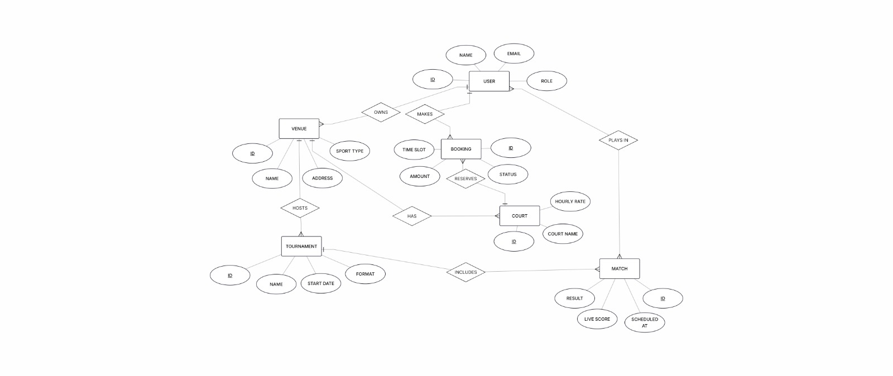

Slide 7
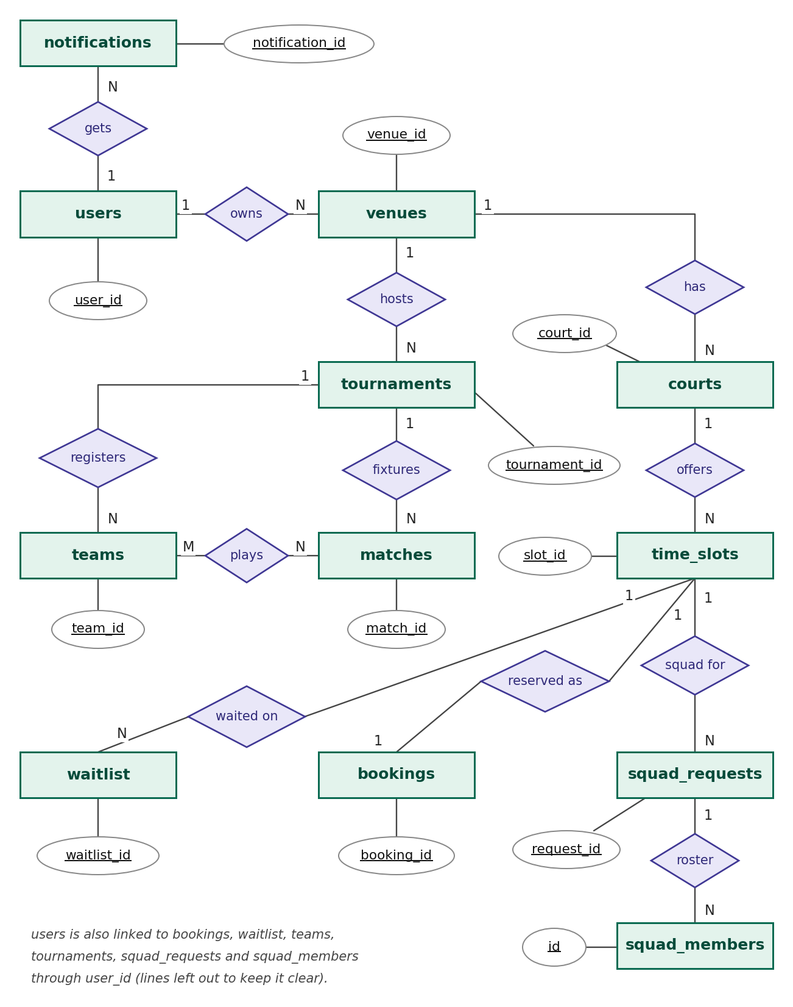

ER DIAGRAM

Slide 8
06 SYSTEM ARCHITECTURE
Three-Tier Architecture
📱
⚙️
🗄️
1. Presentation Tier
2. Application Tier
3. Database Tier
Mobile-first Progressive Web App (14 HTML5, CSS3 & JS screens).
Includes 30s cache, 900ms timeout, and offline fallback.
9 Java Servlets & 7 JDBC DAOs running on Apache Tomcat 9 (Port 8085).
Handles REST APIs, BCrypt security, and ACID transactions.
MySQL 8.0 (12 tables in 3NF, 5 indexes, 2 triggers) for bookings.
MongoDB (3 collections) for flexible player stats & photos.

Slide 9
07 RELATIONAL SCHEMA (3NF)
12 Tables in MySQL 8.0 (slotit_db)
Users & Wallets
Venues, Courts & Slots
users
venues • courts • time_slots
Stores player, owner & admin accounts, BCrypt password hashes, wallet balance, streak count, and loyalty badge.
17 venues (4 cities), 34 courts, and 2,618 hourly slots. Enforces UNIQUE(court_id, slot_date, start_time).
Bookings & Waitlist
Tournaments & Squads
bookings • waitlist • notifications
tournaments • teams • matches • squads
Records confirmed & refunded bookings, tracks waitlisted players, and stores automatic trigger alerts.
Manages tournament registrations, knockout match fixtures, and solo player matchmaking requests.

Slide 10
08 CORE DBMS IMPLEMENTATION
How the Database Solves Key Problems
1
Row-Level Locking (SELECT ... FOR UPDATE): Locks the slot row during checkout so two users can never book the same slot.
2
ACID Wallet Transactions: Wallet deduction, slot status update, and booking insert happen together or roll back completely.
3
Automated Triggers: trg_update_streak adds +1 to booking streak; trg_slot_drop_notify alerts waitlisted users on cancel.
4
HotSlot Dynamic Pricing: SQL CASE query applies a 1.25x–1.50x multiplier for peak floodlit evening hours (5 PM – 9 PM).
5
Haversine Geospatial Search: Calculates real distance in km inside SQL using an index on (latitude, longitude).

Slide 11
DBMS CORE FEATURE
Concurrency Control & ACID Transaction Engine
The Double-Booking Problem
In high-demand sports venues, two players frequently attempt to book the exact same 7:00 PM slot at the same millisecond. Without strict isolation, both payments succeed, causing venue conflict.
ACID Implementation in BookingDAO.java
• Atomicity: All 4 actions (Lock slot → Check balance → Deduct wallet → Record booking) commit together or full rollback occurs.
• Consistency: Foreign keys and table status constraints ensure slots never transition into an invalid or orphaned state.
• Isolation: Pessimistic row-level locking via SELECT ... FOR UPDATE forces concurrent attempts to queue safely.
• Durability: Committed bookings are permanently written to MySQL storage before returning HTTP 200.
// Pessimistic Locking Transaction in Java JDBC
conn.setAutoCommit(false); // Begin Transaction
// 1. Lock slot row exclusively
String lockSql = "SELECT status FROM time_slots " +
"WHERE slot_id = ? FOR UPDATE";
stmt = conn.prepareStatement(lockSql);
rs = stmt.executeQuery();
if (!rs.getString("status").equals("available")) {
conn.rollback();
throw new ConflictException("Slot booked!");
}
// 2. Atomic Wallet Deduction & Status Update
deductWallet(conn, userId, finalPrice);
updateSlotStatus(conn, slotId, 'booked');
insertBooking(conn, userId, slotId, finalPrice);
conn.commit(); // Successfully Committed
return new BookingResult(true, bookingId);

Slide 12
09 APPLICATION FEATURES
Tournaments, Squad Finder & Security
🏆
👥
🔒
Knockout Tournaments
Squad Finder
Security & Offline PWA
Locks tournament row to check max_teams and block duplicate team names.
Auto-generates Round-1 fixtures using Collections.shuffle().
Solo players post open requests for extra teammates or tap Join Squad.
UNIQUE key stops duplicate joins and marks status 'full' automatically.
Custom BCrypt ($2a$10$) password hashing & credentials in setenv.bat.
Works as an installable phone app with offline fallback.

Slide 13
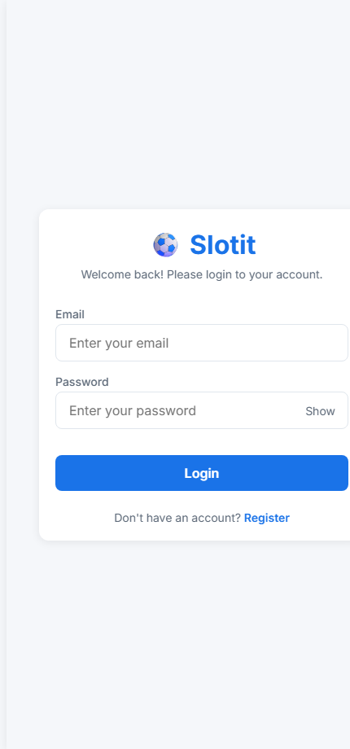
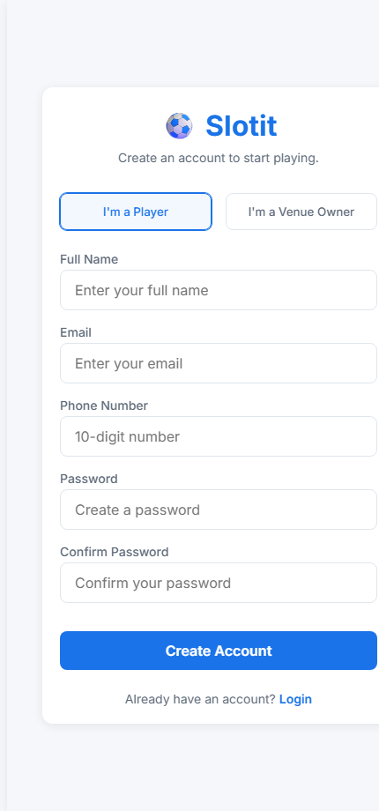
UI SHOWCASE 1
Authentication & GPS Location Access
User Experience Highlights
• Secure Role Selection
Register screen provides intuitive toggle between 'Player' and 'Venue Owner'. Controls dashboard routing upon login.
• Client-Side Form Validation
Real-time regex checking for 10-digit Indian phone numbers, email syntax, and password confirmation.
• GPS Proximity Onboarding
Requests HTML5 Geolocation permission. Falls back seamlessly to manual district selection (Kollam, Kochi, Trivandrum, Kozhikode).
• Persistent Local Storage
Session tokens, coordinates, and role state stored locally for instant app resume.

Slide 14
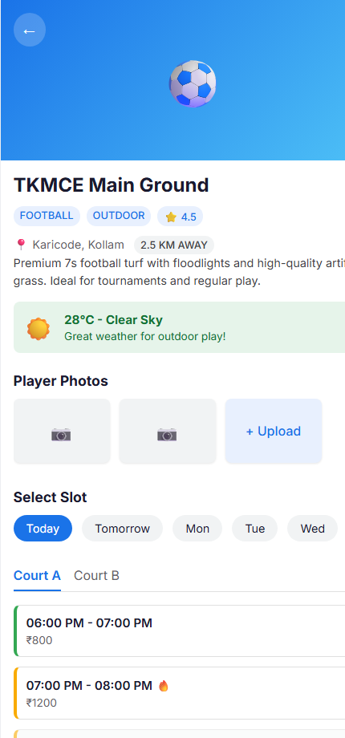
UI SHOWCASE 2
Smart Venue Discovery & Weather Intelligence
Intelligent Venue Discovery
• Proximity Sorting
Venues automatically display exact distance badges (e.g., '2.5 km away') powered by the Haversine backend query.
• Sport Filter Chips
Instant category switching (Football, Cricket, Badminton, Tennis, Basketball) without page reload.
• 🌦️ Weather Intelligence (OpenWeatherMap)
Unique feature: For outdoor venues, Slotit checks real-time forecasts. Displays a prominent warning if rain is predicted to prevent ruined bookings.
• Visual Photo Gallery
Integrated turf photo gallery uploaded by real players and retrieved from MongoDB.
• Court Tabs & Date Carousel
Horizontal 7-day date selector with multi-court tabs for multi-pitch venues.

Slide 15
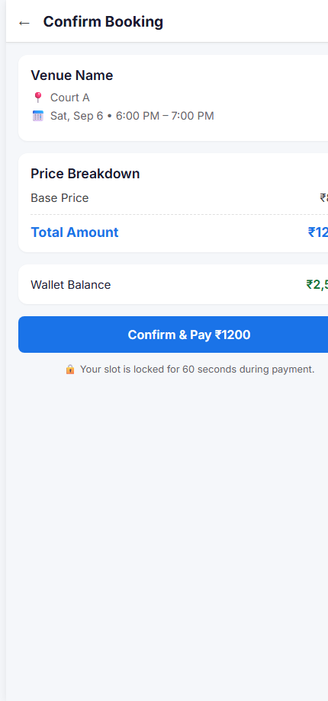
UI SHOWCASE 3
Interactive Slot Selection & Checkout
Real-Time Booking & Concurrency Flow
• Color-Coded Slot Grid
Available slots show green indicators; booked slots are greyed out; peak hours display a distinctive orange 🔥 Peak badge.
• 🔥 HotSlot Dynamic Pricing
Slots during peak hours automatically calculate a 1.5x multiplier. Transparent price breakdown on checkout.
• Atomic Checkout Experience
Summary displays venue, court, exact time, and weather forecast summary. Validates wallet balance before submission.
• Visual Slot Lock & Feedback
Clicking 'Confirm & Pay' triggers the backend transaction with row-level lock. Displays animated checkmark upon confirmation.

Slide 16
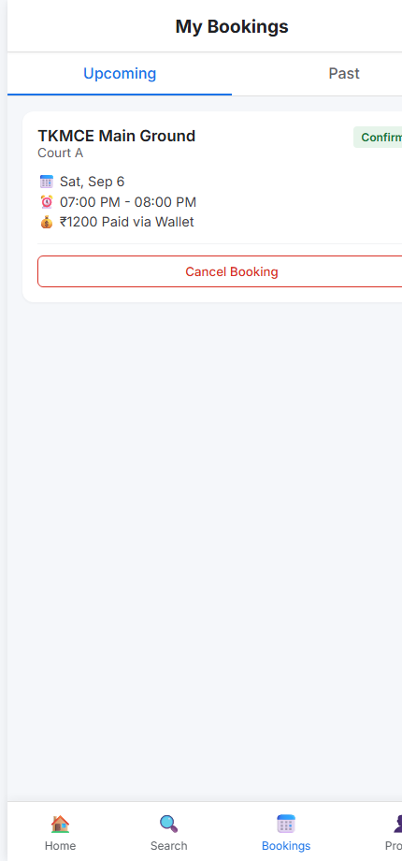
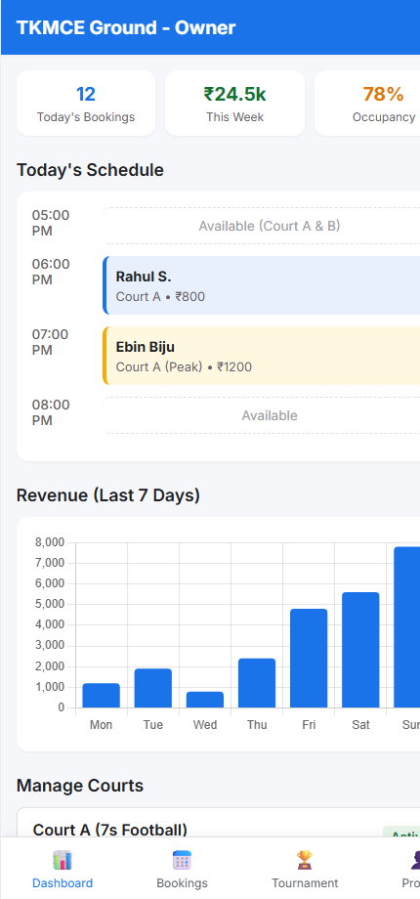
UI SHOWCASE 4
Player History & Venue Owner Analytics
Operational Analytics & Management
• Player Booking History
Split tabs for Upcoming and Past bookings. Allows seamless one-click cancellation with automated wallet refunds.
• Gamification & Reviews
Past games prompt players to rate the turf and track their active booking streak.
• Owner Business Metrics
Real-time cards calculate: Today's Bookings, 7-Day Revenue (₹), and Pitch Occupancy Rate (%).
• Interactive Revenue Chart (Chart.js)
Visual bar graph plotting daily revenue trends for owners to identify peak sales days.
• Daily Timeline & Court Management
Hour-by-hour schedule view and toggles to configure court availability or pricing multipliers.

Slide 17
CURRENT STATUS
Deliverables & Implementation Status
Database Layer
✅ 10 Relational Tables created
✅ 3NF Normalization verified
✅ Foreign Key Constraints & Indexes
✅ Kollam Seed Dataset (5 Venues, 10 Courts)
✅ MongoDB Collections configured
✅ Concurrency Simulation script tested
Backend API (Java JDBC)
✅ DBConnection Singleton pool
✅ BookingDAO Transaction Engine
✅ Pessimistic Row Locking
✅ SlotDAO & VenueDAO
✅ 5 Servlets configured (/api/*)
✅ SHA-256 Auth & Session Security
Frontend Mobile UI
✅ 9 Responsive HTML5 Screens
✅ Unified Clean Light Theme (#1a73e8)
✅ GPS Geolocation integration
✅ OpenWeatherMap rain forecast
✅ Chart.js Revenue Dashboard
✅ Ready for Android WebView packaging

Slide 18
12 DEPLOYMENT & RESULTS
Live Server Setup & Verification
1
MySQL 8.0 Seeded Data: 17 venues (Kollam, Kochi, Trivandrum, Calicut), 34 courts, and 2,618 time slots.
2
Tomcat 9 Deployment: Packaged as Slotit.war with Maven and hosted on port 8085.
3
One-Click Launcher (Start_Slotit_Server.bat): Starts MySQL, opens Firewall port 8085, and starts Tomcat.
4
Mobile PWA Installation: Accessed over Wi-Fi on phone browser and installed via Add to Home Screen.
5
Concurrency Verified: Two-session test confirmed only 1 booking succeeds per slot; second gets HTTP 409.

Slide 19
🙏
Thank You
Slotit — Sports Venue Booking & Tournament Management System

