Slide 1
REWRITE
YOUTH INVITATION SERVICE
JUNE 28th 2026

Slide 2


Slide 3
- THE WORLD TRIES TO MINIMIZE OUR MOURNING. - BUT OUR GOD ACKNOWLEDGES OUR PAIN & MOURNING AND REWRITES IT.

Slide 4
- REWRITING IS A NEW BEGINNING. - REWRITING IS A MEANINGFUL START FOR A GLORIOUS LIFE. - REWRITING IS RESTORING DIGNITY, PURPOSE & CONFIDENCE.

Slide 5
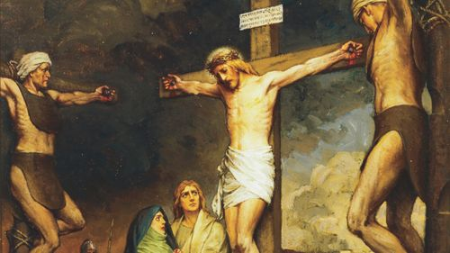

Slide 6
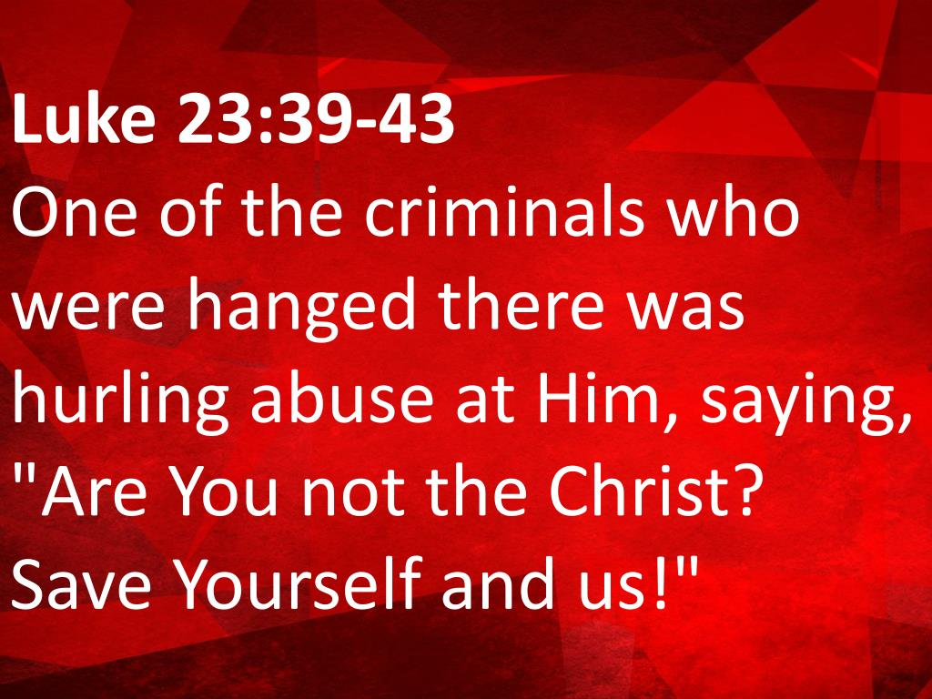

Slide 7
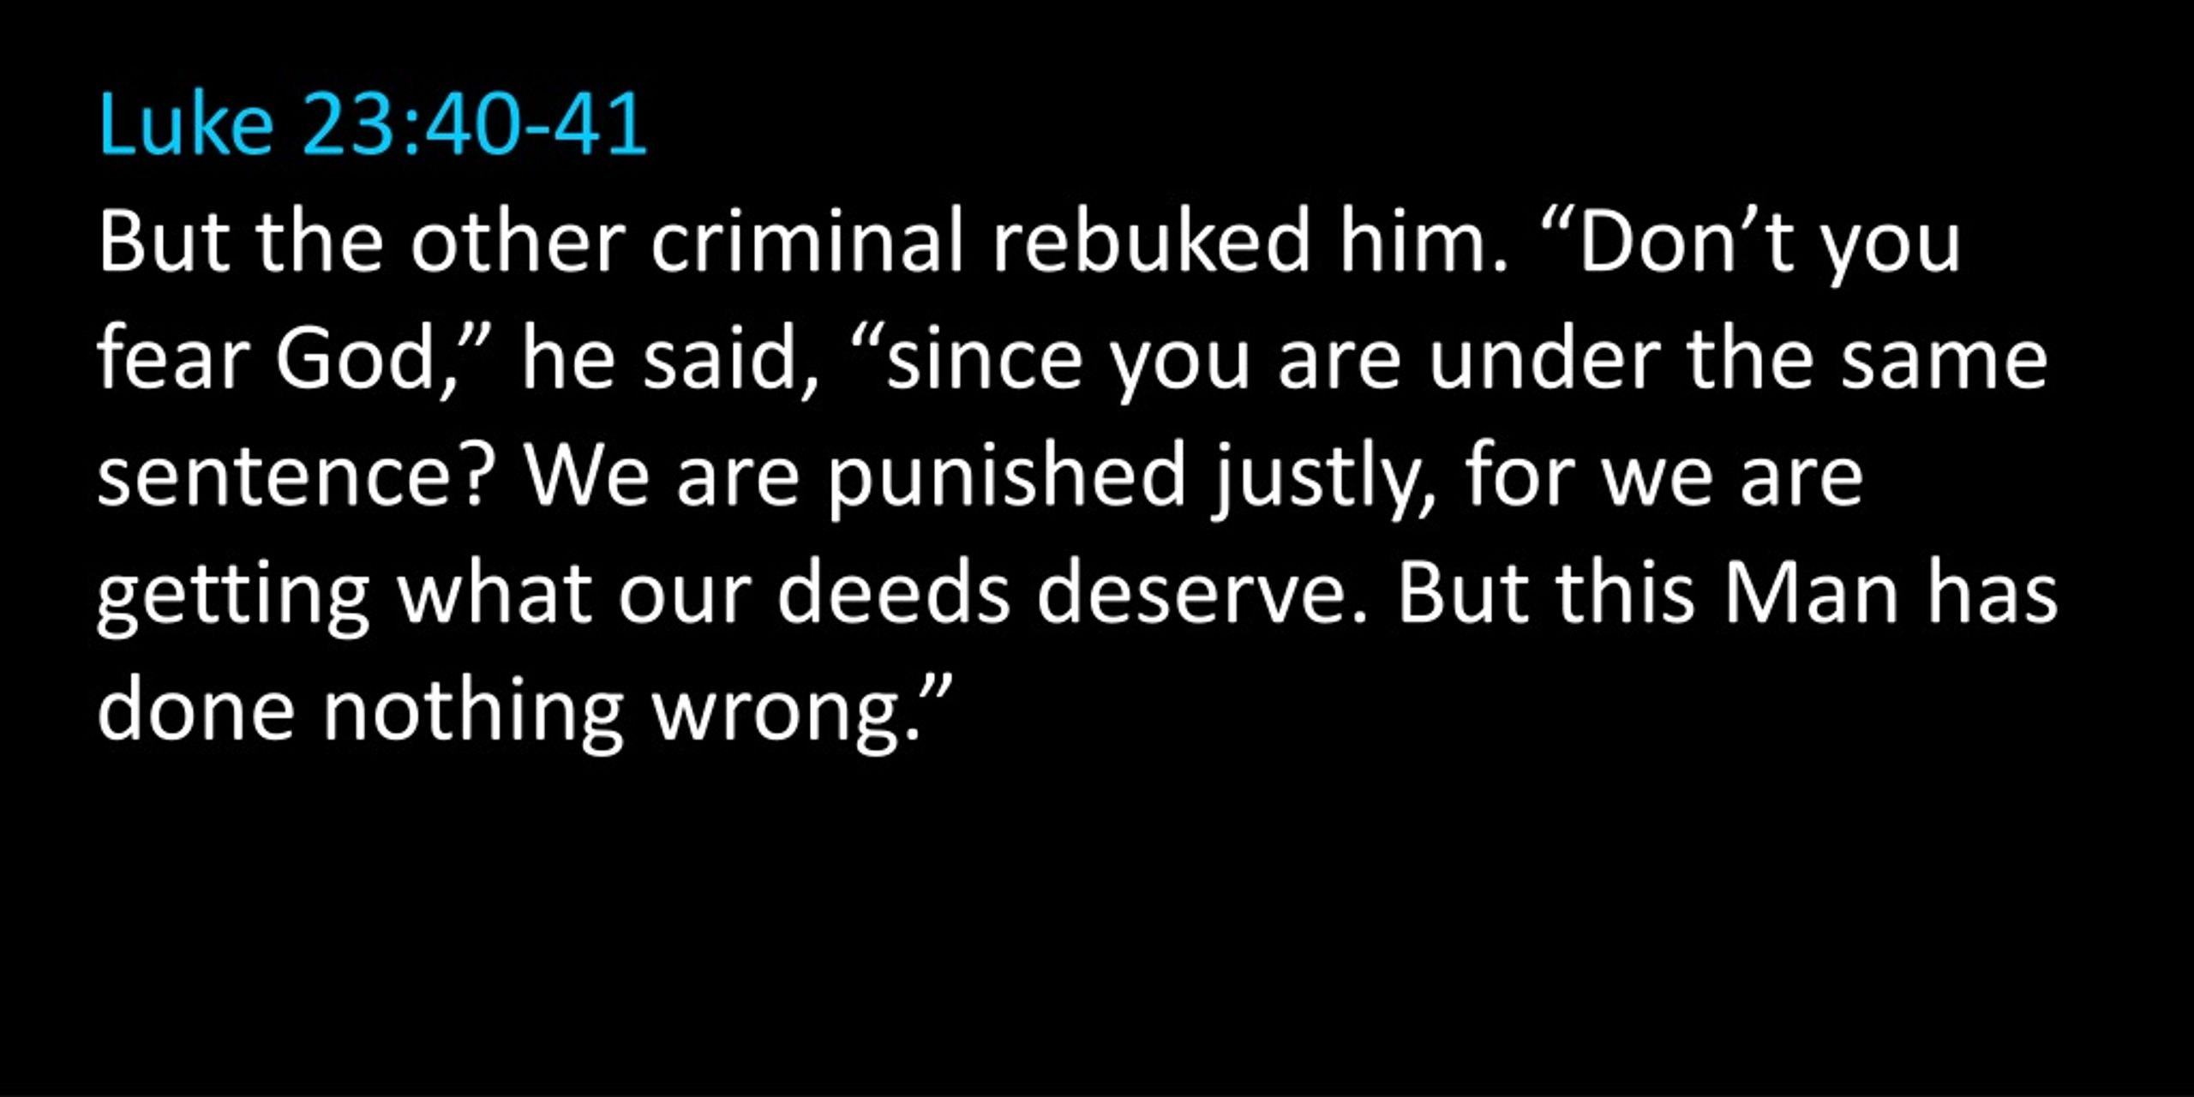

Slide 8
WE OUR

Slide 9
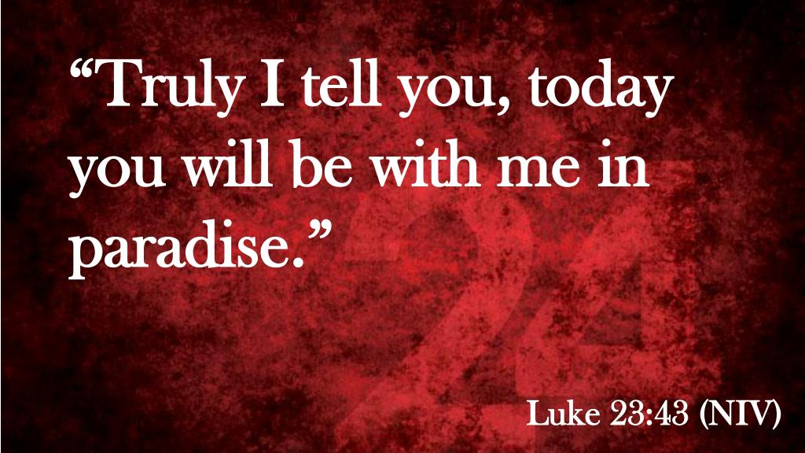

Slide 10


