Slide 1


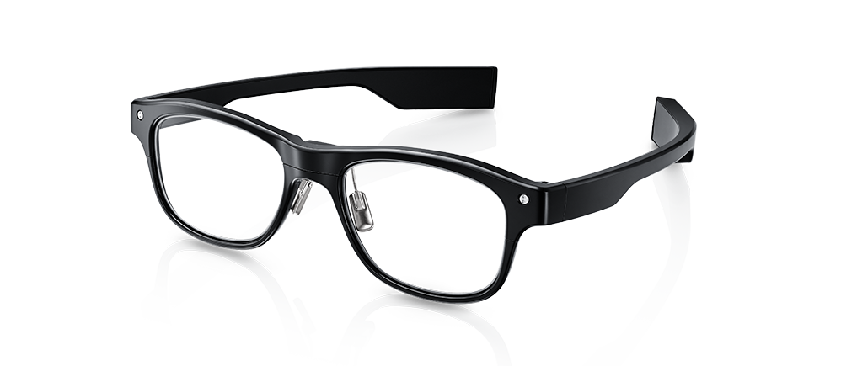
Interactive Analytics: Face Touch
Huidi Zhu, Sebastian Ebi, Johan Krause, Calvin Antonius Tanama

Slide 2
Table of contents
Motivation
Design of experiment
Data collecting
Data preprocessing
Model choosing and training
Results
Prototype demo

Slide 3
Motivation
From a study^{[1]}, students touch their face 23 times per hour on average
Face touching can cause transmission of various respiratory infection (COVID19 Coronavirus, Staphylococcus aureus)
With J!ns Meme Smartglasses and using deep learning want to build detection and warning system for face touching habit
[1] https://pubmed.ncbi.nlm.nih.gov/25637115/

Slide 4
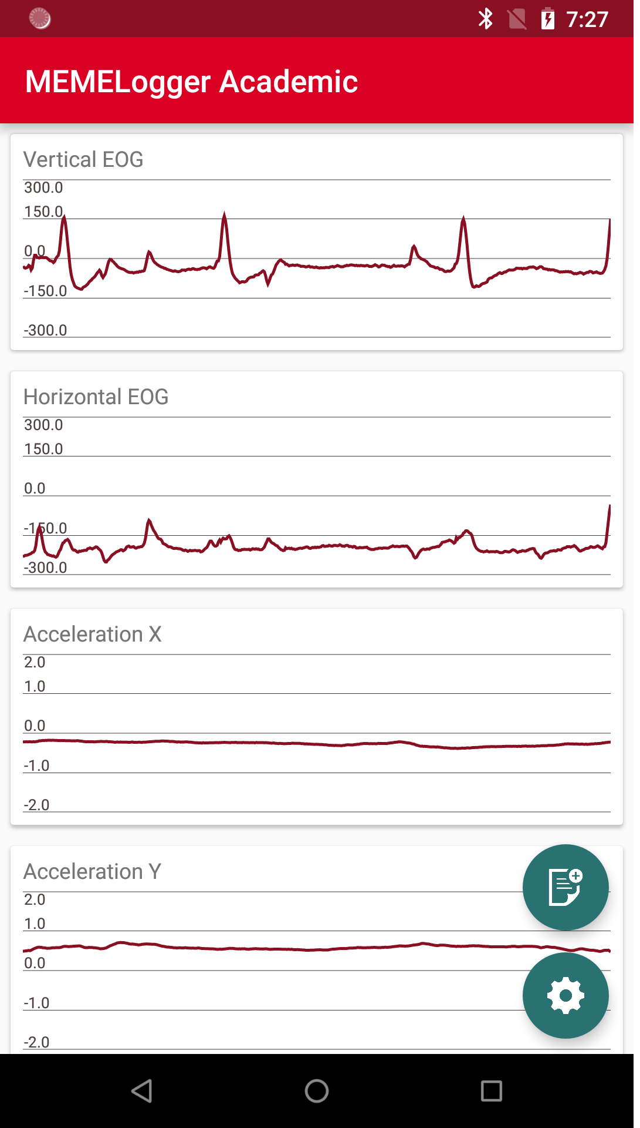
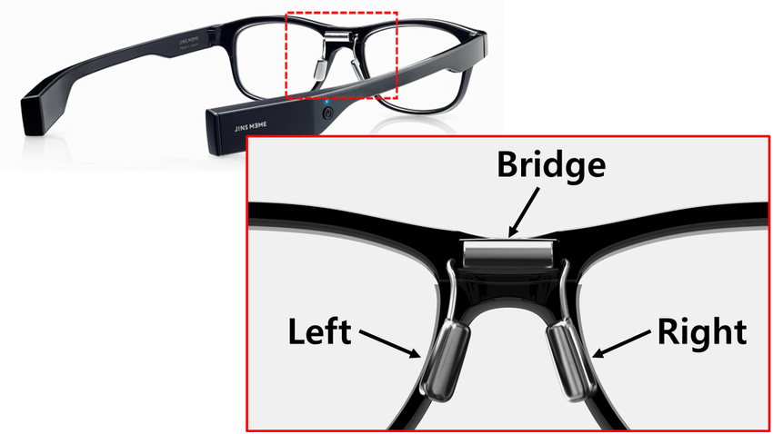
Device Specification
J!ns Meme Smartglasses have a three-point electrooculography sensor that connected to an android device via bluetooth
It measures whether there is a touch nearby the glasses

Slide 5
Design Of Experiment
Data Collecting
Data Preprocessing
Model Choosing and Training
Model Evaluation

Slide 6
Design Of Experiment
Data Collecting
Data Preprocessing
Model Choosing and Training
Model Evaluation

Slide 7
Data Collecting: Natural Data
Goal: To be the test data for our system in the real situation
Modality: Respondents are required to wear the J!ns Meme device while doing activity and record the impulses of touches for 60 minutes

Slide 8
Data Collecting: Sampling Data
Goal: To be the training data for our system
Modality: Fix 4 touch classes (mouth, nose, left eye, right eye) and let the respondents touch these classes while being prompted.
For this experiment, we create a protocol application that would prompt respondents to touch the classes. The sequence of the events are generated randomly

Slide 9
Data Collecting: Labeling
To label the data, we use Anvil^{[2]}. This application annotate videos taken from respondents and convert it into label.
Although the starting point of video recording and J!ns Meme recording are not same, we agree to add starting and ending synchronization by touching the nose 3 times

Slide 10
Design Of Experiment
Data Collecting
Data Preprocessing
Model Choosing and Training
Model Evaluation

Slide 11
Data Preprocessing
Goal: Upscaling the annotation from Anvil
The video is recorded at 30 FPS rate but the J!ns Meme recording is at 50 Hz rate.
After we annotate the video with Anvil, we span the annotation to 50 Hz rate and cut the synchronization mark

Slide 12
Design Of Experiment
Data Collecting
Data Preprocessing
Model Choosing and Training
Model Evaluation

Slide 13
Model Choosing: Decision
We are dealing with time series data (touches in the protocol takes places randomly)
The model of recurrent neuronal network (RNN) and its derivative (for example LSTM) would be suitable for this problem, because of its capability to process data with variable length

Slide 14
Model Choosing: RNN
Hier ergänzen

Slide 15
Model Choosing: LSTM
Hier ergänzen

Slide 16
Design Of Experiment
Data Collecting
Data Preprocessing
Model Choosing and Training
Model Evaluation

