Slide 1

Team 7 Analyzing the relation between #music tweets and Spotify Global 50 playlist
-Vasudha Bangard
-Tanay Saxena
-Ebenezer Ajay Williams

Slide 2
USE CASES
A dashboard which shows the number of music tweets inspired for each song on the top 50 playlist is updated every minute. The dashboard also shows the relation between the sentiment of the tweets and the lyrics.
The actor can view a real-time analysis of the tweets on each song on a dashboard updated every minute.
The System queries the Spotify developer API to get the list of top 50 songs played globally and the lyrics of those songs from the musixmatch API.
The system also queries for tweets with the #music every minute.
The model acts to find a correlation between each song and every tweet.

Slide 3
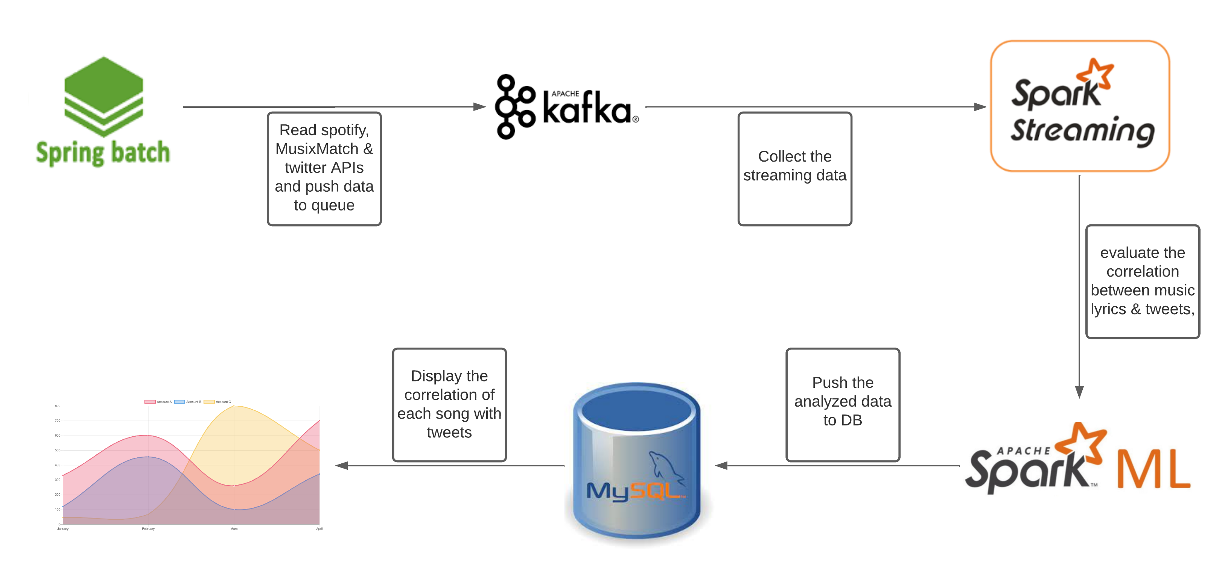
Methodology

Slide 4



Data sources
Twitter API
Spotify API
Musixmatch API
Maintain a list of top 50 songs and their lyrics, refreshed as the trend changes
Kaggle tweets dataset (Sentiment140) for training ML model (160K tweets)
Live stream of tweets with #music

Slide 5
Milestones/sprints
Week1 (27 MARCH– 2 APRIL) | Week2 (3 APRIL – 9 APRIL) | Week3 (10 APRIL – 16 APRIL) | Week4 (17 APRIL – 23 APRIL) | Week5 (24 APRIL – 28 APRIL)
Spring Batch & Kafka | Spark Streaming | Spark ML | Database & JS chart | Buffer

Slide 6
What will you program in Scala ?
Spark Streaming: collecting data from Kafka message queue
SPARK ML: Applying ML model on the streamed data
JAVA: Spring Batch, Kafka
Javascript: Chart.js

Slide 7
Acceptance criteria
Tweets with the exact lyrics must have cosine similarity 0.9
Every tweet must be processed in real-time within a span of 2secs
Sentiment analysis of the Tweets must have an accuracy of 60%

Slide 8
Goals of the project
Establish a relationship between twitter feeds and top trending songs.
Find how the tweet sentiment is related to the sentiment of the lyrics.
How are the top trending songs influencing the tweets with #music.

