Slide 1
Department of Modeling & Simulation · Old Dominion University
Learning LLVM Pass Sequences via Reinforcement Learning
with Autoregressive Policies
Evan Black
eblac013@odu.edu
Reinforcement Learning · LLVM · Pass Ordering · PPO · Transformer

Slide 2
Background: LLVM, IR, and Optimization Passes
C Source
LLVM IR
Optimized IR
Native Binary
.c file platform-agnostic
→
typed SSA platform-independent
→
pass pipeline applied by opt
→
machine code for target arch
clang -O3 -Xclang -disable-llvm-optzns -emit-llvm -S
opt --passes= "inline,sroa,mem2reg,..."
clang -O3 -Xclang -disable-llvm-passes
What is LLVM IR?
Example: array_sum (before passes)
After mem2reg + instcombine:
▸ Platform-independent intermediate representation
▸ Static Single Assignment (SSA) form:
• Every variable defined exactly once
• phi nodes merge values from different paths
▸ Typed: i32, float, ptr, vectors, structs
▸ Explicit control-flow graph (basic blocks + branches)
▸ Close to machine code but still target-agnostic
▸ Right level for optimization:
• High enough to reason about semantics
• Low enough to see memory, loops, calls directly
define i32 @sum(ptr %arr, i32 %n) { entry: %res = alloca i32 ; stack slot store i32 0, ptr %res br label %loop loop: %i = phi i32 [0,%entry],[%i2,%loop] %p = getelementptr i32,ptr %arr, i32 %i %v = load i32, ptr %p %s = load i32, ptr %res %s2 = add i32 %s, %v store i32 %s2, ptr %res ; mem2reg promotes %i2 = add i32 %i, 1 %done = icmp eq i32 %i2, %n br i1 %done, label %exit, label %loop exit: %r = load i32, ptr %res ret i32 %r }
define i32 @sum(ptr %arr, i32 %n) { entry: br label %loop loop: %i = phi i32 [0,%e],[%i2,%l] %s = phi i32 [0,%e],[%s2,%l] %p = gep i32,ptr %arr,%i %v = load i32, ptr %p %s2 = add i32 %s, %v %i2 = add i32 %i, 1 %ok = icmp ne i32 %i2, %n br i1 %ok, %l, %exit exit: ret i32 %s2 }

Slide 3
Motivation & Problem
▸ LLVM exposes hundreds of individual optimization passes
• inlining, vectorization, loop unrolling, dead-code elim, …
▸ Order matters: inline before const-prop → more constants to fold
▸ -O3 uses a fixed pipeline tuned for the average program
• Suboptimal for any specific program
▸ Finding the best pipeline is NP-hard (phase-ordering problem)
▸ ML offers a principled alternative:
• Map IR features → pass choices
• Train on real execution-time feedback
• Generalise to unseen programs
The Goal
Beat -O3 on individual programs by learning a per-program pass sequence.
Prior Work
▸ AutoPhase — LSTM + PPO, targets IR size
▸ CompilerGym — standard RL env for LLVM
▸ MLGO — learned inlining at Google scale
▸ MILEPOST — nearest-neighbour on static features
• Our focus: wall-clock speedup, offline corpus + autoregressive policy

Slide 4
MDP Formulation
State sₜ
Action aₜ
Reward r
48-dim IR delta vector fₜ ∈ ℝ⁴⁸
29 total: 28 passes + 1 Stop
Terminal speedup vs -O3
3 chunk-pairs × 16 dims each:
Example passes:
r = (t_O3 − t_policy) / t_O3
Opcode categories (12):
inline
removes call overhead; exposes callee
Positive = faster than -O3
memory · int-arith · float-arith · bitwise · compare · cast
sroa
scalar replace aggregates → registers
call · control · phi/select · vector · block-boundary · other
mem2reg
alloca → SSA (prerequisite for most)
Concrete example — fft:
instcombine
fold/simplify instruction patterns
t_O3 = 46,509 ns
Metadata rates (4):
simplifycfg
clean dead blocks, merge branches
tbaa · llvm.loop · alias.scope · noalias
t_policy = 41,852 ns
loop-rotate
canonicalize loops for LICM
Δ = chunk(c+1) − chunk(c) for c ∈ {0,1,2}
licm
hoist loop-invariant code out
r = (46,509 − 41,852) / 46,509
loop-unroll
replicate loop body N times
= 4,657 / 46,509
Invariant to function size; responds to loop-rotate, licm, sroa structural shifts
gvn
global value numbering / CSE
Stop
terminate early → compile binary
= +10.0% speedup
Trimmed mean · 201 iterations · 5 warm-up CLOCK_MONOTONIC

Slide 5
Dataset & Exploratory Data Analysis
950k random sequences · 38 benchmarks · bench-cache

Slide 6
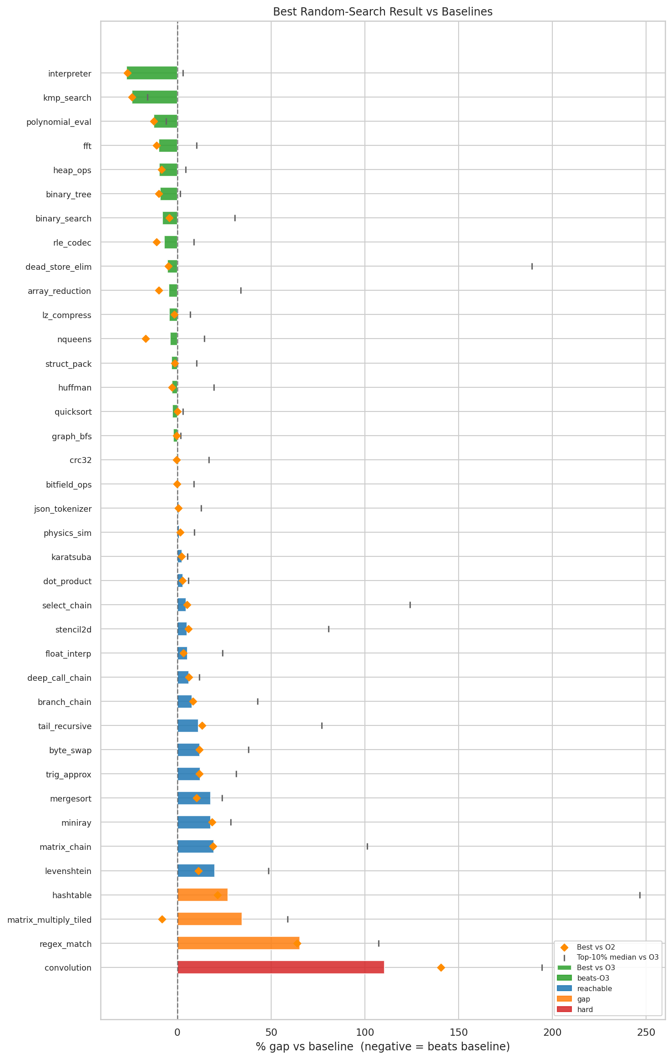
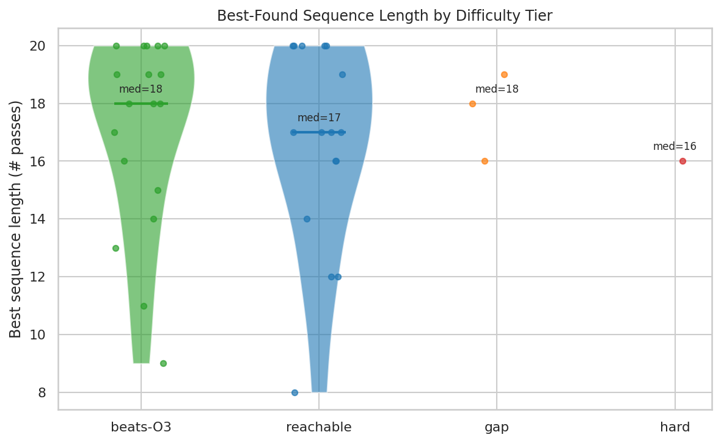
Training Landscape — Bench-Cache Overview
Bench-Cache Statistics
Total sequences
950,000
Benchmarks in pool
38
Training benchmarks
6
Sequences / fn
25,000
Sequence lengths
1 – 20
Pass menu size
28 + Stop
Baselines per fn
-O0, -O2, -O3
Cache format
on-disk key-value

Slide 7
Benchmark Pool & Training Benchmark Selection
▸ Pool: 38 self-contained C benchmarks
• Sorting, numerical, data structures, codecs, recursive
▸ 25,000 random sequences per benchmark → ~950k entries
▸ 3 baselines (-O0, -O2, -O3) recorded per benchmark
Benchmark
O3 (ns)
Best (ns)
vs O3
CV
interpreter
37,918
27,591
−27.2%
13.9%
kmp_search
886,408
671,195
−24.3%
42.7%
6 Training Benchmarks — selection criteria:
▸ At least one random sequence beats -O3
▸ High CV across sequences (rugged reward landscape)
▸ Diverse computational profiles
polynomial_eval
417,235
364,235
−12.7%
46.0%
fft
46,509
41,852
−10.0%
35.5%
array_reduction
97,184
92,619
−4.7%
36.6%
binary_tree
117,990
107,087
−9.2%
18.4%
Green = speedup magnitude
Yellow = landscape ruggedness (CV)

Slide 8
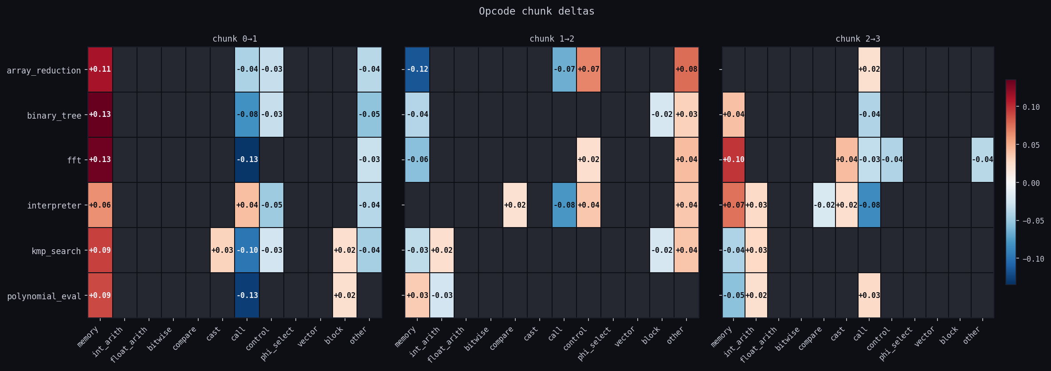
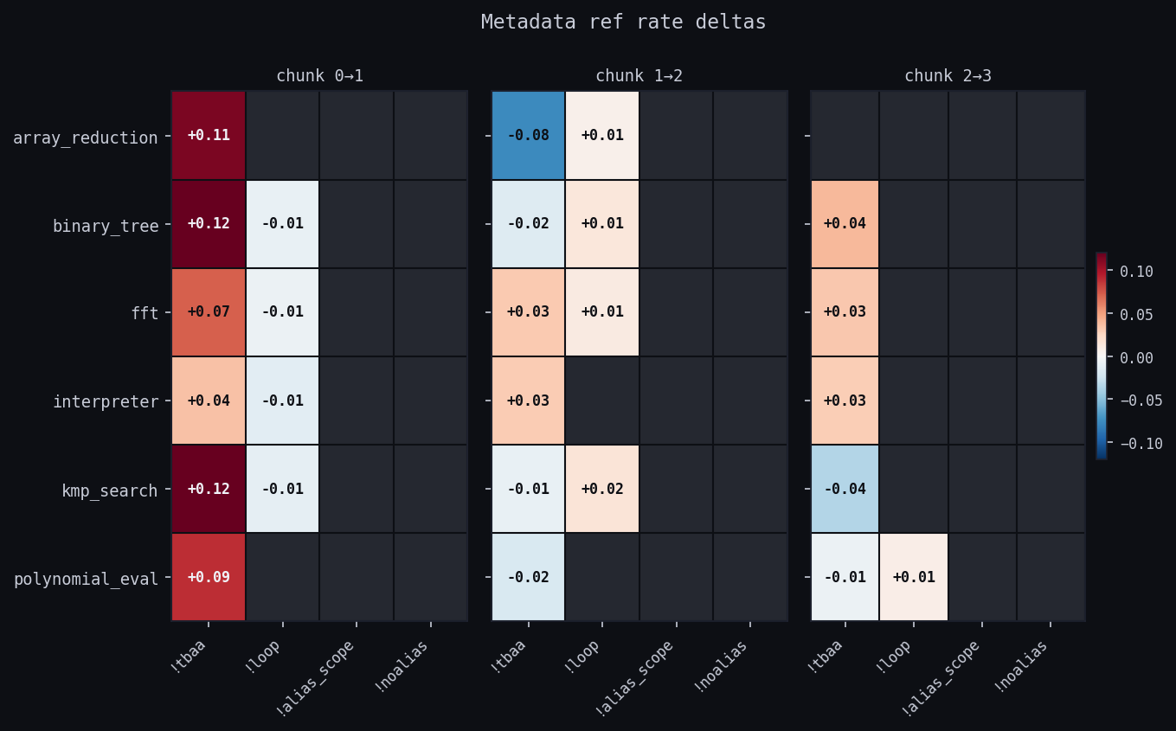
IR Feature Representation
▸ Policy observes a 48-dim IR feature vector fₜ
▸ Split IR into C=4 equal positional chunks
▸ Per chunk: opcode histogram (12 categories) + metadata rates (4 kinds)
• categories: memory, int-arith, float-arith, bitwise, compare, cast,
• call, control, phi/select, vector, block-boundary, other
• metadata: tbaa, llvm.loop, alias.scope, noalias
▸ 3 adjacent-chunk deltas → 3 × 16 = 48-dim vector
▸ Key properties:
• Invariant to function size
• Responds to loop-rotate, licm, sroa — invisible to global counts

Slide 9
Pass Menu & EDA Highlights
▸ 28-pass primary menu + Stop token (29 total)
▸ Inclusion criteria:
• Appears in -O3 inner loop or is a prerequisite
• Demonstrable impact on C compute code
• Covers a distinct optimization category
▸ LLVM 20 nesting handled transparently:
• inline → cgscc(inline)
• licm → loop-mssa(licm) · loop-rotate → loop(loop-rotate)
▸ inline is the top pass-enabler:
• Enrichment 2.35× = in top-decile sequences at 2.35× baseline rate
• Exposes callee bodies to const-prop, DCE, loop transforms
▸ simplifycfg + sroa + mem2reg unlock downstream analyses
• SSA promotion (mem2reg) required before most scalar optimizations
▸ Sequence length distribution ~uniform across 1–20
▸ Best-found median length: 17–18 (no cap spike → K=20 sufficient)
▸ Bench-cache lookup rate grows during training:
• Policy re-generates previously benchmarked sequences → instant reward
Top passes by EDA analysis:
Pass
Top-Decile Enrich.
Geo-Mean Speedup
inline
2.35×
1.26×
simplifycfg
1.98×
1.12×
sroa
1.87×
1.09×
mem2reg
1.76×
1.08×

Slide 10
Policy Architecture & Training
Auto-TFX · Auto-GRU · PPO

Slide 11
Policy Architecture Diagrams
Auto-TFX (Causal Transformer)
Auto-GRU (Recurrent)
W·fₜ
E[a₀]
E[a₁]
…
E[aₜ₋₁]
Step 0 — seed hidden state from initial IR:
f₀
Linear project
h₀
IR proj 48→128
action embed
action embed
action embed
→
→
IR feat
initial hidden state
↓ full cross-step attention ↓
Transformer Encoder
Step t — recurrent update:
fₜ
GRU Cell
2 layers · 4 heads · d=128 · FF 256 · dropout 0.1
→
IR feat
hₜ
↓ token 0
↓ token t
→
Value Head
Policy Head
aₜ₋₁
→
hidden state
action
reads token 0 → V(sₜ)
reads token t → logits (29)
↑ hₜ₋₁ (recurrent)
→ output heads:
▸ No causal mask — decode 1 step at a time; full sequence always visible
▸ Batched replay: K forward passes (one per step position) vs N×K naïve
Value Head
Policy Head
→ V(sₜ)
→ logits (29)
▸ Recency bias: recent IR state has more influence — free inductive prior
▸ Compresses full episode history into a fixed-width hidden vector
Both architectures re-encode current IR features fₜ at every step — neither operates on a stale snapshot.

Slide 12
Concrete Pass-Selection Walkthrough
Example: interpreter · -O3 baseline = 37,275 ns · Greedy policy result: ~27,183 ns → +27.1% speedup
Step 0
Step 1
Step 2
Step 3
Step 4
5–19
fₜ: mem↑ call↑ ctrl↑
fₜ: mem↑ cfg↑ int↓
fₜ: mem↓↓ int↑ SSA↑
fₜ: mem≈0 consts visible
fₜ: stable Δ small /step
fₜ: minor Δ /step (safe)
↓ picks
↓ picks
↓ picks
↓ picks
↓ picks
↓ picks
inline
→
simplifycfg
→
sroa
→
mem2reg
→
instcombine
→
instcombine ×15
remove call overhead
clean dead blocks/branches
stack→regs (mem↓ heavy)
alloca→SSA promotes vals
fold/simplify patterns
safe: rarely hurts, occ. wins
Compile → benchmark · measured = 27,183 ns · r = (37,275 − 27,183) / 37,275 = +27.1% ✓
Why repeat instcombine?
Why is inline so dominant?
▸ Q(Stop)=current speedup; Q(pass)=E[future] — uncertain, possibly higher
▸ Penalty p=0.025 per no-op is tiny vs ~28% gain — rational to continue
▸ interpreter has a tight bytecode dispatch loop — call overhead dominates
▸ After inline: callee body visible → const-prop + DCE fire hard

Slide 13
PPO Training Setup
▸ On-policy collect → update loop
▸ Collect 256 episodes/epoch (Rayon parallel)
▸ 4 PPO inner epochs on mini-batches of 128
▸ KL early-stop ≤ 0.05 aborts inner loop if update too large
▸ AdamW · cosine LR 1e-3 → ~0 over 100 epochs · 100 epochs total
L = −E[ L_clip ] + c_v · E[ L_value ] − c_e · E[ L_entropy ]
CLIP Term — policy gradient
L_clip = min( ρₜ · Âₜ , clip(ρₜ, 1−ε, 1+ε) · Âₜ )
ρₜ = π_θ(aₜ|sₜ) / π_old(aₜ|sₜ)
probability ratio new policy over old collection policy
Âₜ = Rₜ − V_θ(sₜ)
advantage: return minus value baseline, batch-normalised
ε = 0.2
clip threshold — hard limit on policy drift per gradient step
Value Loss — c_v = 0.5
L_value = ( V_θ(sₜ) − Rₜ )²
Hyperparameters
V_θ(sₜ)
value head prediction (token 0 in TFX, hidden state hₜ in GRU)
Rₜ
per-step return (episode or instruction-weighted formulation)
d_model
128
Layers
2
Heads
4
EV → 0.69/0.59
TFX/GRU episode EV at epoch 100; weighted runs reach 0.87/0.86
FF dim
256
Dropout
0.1
Horizon K
20
Entropy Bonus — c_e = 0.03
Actions
29
Ep/epoch
256
Mini-batch
128
L_entropy = H( π_θ(·|sₜ) ) [Shannon entropy]
H(π)
spread over all 29 actions — prevents premature convergence
c_e = 0.03
small enough not to dominate; large enough to prevent collapse
KL ≤ 0.05
per-mini-batch early-stop guard as additional safety net

Slide 14
Return Formulations & Credit Assignment
Episode Return
Instruction-Weighted Return
Rₜ = r ∀ t
Rₜ = r·|ΔIₜ|/Σ|ΔIₛ| + 0.05·sign(−ΔIₜ) − 0.025·𝟙[noopₜ]
▸ Terminal speedup assigned uniformly to all steps
▸ Unbiased maximum-likelihood estimate
▸ No assumptions about which steps were responsible
▸ Redistributes credit proportional to instruction reduction
▸ No-op penalty 0.025; direction bonus 0.05
▸ Sum of first term = r (total reward conserved)
IR-Step Return (Ablation)
▸ Per-step normalised instruction-count delta as reward — bypasses benchmarking entirely
▸ Dense, low-noise signal: verifies model architecture + PPO loop independently of sparse runtime reward
▸ Not evaluated as a policy; training results are an infrastructure verification only
No-op threshold: |ΔI| < 0.01 AND L1(Δfeatures) < 0.05 (dual threshold handles loop-rotate/licm restructuring without instruction-count change)

Slide 15
Results
Auto-TFX + Episode Return

Slide 16
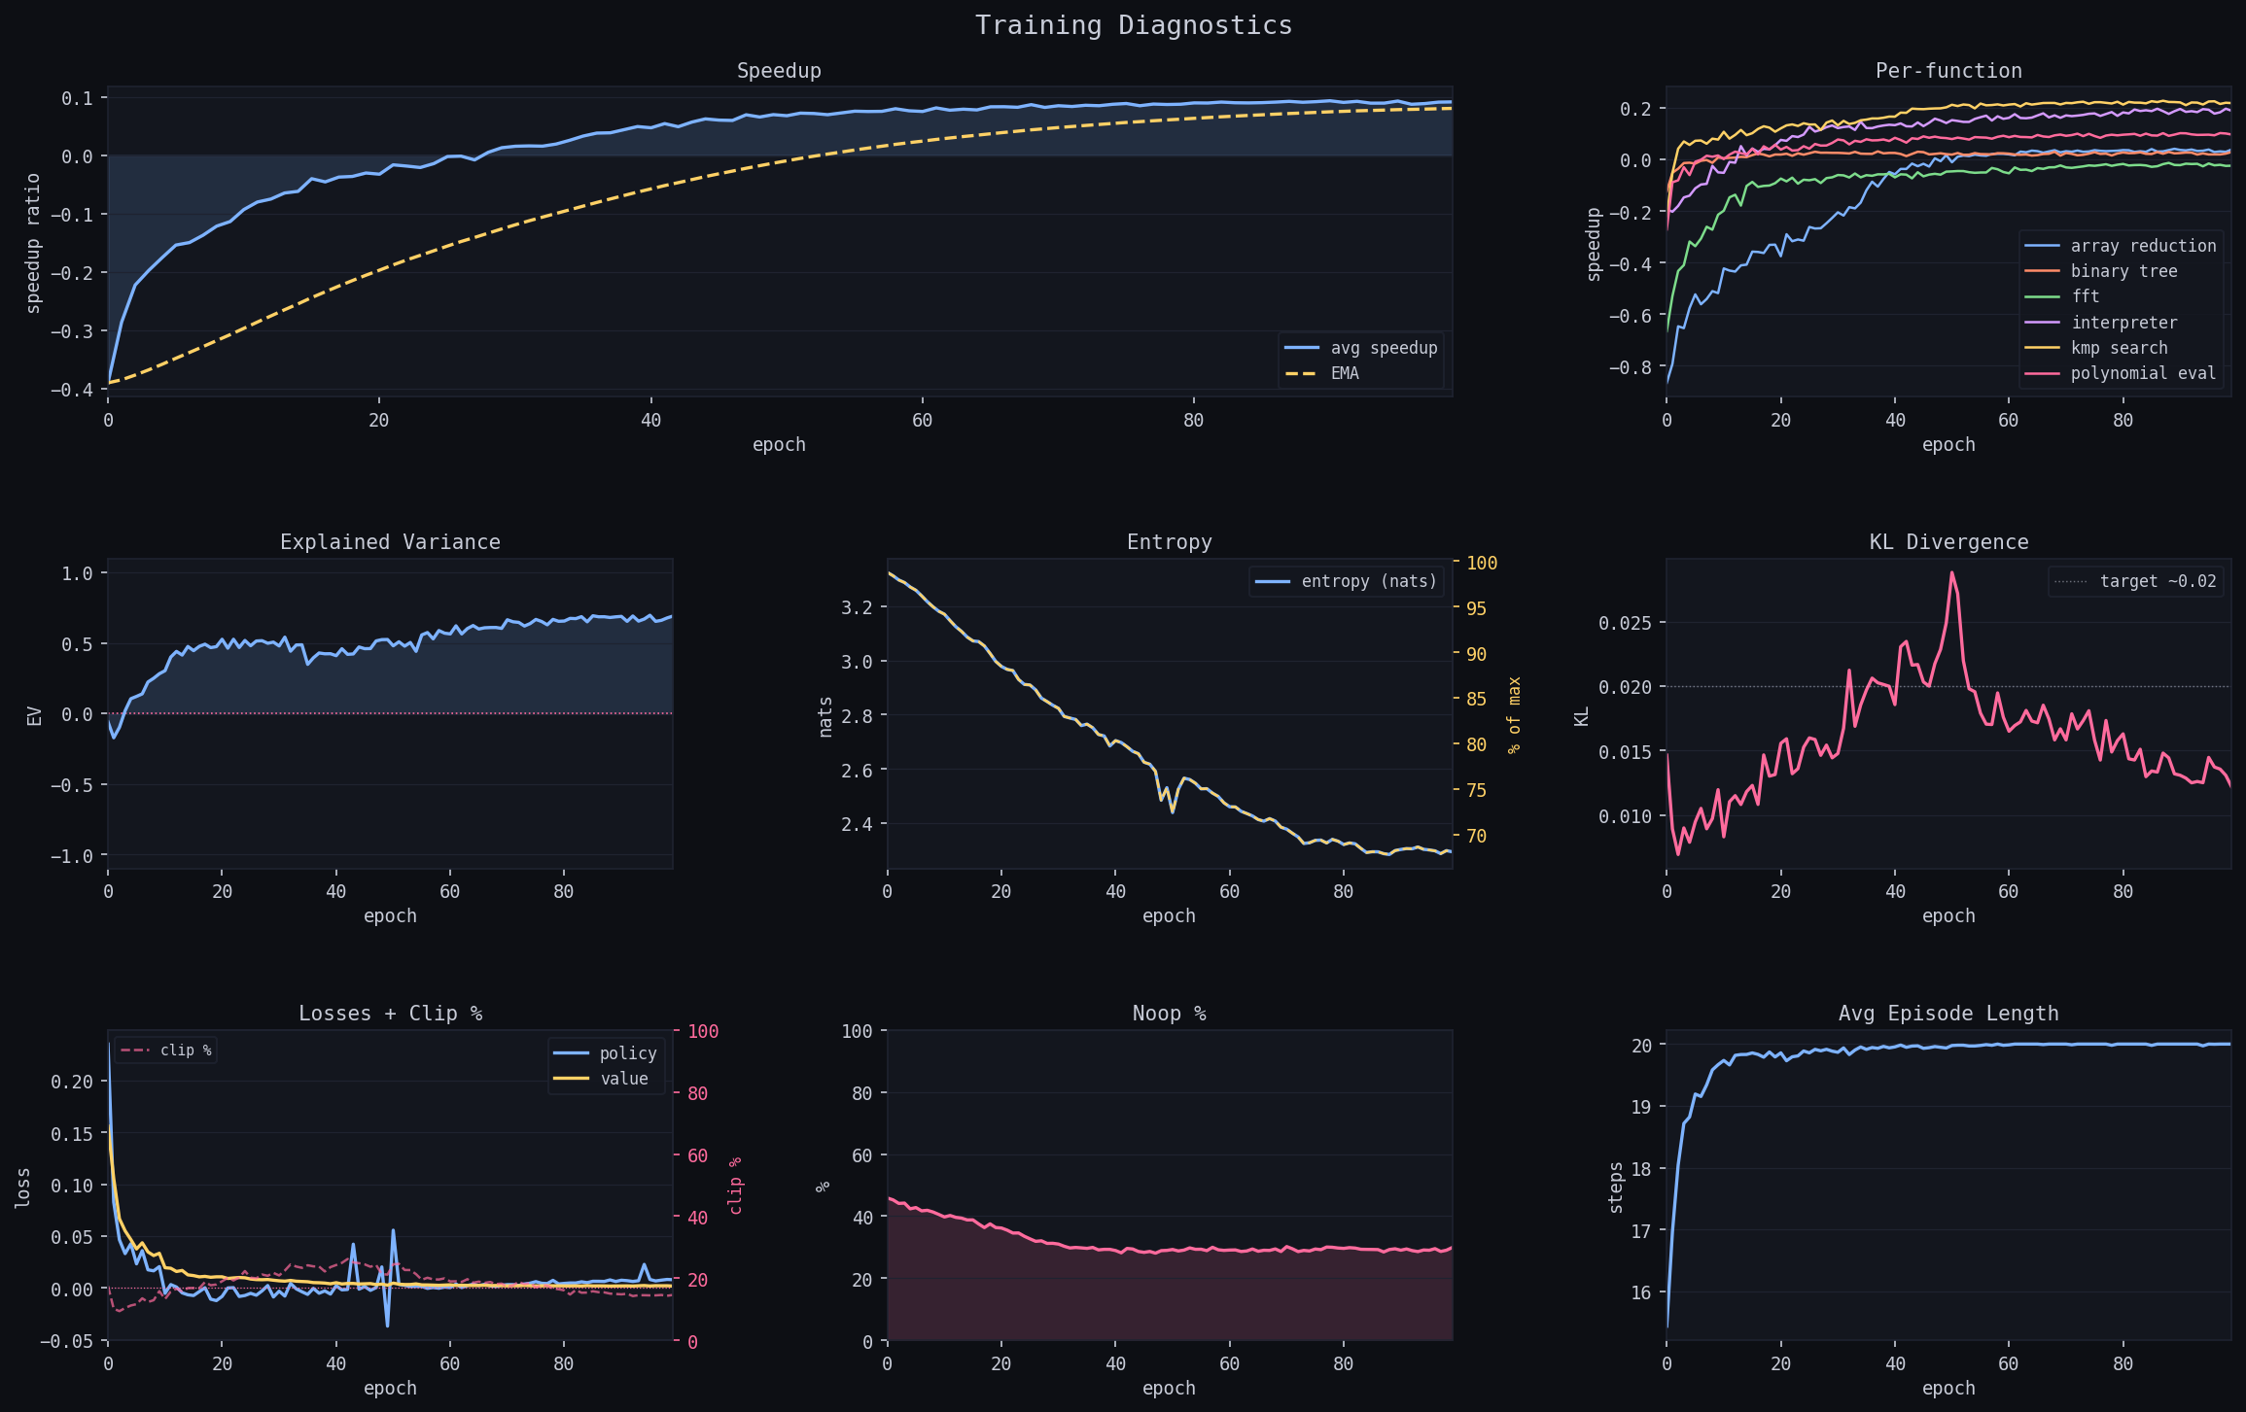
Auto-TFX + Episode Return — Training Curves
▸ Mean speedup: −0.40 → +0.091 (EMA +0.080)
▸ Explained Variance reaches 0.69
• Value head learns accurate return predictions
• 48-dim delta features sufficient for value function
▸ Entropy: max → ~30% of max
• Progressive concentration, no collapse
▸ No-op % stabilises ~30%
• Policy learns to prefer impactful passes
▸ interpreter and kmp_search lead per-function
• Consistent with high random-search ceiling

Slide 17
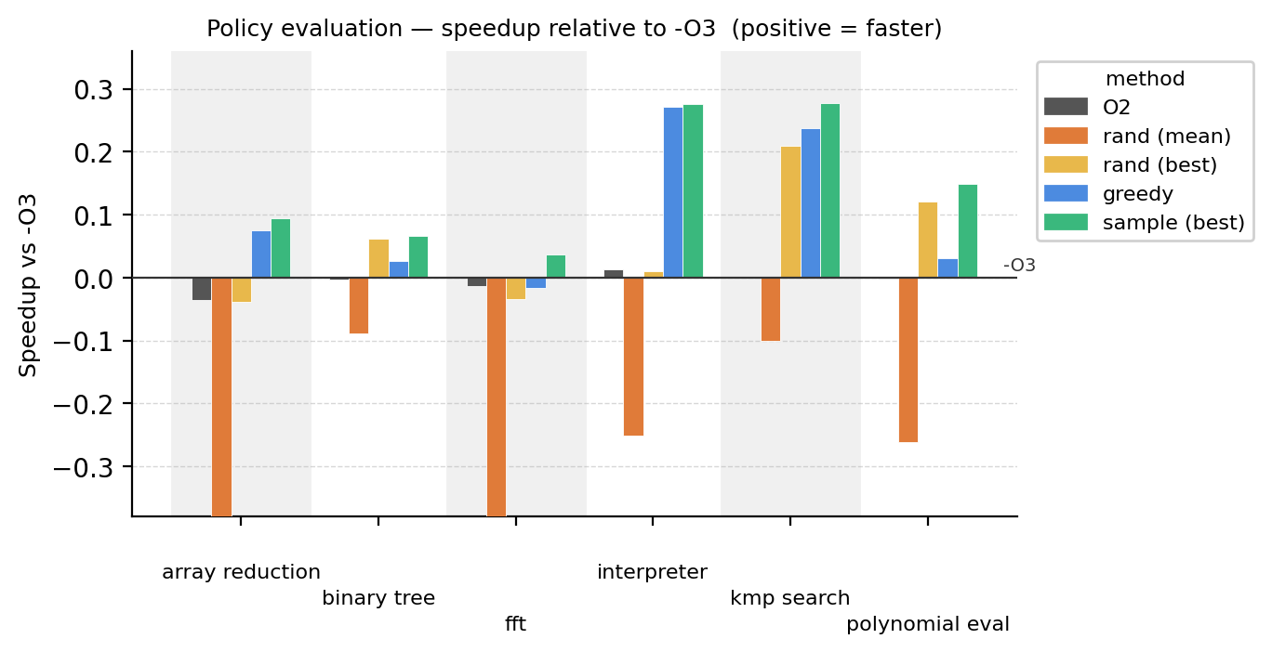
Auto-TFX + Episode Return — Evaluation vs -O3
Function
rand mean
rand best
greedy
samp best
array_red.
−0.795
−0.039
+0.075
+0.095
binary_tree
−0.089
+0.062
+0.027
+0.066
fft
−0.547
−0.033
−0.016
+0.037
interpreter
−0.252
+0.010
+0.271
+0.276
kmp_search
−0.101
+0.209
+0.237
+0.278
poly_eval
−0.261
+0.120
+0.031
+0.149
Greedy: 5/6 beat -O3 · mean +10.4% · sample-best all 6

Slide 18
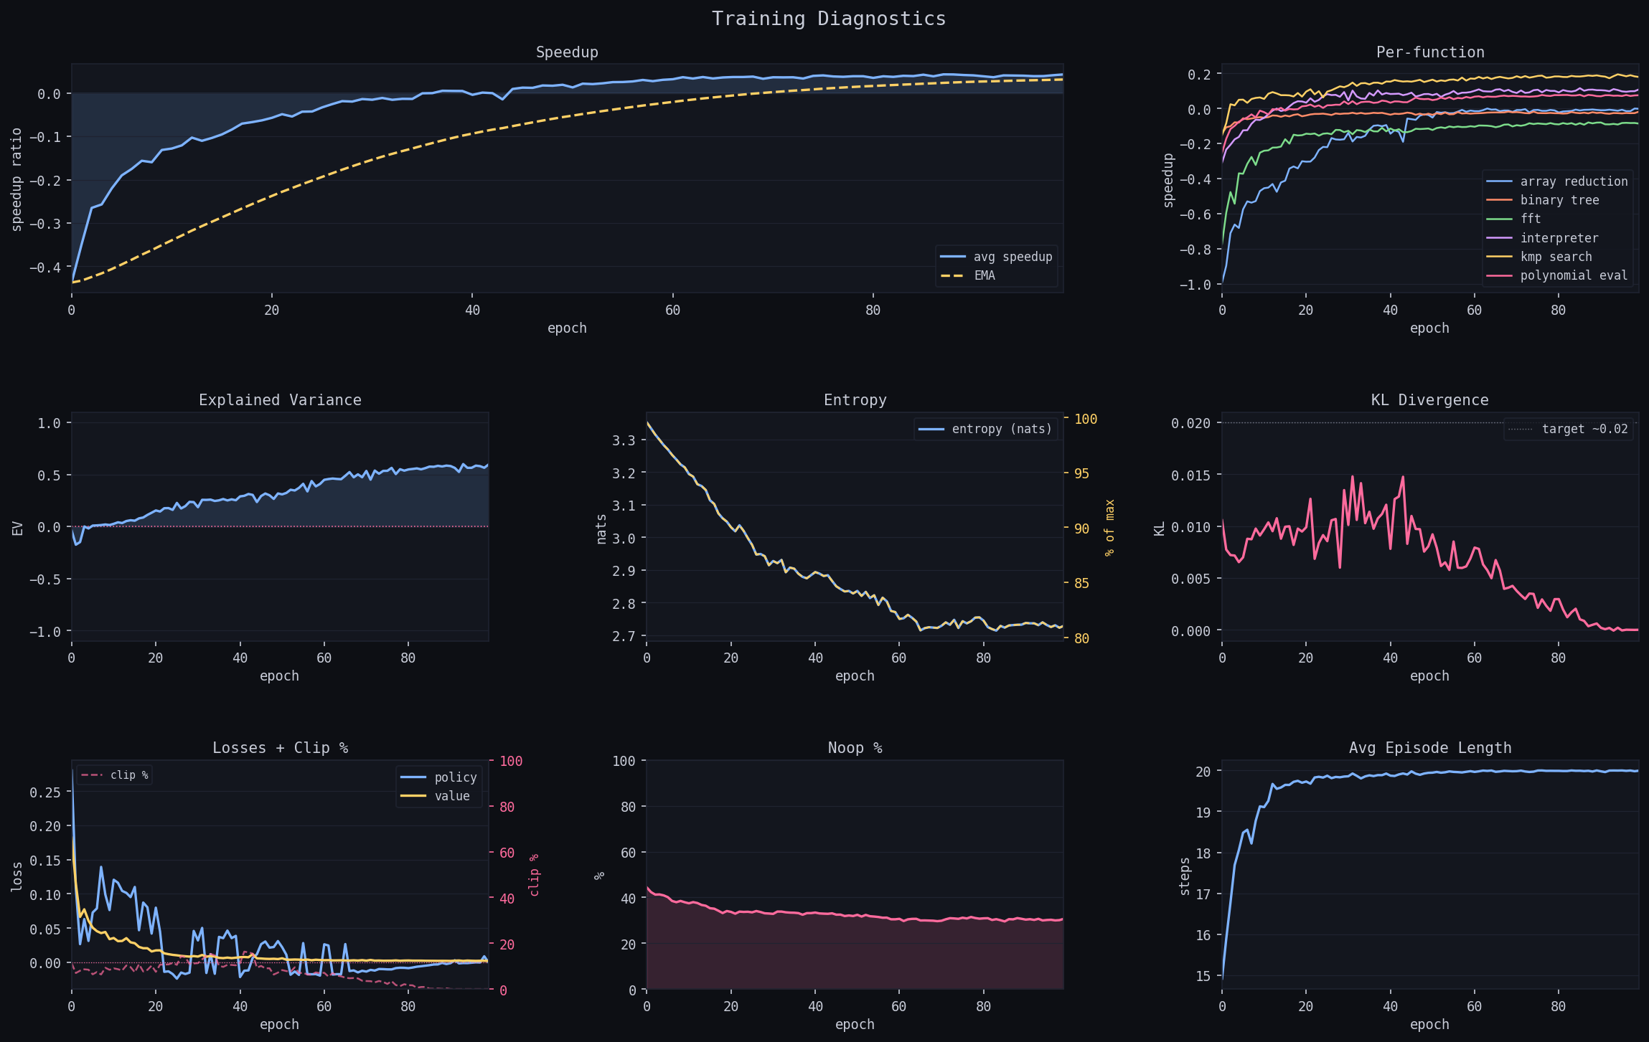
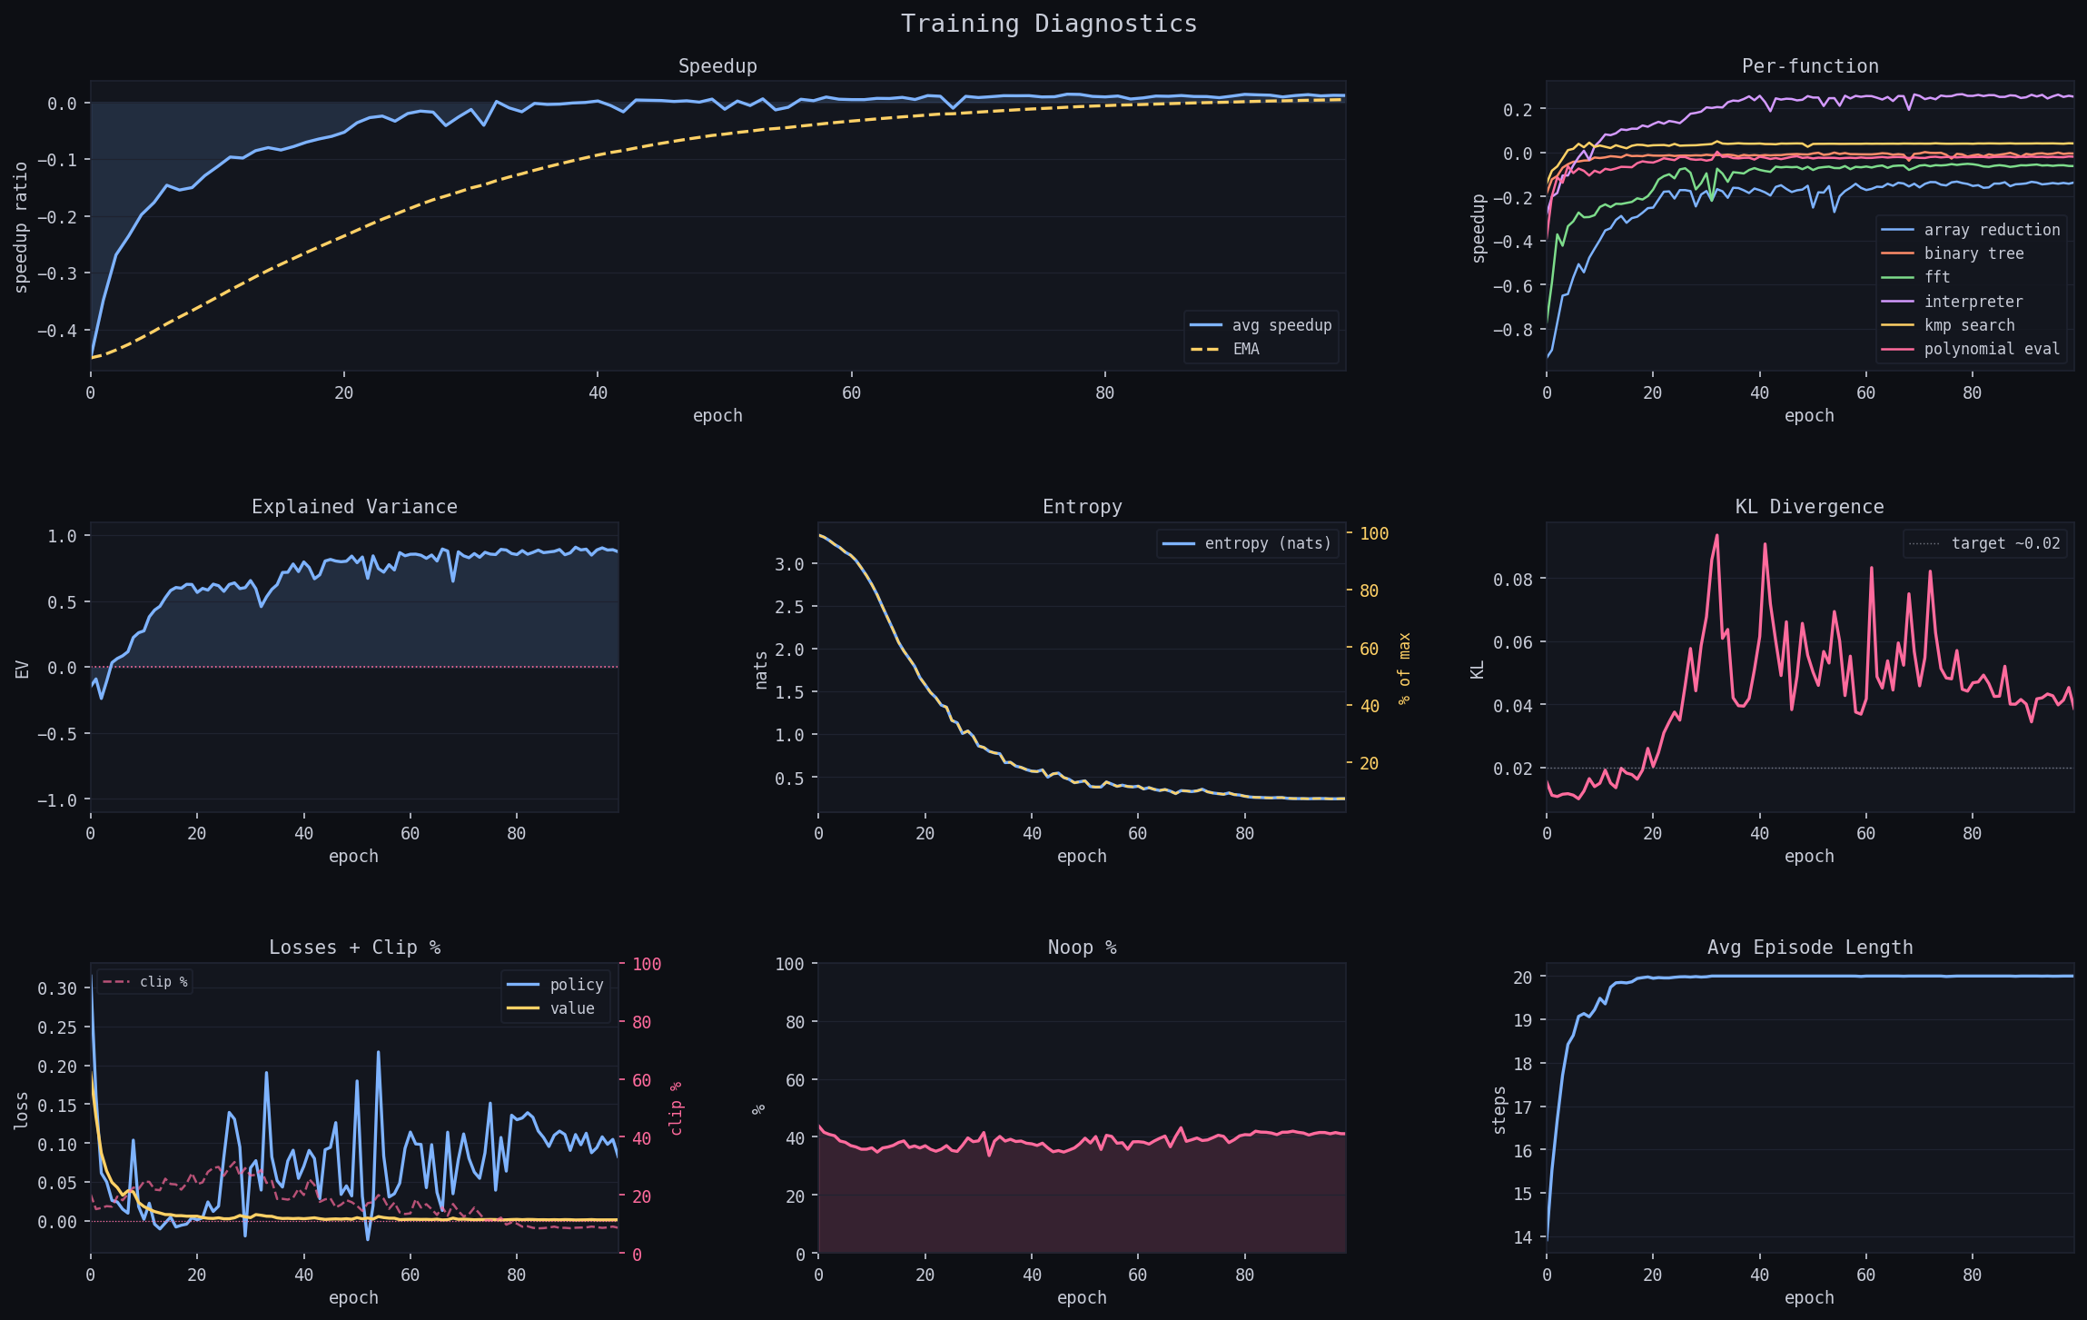
Training Results — GRU Episode & Weighted Returns
Auto-GRU + Episode Return — Training
Instruction-Weighted Return — Both Architectures
▸ Mean speedup −0.44 → +0.043 (EMA +0.031)
▸ EV reaches 0.59 (slower than TFX, same qualitative trajectory)
▸ No-op rate ~31% — consistent with episode-return behaviour
▸ Greedy eval mean: +11.4% — comparable to Auto-TFX (+10.4%)
▸ TFX weighted: speedup → +0.012 (vs +0.091 episode); EV = 0.87
▸ GRU weighted: speedup → +0.023 (vs +0.043 episode); EV = 0.86
▸ Higher EV but lower speedup — proxy misalignment (IR ≠ runtime)
▸ No-op rate ~40–41% — elevated vs episode runs

Slide 19
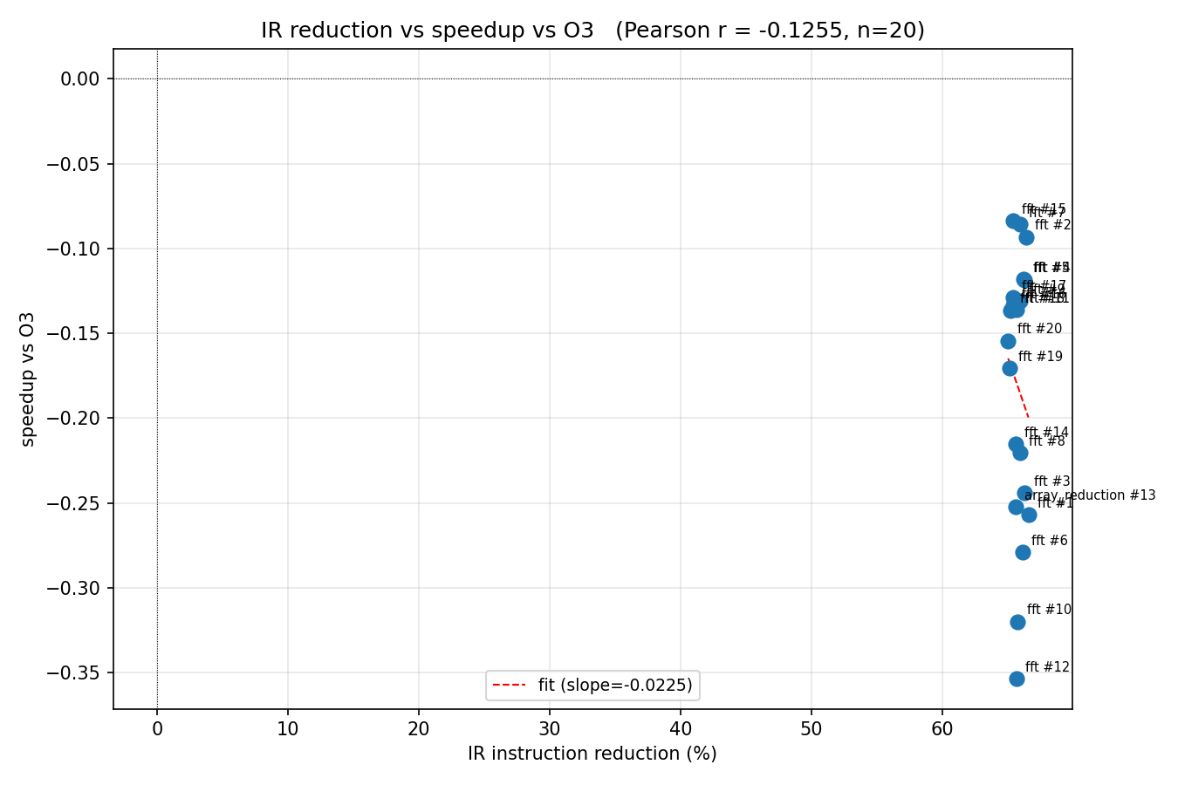
Weighted Evaluation & IR-Reduction Correlation
Auto-TFX Weighted (mean greedy +6.5%)
Auto-GRU Weighted (mean greedy +9.2%)
IR Reduction vs Runtime Speedup (ir_corr)
Function
greedy
samp best
Function
greedy
samp best
array_red.
−0.081
−0.053
array_red.
−0.039
−0.011
binary_tree
+0.079
+0.081
binary_tree
+0.051
+0.058
fft
+0.008
+0.009
fft
+0.016
+0.030
interpreter
+0.307
+0.308
interpreter
+0.306
+0.306
kmp_search
+0.077
+0.081
kmp_search
+0.102
+0.107
poly_eval
+0.002
+0.036
poly_eval
+0.118
+0.133
▸ Top 20 IR-step sequences all from fft
▸ IR reduction: 65–67% (near-vertical cluster)
▸ Runtime speedup: −8% to −35% — all negative
▸ Conclusion: IR reduction ≠ runtime improvement
• Stripping fft IR removes vectorization opportunities
▸ Explains why weighted return underperforms episode

Slide 20
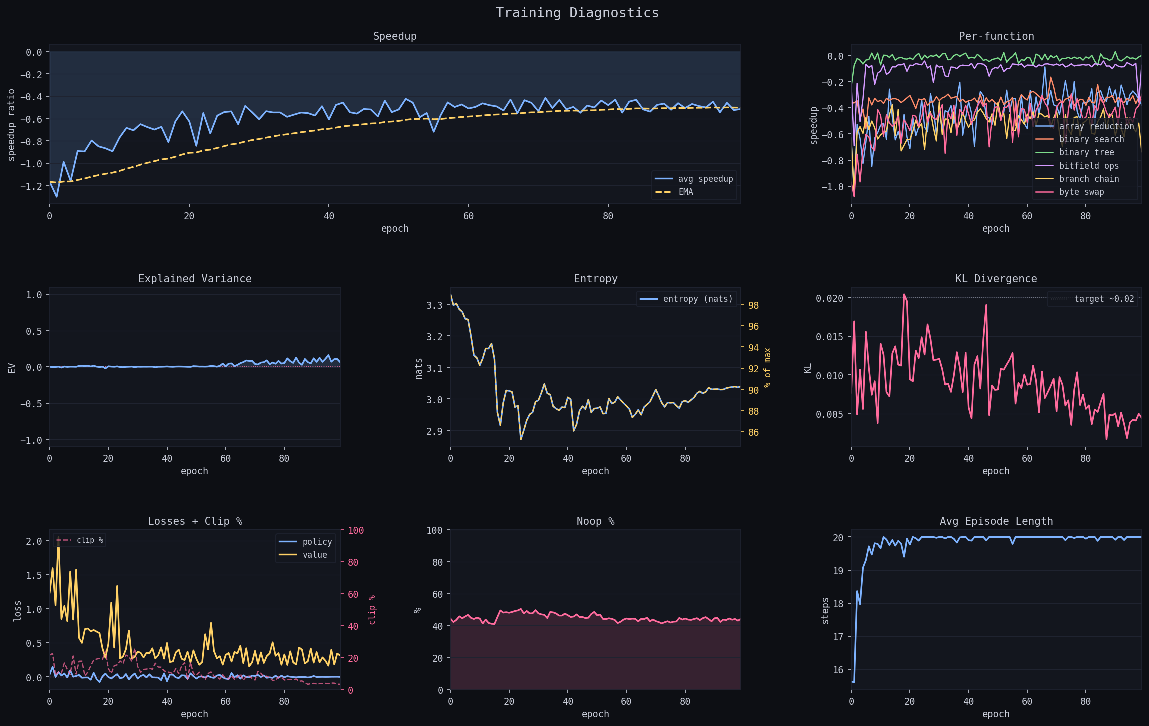
Results Summary & Pool-Training Outcome
Architecture × Return Summary
Pool Training (38 functions) — Failed
Architecture
Return
Greedy mean
Train EV
Auto-TFX
Episode
+10.4%
0.69
Auto-GRU
Episode
+11.4%
0.59
Auto-TFX
Weighted
+6.5%
0.87
Auto-GRU
Weighted
+9.2%
0.86
▸ Episode return outperforms weighted for both architectures
• Weighted EV higher but speedup lower — value head learns IR targets, not speedup
▸ GRU slightly ahead of TFX in greedy eval despite lower training mean
• Best-checkpoint selection can capture an early peak epoch
▸ Architecture gap < return-formulation gap — both arches broadly comparable
▸ Trained on all 38 functions simultaneously
▸ EV = 0.065 at epoch 100 — value head never converged
▸ Greedy eval: all 38 functions negative (mean −2.50)
▸ Cause: too few episodes per function to build reward signal
▸ Key constraint: episodes per function, not total epochs

Slide 21
Benchmarking Harness Rigor
Benchmarking Harness
Reproducibility Verification (diagnose)
▸ 201 timed iterations per measurement
• 10% trimmed mean — removes 10 outliers each tail
• 5 warm-up runs before timing begins
▸ CLOCK_MONOTONIC — monotonic wall-clock, nanosecond resolution
▸ Serial baselines collected once under stable single-threaded conditions
▸ Episode collection: parallelised across all CPU cores via Rayon
▸ Problem: training speedups collected under parallel timing noise
▸ diagnose re-benchmarks top sequences serially under controlled conditions
• 20 independent serial benchmark runs per sequence
• Reports mean, std, and full distribution
▸ Result: cached training speedups correlate strongly with re-measured values
▸ Per-sequence distributions are tight → reward signal is reproducible
▸ Dominant sequences from interpreter and kmp_search — consistent with EDA ceiling
Parallel Noise Characterisation
▸ bench-noise: run each binary solo then across 16 Rayon workers simultaneously
▸ Parallel overhead: small and consistent across all 6 benchmarks
▸ Noise margin 1.01 on -O3 baseline during training:
• Policy must beat -O3 by > noise floor to receive positive reward
▸ Prevents noise-driven false positives in the reward signal
bench_noise-{fft,kmp}.png · diagnose.png [cargo run -- bench-noise / cargo run -- plot-diagnose --results checkpoints/auto-tfx-episode-diagnose.json]

Slide 22
Discussion
▸ Episode return uses the true runtime signal directly
• Every step in a winning sequence reinforced, even modest ones
• No proxy metric — policy cannot be misled by IR statistics
• Consistently steers toward faster binaries
▸ Weighted return: proxy misalignment kills runtime gains
• IR reduction rewarded; no gradient signal for actual speedup
• Higher EV (0.87/0.86) but lower speedup (+6.5%/+9.2%) vs episode
• ir_corr confirms: top IR-reducing fft sequences all −8% to −35% runtime
▸ Transformer vs GRU: both architectures comparable
• GRU: recency bias — free inductive prior, lower training convergence
• TFX: non-local attention — slower training but similar final eval
• Architecture gap < return-formulation gap
Stop-Token Behaviour
▸ Policy never learns to Stop early — always uses all K=20 steps
▸ Rational given credit-assignment structure:
• Q(Stop) = current speedup
• Q(any pass) = E[future speedup] — uncertain, possibly higher
▸ No-op penalty helps at the margin but doesn't fix the asymmetry:
• Cost of stopping: unbounded foregone gain
• Cost of one more pass: at most p = 0.025
▸ Many top sequences: 5–7 repetitions of dominant pass
• Repeating is safe and occasionally lucky
Potential Fix:
▸ Per-step length cost, or Stop bonus ≥ E[marginal return from one more pass]

Slide 23
Limitations & Future Work
▸ Limitations
• Benchmark timing noise limits per-episode credit precision
• Training set of 6 functions is small
• Pass parameters not tuned (loop-unroll count always default)
• Effective horizon = K; Stop token unused
▸ Future Directions
• Per-step length cost or Stop bonus
• Extend pass menu to cover more LLVM 20 transforms
• Transfer to larger, real-world C/C++ programs
• Beam search or MCTS at inference time
• Combine offline bench-cache with online RL updates
• Pass hyperparameter tuning as part of the action space
• Cross-architecture generalisation (ARM, RISC-V)
▸ Key Findings
• Episode return > weighted: IR reduction is a poor runtime proxy
• Pool (38 fn) failed to converge — episodes per function is the constraint
• Architecture gap smaller than return-formulation gap

Slide 24
Conclusion
▸ Episode return beats instruction-weighted for both architectures
• TFX episode: greedy mean +10.4%, 5/6 functions · sample-best all 6 (2–27%)
• GRU episode: greedy mean +11.4% — comparable to TFX despite slower training
• Weighted: +6.5% (TFX) / +9.2% (GRU) — IR-reduction proxy diverges from speedup
▸ ir_corr confirms IR reduction is not a reliable speedup predictor
• Top IR-reducing fft sequences achieve −8% to −35% runtime — all slower than -O3
▸ Stop-token analysis: policy always exhausts horizon K=20
• Rational under terminal reward; fix requires per-step length cost or Stop bonus
▸ Pool-wide training (38 fn) failed to converge — episodes/function is the binding constraint
▸ Key insight: IR delta features must capture structural position, not global counts
• loop-rotate, licm, sroa shifts invisible to global count vectors; visible to deltas
Learning LLVM Pass Sequences via Reinforcement Learning with Autoregressive Policies · Evan Black · ODU

