Slide 1
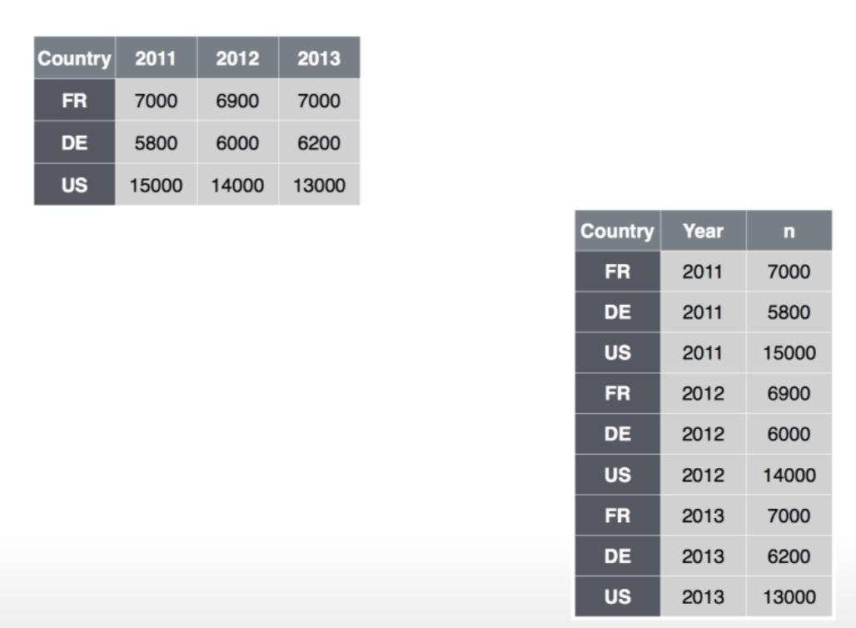
Which is long? Which is wide? What is the key? What is the value?
data %>% gather(Year, n, c(“2011”, “2012”, “2013”))
data %>% gather(Year, n, 2:4)
data %>% spread(Year, n)

Slide 2
Which is long? Which is wide? What is the key? What is the value?
data %>% gather(Attribute, Value, c(“Height”, “Weight”))
data %>% spread(Attribute, Value)

