Slide 1



Analysis of football data
Process-oriented Data Science 23/24

Slide 2




Agenda
Domain Description
Project Description
Methods
Results
Final Remarks

Slide 3




Domain Description Key requirements for our project work
Data includes Games, Players &
Team-specific data
Getting insights for coaches by
Analyzing play patterns
Focus on Process Discovery rather
than performance

Slide 4




Project Description Our approach to analyzing the World Cup data taking Process Mining into account
Use general statistics from Data Analytics as a reference for Process Mining
Comparison of play for the 2 finalists France and Croatia
Analysis of the MVP Luka Modric compared to 2nd & 3rd best player
Comparison of 2 completely different games involving the winner France

Slide 5




Methods Overview of data and pre-processing including our selection of tools
Raw Data
Pre-Processing
Analysis
Actions
Action Team
Adjust data format
Type
Possession Team
Add data (e.g. zones)
Result
Coordinates
Merge files
Player
…
Remove unnecessary data

Slide 6


Results Comparison of two finalists
Actions:
Attacks based more on individual dribblings
Intensive pressing after unsuccessful passes or dribbles, often leading to recovery
Shots after deeper build-up (low number of shots after first initial passes)
Players:
Not clear playmaking leader - most active players Kante, Pogba, Pavard, Varane have similar amount of passes. No player has as thick edges as Modric for Croatia.
Pitch Zones:
Short passes from defensive zones
Most of the possession losses happen in opponent’s half
Actions:
Attacks based on passes, less dribblings
More fouls after miscontrol
More shots from set pieces and accidental (w/o build up)
Players:
Team strongly dependent on Luka Modric, which received and performed most passes, is among players that start and end the ball possession sequences most often
Pitch zones:
Long passes to transport the ball directly from defence to attack
Dispossessions in more central zone of the field than France

Slide 7


Results Analysis of MVP Luka Modric
 | Modric | Hazard | Griezmann
Pass Acc. | 84% | 83% | 75%
Assists | 1 | 2 | 2
Shots | 10 | 18 | 21
On Target | 5 | 13 | 15
Goals | 2 | 3 | 3
Fouls | 13 | 7 | 6
Modric is far more important for opportunity creations of his team
Outstanding success and failure stats when under pressure
Modric is more important for his team as the core of their play

Slide 8



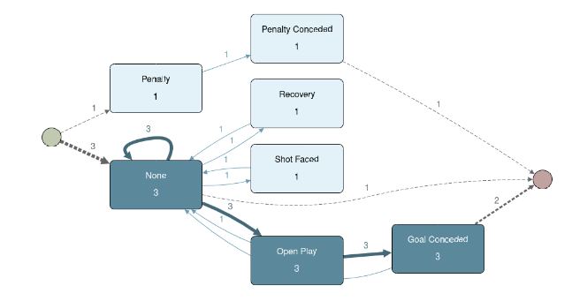
Disclaimer: it might not be completely fair to compare matches of 2 different opponents
Results Comparison of 2 different games with the France team involved: FRA-ARG vs. FRA-DEN
Actions:
more Pressure
ending with Fouls - more intense game
20s less case duration - higher pace in game
Players:
Left-side players more involved
striker Olivier Giroud had more interactions with others
goalkeeper highly involved in opportunity creation
Actions:
longer pass network
Clearance is more dominant
higher ball possession of France
Players:
Kylian Mbappé ony substitute until 78’ minute
more player interaction in the defense
Pitch Zones:
France was playing more through left-side of the pitch
2nd half required more defense work
Notes:
Different players could have a big influence on game output. Concrete play patterns that lead to goals can be obtained easily.

Slide 9



Closing Remarks Reflections on the projects and tools used
In case data is connected to some process, data should also be viewed in a Process Mining context and not only statistically with Data Analytics.
Playing with different perspectives is interesting to obtain new results and get to new findings.
With today's technology standards, extended functionality to perform Data Analytics within Process Mining tools is desired or expected.

Slide 10

Thank you! Any Questions?

Slide 11
Image Sources
FIFA World Cup 2018: https://th.bing.com/th/id/OIP.KUpyt_FLyUX8pNUUoHgQkQHaHa?rs=1&pid=ImgDetMain
Python: https://1.bp.blogspot.com/-ugMNNEeWN0g/X9WezhHRipI/AAAAAAAAJA4/LBtozO1knloe-kg8jBR_s4_dYaa2xncrQCLcBGAsYHQ/s982/pngfind.com-python-logo-png-626208.png
CSV: https://openscience.vn/images/icons/csv-13-512.png
Apromore: https://www.leonardo.com.au/hs-fs/hubfs/ApromoreLogo.png?width=1626&height=328&name=ApromoreLogo.png
Disco: https://do3z7e6uuakno.cloudfront.net/uploads/event/logo/1004960/Disco_400.png
Luka Modric: https://th.bing.com/th?id=OSB.AAyHQxB.png&w=138&h=104&o=6&dpr=1.2&pid=SANGAM
Eden Hazard: https://www.futcards.com.br/wp-content/uploads/2018/10/eden-hazard-chelsea.jpg
Antoine Griezmann: https://th.bing.com/th?id=OSB.AAyB4Wc.png&w=138&h=104&o=6&dpr=1.2&pid=SANGAM

