Slide 1
Solving the Many-Electron Schrödinger Equation by Random Sampling
Phys281 Lecture Tuesday 13th December, 2022
Neil Drummond
Notes:
LANCASTER UNIVERSITY POWERPOINT TEMPLATES
These PowerPoint templates are for use by all Lancaster University staff. Please see below for further information regarding the use of these templates. Should you have any further queries, please contact the marketing team via marketing-services@lancaster.ac.uk
Template slide 3: Insert a new slide
If you need to insert a new slide, from the ‘home’ toolbar, click on ‘new slide’ and select from the templates the style you require from the dropdown box.
Template slide 4: Typing new text and copying text from another document
New text should be typed over the text in the appropriate template. Copy and pasting text from another document will result in changing the style of the typography and layout. This is unavoidable as it is part of the Microsoft software. We appreciate that in sometimes you will need to copy text from another document into this template. Once you have pasted the existing text into the template, you will need to change the formatting so that they typefaces, sizes, colour, line spacing and alignment are consistent with the rest of the template.
Template slide 5: Inserting images
There are three choices of templates with images already inserted. Please use the template with the relevant image size and positioning. To insert an image, please go to ‘insert’ then ‘picture’ and find your image, highlight it and ‘insert’. Resize the image and position as per the example template.
Template slide 6: Text boxes
If a text box is deleted, either insert a new slide (using the appropriate template) or go to another slide and copy a text box. To select a text box for copying, please click on the outer edge of the text box so that the line goes solid (not dashed). Right click your mouse and select ‘copy’, then go back and ‘paste’ it into the slide where the text box is missing which should paste into the correct position on the slide.
Template slide 7: Other information
Typefaces, sizes and colours
All copy is Calibri.
Slide title copy throughout:
Size: 36 point
Colour Lancaster University red: (RGB) R: 181 G: 18 B: 27 (recent colours on PowerPoint)
Small copy on first and last slide:
Size: 16 point
Colour grey: (RGB) R: 102 G: 102 B: 102 (recent colours on PowerPoint)
Sub-headings:
Size: 24 point – italics
Colour grey: (RGB) R: 102 G: 102 B: 102 (recent colours on PowerPoint)
Bullets copy and body copy:
Size: 24 point (see below for a further option)
Colour grey: (RGB) R: 102 G: 102 B: 102 (recent colours on PowerPoint)
It isn’t advisable to have too much text on a slide, however on rare occasions it may be necessary, therefore there is a slide using 20 point bullet pointed text.
Line spacing and alignment
Single line spacing (apart from the main headings which is ‘exactly 35 point’)
All text is aligned left
Slide title options
There are two options for titles on the slides – one line or two lines for longer titles. Ideally, the one line title should be used, however on rare occasions a two line title maybe needed.

Slide 2

Electronic structure calculation
Goal: solve the many-electron Schrödinger equation to obtain the ground-state energy and distribution of electrons for a given arrangement of nuclei in a molecule or solid.
Many researchers in physics, chemistry, engineering, materials science and Earth science use electronic structure methods to calculate material properties from first principles.
Curvature gives vibration frequency
Example: calculate total energy
E of an oxygen molecule as a
function of nuclear separation R.
E
Bond energy
O atom
O atom
0
R
R
Equilibrium bond length
Equilibrium bond length

Slide 3
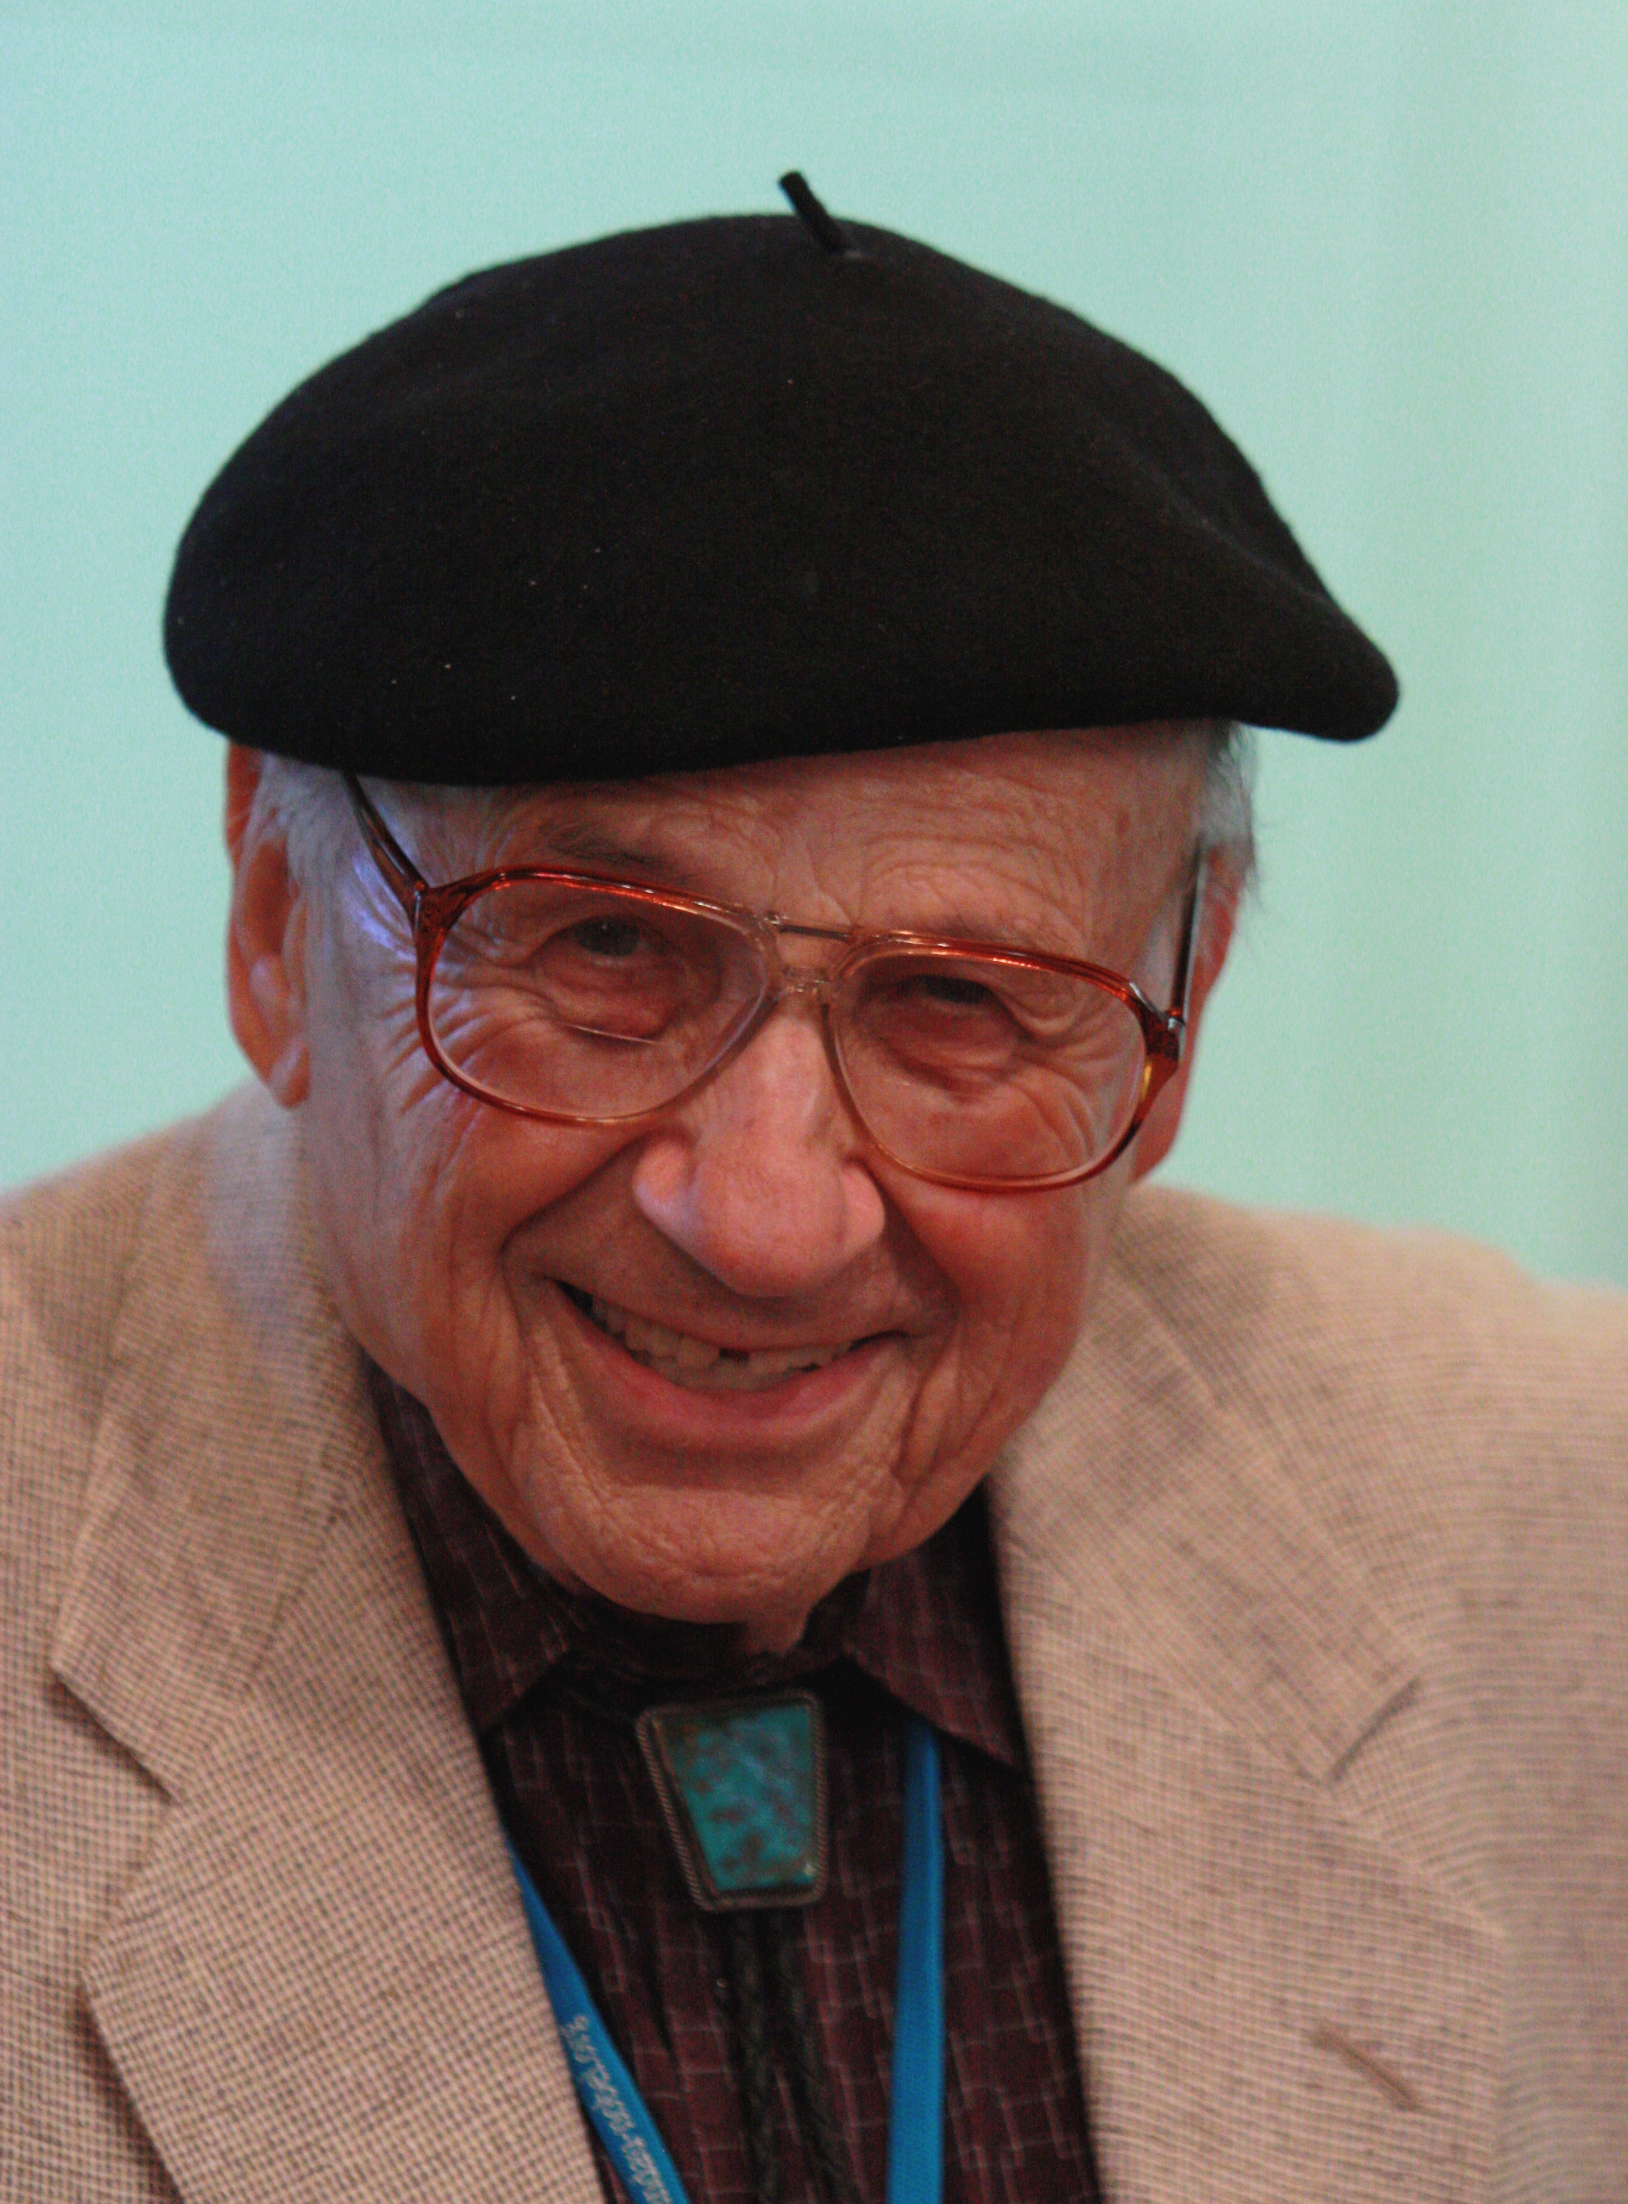
Density functional theory
The theory
Hohenberg & Kohn: ground-state wave function and hence all ground-state properties are uniquely determined by the electronic charge density; for a given external potential the ground-state charge density minimises the total energy.
Kohn & Sham: energy of interacting electrons equals the kinetic energy of a noninteracting system, plus the electrostatic energy of its charge distribution, plus its interaction with the external potential, plus an unknown, density-dependent “exchange-correlation” functional.
Approximate the XC functional, then minimise the energy with respect to the wave functions of the noninteracting system.

Slide 4
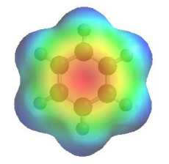
Density functional theory
A good approximation to the exchange-correlation functional is needed:
Basic idea: choose a form that is exact for a homogeneous system, and accurate for a system with a slowly-varying density.
In local density approximation each point in space contributes to the XC energy as if it were a homogeneous electron gas.
Hence we require accurate exchange and correlation energy data for a homogeneous electron gas.
What DFT provides when applied to an inhomogeneous system:
Ground-state energies and charge densities.
Orbitals and energy eigenvalues for the noninteracting system.

Slide 5
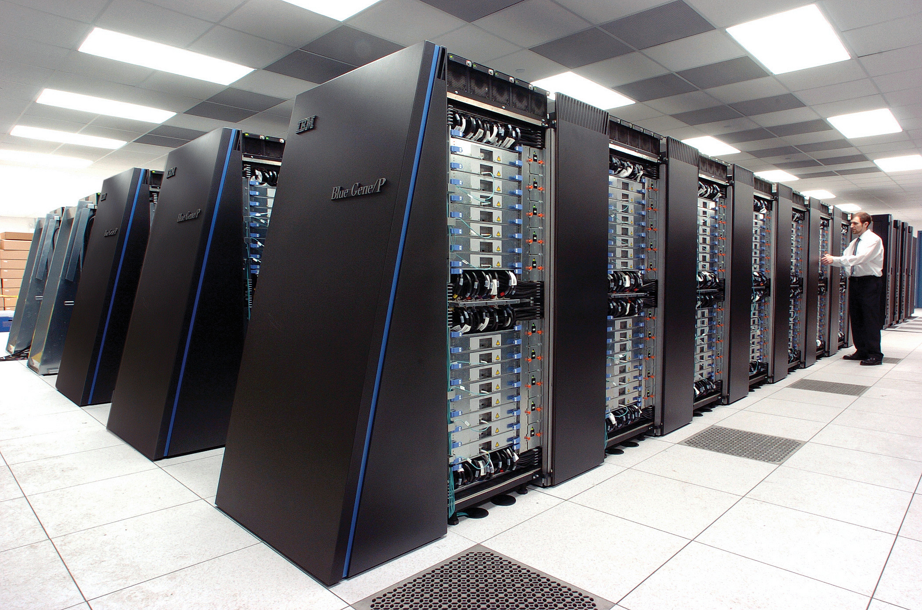
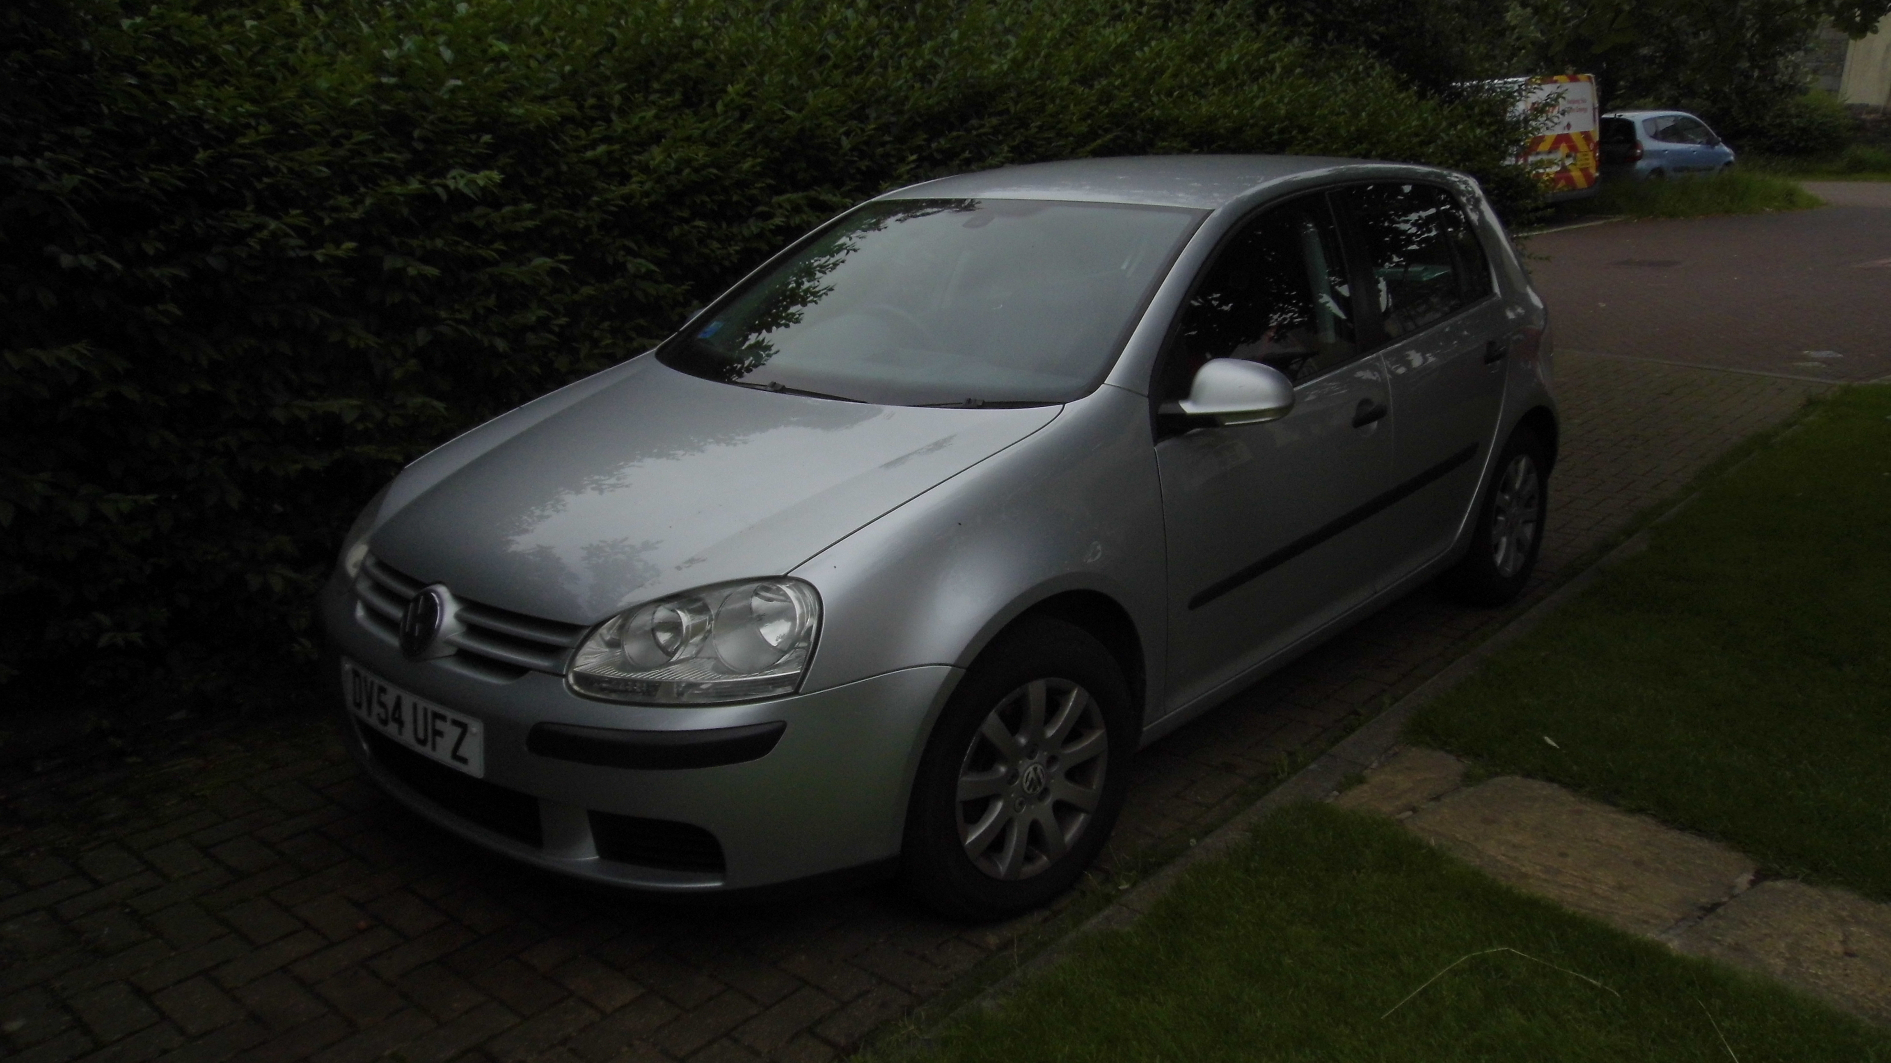


DFT vs. QMC
Pros
Cons
Often accurate
Anyone can use a black-box-like plane-wave DFT code
Cheap, enabling exhaustive structure searching, etc.
Forces, response functions, ... readily available
Capabilities understood
“Band-gap problem”
Van der Waals interactions
Self interaction
General accuracy limitations where cancellation of errors isn't sufficient
Huge number of functionals
Hybrid functionals, etc., not so cheap
DFT
Highly accurate. Quantum chemistry methods are competitors for small molecules. No competitors for clusters, condensed matter or electron(-hole) gases
Parallelisable
Fun and interesting
QMC is ~1000–10,000 times more expensive than DFT
Finite-size effects
Limited availability of forces and response functions
Wave-function optimisation can be problematic
Fixed-node errors
QMC

Slide 6

Monte Carlo methods
Example of Monte Carlo integration: area of a shape in 2D
Random points, uniformly distributed
Area of this shape is approximately given by the area of the rectangle multiplied by the fraction of random points in the shape.
Estimate of the area becomes exact in the limit that the number of points goes to infinity. For finite numbers of sampling points, one can evaluate the statistical error in the estimate of the area.
The statistical error on a Monte Carlo integral falls off as NP^{-1/2}, irrespective of dimensionality.
Monte Carlo integration beats any known grid-based method in seven or more dimensions.

Slide 7
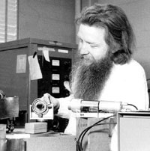
Variational Monte Carlo
Variational principle of QM combined with Monte Carlo integration using Metropolis-Hastings algorithm to sample Ψ².
Need a trial wave function.
Free parameters are optimised by minimising the energy expectation or the variance of the energy.
Problems: can never do better than allowed by the wave-function form; and it is not easy to choose trial wave functions for two different systems “fairly”.
Local energy:
(Constant for an energy eigenfunction)

Slide 8
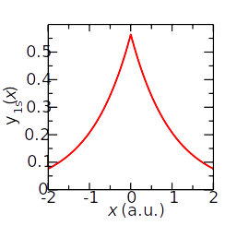
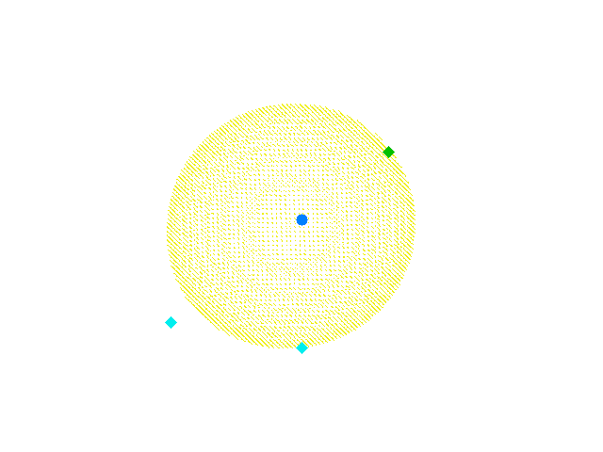
Many-electron trial wave functions
Usual choice: Slater-Jastrow trial wave function.
Slater determinants contain DFT or Hartree-Fock orbitals. Slater part of wave function is antisymmetric and defines state of system.
Jastrow factor is an explicit function of interparticle distances. Jastrow is positive and symmetric and describes dynamic correlation.
Can use multideterminant-pairing-backflow-Jastrow wave functions if really required.
Example image

Slide 9


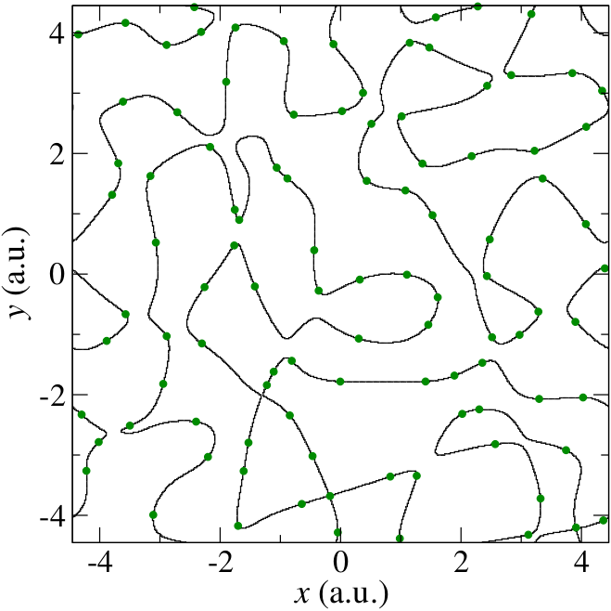
Diffusion Monte Carlo
Solve imaginary-time Schrödinger equation to project out the ground-state component of the trial wave function: excited states die away exponentially relative to ground state.
Simulate drift, diffusion and branching/dying processes governed by imaginary-time Schrödinger equation.
Maintain fermionic symmetry via fixed-node approximation: solve Schrödinger equation subject to boundary condition that the nodal surface is pinned.
Example image

Slide 10

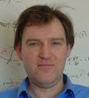



CASINO QMC software (I)
CASINO QMC code developed by Richard Needs (Cambridge), Mike Towler (Towler Institute), Neil Drummond (Lancaster) and Pablo López Ríos (Cambridge), plus countless others.
Website: https://vallico.net/casinoqmc/
Forum: https://vallico.net/casino-forum/
Interfaces to CASTEP, PWSCF, ABINIT, Gaussian, CRYSTAL, etc.
CASINO is not so very difficult to use...
Example image

Slide 11
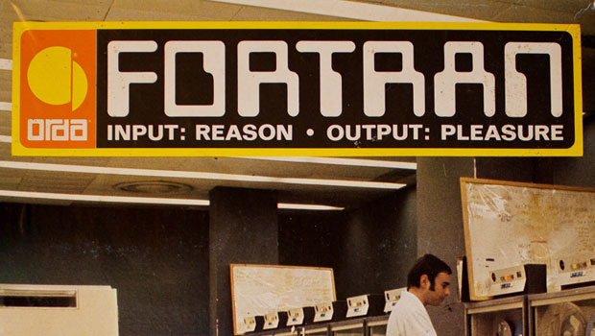
CASINO QMC software (II)
CASINO is written in Fortran 2003.
Multiple layers of parallelism: (i) distributed memory parallelism over random walks using message passing interface (MPI), (ii) shared-memory parallelism over particles using OpenMP and (iii) the ability to offload some tasks to GPUs using OpenACC.
Scales to tens of thousands of processor cores and has been used on some the world’s largest computers over three decades.
Uses the BLAS & LAPACK libraries for linear algebra.
Accompanying utilities are written in Fortran, C, C++, Python, Bash and AWK.
~400,000 lines of code. Project started in early 1990s.
Uses Git for version control.
Example image

Slide 12



QMC costs
“How much does a QMC calculation cost?” Depends enormously on target precision, system size, atoms involved, ...
Like standard DFT, cost of QMC scales as N³ with system size.
Cost scales as 1/ΔE², where ΔE is target error.
For a “useful” level of accuracy, cost may be 1000‒10,000 times greater than DFT.
But QMC scales to tens or hundreds of thousands of cores.
Example image

Slide 13
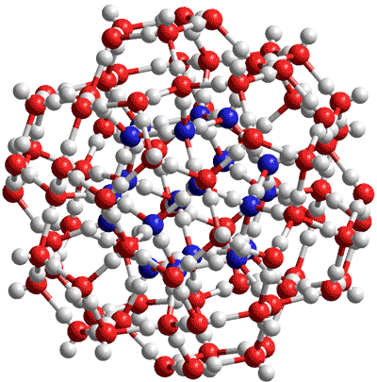
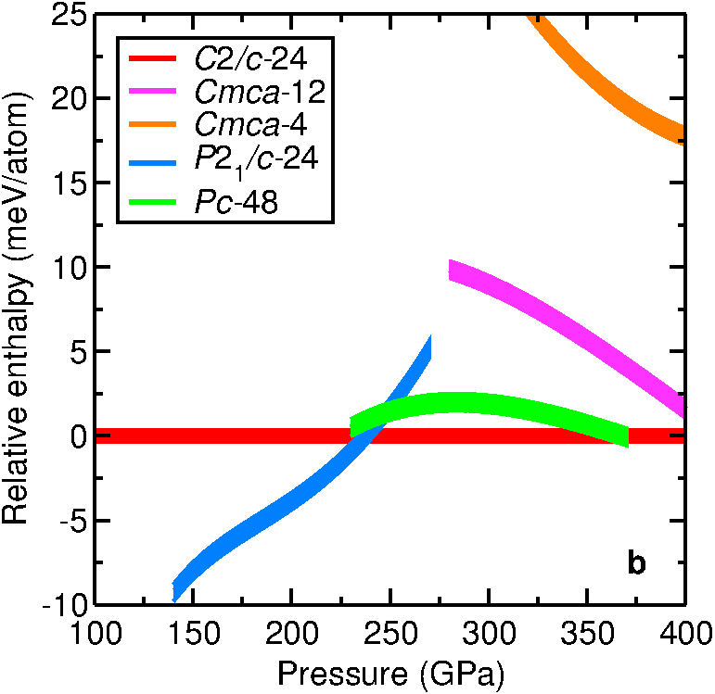
Limitations of QMC
“Heroic” QMC calculations have 1000–2000 electrons.
“Heroic” QMC calculations for crystalline solids achieve precisions of less than 1 meV per atom in total-energy calculations, or 0.05 eV in band-gap calculations.
Difficult to resolve magnetic phenomena.
(Large) exciton binding energies can be resolved.
Much higher precision can be achieved for electron(-hole) gases, atoms and small molecules.
Example image

Slide 14
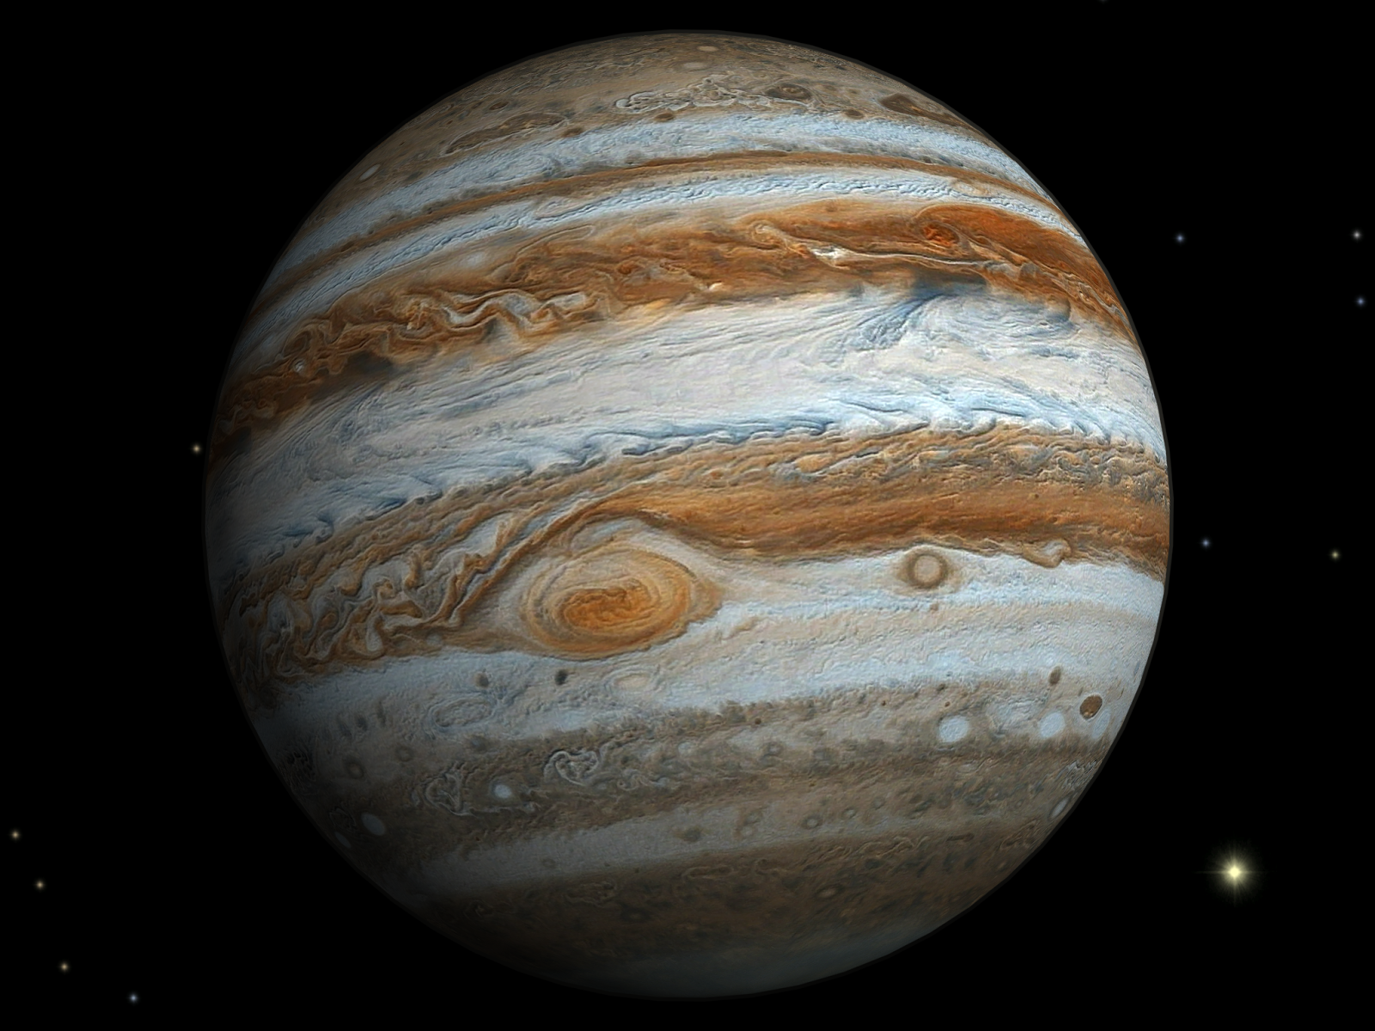
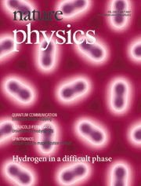
Phase diagram of solid hydrogen
Hydrogen: oldest and most abundant element in the universe.
Rich phase diagram is being explored experimentally and theoretically.
Scatters X rays very weakly. Determining atomic structure experimentally is difficult. Can detect phase boundaries by abrupt changes in Raman spectra.
Use DFT to search for low-energy candidate atomic structures, whose Raman spectra match experimental spectra for different phases.

Slide 15
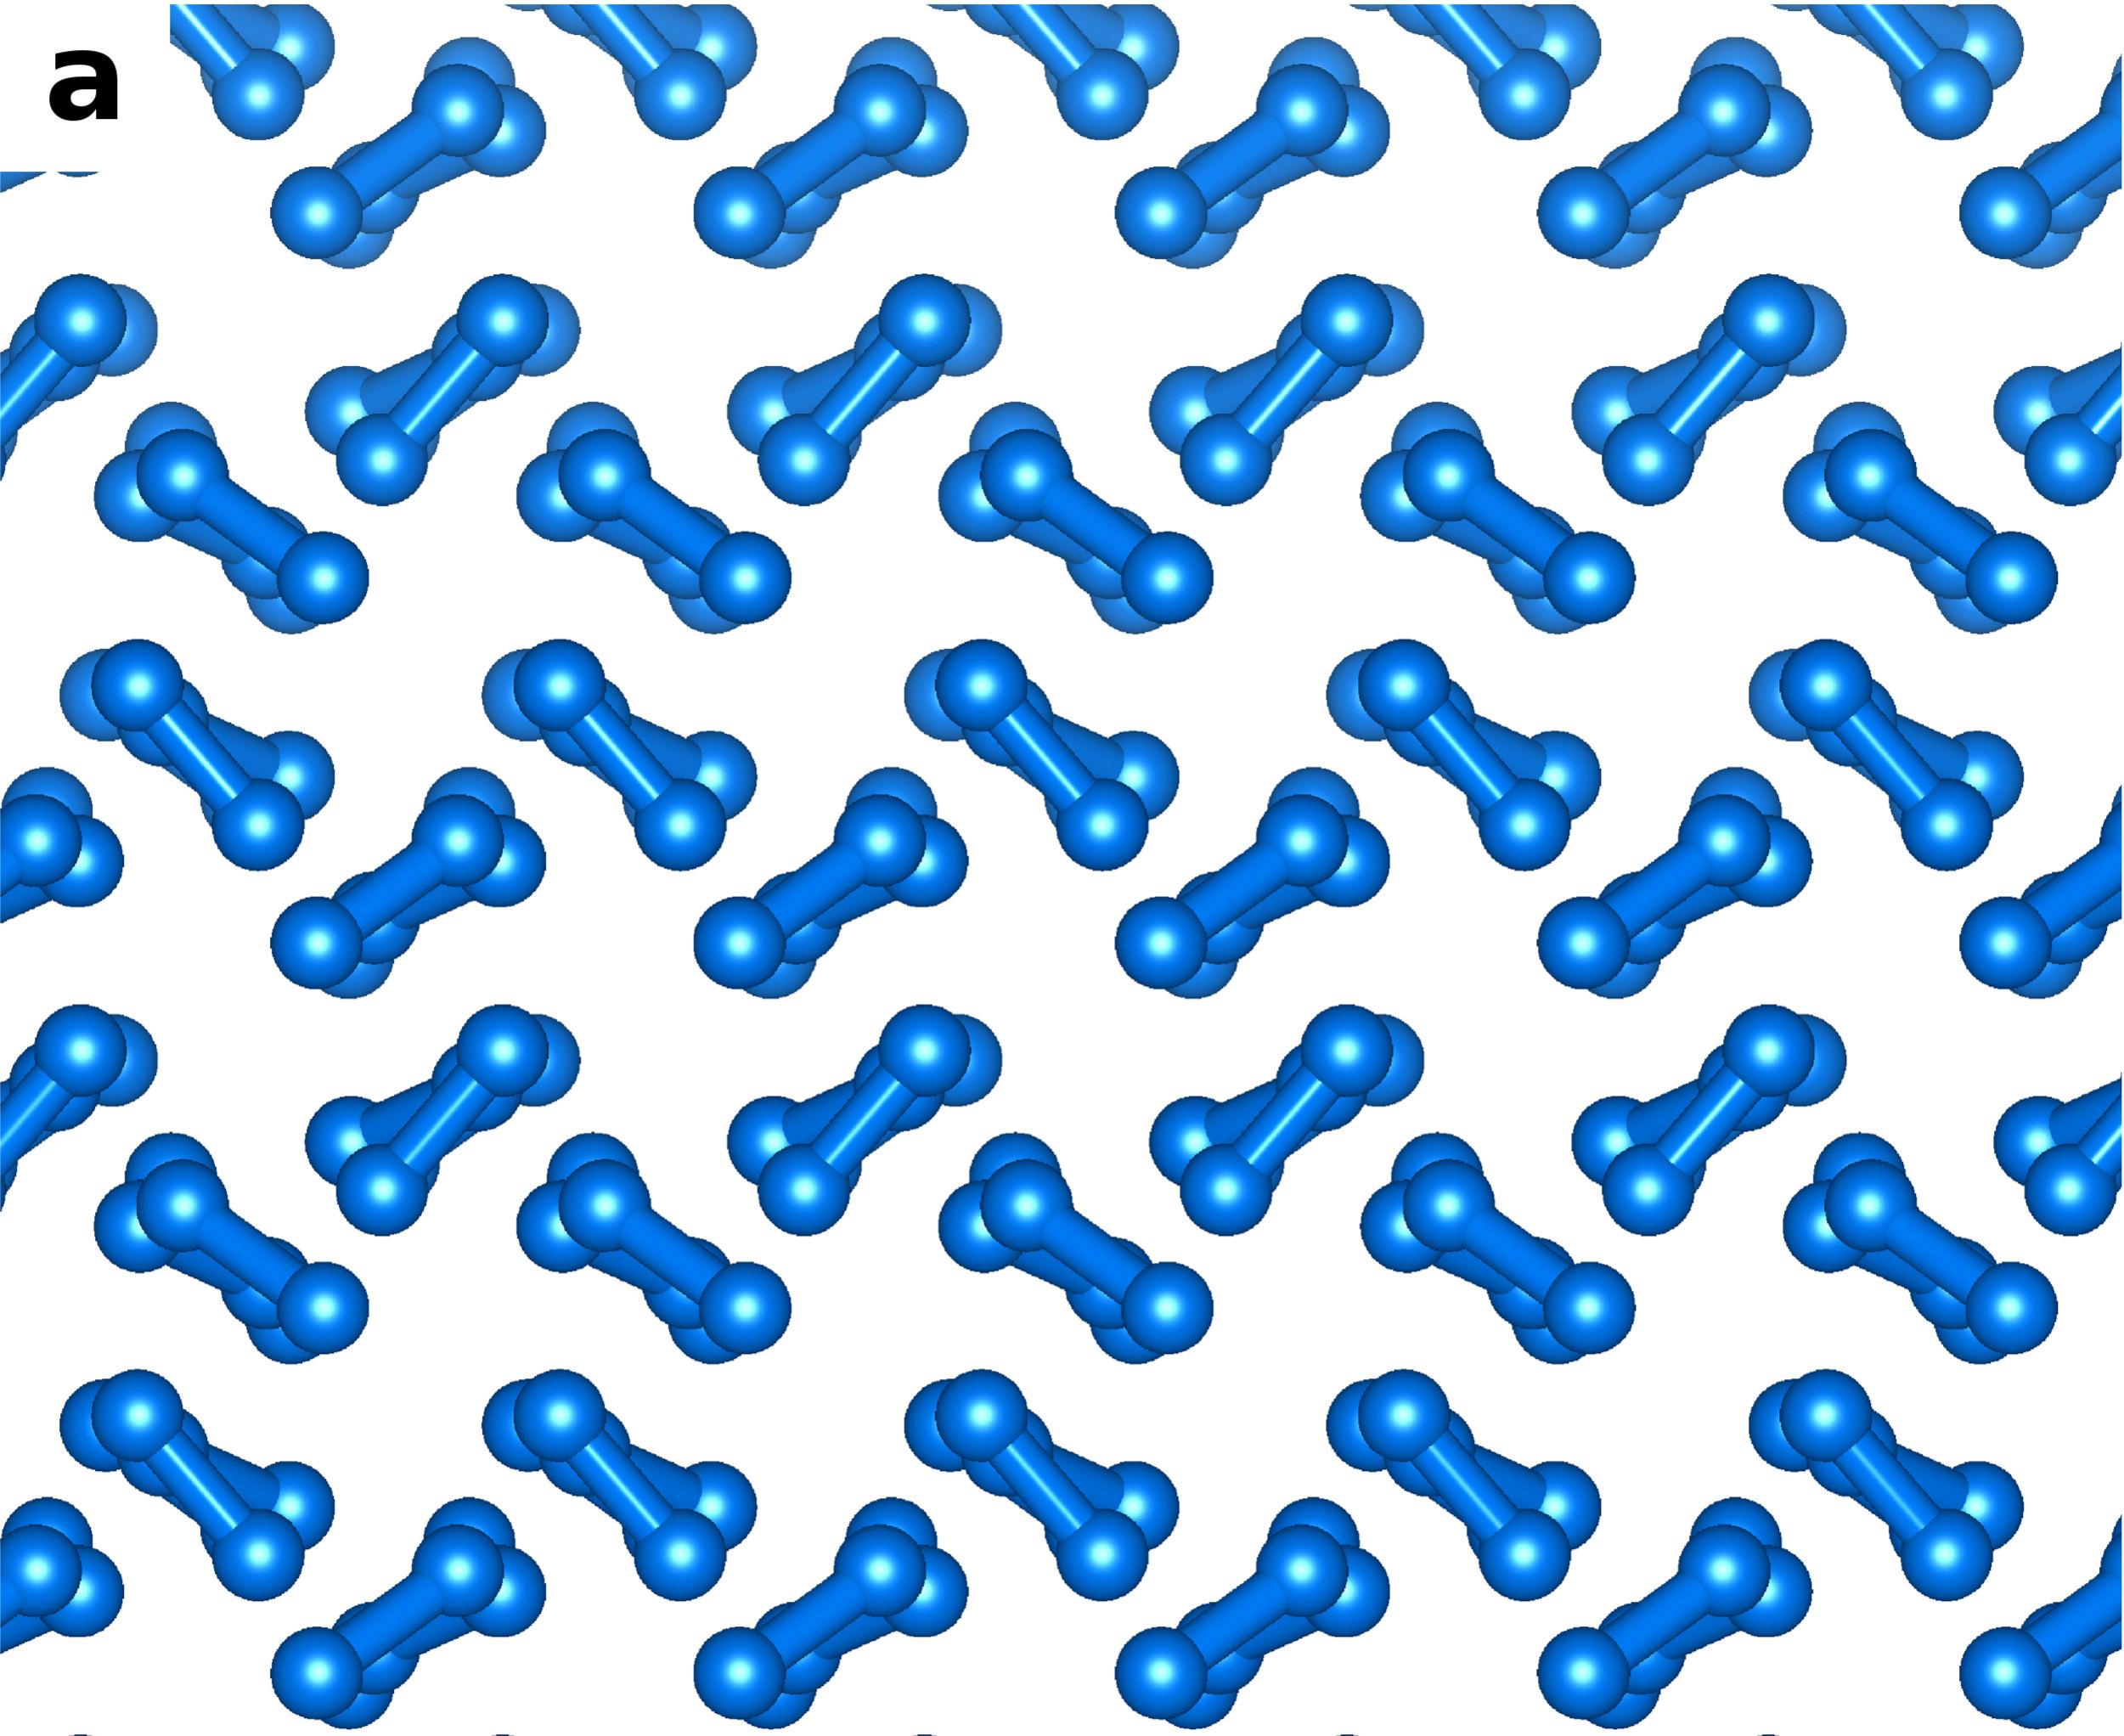
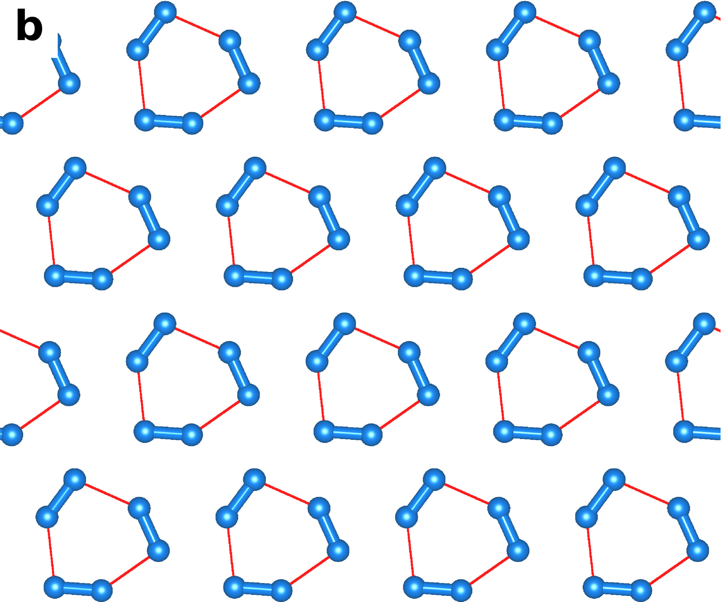
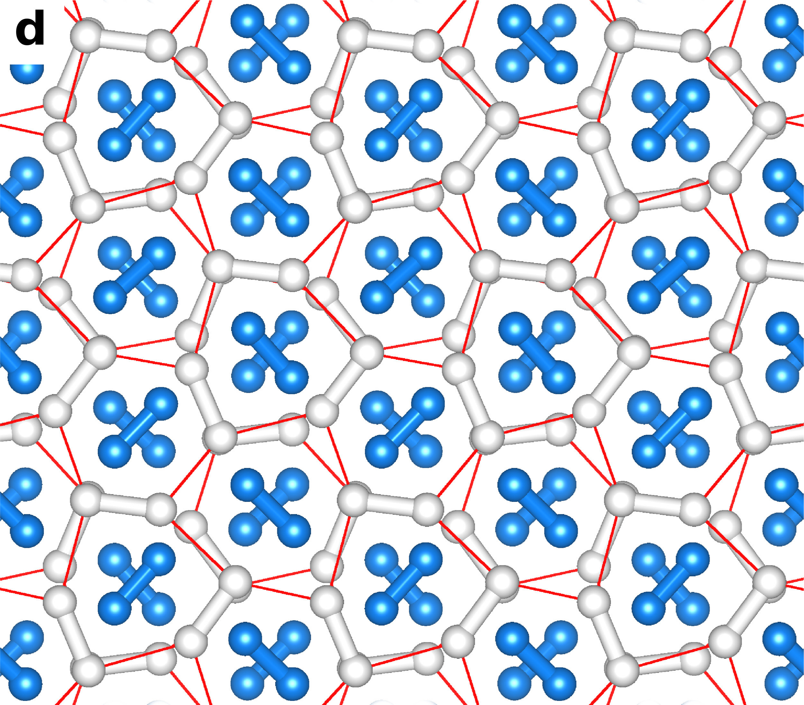
Phase diagram of solid hydrogen
In range 100–400 GPa, consider five candidate structures: P21/c-24 models Phase II; C2/c-24 and Cmca-12 are possible models for Phase III; Pc-48 models Phase IV; and Cmca-4 is the (metallic) structure favoured by DFT.
Experiment: Phase II–III boundary at ~160 GPa; Phase III–IV boundary at ~300 K.
Hydrogen is not metallic at these pressures: DFT is qualitatively wrong.
(Anharmonic) vibrational energy is important and is calculated using DFT.
P21/c-24
(Phase II)
C2/c-24 (Phase III)
Pc-48 (Phase IV)

Slide 16
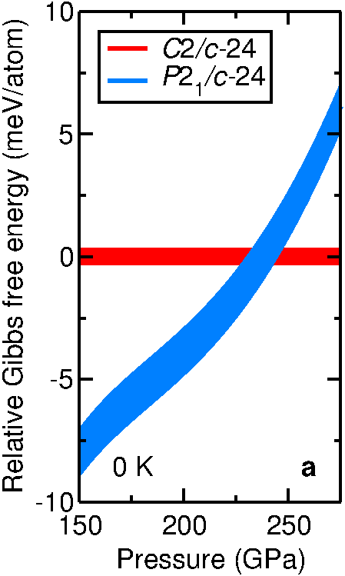
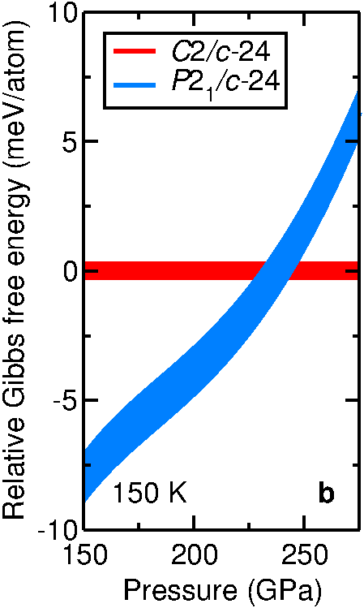
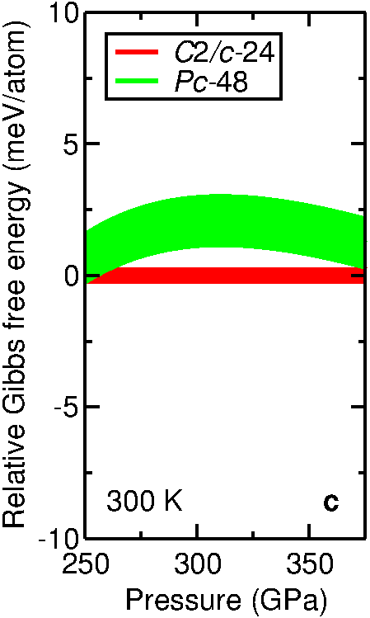
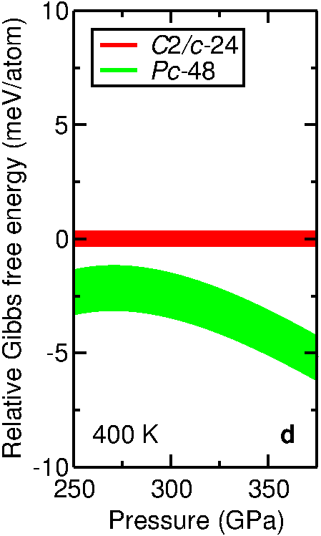
Phase diagram of solid hydrogen
Compare Gibbs free energies to find which phase wins at a given temperature and pressure.
Metallic Pc-48 structure favoured in DFT is uncompetitive in DMC.
Transition from P21/c-24 to C2/c-24 at 235(10) GPa.
Transition from C2/c-24 to Pc-48 at 320(20) K.

Slide 17
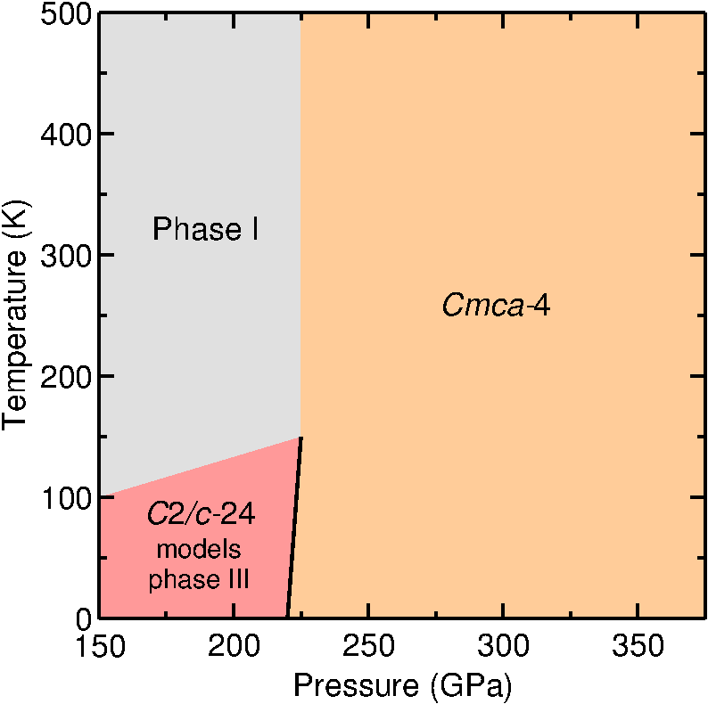
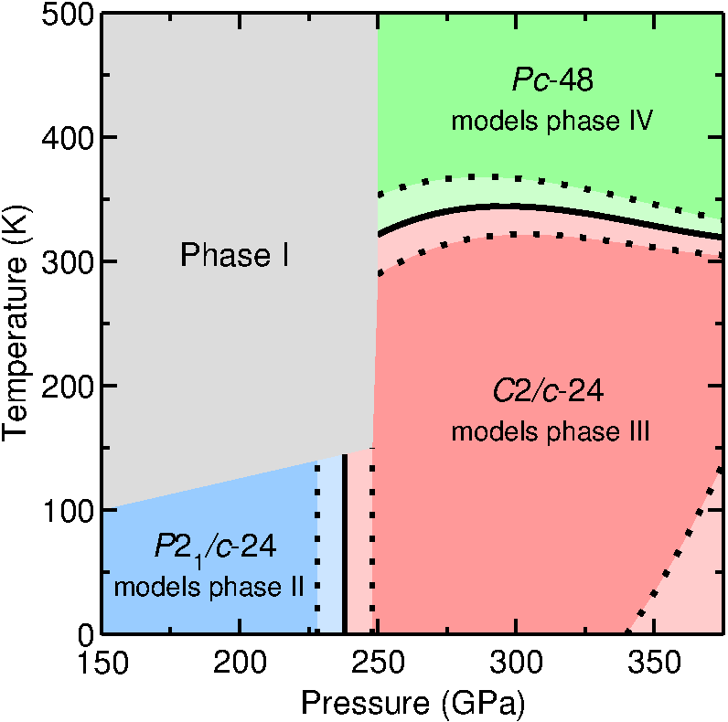
Phase diagram of solid hydrogen
DFT-PBE
DMC
Reasonable agreement between DMC and experimental phase boundaries.
Suggests we have determined the atomic structure of hydrogen.

Slide 18
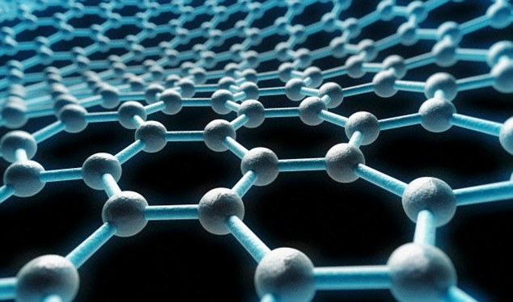
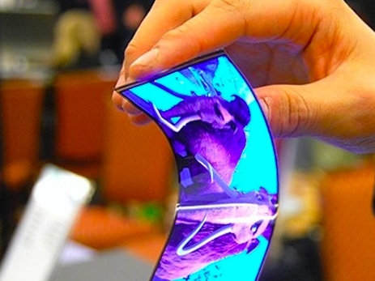
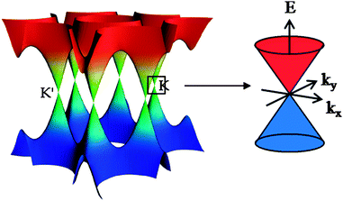
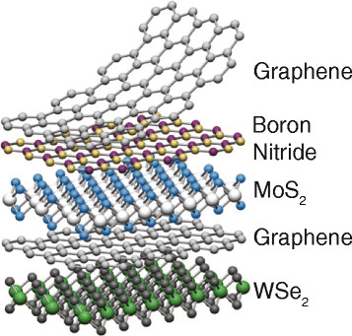
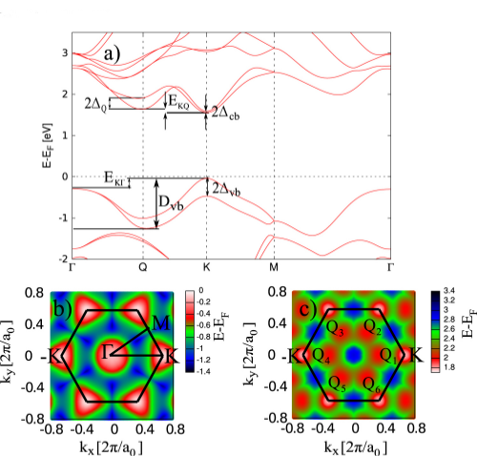
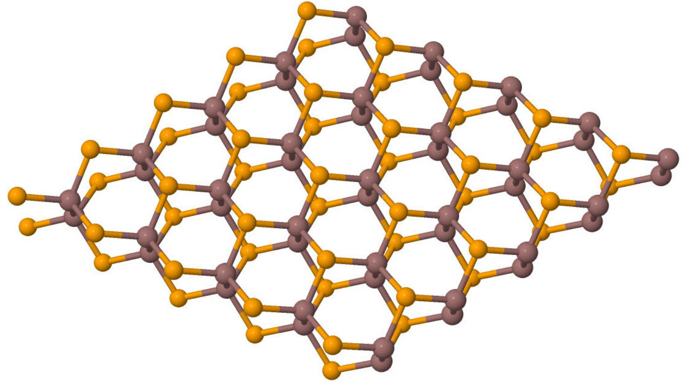
Two-dimensional materials
Low-dimensional materials, especially 2D materials, are being researched intensely. They exhibit extreme and unusual mechanical, electronic and optical properties.
Challenges for first-principles modelling: van der Waals interactions between layers; and optoelectronic properties: band gaps, huge exciton binding energies, formation of trions, biexcitons, ...

Slide 19
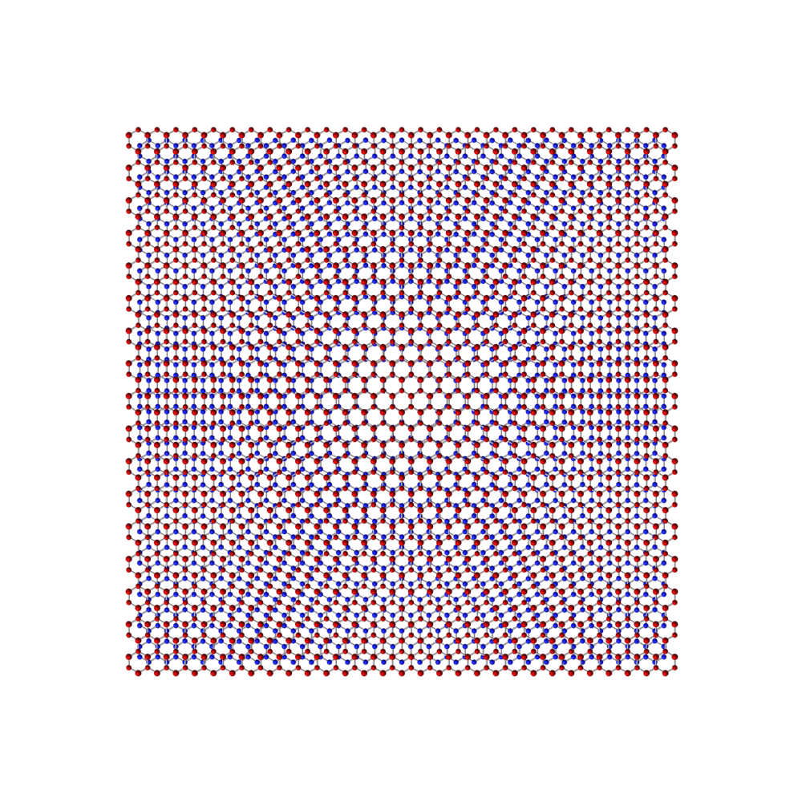
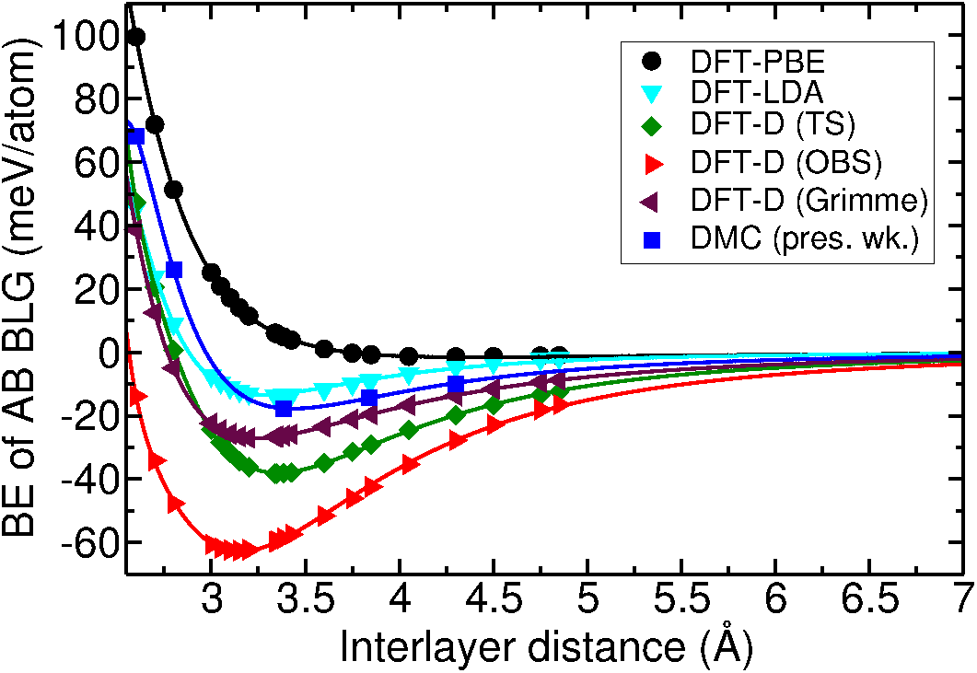
Bilayer graphene and graphene on hexagonal boron nitride
DFT-D and vdW-DF methods give a large spread of binding-energy curves. Quantitative DFT modelling of the interaction of 2D materials is not currently possible.
We have used DMC to provide benchmark binding energy for bilayer graphene and graphene on boron nitride.
DMC curve gives correct breathing-mode Raman frequency.
Moiré patterns in graphene on BN

Slide 20
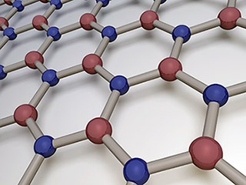
Excitonic properties of 2D semiconductors
Quasiparticle band gaps of 2D semiconductor monolayers are often substantially higher than bulk and are often poorly characterised. Value? Nature (direct/indirect)?
Layered materials exhibit large (0.5‒2 eV) exciton binding energies due to reduced screening. Screening is reduced further in monolayers
Excitonic effects play a key role in optoelectronic properties.
Trions (charged excitons) and biexcitons are stable at room temperature in transition metal dichalcogenides.
Can perform ab initio DMC quasiparticle and excitonic gap calculations, or can perform calculations for charge-carrier complexes using a Mott-Wannier model.

Slide 21
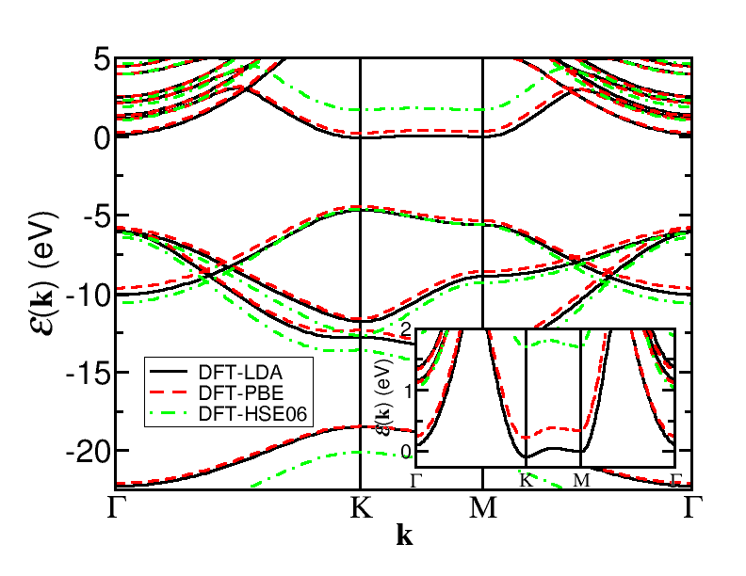
Electronic band structure of monolayer hexagonal boron nitride
Quasiparticle gap of monolayer is indirect (K→Γ), in agreement with HSE06 but not LDA or PBE.
Exciton binding energy [2.0(3) eV] is in quantitative agreement with GW-Bethe-Salpeter eqn. calculations.
Quasiparticle band gap gets larger as one goes from DFT-PBE to DFT-HSE06 to G0W0 to GW to DMC.
Important contribution to include: vibrational renormalisation (calculated using DFT).
Method QP gap (eV)
DFT-PBE 4.69
DFT-HSE06 5.65
G0W0 7.06
GW 7.65
DMC 9.5(1)

Slide 22
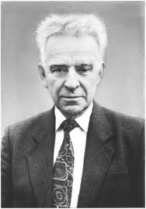
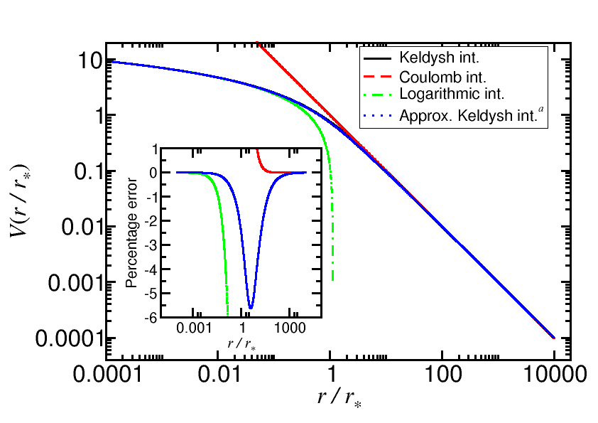
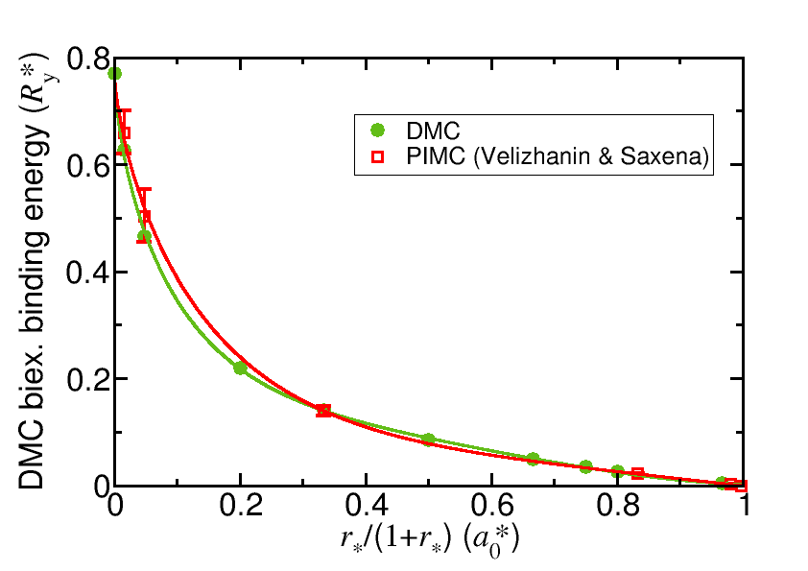
Trions and biexcitons in 2D semiconductors
Keldysh: anisotropic screening of charge carriers modifies interaction between them. Interaction is logarithmic at short range.
Mott-Wannier model: band effective masses for charge carriers together with Keldysh interaction.
DMC is exact for nodeless ground states.
Model provides a good description of experimental exciton and trion energies, but the “biexciton” line disagrees. Misclassification of experimental line? Or problem with model?

Slide 23
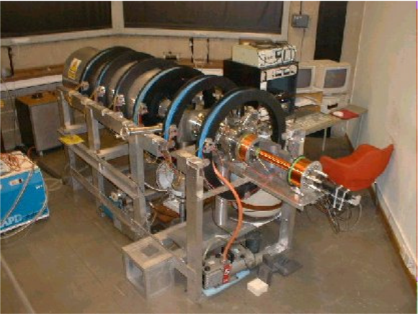
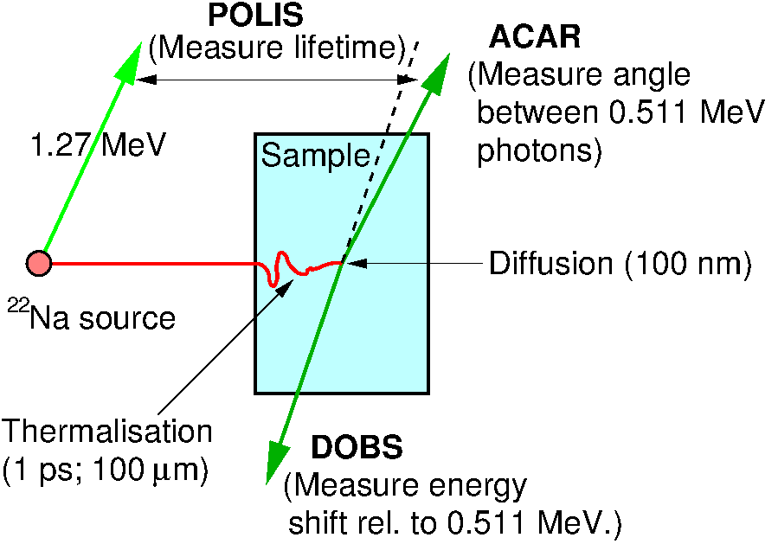
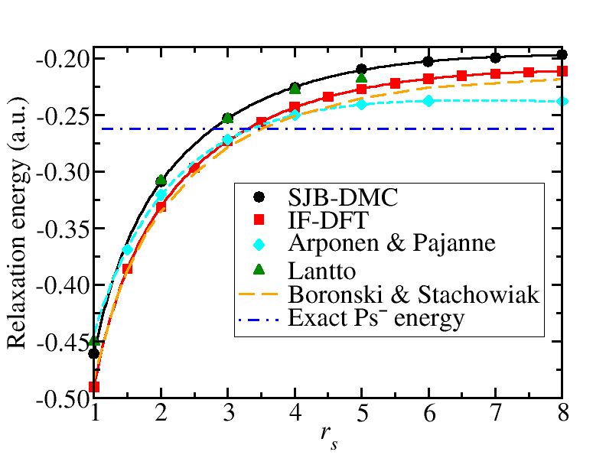
Positrons in electron gases
Positron annihilation spectroscopy: inject low-energy positrons into a sample and measure their lifetime and the distribution of annihilation radiation.
Would like to model positrons in real materials using 2-component DFT; need electron-positron correlation functional and contact density enhancement factor.
Generate these using homogeneous electron gas model, solved by DMC.
New correlation functional leads to more accurate DFT positron lifetimes.

Slide 24
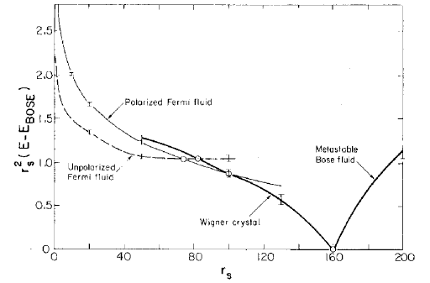
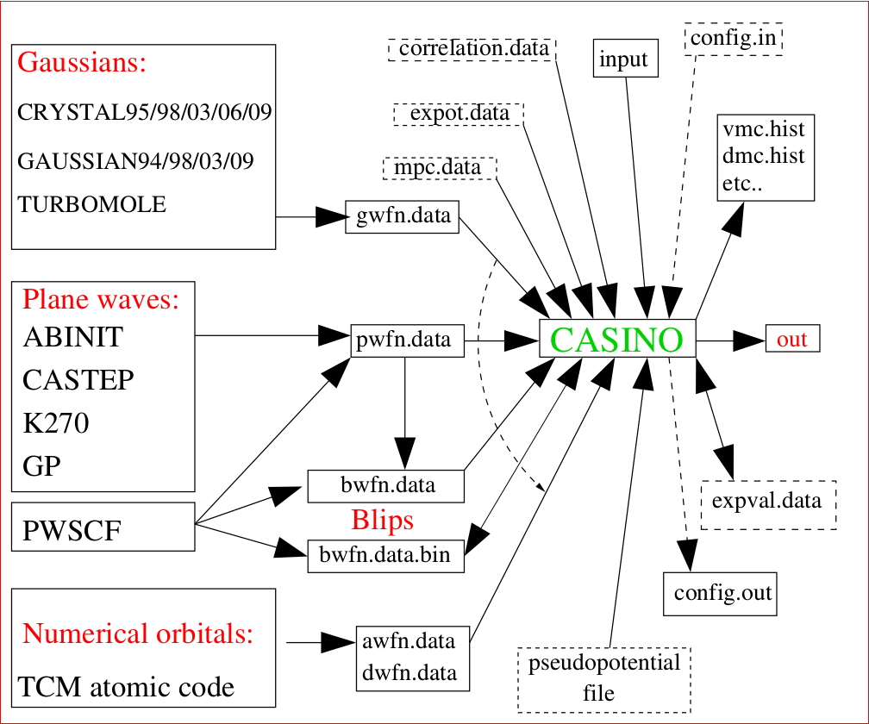
Conclusions: QMC and DFT need each other!
DMC data can be used to improve DFT calculations: e.g., by generating LDA exchange-correlation functionals in studies of electron gases, or benchmark data for constructing van der Waals functionals.
QMC calculations require input from DFT: trial wave functions, geometries, vibrational renormalisations, ...
CASINO can be used as a fairly straightforward extension to a CASTEP or PWSCF calculation.

