Slide 1

HANDYTRACE
BY EBO KOOMSON

Slide 2
Audience and System Description
The HandyTrace Web Application is intented for anyone who would like to identify their exposure to COVID-19
The goal of HandyTrace is to reduce the spread of COVID-19 by making people aware of their possible exposure to the virus.
Users are provided the feature of logging in the locations they have been to and making such information available to other users.

Slide 3
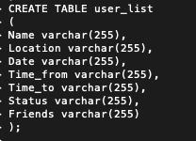
Implementation
HandyTrace was created using HTML, CSS, sqlite, python and flask.
Table creation using SQLITE :

Slide 4
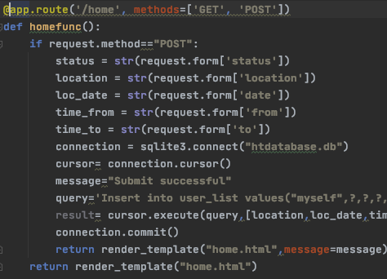
Implementation
Python code that uses the flask framework

