Slide 1
Create and package an S60 application in 10 minutes
Nokia P&P Copenhagen
Akos Polster, akos.polster@nokia.com
20 November 2008

Slide 2
Goals
Create a useful application
And package it so others can use it, too
Upload to Handango Nokia Store
...
Profit!!!

Slide 3
Requirements
Specification
  Create application translating free text from English to Danish

Slide 4
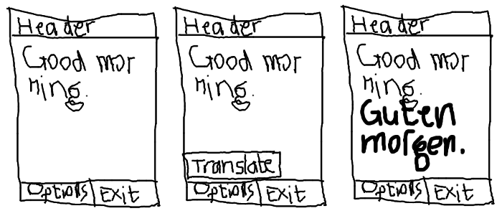
Requirements
UI specification:

Slide 5
Toolbox
Python for S60 http://opensource.nokia.com/projects/pythonfors60/
PC
Phone
Google Translate http://translate.google.com/
Text editor
Symbian packaging tool

Slide 6
Code (translate.py)‏
if __name__ == "__main__":
TranslateApp()‏

Slide 7
Code 2
class TranslateApp(object):
def __init__(self):
self.lock = e32.Ao_lock()‏
self.text = appuifw.Text(u"")‏
self.text.font = "normal"
appuifw.app.screen = "normal"
appuifw.app.menu = [(u"Translate", self.onTranslate)]
appuifw.app.title = u"Translate"
appuifw.app.body = self.text
appuifw.app.exit_key_handler = self.onExit
self.lock.wait()‏

Slide 8
Code 3
# class TranslateApp(object):
def onTranslate(self):
try:
src = self.text.get().split(u'\u2029')[-1]
if len(src):
t = translate(src)‏
self.text.set_pos(self.text.len())‏
self.text.add(u"\n" + t + u"\n")‏
except:
pass
def onExit(self):
self.lock.signal()‏
appuifw.app.set_exit()‏

Slide 9
Code 4
def translate(text):
import urllib
class Opener(urllib.FancyURLopener):
version = "Opera/5.0 (Linux 2.0.38 i386; U) [en]"
sl = "en"
tl = "da"
cmd = urllib.urlencode({"sl": sl, "tl": tl})‏
data = urllib.urlencode({"hl": "en", "ie": "UTF-8", "oe": "UTF-8",
"text": text.encode("utf-8"), "sl": sl, "tl": tl})‏
page = Opener().open("http://translate.google.com/translate_t?" + cmd, data)‏
lines = page.read()‏
start = lines.index("<div id=result_box")‏
start = lines.index(">", start)‏
end = lines.index("</div>", start)‏
return unicode(lines[start + 1:end], "utf-8")‏

Slide 10
Testing
Connect the phone via USB
Copy translate.py to E:\python
Disconnect phone
Start Python application, select Options, run script E:translate.py

Slide 11
Packaging
Ensymble to bundle and sign Python source code into a Symbian SIS package
  ensymble py2sis –uid=0xffffffff --appname=Translate --version=0.0.1 --lang=EN --shortcaption=Translate --caption=Translate --caps=LocalServices+NetworkServices+ReadUserData+UserEnvironment+WriteUserData --vendor="Nokia P&P Copenhagen" --icon=translate.svg translate.py
Download or send package via Bluetooth/e-mail

Slide 12
Questions

Slide 13
Thank you.

