Slide 1

Intro to Databases
Session 1

Slide 2

Welcome! Girl Develop It is here to provide affordable and accessible programs to learn software through mentorship and hands-on instruction.
We are here for you
Every question is important
Help each other
Have fun

Slide 3
Introduction Time
Who are you?
What do you hope to get out of the class?
What’s your favorite podcast (or tv show, book, movie?).

Slide 4
Let’s Get to it
• Why Databases?
Brief history of databases
What’s a database?
• Data modeling: Entities, Attributes, and Relationships

Slide 5
What is a database?
A system that's used to store, organize, and retrieve information or data.
Many different types of databases: hierarchical, relational, non-relational, object-oriented etc.
In this class we will primarily focus on relational databases because of the focus on SQL

Slide 6
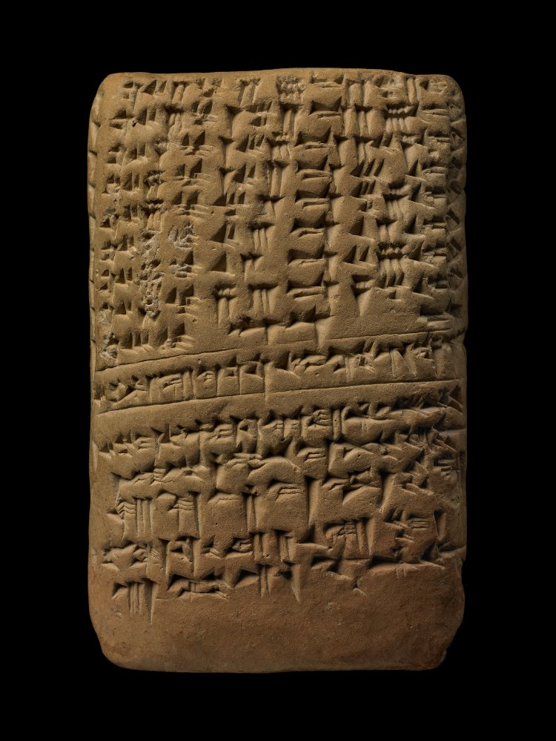
Why Databases?
Humans have been collecting data for thousands of years
Need ways to store, organize, sort, aggregate, and query data
Today we use databases everyday – on websites, in social media, for data storage and archiving
Babylonian clay tablet made during the 7th c. BC (image courtesy the British Museum
http://www.britishmuseum.org/research/collection_online/collection_object_details.aspx?objectId=314884&partId=1&searchText=mesopotamia&page=30
Notes:
Late Babylonian clay tablet: table of lunar longitudes. Contains a table for the daily change in the duration of the visibility of the moon on the thirty days of the month of the winter solstice according to the tradition of the city of Babylon.

Slide 7
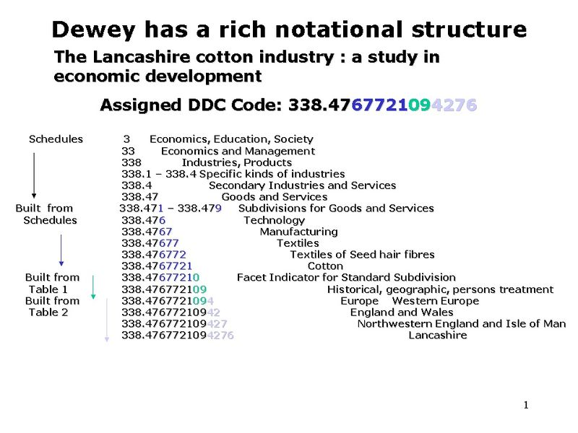
Some History
1890-1950s – Data stored and retrieved through punch cards and hierarchical paper file management systems
Ex: Dewey Decimal System for Library Classifications

Slide 8
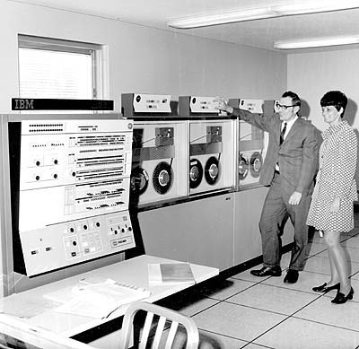
Some History
1960s - First computerized databases
1970-72 E.F. Codd published an important paper to propose the use of a relational database model
key component, provides the ability to relate records AS NEEDED
1980s – Structured Query Language, or SQL, became the standard query language
1990s and beyond – explosion of different types of database systems
http://bobscomputerserviceandrepair.com/computer-history/1960s/
Notes:
Hierarchical model, network model, problems with these systems – hierarchical, each child record could only have one parent, physical pointers from parent to child. Network model – many paths for processing records which allows greater flexibliity but could get stuck in an infinite loop if you didn’t keep track of where they are in the database and how they got there. Multiple ways to get to one destination and could easily get lost without an up-to-date map. Both are inflexible – preconceived paths through the data.

Slide 9
A DBMS
A database management system stores, organizes and manages a large amount of information within a single software application.
Important because:
it manages data efficiently
allows different users to perform multiple tasks with ease without disrupting tasks of other users

Slide 10
What is Data Modeling?
First step in database design and object oriented programming
Goal is to create a conceptual model of how data relate to each other
Exploratory process that progresses from:
Conceptual Models - high level domain models
Logical Data Models - describe logical entities and relationships
Physical Data Models - used to design internal database schemas

Slide 11
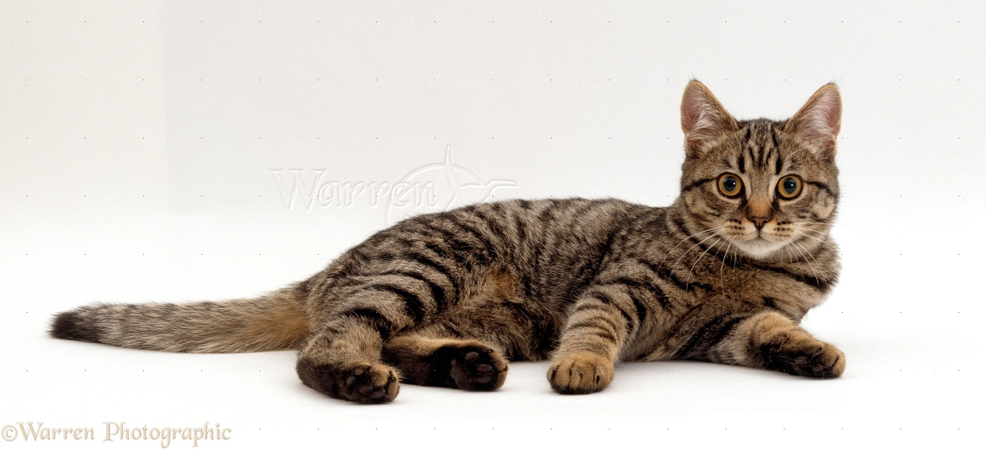
Modeling real things
“name”: Tabitha
“breed”: tabby
“coat”: short hair
“color”: striped
“eye color”: yellow
“personality”: curious
“age”: 4
“dob”:3/1/2013
“sex”: female
“weight”: 7 lbs
“spayed”: True
http://www.warrenphotographic.co.uk/16617-tabby-cat-lying

Slide 12
Kinds of data:
Strings (characters within quotes, "Hi my name is Beth.")
Numbers (numeral characters - 1, 3, 27, 49)
Boolean (true or false)
Arrays(Lists of anything ["Hello", 27, "Arugula"])
Objects (key-value pairs)

Slide 13
Methods of Storing
Plain Text (.txt)
CSV (.csv)
JSON (JavaScript Object Notation)
Relational Database (SQL, Oracle)
Non-Relational Database (Flatfile, MongoDB, etc)

Slide 14
Structuring
cat = {
“name”: “Tabitha”
“breed”: “tabby”
“coat”: “short hair”
“color”: “striped”
“eye color”: “yellow”
“personality”: “curious”
}
cat = {
“name”: “Tabitha”
“breed”: “tabby”
“coat”: “short hair”
“color”: [“orange”; “black”]
“eye color”: “yellow”
“personality”: [“curious”; “playful”; “loving”]
”medical_history": {”sex": ”female", ”age": 4, “dob”: 3/1/2014, ”spayed": true, ”weight": 7},
}
Notes:
B more helpful than A

Slide 15
This matters!!
Data can limit your capabilities, or expand them.
Grouping similar pieces of data together helps you stay organized, and helps the computer use it faster and easier. It also helps engineers program things more efficiently.

Slide 16


How are these things the same?
Let's try to model these books together.
What unique properties do they have? What properties do they share?

Slide 17
How are these things the same?
What does it mean to be a book?
{
title: "",
author: "",
length: "",
ISBN: "",
cover: "",
language: "",
customer_rating: "",
tags: "",
amazon_link: "http://www.amazon.com/The-Power-Habit-What-Business/dp/1400069289/ref=sr_1_1?ie=UTF8&qid=1355257104&sr=8-1&keywords=power+of+habit"
}
{
title: "",
author: "",
length: "",
ISBN: "",
cover: "",
language: "",
customer_rating: "",
tags: "",
amazon_link: “http://www.amazon.com/The-Power-Habit-What-Business/dp/1400069289/ref=sr_1_1?ie=UTF8&qid=1355257104&sr=8-1&keywords=power+of+habit”
amazon_link2:
"http://www.amazon.com/Hyperspace-Scientific-Odyssey-Parallel-Universes/dp/0385477058/ref=wl_it_dp_o_pC_nS_nC?ie=UTF8&colid=N55WK4E5RGPM&coliid=I39ORQQR1YUM18" }

Slide 18
Entity Modeling
Entity – person, place, thing or concept about which data can be collected.
In the last example, the book was the entity
Attribute – a fact that characterizes or describes an entity -- the data that we want to keep about each entity
Title, ISBN, Author etc.
Primary key - the attribute used to identify a specific entity, must be unique! (We’ll talk more about this later)

Slide 19
Baseline
Usually we try to go from generality - what does everything share in common, to specific - what makes everything unique?
Asking "what does something have to have at minimum to be this type of thing?" is a good way to find out a lot about your models.

Slide 20
Develop it! Modeling Places
In this exercise, you'll model two places for storage in a reviews website like Yelp, Google Local, or Foursquare.
We're not terribly worried about format for this. PAIR UP and don't worry about the format - the important part is ”entity" : ”attribute".

Slide 21
Develop it! Modeling Places
We're going to model places from this list, or choose your own favorite places:
Five Guys (Fast food)
Shenandoah Joes (Coffee place)
Marie Bette (Bakery)

Slide 22
Develop It! Modeling Places
Remember, the places (Five Guys, Shenandoah Joes, Marie Bette) are the entities, we are trying to assign attributes
Ask yourselves these questions:
What properties/attributes do each of these places have? An address? A name?
How are they different?
What makes them different in the same way? (like type: grocery store, or pub, or coffee shop)
What information is useful, vs not useful? (phone numbers are useful, but number of bricks isn't. Unless you are building a national brick database.)
What is someone looking for when they look up information about this thing? What am I looking for?

Slide 23
Example: Five Guys
{
PlaceName: FiveGuys,
Type: FastFood,
Address_Line1: "",
Address_Line2: "",
PriceRange: Under10,
Phone_number: "",
customer_rating: 4,
Hours: [Monday:5:00-12:00, Tuesday:5:00-12:00” ..],
EatingType:Reservations:False, Delivery:False, Take-Out:True; Drive-Thru:False, Catering:False}
PaymentType: [CreditCards:False, Cash:True, ApplePay:True, Bitcoin:False]
Attire:Casual}

Slide 24
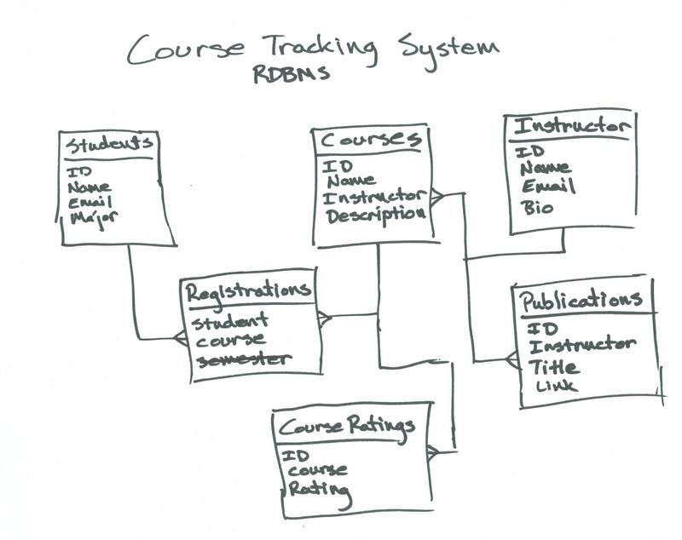
Relationships
Relationships are associations among entities
Allow relational databases to split and store data in different tables, while linking disparate data items.

Slide 25
Relationships
One-to-One: A car model is made by one company.
One-to-Many: One mother can have many children.
Many-to-One: Many employees work in one department.
Many-to-Many: Many orders have many products.
One to One Relationship
CIVIC SEDAN
HONDA

Slide 26
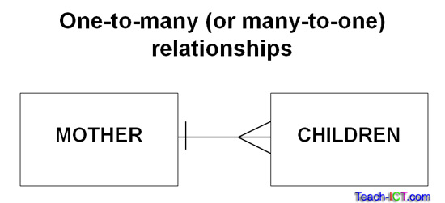
Relationships
One-to-One: A car model is made by one company.
One-to-Many: One mother can have many children.
Many-to-One: Many employees work in one department.
Many-to-Many: Many orders have many products.

Slide 27
Relationships
One-to-One: A car model is made by one company.
One-to-Many: One mother can have many children.
Many-to-One: Many employees work in one department.
Many-to-Many: Many videos can be rented by many customers.
IT
DEPARTMENT
EMPLOYEES

Slide 28
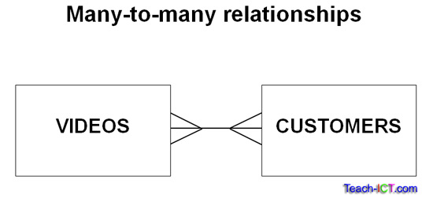
Relationships
One-to-One: A car model is made by one company.
One-to-Many: One mother can have many children.
Many-to-One: Many employees work in one department.
Many-to-Many: Many videos can be rented by many customers.
Notes:
An intersection table is placed in the middle of a many to many relationship to hold the data that is common to the intersection of two entities. It transforms the many to many into two one to many with the intersection table on the many side of both relationships. For example, a rental table could be placed in between customers and videos.

Slide 29
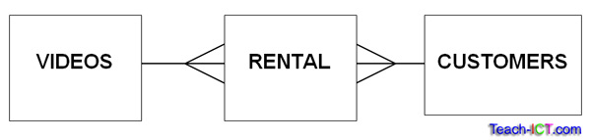
Many-to-many relationships can pose a problem to the dbms because of duplicated data, one way to address this is to create mapping tables, or intersection tables
Notes:
Thus the relationship becomes:
Customers can have many different rentals
A rental belongs to one customer
AND
A video can be rented many times
Many rentals can contain that video

Slide 30
Develop it! Modeling Interviews
Conducting job searches produces lots of relationships - companies, interviewers, applicants - we don't want to duplicate data, so let's form some relationships
We’re going to focus on two entities: applicants and interviewers

Slide 31
Develop it! Modeling Interviews
Conducting job searches produces lots of relationships - companies, interviewers, applicants - we don't want to duplicate data, so let's form some relationships
There can be a many-to-many relationship between interviewers and applicants
One applicant could be interviewed by many people and one interviewer can host many applicants
What kind of table could serve as an intersection table?

